Slide 1

Satellite Attitude Control System
By Tasmay Patel

Slide 2


BACKGROUND
Satellite attitude control ensures proper orientation in orbit.
Essential for communication, navigation, and remote sensing satellites.
Key challenges:
Precise angular position (Roll, Pitch, Yaw).
Overcoming disturbances in space.

Slide 3
Satellite Dynamics and Orbits
Common Satellite Orbits: Geostationary (24-hour period at 35,786 km altitude).
Forces affecting satellites:
Centripetal force (gravity).
Centrifugal force (inertia).
Control systems maintain stability.

Slide 4
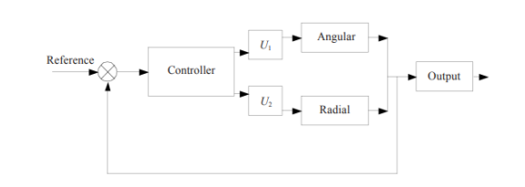
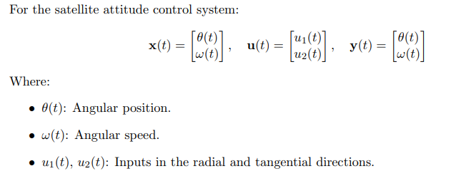
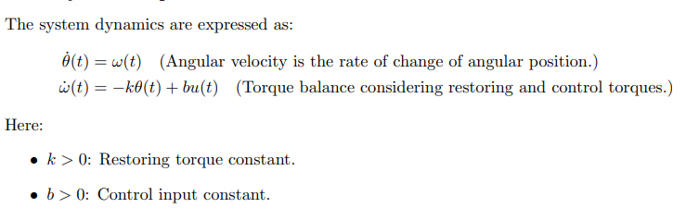
State Space Model
State-space representation:
ẋ(t) = Ax(t) + Bu(t),
y(t) = Cx(t) + Du(t)
State variables:
θ(t) (angular position), ω(t) (angular speed).
Inputs: Roll, Pitch, Yaw.

Slide 5
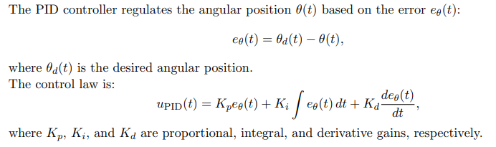

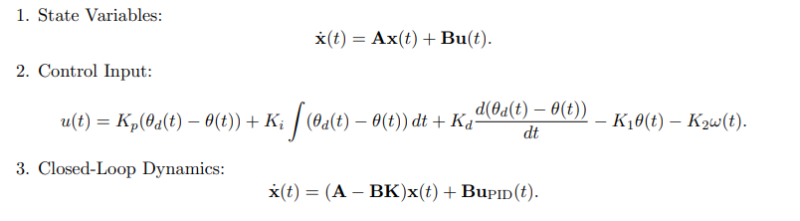
PID-Based Feedback Control
Regulates angular position (θ) and velocity (ω).

Slide 6
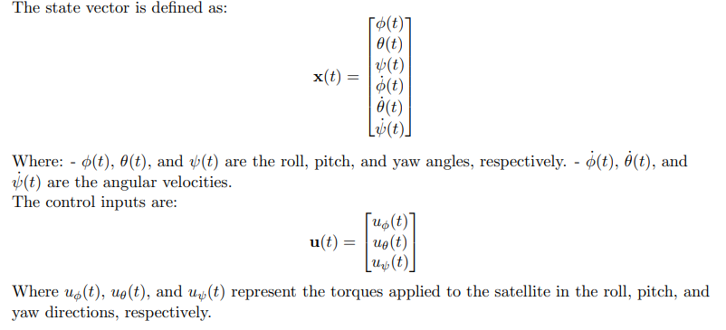
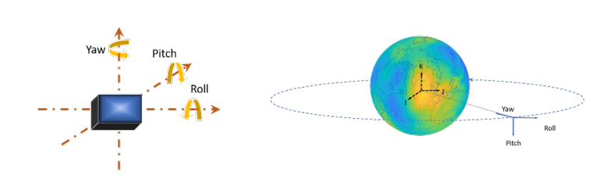
Roll, Pitch, and Yaw Dynamics

Slide 7
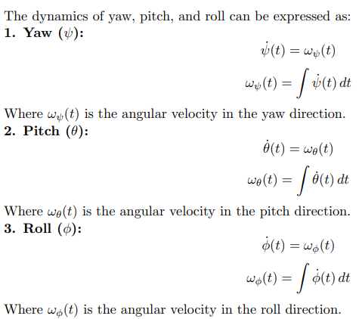
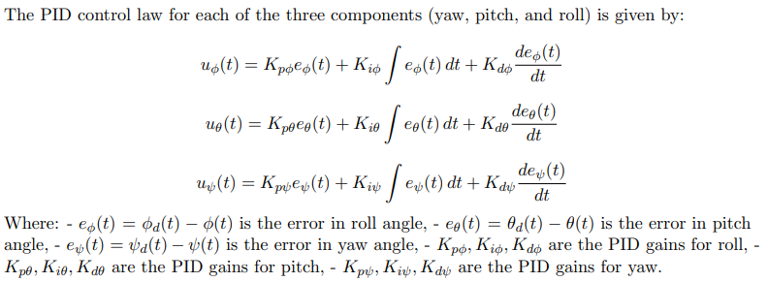
Roll, Pitch, and Yaw Dynamics
https://compsci290-s2016.github.io/CoursePage/Materials/EulerAnglesViz/

Slide 8
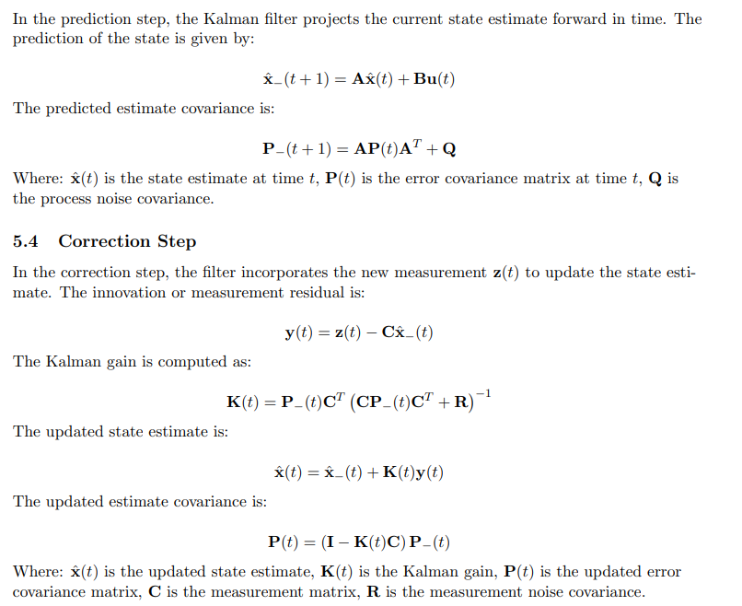
State Estimation Using Kalman Filter

Slide 9
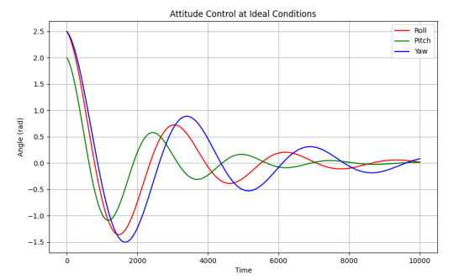
Simulation Results
Initial Overshoot: Roll, Pitch, and Yaw exceed desired values briefly.
Damping Behavior: Oscillations reduce over time.
Stabilization:
Roll, Pitch stabilize faster.
Yaw stabilizes slower due to higher inertia.

Slide 10
Future Work
Explore nonlinear control techniques.
Hardware-in-the-loop (HIL) simulations.
Enhance disturbance rejection methods.

Slide 11
THANK
YOU

