Slide 1

BANK FINANCE

Slide 2
KPI-1
Group Member’s
Kpi-2
Md.Tasmeem Qureshi
Sonali Navnath Khedkar
Akshay Madhav Shinde
Yamini Vinod Bansode
5.Smruti Ranjan Nayak
6. Mohit Dongre
Kpi-3
Kpi-4
Kpi-5

Slide 3
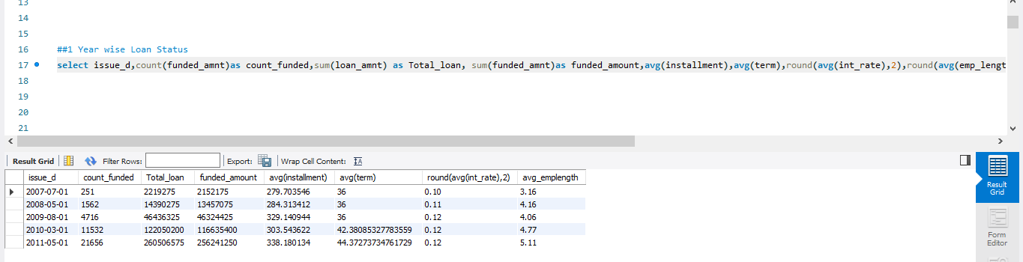
#1. Insight Year wise Loan Status
There is year-wise increase in Clients for the need of Loan.
Its clear that there is Gradually increase in the requirement of loans so loan amounts are released.
In the year 2010,2011 the average installment is like 45 months increase from previous year trends of only 36 months.

Slide 4
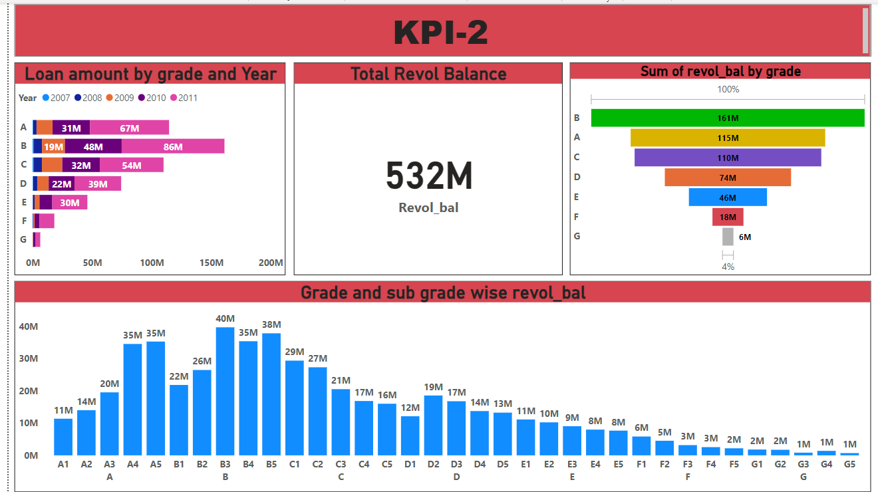
#2. Grade and sub-grade Wise revol balance
Highest Revol balance is maintained by B grade following A and C.
Majorly B3,B4,B5 are having high revol balance.
Grade ‘G’ has lowest revol balance.
Revol balance is increase’s every year , Highest in 2011.

Slide 5
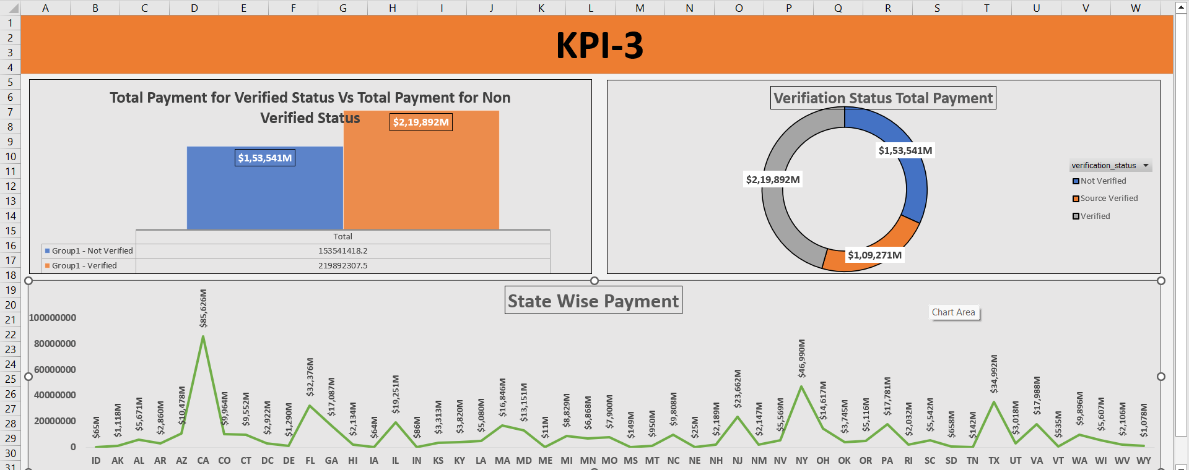
#3. Verified and non-verified payment status.
The verified payments hold the high payment of more than 2.1 Billions.
Where as un-verified payments like mostly contains cash payments hold of 1.5
Billion+
3. Source verified hold the most least payment of 1.09 billion+.
4. State wise CA state hold the highest payment of 85,626 million and
ME state hold the lowest Payment of 11 million

Slide 6
KPI-4
#4. State wise and last credit pull d wise loans status.
1. IN ,ME and IA states have mostly fully-paid status.
2. AK have more Average funded amount in the last Credit_pull_d. following with DC and NU.

Slide 7
KPI-5
#5. Home Ownerships and their payment Date status.
Rental clients stands at highest with 19k clients with more Loan Amounts.
Where as Mortgage Ownership stands 2nd highest.
None ownership are the lowest loan preferred.

