Slide 1

Global portfolio analysis
Group Name: STYRERS
Members Names: Ramesh
Silvia
Tasmia
Harri

Slide 2

Motivation and summary
As global financial portfolio director, (GFPD) our objective is to guide or provide optimal investment choice to our investors
Given the dynamics of financial market, individual investors are not comfortable placing their money into portfolios that is not optimal and through non trustable investment firms
We asked specific questions to the investors to determine their risk tolerance level. The outcome of the questionnaire helps us to provide unique & detail quantitative analyses based on which investors can identify the best performing portfolio.

Slide 3
Motivation and summary
We are satisfied with our questions because our questionnaire collects information about investors age, money, their financing choice etc, that helps us to identify investors risk tolerance level.
We also make sure to provide number of portfolios (i.e. P1 – P5) with the combination of risky to low-risk instruments based on the analysis of dividend, earnings, growth, and stability during different economic conditions.
Hence, GFPD is the best! .

Slide 4
Questions and data
For our data sets we have used:
investor input dataset
each instrument market data
Stock exchanges we used
NASDAQ
ASX
EURONEXT
Portfolio Instruments:
Crypto – USD denominated coin / bitcoin
Shares
Govt. Bond

Slide 5
Questions and data
Libraries/Packages we used
Yahoo_Fin
FinQuant
Pandas
Matplotlib
Numpy
Panel
Holoviz

Slide 6
Data cleanup And exploration process
Through each securities exchange website, we collected the top 50 companies tickers with market cap
We also collect the dividend information to perform the dividend analysis:
dividend payout ratio (DPR)
dividend coverage ratio (DCR)
free cash flow to equity (FCFE)
net debt to EBITDA
P/E and Beta information
While conducting dividend analysis we had to clean up our data because there were companies which did not pay dividend
After calculating for all companies, we selected the top performing stocks
Risk based allocation of crypto and treasury
Portfolio real time risk free interest used.
Detailed analysis of portfolio and instruments

Slide 7
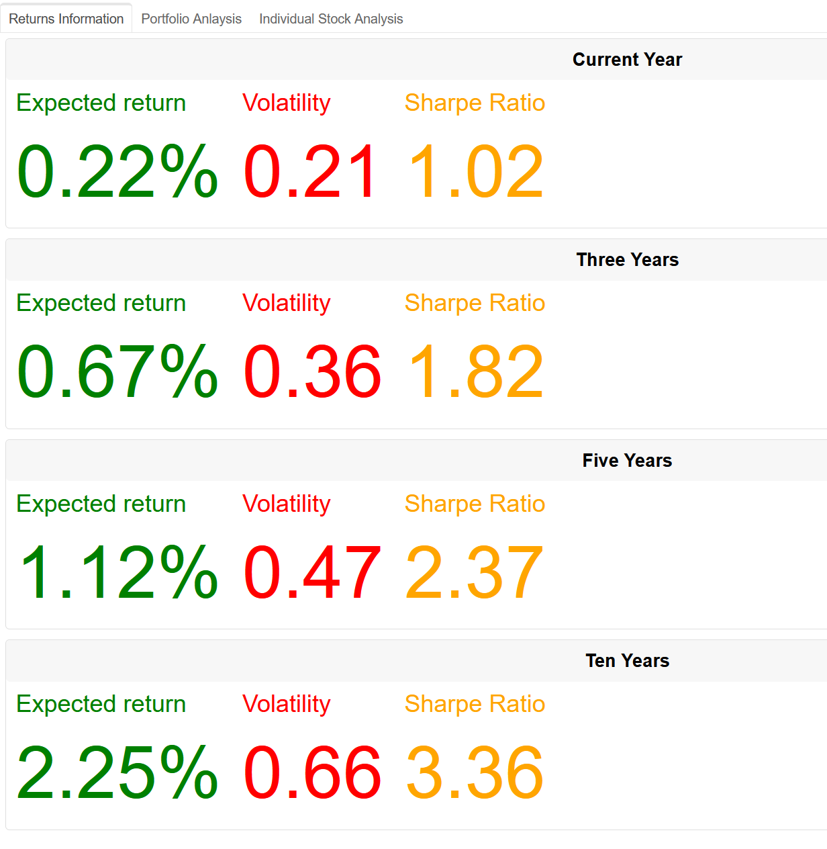
Portfolio RETURNS

Slide 8
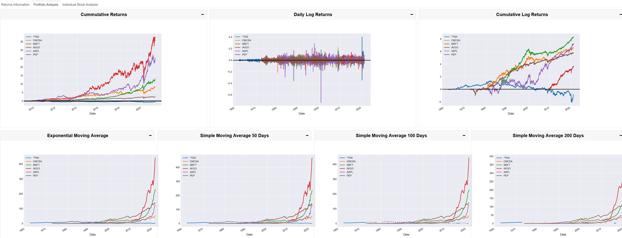
Portfolio Detailed ANALYSIS

Slide 9
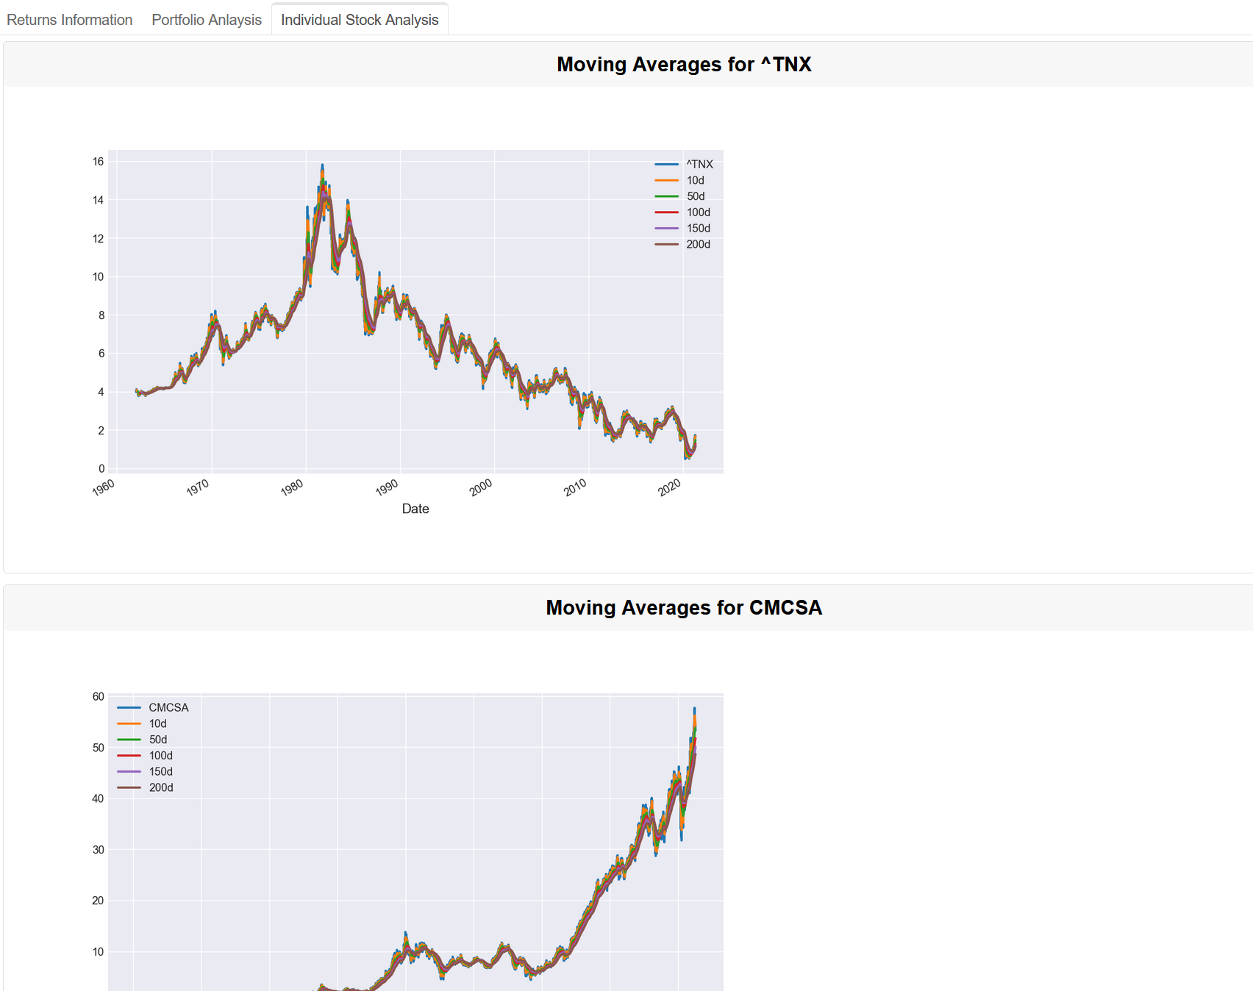
ANALYSIS FOR ALL INSTRUMENTS IN THE PORTFOLIO

Slide 10
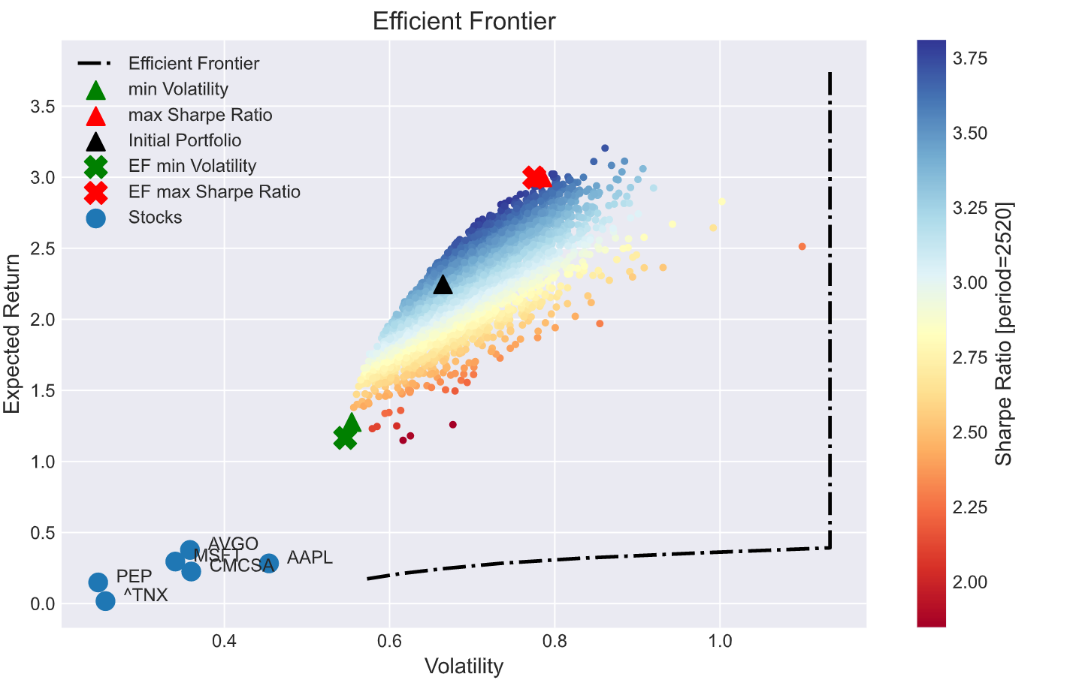
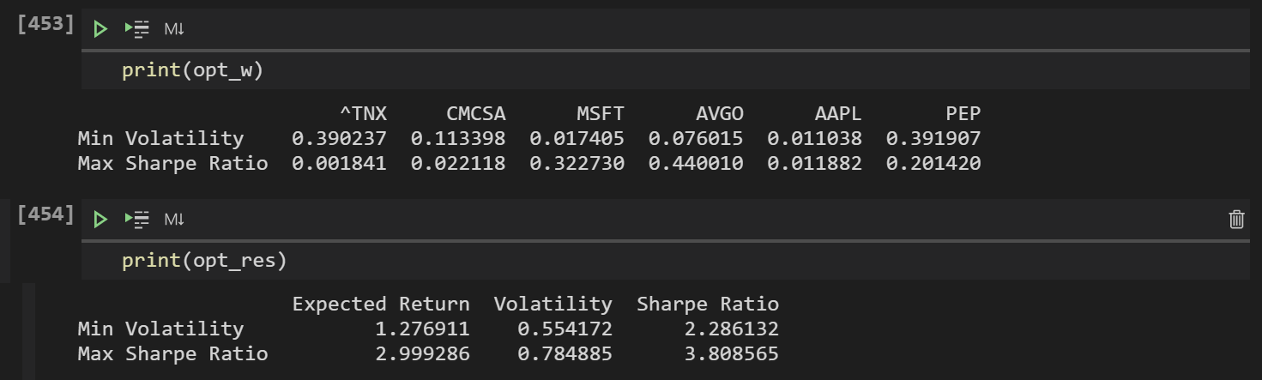
Montecarlo and EFFICIENT FRONTIER OPTIMISATION

Slide 11

Thank you

