Slide 1





DIGITAL IMAGE PROCESSING
EMOTION
DETECTION AI
Real-Time Face Emotion Recognition
Live webcam-based system · Flask · OpenCV
Ammara Bibi · Ayesha Noor · Tasmia Fatima · Soha Faisal

Slide 2
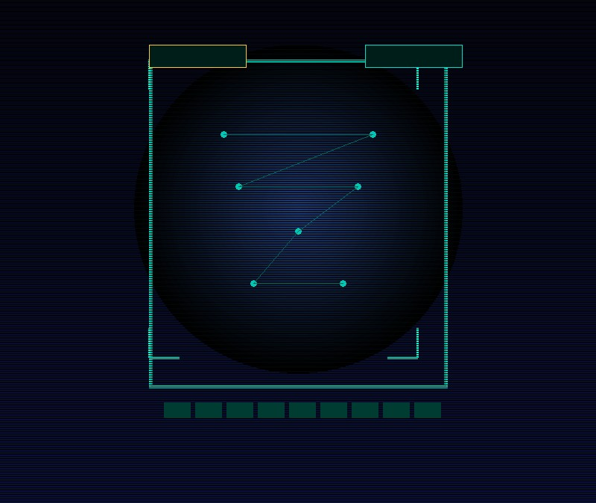
WHY IT MATTERS
Real-time emotion
feedback, made
accessible
Humans misinterpret expressions every day. This AI tool delivers instant, accurate emotion feedback directly from your webcam — no GPU required.
5
RT
0
Emotions Detected
Real-Time Processing
GPU Required

Slide 3


PROBLEM STATEMENT
Emotion is easy to miss
People often misread emotions. Many systems still lack real-time emotion analysis.
Students and basic apps need a lightweight, immediate detection tool.
Happy
Sad
Angry
Neutral
Surprise

Slide 4
PROJECT OBJECTIVES
Build a real-time emotion analysis experience
Webcam Detection
5 Emotion Classes
Emoji Feedback
01
Detect facial expressions live from webcam feed in real time.
02
Classify Happy, Sad, Angry, Neutral, Surprise accurately.
03
Display emoji + contextual messages for immediate user feedback.
Session Logging
Graph Visualizations
04
Log emotion history with timestamps to local files.
05
Generate Matplotlib distribution charts after each session.

Slide 5

TECHNOLOGY STACK
Technologies & Tools
Core components powering real-time emotion detection and live analytics
01
02
03
04
05
Python
Flask
OpenCV
Matplotlib
HTML/CSS
Core language — model, processing, server logic
Lightweight web server, live video & UI endpoints
Haar cascades face detection & image preprocessing
Emotion distribution graphs & session timelines
Dashboard UI — login, live view, history pages

Slide 6
SYSTEM FEATURES
What makes it powerful
Emoji Reactions
User Authentication
Start / Stop Camera
ALL IN ONE
5
Secure registration & login to personalize and protect each session.
Manual controls to begin or pause detection safely at any time.
Instant visual emoji feedback mapped to the predicted emotion class.
CORE
FEATURES
Emotion History
Graphical Analysis
Secure · Live · Visual
Session logging to local text files — revisit and compare sessions.
Matplotlib charts showing distributions and timelines across sessions.

Slide 7
WORKFLOW
End-to-End Pipeline
01
02
03
04
05
Auth
→
Capture
→
Detect
→
Classify
→
Feedback
Register or login to access dashboard & session history
Flask serves live video; client captures webcam frames
OpenCV Haar cascade locates faces & crops regions
Feature extraction maps face crop to one of 5 emotions
Emoji + suggestion displayed; entry logged; graphs refresh

Slide 8
SYSTEM ARCHITECTURE
Data flows from capture → analysis → feedback
L1
L2
L3
L4
L5
Webcam
Capture
Flask
Server
AI Module
Storage
Visualization
Live video feed
/login /stream
/analyze /history
OpenCV detection
+ emotion classifier
users.txt
history.txt
Matplotlib PNG
charts → dashboard

Slide 9
EMOTION TRACKING
History & Session Analysis
Peak Moments
Identify peak emotional moments for targeted review
35%
20%
15%
Cross-Session
Compare sessions to detect consistent emotional patterns
15%
15%
Distribution
Counts, timelines, and chart breakdowns per emotion

Slide 10

CONCLUSION
Next Steps
🏆
🚀
▶
Key Outcomes
Future Improvements
Try It Now
Working real-time emotion detection with usable UI
emoji feedback
session logging
ideal for learning and prototyping.
Upgrade to deep-learning for higher accuracy;
add cloud DB
mobile app,
face-based login,
and privacy controls.
Demo available on local network via Flask server. Questions and feedback are very welcome — thank you for your attention!

Slide 11
🚀
▶
Thank You

