Slide 1

Title: Dual-axis Solar Tracking System Using Arduino
Course: Microprocessor And Embedded Systems
Group: 08 Section: N
Date of Presentation: 23rd January 2025
Supervised By
DR. MD RUKONUZZAMAN
Associate Professor, Department of EEE
American International University - Bangladesh

Slide 2
Contents
Introduction
Literature Review
Aims & Objectives
Components used
Operation Flow
Software Implementation
Circuit Diagram
Simulation and Results
Future Improvements
Challenges
Q&A

Slide 3
Group Introduction
Name | ID
Md Mansur Islam | 22-46550-1
Md Tasmim Al Tahsin | 22-46299-1
Tonima Islam Dristy | 22-46686-1
Instisar Ahmed Siyan | 22-47483-2
Sayeda Rumaiya Islam | 22-47474-2

Slide 4
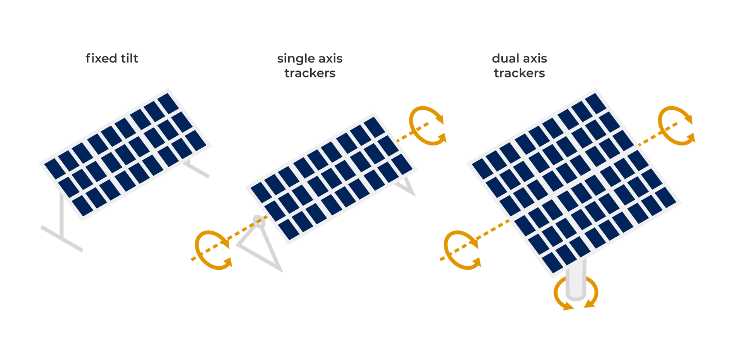
What is a Dual-Axis Solar Tracking System?
Solar tracking systems aim to align solar panels with the sun for optimal energy collection.
Dual-axis systems move both horizontally and vertically, ensuring precision.
This project focuses on designing and implementing a reliable tracking mechanism.

Slide 5
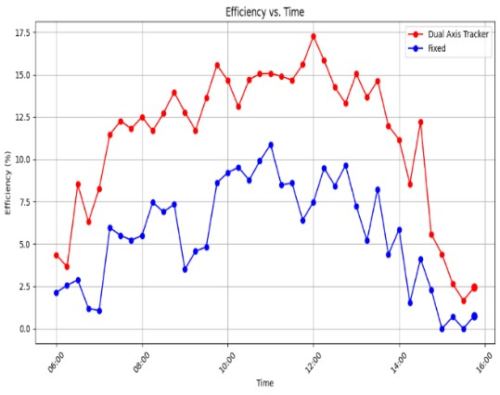
Literature Review
Fixed solar panels lose energy during the day due to static positioning.
Studies show dual-axis trackers improve energy collection by up to 30%.
Advances in servo motor technology enable precise movement for tracking systems.
Figure : Efficiency Percentage Difference Versus Time.

Slide 6
Aims & Objectives
Design: Develop a dual-axis solar tracking mechanism for accurate alignment.
Simulate: Test the tracking mechanism under varying sunlight conditions.
Implement: Build a functional system with precise servo motor control.
Analyze: Compare energy efficiency gains against fixed solar panels.

Slide 7
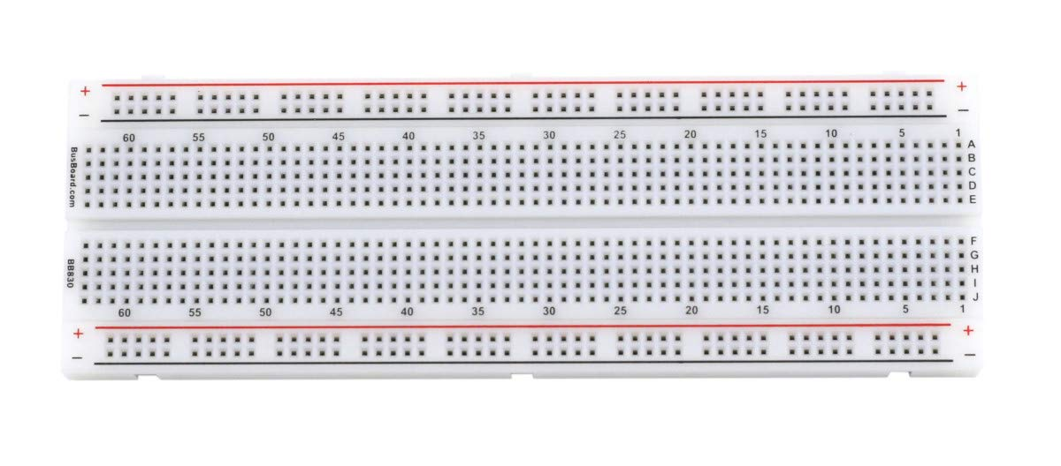
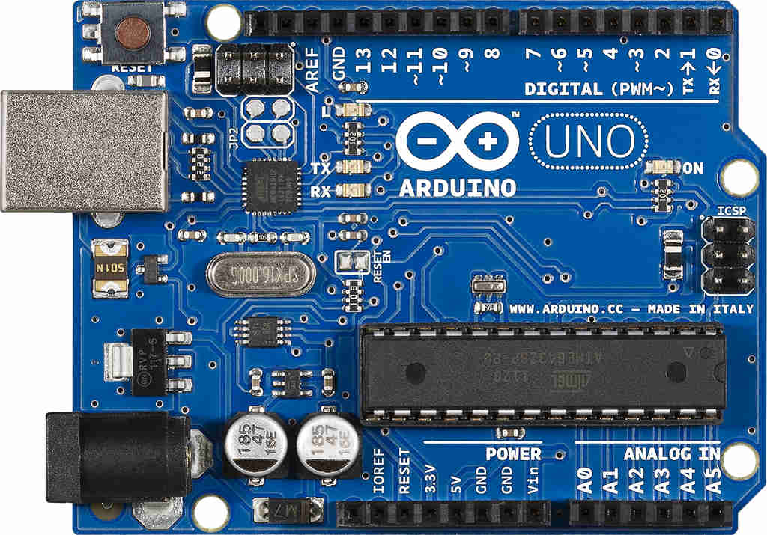
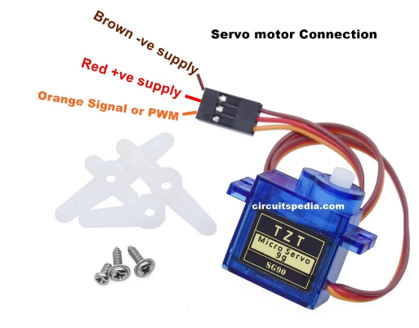
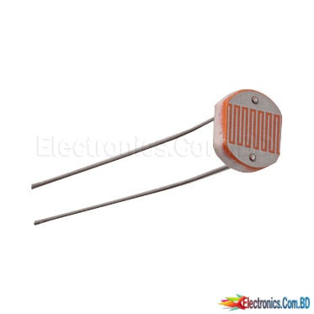
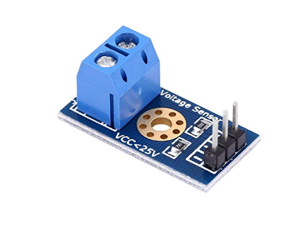
Components used
Arduino Uno
Breadboard
Servo Motor
LDR Sensor
Voltage Sensor

Slide 8
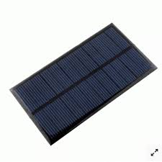
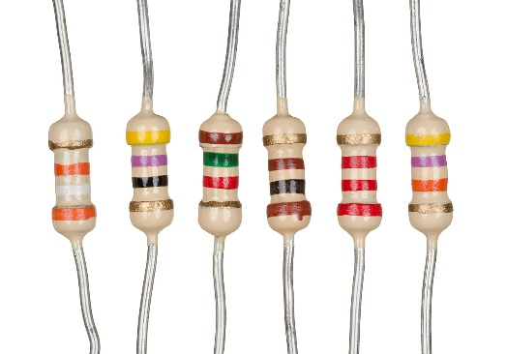
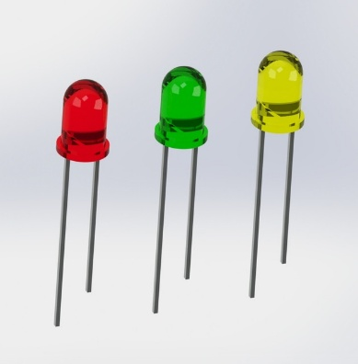
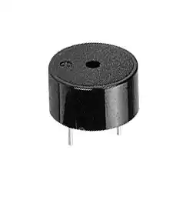
Components used
Solar panel
Resistors
LED
Buzzer

Slide 9
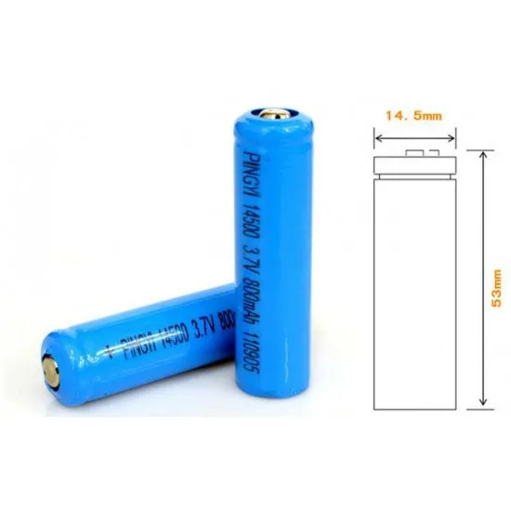
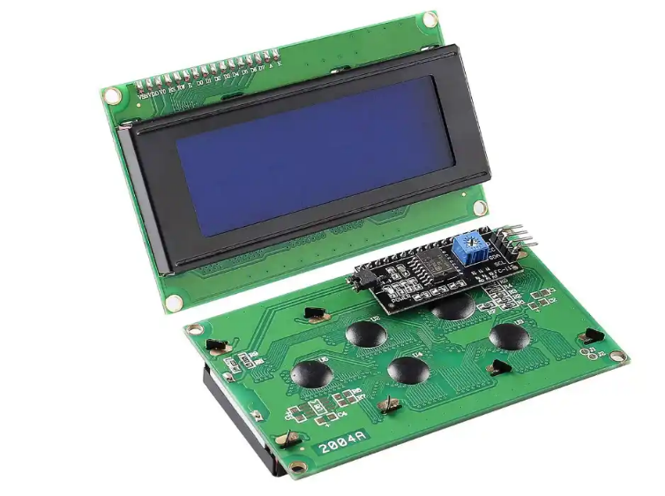
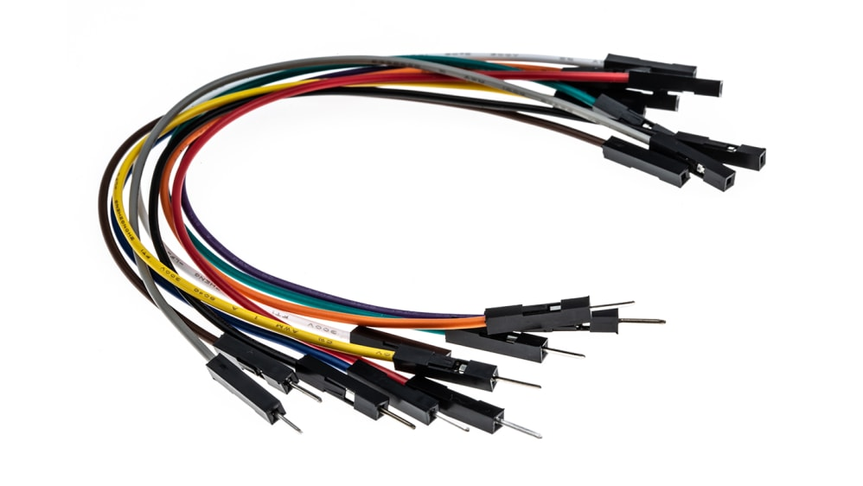
Components used
Battery 14500 mAh
LCD Display
Jumper Wire

Slide 10
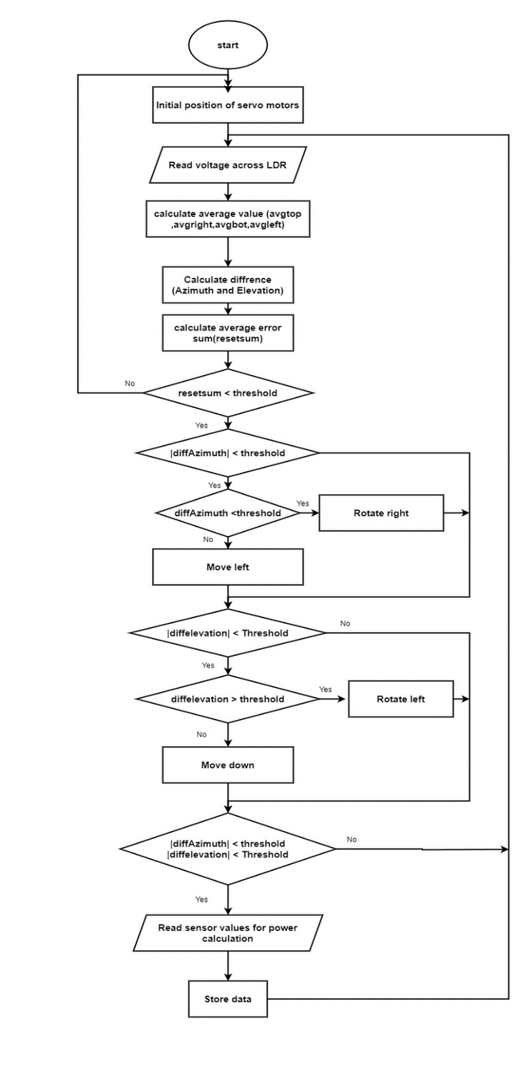
Operation Flow
LDR sensors detect sunlight intensity and send data to Arduino.
Arduino adjusts servo motors to align the panel with the sun.
Voltage sensor monitors battery status for proper energy usage.
Notes:
Good day everyone,
I am here to discuss the operation flow and software design of our dual-axis solar tracking system, a project that aims to optimize solar energy harvesting through automation.
Operation Flow
The system begins with four Light Dependent Resistors (LDRs) placed at the corners of the solar panel. These LDRs sense sunlight intensity from different directions and send analog signals to the Arduino Uno microcontroller. Based on the differences in light levels, the Arduino calculates how the panel should be oriented.
Two servo motors are responsible for the movement—one for horizontal rotation and the other for vertical tilt. By adjusting these motors, the panel aligns with the direction of maximum sunlight. Additionally, the system includes a voltage sensor to monitor the battery's charging status, while an LCD screen displays real-time information, such as battery percentage and system state. LEDs and a buzzer provide visual and audible status updates, ensuring the system operates efficiently and communicates its functionality to the user.

Slide 11
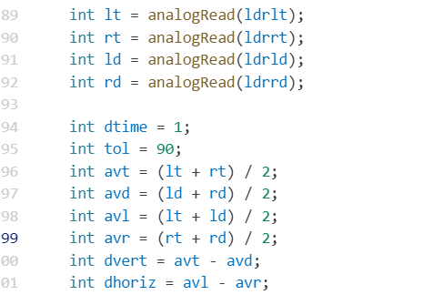
Software Implementation
Reads LDR values to determine sunlight direction.
Notes:
Software Design
The system's software is programmed using the Arduino IDE, written in C++. The code begins with initializing components like the LDRs, servos, voltage sensor, LCD, and status indicators. The core logic involves reading LDR inputs, calculating the intensity differences, and commanding the servos to adjust the panel's orientation.

Slide 12
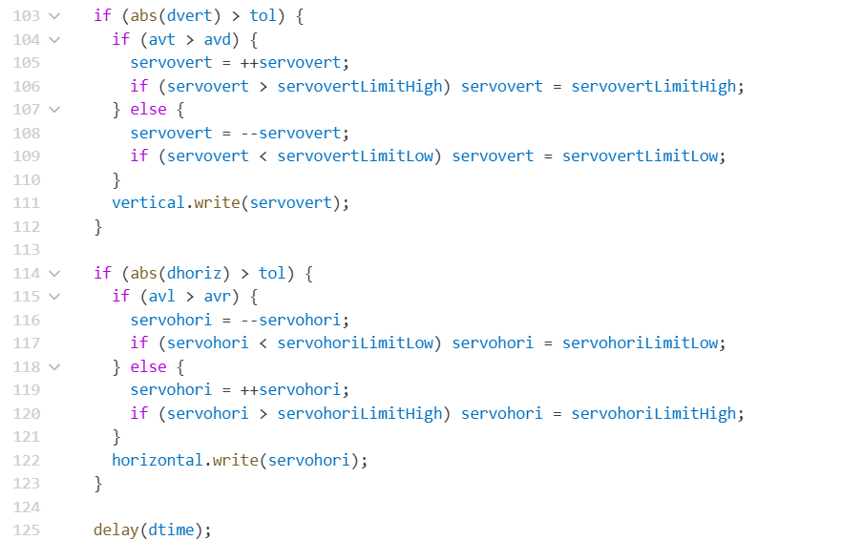
Software Implementation
Adjust servo motor to optimize panel adjustment
Notes:
The program continuously loops to ensure real-time adjustments. It also processes battery voltage data from the sensor, maps it to a percentage, and updates the LCD screen. Conditional statements control the LEDs and buzzer—for instance, signaling charging, tracking, or full-charge status.

Slide 13
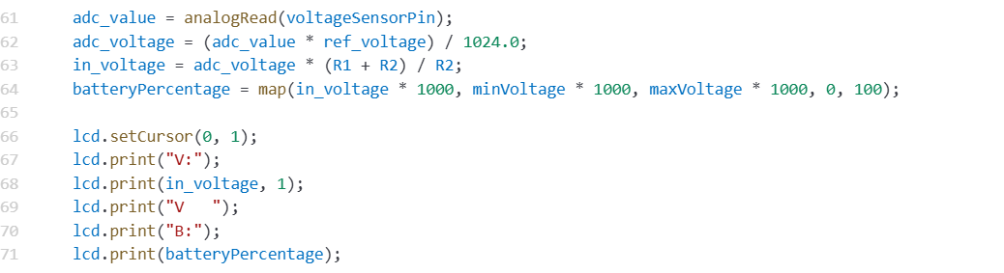
Software Implementation
Monitors and displays battery voltage.
Notes:
Through this modular and logical software structure, the system operates seamlessly, ensuring efficient energy capture.
In conclusion, the combination of precise operation flow and efficient software design enables our solar tracking system to be both intelligent and reliable. This project highlights the potential of automation in renewable energy solutions.
Thank you!

Slide 14
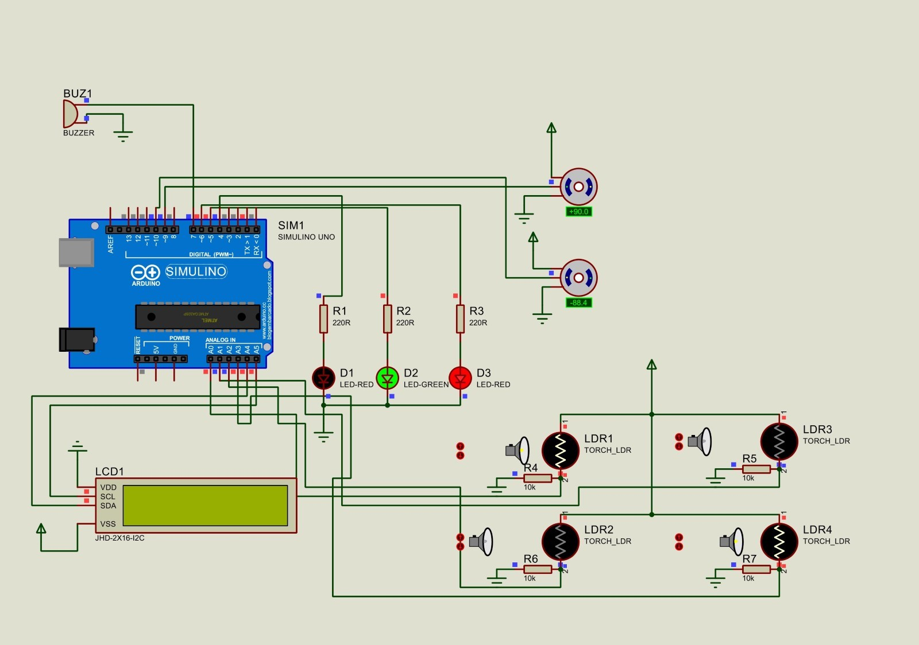
Circuit diagram

Slide 15
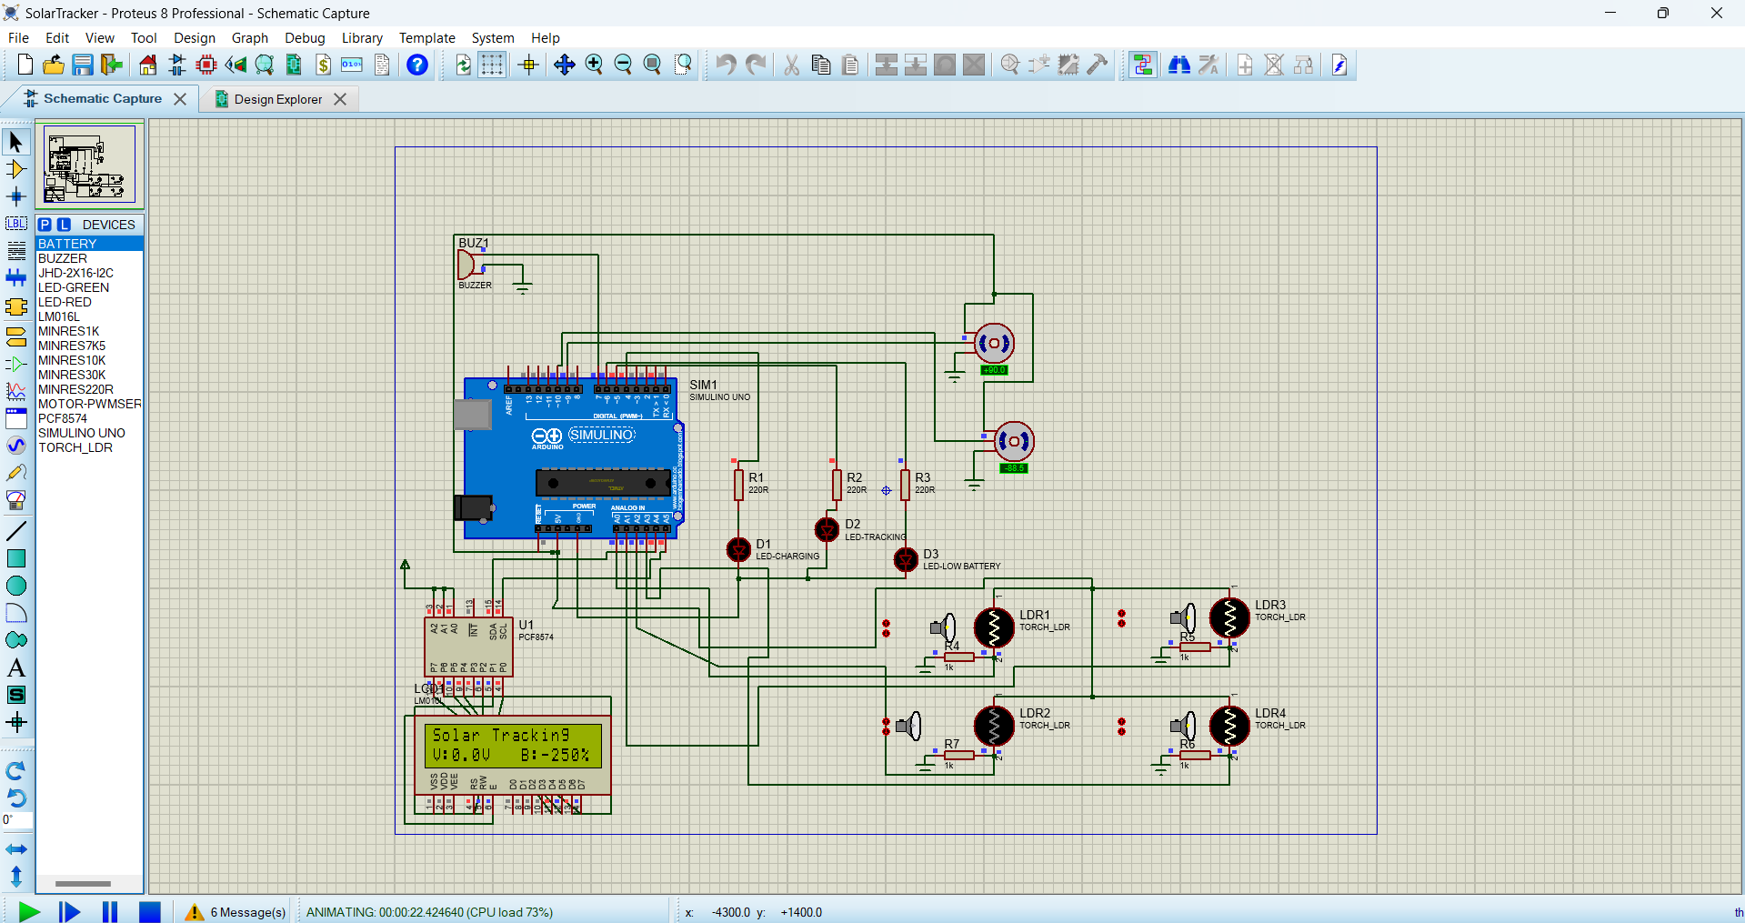
Simulation and result

Slide 16
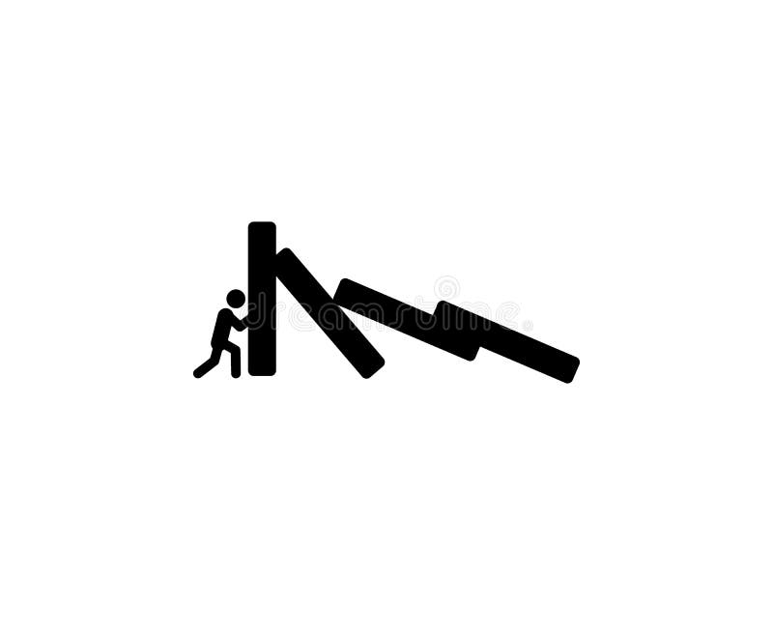
Challenges
Challenges Faced
Precise control of servo motors for dual-axis movement.
Managing battery voltage without overcharging.
Potential mechanical wear and tear over time.

Slide 17
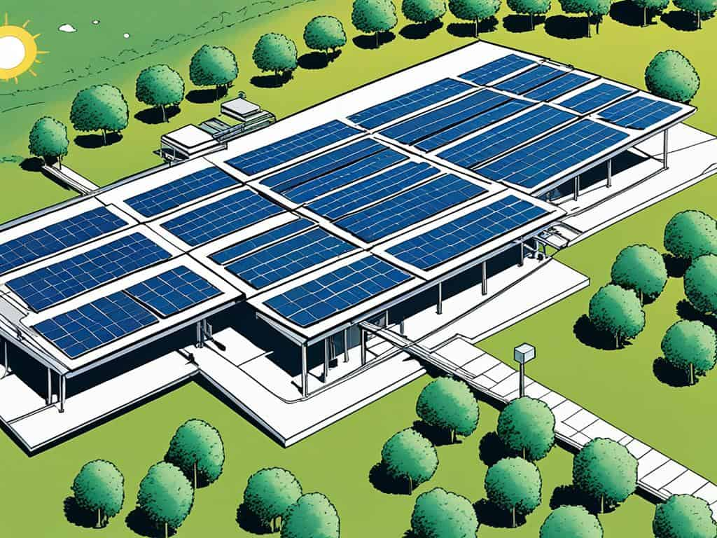
Future Improvement
Adding advanced sensors for enhanced sunlight detection.
Implementing machine learning to predict sun movements.
Optimizing the system for different panel sizes and configurations.
Notes:
Our project holds significant potential for enhancement, and we have identified three key areas of improvement:
Advanced Sensors for Enhanced Sunlight Detection In the future, we aim to integrate more advanced sensors into our system, such as photodiodes or spectral sensors. These would allow for more precise tracking of sunlight, ensuring maximum energy capture even in varying weather conditions.
Implementing Machine Learning to Predict Sun Movements By incorporating machine learning algorithms, our tracker could predict the sun's movement based on historical data and environmental patterns. This predictive ability would improve efficiency by allowing the system to adjust preemptively rather than relying solely on real-time data.
System Optimization for Versatility To make our design more adaptable, we plan to optimize it for compatibility with different solar panel sizes and configurations. This would broaden its application in both residential and industrial settings, providing greater flexibility and scalability.
These developments will not only enhance the efficiency and versatility of our tracker but also ensure that it remains a forward-thinking solution in the rapidly evolving field of renewable energy.
Thank you!

Slide 18
Conclusion
The dual-axis solar tracking system demonstrates a significant improvement in solar energy efficiency by enabling precise alignment with the sun throughout the day. Through the integration of sensors, servo motors, and effective control algorithms, the system ensures optimal energy collection, enhancing sustainability and usability. This project serves as a practical solution for renewable energy advancements and provides a foundation for further innovation in solar tracking technologies.
Notes:
As we conclude, I’d like to highlight the essence of our project—a dual-axis solar tracking system that exemplifies innovation in renewable energy optimization. By integrating precise sensors, real-time processing, and automated adjustments, our system ensures maximum sunlight capture throughout the day, enhancing efficiency significantly. The project combines the power of hardware and software, from servo-controlled panel movements to dynamic monitoring through an LCD display and status indicators.
This project serves as a practical solution for renewable energy advancements and provides a foundation for further innovation in solar tracking technologies.

Slide 19
Thank You

Slide 20

Q&A

