Slide 1
AXI4 Interconnect Microarchitecture
Master_0 Interface
Common
Fabric
AW arbiter
Slave_0
Interface
Skid
Buffer
Address
Decoder
ID Extension
+ Scoreboard
AW queue
AR
AW
W
B
R
Master_0
Slave_0
16 x 16 register array
W engine
W-dest FIFO
Valid Txn Request Array
R engine
B arbiter
AR queue
W Interlock
(matches destination and source since W channel has no WID)
R Arbiter
AR arbiter
Master_1
Master_1 Interface
Slave_1 Interface
Slave_1
Master_2
Master_2 Interface
Slave_2 Interface
Slave_2

Slide 2
Main dataflow
Inputs: each master m offers { valid, id, addr, len, qos }
Output: one winner drives the slave;
ready returns to winner only
1. if a held winner exists (offer made last cycle, not yet accepted):
keep that same winner ← grant hold: payload can't change
else:
E = { masters that are requesting AND eligible }
g = Pick(E) ← choose the winner
2. drive winner g's payload to the slave
send ready back to master g only
3. on handshake (winner accepted):
advance round-robin pointer
OnGrant(g) ← per-scheme pointter
Three architectures:
Round Robin (RR)
Eligible(m) = always
Pick(E) = first requester, scanning from the round-robin pointer
OnGrant(g) = nothing
Quality of Service (QoS): Priority Based
Eligible(m) = always
Pick(E) = highest effective priority
eff(m) = QOS_MAX if m has waited ≥ STARVE_LIMIT
qos(m) otherwise
OnGrant(g) = clear g's age; increment age of everyone still waiting
Deficit Round Robin(DRR)+ QoS
Eligible(m) = deficit(m) ≥ cost(m) ← the key difference
cost(m) = len(m) + 1 (beats, not requests)
Pick(E) = highest qos among the eligible (round-robin breaks ties)
OnGrant(g) = deficit(g) −= cost(g)
Round end = if masters are requesting but none is eligible,
credit every requester: deficit(m) += quantum(m)
quantum(m) = QUANTUM_MIN + weight(m) × STEP

Slide 3
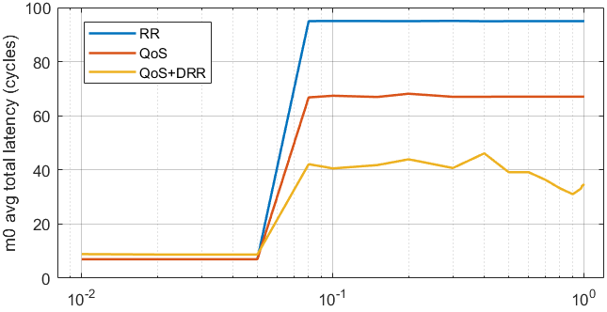
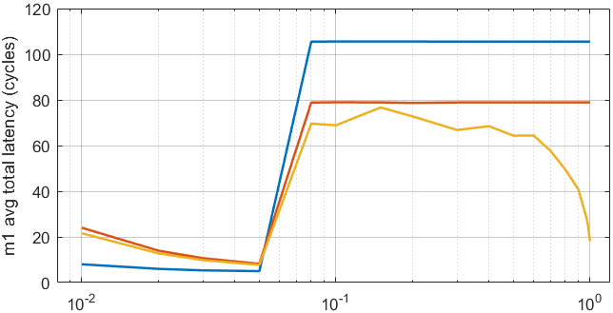
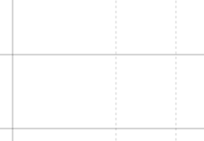
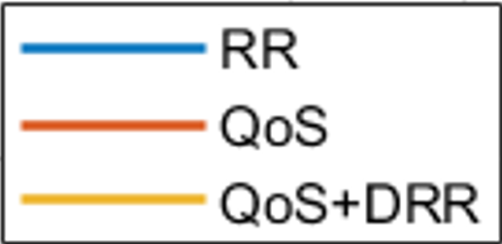
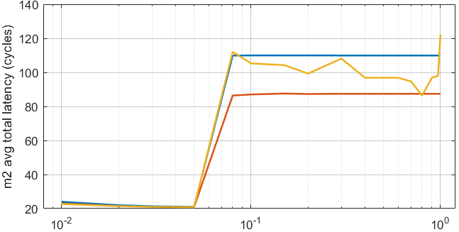
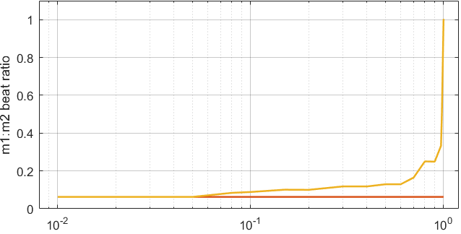
(a)
(b)
(c)
(d)
Ideal at 1
Per request at 1/16
Here the high-priority master m0’s latency improves as we move towards QoS and DRR based architecture.
Equal priority masters m1 and m2 have different burst sizes (m2 bigger burst, m1 smaller burst), so m2 will hog up the bandwidth unfairly in regular round robin architecture. So, as we move to DRR architecture, this ratio evens out and reaches 1. But this BW fairness also increases m2’s latency slightly while decreasing m1’s latency significantly.

Slide 4

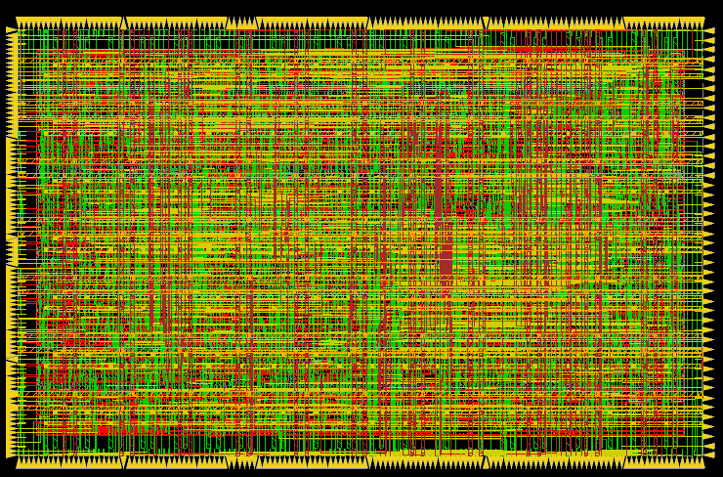
RR architecture synthesis
Final chip at 60% n core area utilization

Slide 5

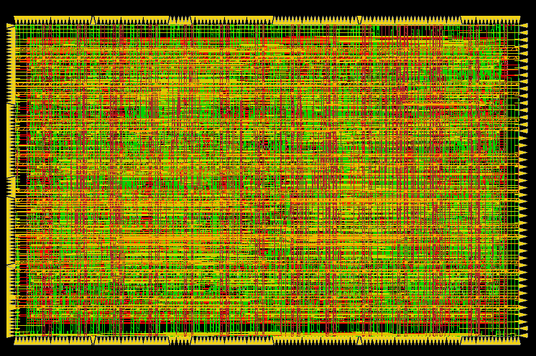
Final chip at 60% n core area utilization
QoS

Slide 6
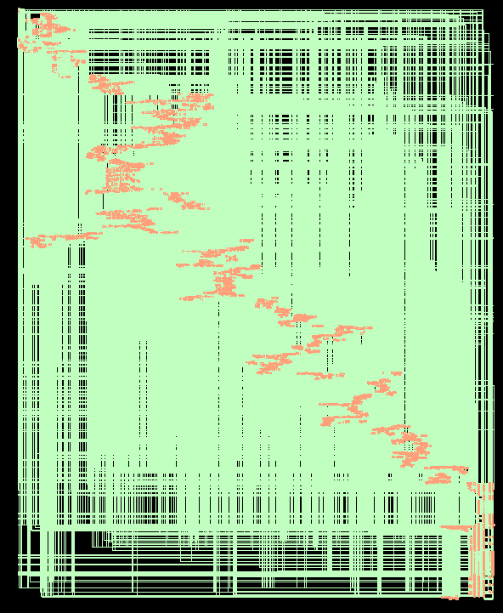
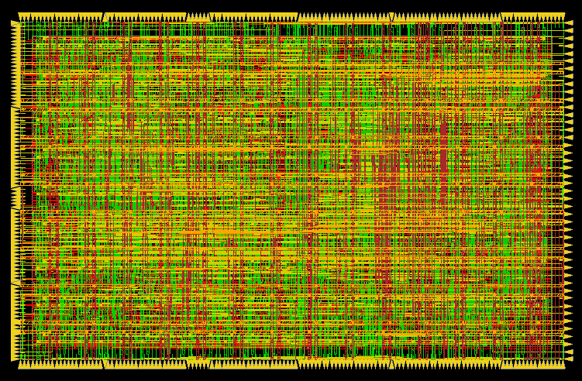
DRR
Final chip at 60% n core area utilization

Slide 7
master 0 ports
slave 0 ports
master 1 ports
slave 1 ports
AResetn
master 2 ports
ACLK
slave 2 ports

Slide 8
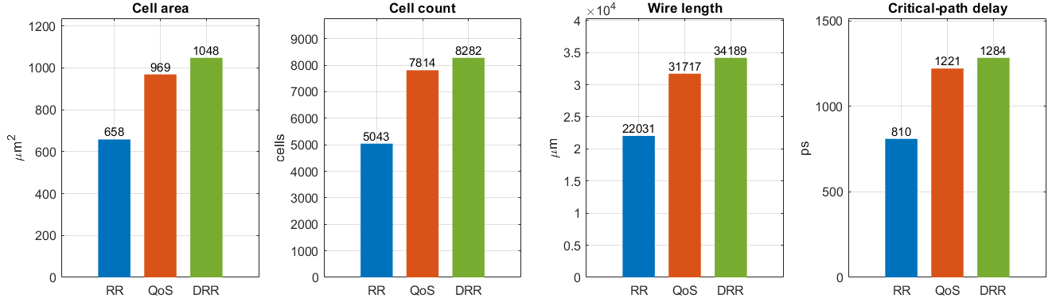
(a) (b) (c) (d)
QoS+DRR
QoS+DRR
QoS+DRR
QoS+DRR

Slide 9
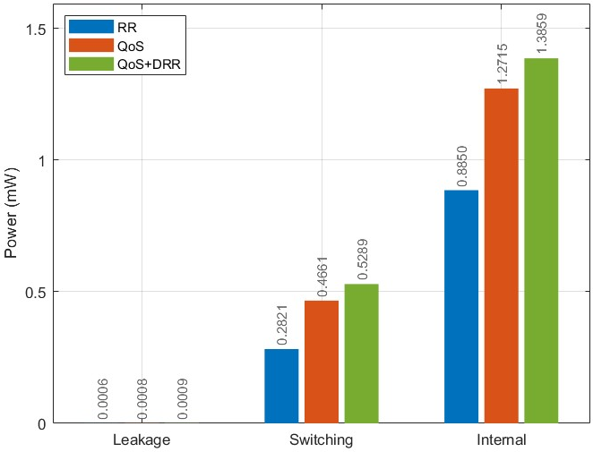
Everything costs more to make our architecture be more aware of the requests its serving, but even though critical path delay rises, we get decreased latency for our request servicing, which for critical requests like time sensitive camera/sensor data processing is very important

