Slide 2
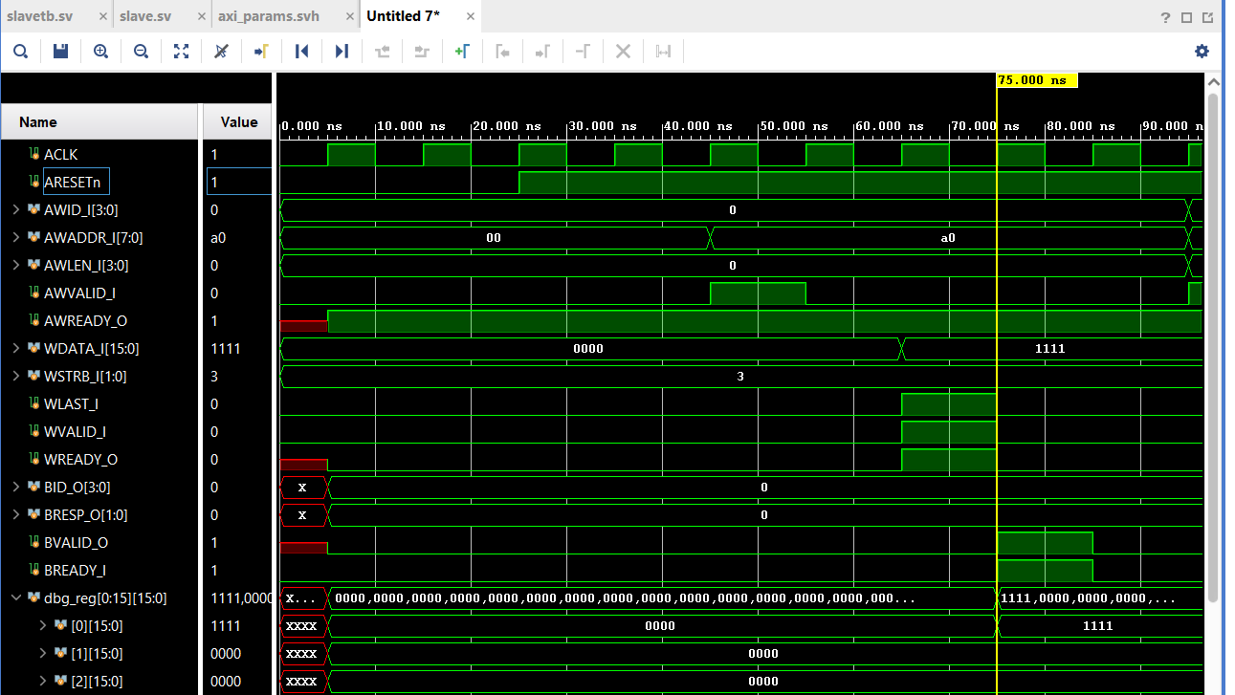
Slave single address pop – write - resp

Slide 3
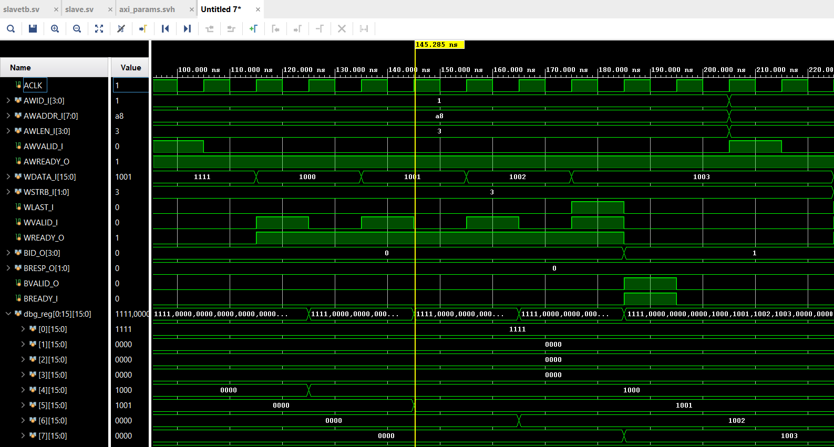
Slave address push - 4 burst pop – write - resp

Slide 4
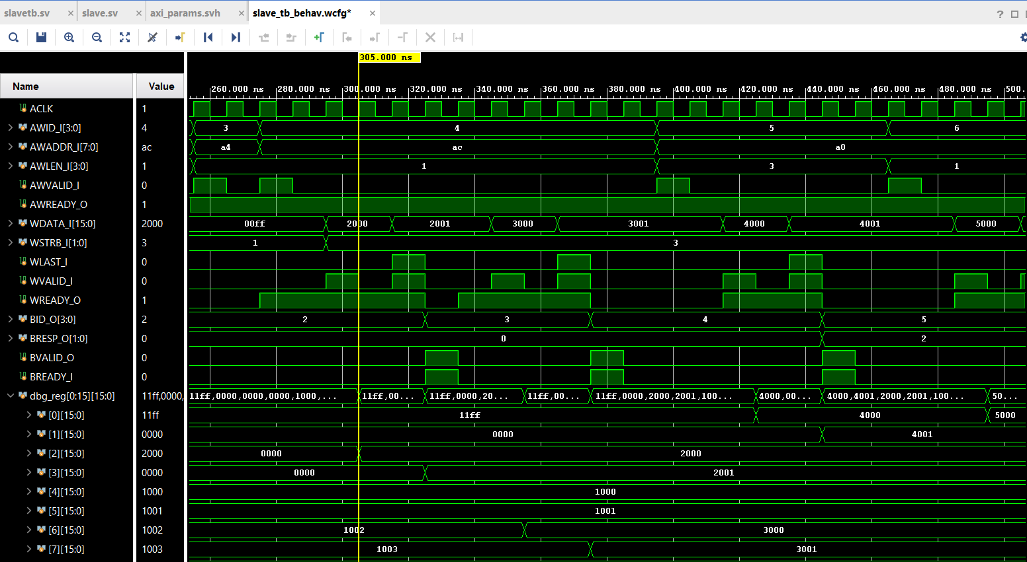
Two outstanding address push - pop (when write valid) - resp

Slide 5
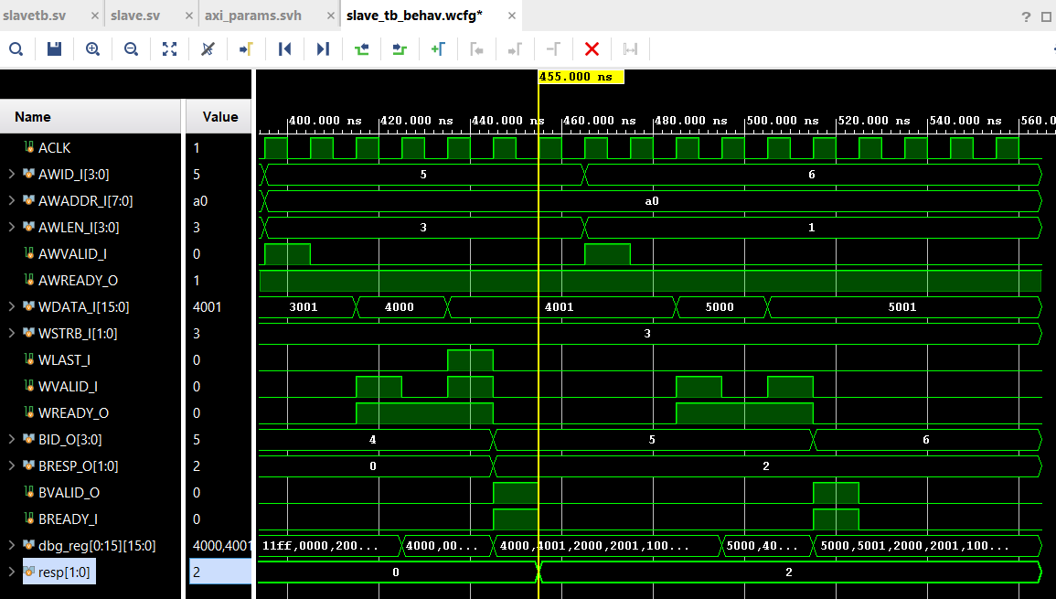
BRESP = SLVERR for WLAST mismatch

Slide 6
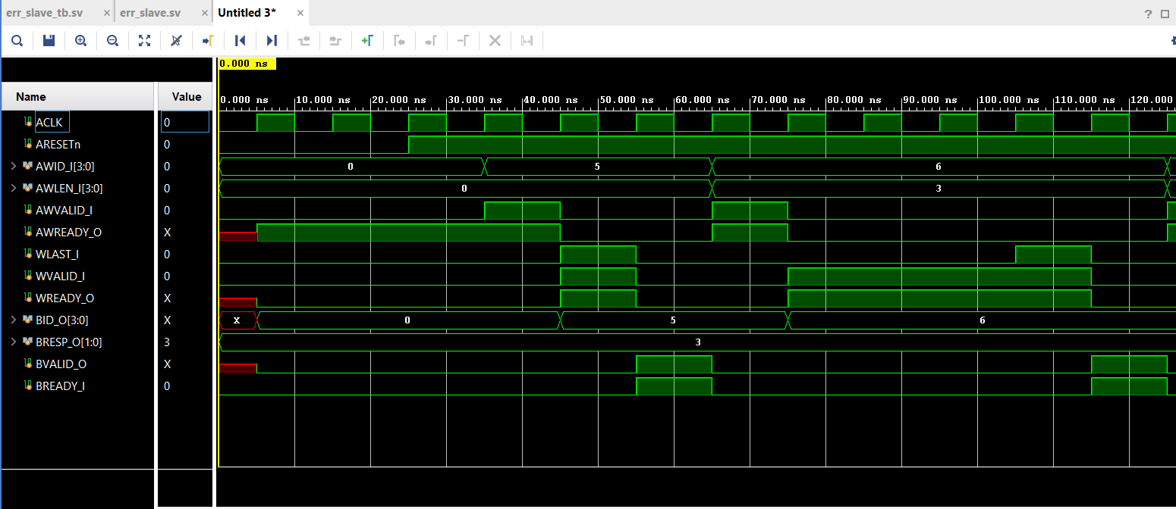
Error slave consuming addresses and write data with RESP fixed at DECERR

Slide 7
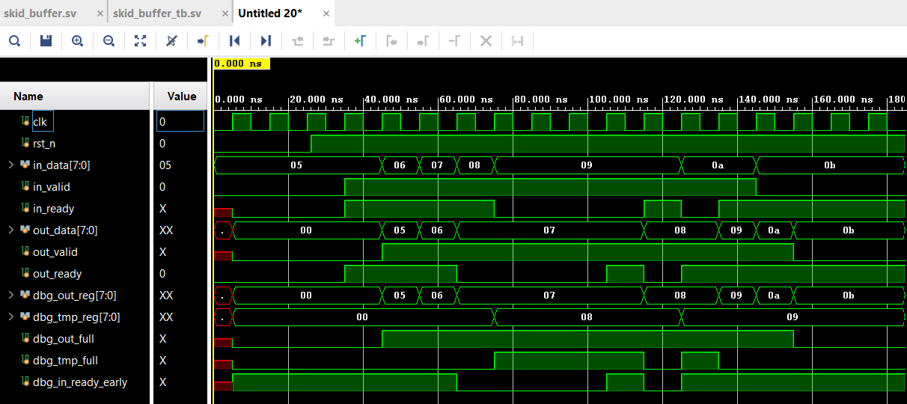
Skid – buffer value storing

Slide 8
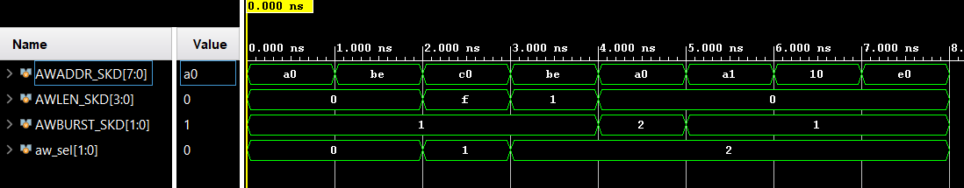
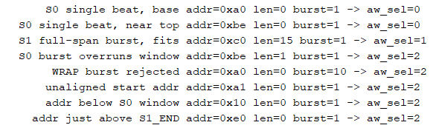
Address decoder after skid buffered address

Slide 9
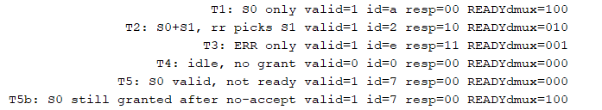
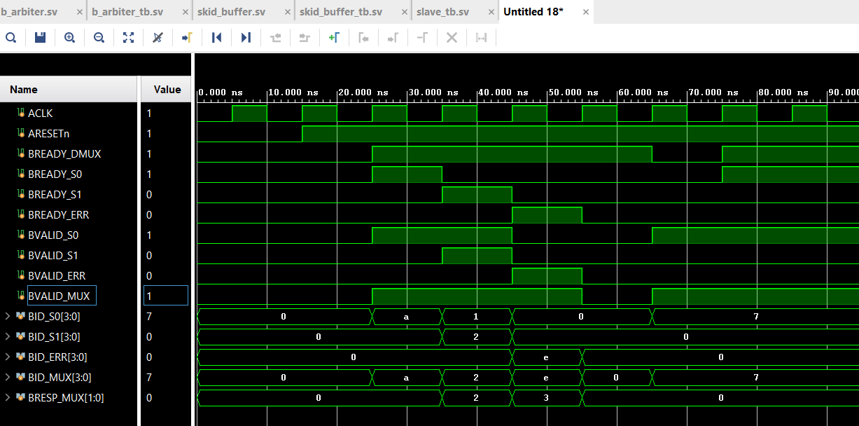
Response Arbiter S0 > S1 > ERR

Slide 10
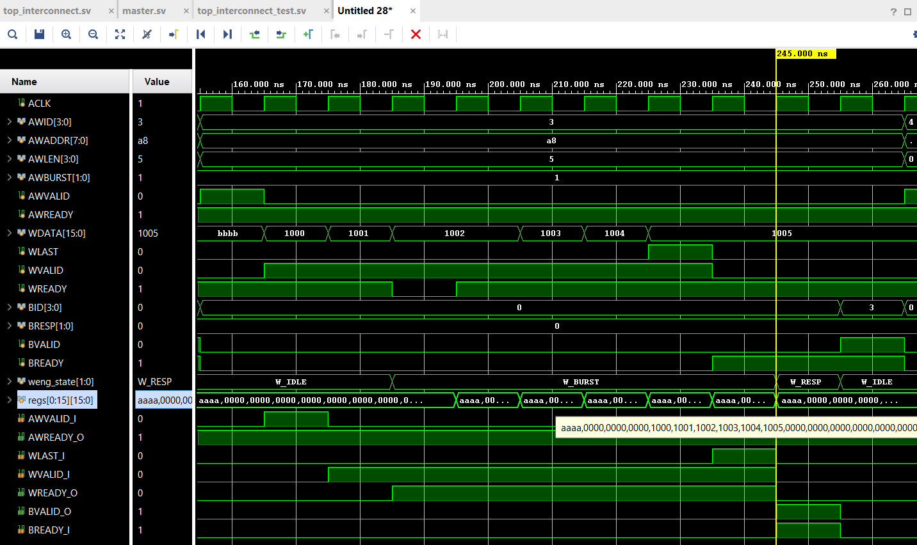
6 LEN Burst Write in Slave0 from interconnect top

