Slide 1
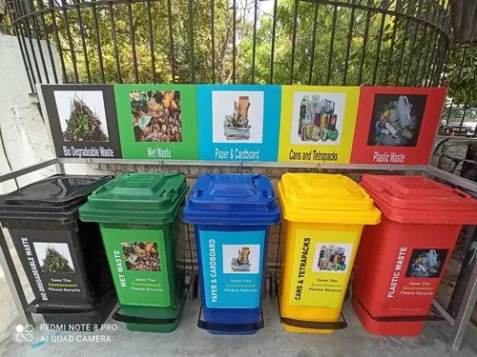
EEE 318: Control Systems I Laboratory
AUTOMATED
SMART WASTE
SEGREGATION
Project Progress
Group 06 | Presentation

Slide 2
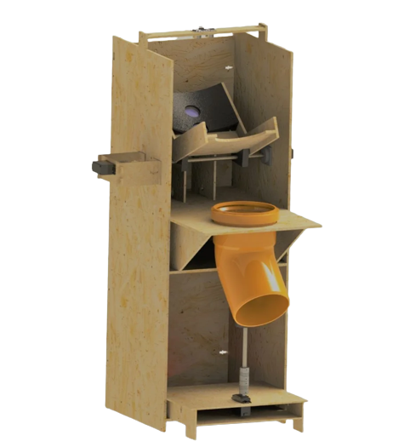
EXPECTED STRUCTURE

Slide 3
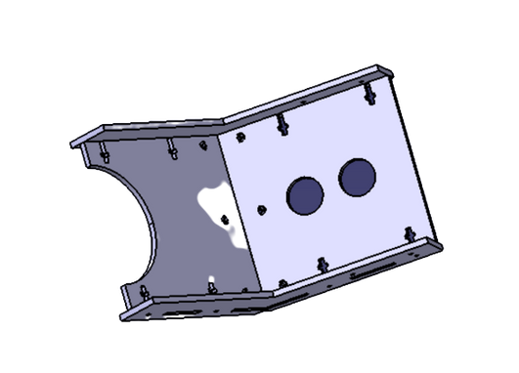
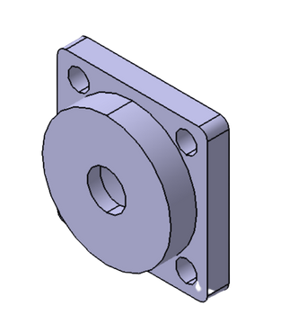
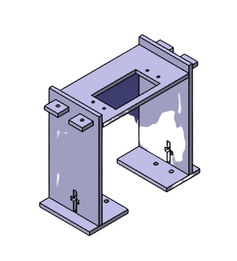
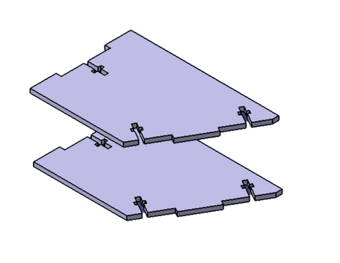
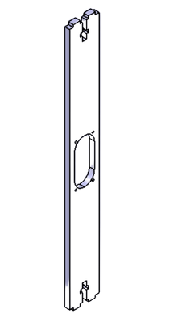
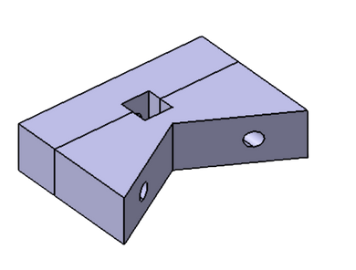
PHYSICAL STRUCTURE
3D PRINTED PARTS

Slide 4
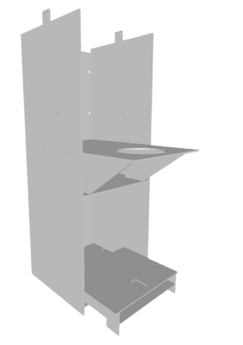
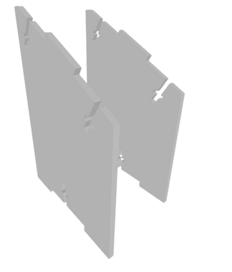
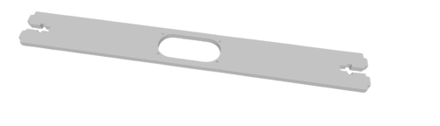
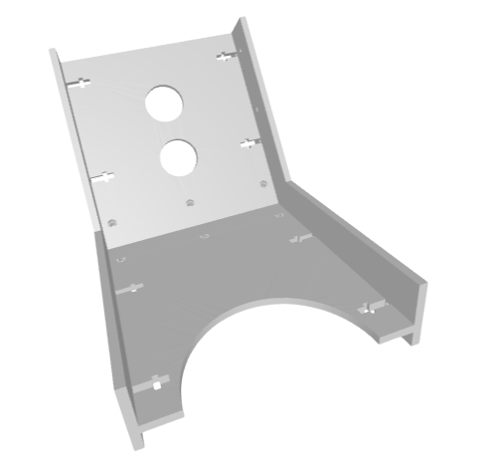
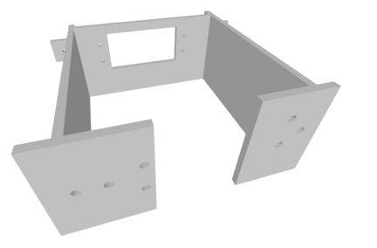
PHYSICAL STRUCTURE
LASER CUT PARTS

Slide 5
MOTOR CALCULATION
Wood Density, d= 0.600 gm/cc
Volume (CAD design), V= 206.4 cc
Total weight= d*V/1000= 0.12348 kg
W1=W2=(0.12348*9.8)/2= 0.61 N
Let us take a maximum waste mass, MWM=0.72 Kg
Torque F*L=MWM*9.8*150 +0.61*75-0.61*cos(60)*75
F*L=104.95 N-mm=1.72875 kg-cm
Yield Strength, T=250 MPa=250 N/sq. mm
T= (F/A)/(d/L)=(F*l)/(A*l)=(F*l)/V=(104.95)/V
V= (1/16) * pi * d^3
d= 4mm
W1
75 mm
W2

Slide 6
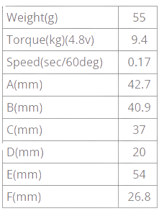
MOTOR CALCULATION
Specifications of MG 996R
MWM= 0.72 Kg
Using simple approximations, torque T= 0.72*7.5*sin(120)
T= 4.8 kg-cm

Slide 7
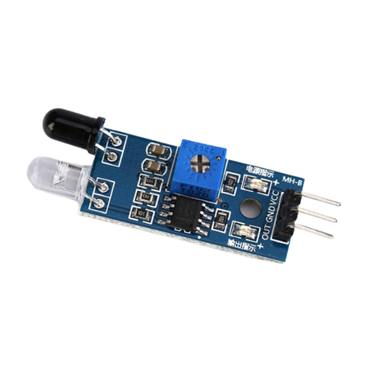
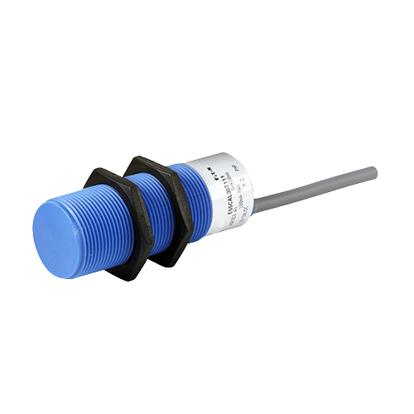
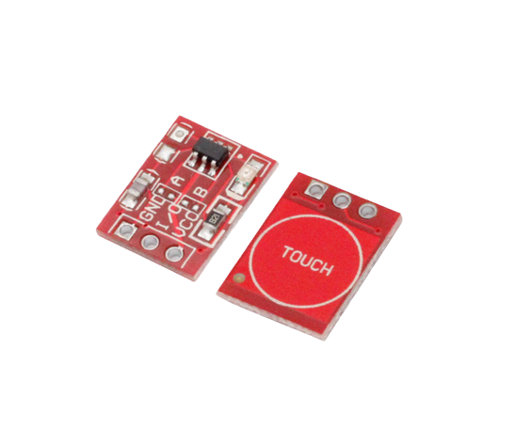
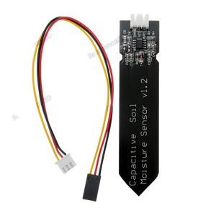
DETECTION
IR sensor
Inductive Proximity Sensor
Capacitive touch Sensor
Capacitive Soil Moisture Sensor
METAL
PLASTIC
ORGANIC

Slide 8
LOGIC DEVELOPMENT
Case | Inductive | Capacitive | Soil Sensor
Metal | No | Yes | No
Plastic | Yes | Yes/no | No
Organic | No | No | Yes

Slide 9
LOGIC DEVELOPMENT
Case | Inductive | Capacitive | IR sensor
Metal | No | Yes | X
Plastic | Yes | X | X
Organic | No | No | Yes

Slide 10
DIFFICULTIES
Absolute Dryness of internal structure: Capacitive Soil Moisture sensor detects even the slightest moisture. Possible solution: Paint coating.
IR sensor: Alternative process is to first cross out metal and plastic and use IR sensor to detect waste and label it organic.
Pipe Dynamics: Try and test pipe dynamics to see if motion is as predicted.

