Slide 1
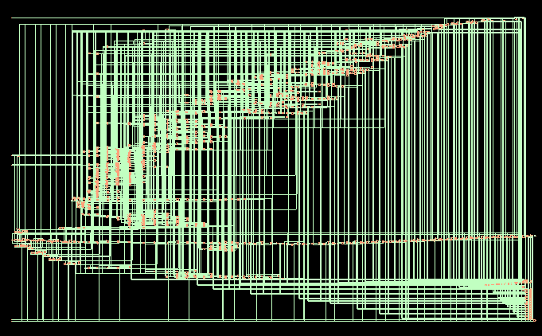
Synthesized Netlist ASAP7 CCS

Slide 2
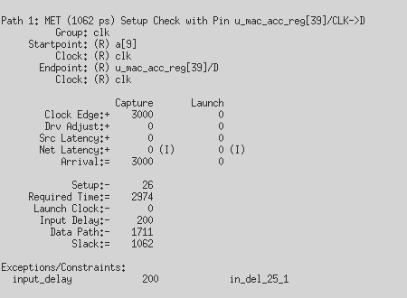
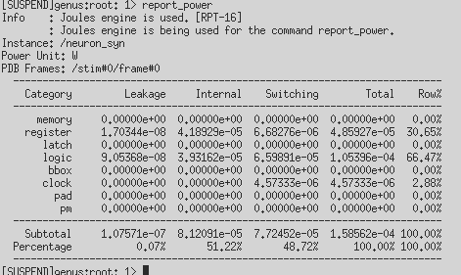
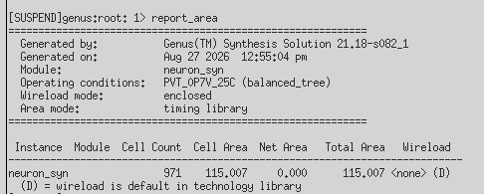
Synthesis Report ASAP7 CCS: timing
Timing power area

Slide 3
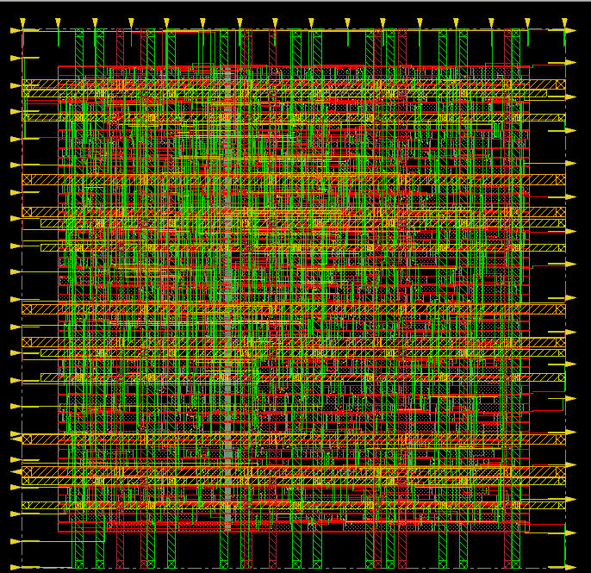
PnR ASAP7 60% utilization no ring no filler

Slide 4
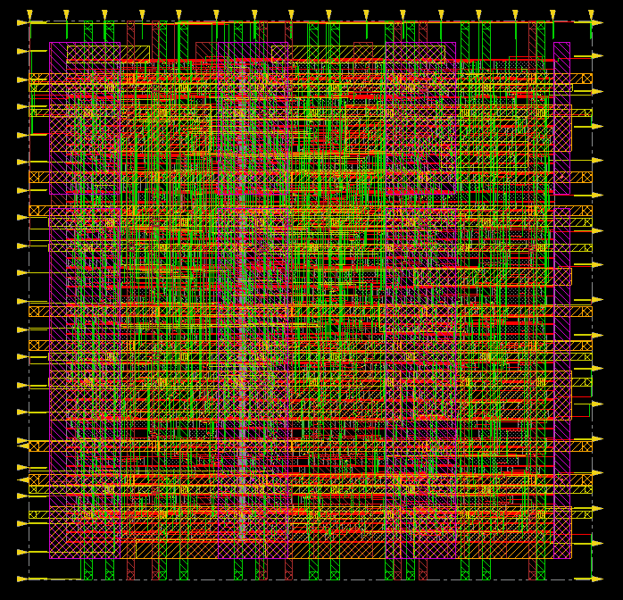
PnR ASAP7 60% utilization no ring with filler

Slide 5
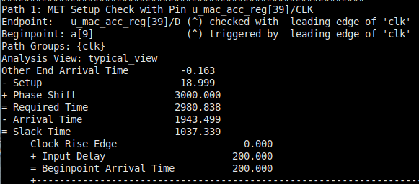
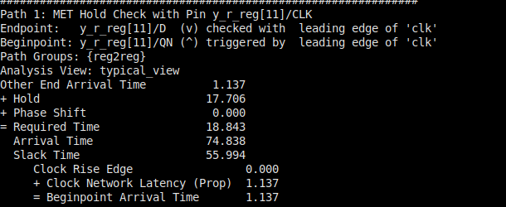
Nanoroute ASAP7 reports
Timing setup hold

Slide 6


Nanoroute ASAP7 reports
power area

Slide 7
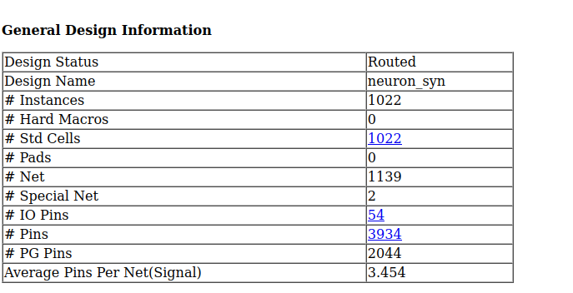
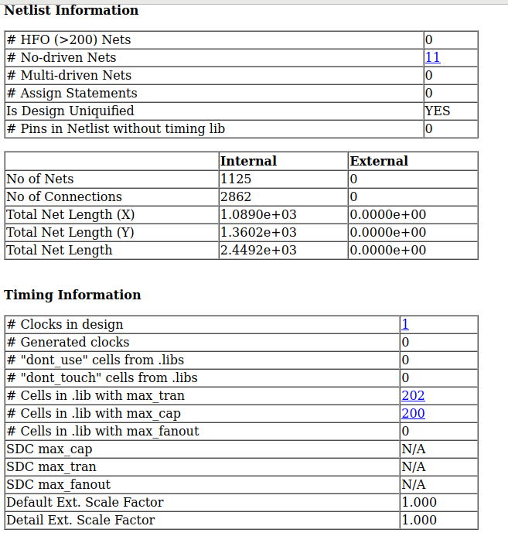
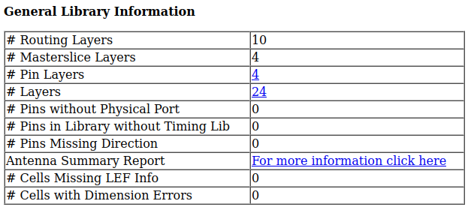
report ASAP7 60% utilization no ring

Slide 8
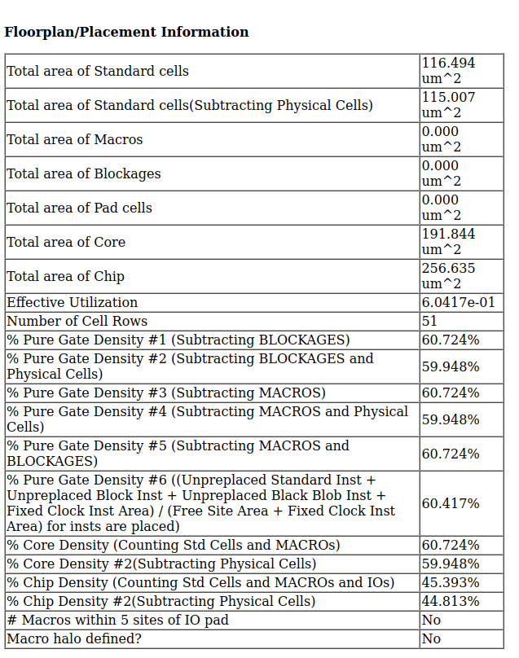
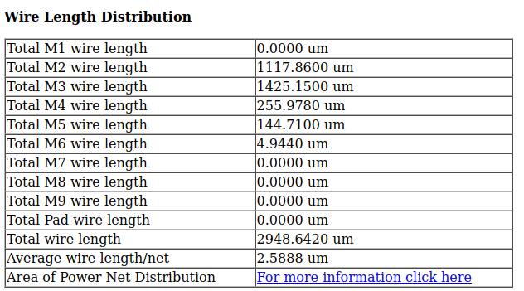
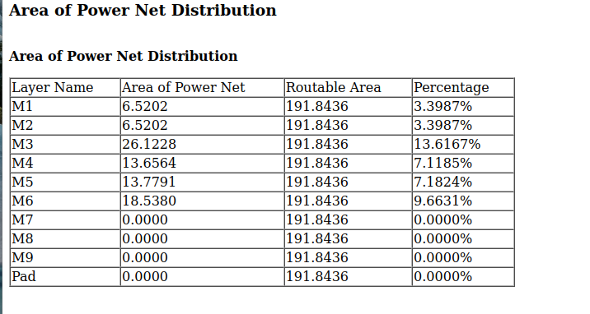
report ASAP7 60% utilization no ring

Slide 9
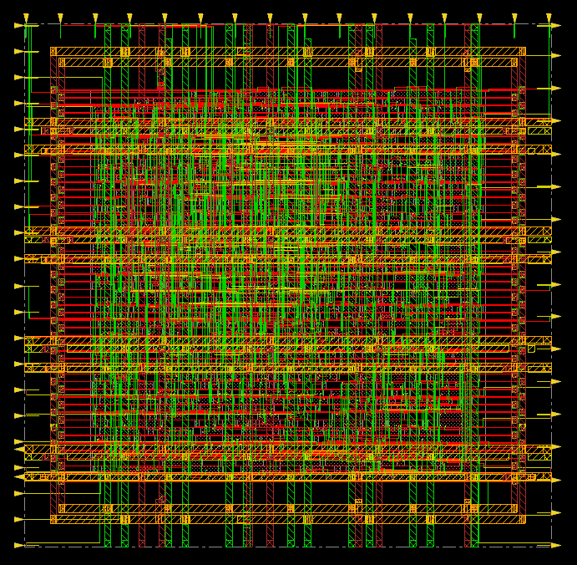
PnR ASAP7 60% utilization yes ring no filler

Slide 10
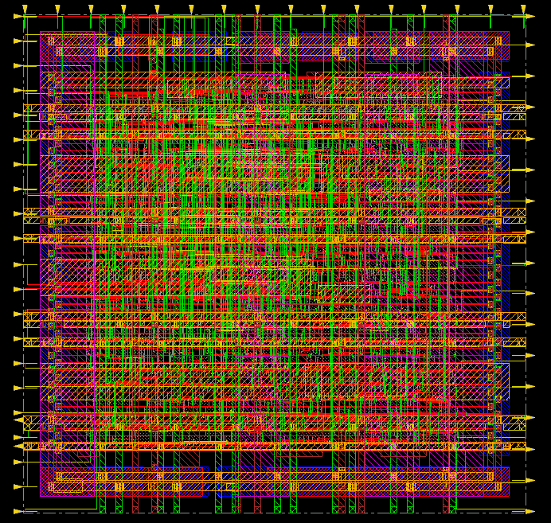
PnR ASAP7 60% utilization yes ring with filler

Slide 11
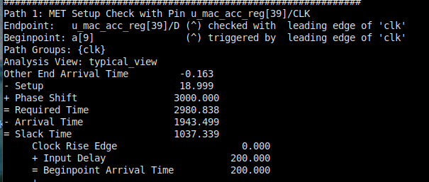
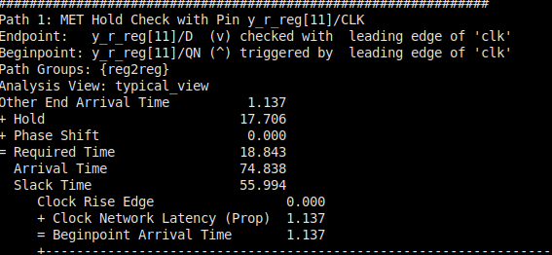
Nanoroute ASAP7 reports
Timing setup hold

Slide 12


Nanoroute ASAP7 reports
power area

Slide 13
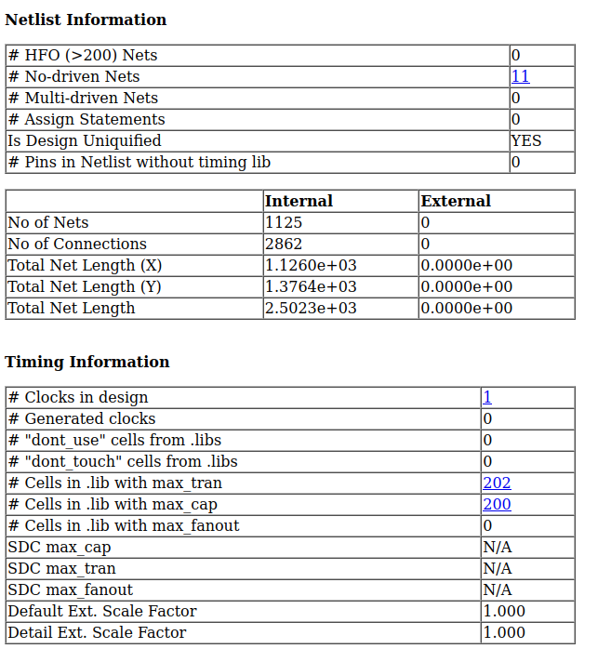
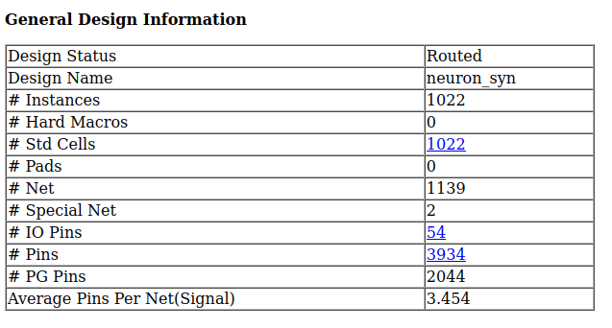
report ASAP7 60% utilization yes ring

Slide 14
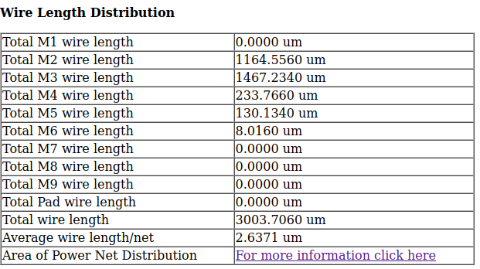
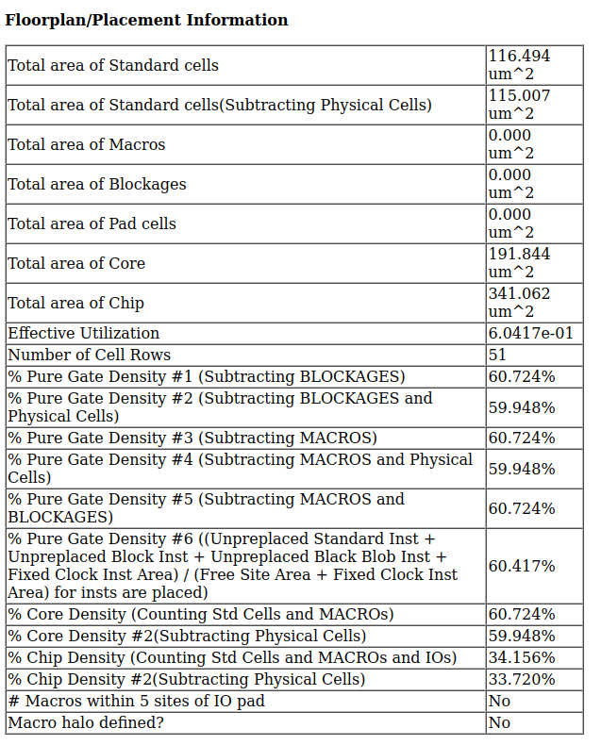
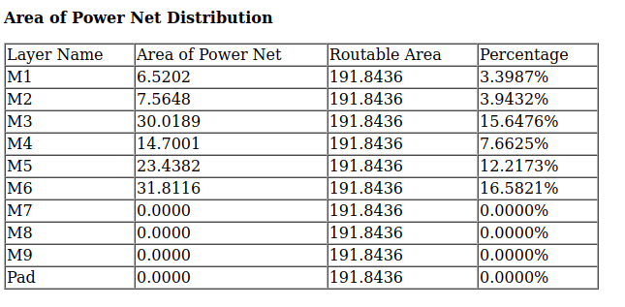
report ASAP7 60% utilization yes ring

