Slide 1
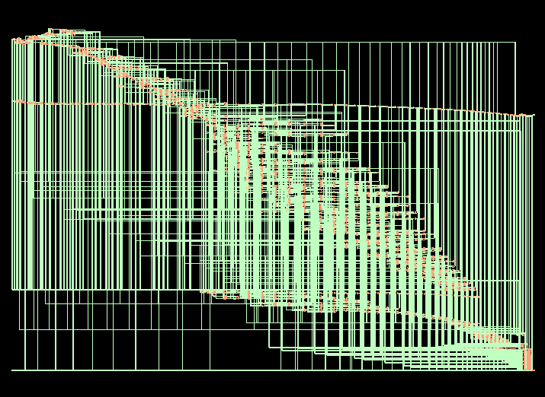
Synthesized Netlist cnfet7 CCS

Slide 2
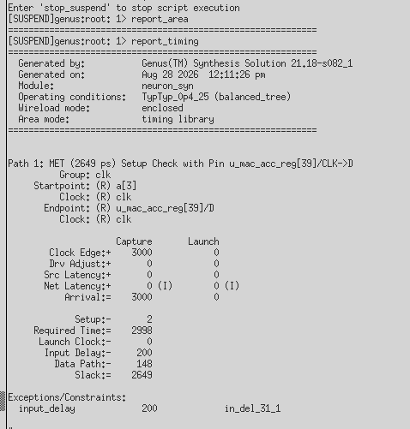
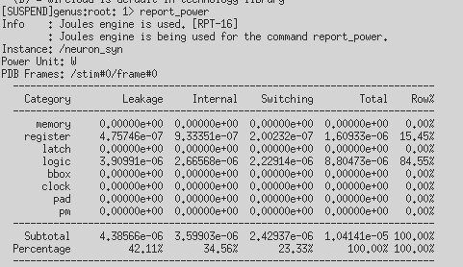
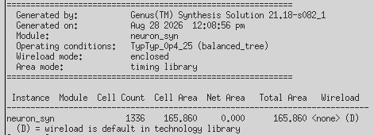
Synthesis Report ASAP7 CCS: timing
Timing power area

Slide 3
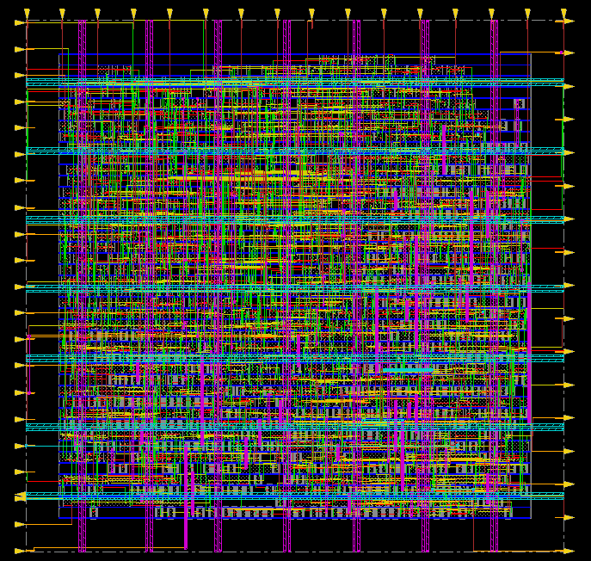
PnR CNFET7 no ring no filler

Slide 4
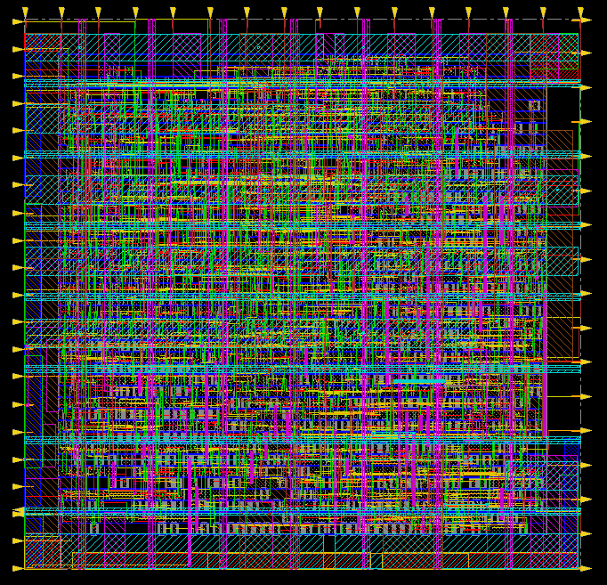
PnR CNFET7 no ring metal fill

Slide 5
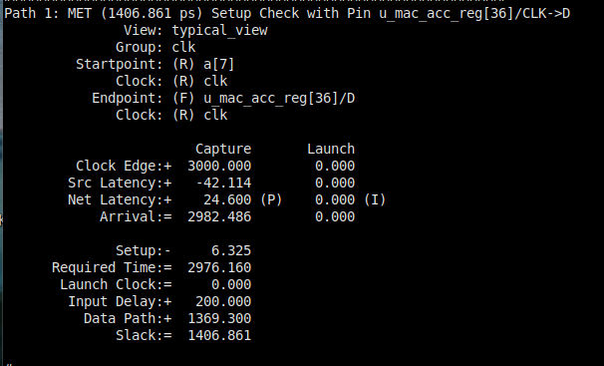
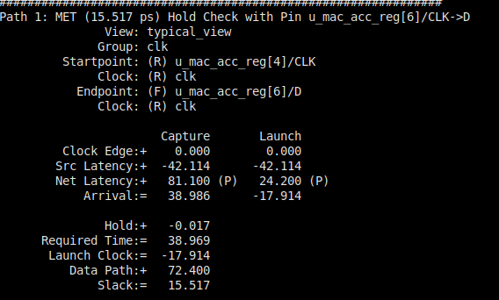
Nanoroute Cnfet7 reports
Timing setup hold

Slide 6


Nanoroute Cnfet7 reports
power area

Slide 7
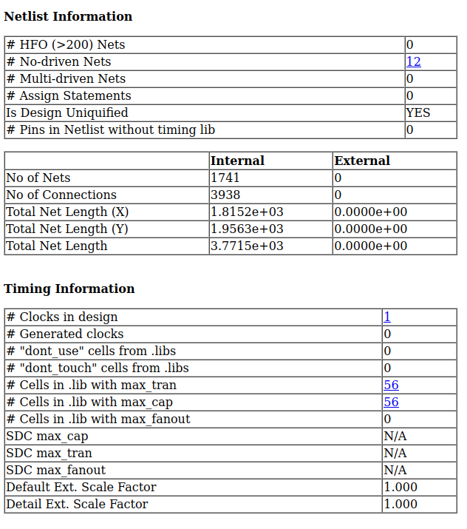
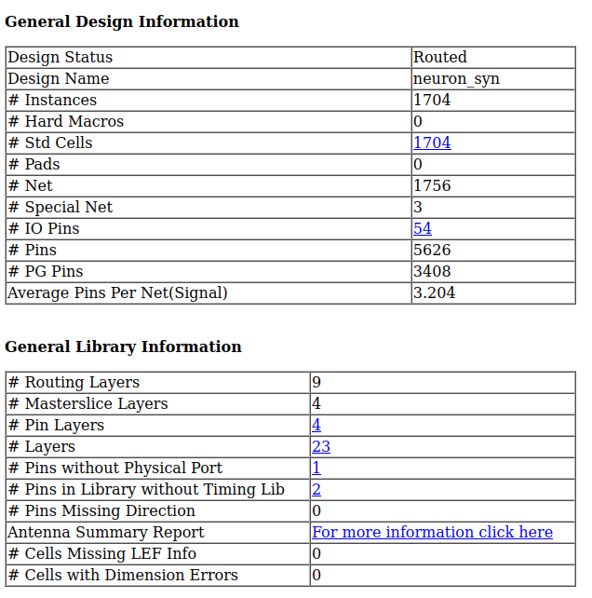
Nanoroute HTML report

Slide 8
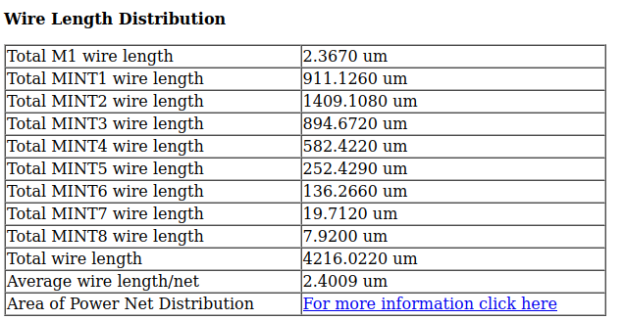
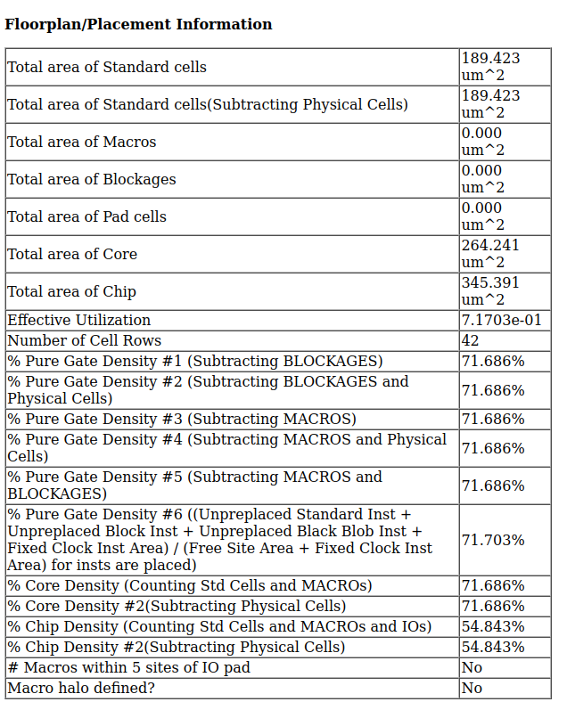
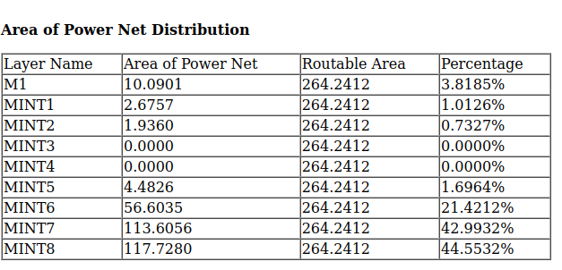
Nanoroute HTML report

Slide 9
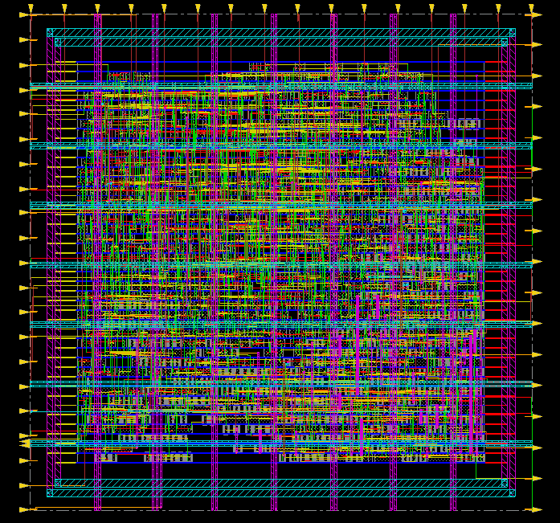
PnR CNFET7 yes ring no filler
Neuron PnR in CNFET7

Slide 10
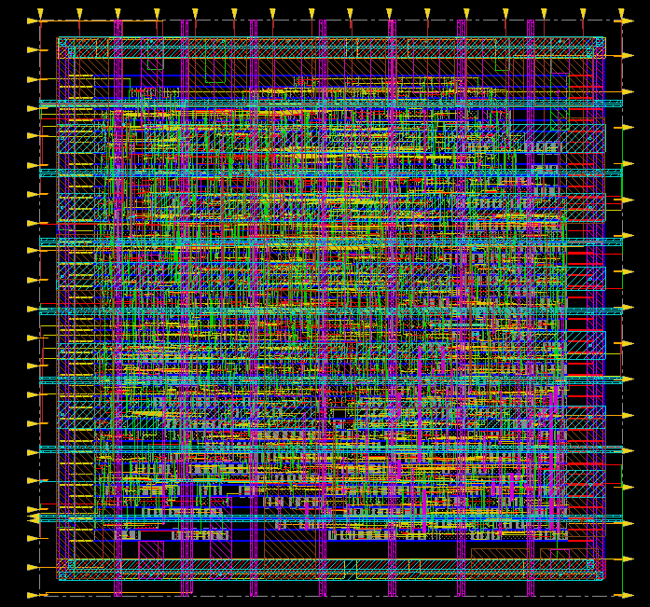
PnR CNFET7 yes ring metal fill

Slide 11
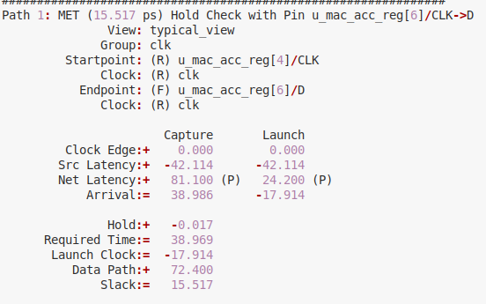
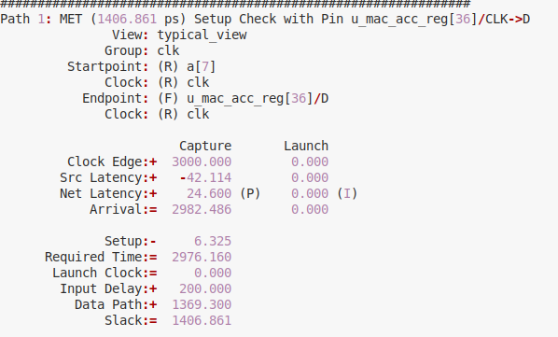
Nanoroute Cnfet7 reports
Timing setup hold

Slide 12


Nanoroute Cnfet7 reports
power area

Slide 13
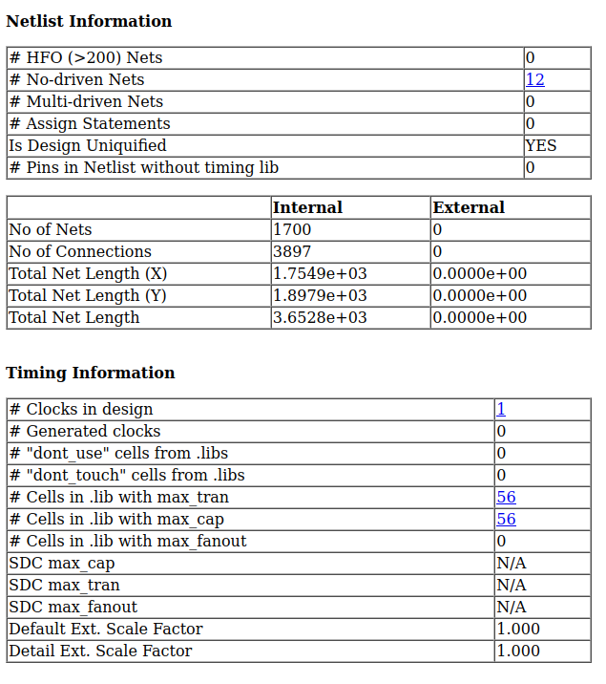
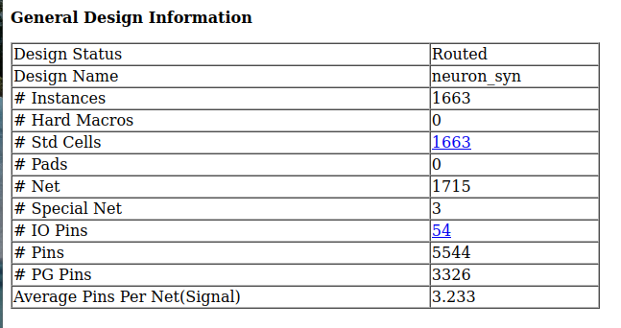
Nanoroute HTML report

Slide 14
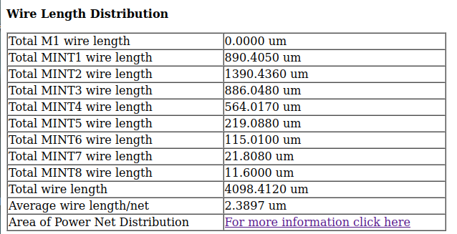
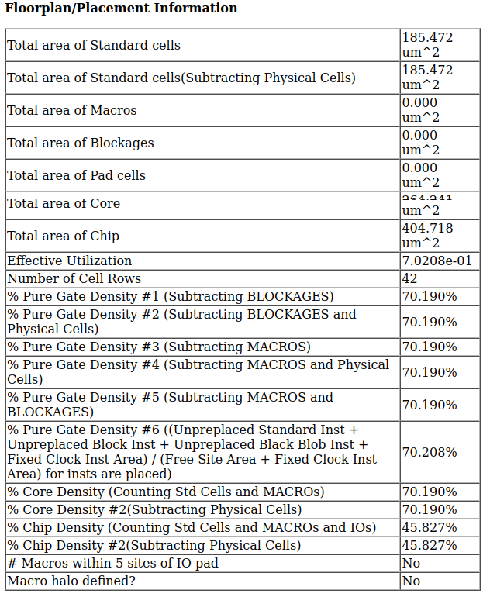
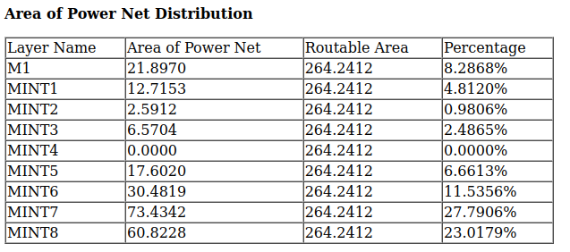
Nanoroute HTML report

Slide 15
PnR CNFET7 yes ring no metal fill 70%

Slide 16
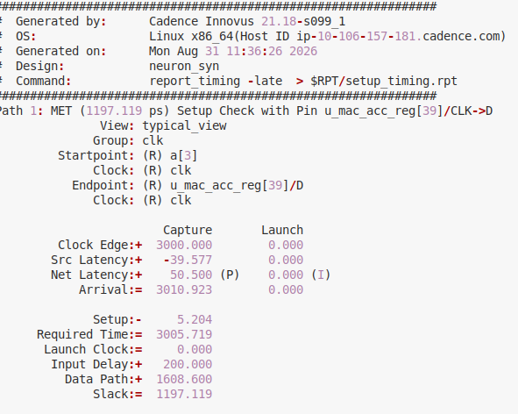
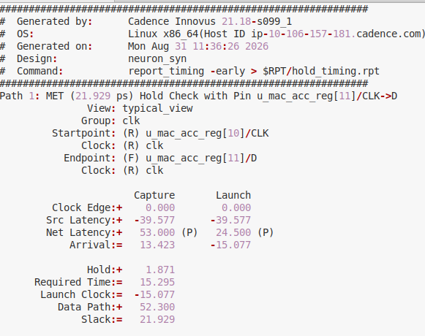
Nanoroute Cnfet7 reports
Timing setup hold

Slide 17


Nanoroute Cnfet7 reports
power area

Slide 18

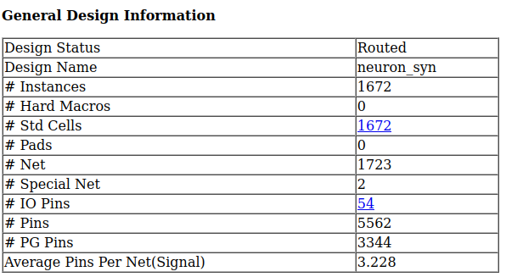
Nanoroute HTML report

Slide 19
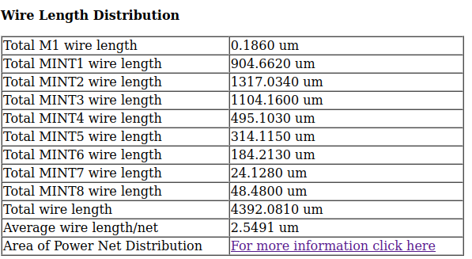
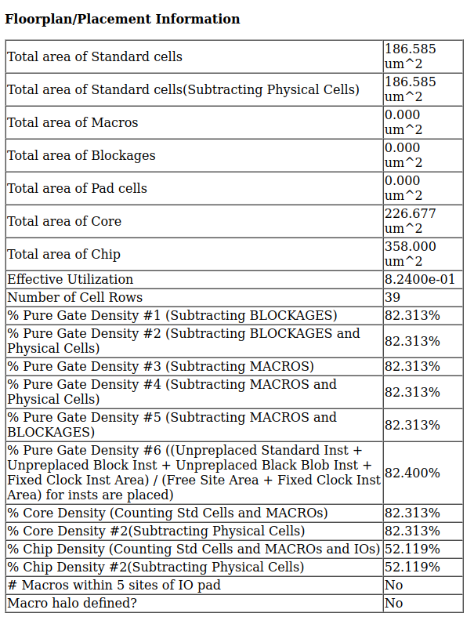
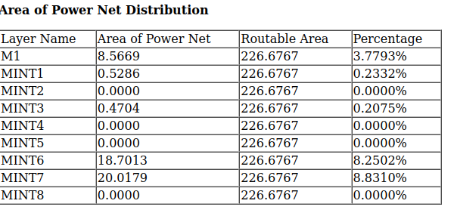
Nanoroute HTML report

