Slide 1
Neuron Microarchitecture
MAC
rst_n en
16
combinational
w [15:0]
ACC
×
32
+
40
M
40-bit
async rst_n
16
product
sequential (clocked)
a [15:0]
acc + product
signed multiply
M = multiplexer ·
clk
clear
acc → sign-extend 40 → 42
40
acc feedback
42
result_en
REQUANTIZE
ReLU
OUTPUT REGISTER
y_r
y_r [15:0]
42
> MAX_V
y
16-bit
'0'
16
16
+
≫ 12
x_q
Fixed arithmetic right shift
M
trunc
M
clk
16
< MIN_V
result_en
y_valid
y_valid
BIAS = 2^11
rounded
sign bit x[15]
1-bit
over / under
clk

Slide 2
Neuron Microarchitecture
MAC
rst_n en
Signed bit-extend
[39:0]
ACC_reg
w [15:0]
MUX
40-bit
a [15:0]
product
[31:0]
acc +
product
signed multiply
[39:0]
clk
clear
acc feedback
40
REQUANTIZE
> MAX_V
acc → sign-extend 40 → 42
MUX
≫ 12
[41:0]
trunc
Fixed arithmetic right shift
[15:0]
< MIN_V
rounded
BIAS = 2^11
over / under
y_r [15:0]
16
y_r
MUX
16-bit
result_en
y_valid
y_valid
'0'
1-bit
sign bit
clk
ReLU
OUTPUT REGISTER

Slide 3
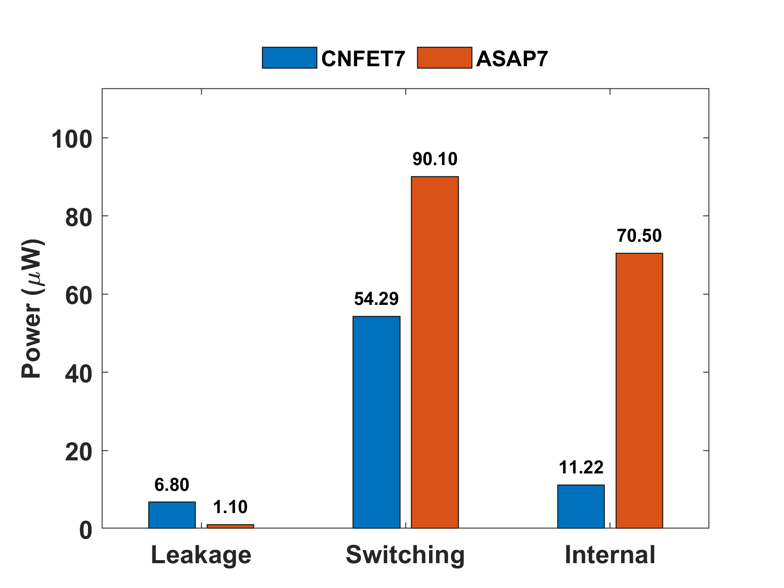

Slide 4
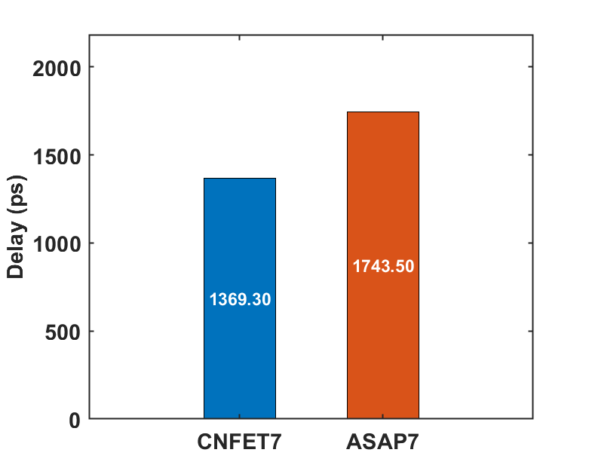
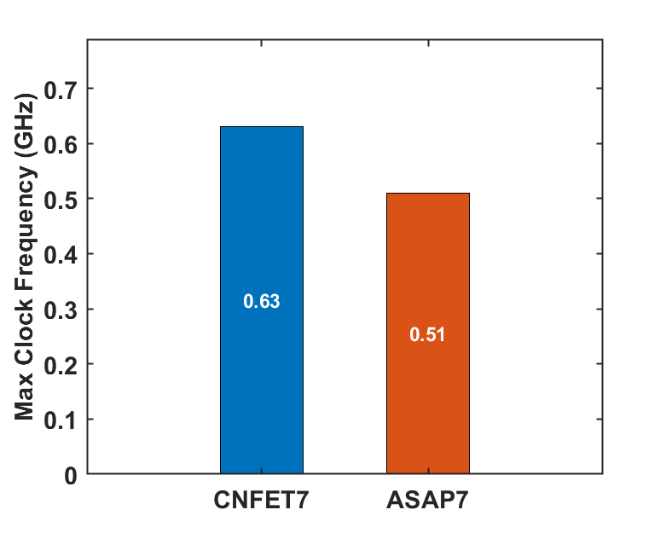

Slide 5
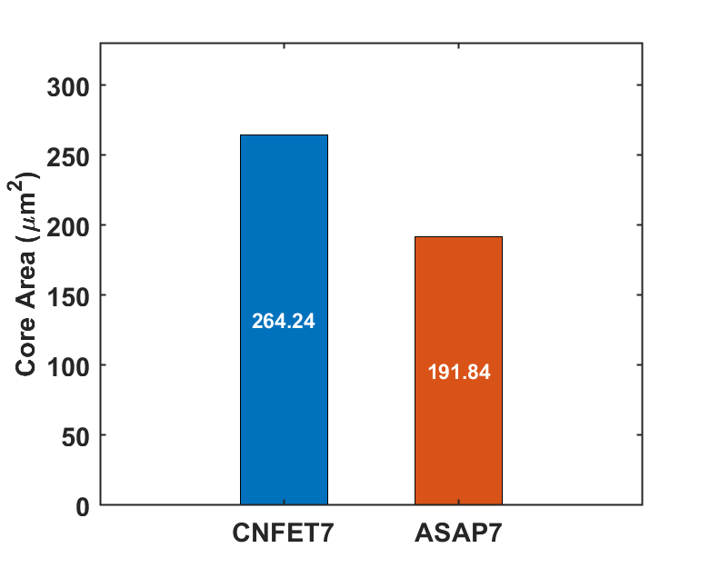
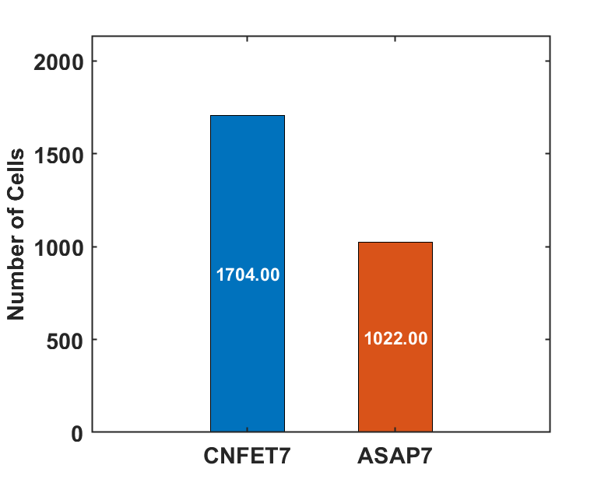
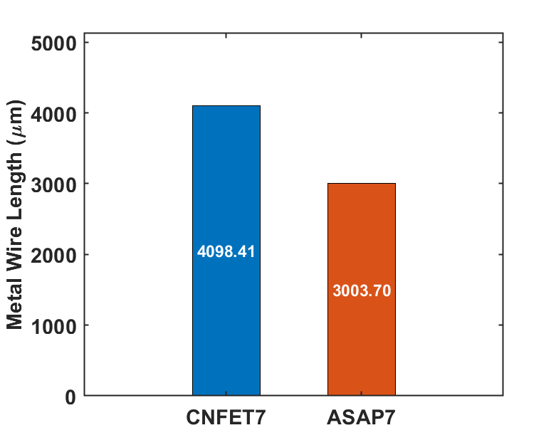

Slide 6
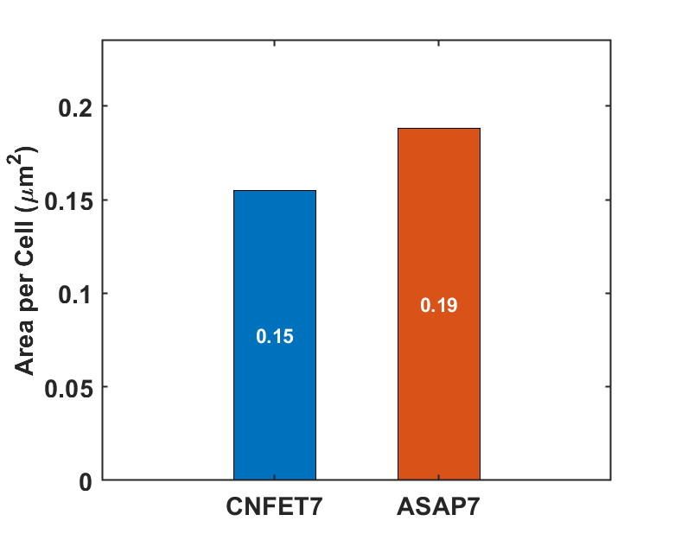
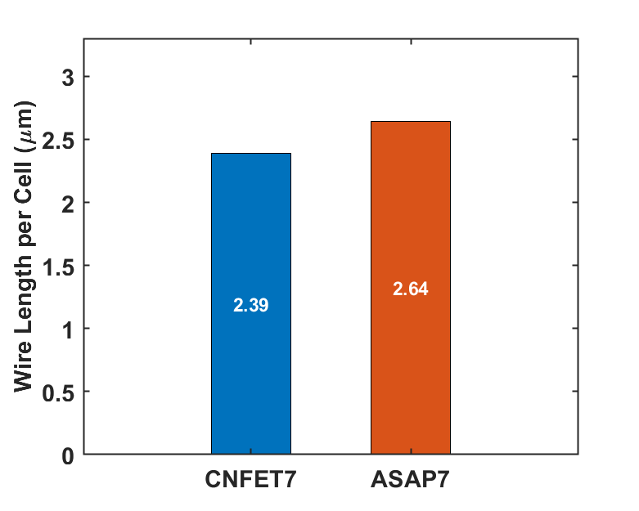

Slide 7
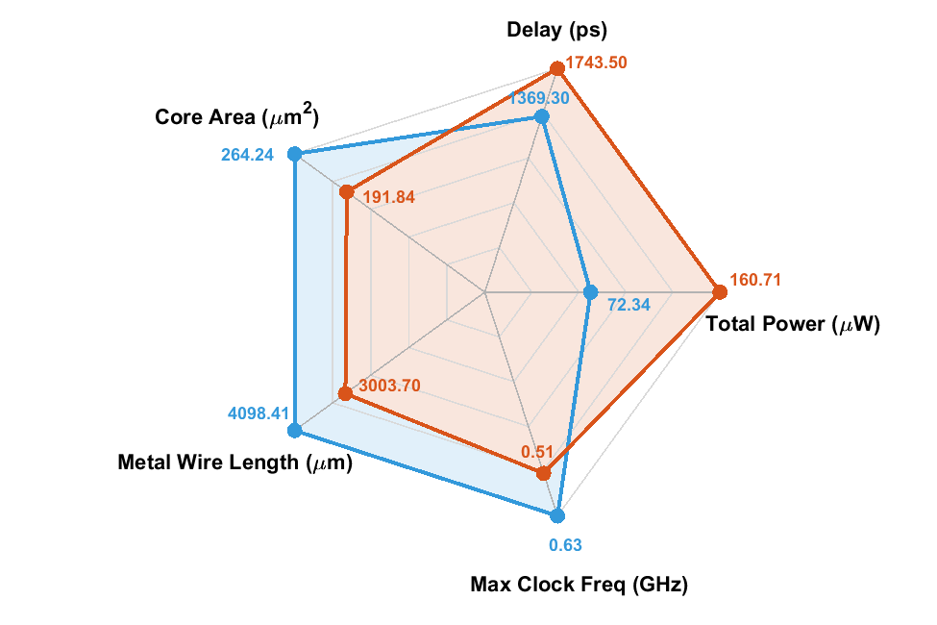
ASAP7
CNFET7

