Slide 1


EEE-414 Electrical Services Design
Final Project Presentation
Group-04
Group Members:
1. Md. Fahadul Islam- 1906054
2. Tasmin Khan- 1906055
3. Bokhtiar Foysol Himon- 1906056
4. Tawsif Arefin- 1906057
5. Mohammad Ismail Chowdhury- 1906058
6. Md. Hasib Ur Rashid- 1906059

Slide 2
7. Earthing System Diagram
8 . SwitchBoard Connection Diagram(with Calculation)
Ground Floor
Basement
Typical Floor
Rooftop
8. Emergency SwitchBoard Connection Diagram(with Calculation)
Ground Floor
Basement
Typical Floor
8. Sub Distribution Board Diagram(with Calculation)
Ground Floor
Garage
Typical Floor
9. Emergency Sub Distribution Board Diagram(with calculation)
Ground Floor
Garage
Typical Floor
10. Load Calculation Sample
11. Reference
Building Overview
Symbols & Legends
Floor Plans (with Fittings and Fixtures)
Floor Plan : Single Unit
Floor Plan : Typical Floor
Floor Plan : Ground Floor (with Substation Layout)
Floor Plan: Basement
Conduit Layout
Conduit Layout: Single Unit
Conduit Layout : Typical Floor
Conduit Layout : Ground Floor
Conduit Layout : Basement
Emergency Conduit Layout
Emergency Conduit Layout: Single Unit
Emergency Conduit Layout : Typical Floor
Emergency Conduit Layout : Ground Floor
Emergency Conduit Layout : Basement
5. Power Socket Conduit Layout
a. Single Unit
b. Ground Floor
6. Lightning Protection System Layout

Slide 3
Building Overview:
We are designing a 9-storeyed building
We have 4 units each floor
We have 3 different types of floor design:
Typical floor consisting of 4 identical units
Ground floor containing car parking, guard room, guard and caretaker residence and a substation
Basement containing car parking
Each floor contains two lifts (one main, one emergency) and two flights of stairs (one main, one emergency exit)
Lightning protection system is added to prevent damage from lightning strikes
Proper earthing system is installed

Slide 4
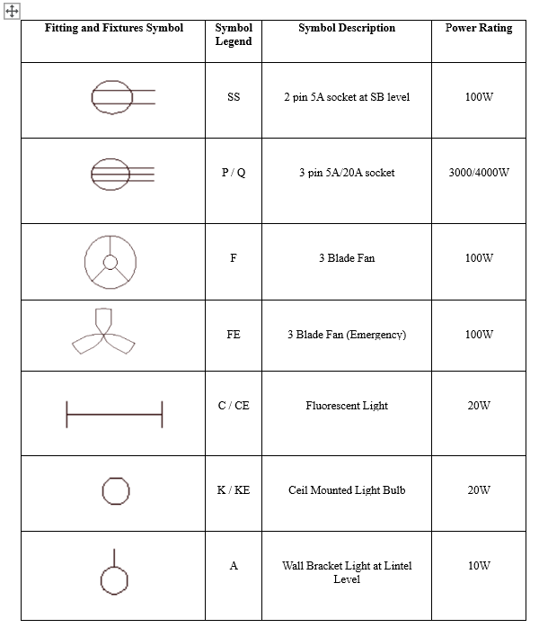
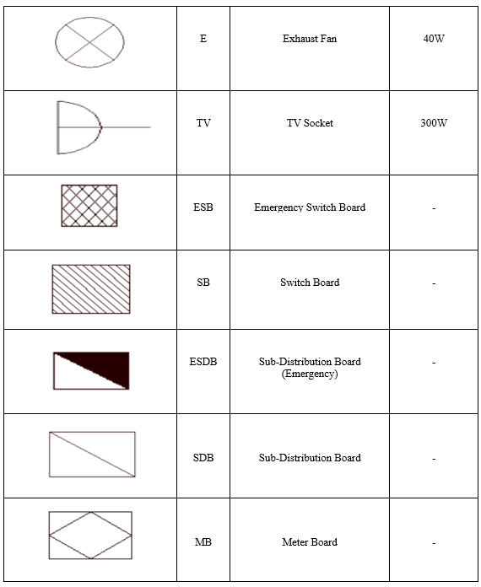

Electrical Appliances Symbols and Legends:

Slide 5
Floor Plan with Fittings and Fixtures

Slide 6
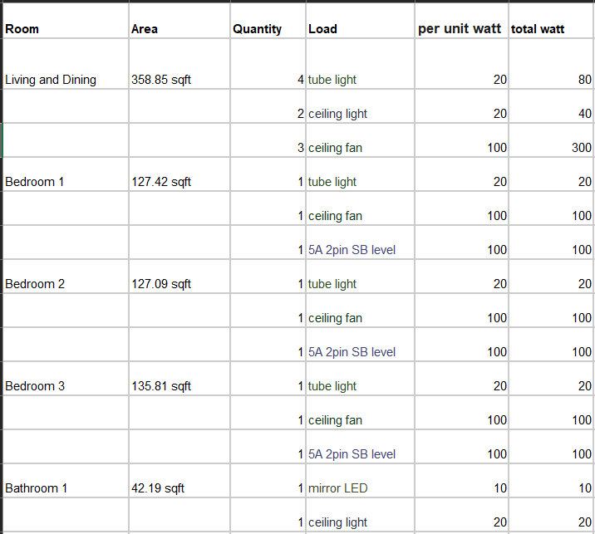
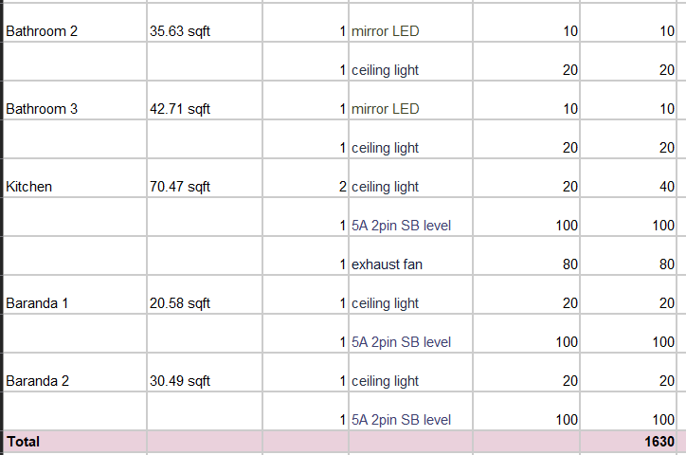
Fittings calculation:

Slide 7
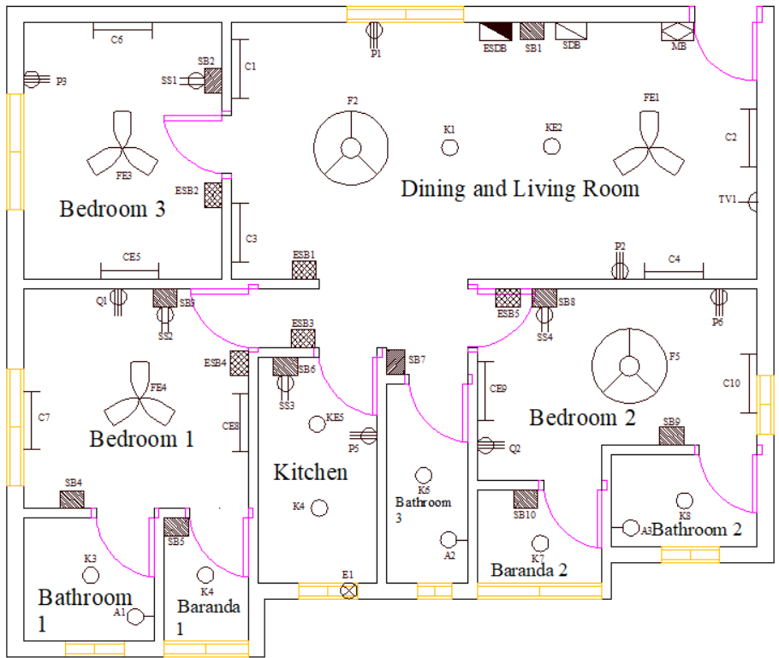
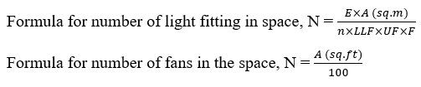
Single Unit Floor Plan (with Fittings and Fixtures):
Area (Unit)= 992 sq ft

Slide 8
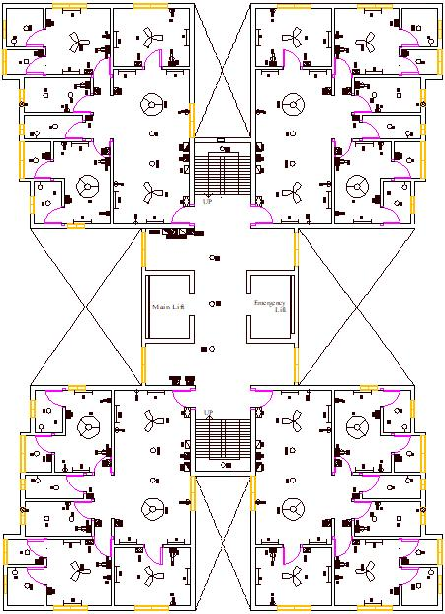
Typical Floor Plan:
(with Fittings and Fixtures)
Two lifts- 1 main lift, 1 emergency lift
Two staircases- 1 main staircase, 1 emergency staircase during hazard
The lobby has 3 ceiling lights placed at suitable distance
The staircases have 1 ceiling light each

Slide 9
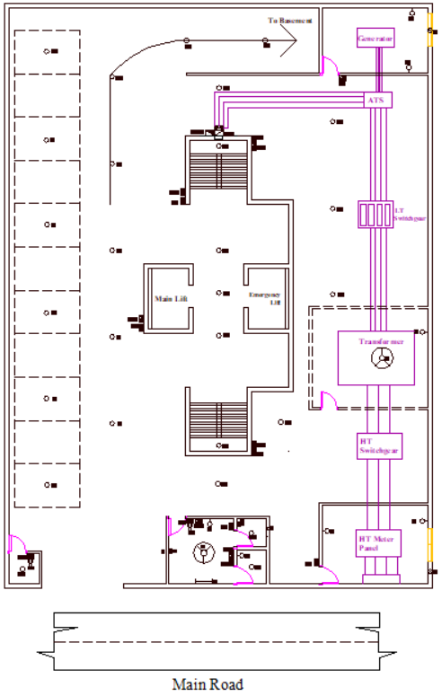
Ground Floor Plan:
(with Fittings and Fixtures
and Substation Layout)
The ground floor has a guard room
It has a separate residence for guard and caretaker
The substation consists of-
HT meter panel room (Door locked and only accessible to grid operators). It has a window on the outside for reading the meter
HT switchgear
Transformer is surrounded by a netted boundary.
LT switchgear
Generator room with proper fittings
ATS

Slide 10
Substation Design:
Capacity of Transformer (kVA) | Transformer Area (sq. m) | Total Substation Area (with HT, LT Panels & Transformer Room but Without Generators) (sq. m.)
1x150 | 12 | 45
1x250 | 13 | 48
2x250 | 26 | 100
1x400 | 13 | 48
2x400 | 30 | 100
3x400 | 40 | 135
2x630 | 26 | 100
3x630 | 40 | 190
2x1000 | 40 | 180
3x1000 | 45 | 220
Transformer used- 11/0.415 kV, 315 kVA, DYN11
Transformer area= 13 sq. m
Substation Area (With HT Panel, LT Panel, Transformer Room and HT Metering Room)= 46.44 sq. m.
Generator Requirement= 13 kW
Generator Room Area= 21.73 sq. m.
Capacity of Generator (kW) | Area of Generator Room (sq. m.)
1x25 | 20
1x48 | 24
1x100 | 30
1x150 | 36
1x300 | 48
1x500 | 56

Slide 11
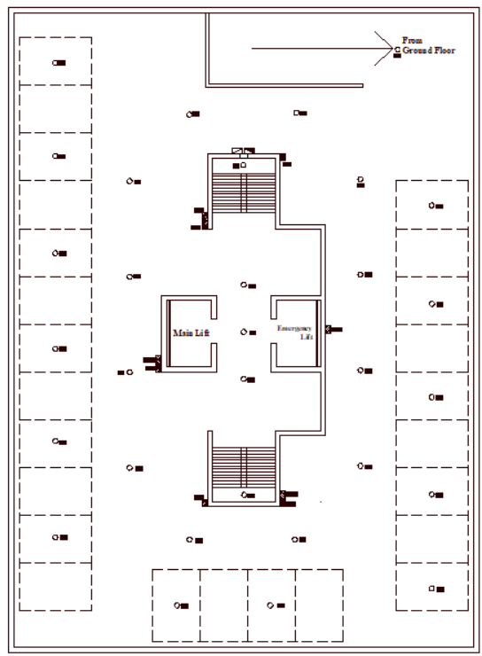
Basement Plan:
(With Fittings and Fixtures)
Basement has adequate space for parking
It has adequate ceiling lights at appropriate spaces

Slide 12
Conduit Layout

Slide 13
Conduit Schedule
Symbol | Containing Power Cable | Current Rating
C1 | 2*1.5 rm BYM + 1.5 rm BYA | 5A
C2 | 4*1.5 rm BYM + 2*1.5 rm BYA | 5A
C3 | 6*1.5 rm BYM + 3*1.5 rm BYA | 5A
C4 | 8*1.5 rm BYM + 4*1.5 rm BYA | 5A
C5 | 10*1.5 rm BYM + 5*1.5 rm BYA | 5A
C6 | 2*2.5 rm BYM + 2.5 rm BYA | 10A
C7 | 4*2.5 rm BYM + 2*2.5 rm BYA | 10A
C8 | 2*4 rm BYM + 4 rm BYA | 15A
C9 | 4*4 rm BYM + 2*4 rm BYA | 15A
C10 | 2*6 rm BYM + 6 rm BYA | 20A
C11 | 2*10 rm BYM + 10 rm BYA | 30A
C12 | 2*25 rm BYM + 16 rm BYA | 50A

Slide 14
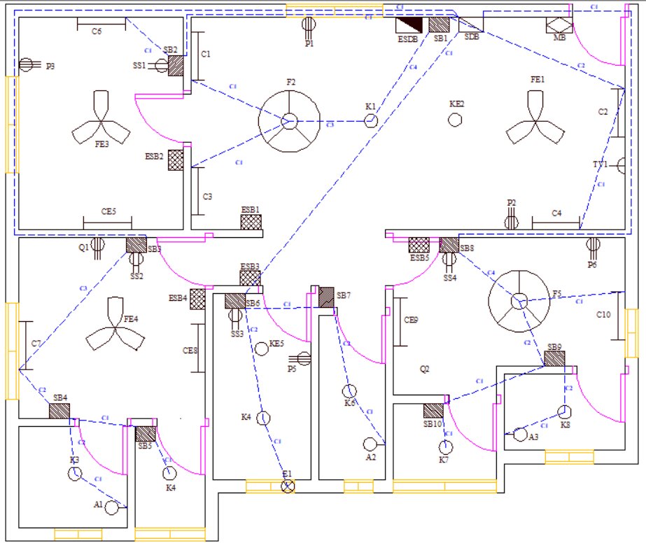
Conduit Layout
(Single Unit):

Slide 15
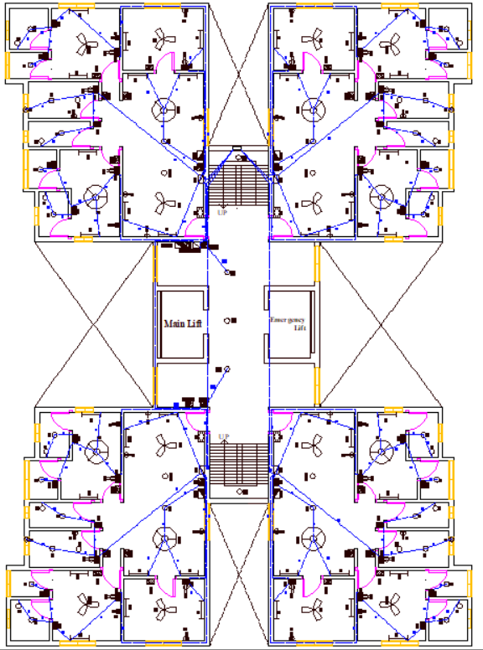
Conduit Layout (Typical Floor):
Separate SB and SDB for lights in the lobby and staircase
Conduit from SDB of each unit and from SDB of lobby carried to MDB through electrical service shaft*
* 200 mm x 400 mm for every 1500 sq. m. floor area as per BNBC 2020

Slide 16
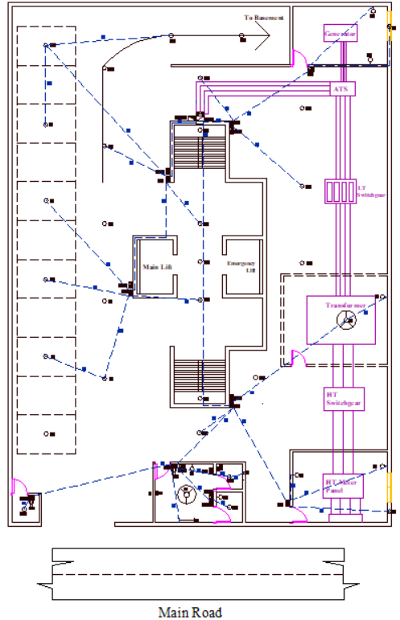
Conduit Layout (Ground Floor):
Proper fittings and fixtures at the rooms in substation as per BNBC 2020
Generator and HT metering rooms have proper ventilation with windows and exhaust fans
A fan has been included in transformer room for proper ventilation
Generator room has proper clearance on all sides (> 1.0 m)
Similar clearance for transformer room

Slide 17
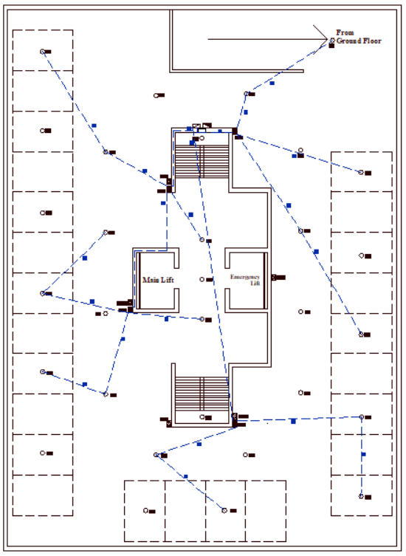
Conduit Layout (Basement):

Slide 18
Emergency Conduit Layout

Slide 19
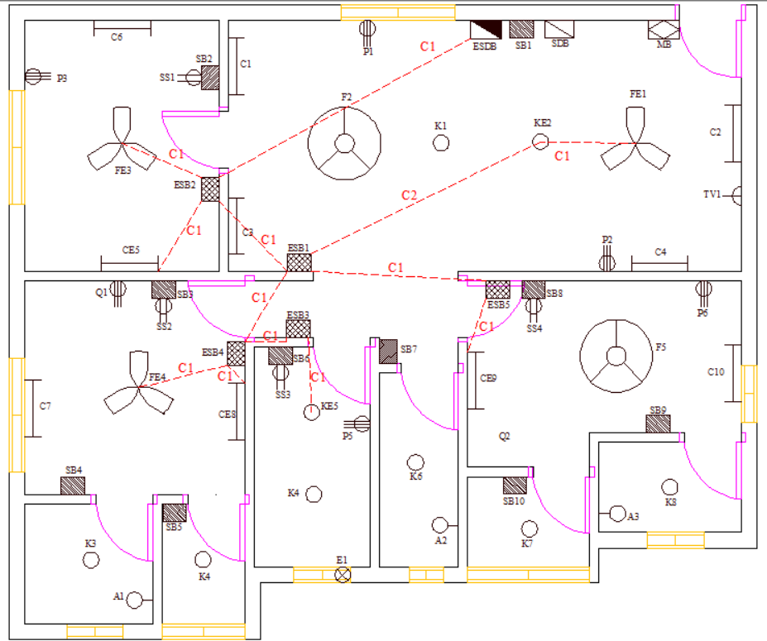
Emergency Conduit Layout (Single Unit):
The fittings connected to emergency line has been named with a suffix ‘E’ for quick identification
The fans connected with emergency line has been indicated by a symbol separate from fans connected with normal supply from grid.

Slide 20
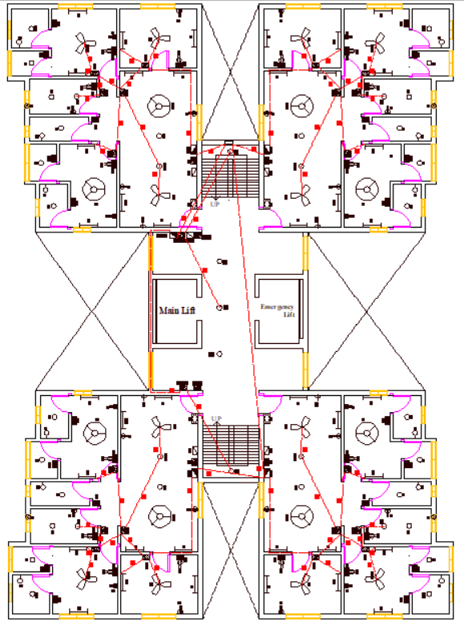
Emergency Conduit Layout
(Typical Floor):
One of the lights in the lobby and both of the lights in the staircase have been connected to the emergency line
Conduit from ESDB of each unit and ESDB of lobby goes to EMDB through electrical service shaft

Slide 21
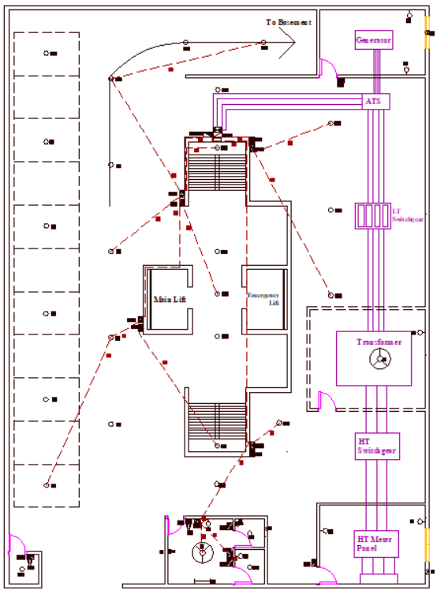
Emergency Conduit Layout
(Ground Floor):

Slide 22
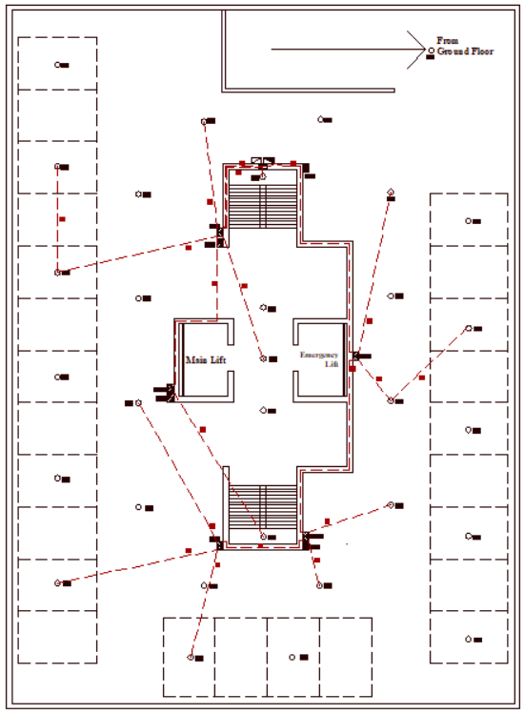
Emergency Conduit Layout
(Basement):

Slide 23
Conduit Layout for Power Sockets

Slide 24
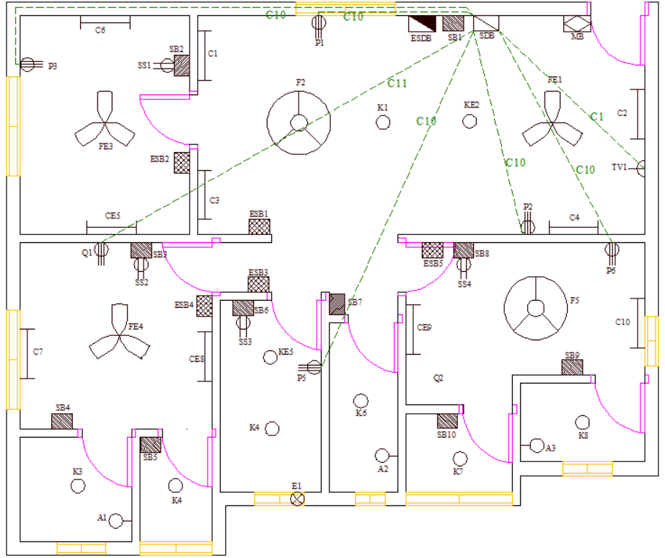
Power Socket Conduit Layout (Single Unit):
C10 and C11 conduits (as mentioned in the conduit list) has been used for P and Q sockets since they have higher current ratings.

Slide 25
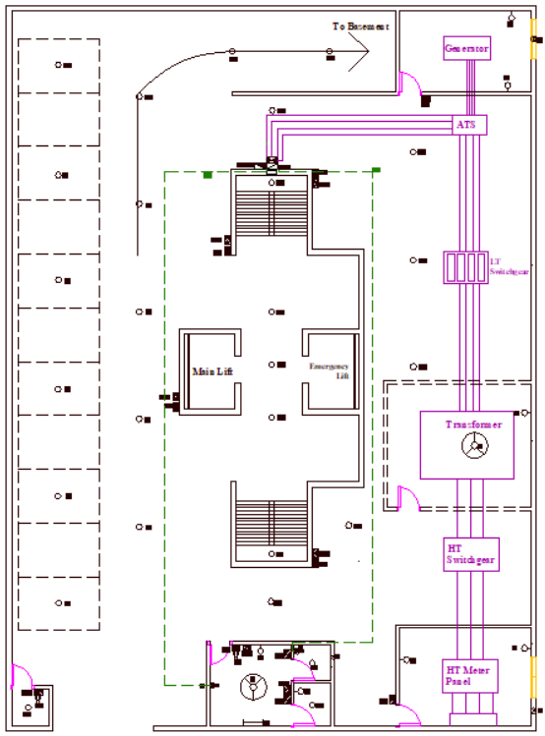
Power Socket Conduit Layout
(Ground Floor):

Slide 26
Lightning Protection System Layout

Slide 27
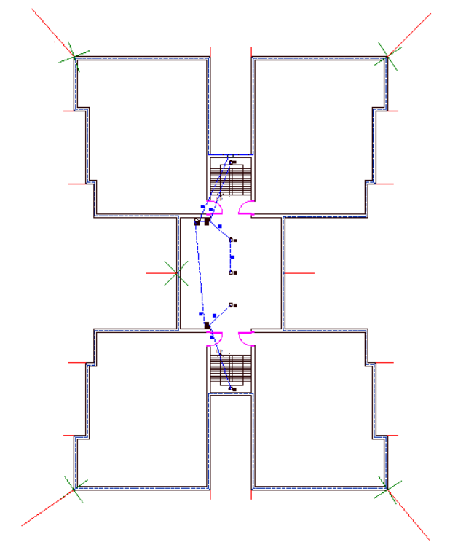
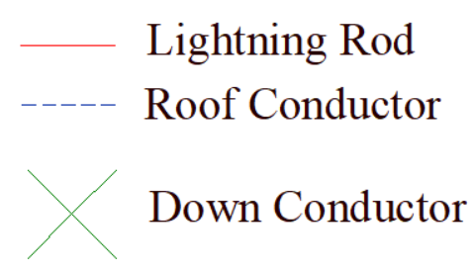
Lightning Protection System:
The distance has been fixed and the height of the conductors have been determined using the rolling sphere method.
R for rolling sphere method has been considered as 45 m
Number of down conductors have been calculated by taking the entire area in sq. m and putting 1 down conductor for the first 80 sq. m and 1 down conductor for every 100 sq. m after the first conductor.
Total number of down conductors= 5
The lightning rods have been expanded in the figure for visual identification
Separate SB and SDB for fittings in the lobby for the roof

Slide 28
Earthing System Diagram:

Slide 29
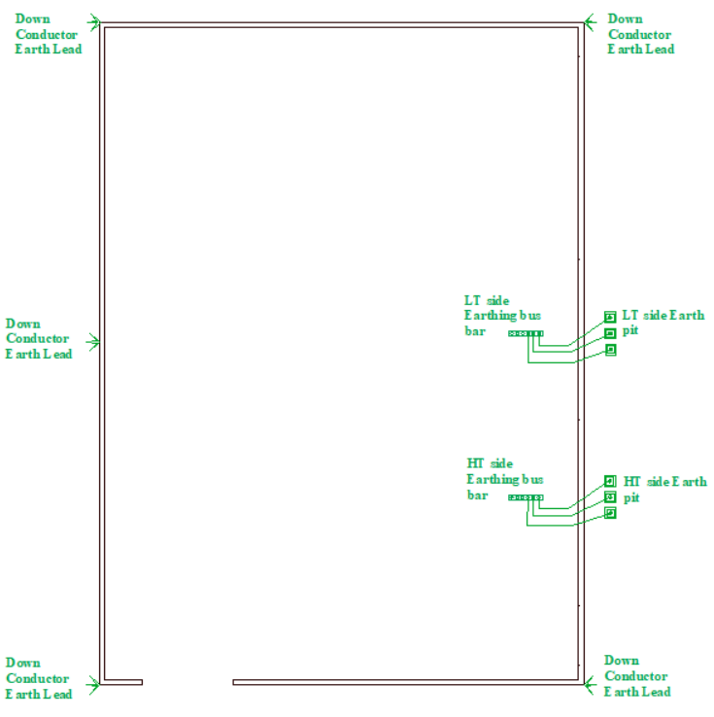
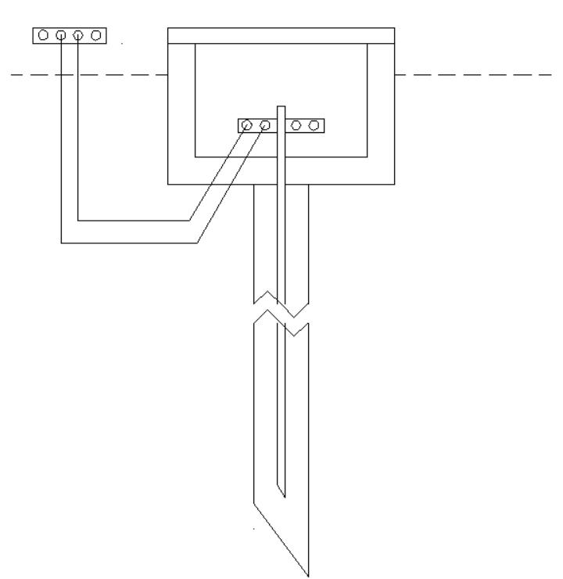
Earthing System:
Minimum Cu rod diameter= 12.5 mm
Minimum length= 3.33 m
An earthing pit has been used with each down conductor
Multiple earth electrodes may have to be installed for earth resistance < 1 Ohm
2 earthing pits have been placed at HT and LT sides of transformer for safety

Slide 30
Switchboard Diagrams:

Slide 31
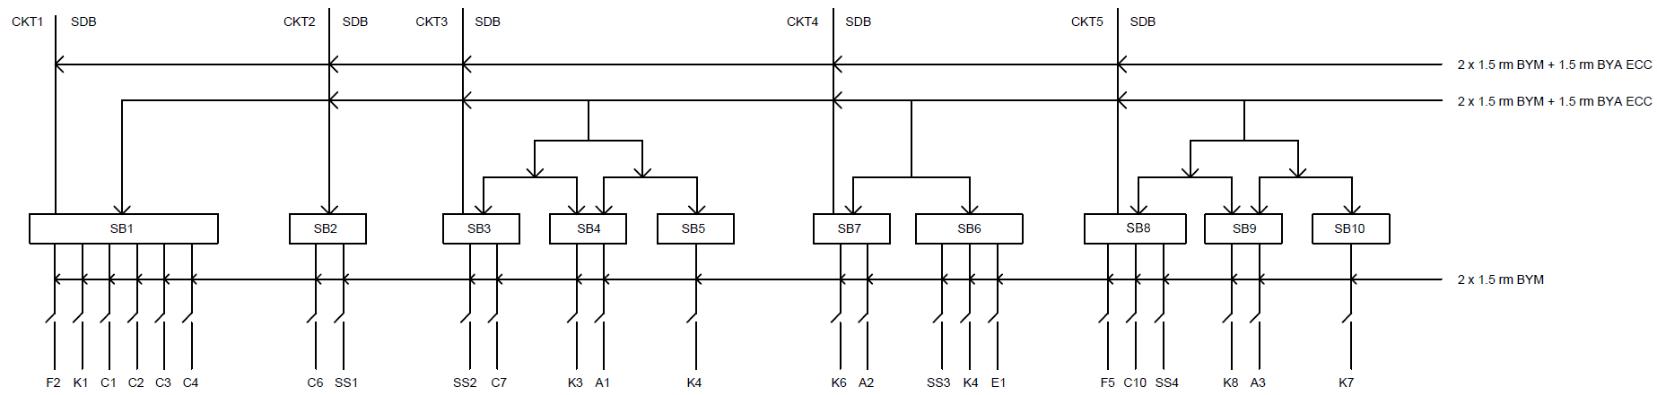
Switch Board(Each Unit):

Slide 32
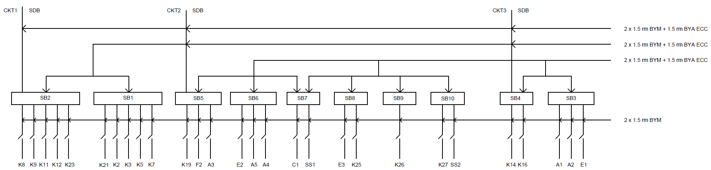
Switch Board(Ground Floor):

Slide 33
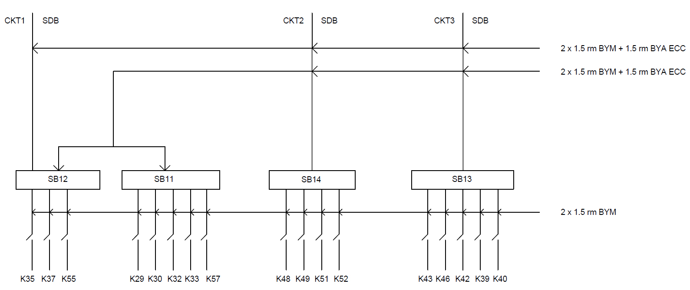
Switch Board(Basement):

Slide 34
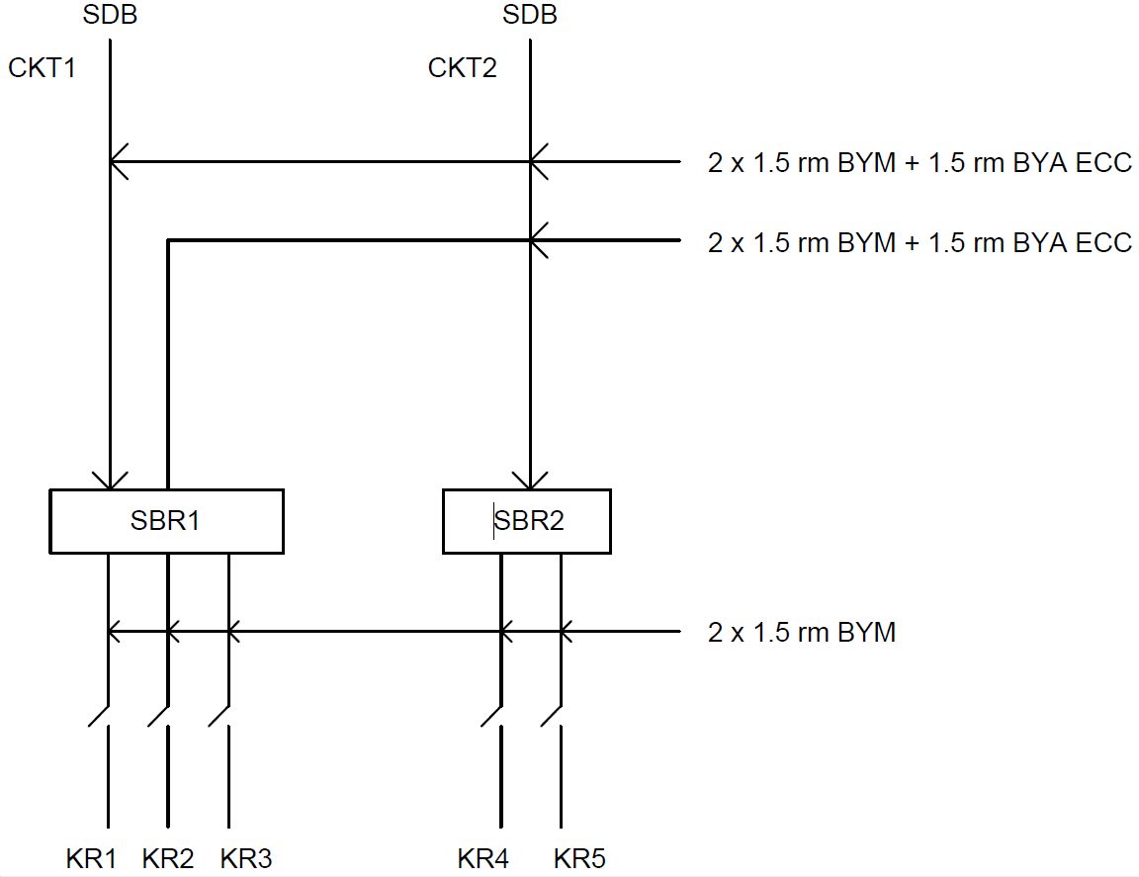
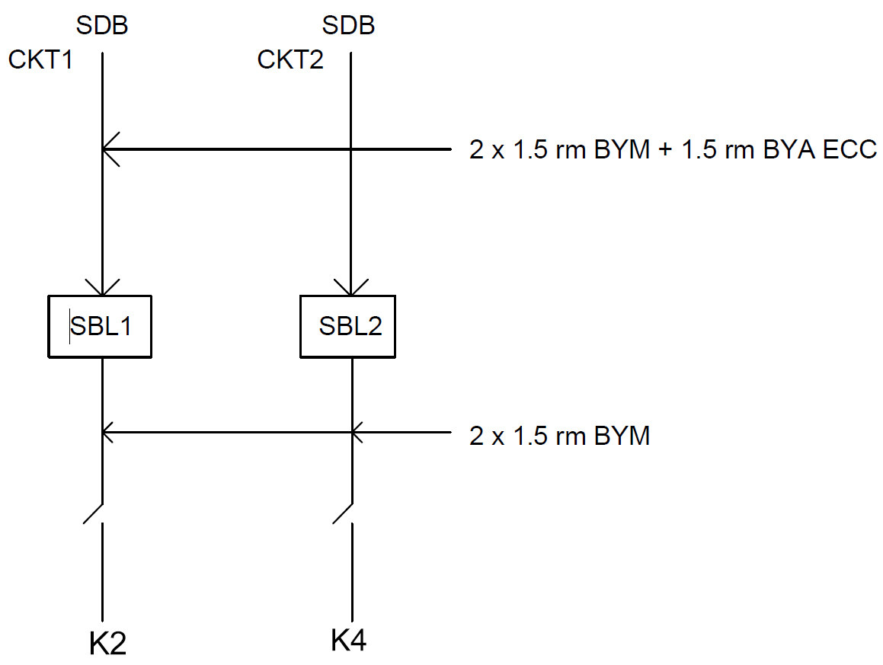
Switch Board(Lobby and Roof):

Slide 35
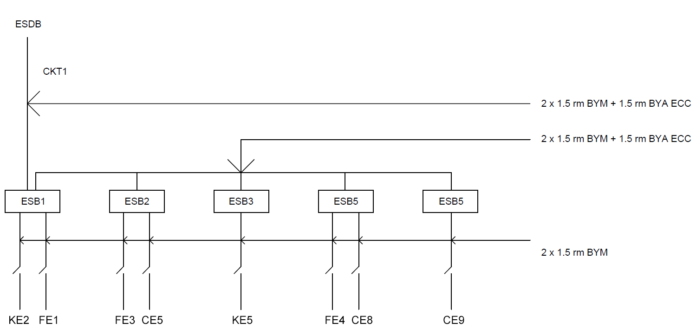
Emergency Switch Board(Each Unit):

Slide 36
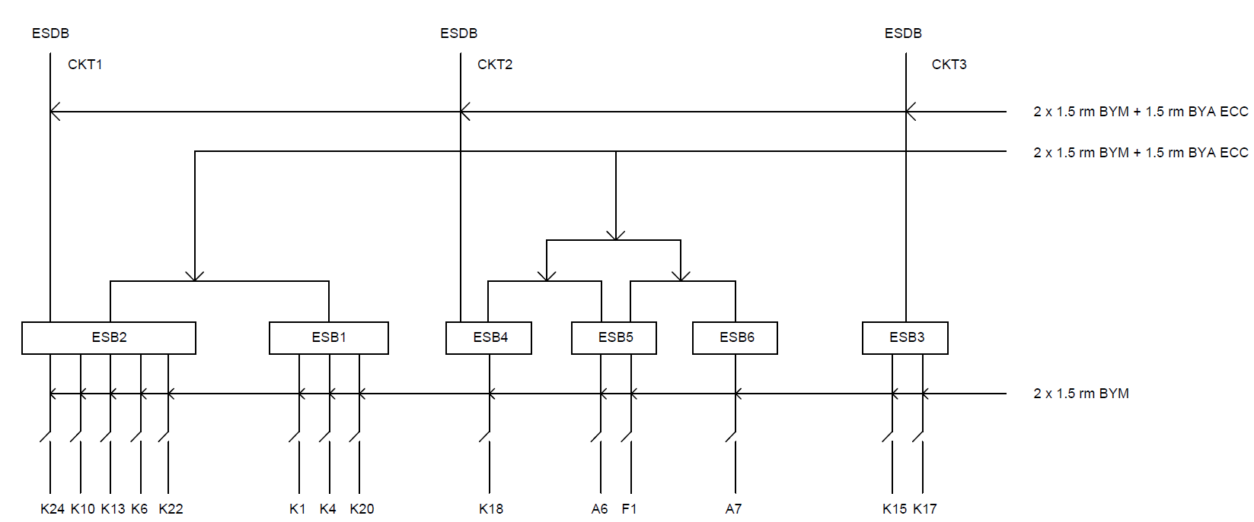
Emergency Switch Board(Ground):

Slide 37
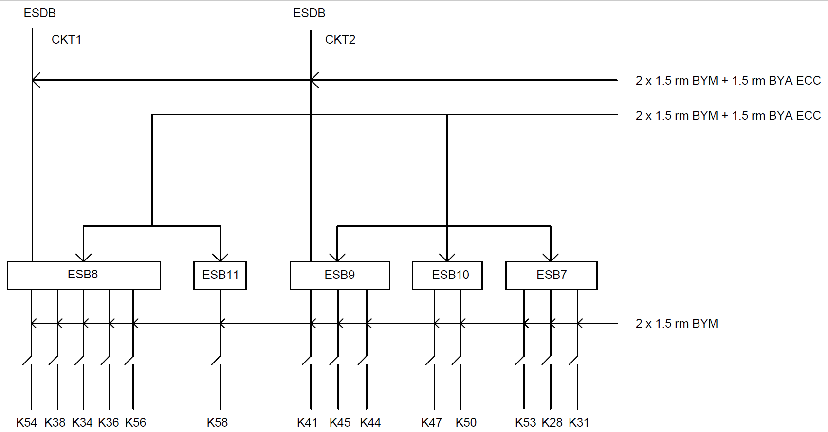
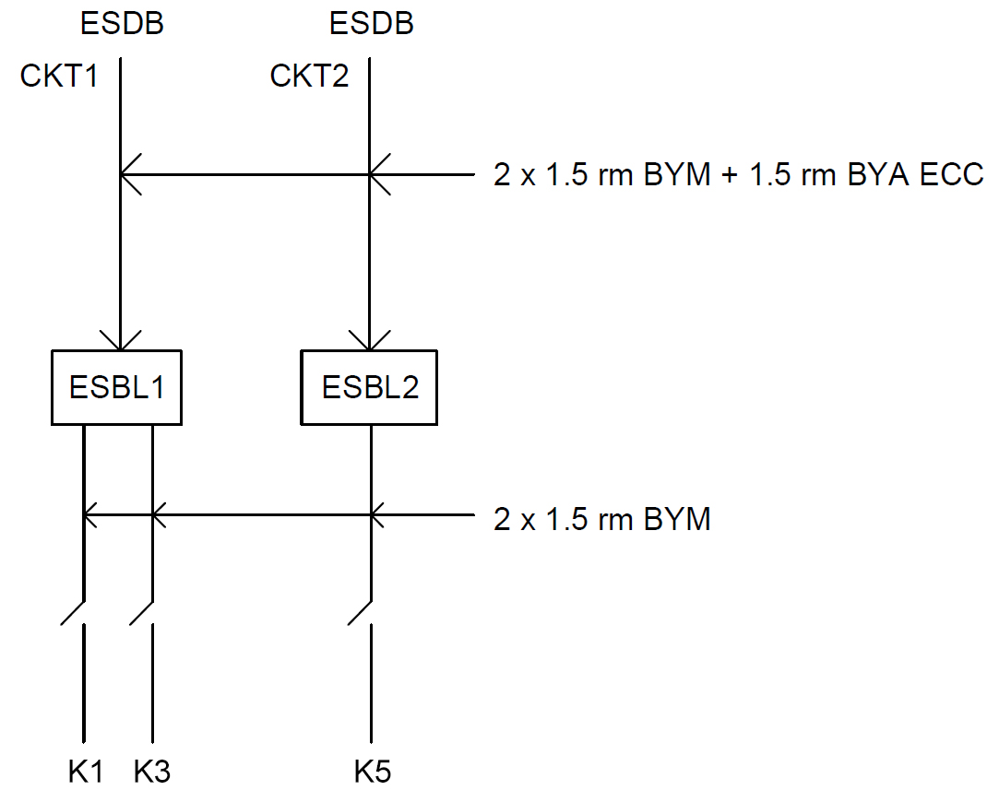
Emergency Switch Board(Basement and Lobby):

Slide 38
Distribution Board Diagrams:

Slide 39
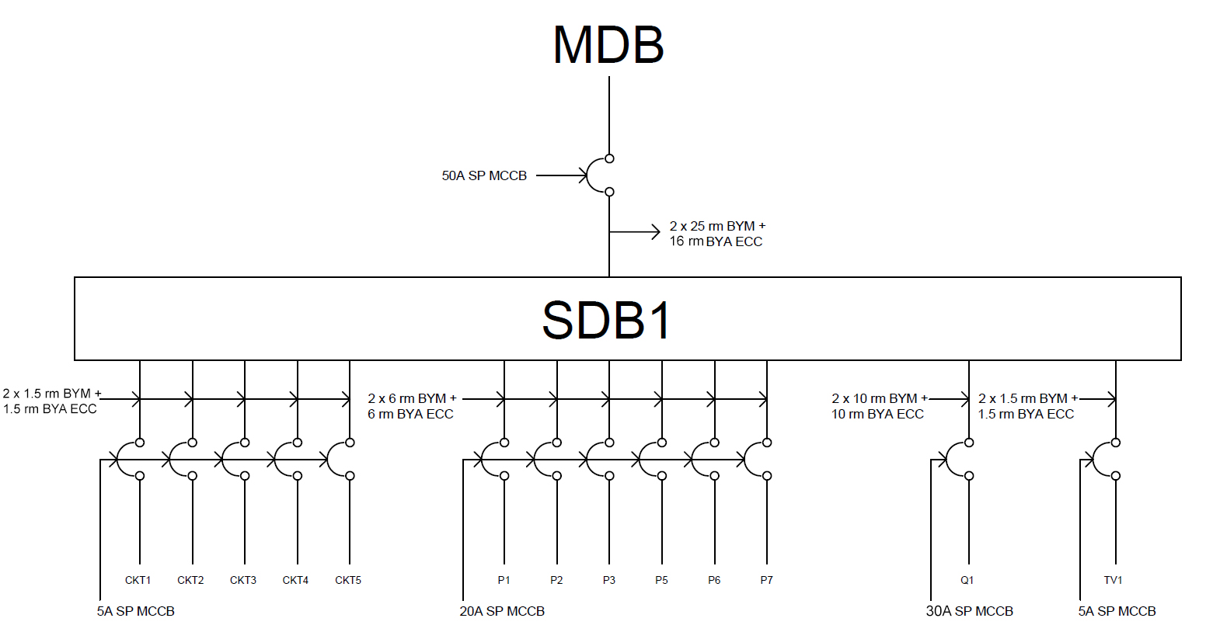
SDB Diagram (Each Unit):

Slide 40
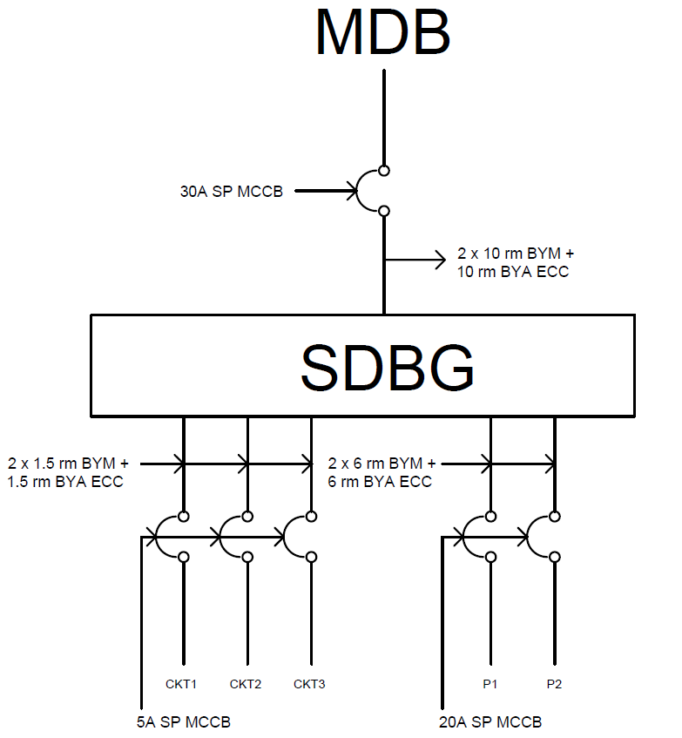
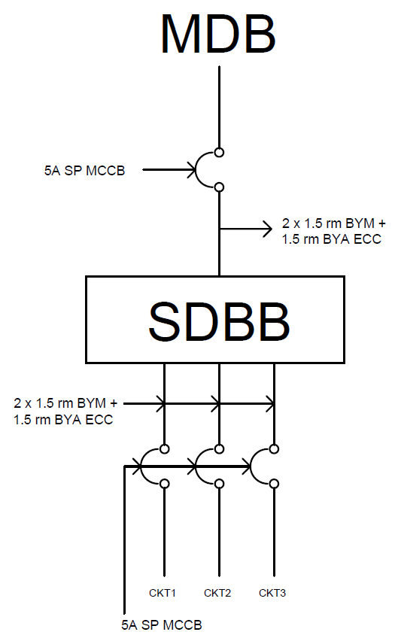
SDB Diagram (Ground Floor and Basement):

Slide 41
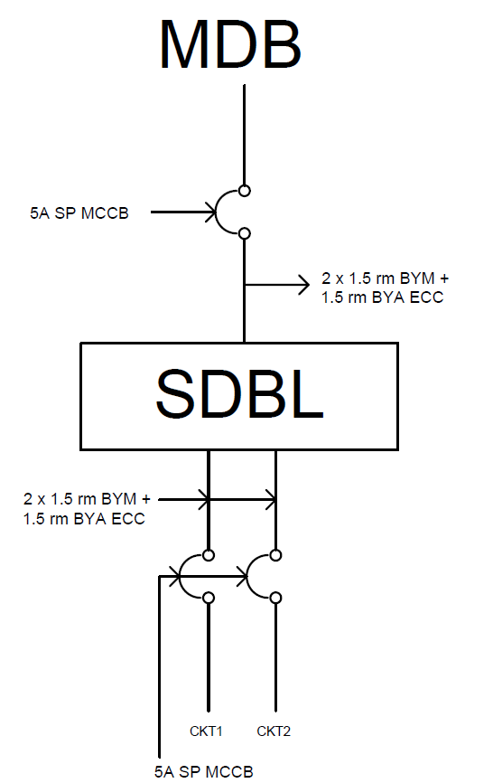
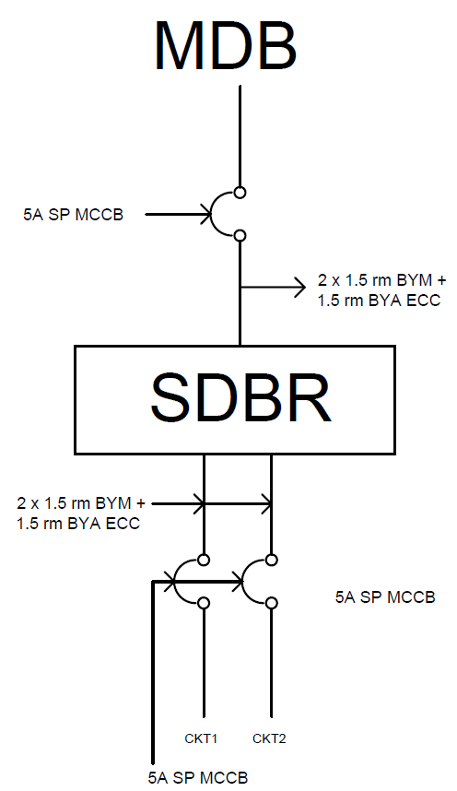
SDB Diagram (Lobby and Roof):

Slide 42
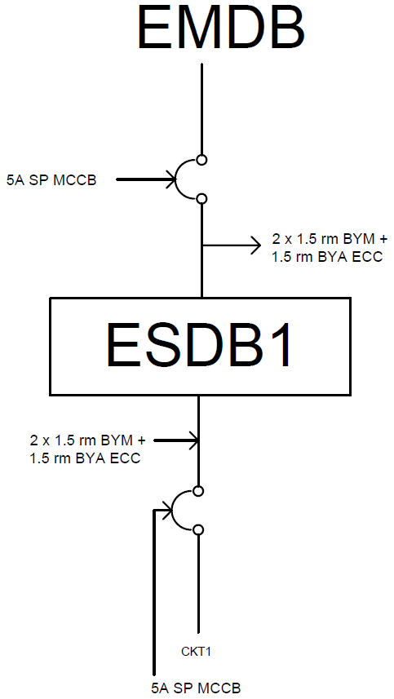
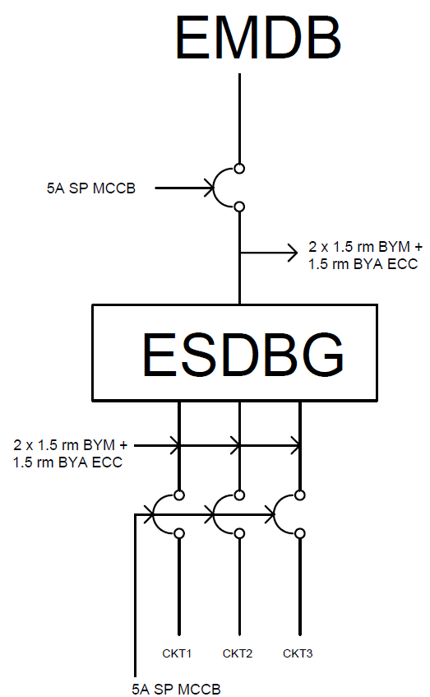
ESDB Diagram (Each Unit, Ground):

Slide 43
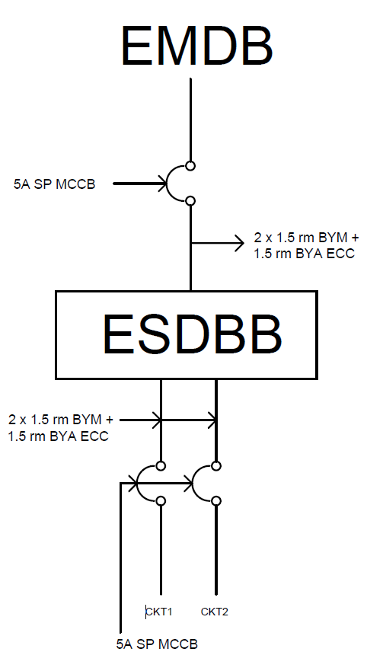
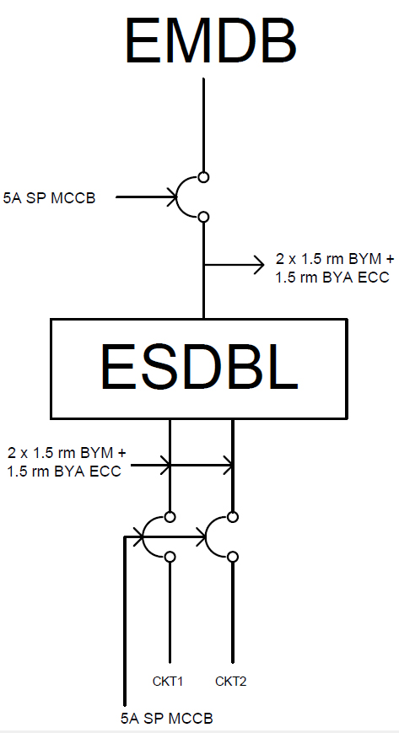
ESDB Diagram (Basement and Lobby):

Slide 44
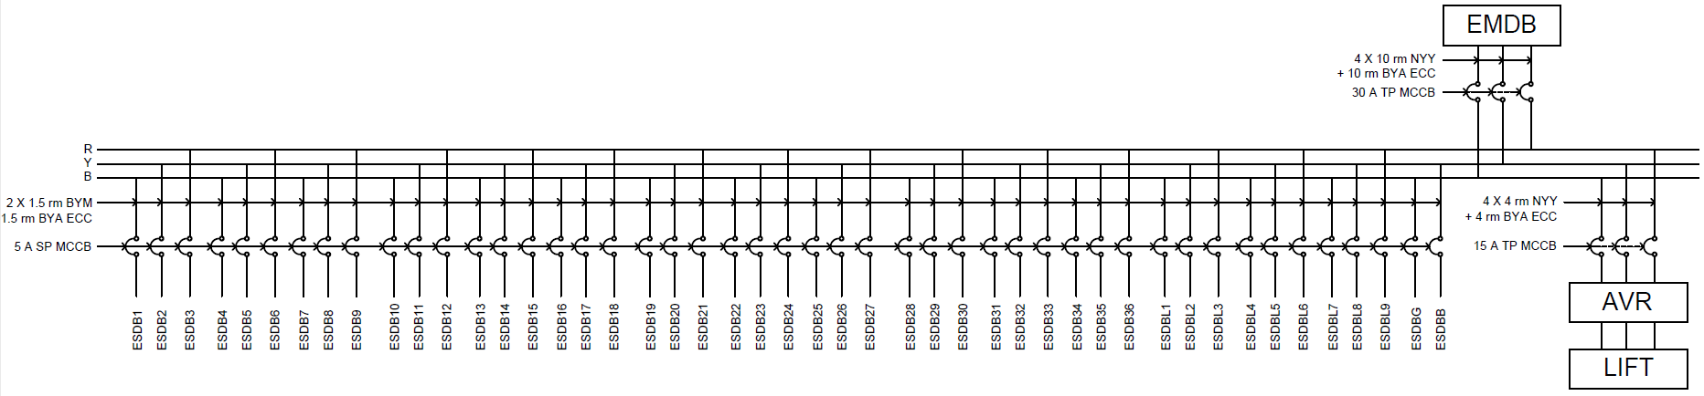
EMDB Diagram:

Slide 45
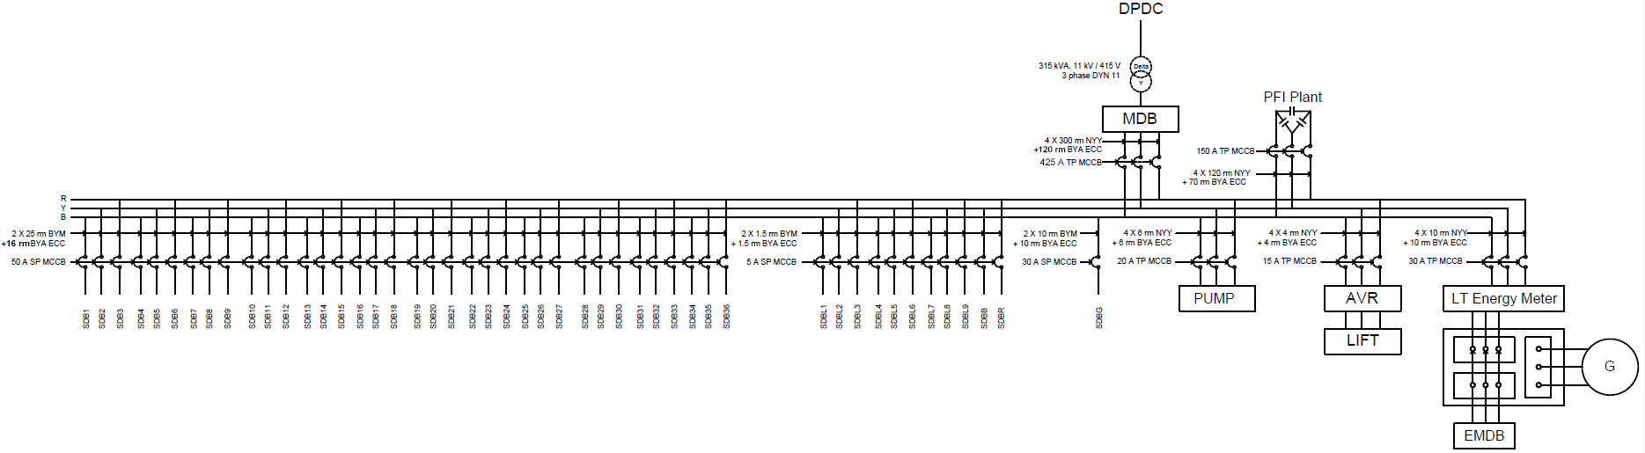
MDB Diagram:

Slide 46
Relevant Calculations:

Slide 47
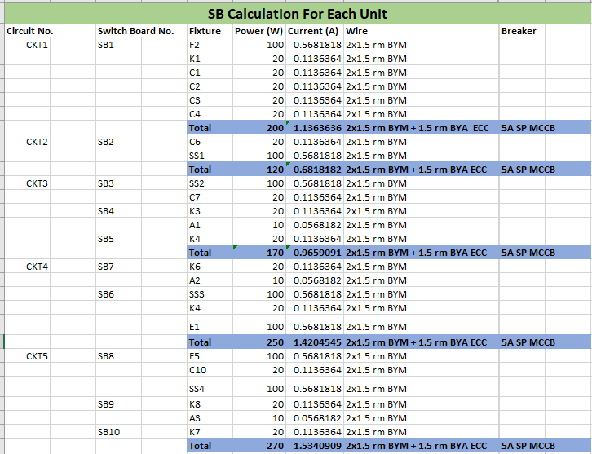
Sample Calculation(SB Calculation _ Each Unit):

Slide 48
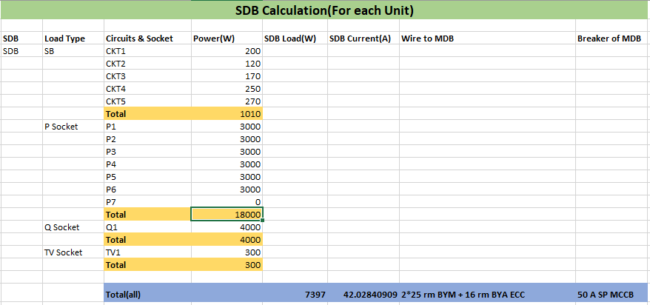
Sample Calculation(SDB Calculation- Each Unit):

Slide 49
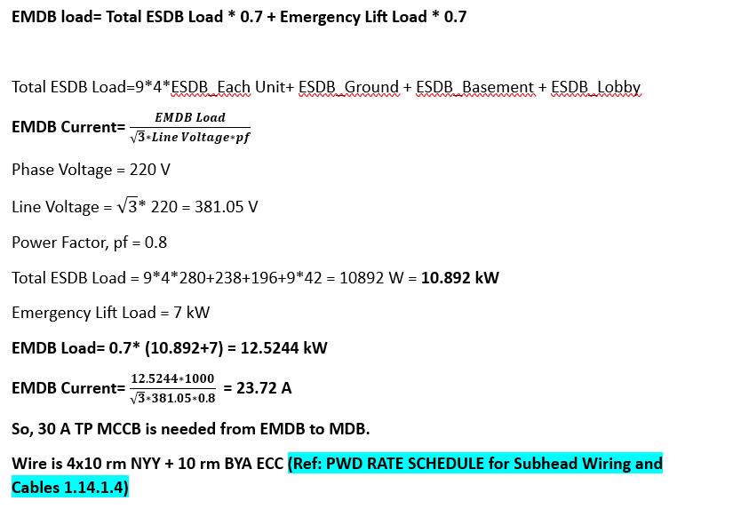
Sample Calculation(EMDB Calculation):

Slide 50
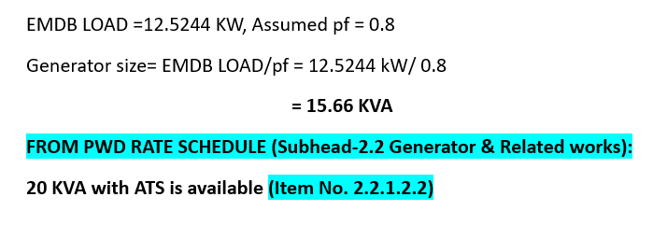
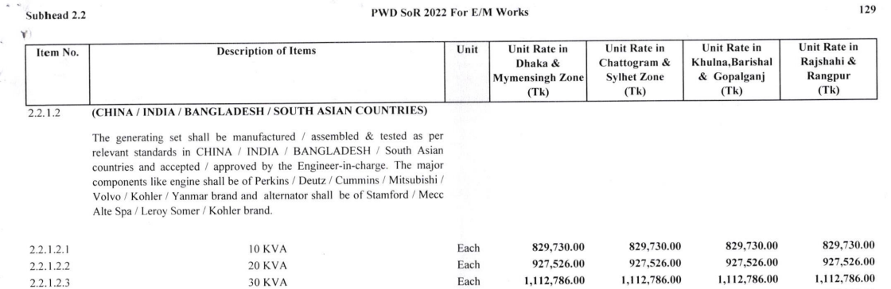
Sample Calculation(Generator Sizing):

Slide 51
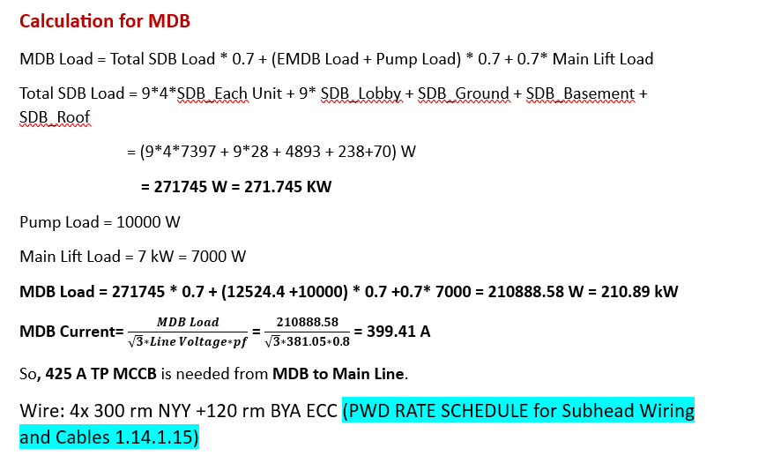
Sample Calculation(MDB Sizing):

Slide 52
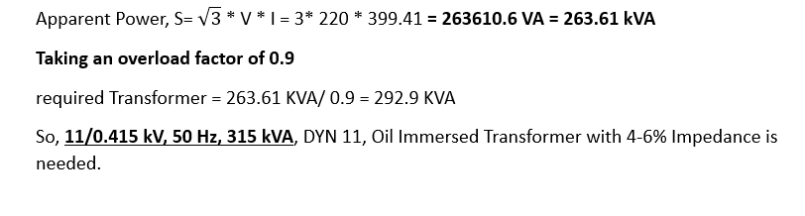

Sample Calculation(Transformer Rating):
(reference) PWD RATE SCHEDULE 2.1.4.6

Slide 53

Sample Calculation(PFI Plant):

Slide 54

References:

Slide 55
References:
2. PWD Website : https://ss.pwd.gov.bd/sor/sordownload/2

