Slide 1
MoDL-QSM: Model-based deep learning for quantitative susceptibility mapping
A deep learning approach for enhanced accuracy in quantitative susceptibility mapping (QSM), through integration with susceptibility tensor imaging (STI) physical model.
Training targets: susceptibility tensor terms (𝜒13, 𝜒23 and 𝜒33)
Training data: Unwrapped phase image and mask
Intermediate data: dipole kernel, patch indices and phase induced by 𝜒13 and 𝜒23

Slide 2
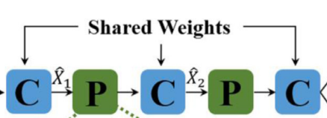
Potential strategies for retrain
Training with advanced loss function like morphological loss function
Training with non-shared weights between CNN blocks
Exploring the effects of sources of chemical shift
Training on Alzheimer patient data to verify cortical iron quantification

Slide 3
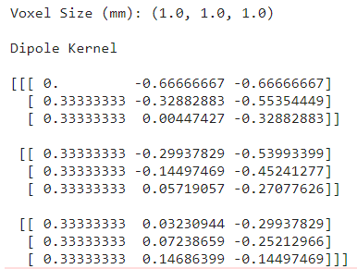
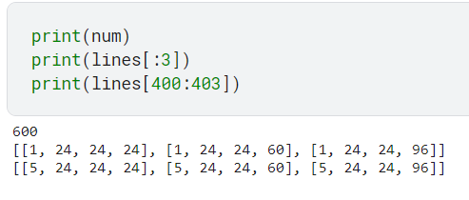
Progress 1
Generating dipole kernel and patch indices for the dataset
Debugging the process to get The field perturbation, (𝛿𝐵′ ) from 𝜒13 and 𝜒23

