Slide 1
QSM image reconstruction with Deep Learning
Presented by: Tasmin Khan
ID: 201906055

Slide 2
QSM dipole inversion with DL
QSM estimates tissue susceptibility from MRI phase data.
Dipole inversion is ill-posed, leading to noise and artifacts.
Deep learning (e.g., MoDL) combines physics and neural networks to reconstruct images from single orienation.
This approach improves accuracy and preserves fine details.

Slide 3
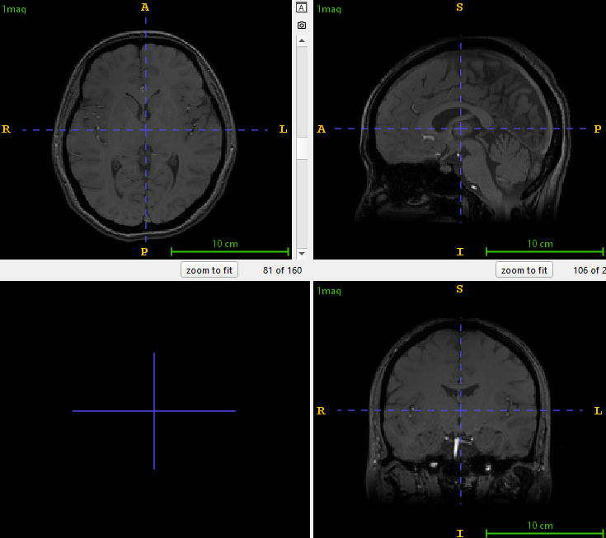
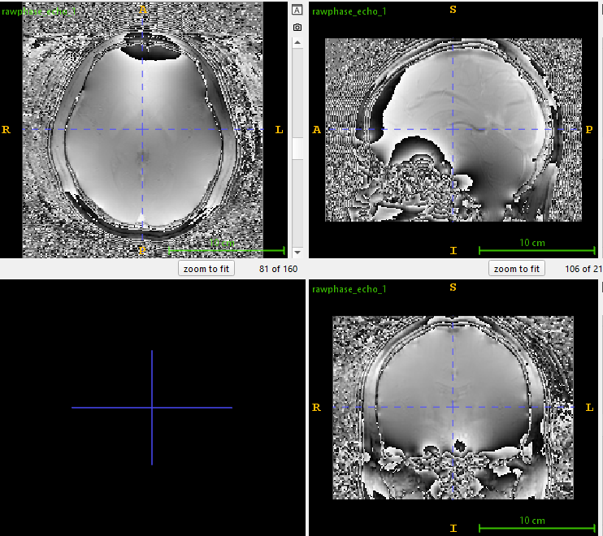
Phase processing steps-Raw image

Slide 4
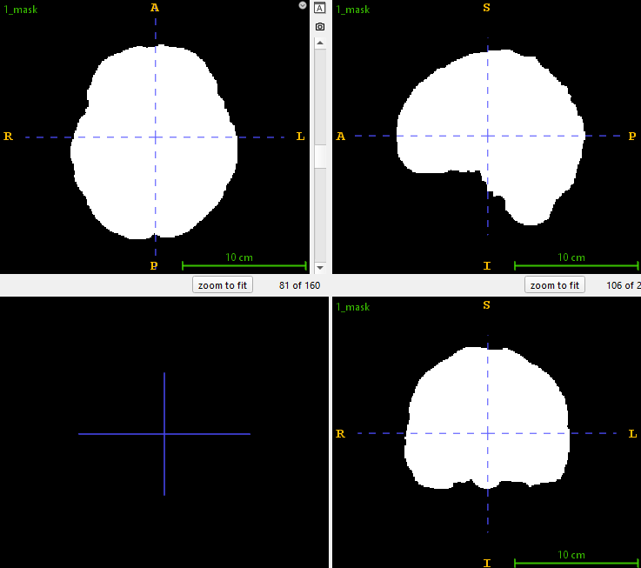
Brain mask from FSL BET

Slide 5
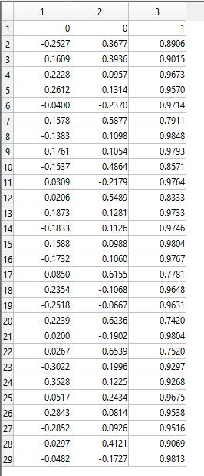
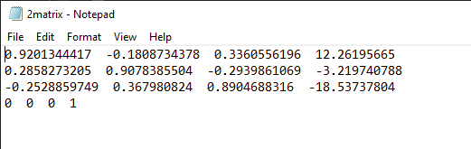
Mag registration with FSL flirt

Slide 6
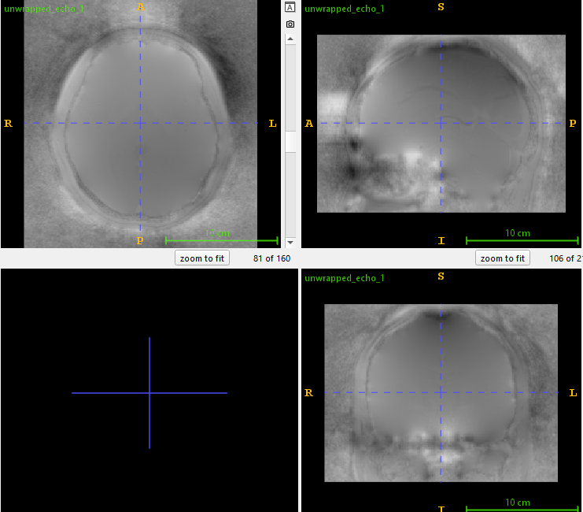
Phase unwrapping with STI suite

Slide 7
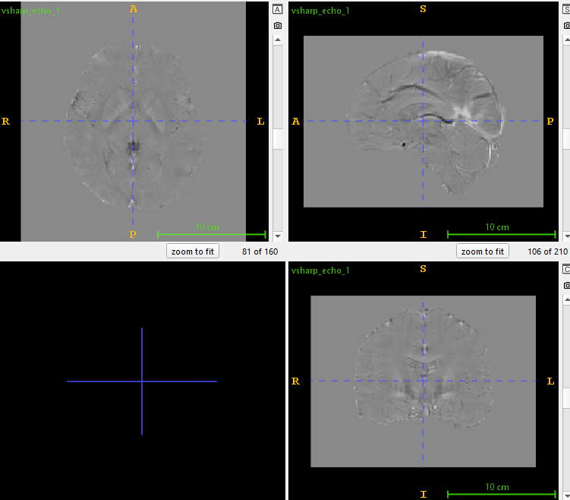
Background phase removal with VSHARP

Slide 8
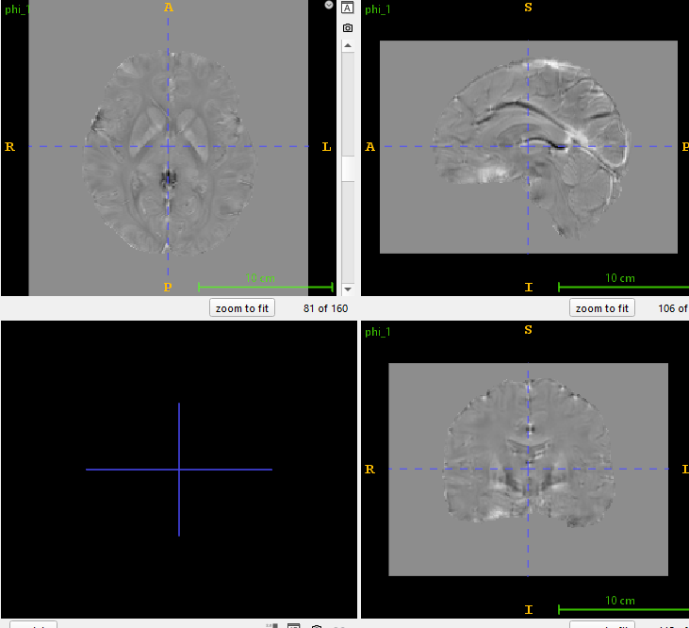
Averaging over echos

Slide 9
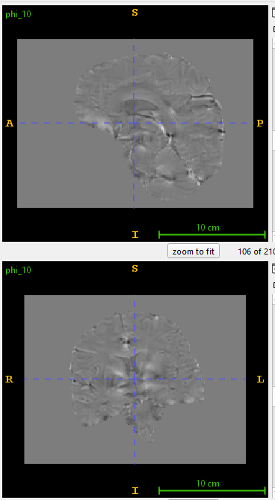
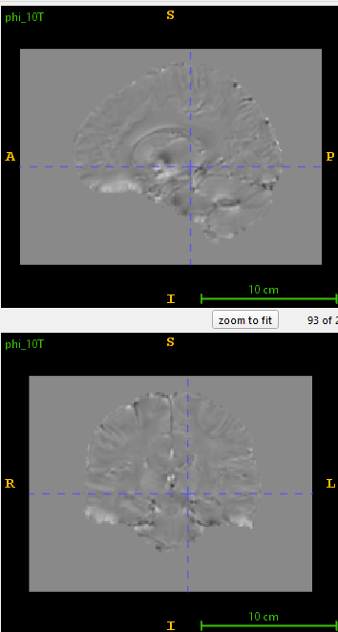
Transforming phase images to supine position for each subject

Slide 10
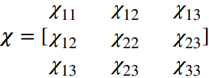
Phase reconstruction
Phase image reconstruction is necessary to establish a ground truth for the model. There are various models for example: DTI, STI, aSTI and aSTI+
We used aSTI and used the diagonal elements from the susceptibility tensor distribution 𝝌 as our ground truth

Slide 11

What is aSTI?
aSTI indicated anisotropic susceptibility tensor where the value of 𝝌 depends on orientation.
If an image has the rotation matrix R compared to the supine position, then the tensor for it is

Slide 12
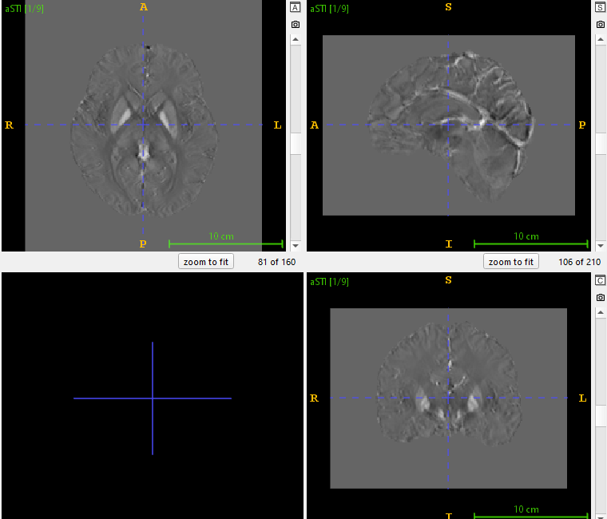
aSTI tensor formation

Slide 13
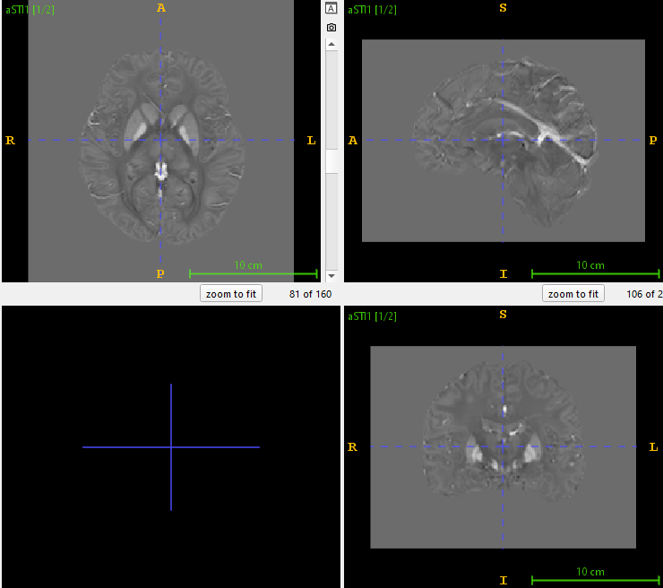
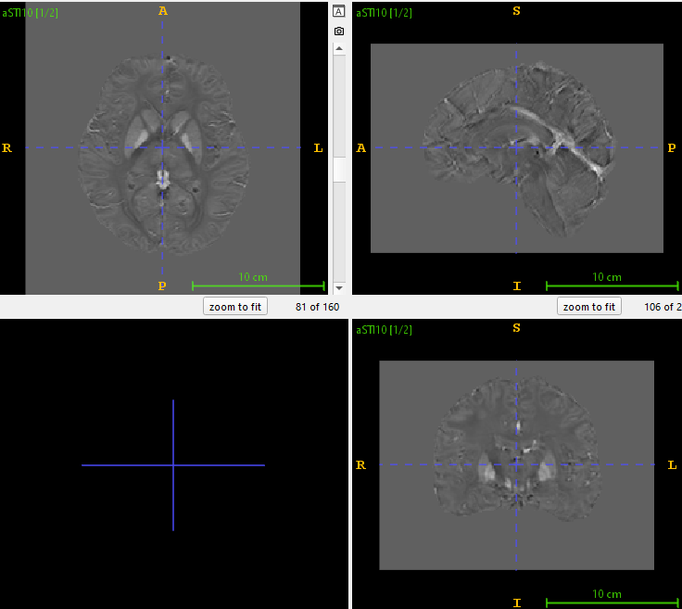
aSTI tensor rotation with R matrix

Slide 14


Label data formation
We have two channels in our label data derived from the nine channels of susceptibility tensor.

Slide 15
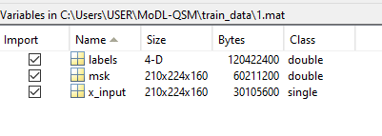
Preparing the dataset with Susceptibility tensor, phase maps and brain masks in a single mat file

Slide 16

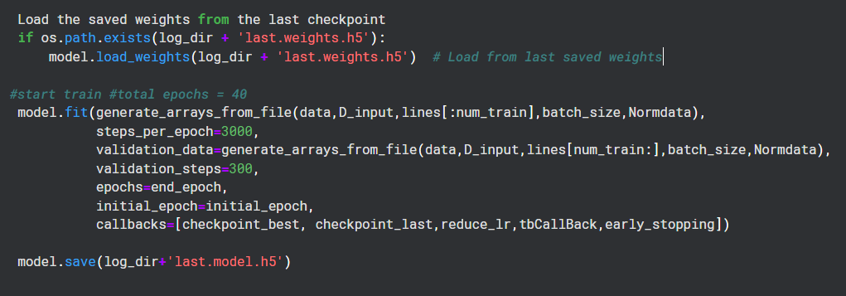
Training in Kaggle with 10 epochs at a time

Slide 17
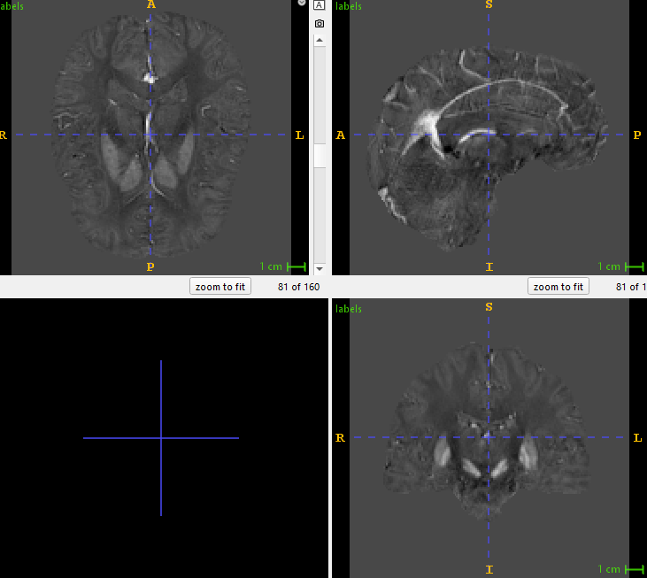
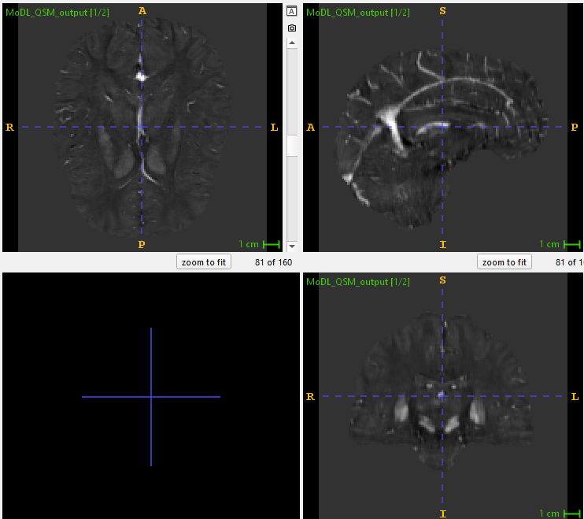
Testing on QSM challenge data 2016

Slide 18
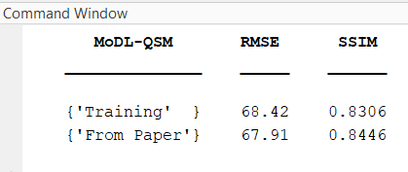
Metrics calculation

Slide 19

Initial plans
To add morphological loss function: msQSM
Accounts for morphological similarity between Δ𝐵 and 𝝌 instead of Δ𝐵 and 𝐹⁻¹𝐷𝐹𝝌

Slide 20
Dynamic loss function: QSMGAN
To construct a GAN network: QSMGAN
Here a discriminator block acts as the dynamic loss function trying to penalize the outputs from the generative block
We can use model-based network for generative block with a simple discriminator block

Slide 21
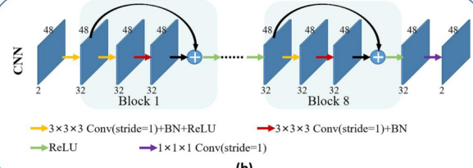
CNN blocks

Slide 22
Transformer based architecture: SWINGAN
limited ability of CNN to capture long-distance information
Transformer-based encoder-decoder structure is designed to replace the convolutional filters in the U-shaped network for extracting the high-quality global information
Github: https://github.com/learnerzx/SwinGAN?tab=readme-ov-file

Slide 23
Data augmentation: QSMnet+
Trained network on healthy subjects perform poor on patients
Data augmentation is suggested to improve linearity range of trained networks to perform better on high susceptibility
It is done by scaling the positive susceptibiliy values
Additional dataset is made by inverting all the data to ensure symmetric susceptibility distribution

Slide 24
Thank you

Slide 25
Refining network RDN: AFTER-QSM
RDN is a deep learning architecture for image super-resolution that uses Global Feature Fusion (GFF) to combine features from various network levels. After passing through Residual Dense Blocks (RDBs), features are fused with two convolutional layers.
In QSM, RDN refines susceptibility maps by reducing blurring and improving accuracy.
Github: deepMRI/AFTER-QSM at master · sunhongfu/deepMRI · GitHub

Slide 26
Convolution layer alternatives
The three stages freed from sharing common weights
Attention aware dynamic convolution to focus on special regions on the fly
Vision Transformer's self-attention mechanism to focus on important spatial features

Slide 27
Loss function: msQSM
𝑙oss(𝑇 ) = ‖ abs( QSM0)(QSM0 − 𝑇 ( QSM0)) ‖
The absolute value of QSM0 is the weight matrix, which constrains the regions of high susceptibility regardless of the low susceptibility regions, where more streaking artifacts exist thus putting more emphasis on high susceptibility regions.

Slide 28
SWIN3D tricks
Shallower Network: Reduce the depth of the transformer and CNN layers to prevent overfitting. For example, use fewer layers in each encoder and decoder stage (e.g., layers=(1, 1, 2, 1)).
Fewer Attention Heads: Transformers are data-hungry, so reduce the number of attention heads (e.g., heads=(2, 4, 6, 8)) to make them more data-efficient.
Smaller Hidden Dimensions: Reducing the dimensionality (e.g., hidden_dim=64 instead of 96) can help avoid overfitting while reducing computational complexity.
Dropout: Adding dropout layers (e.g., dropout=0.2) to both CNN and transformer layers helps reduce overfitting. Use slightly higher dropout rates, especially in deeper layers.
Weight Decay: Use a slightly higher weight decay (e.g., 1e-4 to 1e-3) in the optimizer. This will help the model generalize better by penalizing overly large weights
Cross-Validation: Use k-fold cross-validation (e.g., 5-fold) to make the most of your data by training on different subsets and testing on others. This improves model robustness and gives a better estimate of its performance.
Early Stopping: Monitor the validation loss and stop training if it doesn't improve over a few epochs, to avoid overfitting.
GELU activation:

Slide 29
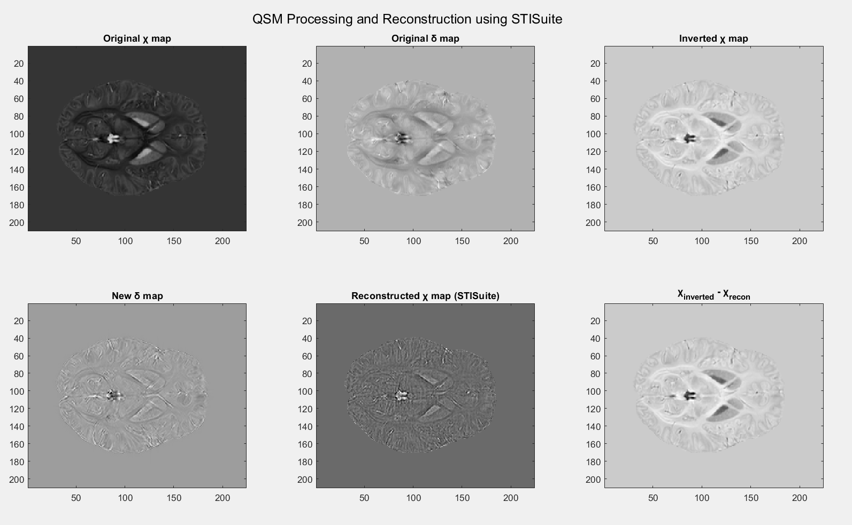

Slide 30
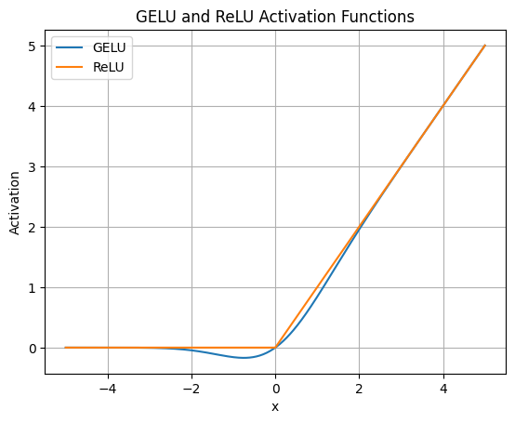
GELU vs RELU

Slide 31
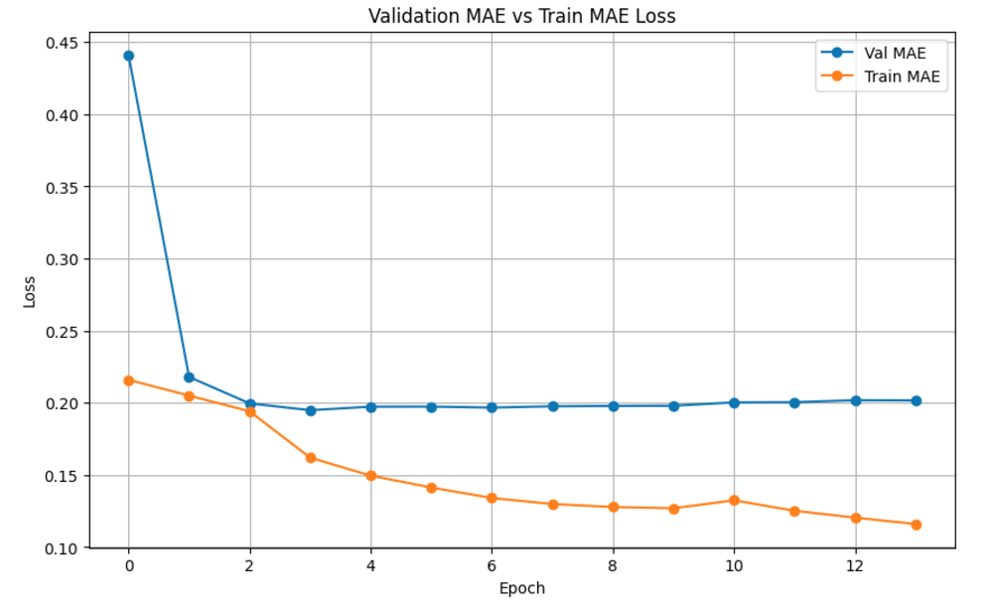

Slide 32
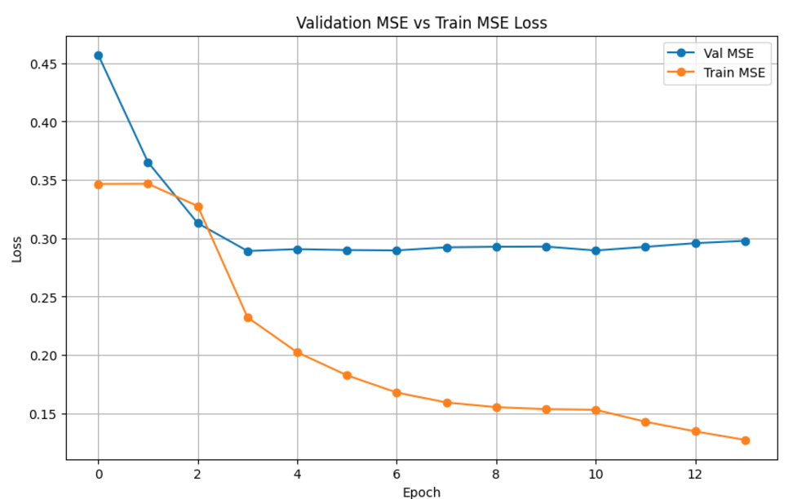

Slide 33
