Slide 1
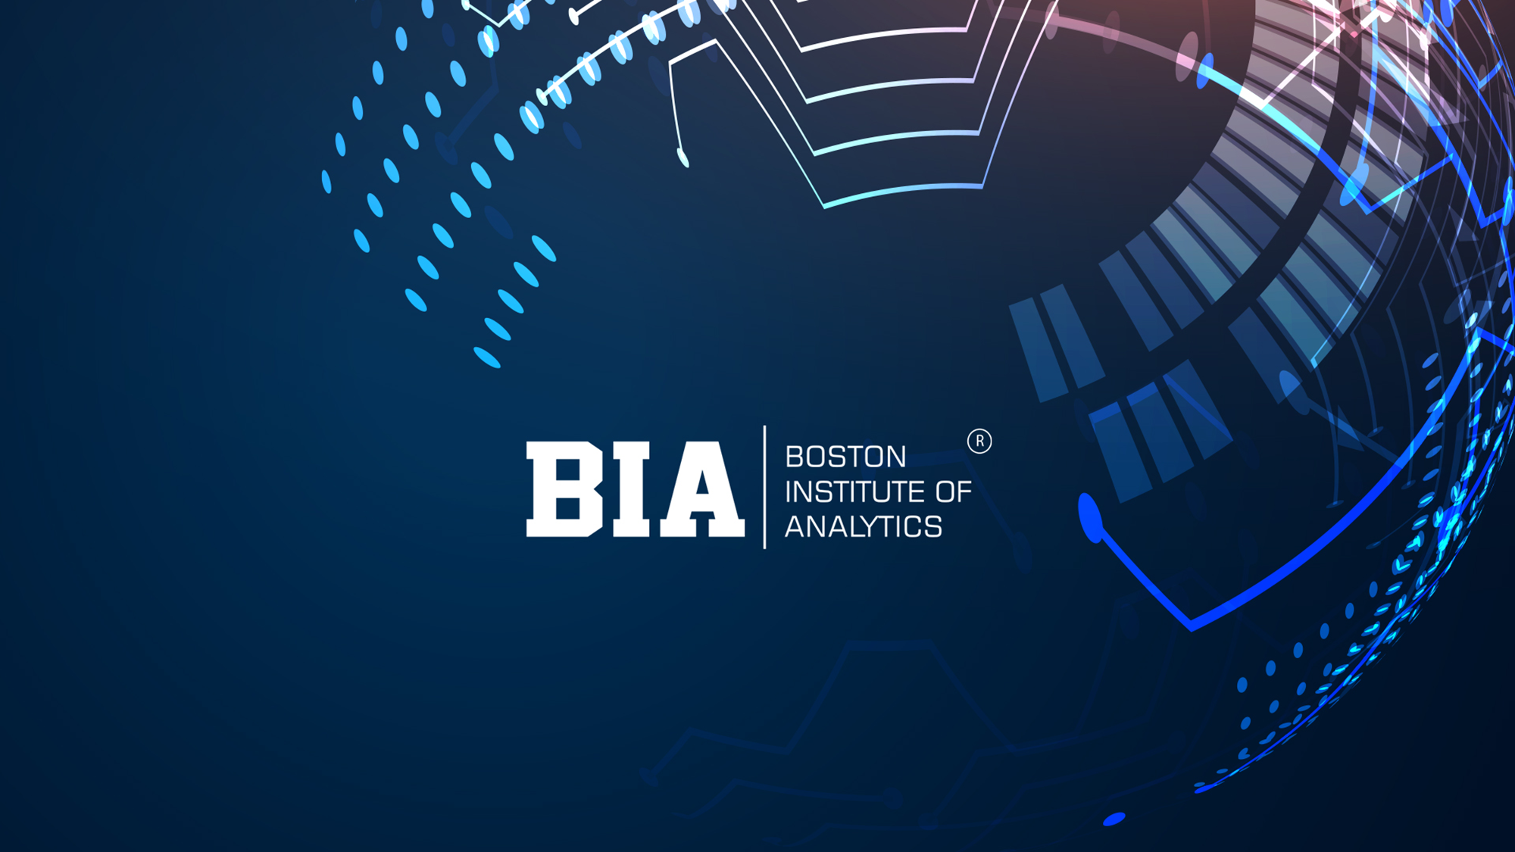

Slide 2

Digital Marketing Campaign Conversion Prediction
"In the ever-evolving landscape of digital marketing, this project aims to refine and optimize predictive models using machine learning techniques to enhance the effectiveness of our conversion campaigns. By focusing on conversion rate prediction, we intend to leverage data-driven insights to forecast user behavior, personalize engagement strategies, and optimize ad spend. The ultimate goal is to empower marketing teams to anticipate customer actions, improve conversion rates, and drive measurable business growth through targeted, efficient campaigns that maximize ROI and enhance customer engagement."

Slide 3
1. Introduction
Importance of predicting campaign conversions.
How predictive models help optimize marketing strategies.
2. Data Gathering/Data Refinement
Data Collection.
3. Exploratory Data Analysis (EDA)
Data Cleaning and preprocessing steps.
Identifying trends in user engagement.
Key factors influencing conversion rates.
4. Data Preprocessing
Selecting important variables (ad spend, click-through rates, user demographics, etc)
Techniques used (one-hot encoding, scaling, etc)
5. Methodology
Algorithms used (Logistic Regression, Decision tree, Random Forest, XGBoost etc)
Comparison of model performance
6. Experimental Results
Accuracy, precision, recall, F-1 score.
Visualization of model predictions.
7. Conclusion
Key insights from the model.
Recommendations for optimizing future campaigns.

Slide 4
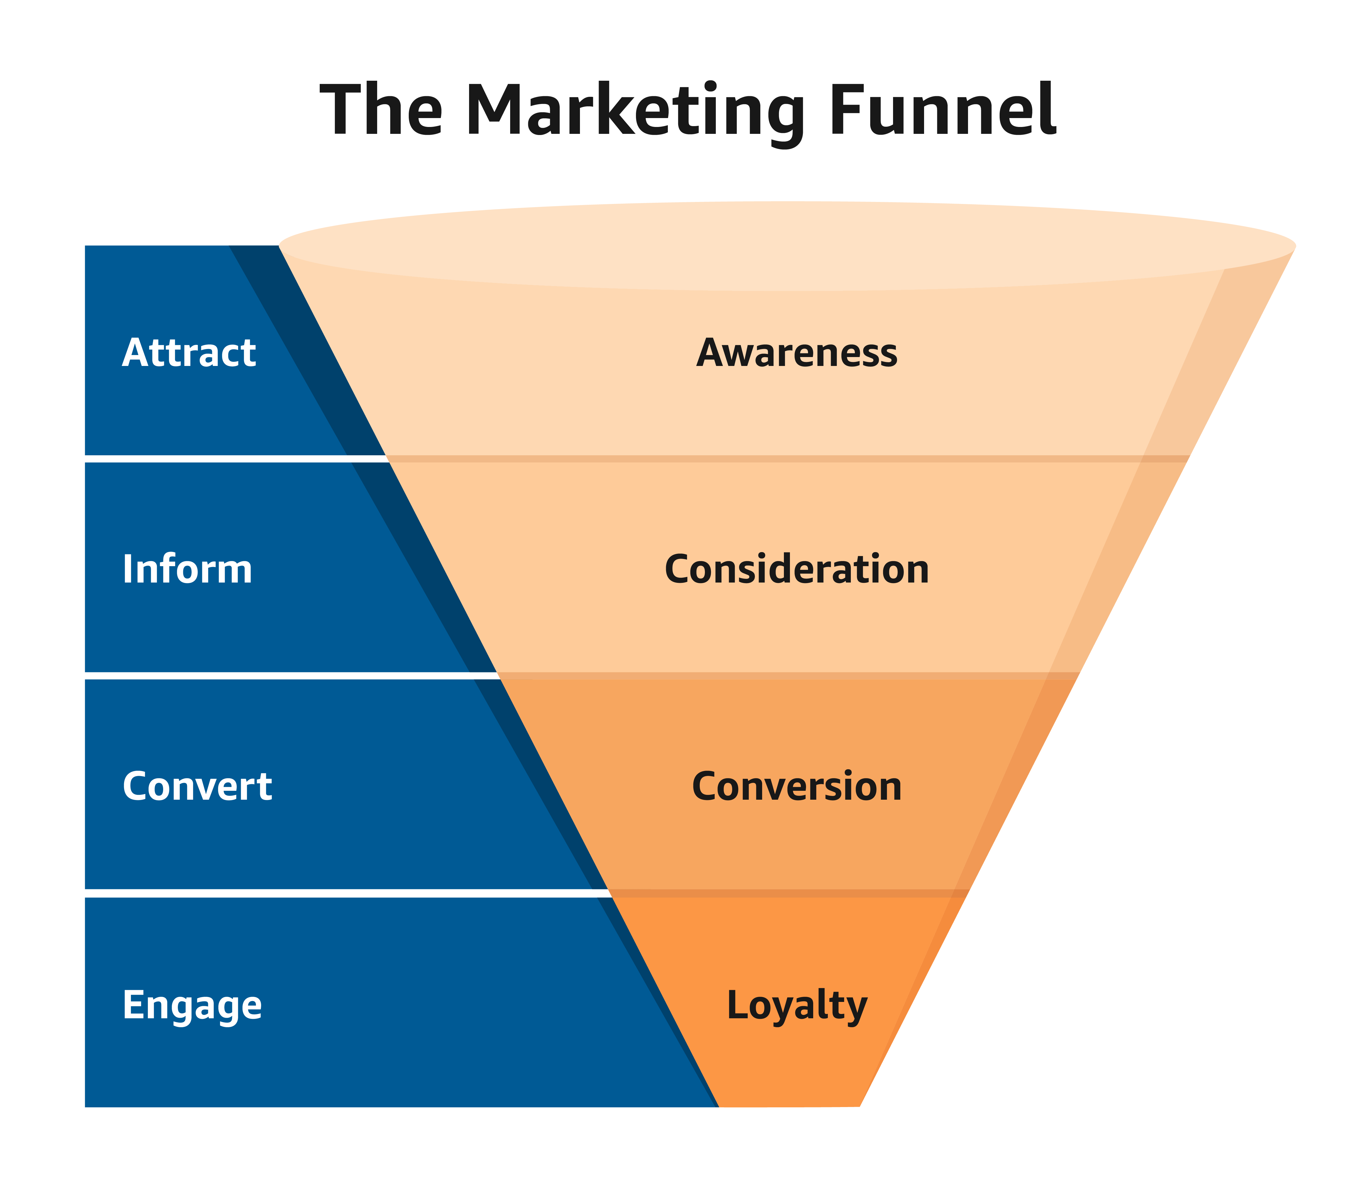
INTRODUCTION
Digital marketing plays a crucial role in modern business growth. Analyzing conversion rates helps businesses optimize ad spend and improve customer engagement. Predictive analytics and data science models allow marketers to make data-driven decisions, leading to higher ROI and improved targeting strategies.
This dataset provides a comprehensive analysis of digital marketing campaign performance, focusing on key factors influencing conversion rates.
Machine learning models can analyze vast amounts of marketing data to identify patterns and trends. By leveraging algorithms like logistic regression, decision trees, and neural networks, businesses can predict which marketing channels and strategies yield the highest conversions.

Slide 5
WORK FLOW
Understand User Behavior
Feature Engineering & Selection
Compare Machine Learning Models
Predict Conversion Rates
Evaluate Model Metrics
Deploy the Best Model
Enhance Marketing Strategies

Slide 6
DATA DESCRIPTION
Digital_marketing_campaign_conversion | 8000 Rows | 20 Columns
Features | Demographic Information | Marketing Specific Variables | Customer Engagement Variables | Historical Data | Target Variable
 | Age Gender Income | Campaign Channel Campaign Type Ad Spend Click Through Rate(CTR) Conversion Rate | Website visits Pages per visit Time on site Social Shares Email Opens Email Clicks | Previous Purchases Loyalty Points | Conversion (1- Converted and 0- Not Converted

Slide 7
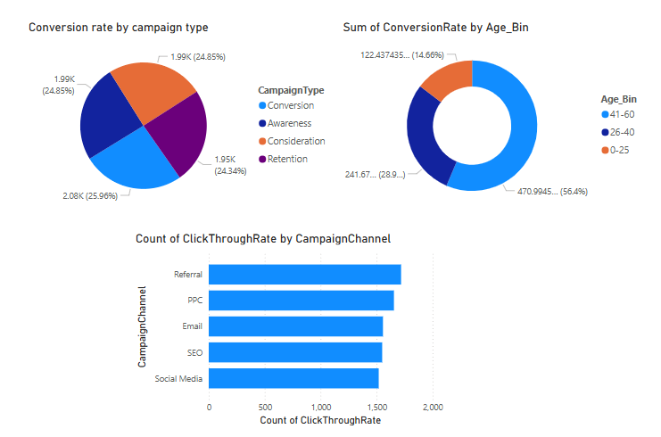
EXPLORATORY DATA ANALYSIS
Through EDA, we gained a comprehensive understanding of the dataset’s structure, enabling us to uncover key trends and insights.
Our analysis involved exploring feature distributions, identifying correlations, and detecting anomalies that could impact model performance.
By leveraging visualizations, we identified meaningful relationships between marketing efforts and customer engagement, leading to data-driven decision-making.
The dataset was thoroughly examined for inconsistencies, revealing the presence of duplicate records and outliers, which were addressed for better accuracy.
A mix of numerical and categorical variables required appropriate transformations to ensure optimal data representation for analysis and modeling.
Univariate and bivariate analyses provided deep insights into feature behavior, helping us determine which attributes most influence campaign conversion success.

Slide 8
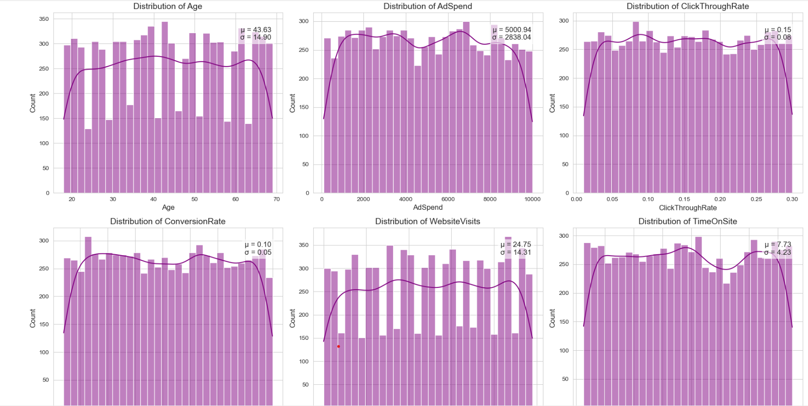
DISTRIBUTION OF KEY MARKETING METRICS
Age: The distribution of age appears fairly uniform, with a mean age of approximately 43.63 years and a standard deviation of 14.90. This suggests that customers across various age groups are fairly evenly represented.
Ad Spend: The average advertising spend is $5000.94, with a standard deviation of $2838.04. The distribution shows variability, indicating different levels of investment across campaigns.
Click-Through Rate (CTR): The mean click-through rate is 0.15, with a standard deviation of 0.08. The distribution is relatively uniform, suggesting a consistent engagement level across different campaigns.
Conversion Rate: The average conversion rate is 0.10, with a standard deviation of 0.05. This shows some variation in conversion success across campaigns, indicating that certain strategies perform better than others.
Website Visits: The mean number of website visits is 24.75, with a standard deviation of 14.31. The distribution suggests varying engagement levels, with some customers visiting the site more frequently than others.

Slide 9
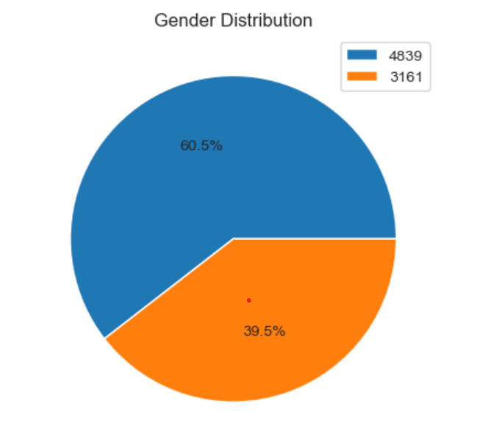
GENDER DISTRIBUTION
The dataset shows that 60.5% of the members are female, indicating a higher proportion of female participants in the digital marketing campaign.
This suggests that the campaign may be targeting or attracting more female users.
Depending on the business objective, this insight can help refine marketing strategies, such as tailoring ad content, adjusting campaign channels, or exploring ways to engage more male customers if needed.

Slide 10
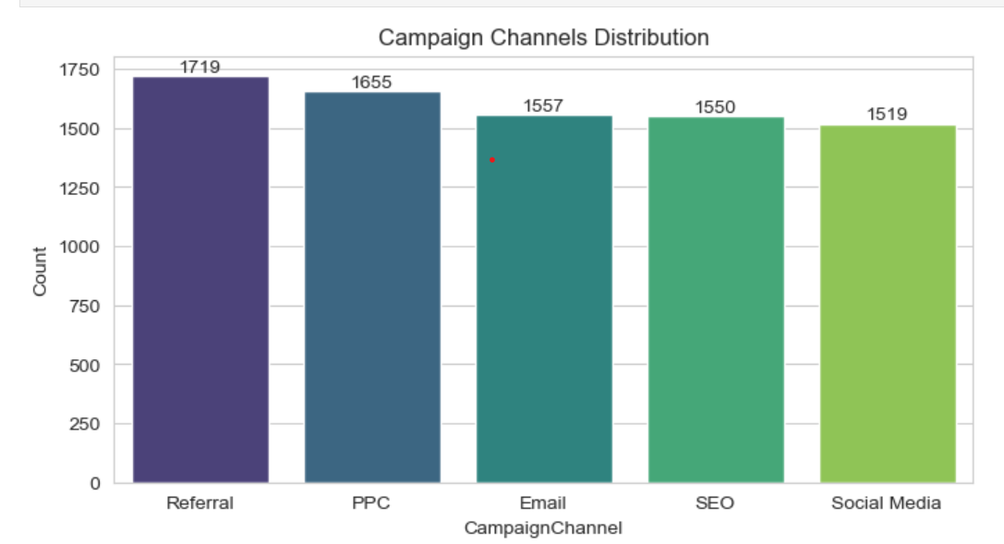
CHAMPAIGN CHANNEL DISTRIBUTION
The most used campaign channel is Referral (1719 campaigns), followed by PPC (1655), Email (1557), SEO (1550), and Social Media (1519).
This suggests that Referral marketing is the most utilized strategy in this dataset, potentially indicating strong word-of-mouth marketing.
PPC and Email are also widely used, showing a focus on paid advertisements and direct customer engagement.
Social Media, while commonly seen as an effective platform, has the lowest count, suggesting that it may be underutilized in this campaign.
Further analysis can explore which channels have the highest conversion rates to optimize marketing efforts.

Slide 11
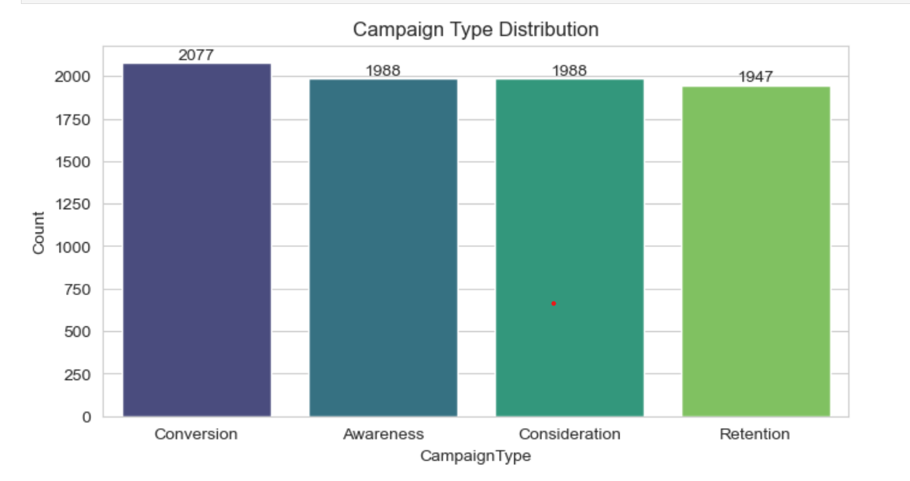
CAMPAIGN TYPE DISTRIBUTION
The most frequent campaign type is Conversion (2077 campaigns), followed by Awareness (1988), Consideration (1988), and Retention (1947).
This suggests that the primary focus of the marketing efforts is driving conversions, which aligns with business goals aimed at increasing sales or sign-ups.
Awareness and Consideration campaigns are equally prioritized, indicating a balanced effort in attracting potential customers.
Retention campaigns, though slightly lower in count, are still significant, reflecting efforts to engage existing customers.
Further analysis can explore which campaign type is most effective in driving actual conversions.

Slide 12
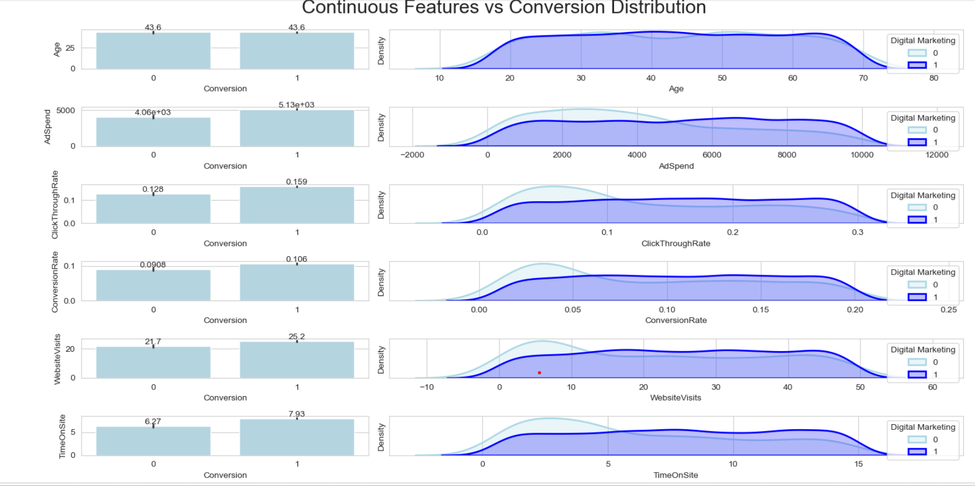
CONTINUOUS FEATURES VS CONVERSION
Age: The average age for both converted (1) and non-converted (0) users is around 43.6 years, indicating that age alone may not be a strong differentiator for conversion.
* Ad Spend: Converted users tend to have higher ad spend (5.13k) than non-converted users (4.06k). This suggests that higher ad investments could lead to better conversions.
Click-Through Rate (CTR): Users who converted have a higher mean CTR (0.159) than those who didn’t (0.128), showing that a better engagement rate might contribute to conversions.
Conversion Rate: Converted users have a higher mean conversion rate (0.106) compared to non-converted ones (0.0908), indicating that past conversion trends influence new conversions.
Website Visits: On average, users who converted visited the website more frequently (25.2 visits) compared to non-converted users (21.7 visits), implying that repeated engagement may drive conversions.
Time on Site: Converted users spent more time (7.93 mins) on the site compared to non-converted users (6.27 mins), suggesting that longer interaction increases the likelihood of conversion.

Slide 13
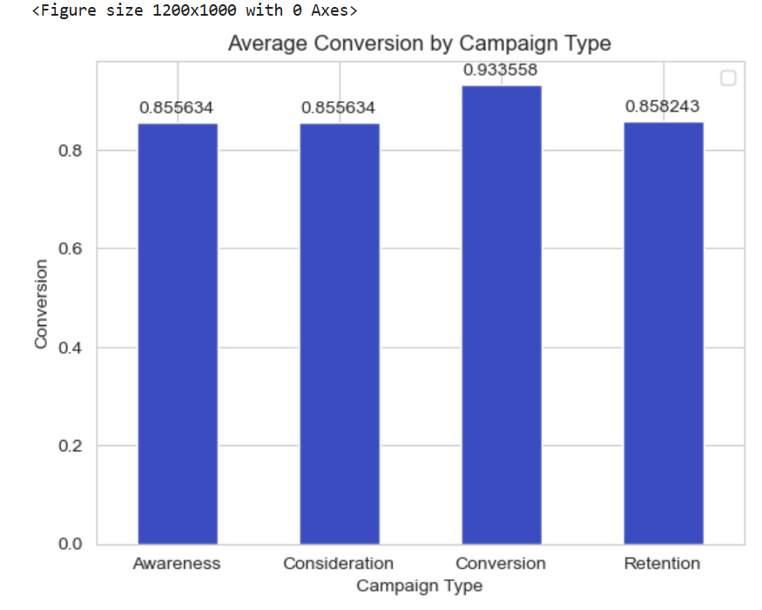
CAMPAIGN TYPE VS CONVERSION
The bar plot illustrates the average conversion rate for different campaign types:
Conversion Campaigns (0.93) show the highest conversion rate, indicating that campaigns directly focused on conversion are the most effective at driving customer actions.
Awareness (0.86), Consideration (0.86), and Retention (0.86) campaigns have slightly lower but still strong conversion rates.
The similarity in conversion rates across Awareness, Consideration, and Retention suggests that these campaigns are performing well but may not be optimized specifically for driving immediate conversions.

Slide 14
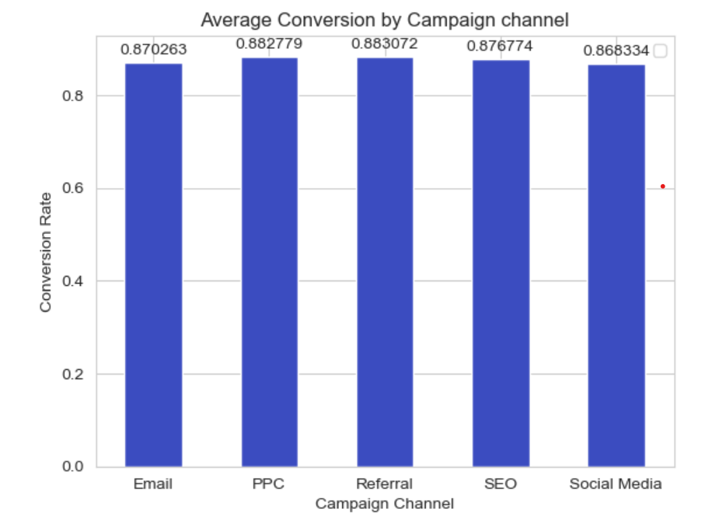
CHAMPAIGN CHANNEL VS CONVERSION
The bar plot shows the average conversion rate across different marketing channels:
Referral (0.88) and PPC (0.88) have the highest conversion rates, indicating that these channels are the most effective at driving conversions.
SEO (0.88) and Email (0.87) perform slightly lower but still maintain strong conversion rates.
Social Media (0.87) has the lowest conversion rate among the channels but is still highly competitive.

Slide 15
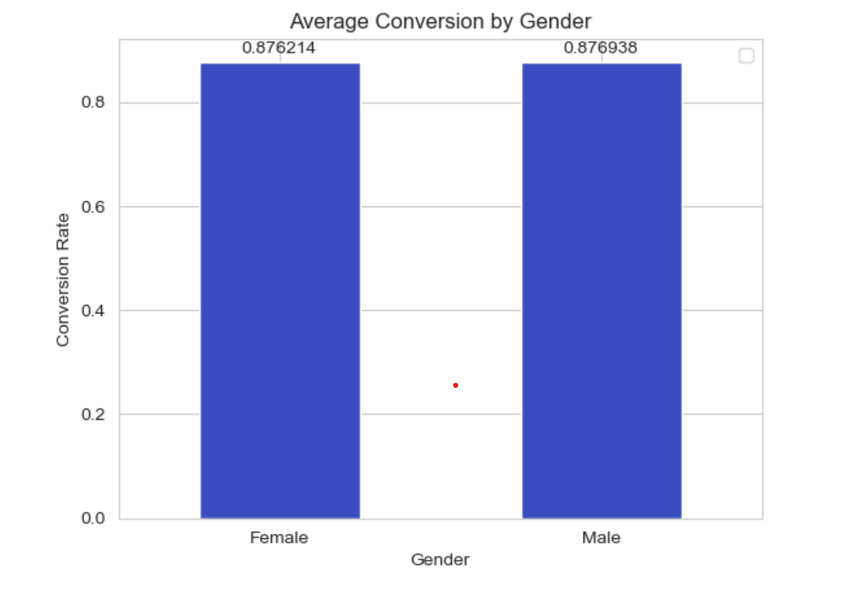
GENDER VS RESPONSE
The bar plot shows the average conversion rates for male and female customers:
Males (0.8769) and Females (0.8762) have nearly identical conversion rates.
The difference is negligible, suggesting that gender does not play a significant role in conversion rates for this campaign.

Slide 16
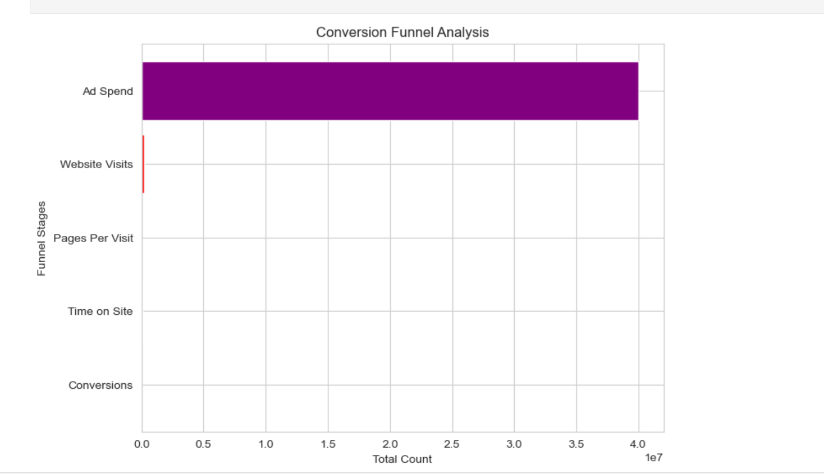
CONVERSION FUNNEL ANALYSIS
Significant Drop-off:
A huge difference exists between Ad Spend and the following stages (Website Visits, Pages Per Visit, Time on Site, and Conversions).
This indicates that many users do not engage with the ads or visit the website after exposure.
Low Website Visits:
The red bar for Website Visits is extremely small compared to Ad Spend.
This suggests poor ad targeting, low engagement, or unappealing ad creatives.
High Bounce Rate:
The subsequent stages (Pages Per Visit, Time on Site) are almost negligible.
Users who do visit the site may not find it engaging or relevant, leading to quick exits.
Actionable Insights - Improve Ad Targeting - Optimize Website Experience - A/B Testing for Ads & Landing Pages - Retargeting Strategy.

Slide 17
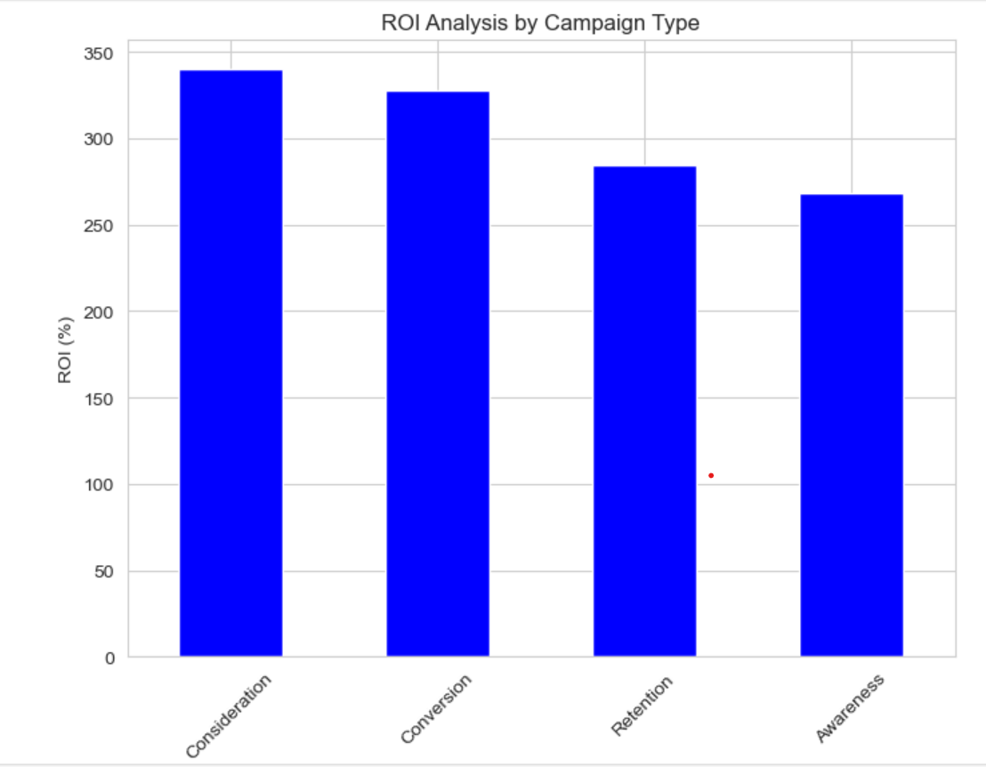
MARKETING SPEND ROI
Consideration and Conversion Campaigns Perform Best .
The Consideration and Conversion campaigns have the highest ROI (~340% and ~320%), indicating these campaigns are driving the most return on investment.
These campaigns effectively convert engaged users into customers.
Retention Campaigns Have Moderate ROI.
Retention campaigns have a lower ROI than Conversion and Consideration but still generate substantial returns (~270%).
This suggests that keeping existing customers engaged is profitable but could be optimized further.
Awareness Campaigns Have the Lowest ROI (~250%).
Awareness campaigns, designed to introduce users to the brand, have the lowest return on investment.
This is expected since these campaigns focus on visibility rather than direct conversions.

Slide 18
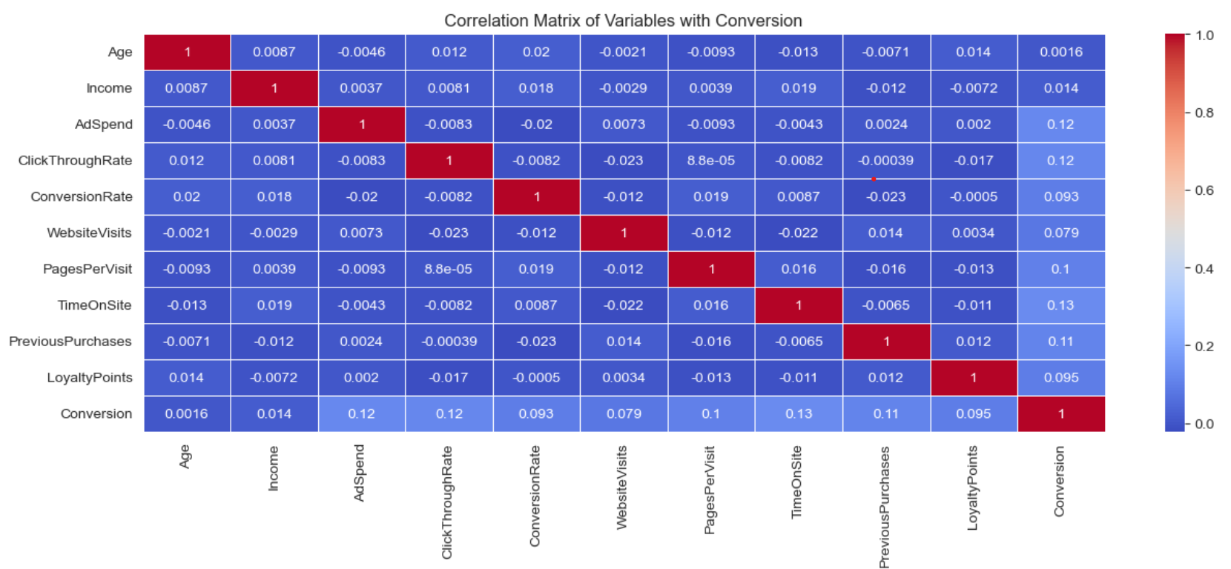
CORRELATION HEATMAP
No Strong Correlation with Conversion.
The highest correlation with Conversion is 0.13 (Email Clicks and Time On Site), which is weak.
Other attributes like Ad Spend (0.12), Click-Through Rate (0.12), and Email Opens (0.12) also have weak positive correlations.
This suggests that no single factor dominates conversion rates, and multiple elements likely contribute.
Loyalty Points & Previous Purchases Show Weak Influence. Loyalty Points (0.10) and Previous Purchases (0.11) have weak correlations with Conversion.

Slide 19
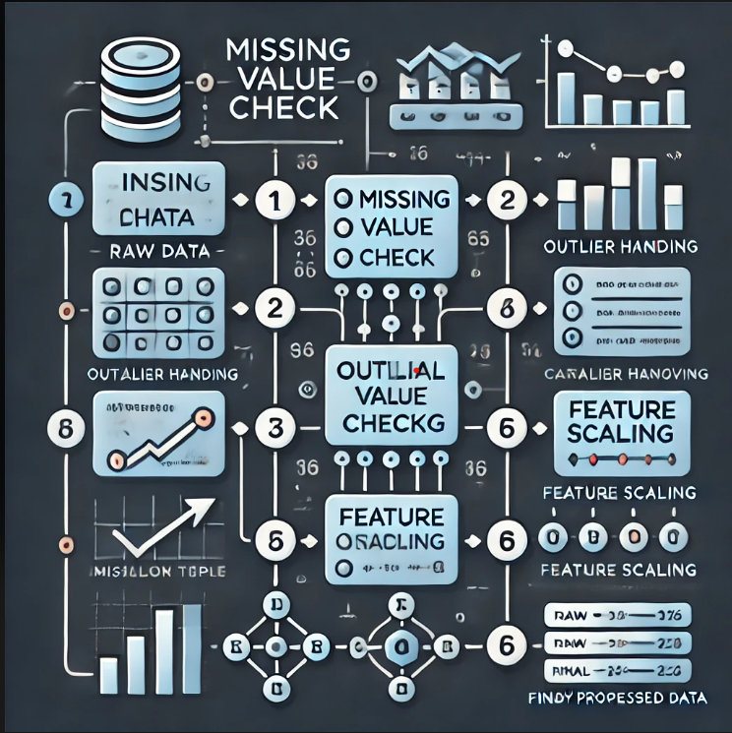
DATA PREPROCESSING
Missing Value Treatment: No missing values were found in the dataset.
Outlier Treatment: Outlier removal or transformation was not applied, as it was deemed unnecessary for this dataset.
Categorical Feature Encoding: Applied one-hot encoding to categorical variables, including Gender, Campaign Type, and Campaign Channel, to ensure they are appropriately represented in the model.
Feature Scaling: Used MinMax Scaling to normalize the numerical features, ensuring that all values fall within a consistent range while preserving relationships in the data.

Slide 20
USING SMOTE FOR HANDLING IMBALANCE DATA
SMOTE (Synthetic Minority Over-sampling Technique) has been applied to balance the dataset by generating synthetic samples for the minority class.
Before applying SMOTE, the dataset likely had an imbalance where one class (e.g., 1) had significantly fewer samples than the other (0).
After applying SMOTE, both classes have equal representation (7012 samples each), ensuring a balanced dataset for training the model.
This helps improve model performance, especially for classifiers that struggle with imbalanced data by reducing bias toward the majority class.

Slide 21
We divided the data into training (80%) and testing (20%) sets.
Setting a random state ensures consistent results, and using stratify=y maintains a proportional distribution of the conversion variable in both sets.
TRAIN TEST SPLIT
SPLITTING THE DATA INTO X & Y
We divided the dataset into two parts: X and y.
"X" represents the independent variables, including features like Age, Gender, Campaign Type, Campaign Channel, Ad Spend, Previous Purchases, and Loyalty Points.
"y" represents the Dependent (target variable) – Conversion, which we aim to predict.

Slide 22
MODEL SELECTION
MODELS USED:
Logistic Regression: Logistic Regression is widely used for binary classification as it predicts the probability of an outcome based on input features. It is a lightweight and interpretable model that performs well when the relationship between variables is approximately linear.
Decision Tree: A Decision Tree is a rule-based model that splits data into branches to make predictions. It is easy to understand, works well with both numerical and categorical data, and does not require feature scaling, making it useful for various classification tasks.
Random Forest Algorithm: Random Forest is an ensemble learning technique that constructs multiple decision trees and combines their outputs for better accuracy and stability. It is resistant to overfitting, handles large datasets well, and improves generalization in classification problems.
XGBoost: XGBoost is a gradient boosting algorithm designed for speed and performance. It applies a series of weak learners to iteratively minimize errors, making it highly effective for complex datasets while offering regularization to prevent overfitting.

Slide 23
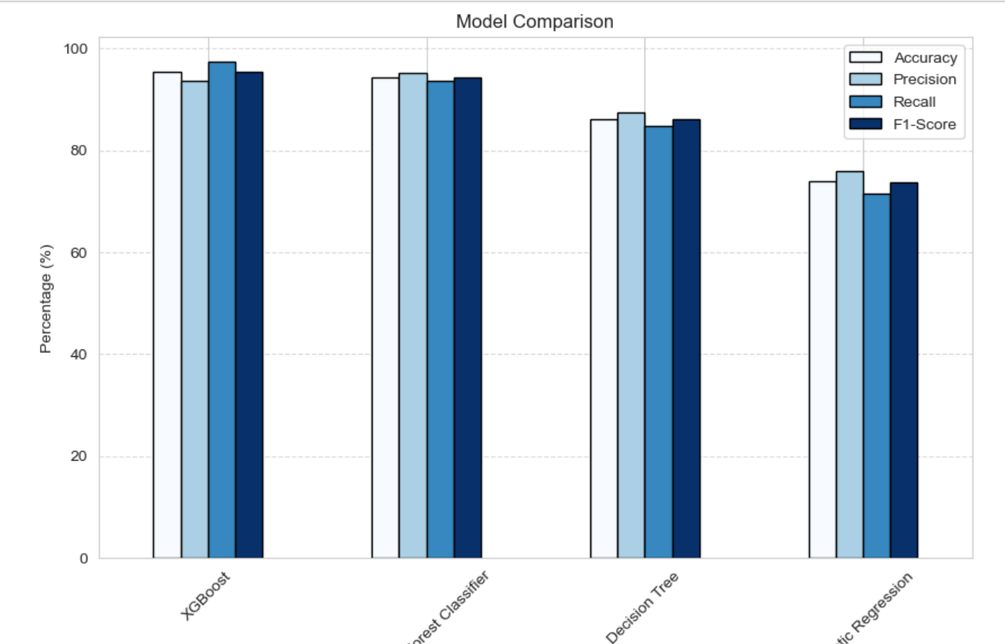
MODEL COMPARISON
Model | Accuracy | Precision | Recall | F1-Score | Roc _auc score
XGBoost | 95.29 | 93.66 | 97.33 | 95.46 | 98.43
Random Forest Classifier | 94.29 | 95.09 | 93.62 | 94.35 | 98.59
Decision Tree | 86.06 | 87.49 | 84.73 | 86.09 | 86.08
Logistic Regression | 73.97 | 75.96 | 71.49 | 73.66 | 81.61
Accuracy: Measures the overall correctness of the model by calculating the proportion of correctly predicted instances out of all instances.
Precision: Indicates how many of the predicted positive cases are actually positive, minimizing false positives.
Recall (Sensitivity): Measures how well the model identifies actual positives, minimizing false negatives.
F1-Score: A harmonic mean of precision and recall, balancing both metrics when data is imbalanced.
ROC-AUC Score: Represents the model’s ability to distinguish between classes, with a higher score indicating better discrimination.

Slide 24
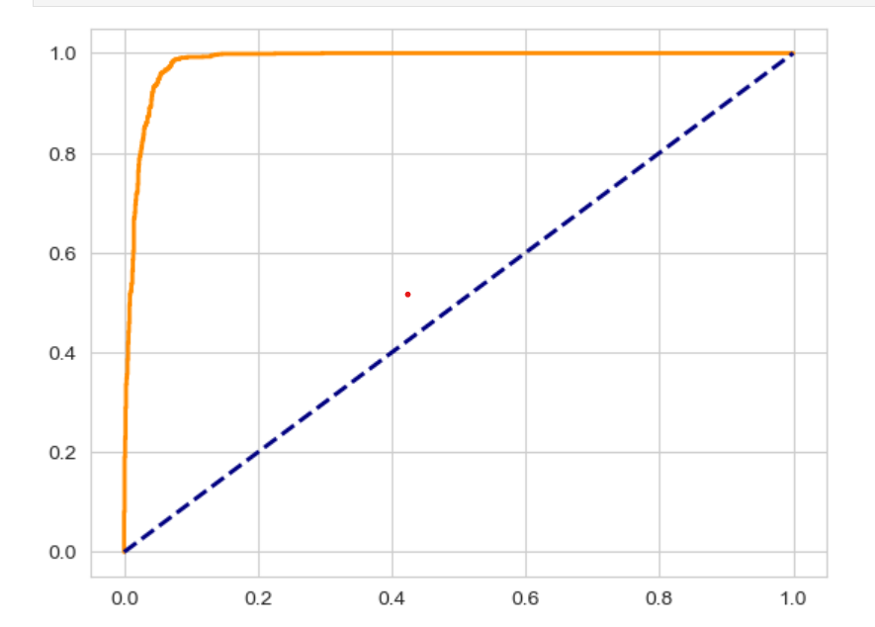
ROC-AUC CURVE FOR XGBOOST
Excellent Model Performance: The ROC curve (orange line) is very close to the top-left corner, indicating high true positive rate (sensitivity) and low false positive rate. This suggests that the model is highly effective in distinguishing between conversions and non-conversions.
High AUC (Area Under Curve) Score: Given the shape of the curve, the AUC score is likely close to 1, meaning strong classification capability. The model significantly outperforms a random classifier (represented by the diagonal dashed blue line).
Comparison with Previous Models: This ROC curve is the steepest and closest to 1 compared to earlier models, showing that this is the best-performing model. The previous models had more gradual curves, indicating a lower AUC score.
Final Verdict: Best Model for Conversion Prediction—minimizing errors while maximizing correct predictions. - High AUC & ROC Curve Performance—making it ideal for deployment in marketing campaigns.
This model is the most optimized for predicting digital marketing conversions!

Slide 25
EXPERIMENTAL RESULTS:
XGBoost Leads the Way: XGBoost emerged as the best-performing model, achieving the highest accuracy, precision, and recall. This indicates its robustness in correctly predicting conversions while minimizing false negatives. It is an ideal choice when both precision and recall are crucial.
Random Forest & Decision Tree Consistency: Both Random Forest and Decision Tree showed solid accuracy and recall, making them reliable alternatives. However, Random Forest performed slightly better in recall, making it a preferable choice when identifying all potential conversions is important.
Logistic Regression Trade-off: Logistic Regression performed reasonably well but had the lowest recall, indicating it might miss some potential conversions. It is still a good choice when model interpretability is a priority.

Slide 26
CONCLUSION
In our digital marketing conversion prediction analysis, we conducted extensive exploratory data analysis (EDA) and applied various preprocessing techniques to refine the dataset.
Key insights revealed strong correlations between conversion rates and factors such as campaign type, campaign channels, previous purchases, and customer demographics.
To develop an effective predictive model, we implemented multiple machine learning algorithms, including Logistic Regression, Decision Trees, Random Forest, XGBoost. Special emphasis was placed on achieving a high recall for the positive class to ensure potential customers were accurately identified.
Through model evaluation using precision, recall, F1-score, and ROC-AUC, we selected the best-performing model that balances both accuracy and minimizing false negatives.
Additionally, to address class imbalance, we applied SMOTE (Synthetic Minority Over-sampling Technique), ensuring a fair representation of both conversion and non-conversion cases. Our optimized model provides valuable insights for targeted marketing strategies, helping businesses allocate resources efficiently and improve conversion rates.

Slide 27
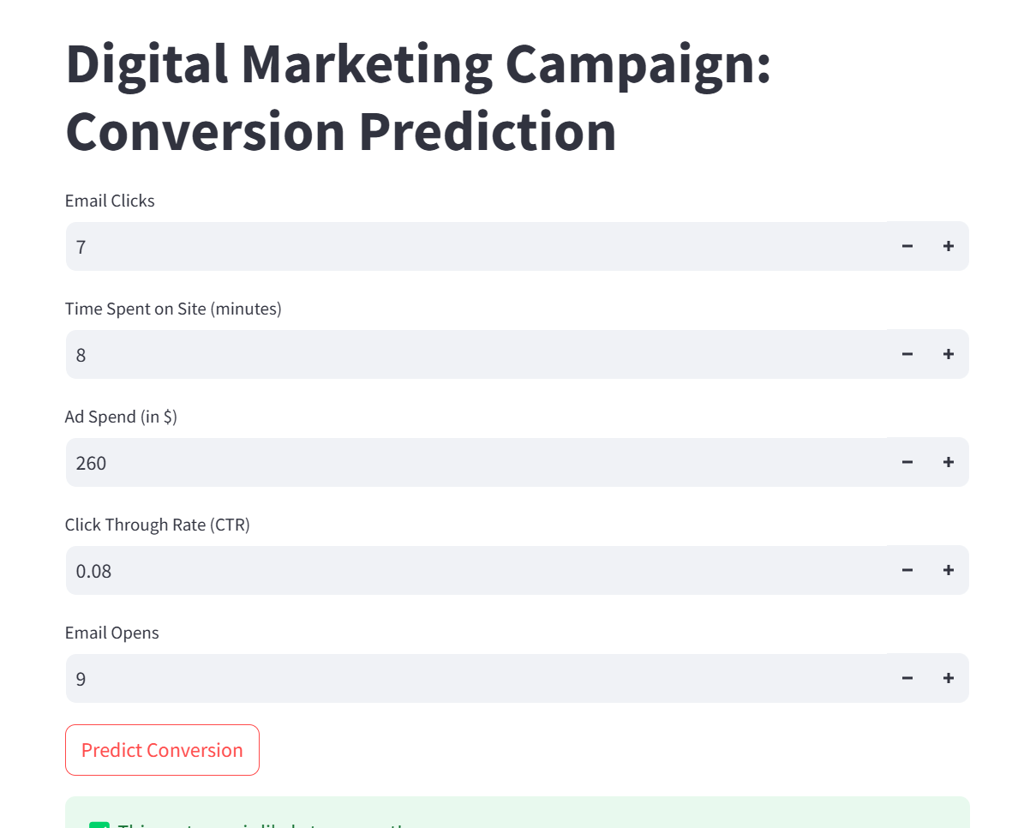
DEPLOYMENT

Slide 28
THANK YOU

