Slide 1
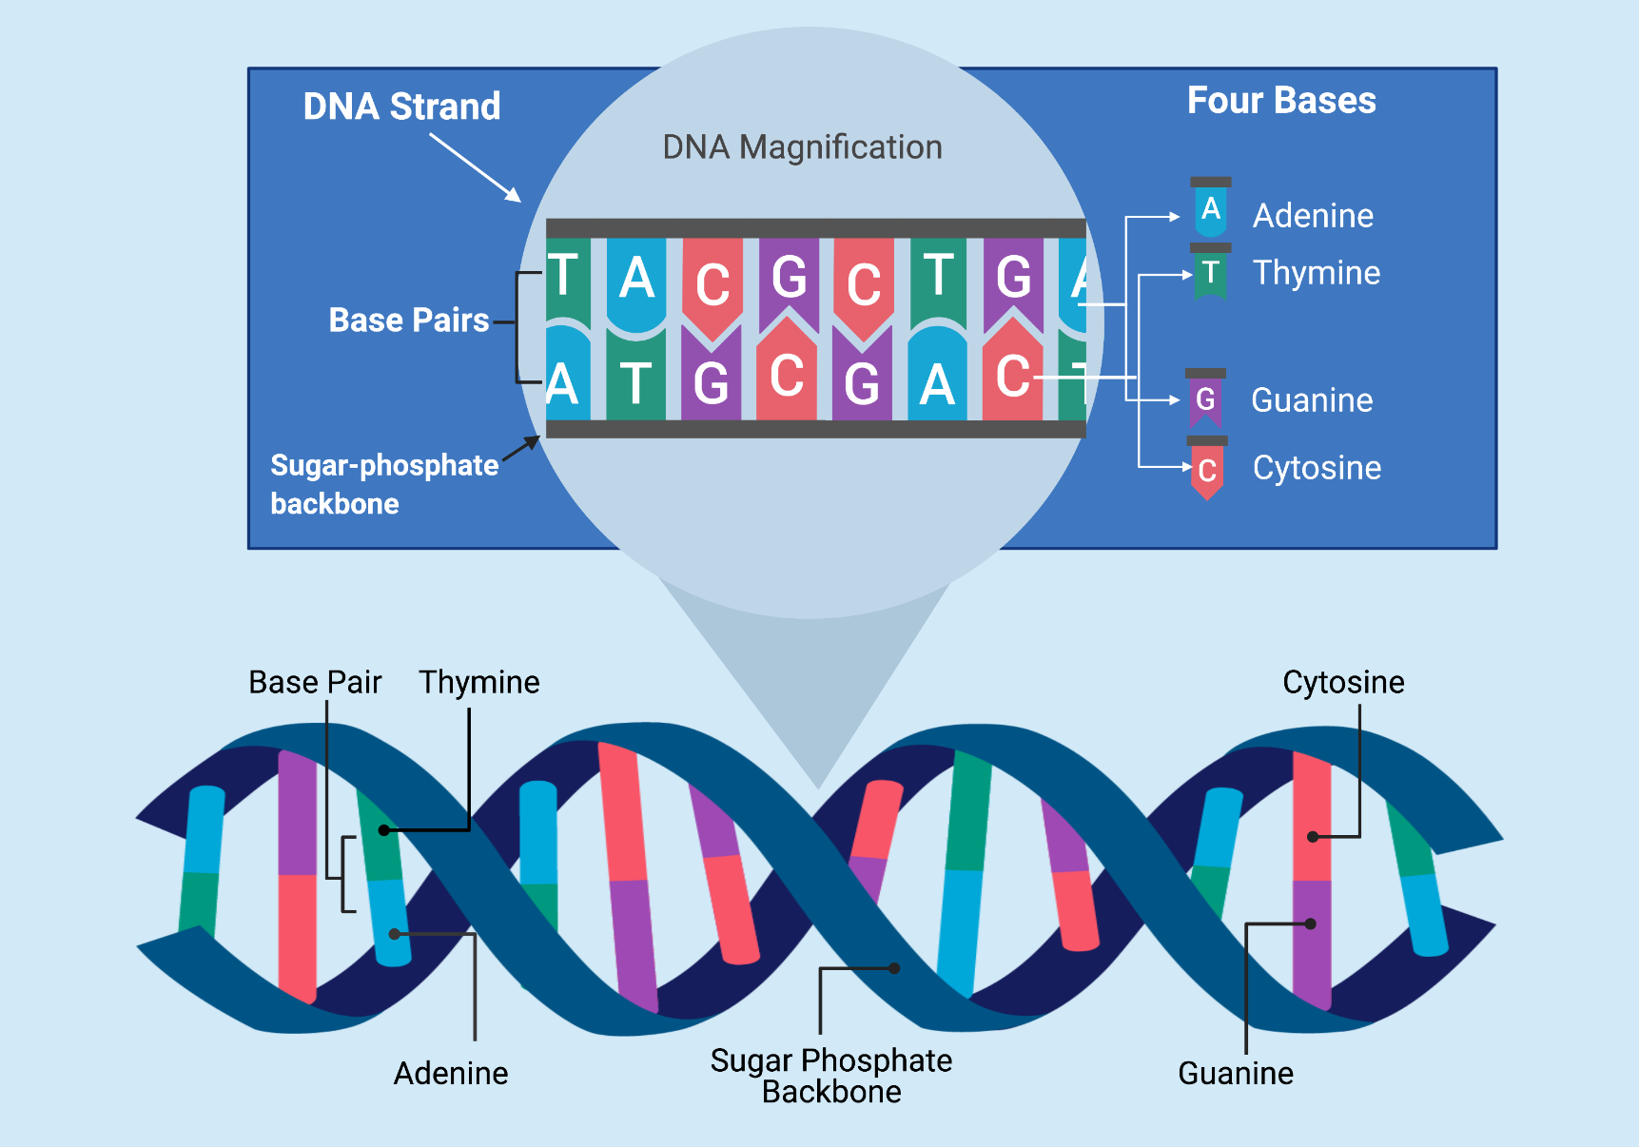
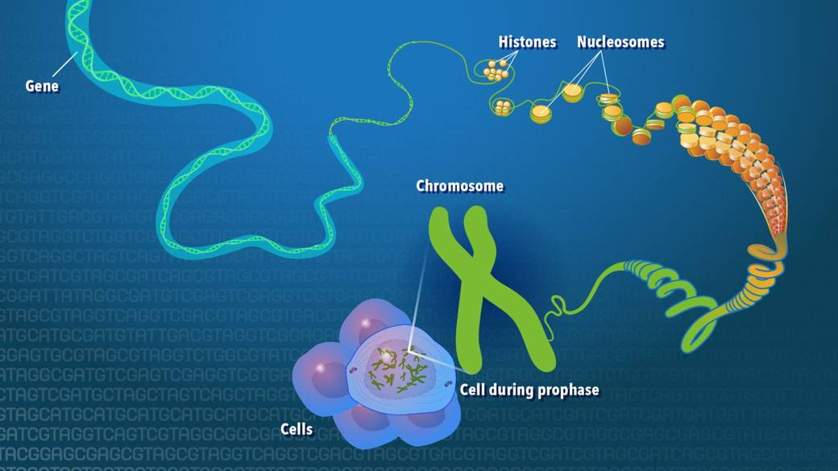


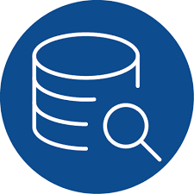
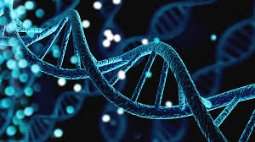
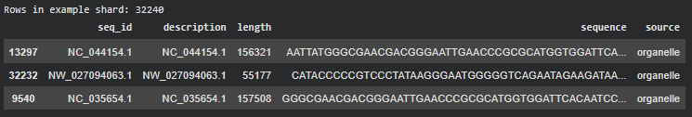
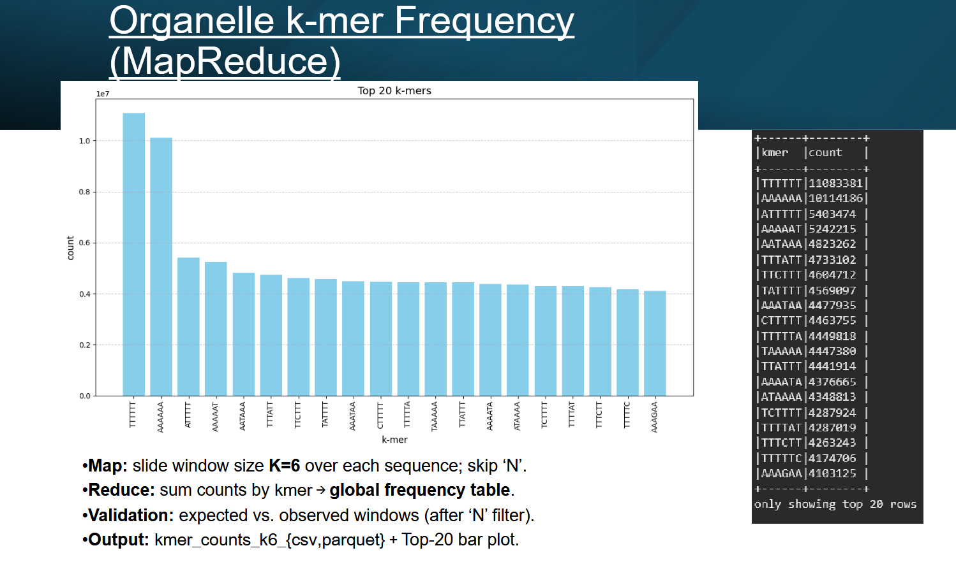

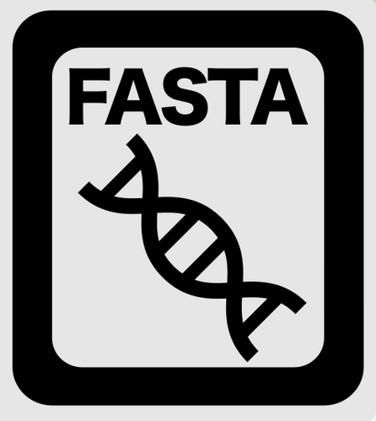

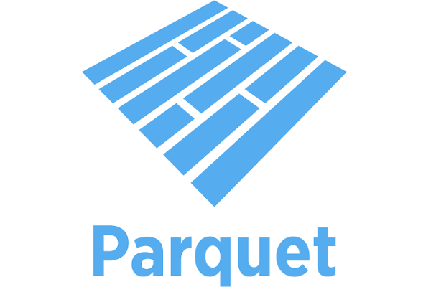

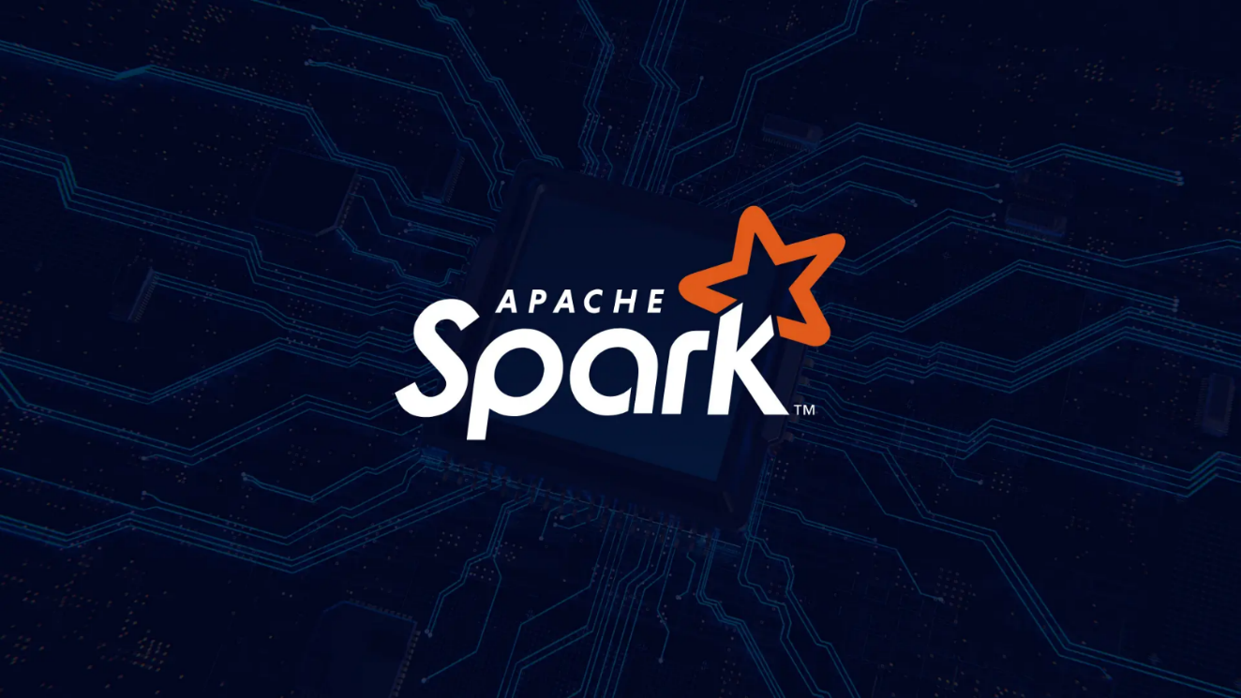
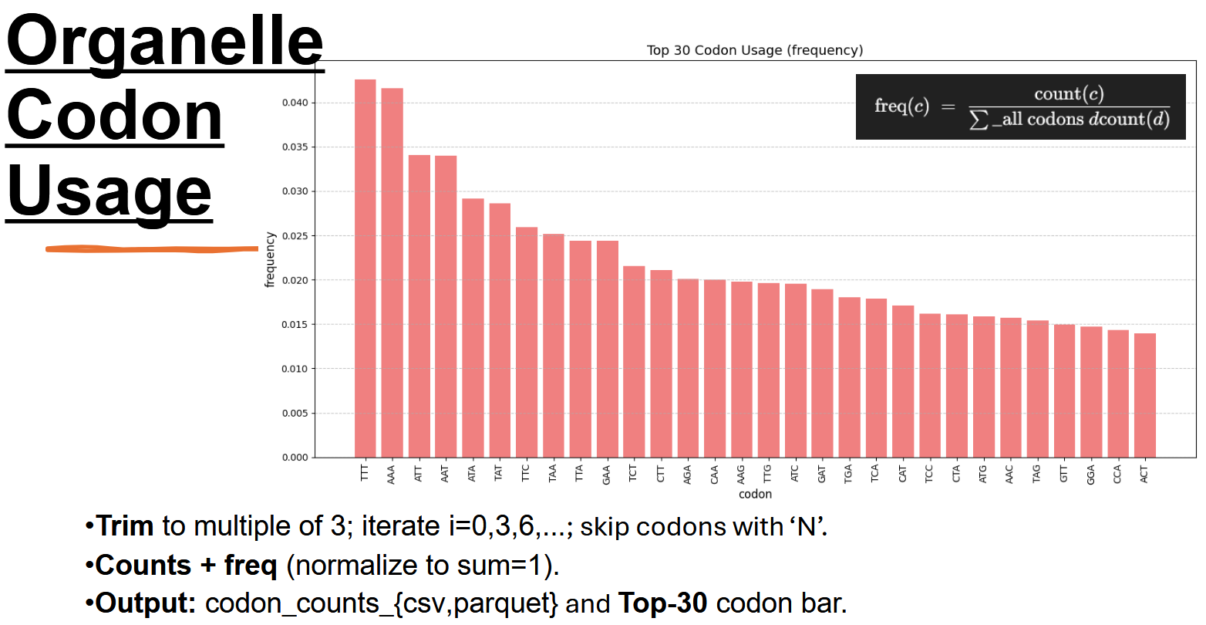

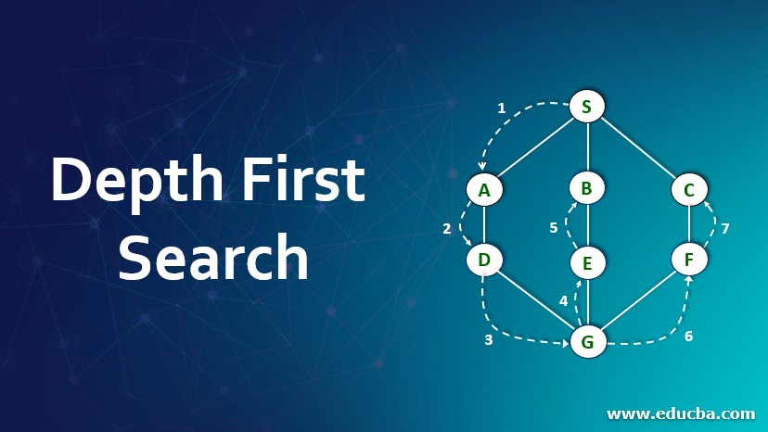
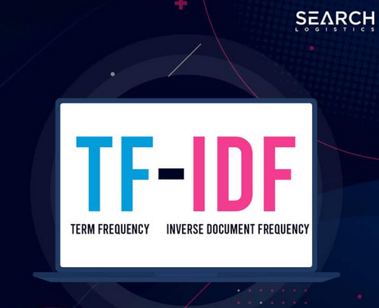
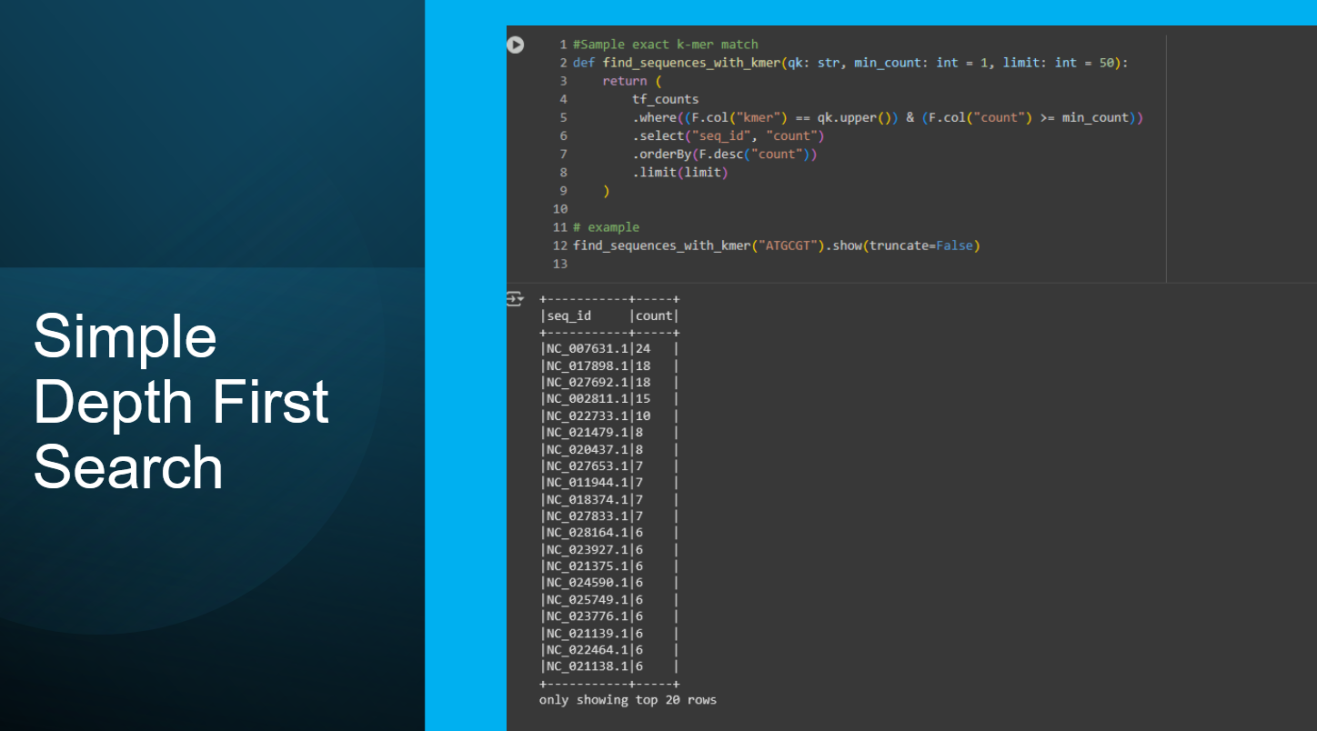
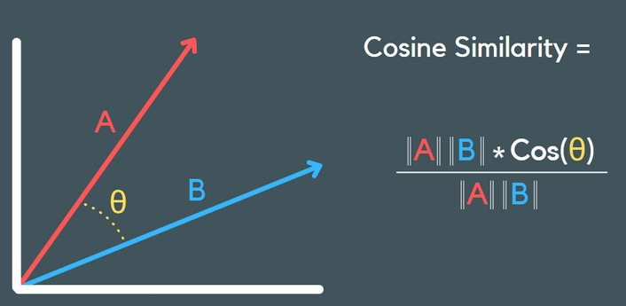
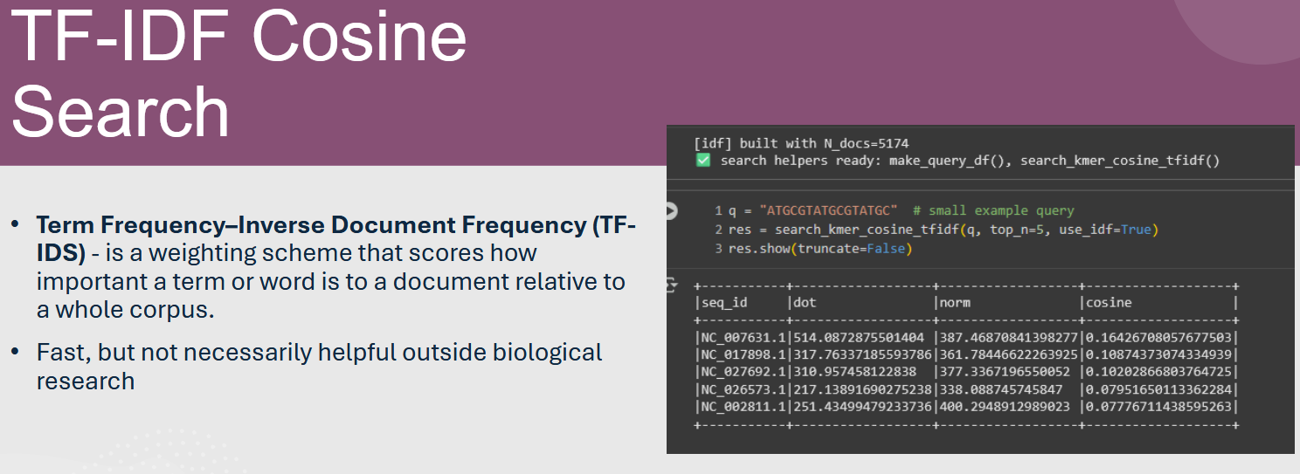


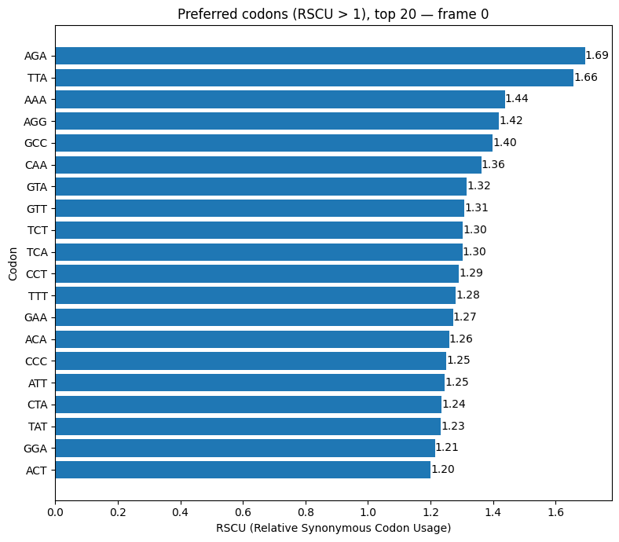

Distributed Genomic Search and Sequence Analysis Using Apache Spark
By: Tom Steinman (University of Missouri-Kansas City)
&
Thomas Jones (University of Missouri-Kansas City)
Introduction
Methodology
Results
Conclusion
Genomes:
A genome is an organism’s full DNA blueprint—long strings over the alphabet A, C, G, T—encoding genes, regulatory elements, and structural signals across millions to billions of bases.
Nucleotides:
These four letters (A/C/G/T) form the basic units. Their order determines biochemical function, from promoters and enhancers to protein-coding regions.
Codons (3-mers in coding regions):
DNA is read in triplets during translation. Each codon maps to an amino acid (or stop), so codon usage bias reflects organismal preferences that affect expression efficiency and protein synthesis.
K-mers (fixed-length substrings):
Short overlapping DNA fragments whose frequency patterns act like a genomic fingerprint, enabling fast comparison and search.
Why it matters biologically:
k-mer and codon patterns reveal evolutionary signals, GC content shifts, repeats, horizontal transfer, and expression/translation constraints, supporting tasks from variant calling to comparative genomics.
Why distributed/parallel computing:
modern datasets (e.g., pan-genomes, metagenomes) are terabytes; computing k-mer counts and codon tables requires parallel map (local counting) and reduce (global aggregation) across billions of substrings—an ideal fit for Spark/MapReduce.
Impact:
scalable pipelines turn raw sequences into vectorized features for search, clustering, anomaly detection, and visualization, enabling rapid iteration over large collections (e.g., OpenGenome2) that are impractical on a single machine.
Takeaway:
combining biological signal (codons/k-mers) with distributed systems yields reproducible, high-throughput analytics that power both foundational biology and real-world applications (diagnostics, surveillance, and genome engineering).
Dataset
OpenGenome2 (Organelles only at this time)
Contains millions of DNA sequences from a wide variety of bacterial, archaeal, viral, organelle, and metagenomic sources.
Distributed as multiple partitions/shards to support parallel and cluster-based processing (ideal for Spark, Dask, Ray, HPC).
Each record typically includes:
A sequence identifier, a raw nucleotide sequence, metadata describing organism/source where available
Sequences vary in length: includes short fragments, full genes, organelle genomes (e.g., mitochondrial & chloroplast), and other structured genomic components.
Well-suited for: k-mer frequency analysis, Codon usage profiling, Comparative genomics, Sequence similarity search / clustering
Add your information, graphs, and images to this section.
This project demonstrates that large-scale genomic sequence analysis can be effectively performed using distributed computing techniques.
By converting organelle genome data from the OpenGenome2 dataset into a Spark-friendly format and computing k-mer frequency distributions and codon usage profiles, we showed how MapReduce-style workflows can extract biologically meaningful patterns at scale.
We also implemented sequence similarity search using vectorized k-mer term-frequency representations, enabling retrieval of closest-matching sequences based on cosine similarity.
These results highlight that distributed computation is not only necessary for handling datasets of this size, but also provides meaningful biological insights into sequence structure, composition, and relatedness.
Fast and scalable sequence search is increasingly important in modern genomics because biological databases are growing exponentially with ongoing sequencing efforts. Researchers often need to:
  identify unknown sequences,
  compare genomes across species,
  trace evolutionary relationships, or
  detect mutations linked to disease.
Traditional search and alignment tools work well for small datasets but become prohibitively slow as genomic repositories reach terabyte and petabyte scale. By demonstrating how distributed computing can parallelize k-mer extraction, normalization, and similarity search, this project shows a pathway toward real-time or near-real-time genomic querying—an essential capability for comparative genomics, pathogen surveillance, and personalized medicine.
Future Work
Scale from organelle subset → full OpenGenome2 dataset using cluster execution (e.g., UMKC Hellbender Cluster).
Expand sequence search to include:
  Jaccard similarity search (set-based comparison)
  Local alignment or approximate edit-distance methods
  Learned embeddings (e.g., DNA2Vec, k-mer transformers)
Add biological annotation context such as gene boundaries, translation frame information, and organism taxonomy for deeper comparative genomics.
Optimize performance with:
  broadcast indexing for top-k retrieval
  Build a user-facing query interface (web tool or command-line API) for interactive sequence search and visualization.
MapReduce
Search Algorithms
What is RSCU (Relative Synonymous
Codon Usage)?
• RSCU measures how often a codon is used relative to how often it would be used if all synonymous codons for
that amino acid were used equally.
Acknowledgements
Special thanks to Dr. Yusuf Sarwar for the opportunity and knowledge he has provided to engage in this work.

