Slide 1
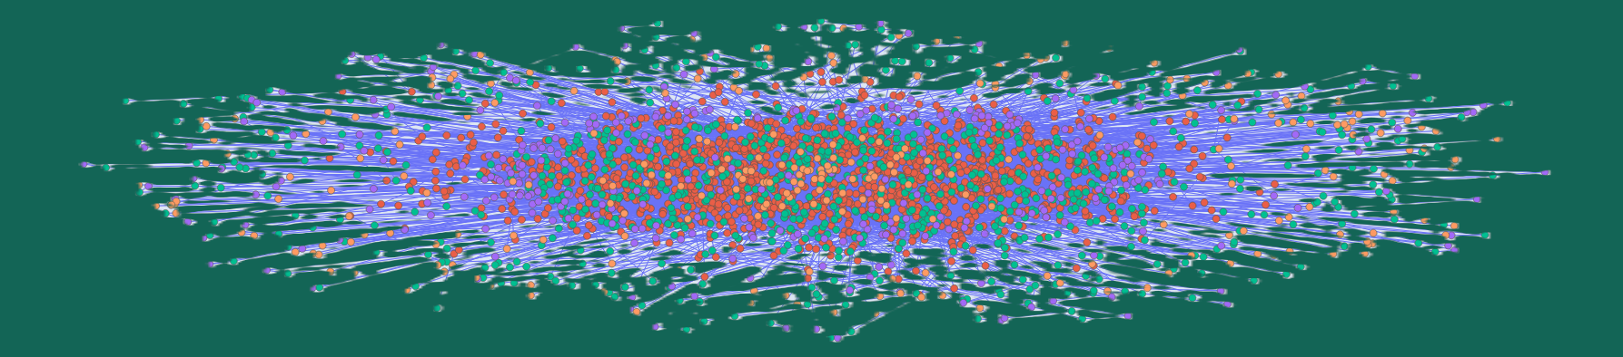
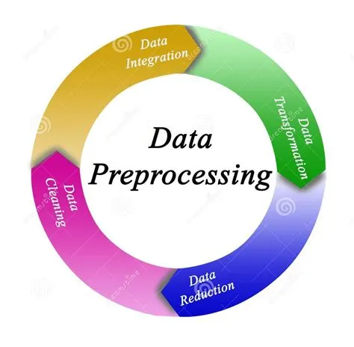

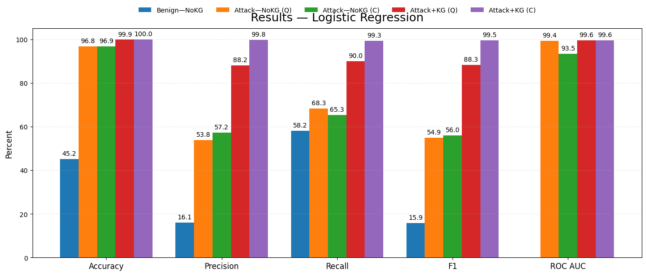

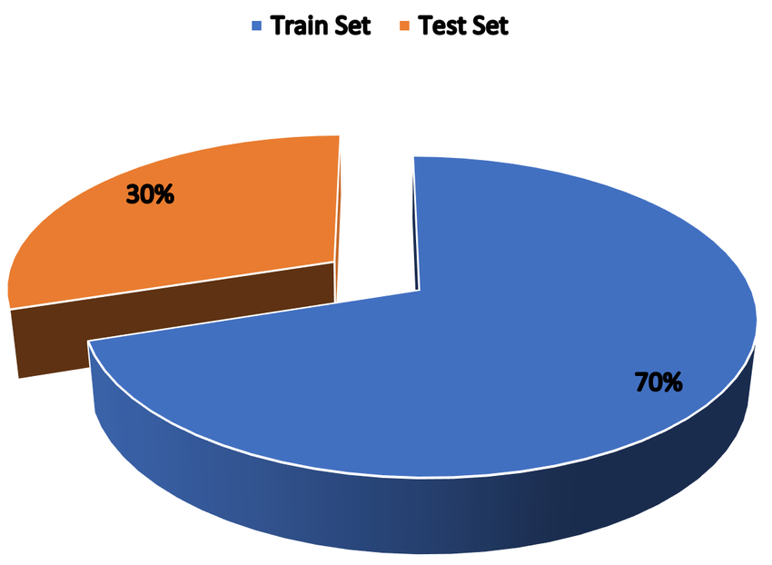
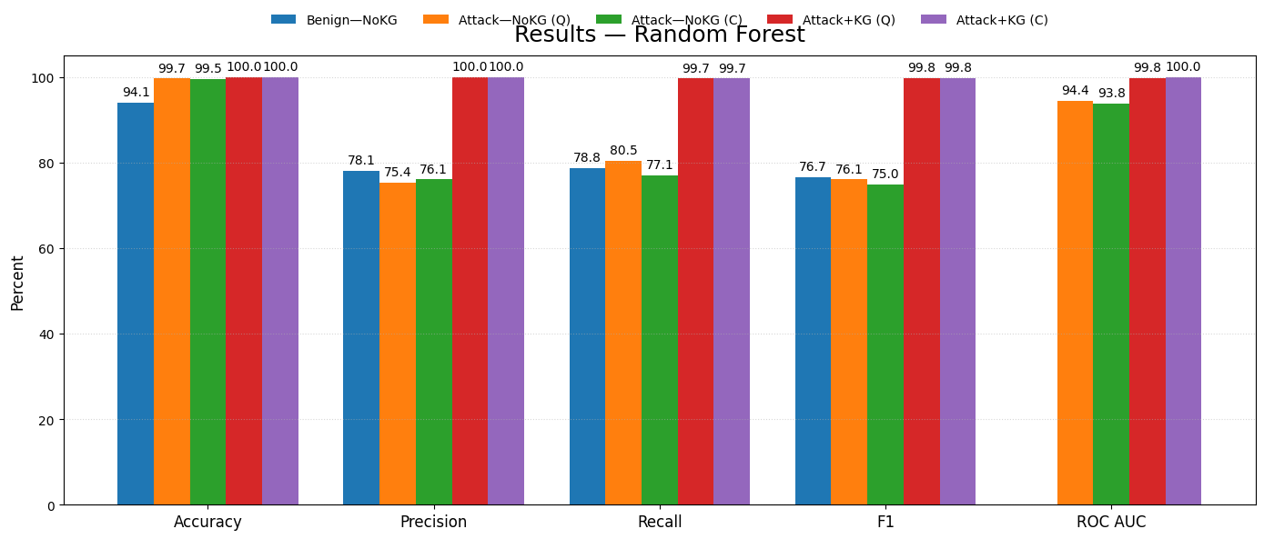

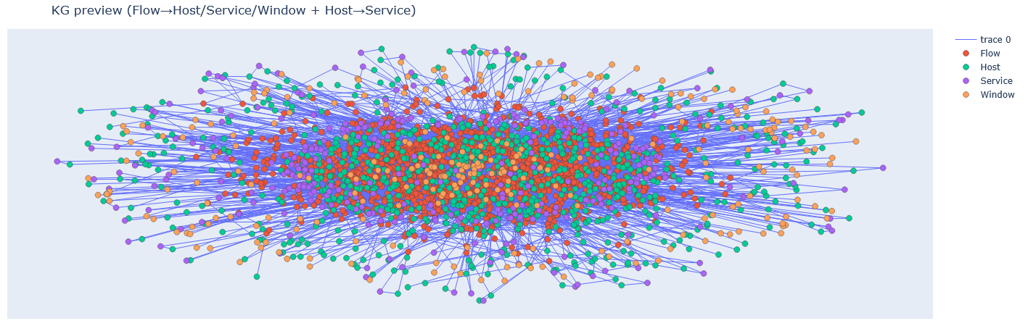
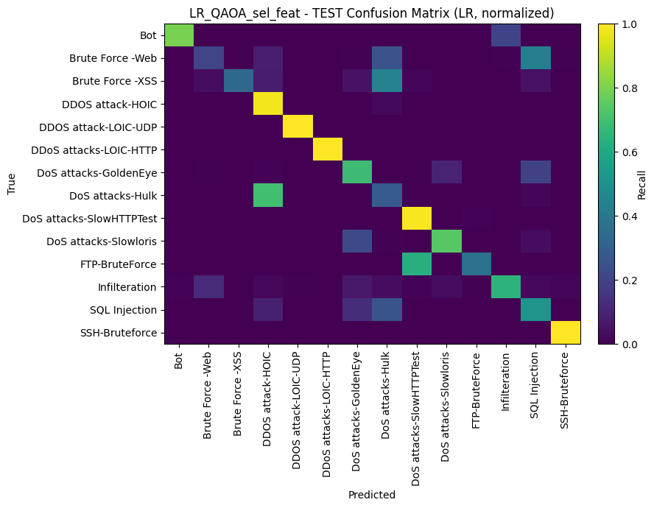
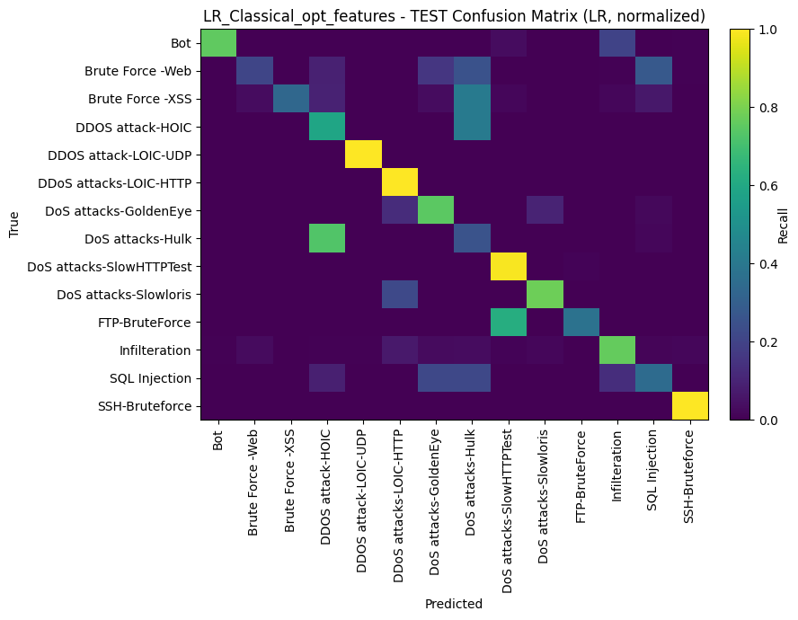

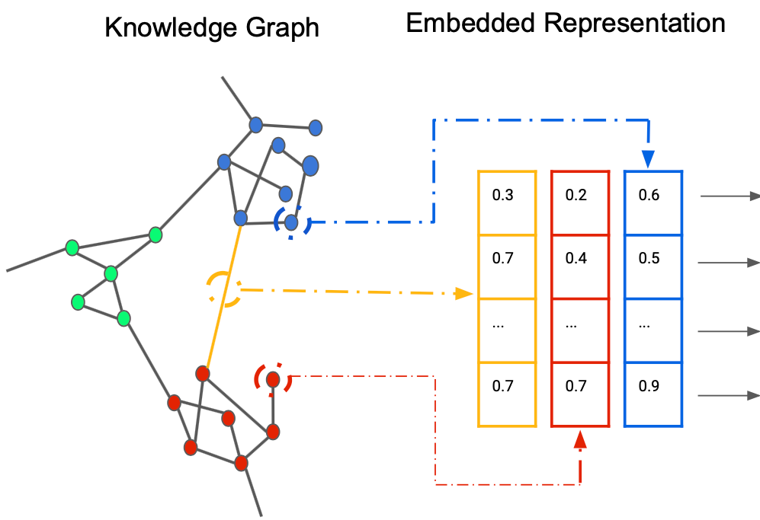
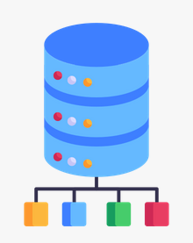
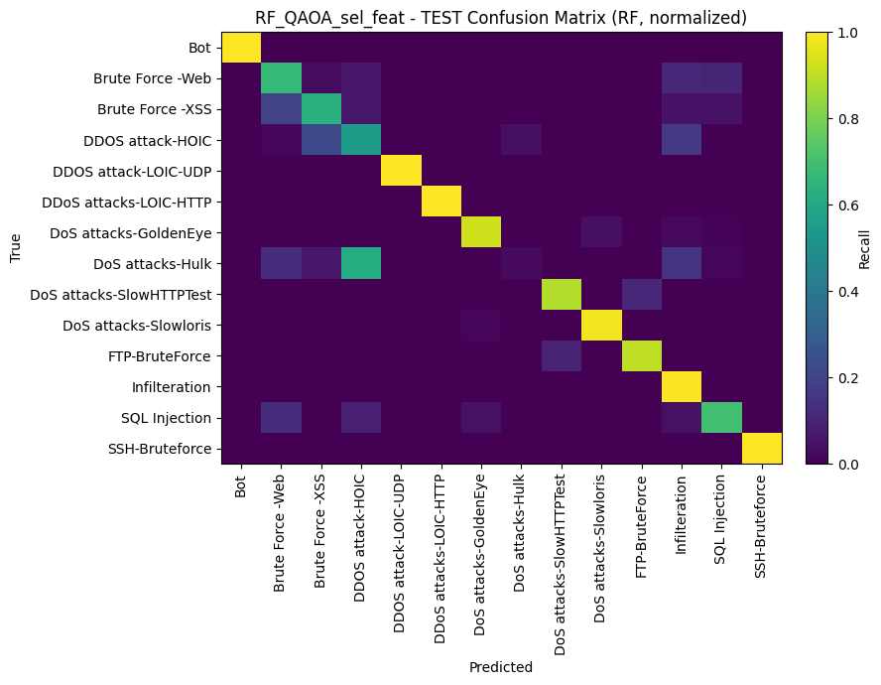
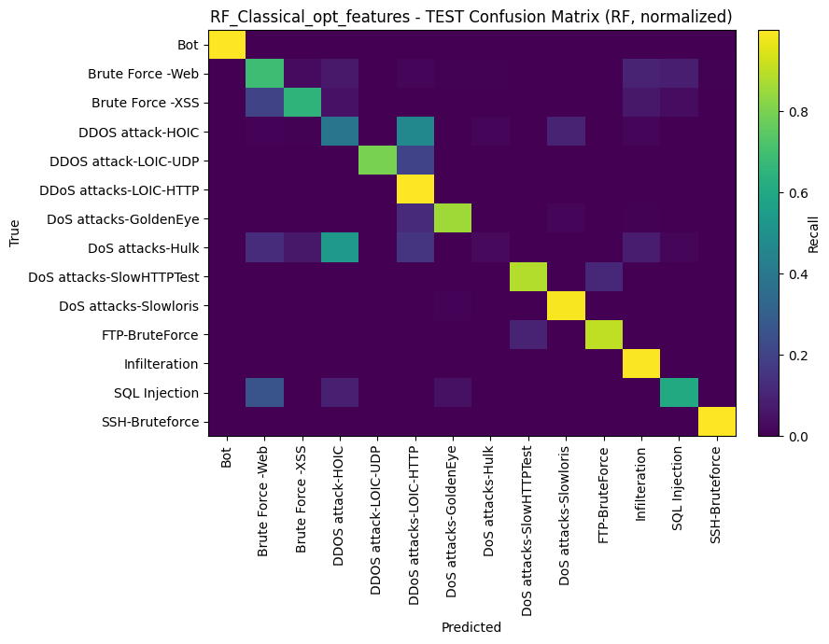

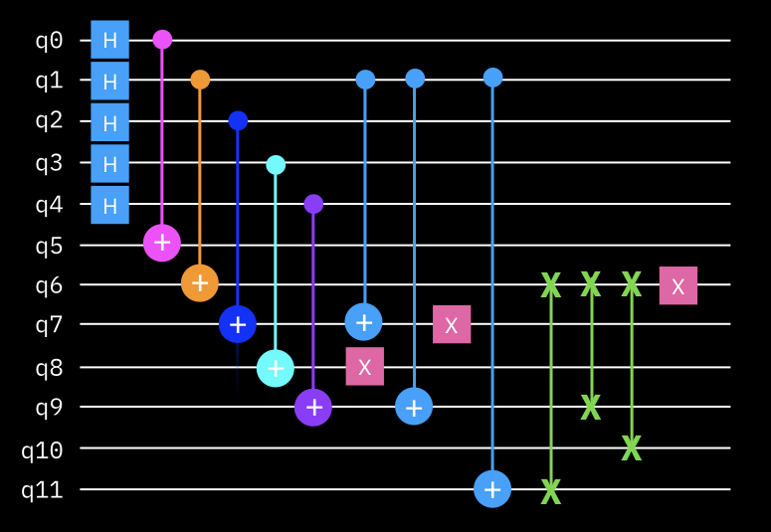
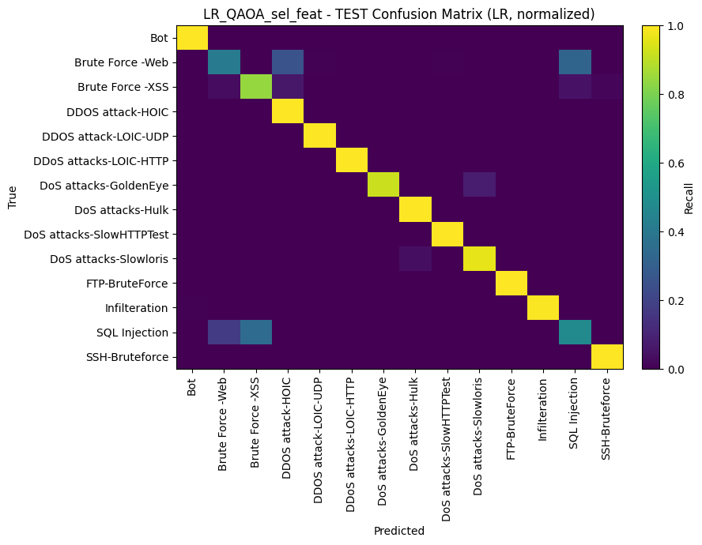
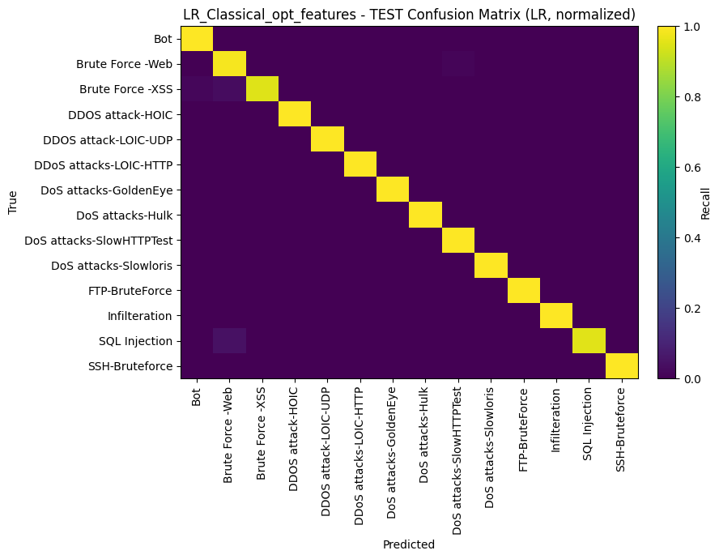

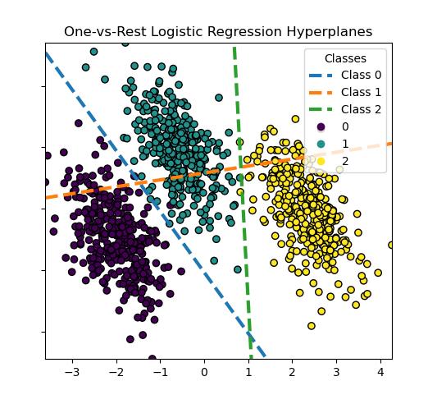
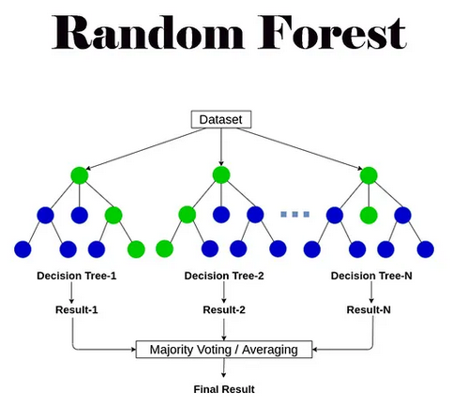
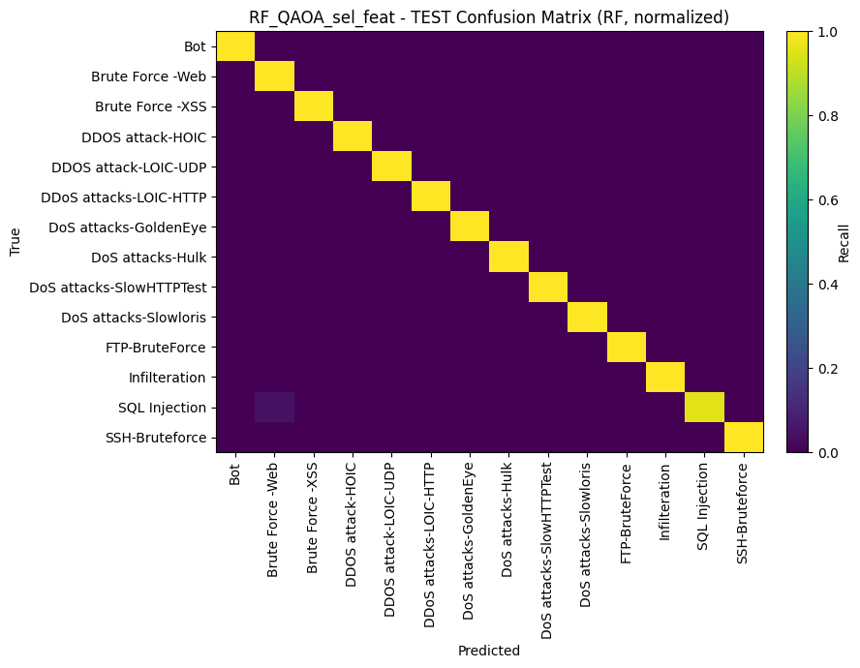



Improving Minority-Class Classification in Large,
Imbalanced Datasets
By:
Tom Steinman (University of Missouri-Kansas City)
Indraraj Biswas (University of Missouri-Kansas City)
Advisors: Yugyung Lee (Leeyu@umkc.edu)
Luke Miller (ljmbm5@umsystem.edu)
Introduction
Methodology
Results
Conclusion
Problem
Minority-class classification is difficult in large imbalanced datasets, causing misclassifications in classification models.
Motivation
In cybersecurity intrusion detection models, many attacks are rare.
Big datasets have very few examples of these rare, minority classes, so even good models miss them and can lead to blind spots in security monitoring.
Improving minority classification in cybersecurity is transferable to many domains, including healthcare, medical imaging, insurance, E-commerce, financial investments and more.
Goals
Improve minority-class detection without hurting other classes.
Add knowledge graph (KG) context to flows (who talks to whom, how often, how rare).
Compare methods with and without knowledge graph context.
Compare classical vs. quantum computing methods.
70/30 Train/Test Statified Split by time window
Comparison (10 Features)
Setup | Model | Selector | Acc% | Prec % | Rec% | F1 % | ROC AUC%
Benign – No KG | LR | Classical | 45.2 | 16.1 | 58.2 | 15.9 | —
Benign – No KG | RF | Classical | 94.1 | 78.1 | 78.8 | 76.7 | —
Attack only No KG | LR | Quantum | 96.8 | 53.8 | 68.3 | 54.9 | 99.4
Attack only No KG | LR | Classical | 96.9 | 57.2 | 65.3 | 56.0 | 93.5
Attack only No KG | RF | Quantum | 99.7 | 75.4 | 80.5 | 76.1 | 94.4
Attack only No KG | RF | Classical | 99.5 | 76.1 | 77.1 | 75.0 | 93.8
Attack only with KG | LR | Quantum | 99.9 | 88.2 | 90.0 | 88.3 | 99.6
Attack only with KG | LR | Classical | 100 | 99.8 | 99.3 | 99.5 | 99.6
Attack only with KG | RF | Quantum | 100 | 100 | 99.7 | 99.8 | 99.8
Attack only with KG | RF | Classical | 100 | 100 | 99.7 | 99.8 | 100
Create Knowledge Graph on Train Split
Logistic regression without KG features:
Quantum Features vs Classical Features
Dataset & Knowledge Graph
Dataset & Preprocessing
CSE-CIC-IDS2018, (15 classes, 14 attack classes, highly imbalanced) multi-class network flows.
Dataset size post processing: 10189072 Rows, 89 Columns
CSE-CIC-IDS2018 Preprocessed
Attack Label | Count | %
Benign | 9,540,178 | 93.63%
DDoS attacks-LOIC-HTTP | 569,454 | 5.59%
Infilteration | 34,581 | 0.34%
Bot | 24,590 | 0.24%
FTP-BruteForce | 2,526 | 0.025%
SSH-Bruteforce | 5,442 | 0.053%
DoS attacks-SlowHTTPTest | 2,755 | 0.027%
DoS attacks-Slowloris | 2,449 | 0.024%
DDOS attack-HOIC | 1,342 | 0.01%
DDOS attack-LOIC-UDP | 974 | 0.01%
DoS attacks-GoldenEye | 647 | 0.01%
Brute Force -Web | 410 | 0.004%
DoS attacks-Hulk | 198 | 0.0019%
Brute Force -XSS | 177 | 0.0017%
SQL Injection | 76 | 0.0007%
Dataset
Random Forest without KG features:
Quantum Features vs Classical Features
KG signals work: Graph and time-aware features improved separation of rare attack types compared to raw flow stats alone.
Quantum vs. classical selection: The quantum selector chose 3 of 10 KG-derived signals (classical chose 1 of 10), with a 6/10 overall overlap—showing strong agreement while elevating relational and temporal context.
Quantum selection delivered similar test results to the classical selector, indicating you can keep accuracy while biasing the feature set toward richer KG structure.
Takeaway:
For imbalanced problems where context matters, KG + quantum feature selection is a practical path to better minority-class detection. While quantum metrics were lower, combining features is simple. Quantum feature selection is cheap in comparison to many quantum computing methods. Combining classical and quantum features is an efficient way to improve classical methods.
Quantum and Classical Feature Selection
QUBO → Ising Hamiltonian → SparsePauliOp
Build QAOA circuit (Ansatz)
Estimator = optimize parameters
Sampler = sample subsets
Warm starts
Read quantum computing errors and mitigate
Decode and select features
Logistic Regression with KG features:
Quantum Features vs Classical Features
Why this transfers beyond cybersecurity:
Healthcare/imaging: Rare subtypes, time correlation
Insurance: Claim-network links expose organized fraud.
Finance: Trade patterns; trade anomalies; social media aspects as KG features.
Any imbalanced domain: KG + quantum boosts rare-event signal.
Future Plans:
Investigate further quantum methods such as a Quantum Neural Network (QNN) to evaluate efficacy of quantum feature selection.
Use knowledge graphs as a sanity check for models instead of additional features.
Apply to other domains.
Knowledge Graph
KG build: For each 5-minute window, make a Host↔Service graph and keep a short rolling history. Also add Host↔Host links when two hosts use the same service (H→S→H).
KG features: Popularity (degree), rarity (IDF), host–service association (PMI), time spikes (burstiness), and simple metapath counts over time. This data is appended to the dataset.
Quantum Feature Selection
Quantum search (QUBO → QAOA): the circuit tries different combinations of features, keeping the ones that give the best score (lowest “energy”).
Noise mitigation: we use error-reduction steps to reduce noise (twirling, XY4).
Compare Methods: Logistic Regression and Random Forest
Random Forest with KG features:
Quantum Features vs Classical Features
Acknowledgements
Special thanks to:
Dr. Yugyung Lee and Luke Miller in their guidance on this project.
Link : https://colab.research.google.com/drive/1DC8KBelVWDp3NdKmdVvaZvT0nKKpMgDr?usp=sharing

