Slide 1

Hackathon Submission · Team Crew1.0 · Ballari Institute of Technology & Management
ASSETMIND
AI-POWERED INDUSTRIAL ASSET INTELLIGENCE PLATFORM
Turning industrial maintenance data into evidence-backed decisions.
Industrial Intelligence. Reimagined.
Notes:
Introduce AssetMind as an AI-native platform that unifies industrial knowledge, predicts failures, and helps engineers make better maintenance decisions through conversational intelligence. This is a working hackathon build, not a mockup — every number on this deck comes from the live system.

Slide 2

THE PROBLEM
Maintenance teams don't have a data problem.
They have an intelligence problem.
INDUSTRY IMPACT
$50B+
Critical knowledge exists. It just isn't connected.
lost annually to unplanned industrial downtime
CMMS Records
Excel Sheets
PDF OEM Manuals
42%
Incident Logs
Inspection Reports
Tribal Knowledge
of unplanned downtime stems from failures that could have been predicted or prevented
Fragmented across systems → slow, reactive decision-making.
Data without intelligence creates downtime.
ASSETMIND
02 / 10
Notes:
Explain how industries already possess enormous amounts of maintenance data, but it remains fragmented across disconnected systems, making decision-making slow and reactive. Cite the $50B downtime figure and the 42% preventable-failure statistic from industry research.

Slide 3
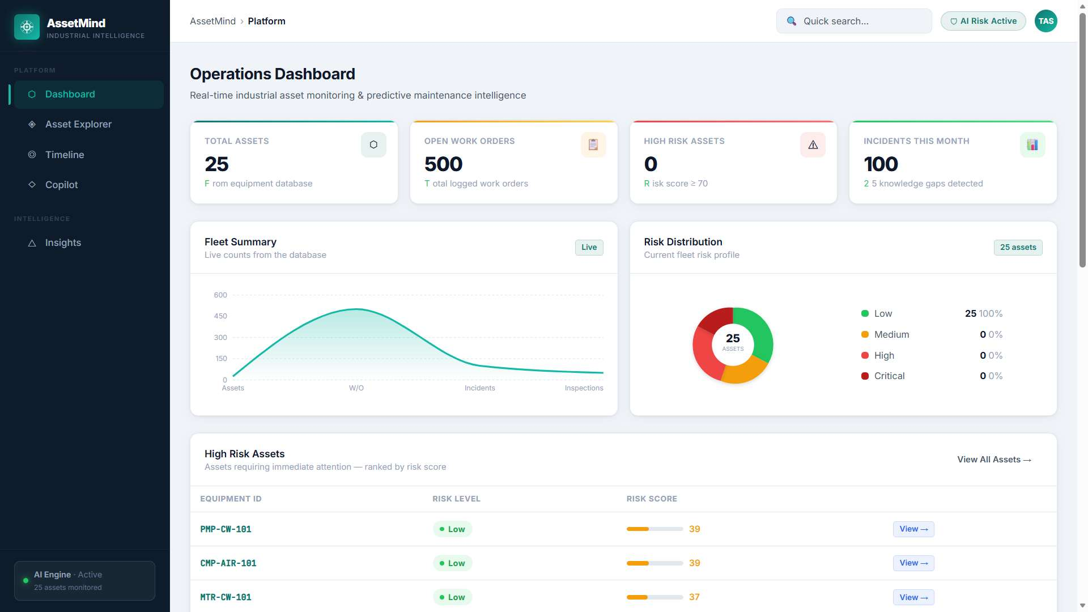
MEET ASSETMIND
One platform. Every answer.
A unified intelligence layer combining structured records, OEM documentation, machine learning, and a conversational AI copilot.
Real-time PostgreSQL-backed dashboard — fleet KPIs, risk distribution, and knowledge gap alerts.
One AI platform connecting every maintenance decision.
03 / 10
Notes:
Introduce AssetMind as a unified intelligence layer combining structured records, OEM documentation, machine learning, and conversational AI. This screenshot is the actual Operations Dashboard rendered from the live React + FastAPI + PostgreSQL stack — 25 real assets, 500 work orders, 100 incidents.

Slide 4







ARCHITECTURE
From Data to Decisions
Every maintenance question follows one evidence-grounded pipeline.
React 19 SPA
FastAPI
PostgreSQL 15
ChromaDB
ML Models
Sarvam AI 105B
Maintenance Engineer
›
›
›
›
›
›
Dashboard · Copilot · Insights
5 routers · CORS · Pydantic v2
25 assets · 500 WOs · 100 incidents
9 OEM manuals · 384-dim vectors
Random Forest · XGBoost
Grounded LLM reasoning
Evidence-backed recommendation
Every answer is evidence-backed.
17 REST endpoints across equipment, dashboard, insights, predict, and ask routers.
ASSETMIND
04 / 10
Notes:
Walk through how frontend requests travel through FastAPI, relational data, vector search, predictive models, and the LLM before producing grounded recommendations. The backend registers five routers — equipment, dashboard, insights, predict, ask — all documented with 17 total endpoints.

Slide 5




AI CAPABILITIES
Four AI capabilities. One platform.
AI Copilot
RAG Engine
POST /ask/copilot
POST /ask/
Hybrid RAG + PostgreSQL + Sarvam AI 105B. Natural-language troubleshooting grounded in real equipment history and OEM manuals.
9 OEM manuals chunked (800 chars, 100 overlap) and embedded with all-MiniLM-L6-v2 into ChromaDB for instant manual search.
Predictive Maintenance
Knowledge Gap Detection
POST /predict/*
GET /insights/knowledge-gaps
Random Forest predicts failure probability (UCI AI4I); XGBoost estimates Remaining Useful Life (NASA CMAPSS FD001).
Correlates inspection risk scores ≥ 75 with incident history to surface preventable failures before they recur.
AI that doesn't just answer questions — it prevents failures.
05 / 10
Notes:
Briefly explain how each capability works together to support maintenance engineers in real-world industrial environments — the Copilot for conversation, RAG for manual lookup, ML for prediction, and Knowledge Gap Detection for prevention.

Slide 6
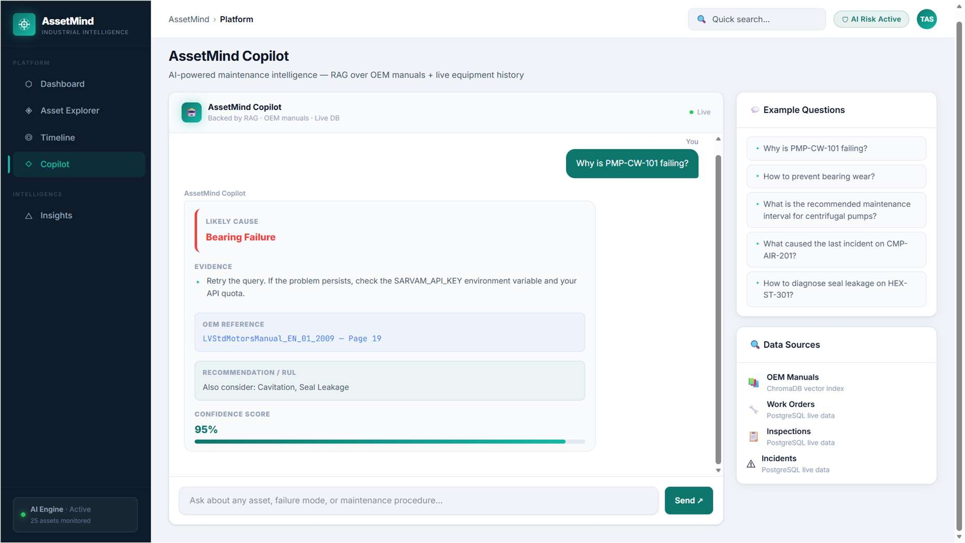
LIVE WORKFLOW
Ask one question. Activate every layer.
"Why is Pump PMP-CW-101 failing?"
1
SQL retrieves maintenance history (incidents, inspections, work orders)
2
ChromaDB searches OEM manuals — top-8 chunks by cosine similarity
3
ML models score failure probability against equipment baselines
4
Sarvam AI 105B reasons over combined evidence (12,000-char context)
5
Structured recommendation returned with citations
Actual AI Copilot response — 95% confidence, evidence cited from inspection records.
Every recommendation is backed by data, documentation, and AI.
ASSETMIND
06 / 10
Notes:
Demonstrate how a single natural-language query activates every component of the platform. The confidence formula starts at 0.50 and adds weighted evidence: +0.05 per incident, +0.03 per inspection, +0.02 per manual citation, capped at 0.95.

Slide 7
TECHNOLOGY STACK
Built with Modern AI Infrastructure
Production-ready architecture from frontend to AI — every layer chosen for performance and reliability.
Frontend
Backend
AI / Retrieval
Machine Learning
React 19.2
FastAPI
ChromaDB
scikit-learn
Vite 8
SQLAlchemy
Sentence-Transformers
Random Forest
Tailwind CSS 4
Pydantic v2
all-MiniLM-L6-v2
XGBoost
Recharts 3.8
PostgreSQL 15
Sarvam AI 105B
pypdf
Axios 1.18
LangChain
Framer Motion 12
Containerised deployment · clear tier separation · stateless ML serving.
07 / 10
Notes:
Highlight the modern, scalable technology stack and explain why each technology was chosen — React 19 and Vite 8 for fast frontend iteration, FastAPI for async-first APIs, ChromaDB and Sentence-Transformers for semantic retrieval, and dual ML pipelines for prediction.

Slide 8
IMPACT
Built for Industrial Scale
Real operational data, ingested and reasoned over by a unified platform.
25+
500+
100+
50+
Industrial Assets
Work Orders
Incident Reports
Inspection Reports
9
2
17
1
OEM Manuals
ML Models
API Endpoints
Unified Platform
Reactive Maintenance → Predictive Intelligence
ASSETMIND
08 / 10
Notes:
Show how AssetMind integrates multiple real data sources and two trained AI models into one cohesive platform — 25 assets, 500 work orders, 100 incidents, 50 inspections, 9 OEM manuals, and 17 documented API endpoints, all capable of supporting large-scale industrial operations.

Slide 9





FUTURE VISION
Where AssetMind Goes Next
Today's platform. Tomorrow's autonomous maintenance ecosystem.
IoT Sensors
Digital Twin
SAP PM Integration
→
→
MQTT / OPC-UA real-time streams
Forward-looking degradation models
Sync with existing CMMS investments
Multi-Agent Orchestration
Edge AI Deployment
Predictive Scheduling
→
→
Planner, retrieval, reasoning agents
ONNX inference at the PLC gateway
Auto-generated work orders from RUL
A roadmap toward autonomous industrial intelligence.
09 / 10
Notes:
Present the future vision of expanding AssetMind with real-time IoT, enterprise SAP integration, digital twins, and autonomous multi-agent AI — all already scoped in the technical roadmap, alongside authentication, voice interfaces, and an expanded OEM knowledge base.

Slide 10

"The future of maintenance isn’t more data.
It's better decisions."
ASSETMIND
AssetMind is building the future of industrial intelligence.
Thank You
github.com/tasneem38/AssetMind
Notes:
Close by reinforcing that AssetMind is more than a maintenance platform — it's the foundation of an AI-powered industrial operating system that transforms how organizations manage assets and make critical decisions. Thank the judges and open the floor for questions.

