Slide 1
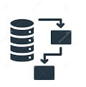
İn this package I create two Data flow - one for dimension - one for fact table
Bi task
Created by : Tasneem Ahmed

Slide 2
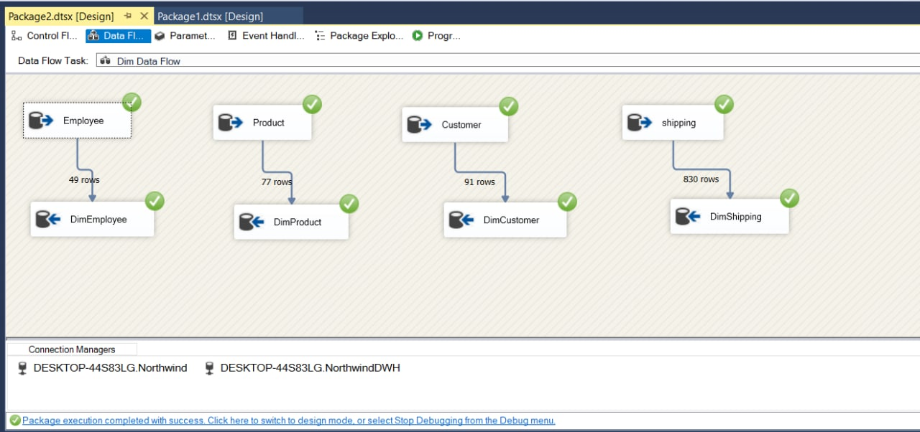
Dim Data Flow

Slide 3
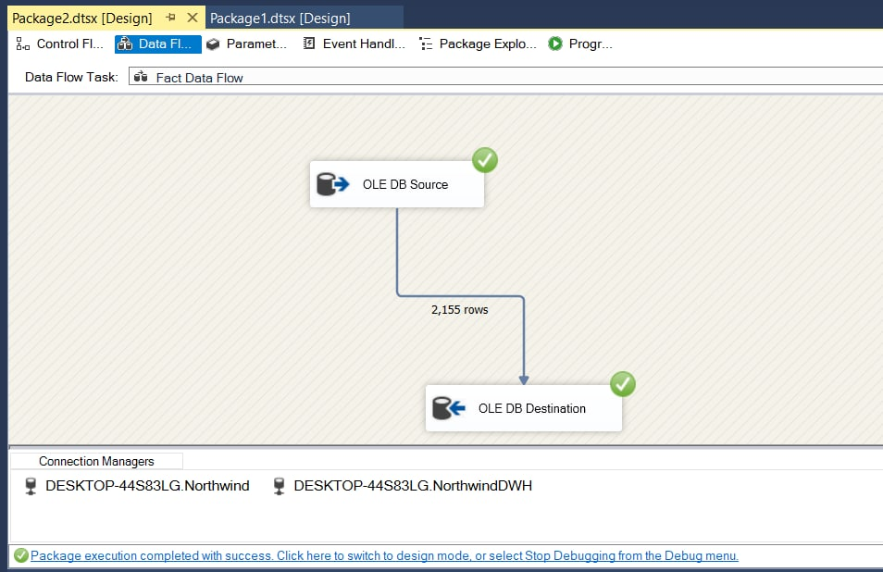
Fact table Data Flow

Slide 4
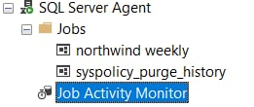
Finally I create a job called north wind weekly

Slide 5
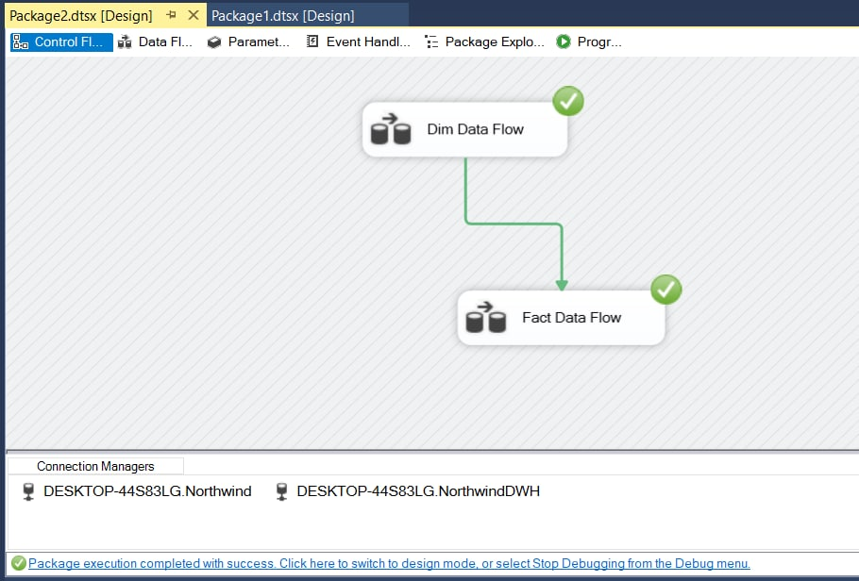

Slide 6
End

