Slide 1
Data structure project report
Library Manegement System

Slide 2
Book class
The Book class in Java represents a book within a library system. It encapsulates various attributes of a book, such as its title, author name, category, ISBN, publication year, number of available copies, borrowability status, price, and due date. The class provides multiple constructors to accommodate different scenarios of creating a book object. It also includes getter and setter methods for accessing and modifying the book's attributes, facilitating proper encapsulation.
Additionally, the class overrides the toString method to provide a formatted string representation of a book's details, and the equals method to compare books for equality based on their attributes. The DisplayBook method offers a concise display of essential book information.
One notable aspect is the use of the LocalDate class for representing the due date, providing support for modern date handling in Java. The setPrice method, marked with UnsupportedOperationException, indicates that the price setting operation is not supported, potentially intended for future modifications or restrictions in the class behavior. Overall, the Book class serves as a flexible and comprehensive model for managing book data within a library system.

Slide 3
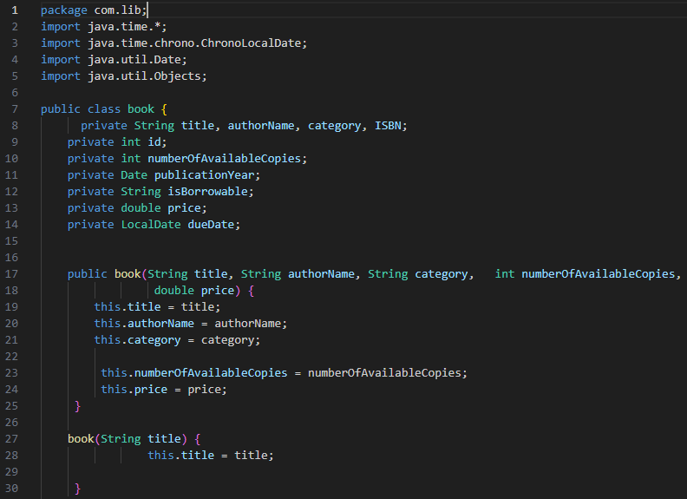

Slide 4
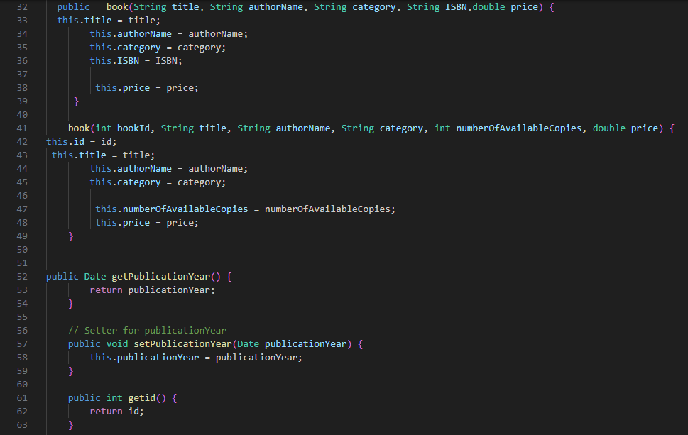

Slide 5
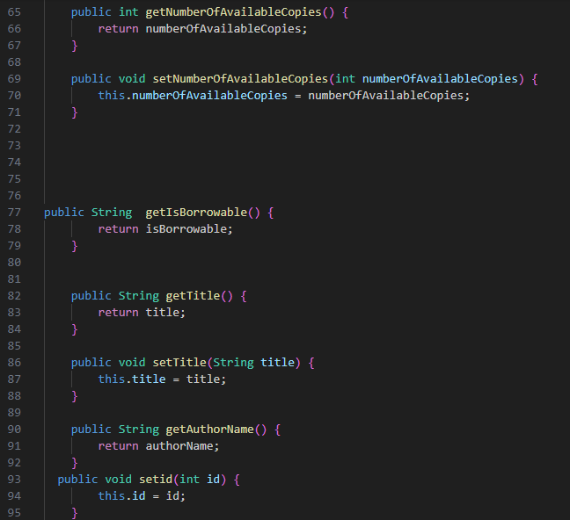

Slide 6
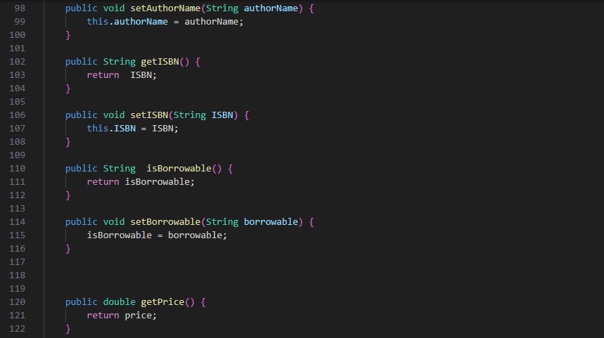

Slide 7
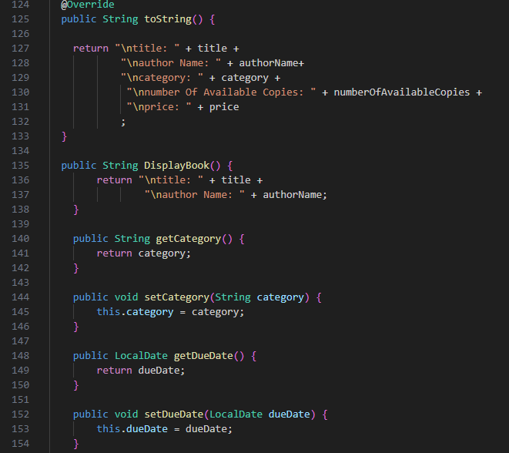

Slide 8
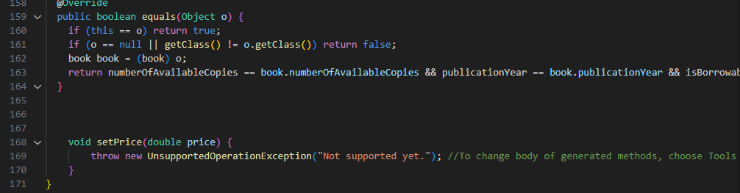

Slide 9
Catalog class
The Catalog class in Java serves as a catalog for managing books in a library system. It contains an inner class named catalog that encapsulates the functionality of the catalog. The catalog maintains a linked list of Book objects, and the class provides methods for adding a book (addBook), updating book details both in-memory and in the connected database (updateBookDetails), and searching for a book by its ISBN (searchBook). The in-memory catalog enables efficient retrieval and manipulation of book data, and the updateBookDetails method ensures synchronization of changes between the in-memory catalog and the underlying database. The database connection is established using JDBC with connection details specified in constants (URL, USER, PASSWORD). Additional methods can be added to the catalog class as needed, providing a modular and organized structure for managing book-related operations within the library system.

Slide 10
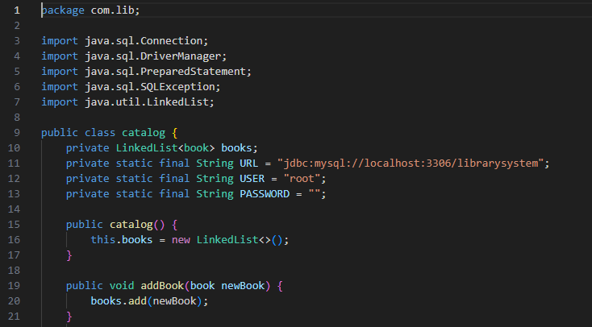

Slide 11
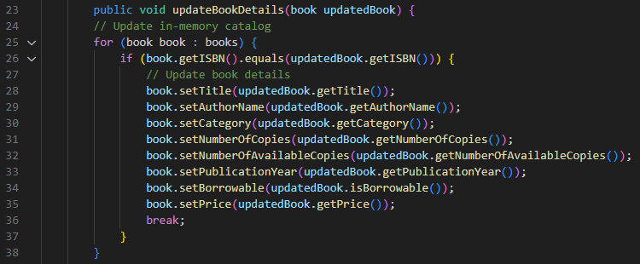

Slide 12
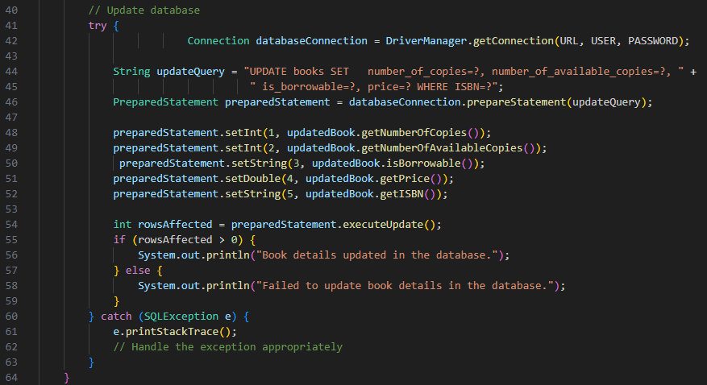

Slide 13
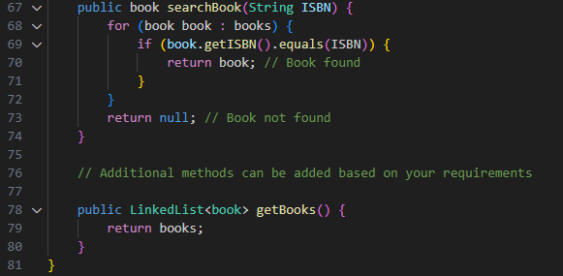

Slide 14
Database connection
The DataBase class in Java serves as a utility class for handling database operations related to the library project. It establishes a connection to a MySQL database using JDBC and provides methods for inserting new book records (Insert_into_books_table), updating book details (updateBookDetailsInDatabase), and deleting books from the database (deleteBookFromDatabase). The class follows the singleton pattern by maintaining a single static connection instance to the database throughout its lifecycle, ensuring efficiency in resource usage. The getConnection method returns the existing connection or creates a new one if it doesn't exist, and the closeConnection method allows for closing the database connection when necessary. Overall, the class encapsulates database interactions specific to the library system, promoting modular and organized code for database-related tasks.

Slide 15
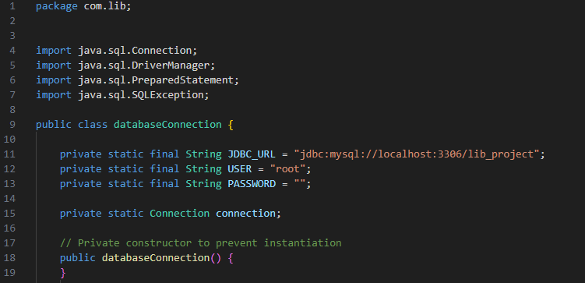

Slide 16
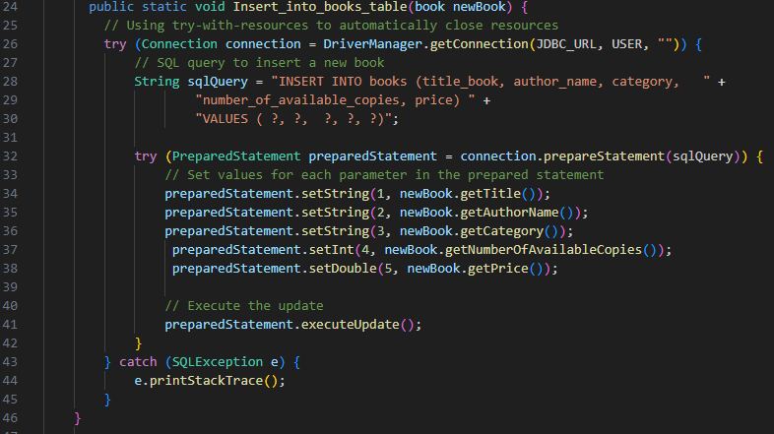

Slide 17
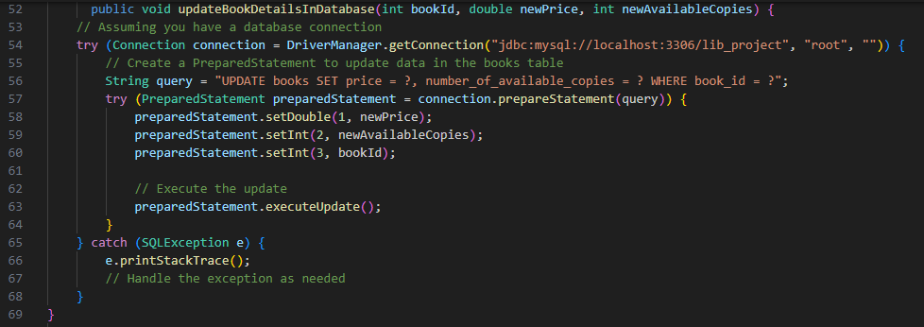

Slide 18
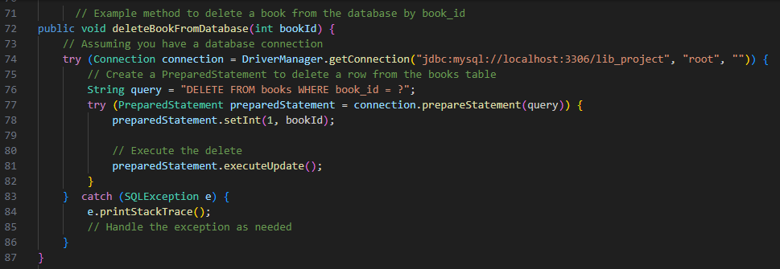

Slide 19
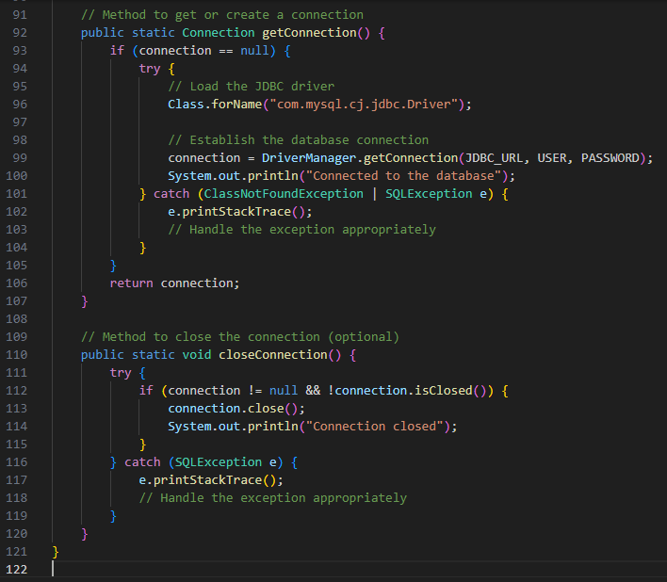

Slide 20
Linked list class
The LinkedList class in Java represents a singly linked list, a data structure composed of nodes where each node contains an item and a reference to the next node in the sequence. This linked list implementation includes basic operations such as retrieving an element at a given index (get), determining the index of a specified item (getIndexOf), inserting an item at the end of the list (insert), removing an item from the list (remove), checking if the list contains a specific item (contains), checking if the list is empty (isEmpty), and finding the middle node of the list (getMiddle). Additionally, the class provides methods for performing merge sort on the linked list, both based on book titles (mergeSort) and ISBNs (mergeSortISBN). The merging process is customized to compare and sort elements of type Book or User. The toString method generates a string representation of the linked list for convenient output. Overall, this class facilitates the manipulation and sorting of data in a linked list structure.

Slide 21
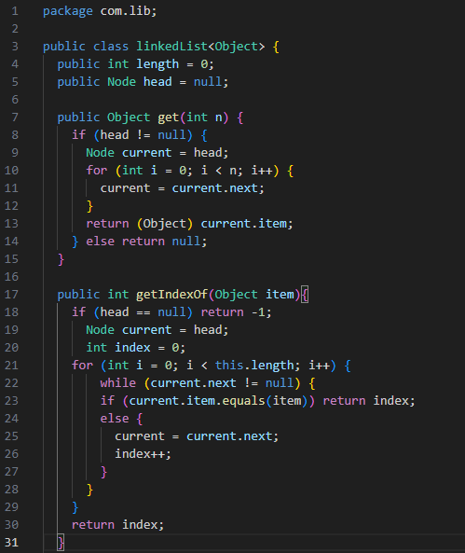

Slide 22
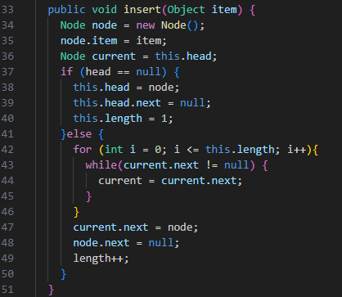

Slide 23
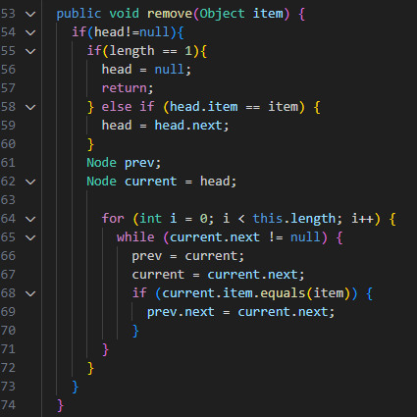

Slide 24
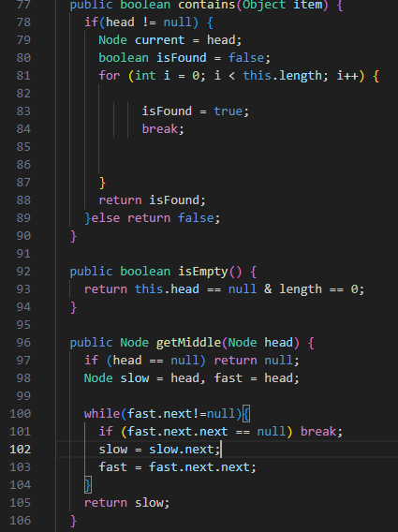

Slide 25
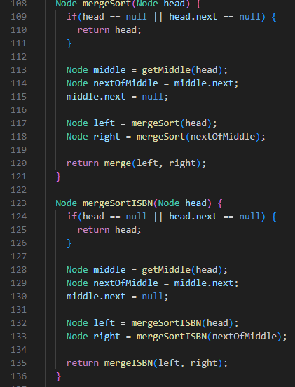

Slide 26
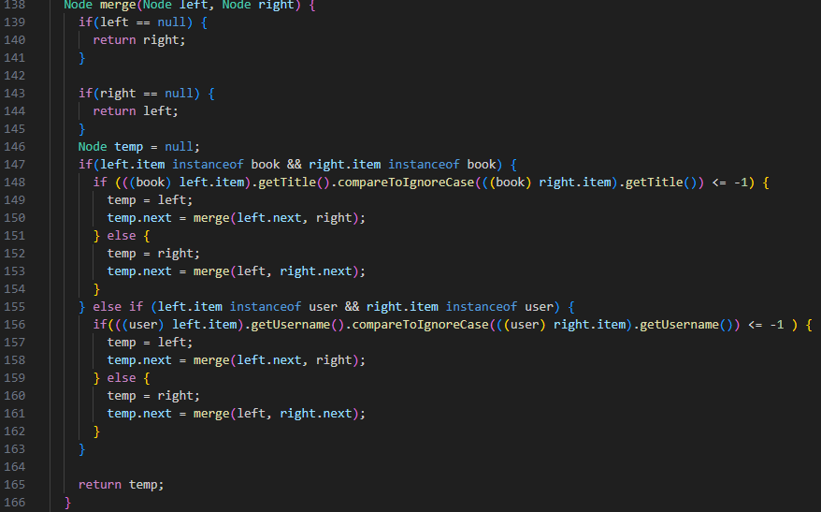

Slide 27
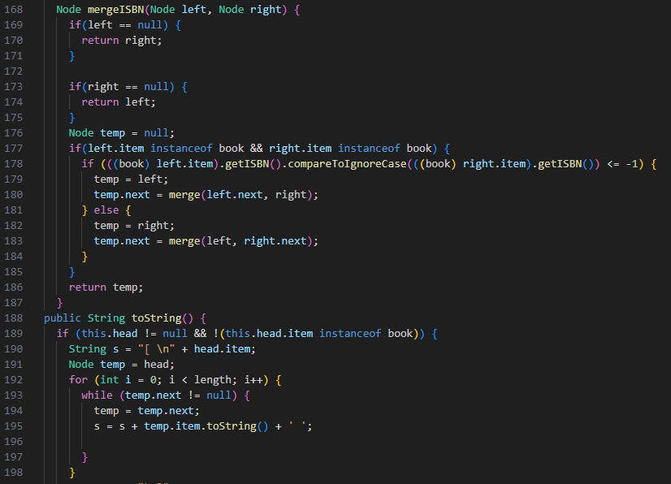

Slide 28
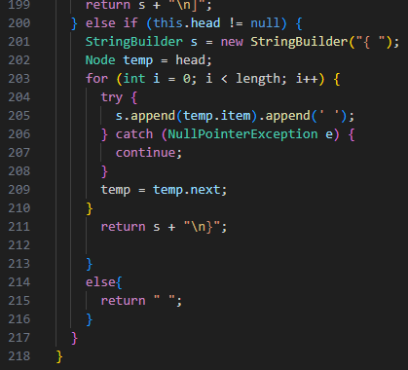

Slide 29
Loan class
The Loan class is a Java class that extends another class named User. It represents a loan transaction in a library system, capturing various details related to both the user and the book being borrowed. The class includes fields such as bookId, title, author, category, ISBN, price, dateBorrowed, dateReturned, and daysBorrowed to store information about the book and the loan period. Two constructors are provided to accommodate different ways of initializing the object, one using LocalDate for date representation and the other using Date for compatibility with older code. The class also includes getter and setter methods for accessing and modifying the private fields. Additionally, there is a method displayLoanDetails that prints out a formatted display of the loan information, and the toString method overrides the default toString implementation to provide a string representation of the object. Note that the class contains fields for user information, such as username, email, password, and mobile, but these fields are not initialized in the constructors, and their values are not used in the toString or displayLoanDetails methods. If user information is essential, it may need to be initialized and utilized accordingly in the class methods.

Slide 30
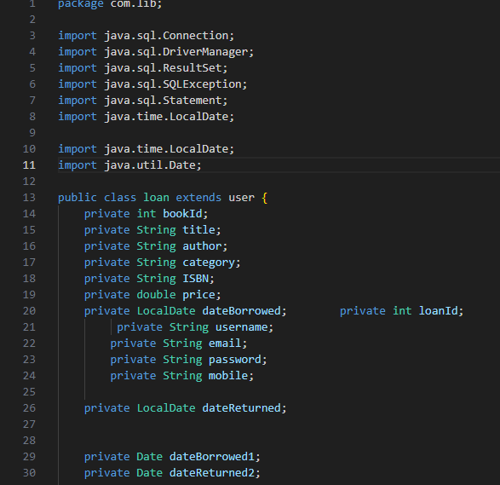

Slide 31
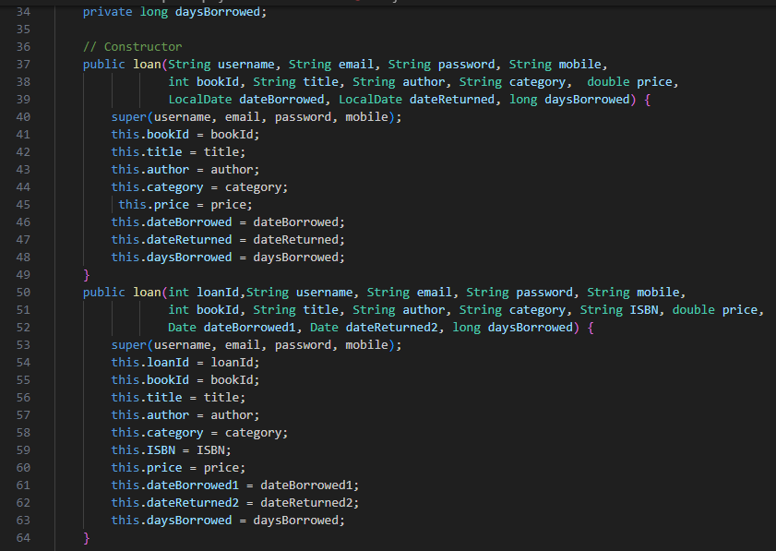

Slide 32
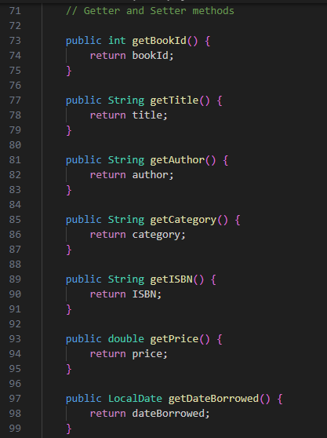

Slide 33
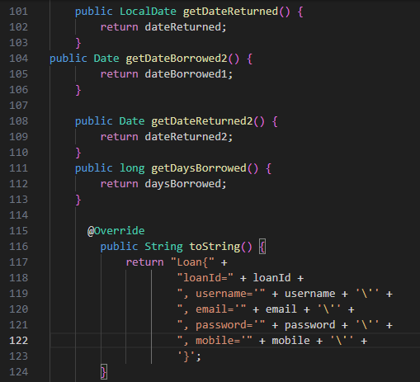

Slide 34
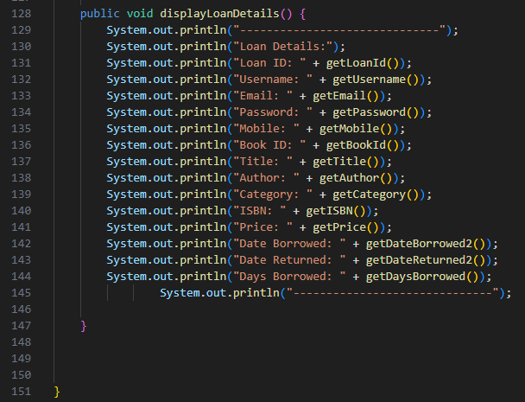

Slide 35
Merge sort books price
The MergeSortBooksprice class in Java implements the merge sort algorithm specifically tailored for a list of Book objects. The class contains a merge method responsible for merging two sublists of booksList during the sorting process. It calculates the sizes of the two sublists, creates temporary lists (leftList and rightList) to hold the sublists, and then iterates through both sublists, comparing the prices of books. It merges the sublists back into the main list (booksList) in ascending order of book prices. The class leverages indices i, j, and k to traverse the left sublist, right sublist, and the main list, respectively. This implementation ensures that the original booksList is sorted based on the price attribute of the Book objects. It's important to note that this class assumes the existence of a Book class with a getPrice method, and the sorting is done in ascending order.

Slide 36
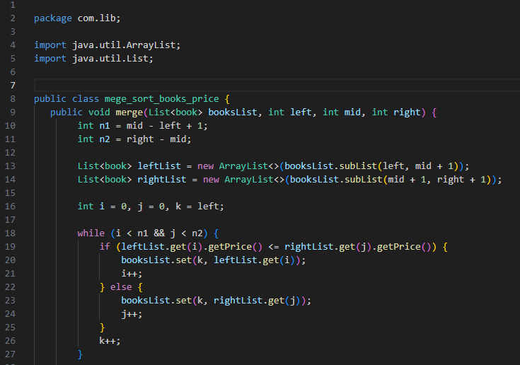

Slide 37
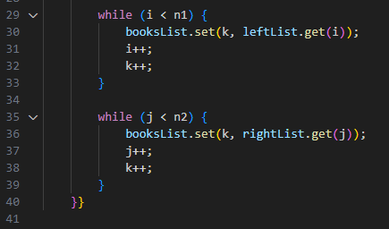

Slide 38
Node class
The Node class is a basic implementation of a singly linked list node in Java. Each node in the linked list contains an item of type Object and a reference to the next node in the sequence (next). The equals method is overridden to compare two Node objects for equality. In the overridden equals method, the equality is checked based on both the item and the next reference of each node. The equals method first compares the item of the current node with the item of the provided node and then recursively compares the next references. This implementation ensures that two nodes are considered equal if their corresponding items and the structure of subsequent nodes in the linked list are identical. It's worth noting that for this equality check to work correctly, the equals method of the Object class must be properly implemented for the type of objects stored in the item field. Additionally, this implementation assumes that the linked list is singly linked, meaning each node points to the next node but not the previous one.

Slide 39
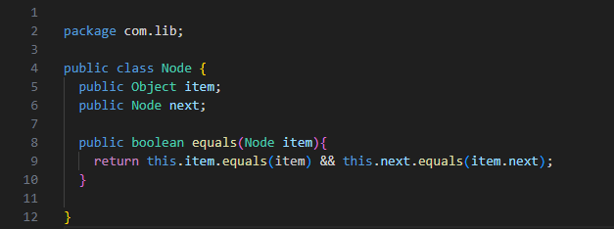

Slide 40
Request class
The Request class in Java represents a user's request to borrow a book in a library system. It has private fields for the requesting user's username, the desired title of the book, and the date when the request is made, stored as a LocalDate object. The class provides a constructor that initializes the username, title, and date based on the parameters passed during object creation. Accessor and mutator methods (getUsername, setUsername, getTitle, setTitle, getDate, and setDate) are included to retrieve and modify the values of these fields. Additionally, the class overrides the toString method to generate a formatted string representation of the request, including the username, book title, and date. Overall, the Request class encapsulates the essential information related to a user's request for a book, providing a clear and organized way to manage and display request details within a library system.

Slide 41
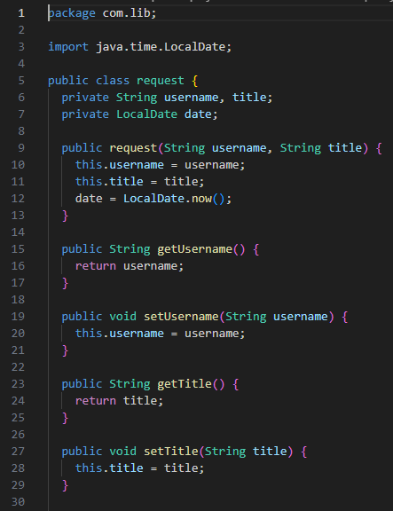

Slide 42
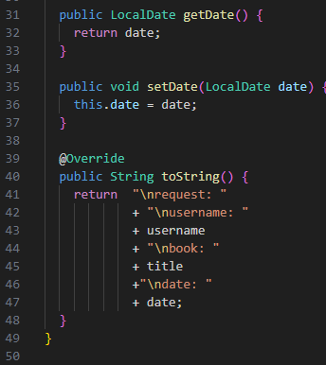

Slide 43
Search class
The Search class in Java appears to be a simple class with a private field, scanner, which is an instance of the Scanner class. The Scanner class is commonly used to obtain user input from the console. However, as it stands, the Search class itself does not contain any specific functionality or methods. It may be intended to be extended or used as a utility class for handling search-related functionality in a larger program. The absence of methods or further implementation details makes it challenging to provide a comprehensive explanation of the class's purpose. To enhance its functionality, one might consider adding methods for handling different search operations, taking advantage of the Scanner instance for user input.

Slide 44
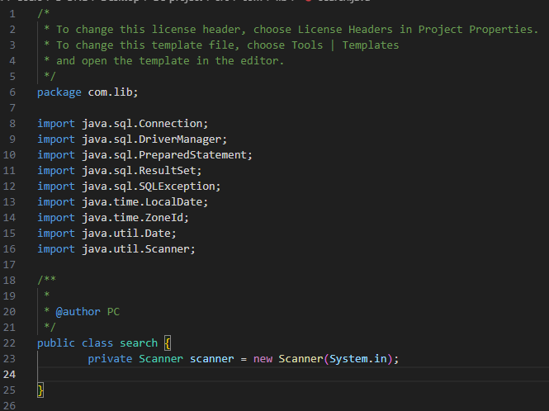

Slide 45
Sort members by name class
The SortMembersByName class in Java is designed to retrieve user information from a database table named book_you_are_borrowed and sort the users based on their usernames. The class establishes a connection to a MySQL database, executes a SQL query to retrieve user data, and then constructs User objects with the fetched information. The users are stored in a List<User> named users. Subsequently, the class utilizes the Collections.sort method along with a Comparator to sort the user list based on their usernames in ascending order. The sorting logic is specified using the Comparator.comparing(User::getUsername) expression, indicating that the sorting should be done based on the getUsername method of the User class. The sorted list of users is then returned. It's important to note that this class assumes the existence of a User class with appropriate methods for retrieving and comparing usernames. Additionally, it relies on a specific database schema and connection details for the book_you_are_borrowed table in the MySQL database.

Slide 46
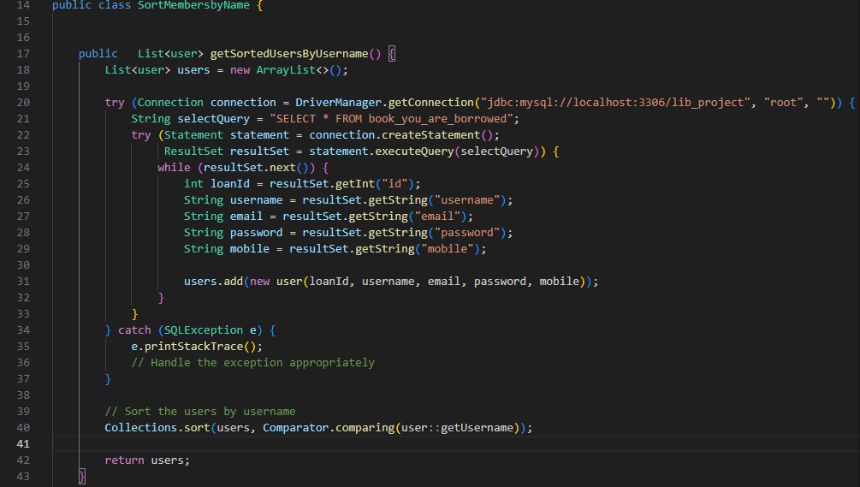

Slide 47
Start page class
The StartPage class in Java is designed to serve as the entry point for a simple library system. It contains a nested public class named start_page with a main method. The main method utilizes Swing's JOptionPane to display a welcome message to the user. It then enters a perpetual loop where the user is presented with a dialog box prompting them to choose an option: "library Interface," "user (member) Interface," or "Exit." Depending on the user's choice, the program either invokes the runMemberInterface method (assuming it is intended to be part of the StartPage class), exits the program with a goodbye message, or displays an error message for an invalid choice. However, there seems to be a logical issue in the code where both the "library Interface" and "user (member) Interface" options lead to the same method (runMemberInterface). This may need to be corrected based on the intended behavior. Additionally, it's worth noting that the perpetual loop could potentially lead to an infinite execution, and a mechanism to exit the loop (and the program) is triggered only by the "Exit" option.

Slide 48
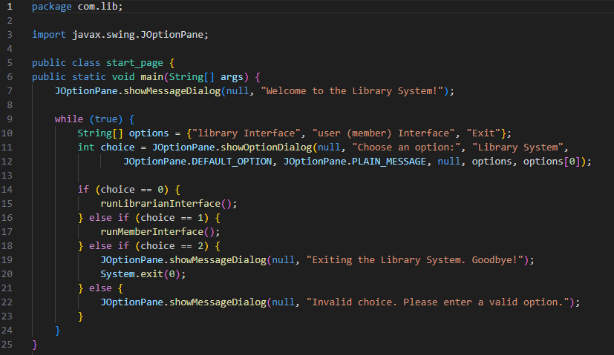

Slide 49
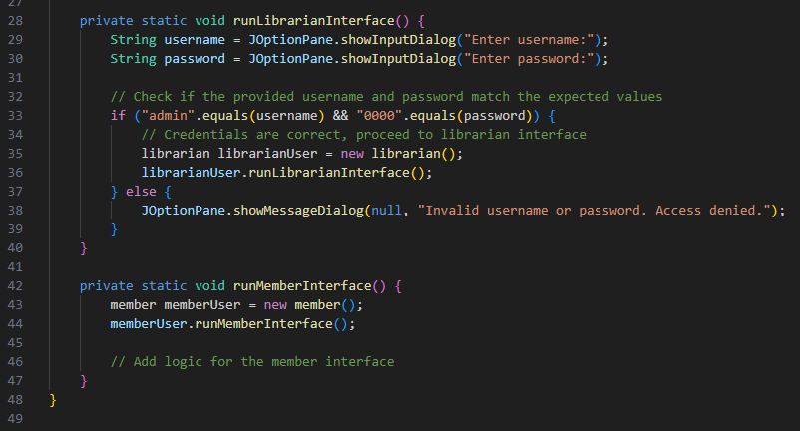

Slide 50
User class
The User class in Java represents a user within a library system, with attributes including a unique loan identifier (loanId), a username, email, password, and mobile number. The class provides two constructors—one for creating a user without a loan identifier and another for a user with a loan identifier. It includes getter and setter methods for each attribute, allowing for the retrieval and modification of user information. The toString method is overridden to generate a string representation of a user, including details such as loan ID, username, email, password, and mobile number. This class serves as a basic structure for storing and managing user information within a library system, providing a convenient way to encapsulate and manipulate user date

Slide 51
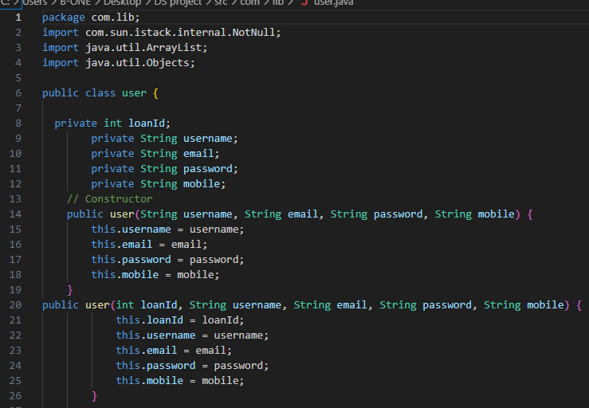

Slide 52
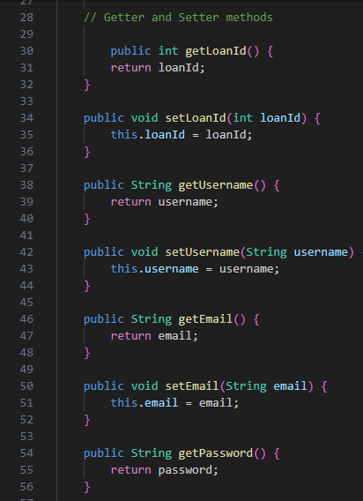

Slide 53
