Slide 1

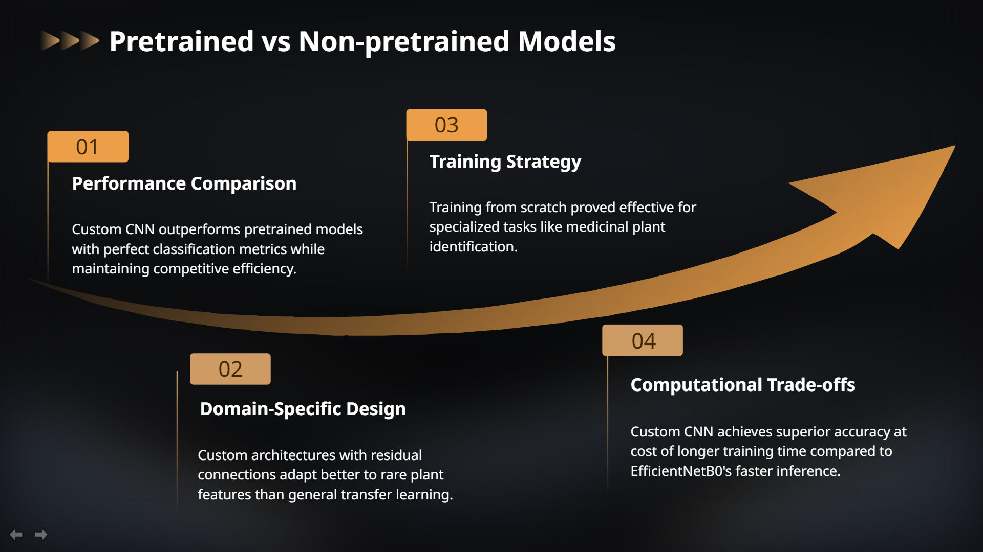
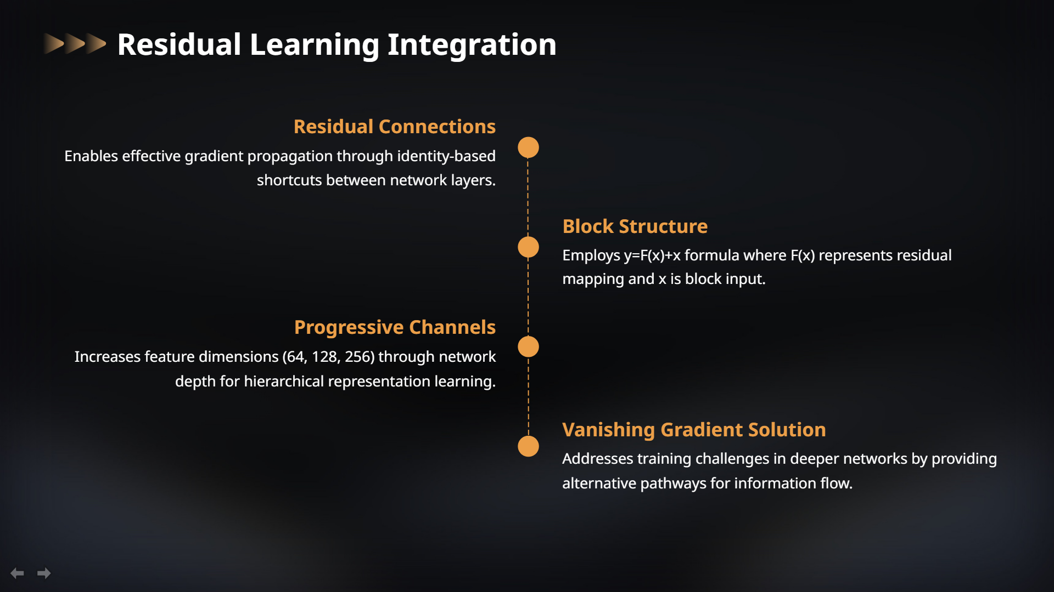
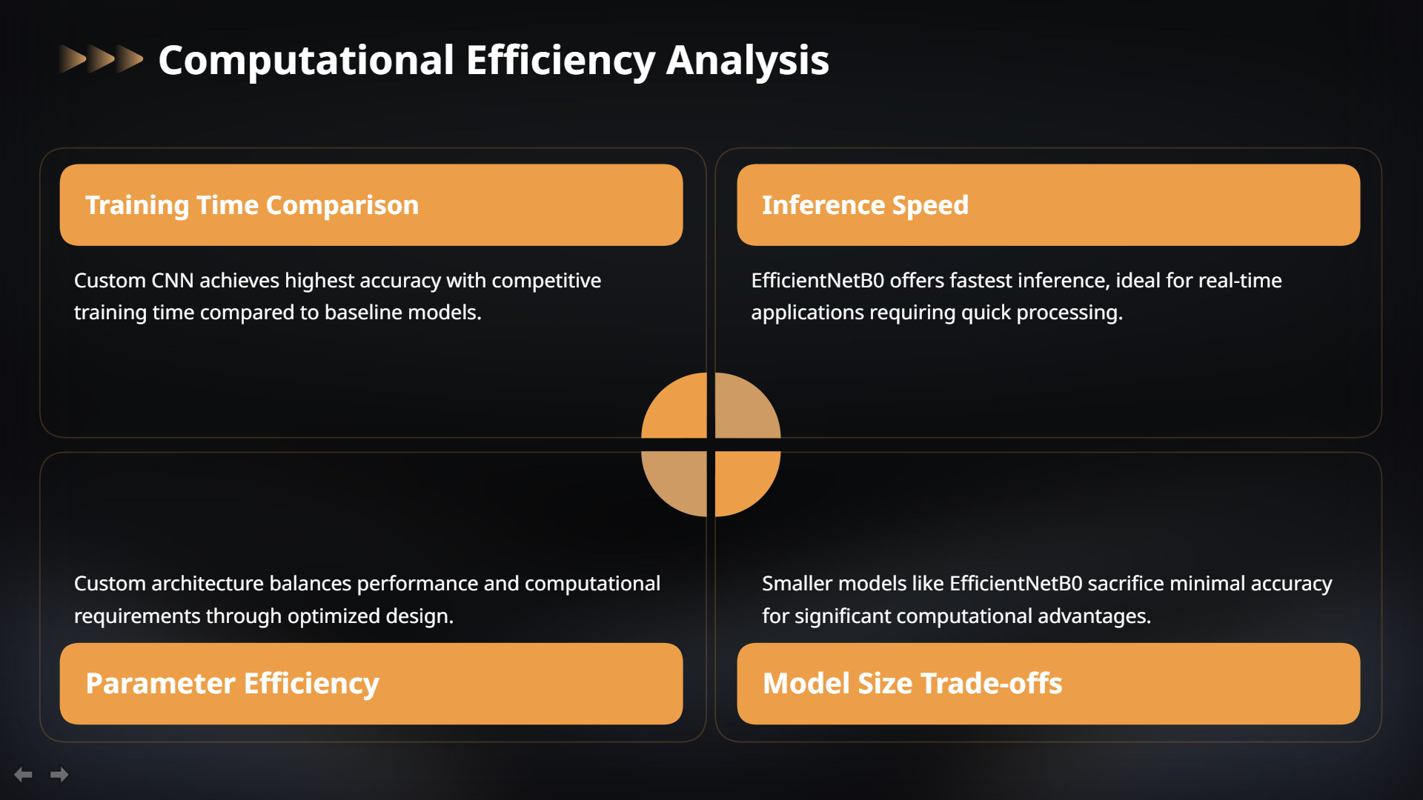

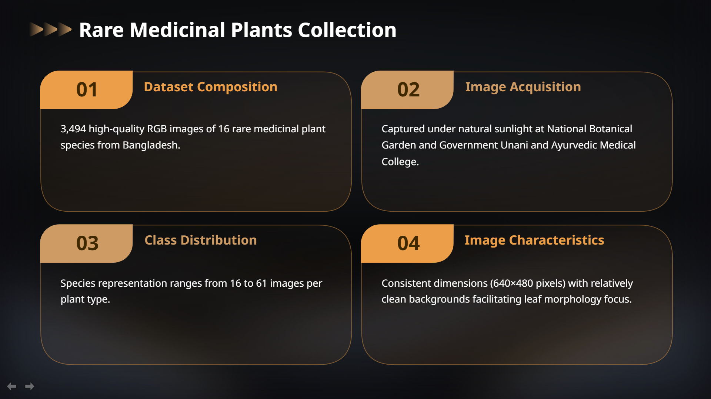

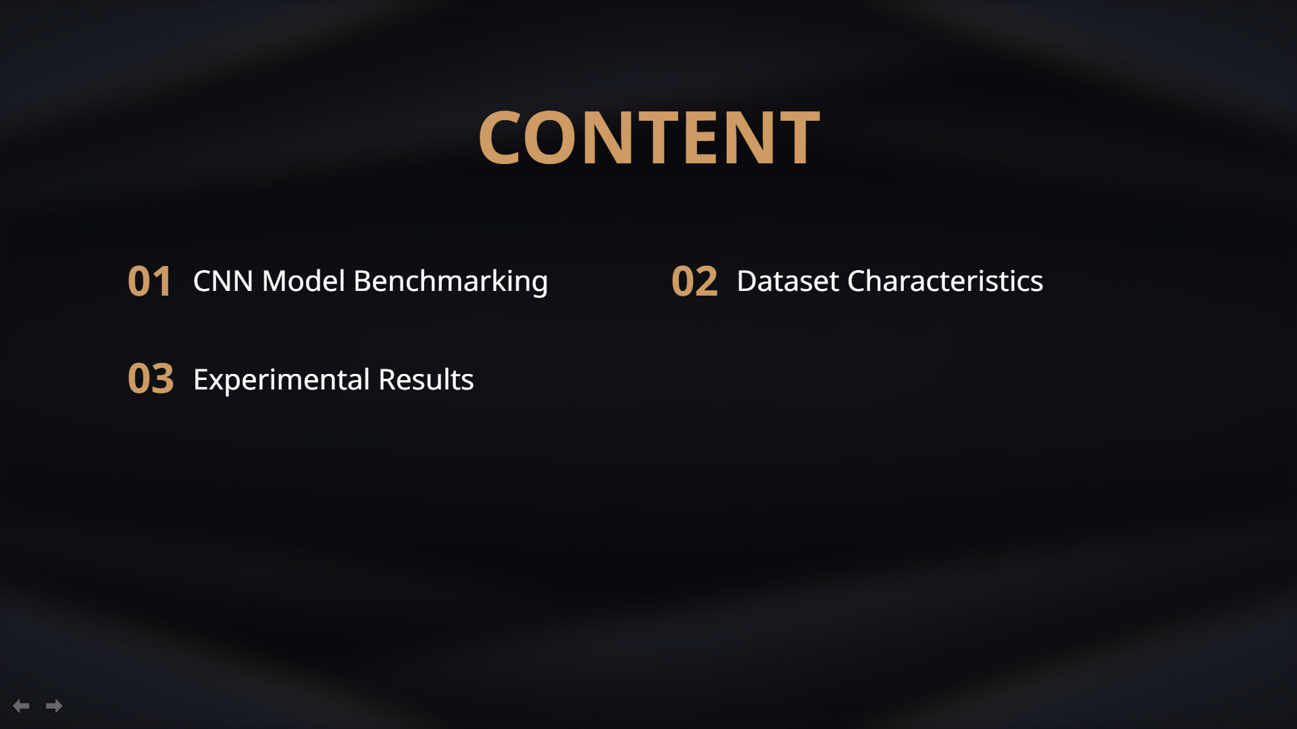

Slide 2
Presentation

Slide 3
Presentation

Slide 4
Presentation

Slide 5
Presentation

Slide 6
Presentation

Slide 7
Presentation

Slide 8
Presentation

Slide 9
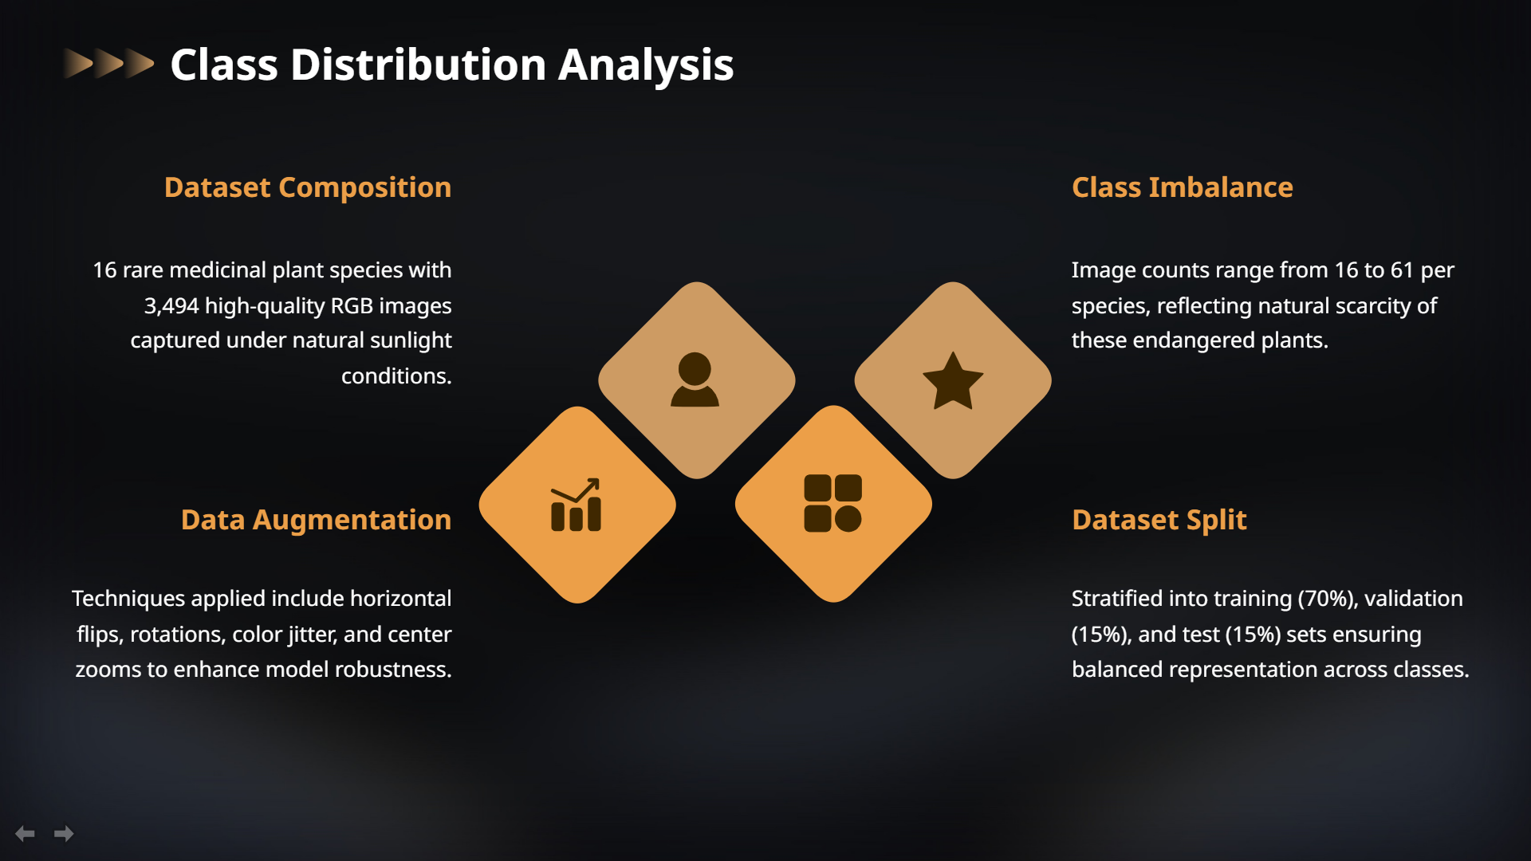
Presentation

Slide 10
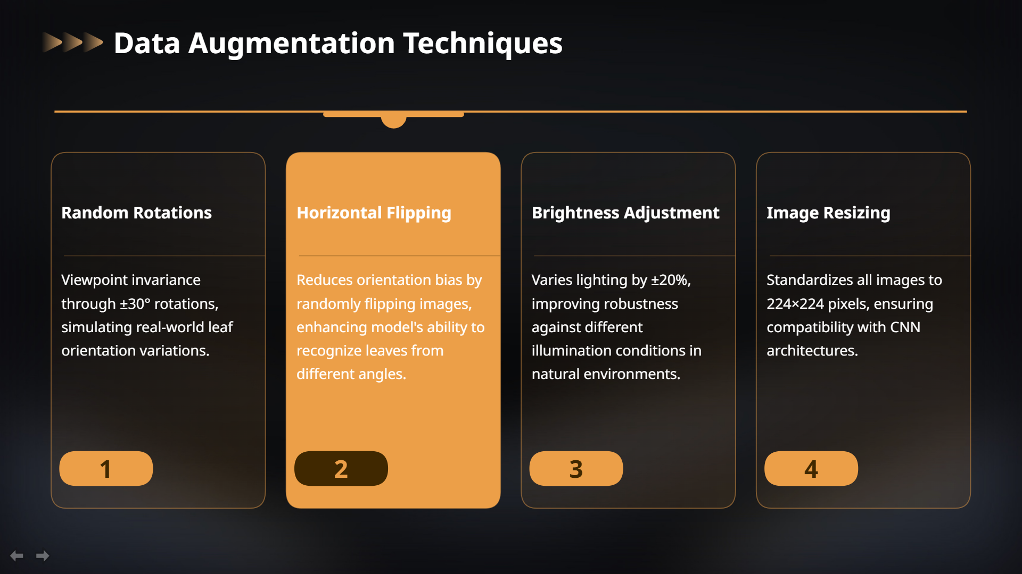
Presentation

Slide 11

Presentation

Slide 12
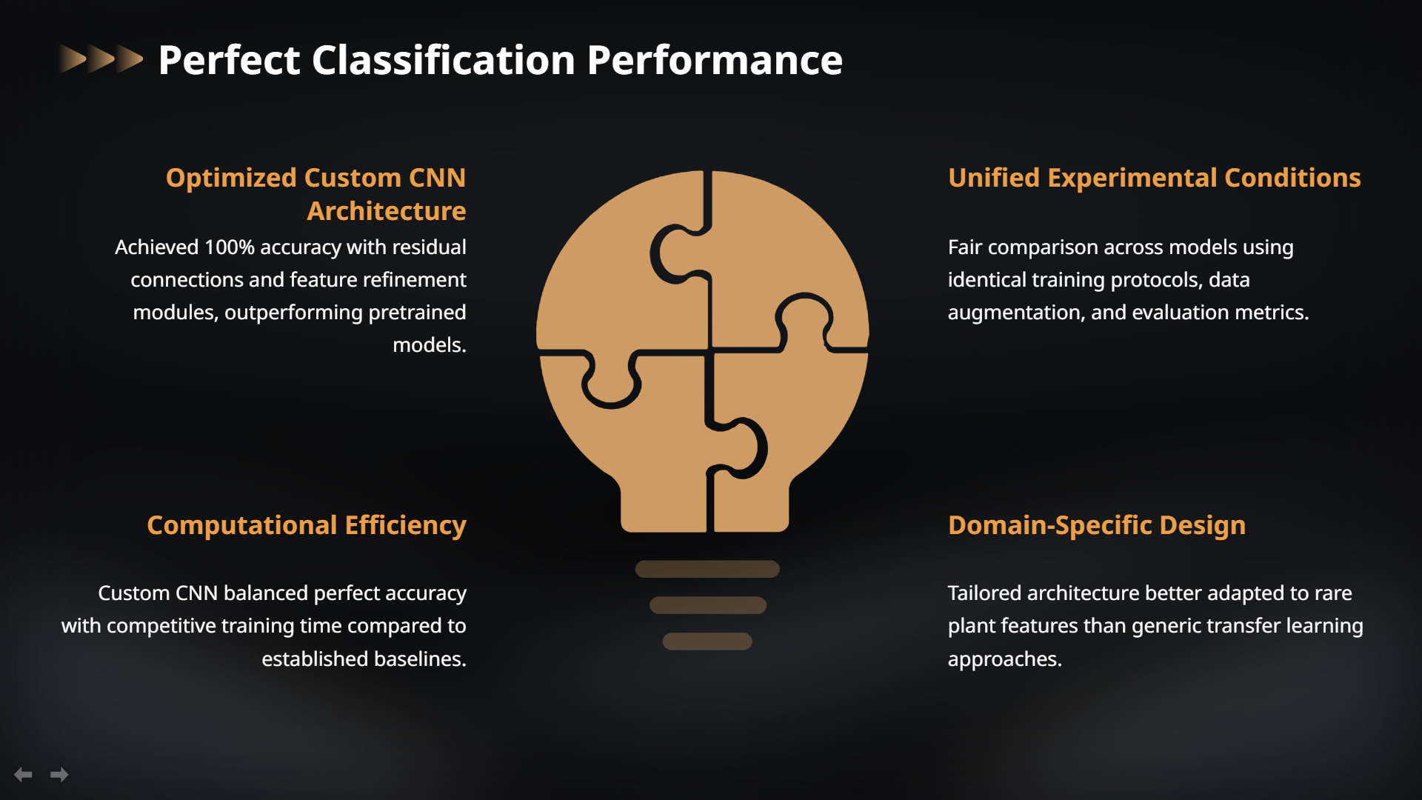
Presentation

Slide 13
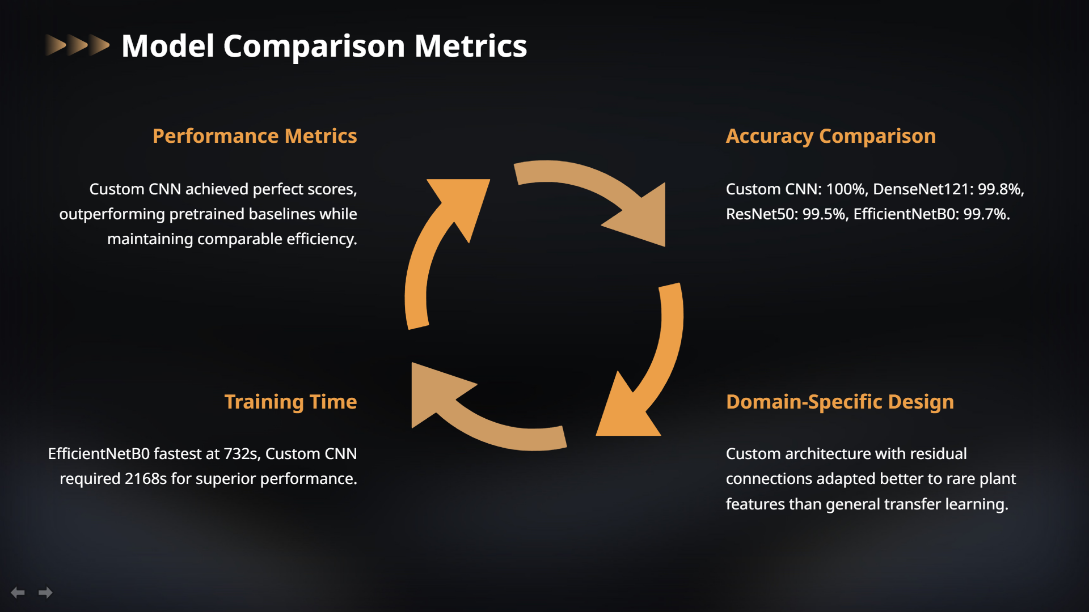
Presentation

Slide 14
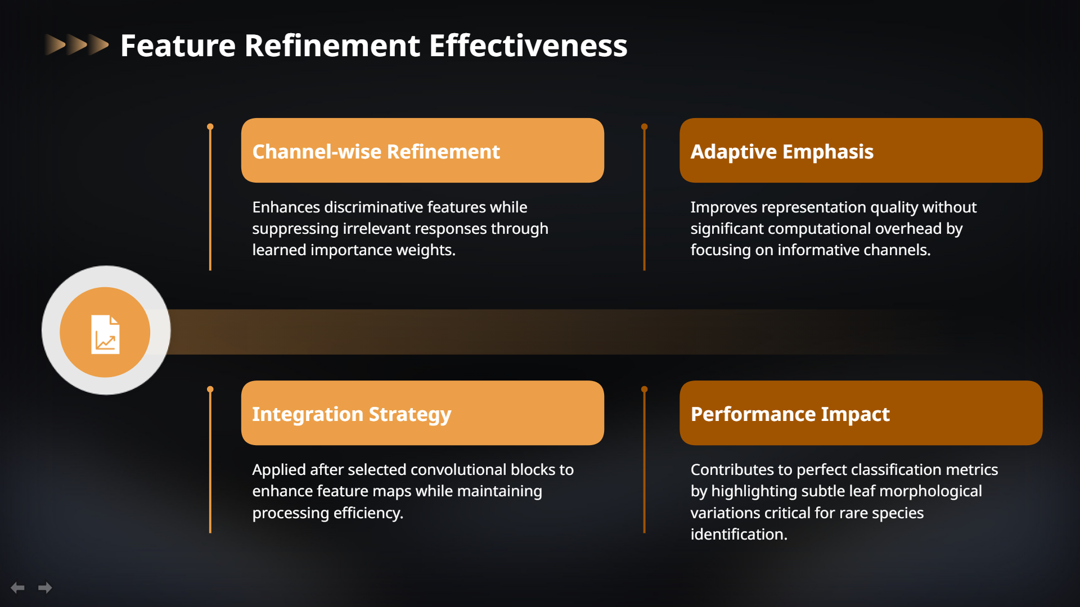
Presentation

Slide 15

Presentation

