Slide 1
Shedding Light on Disinformation: Detecting Bangla Fake News using low rank adaption of large language model
Group 21
Group members:
23366016 Pranto Dev
23366017 Kazi Kamaruzzaman
23366035 Tasnim Fuyara Chhoan
24166020 Husne Mubarak
Submitted to: Annajiat Alim Rasel

Slide 2
Outline
Introduction
Literature Review
Methodology
Dataset
BanglaBERT
LoRA
Methodology
Result Analysis
Conclusion
References

Slide 3
Introduction
Rapid spread of false information online is a major issue in Bangladesh
Bangla-speaking population is increasingly consuming news digitally
Traditional methods for detecting fake news often fail due to unique Bangla grammar and limited datasets
Combining large language models with Low-Rank Approximation techniques offers a promising solution
Large language models excel at sentiment analysis, crucial for fake news detection
By leveraging these tools, more effective systems can be developed to combat misinformation and maintain public trust

Slide 4
Literature Review
[1] PLoRA Method: Proposes PLoRA for personalized text understanding, focusing on sentiment analysis.
[2] Fake News Detection in Bangla: Uses deep learning models to improve accuracy but faces limitations in real-world applicability.
[3] SVM and MNB Classifiers: Achieves high accuracy with SVM but needs further exploration into hybrid models and larger datasets.
[4] Combating Fake News: Uses ML, DL, and transformer models, achieving high accuracy but requires more exploration.
[5] Spam Detection: Uses MNB classifier for Bangla social media, suggesting improvements for a healthier online environment.

Slide 5
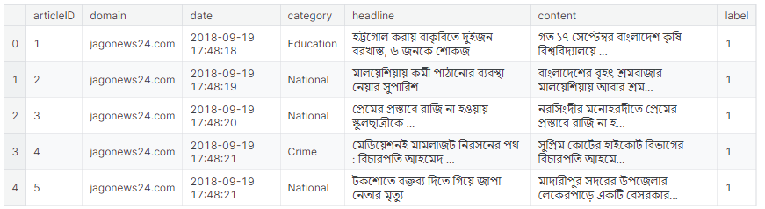
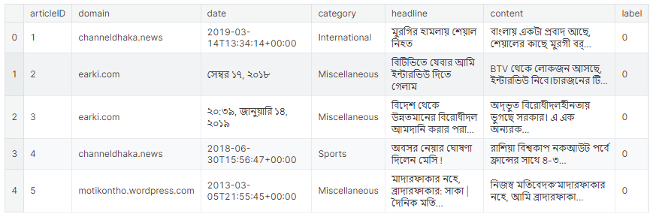
Methodology
Dataset:
BANFakeNews combines approximately 48,000 authentic Bangla news articles with over 1,000 fabricated ones, totaling nearly 50,000 Bangla news pieces.
Figure 1: Authentic News
Figure 2: Fake News

Slide 6
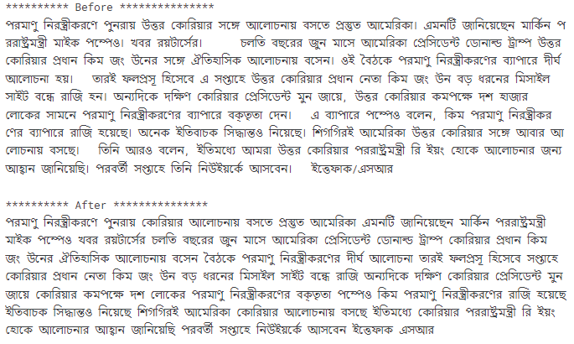
Methodology
Dataset PreProcessing:
Tokenization: Break text into tokens.
Stopword Removal
Punctuation Removal
Cleaning:remove noise from text.
Data Splitting: 80% , 20%
Prepare data for model input.
Data Loader Creation
Store preprocessed datasets.
Figure 3: Before & After Text Cleaning

Slide 7
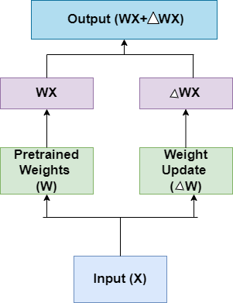
Methodology
BanglaBERT: Pre-trained on a custom dataset of nearly 2.2 billion tokens, BanglaBERT utilized the ELECTRA architecture, featuring a 12-layer Transformer encoder with 110 million parameters, achieving commendable performance in benchmark tests.
LoRA: To address the computational demands of large language models like BERT, the Low-rank Adaptation (LoRA) technique was introduced, fine-tuning only specific matrices while keeping other layers frozen, reducing trainable parameters and optimizing performance.
Figure 4: Lora Architecture

Slide 8
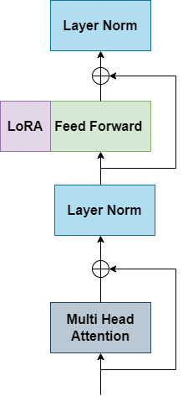
Methodology
Methodology:
Leveraging LoRA with BanglaBERT
Streamlines parameter optimization and enhances efficiency in classification tasks.
Utilizes a rank dimension of 16 and an alpha value of 32 for LoRA injected matrices.
Incorporates a dropout of 0.1 to improve model robustness.
Converts the BanglaBERT model into a LoRA-based BanglaBERT model for improved performance.
Figure 5: Model Architecture with LoRA

Slide 9
Result and Analysis
80% of training data set and 20% for test data set.
BanglaBert model and the LoRA based BanglaBert model has been implemented independently.
BanglaBert Model:
Takes significant amount of computational processing time even in a smaller amount of epochs.
BanglaBert Model has been trained with 5 epochs.

Slide 10
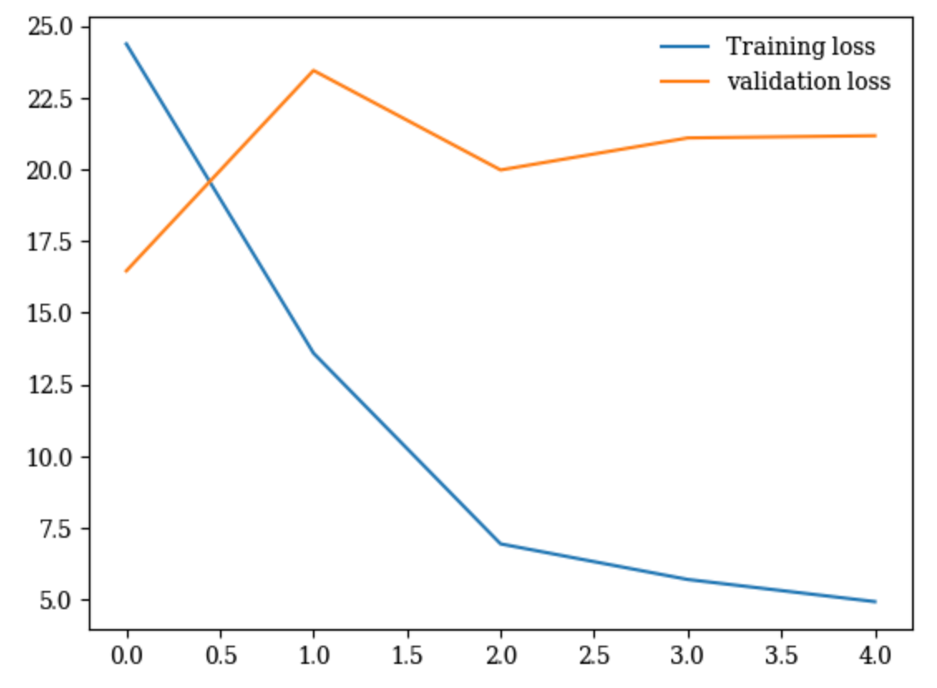
Result and Analysis
Results- Accuracy of 95.31% with validation loss of .05% and a training loss of 20.05%
Final verdict- Underfitting on the data.
BanglaBert Model Training and validation loss curve

Slide 11
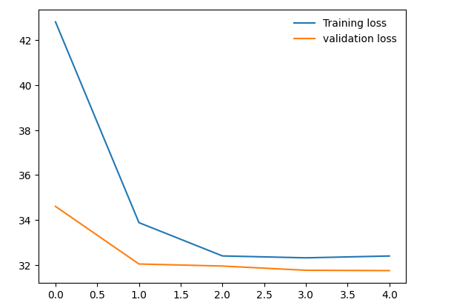
Result and Analysis
BanglaBert fine tuned using LoRA Model:
BanglaBert fine tuned using LoRA Model has been trained with 5 epochs.
Results- Accuracy of almost 88% with training loss of .32% and the validation loss was .31%.
Final Verdict- Better Performance in less number of trainable parameters.
BanglaBert fine tuned using LoRA Model Training and validation loss curve

Slide 12
Result and Analysis
Training History:
Model | Validation Loss | Training Loss | Accuracy
BanglaBert | .18% | .05% | 96.15%
BanglaBert_LoRa | .32% | .31% | 88%

Slide 13
Conclusion
Our study addresses the critical issue of detecting fake news in Bangla language by leveraging advanced machine learning techniques.
BanglaBERT model and the Low-rank Adaptation (LoRA) architecture has been implemented to optimize parameter training. Our proposed LoRA-based BanglaBERT model demonstrated promising results, accuracy but showed signs of underfitting.
Implementing more robust approaches.
Aiming to increase the number of epochs for training to further improve model performance.
Exploring the potential of hybrid models and larger datasets to enhance the detection of fake news in Bangla.

Slide 14
References
[1] Quazi Adibur Rahman Adib, Md. Humaion Kabir Mehedi, Md. Sadman Sakib, Kabbya Kantam Patwary, Md Sabbir Hossain, and Annajiat Alim Rasel. 2021. A Deep Hybrid Learning Approach to Detect Bangla Fake News. In 2021 5th International Symposium on Multidisciplinary Studies and Innovative Technologies (ISMSIT). 442–447. https://doi.org/10.1109/ISMSIT52890.2021.9604712
[2] Md Gulzar Hussain, Md Rashidul Hasan, Mahmuda Rahman, Joy Protim, and Sakib Al Hasan. 2020. Detection of Bangla Fake News using MNB and SVM Classifier. In 2020 International Conference on Computing, Electronics Communications Engineering (iCCECE). 81–85. https: //doi.org/10.1109/iCCECE49321.2020.9231167
[3] Tanvirul Islam, Subhenur Latif, and Nadim Ahmed. 2019. Using Social Networks to Detect Malicious Bangla Text Content. In 2019 1st International Conference on Advances in Science, Engineering and Robotics Technology (ICASERT). 1–4. https://doi.org/10.1109/ICASERT.2019.8934841
[4] Utsha Roy, Mst. Sazia Tahosin, Md. Mahedi Hassan, Taminul Islam, Fahim Imtiaz, Md Rezwane Sadik, Yassine Maleh, Rejwan Bin Sulaiman, and Md. Simul Hasan Talukder. 2024. Enhancing Bangla Fake News Detection Using Bidirectional Gated Recurrent Units and Deep Learning Techniques. (2024). arXiv:2404.01345 [cs.CL]
[5] You Zhang, Jin Wang, Liang-Chih Yu, Dan Xu, and Xuejie Zhang. 2024. Personalized LoRA for Human-Centered Text Understanding. CoRR abs/2403.06208 (2024). https://doi.org/10.48550/ARXIV.2403.06208 arXiv:2403.06208

Slide 15
Thank you

