Slide 1
Paper Review- “Enhancing Smart Agriculture Scenarios with Low-code, Pattern-oriented functionalities for Cloud/Edge collaboration”
Tasnim Fuyara Chhoan(ID: 23366035)
CSE707 DIstributed Computing System
Mehnaz Ara Faizul (ST)
Humaion Kabir Mehedi (RA)
Submitted to : Annajiat Alim Rasel
Group 21

Slide 2

Table of Content
Summary
Motivation
Contribution
Methodology
Conclusion
Limitations
First Limitation
Second Limitation
Synthesis

Slide 3
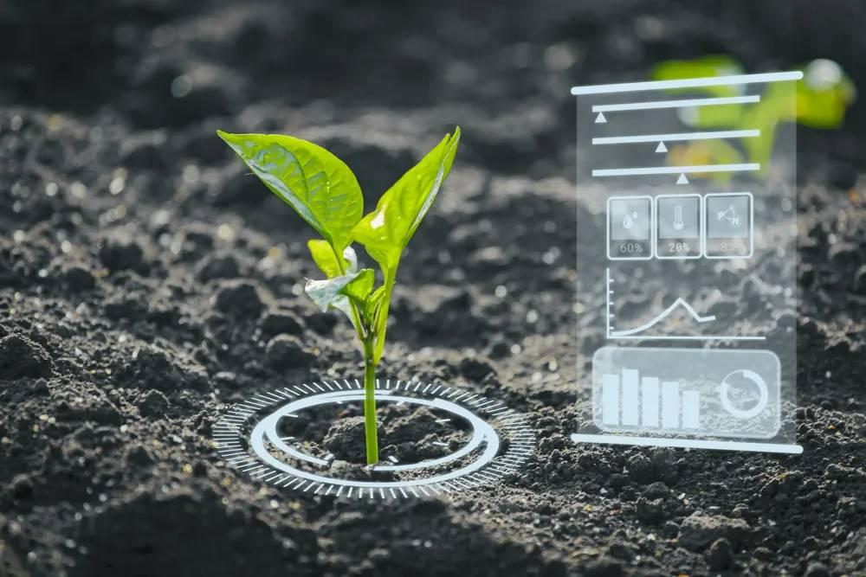
Summary
Motivation
Addresses challenges in smart agriculture, particularly data handling.
Explore low-code patterns for enhanced smart agriculture platforms.
Investigate Edge ETL pattern integration for improved data processes and system scalability.

Slide 4
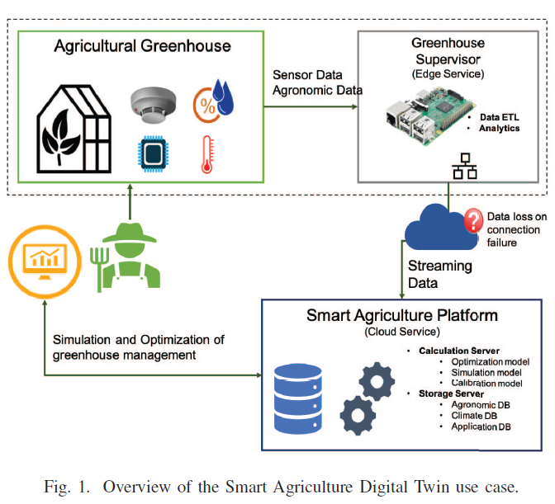
Summary
Contribution
Introduces adaptable low-code patterns, focusing on Edge ETL, addressing smart agriculture challenges.
Designed to tackle data loss, service availability, scalability, and onboarding efficiency.
Innovative application in the smart agriculture digital twin use case yields significant improvements.

Slide 5
Summary
Methodology
Leverages low-code patterns from the PHYSICS project in a smart agriculture digital twin use case.
Key technologies: Node-RED, FaaS cloud paradigm (OpenWhisk).
Edge devices (e.g., Raspberry Pi) serve as execution environments for simulation logic in functions.

Slide 6
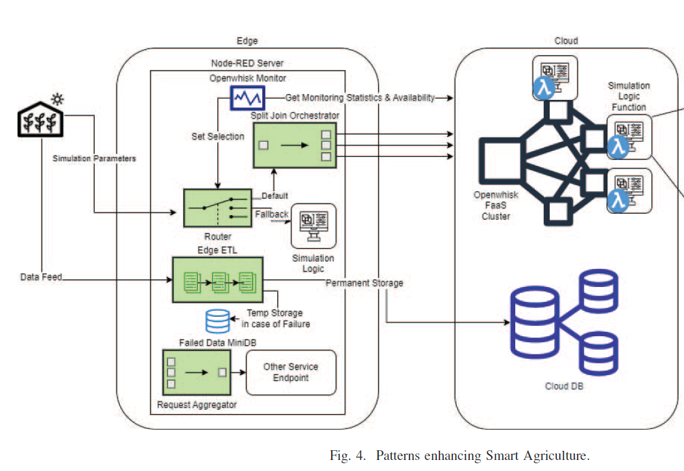
Summary
Methodology
Utilizes Split Join pattern for parallelized execution and FaaS time window monitoring for high availability.
Implements Edge ETL pattern for reliable data collection at the edge.

Slide 7

Summary
Conclusion
Introduces low-code patterns i.e ETL pattern, to tackle smart agriculture challenges
Adaptability in real-world scenarios, employing Node-RED and edge devices
Highlights the broad applicability of the proposed solution, offering a practical approach

Slide 8
Limitations
First Limitation
Second Limitation
Focus on Edge ETL pattern, with other low-code patterns still under evaluation.
Success in smart agriculture may not represent broader applicability of additional patterns.
Specificity of smart agriculture digital twin use case limits generalizability.
Concentration on greenhouse modeling and crop management may not apply universally.

Slide 9

Synthesis
Emphasizes broad applicability and scalability of low-code patterns, especially Edge ETL.
Technologies like Node-RED and Raspberry Pi contribute to feasibility and effectiveness.
Future work involves comprehensive evaluations, development of new patterns, and exploration of diverse smart agriculture scenarios.
Highlights potential for addressing challenges across different domains, showcasing the versatility of the proposed low-code approach.

Slide 10

Reference
Fatouros, G., Kousiouris, G., Lohier, T., Makridis, G., Polyviou, A., Soldatos, J., & Kyriazis, D. (2023). Enhancing Smart Agriculture Scenarios with Low-code, Pattern-oriented functionalities for Cloud/Edge collaboration. 19th International Conference on Distributed Computing in Smart Systems and the Internet of Things (DCOSS-IoT). Retrieved from DOI: 10.1109/DCOSS-IOT58021.2023.00055

Slide 11
Thank you

