Slide 1
Paper Review: Ground-level Mapping And Navigating for Agriculture Based on IoT And Computer Vision
Tasnim Fuyara Chhoan(ID: 23366035)
CSE707 - DIstributed Computing System
Mehnaz Ara Faizul (ST)
Humaion Kabir Mehedi (RA)
Submitted to : Annajiat Alim Rasel
Group 21

Slide 2
Summary
Motivation/purpose/aims/hypothesis
Contribution
Methodology
Conclusion

Slide 3
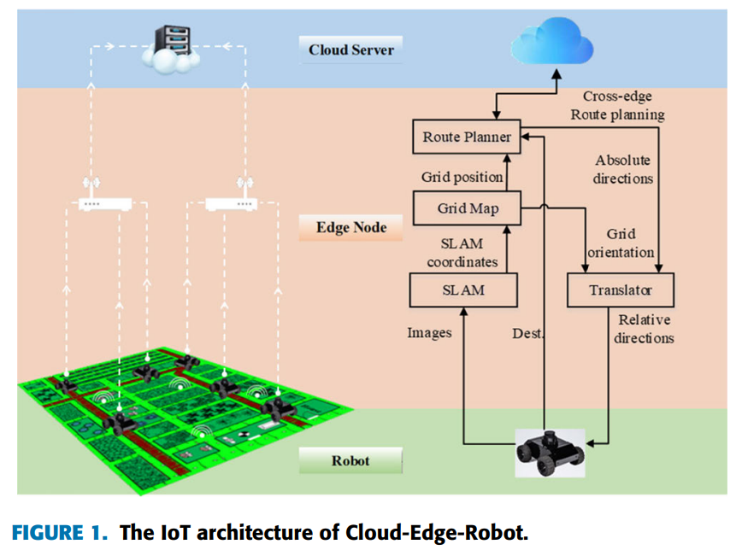
Summary
Motivation/purpose/
aims/hypothesis
Enhance agriculture mapping
Combine IoT and computer vision
IoT benefits precision agriculture

Slide 4
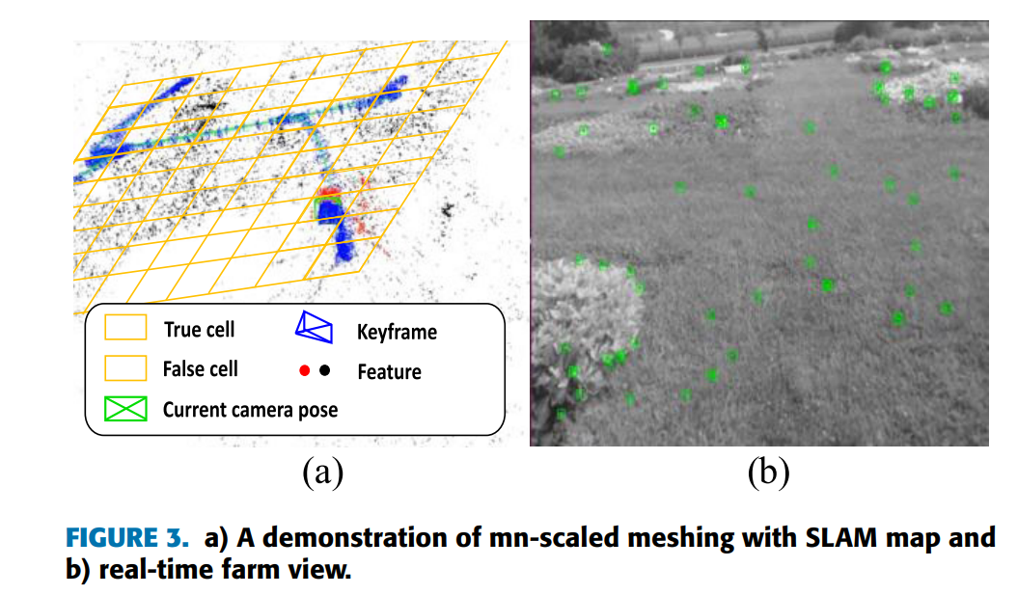
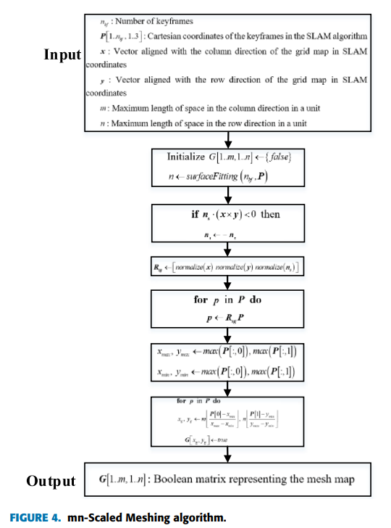
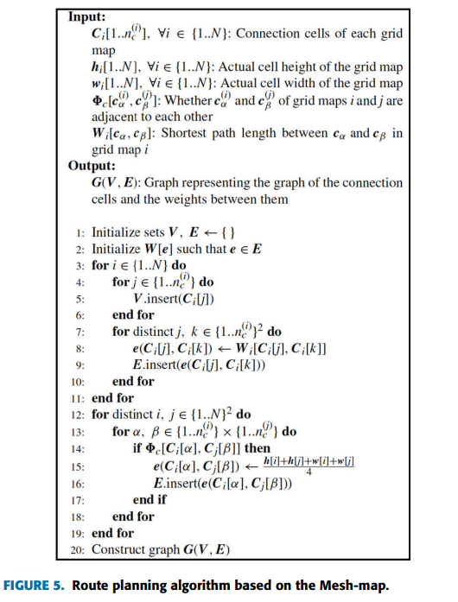
Summary
Contribution
IoT-based mapping (Fig. 3)
Computer vision and edge computing (Fig. 4)
Advancing precision agriculture (Fig. 5)

Slide 5
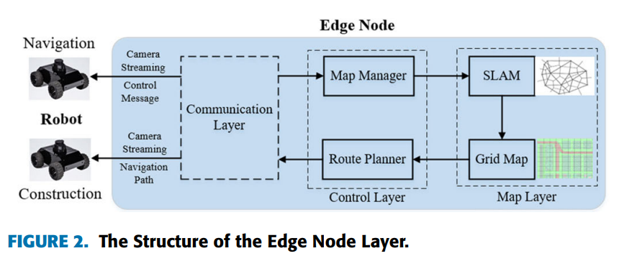
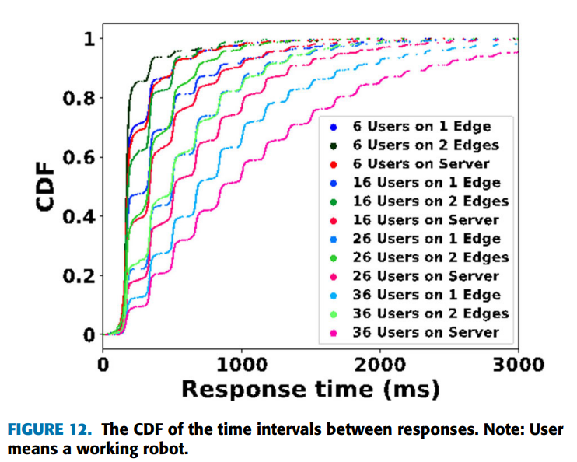
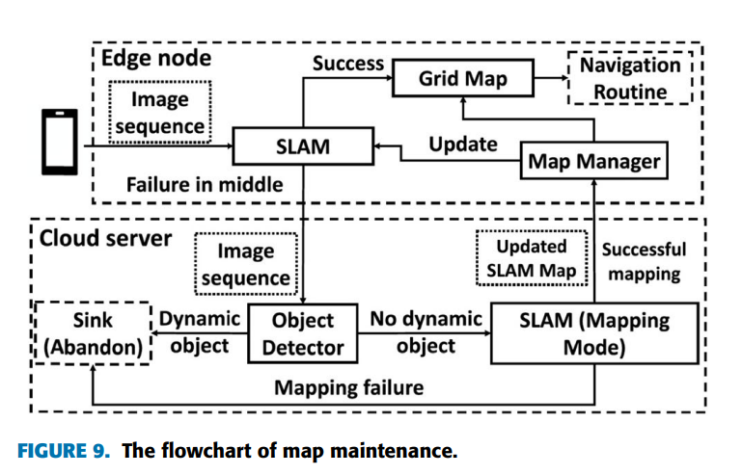
Summary
Methodology
Monocular cameras, SLAM, mesh maps (Figs. 2, 5)
Accuracy, CPU usage, localization
experiments (Figs. 9, 12)
Real-time mapping for precision agriculture(Fig. 8)

Slide 6
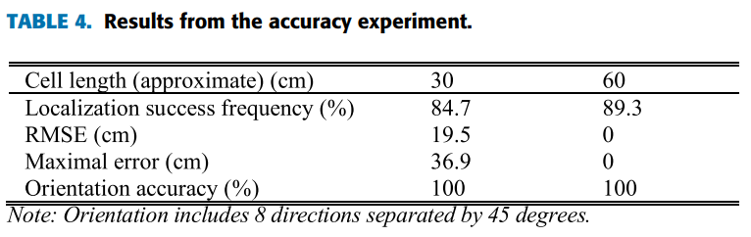
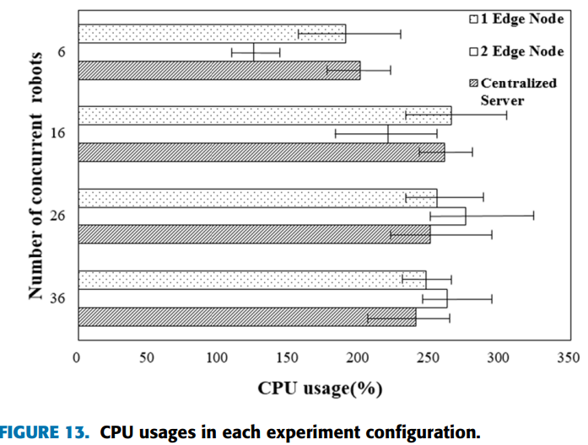
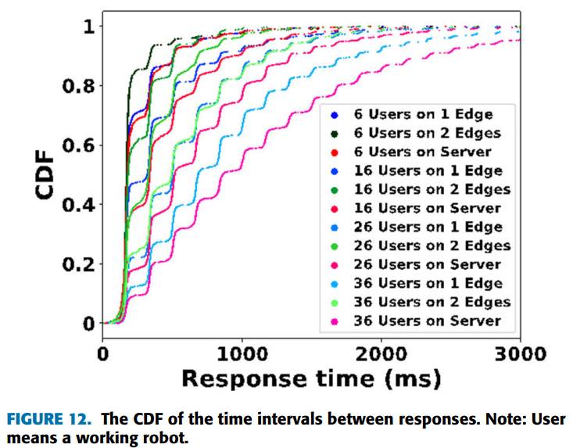
Summary
Conclusion
High accuracy (Table 4).
Efficiency of edge computing (Fig. 13).
Real-time data and map updates (Fig. 12).

Slide 7
Limitations
Limitation 1
Planar terrain assumption
Limitation 2
SLAM technology limitations

Slide 8
Synthesis
Future Applications
Environmental Monitoring
Smart
Cities
Disaster
Response
Exploration & Mapping
Versatile
Industries
Overcoming Limitations
Enhancing Adaptability

Slide 9
Reference: Wei Zhao, Xuan Wang, Bozhao Qi, & Troy Runge. (2020). Ground-Level Mapping and Navigating for Agriculture Based on IoT and Computer Vision. API (Digital Object Identifier 10.1109/ACCESS.2020.3043662).

