Slide 1
Paper Review: Ground-level Mapping And Navigating for Agriculture Based on IoT And Computer Vision
Name: Tasnim Fuyara Chhoan
ID: 23366035; CSE 707 (Fall’23)
Submitted to- Annajiat Alim Rasel (AAR)

Slide 2
Summary
Motivation/purpose/aims/hypothesis
Contribution
Methodology
Conclusion

Slide 3
Summary
Motivation/purpose/
aims/hypothesis
Contribution
Methodology
Conclusion

Slide 4
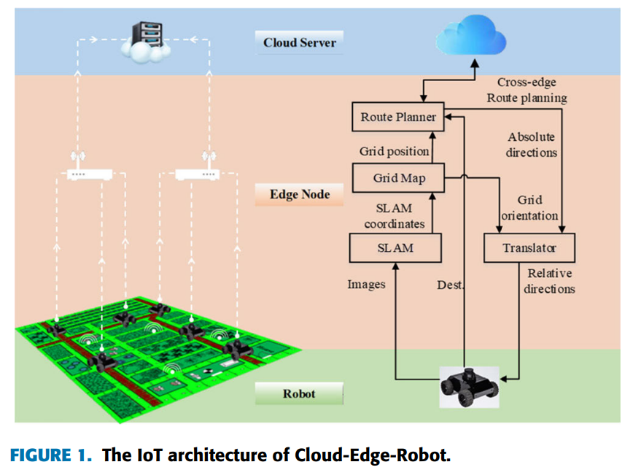
Summary
Motivation/purpose/
aims/hypothesis
Enhance agriculture mapping
Combine IoT and computer vision
IoT benefits precision agriculture
Contribution
Methodology
Conclusion

Slide 5
Summary
Motivation/purpose/
aims/hypothesis
Enhance agriculture mapping
Combine IoT and computer vision
IoT benefits precision agriculture

Slide 6
Summary
Motivation/purpose/
aims/hypothesis
Contribution
Methodology
Conclusion

Slide 7
Summary
Motivation/purpose/
aims/hypothesis
Contribution
Methodology
Conclusion

Slide 8
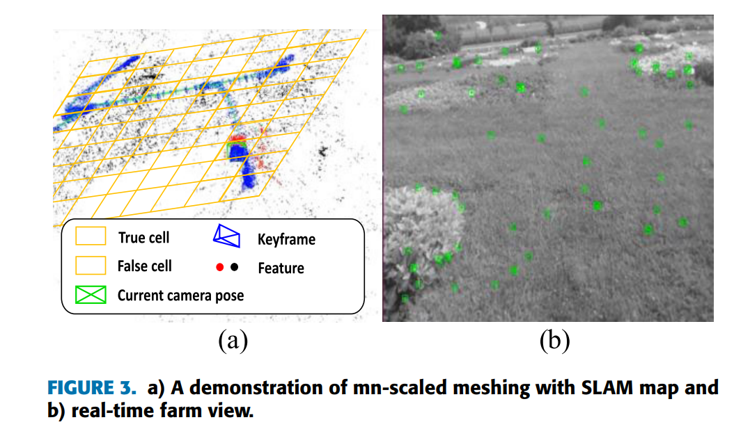
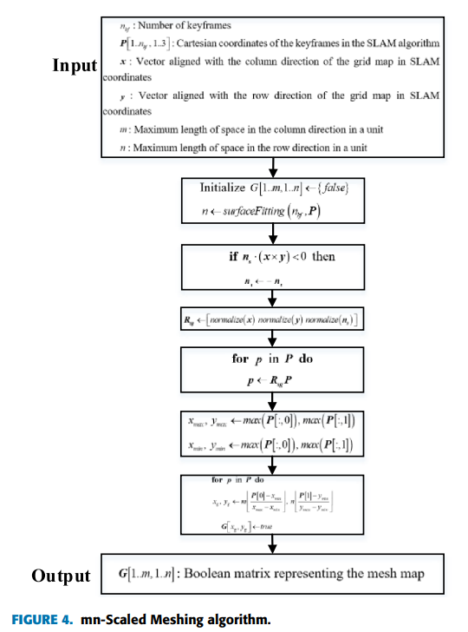
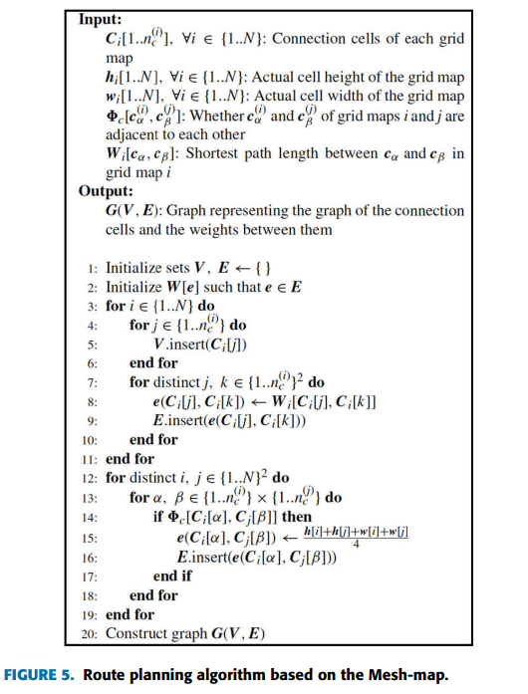
Summary
Contribution
Motivation/purpose/
aims/hypothesis
IoT-based mapping (Fig. 3)
Computer vision and edge computing (Fig. 4)
Advancing precision agriculture (Fig. 5)
Methodology
Conclusion

Slide 9
Summary
Contribution
IoT-based mapping (Fig. 3)
Computer vision and edge computing (Fig. 4)
Advancing precision agriculture (Fig. 5)

Slide 10
Summary
Contribution
IoT-based mapping (Fig. 3)
Computer vision and edge computing (Fig. 4)
Advancing precision agriculture (Fig. 5)

Slide 11
Summary
Contribution
IoT-based mapping (Fig. 3)
Computer vision and edge computing (Fig. 4)
Advancing precision agriculture (Fig. 5)

Slide 12
Summary
Motivation/purpose/
aims/hypothesis
Contribution
Methodology
Conclusion

Slide 13
Summary
Motivation/purpose/
aims/hypothesis
Methodology
Contribution
Conclusion

Slide 14
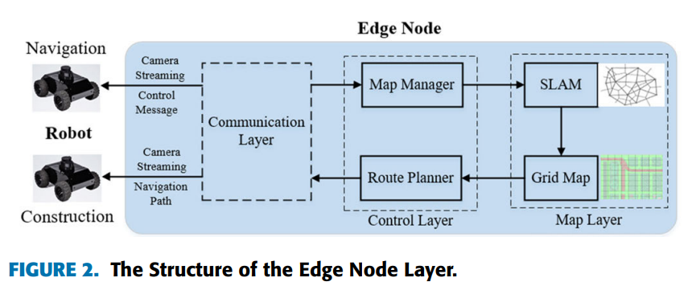
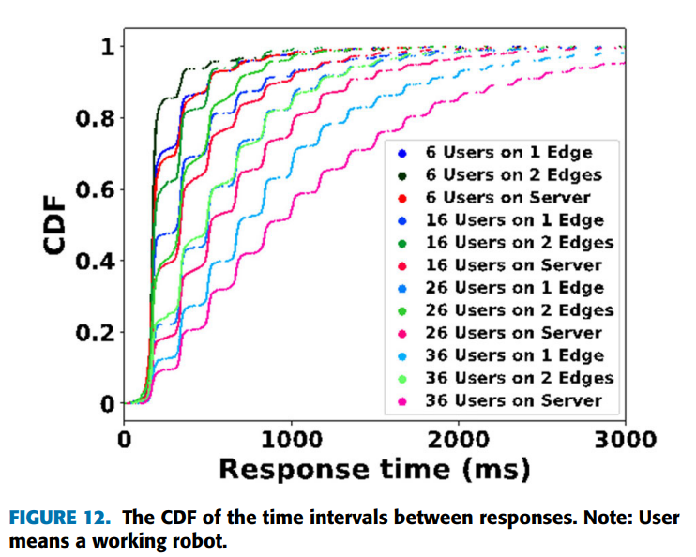
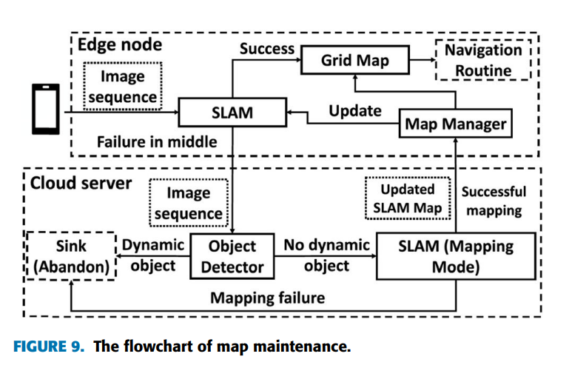
Summary
Methodology
Monocular cameras, SLAM, mesh maps (Figs. 2, 5)
Accuracy, CPU usage, localization
experiments (Figs. 9, 12)
Real-time mapping for precision agriculture(Fig. 8)
Motivation/purpose/
aims/hypothesis
Contribution
Conclusion

Slide 15
Summary
Methodology
Monocular cameras, SLAM, mesh maps (Figs. 2, 5)
Accuracy, CPU usage, localization
experiments (Figs. 9, 12)
Real-time mapping for precision agriculture(Fig. 8)

Slide 16
Summary
Methodology
Monocular cameras, SLAM, mesh maps (Figs. 2, 5)
Accuracy, CPU usage, localization
experiments (Figs. 9, 12)
Real-time mapping for precision agriculture(Fig. 8)

Slide 17
Summary
Methodology
Monocular cameras, SLAM, mesh maps (Figs. 2, 5)
Accuracy, CPU usage, localization
experiments (Figs. 9, 12)
Real-time mapping for precision agriculture

Slide 18
Summary
Methodology
Monocular cameras, SLAM, mesh maps (Figs. 2, 5)
Accuracy, CPU usage, localization
experiments (Figs. 9, 12)
Real-time mapping for precision agriculture

Slide 19
Summary
Methodology
Monocular cameras, SLAM, mesh maps (Figs. 2, 5)
Accuracy, CPU usage, localization
experiments (Figs. 9, 12)
Real-time mapping for precision agriculture

Slide 20
Summary
Motivation/purpose/
aims/hypothesis
Contribution
Conclusion
Methodology

Slide 21
Summary
Motivation/purpose/
aims/hypothesis
Contribution
Methodology
Conclusion

Slide 22
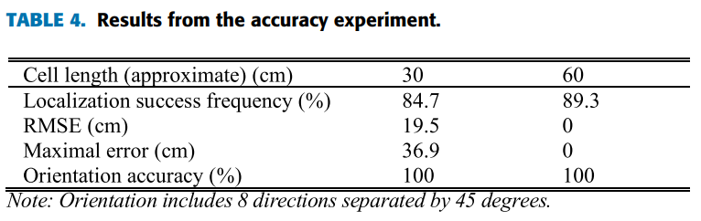
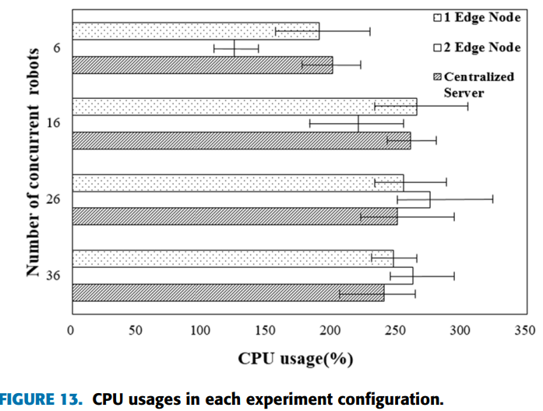
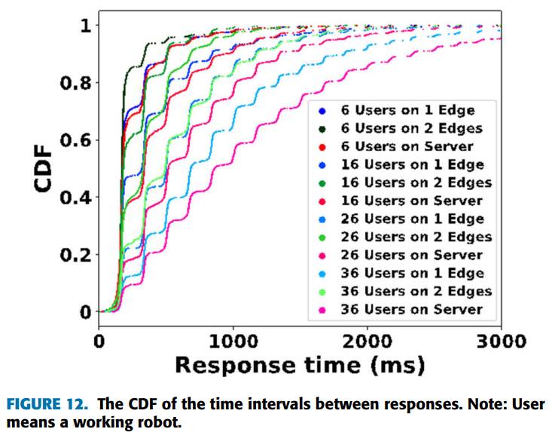
Summary
Conclusion
Motivation/purpose/
aims/hypothesis
High accuracy (Table 4).
Efficiency of edge computing (Fig. 13).
Real-time data and map updates (Fig. 12).
Contribution
Methodology

Slide 23
Summary
Conclusion
High accuracy (Table 4).
Efficiency of edge computing (Fig. 13).
Real-time data and map updates (Fig. 12).

Slide 24
Summary
Conclusion
High accuracy (Table 4).
Efficiency of edge computing (Fig. 13).
Real-time data and map updates (Fig. 12).

Slide 25
Summary
Conclusion
High accuracy (Table 4).
Efficiency of edge computing (Fig. 13).
Real-time data and map updates (Fig. 12).

Slide 26
Summary
Motivation/purpose/
aims/hypothesis
Contribution
Methodology
Conclusion

Slide 27
Limitations
Limitation 1
Limitation 2

Slide 28
Limitations
Limitation 1
Planar terrain assumption
Limitation 2
SLAM technology limitations

Slide 29
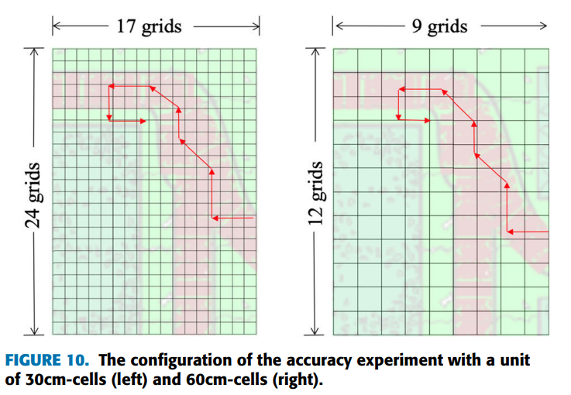
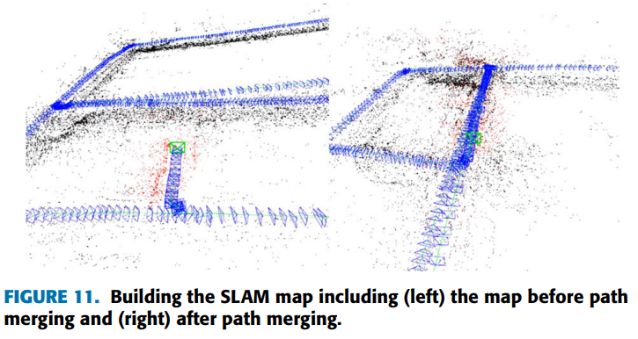
Limitations
Limitation 1
Planar terrain assumption
Limitation 2
SLAM technology limitations

Slide 30
Synthesis
Future Applications
Environmental Monitoring
Smart
Cities
Disaster
Response
Exploration & Mapping
Versatile
Industries
Overcoming Limitations
Enhancing Adaptability

Slide 31
Synthesis
Future Applications
Environmental Monitoring
Smart
Cities
Disaster
Response
Exploration & Mapping
Versatile
Industries
Overcoming Limitations
Enhancing Adaptability

Slide 32
Synthesis
Future Applications
Environmental Monitoring
Smart
Cities
Disaster
Response
Exploration & Mapping
Versatile
Industries
Overcoming Limitations
Enhancing Adaptability

Slide 33
Synthesis
Future Applications
Environmental Monitoring
Smart
Cities
Disaster
Response
Exploration & Mapping
Versatile
Industries
Overcoming Limitations
Enhancing Adaptability

Slide 34
Synthesis
Future Applications
Environmental Monitoring
Smart
Cities
Disaster
Response
Exploration & Mapping
Versatile
Industries
Overcoming Limitations
Enhancing Adaptability

Slide 35
Synthesis
Future Applications
Environmental Monitoring
Smart
Cities
Disaster
Response
Exploration & Mapping
Versatile
Industries
Overcoming Limitations
Enhancing Adaptability

Slide 36
Synthesis
Future Applications
Environmental Monitoring
Smart
Cities
Disaster
Response
Exploration & Mapping
Versatile
Industries
Overcoming Limitations
Enhancing Adaptability

Slide 37
Synthesis
Future Applications
Environmental Monitoring
Smart
Cities
Disaster
Response
Exploration & Mapping
Versatile
Industries
Overcoming Limitations
Enhancing Adaptability

Slide 38
Synthesis
Future Applications
Environmental Monitoring
Smart
Cities
Disaster
Response
Exploration & Mapping
Versatile
Industries
Overcoming Limitations
Enhancing Adaptability

Slide 39
Reference: Wei Zhao, Xuan Wang, Bozhao Qi, & Troy Runge. (2020). Ground-Level Mapping and Navigating for Agriculture Based on IoT and Computer Vision. API (Digital Object Identifier 10.1109/ACCESS.2020.3043662).

