Slide 1
Apex Asset Management
Where growth leaks — and the three moves that plug it
Senior Data Analyst case study · Customer, fund & RM analytics
Data as-of 31 May 2026 · 12,229 accounts · 8,570 customers · 4 funds · 16 RMs
Reproduced from cleaned source data; independently QA-validated (Gate 1 & Gate 2 PASS)

Slide 2
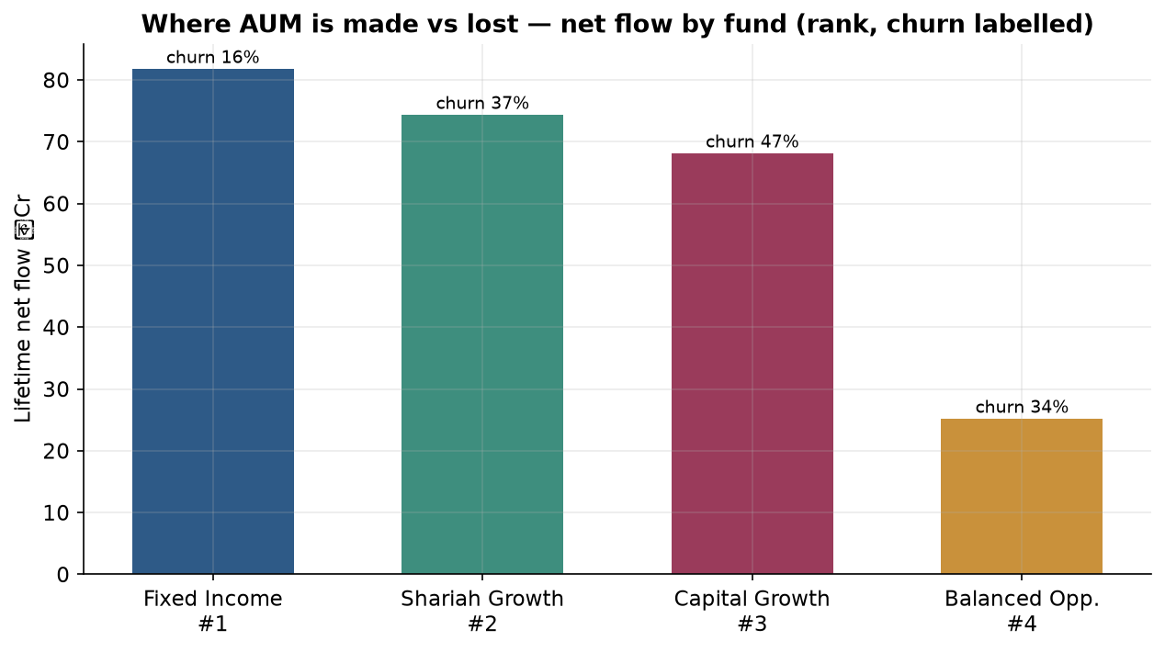
EXECUTIVE SUMMARY
Apex's growth problem is a retention problem, not acquisition
+৳249.3 Cr lifetime net flow — money is
being gathered fast (+৳37.8 Cr in 2025 alone)…
…but it leaks back out.
1 fund grows; 3 leak.
Fixed Income gathers AND keeps; Capital Growth
posts +৳68 Cr yet loses 47% — a leaky bucket.
The base is single-fund (~82%)
and a few RMs out-acquire what they retain.
Bars = lifetime net flow (Purchase − Surrender) by fund; label = strict churn %; #rank = durable-growth composite. ‘Performance’ = flow/retention, not investment return (no NAV data).

Slide 3
METHODOLOGY & DATA
How we measured — and one assumption that matters
Data: 12,229 accounts · 8,570 customers (by mobile) ·
231k transactions · 4 funds · 16 official RMs.
Cleaned & reconciled: flow totals tie to the
cent across raw → ledger → monthly panel; 3 unknown
accounts quarantined; anomalies flagged, never dropped.
Beyond the 4 given formulas: cohort survival
(Kaplan–Meier), SIP persistency curves, customer
clustering (k=4, stable ARI=1.0), RM acquisition quality.
KEY ASSUMPTION — point-in-time retention
Account status is a TODAY snapshot. Measuring last
year's retention from today's status would be wrong.
We rebuild each account's status AT the measurement
date from dated close / discontinue events.
Result: the case cohort (May-24 → May-25) is
84.6% retained (115/136) point-in-time — vs 93/136
in a naïve snapshot. We use the rigorous number.
Churn = Closed + Discontinued (headline).
Inactive shown only as a sensitivity. ‘Performance’
= flow / retention / engagement — NOT return.
Single source of truth: definitions.yaml · every judgment call logged in decisions_log.md · reproduction in qa/qa_report.md.

Slide 4
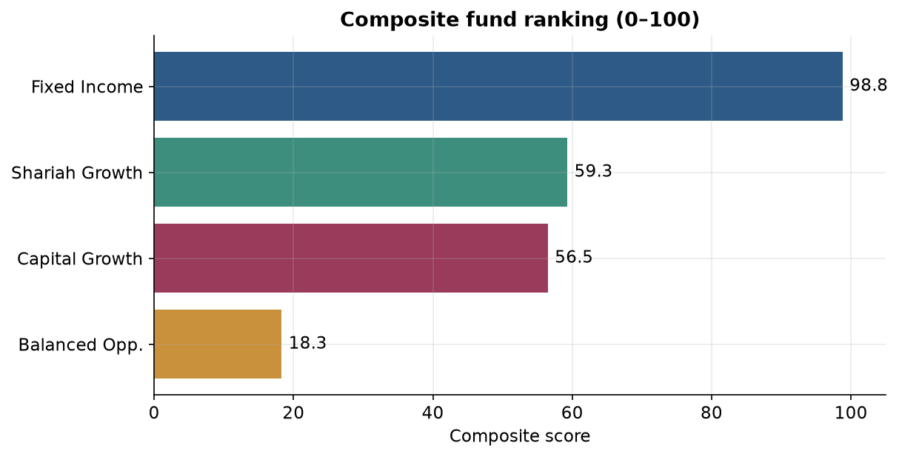
FUND PERFORMANCE · 1
Rank funds on durable growth, not on size
Composite (0–100) = net flow, 36-mo
survival, SIP persistency, AUM, low churn.
#1 Fixed Income 99
#2 Shariah Growth 59
#3 Capital Growth 56
#4 Balanced Opp. 18
Implication: defend the leaky funds —
don't pour growth spend into the winner.
Owner: Head of Funds / PMs.
Composite weights favour durable growth (survival × persistency) over raw AUM; full scorecard in apex_analysis.ipynb §4.

Slide 5
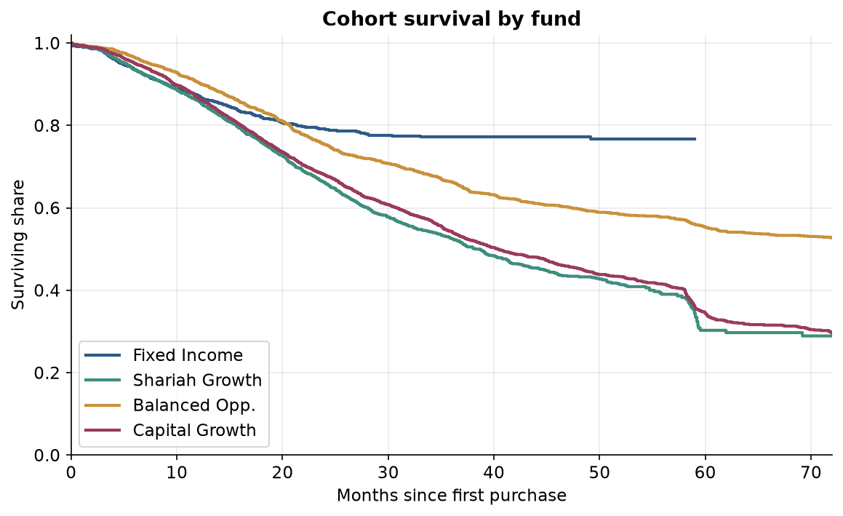
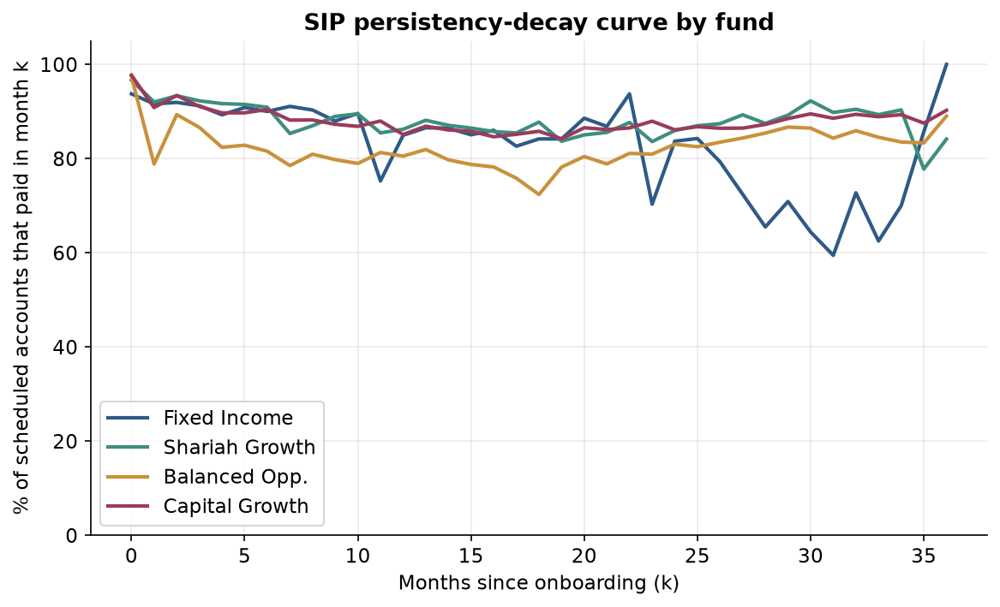
FUND PERFORMANCE · 2
The leak is retention: cohorts fade, SIPs stop early
Capital Growth keeps only ~54% of a cohort to 3 years vs Fixed Income ~77%. SIP persistency is 87.9% overall but attrition concentrates in the early months.
Move: auto-flag the FIRST missed installment in the monthly panel and fire a save-call; win-back team on Capital Growth (47.2% churn). Owner: Head of Retention / Ops.

Slide 6
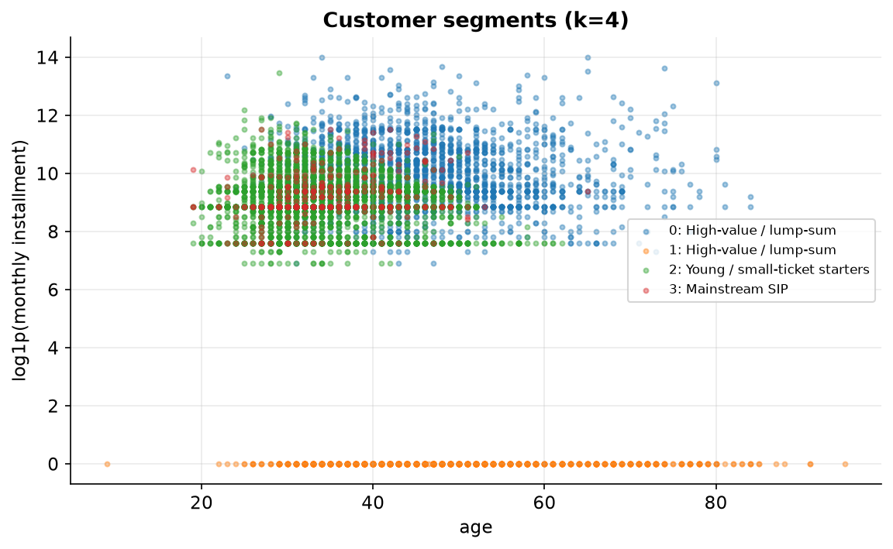
CUSTOMERS · 1
Four stable segments — the book is single-fund & concentrated
k=4 segments — stable across 3 seeds
(ARI = 1.0; silhouette 0.42):
• High-value / lump-sum tier
• Committed SIP savers
• Young, small-ticket mass
• Dormant non-SIP group
~82% hold ONE fund; top 10% of
customers hold ~68% of AUM.
Each segment maps to a primary fund
for targeted offers (see notebook §5/§7).
Clustering at customer (mobile) level on age, installment, tenor, onboarding amount (monetary log-scaled); k=2 rejected as trivial SIP/non-SIP split.

Slide 7
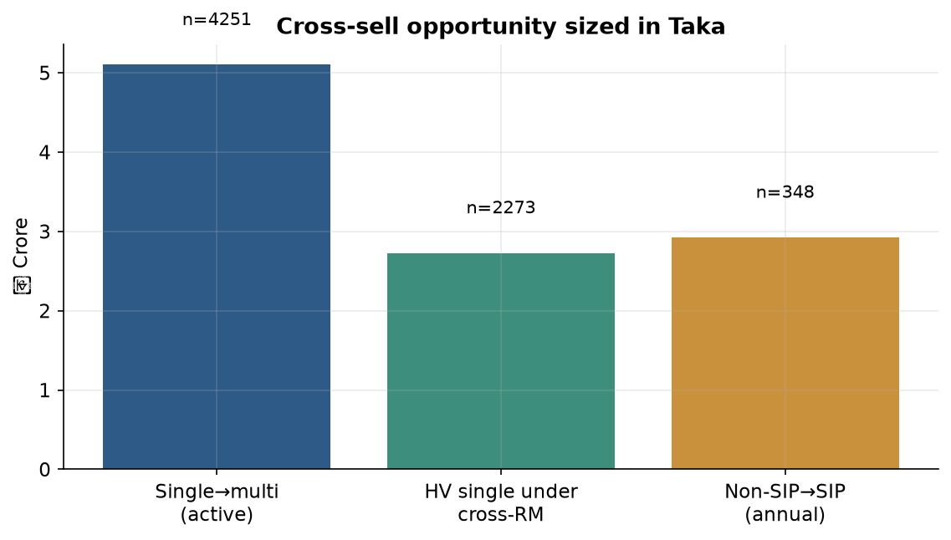
CUSTOMERS · 2
The cheapest AUM: a second fund to people who already trust us
Two sized plays, ready now:
1 · Single → second fund
4,251 customers ≈ ৳5.1 Cr
start with 2,273 high-value leads
already under a cross-capable RM.
2 · Non-SIP → SIP migration
348 customers ≈ ৳2.9 Cr/yr recurring
Owner: Head of Sales.
Taka = target count × explicit median ticket (2nd-fund ৳12,000; SIP annual ৳84,000). Reproducible; headline wallet excludes the overlapping warm-lead subset.

Slide 8
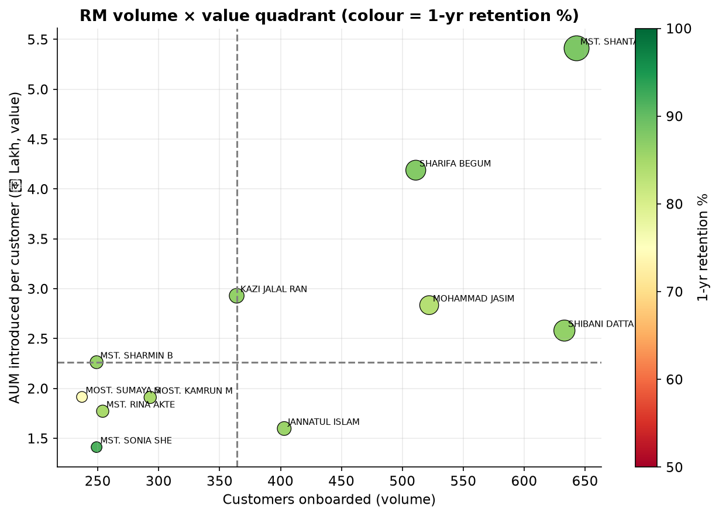
RM PRODUCTIVITY · 1
Reward retention, not raw sign-ups
Volume × value, coloured by
1-year retention. Overall book
retention = 86.2%.
Coach, don't celebrate:
high-volume but below-median
retention —
MOHAMMAD JASIM AHMED, JANNATUL ISLAM.
Move: tie a slice of incentive
to 1-yr retention. Owner: Sales Mgr.
Acquisition attributed on Introducer role, 16 official RMs; 1-yr retention on cohorts old enough to observe it (onboarded ≤ as-of − 12m), reconstructed point-in-time.

Slide 9
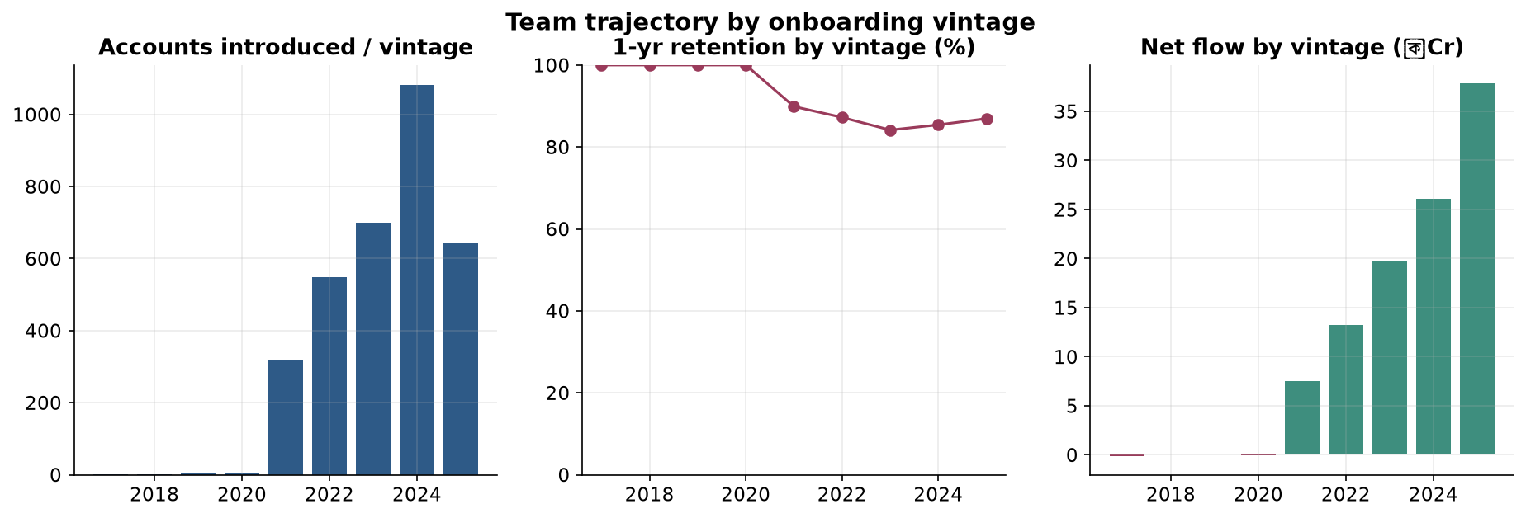
RM PRODUCTIVITY · 2
A mild systemic dip — and where to deploy specialists
Team 1-yr retention dipped
across the 2021→2023 vintages
(≈90% → 84%) then recovered to
86.9% (2025) — a mild systemic
signal, not just two people.
Deploy high-retention
specialists onto Capital Growth
(the leakiest fund) rather than
retraining them.
Owner: Head of Sales.
Net flow by introducing vintage rising (to +৳37.8 Cr in 2025); systemic vs individual separated so the fix matches the cause.

Slide 10
RECOMMENDATIONS
Five owner-assigned moves, sequenced
NOW
Stop the leak
Auto-flag first missed SIP installment + win-back on Capital Growth (47.2% churn)
Head of Retention / PM
NOW
Cheapest AUM
Second-fund campaign to 4,251 single-fund customers (~৳5.1 Cr)
Head of Sales
NEXT
Fix incentives
Tie RM incentive to 1-yr retention (86%); coach 2 flagged RMs
Sales Manager
NEXT
Recurring revenue
Non-SIP → SIP migration for 348 customers (~৳2.9 Cr/yr)
Head of Sales
ONGOING
Pre-empt redemptions
Dividend-reinvest offer WITH each Jul/Jan distribution (20.4% vs 16.7% post-dividend surrenders)
Marketing + PM
Every number traces to apex_analysis.ipynb and the recommendation register (analysis/synthesis). ‘Performance’ throughout = flow/retention/engagement, not investment return.

