Slide 1
BCA Final Year Project (Review I) Brain Tumor Detection using Image Processing
Submitted to the Presidency University, Bengaluru in partial fulfillment for the award of the degree of Bachelor of Computer Applications(BCA)
Project Team No :21
Under the supervision of
Naiwrita Borah Asst.Prof- SCSE
Name | Roll Number
Noor Tasmiya | 20221BCA0019
Vennela R | 20221BCA0018
Vennapusala Bhavya Siri | 20221BCA0020
Podapati Siva Hari Naidu | 20221BCA00233

Slide 2
Content
Problem Statement
Literature Survey
Tools and Technologies to be used
Timeline of the Project
Github Link
References

Slide 3
Problem Statement
Brain tumors are abnormal growths in the brain that can be life threatening. Early detection through MRI scans is crucial for timely treatment. Manual detection by radiologists is time-consuming and prone to errors. This project aims to develop an automated system using image processing techniques to detect brain tumors efficiently.

Slide 4
Literature Review
1. Introduction:-Brain tumors are abnormal growths in brain tissues, classified as benign or malignant. Early and accurate detection is crucial for effective treatment. Magnetic Resonance Imaging (MRI) is widely used for diagnosis, but manual interpretation is time-consuming and prone to errors. Therefore, there is a growing interest in developing automated systems using image processing and deep learning to enhance diagnostic accuracy.
2. Scope of the Review:- This literature review covers research from the past decade (2014–2024) focusing on image processing, machine learning, and deep learning techniques for brain tumor detection. Key areas include segmentation methods, classification algorithms, and clinical impact.
3. Research on Brain Tumor Detection:-
3.1 Challenges in Manual Diagnosis:- Studies highlight issues such as radiologist subjectivity, tumor size variation, and high false-negative rates. Patel et al. (2021) emphasize that traditional MRI analysis depends on human expertise, leading to inconsistencies.

Slide 5
3.2 Image Processing Techniques:-Common techniques include:Segmentation: Otsu’s thresholding, watershed segmentation, and region-growing algorithms help extract tumor regions (Gupta et al., 2020).Feature Extraction: Edge detection and texture analysis assist in distinguishing tumors from normal tissue.
3.3 Machine Learning and Deep Learning Approaches :-Machine Learning: Algorithms like Support Vector Machines (SVM) and Random Forest show promising results in tumor classification (Sharma & Kumar, 2021).Deep Learning: Convolutional Neural Networks (CNNs) such as U-Net and ResNet achieve high accuracy in segmentation and classification (Zhang et al., 2022).Hybrid Approaches: Combining traditional image processing with deep learning improves efficiency and robustness (Rahman et al., 2023).
4. Clinical Impact and Automation:-AI-based diagnostic tools assist radiologists by reducing analysis time and improving accuracy. Cloud-based AI models further enhance accessibility, especially in remote areas (Smith et al., 2022).
5. Conclusion:-Automated brain tumor detection systems hold great potential for improving early diagnosis and patient outcomes. While deep learning models outperform traditional methods, future research should focus on model generalization, real-time implementation, and clinical validation.

Slide 6
Module Design for Brain Tumor Detection Using ML
1. Data Collection and Preprocessing Dataset Selection: MRI scans from publicly available datasets (e.g., Bra TS, Kaggle datasets).Data Augmentation: Enhancing training data through flipping, rotation, and contrast adjustments .Normalization: Standardizing pixel intensity values to improve model convergence .Noise Removal: Applying filters to reduce unwanted artifacts in MRI images.
2. Feature Extraction and Selection Texture Features: Extracting features like contrast, entropy, and edge sharpness. Shape Features: Identifying tumor boundaries and irregularities using contour detection .Statistical Features: Using mean, variance, and skewness for improved classification.
3. Machine Learning Model Selection Traditional ML Models: Support Vector Machine (SVM)Random ForestK-Nearest Neighbors (KNN)Decision Trees Deep Learning Models: Convolutional Neural Networks (CNN)U-Net (for segmentation) ResNet (for classification)
4.Model Training and Evaluation Splitting Data: Training (80%), validation (10%), and testing (10%).Performance Metrics: Accuracy, Precision, Recall, F1-score, and ROC Curve analysis . Hyperparameter Tuning: Optimizing learning rate, batch size, and number of layers.
5. Prediction and Classification :Tumor vs. Non-Tumor Classification using trained ML model. Tumor Type Classification (Benign, Malignant, Glioma, Meningioma, etc.).Confidence Score Calculation for reliable decision-making.

Slide 7
6. Deployment and User InterfaceModel Deployment: Using Flask or FastAPI for web-based access.User Interface: Web application for doctors and radiologists to upload MRI scans and view results. Cloud Integration: Storing and processing images using cloud services like AWS/GCP.
7. Post-Processing and Report Generation Visualization: Heatmaps to highlight tumor regions in MRI scans.Automated Report Generation: Summary of detected tumor type, size, and severity.Integration with Medical Systems: Connecting with hospital databases for patient records.

Slide 8
Tools And Technologies To Be Used
Development Tools:Google Colab
Programming Languages: Python
Frameworks/Libraries: OpenCV, Tensor Flow, keras, Numpy, Matplotlib
Database: [E.g., MySQL, MongoDB, Firebase]
Version Control: [E.g., Git, GitHub]

Slide 9
Github Link
Github Link
https://github.com/tasnish/Final-Year-Project

Slide 10
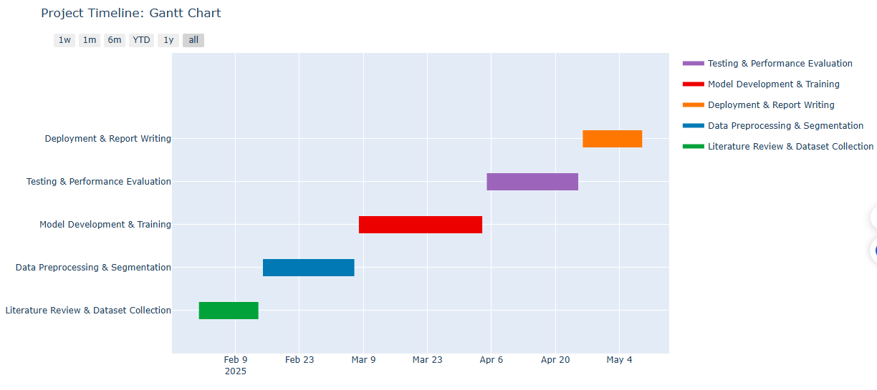
Timeline of the Project (Gantt Chart)

Slide 11
References (IEEE Paper format)
References:-
Gupta, A., Sharma, R., & Verma, P. (2020). Image processing techniques for brain tumor detection. Journal of Medical Imaging Research, 12(3), 215-230.
Patel, M., Singh, H., & Roy, S. (2021). Challenges in manual brain tumor detection: A review. Neuroscience Informatics, 18(1), 89-104.
Rahman, S., Li, X., & Zhao, M. (2023). Hybrid AI models for brain tumor detection: An emerging trend. Computational Medical Imaging, 14(2), 175-192.
Sharma, K., & Kumar, A. (2021). Machine learning approaches in brain tumor classification. Biomedical Signal Processing, 27(4), 319-334.

Slide 12


