Slide 1


Machine Learning: Google_Playstore
Tasnuva Airen
Rutgers Data Science Bootcamp

Slide 2


Google Play Store
Web scraped data of 10k Play Store apps for analyzing the Android market to predict the potential of app-making businesses success
Source: https://www.kaggle.com/lava18/google-play-store-apps
Tools Used: Python Pandas, Matplotlib, Tableau
Database : SQL Database (Postgres)
Data Type : CSV

Slide 3
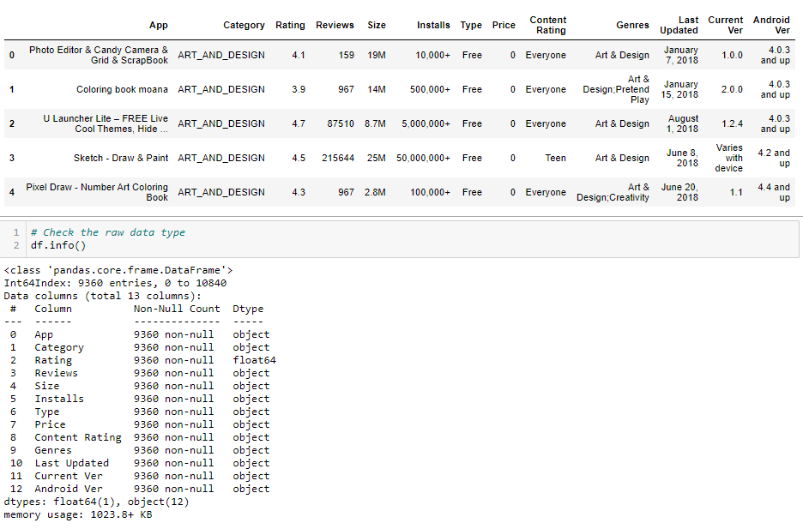
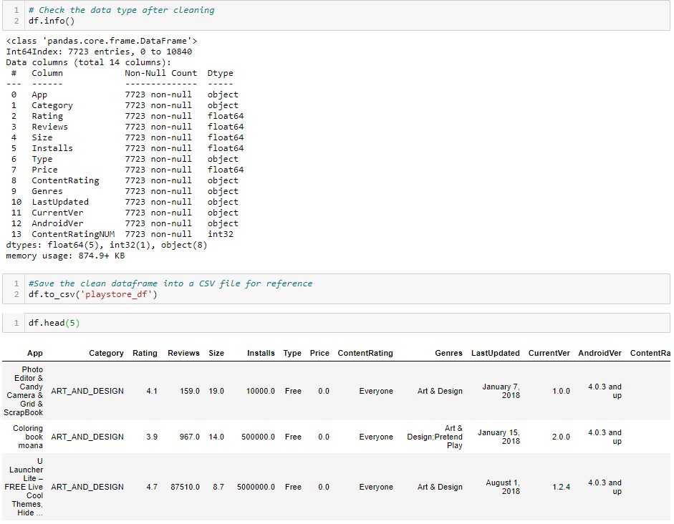
Data Cleaning
Got rid of unnecessary data fields and convert the necessary data fields from object to float or integers

Slide 4

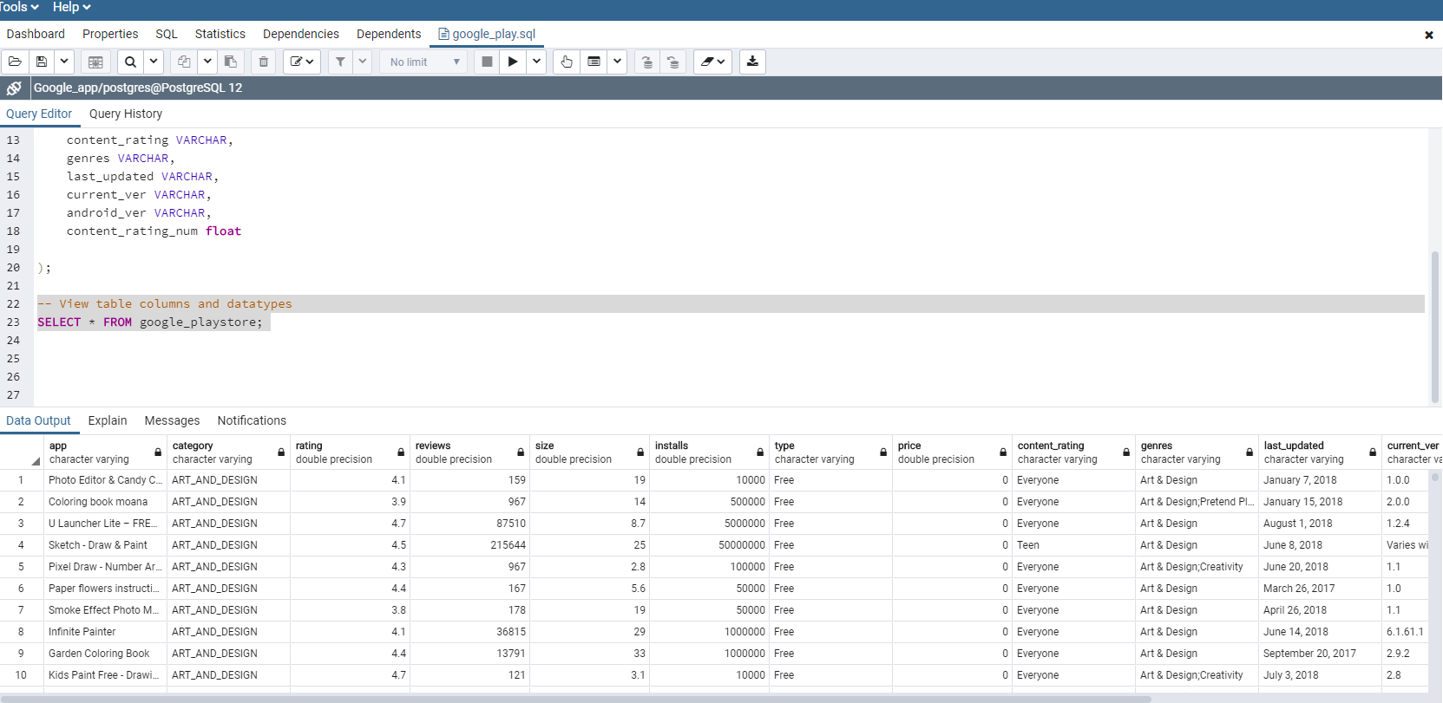
Postgres Database to store Data

Slide 5


Exploratory Data Analysis Tableau

Slide 6
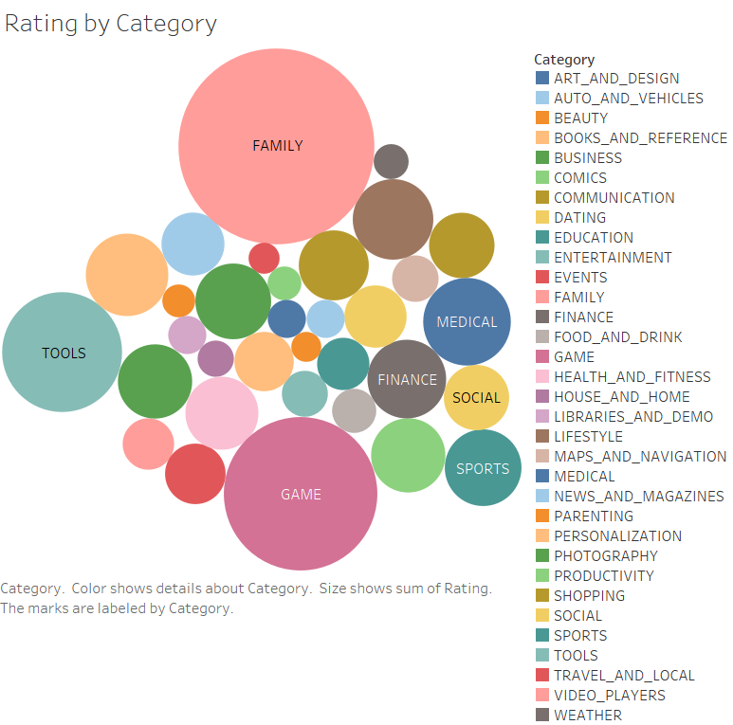

Slide 7

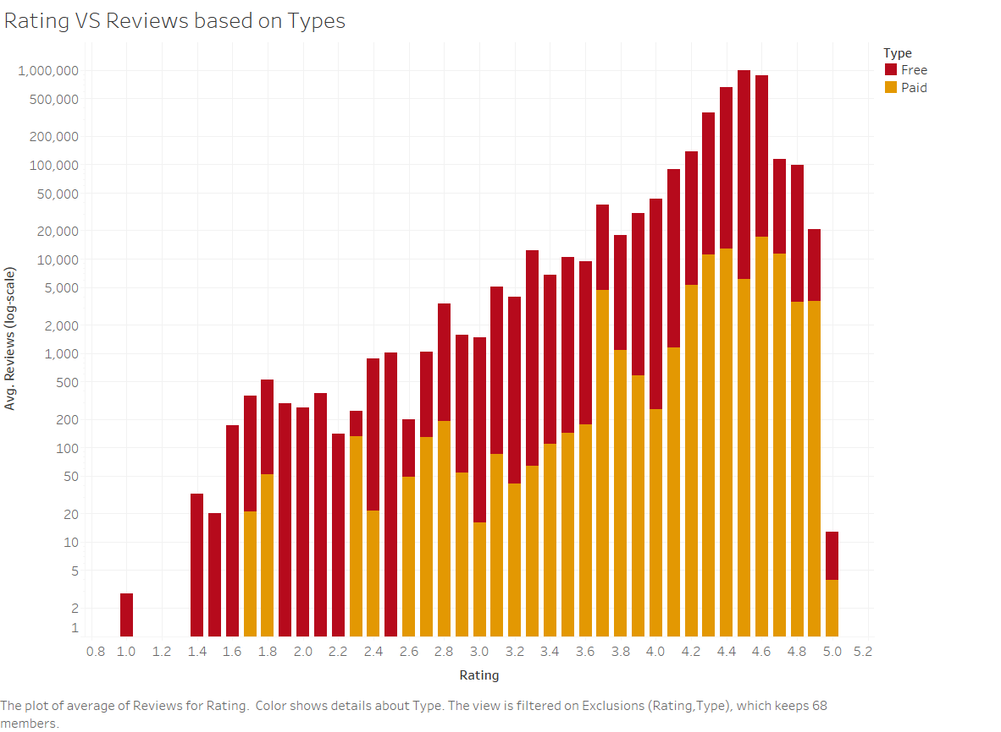

Slide 8
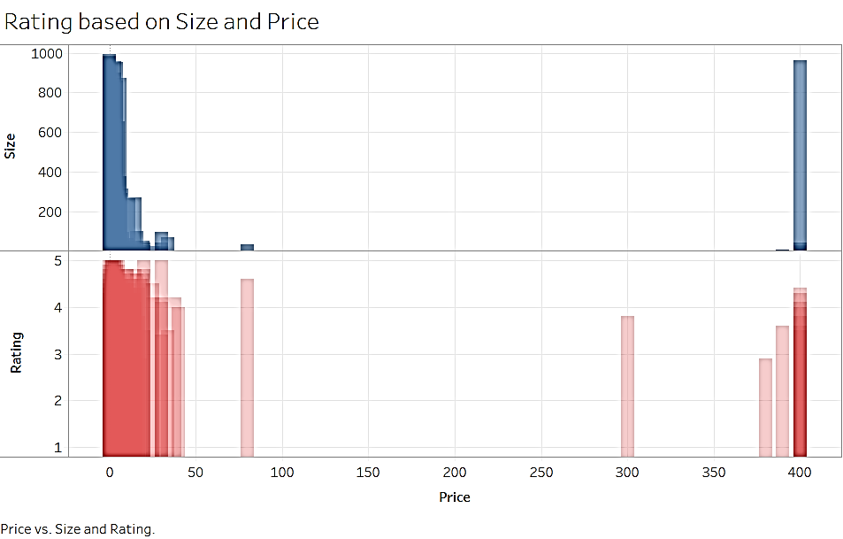

Slide 9
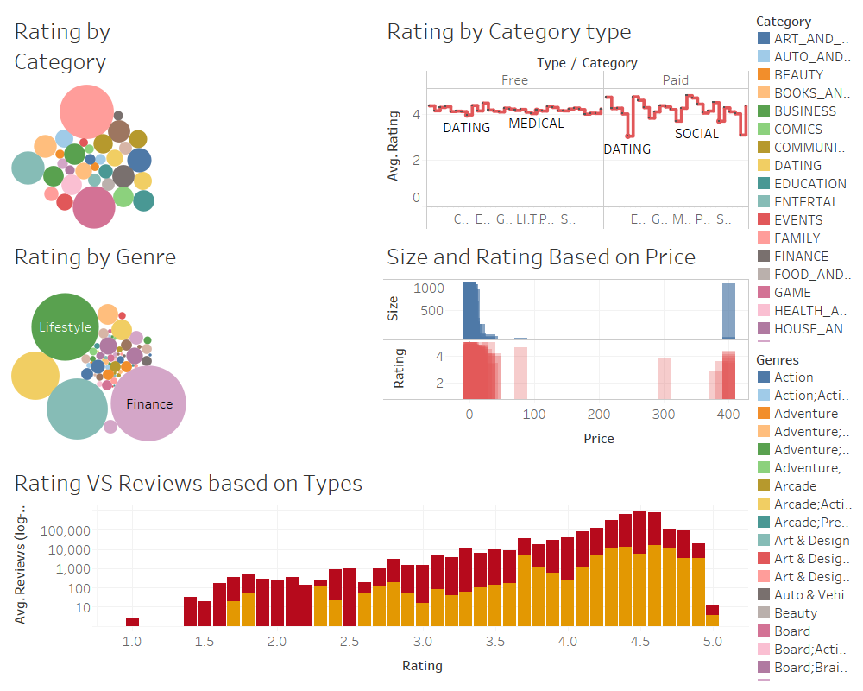

Slide 10

Machine Learning
Machine learning is a program or system that builds (trains) a predictive model from input data. It is a branch of artificial intelligence based on the idea that systems can learn from data, identify patterns and make decisions with minimal human intervention.

Slide 11


Machine Learning
1. Supervised Learning
a. Regression, Taxi Fare/ Housing Price Prediction
B. Classification, e.g. Sentiment/Spam filter prediction
.
2. Unsupervised Learning
a. Clustering , e.g. Product Customer Segment
3. Semi-Supervised Learning
a. Clustering/Classification, e.g. Speech Analysis
4. Reinforcement Learning
a. Classification/Control, e.g. Self-Driving Car

Slide 12
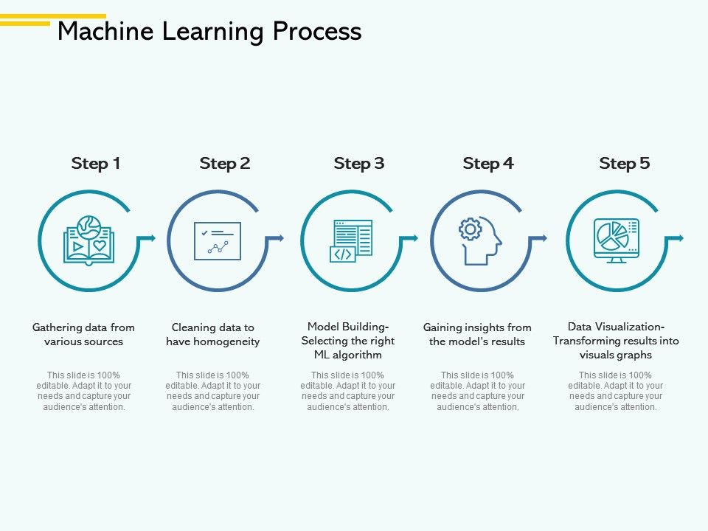

Slide 13
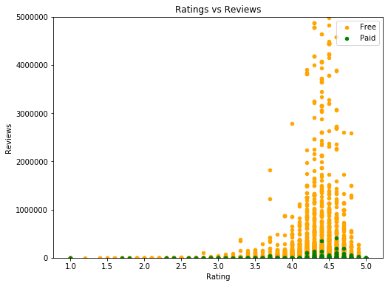
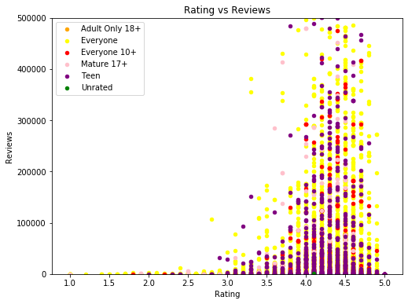
Majority ratings are between 4 and 5. Free app customers are most likely giving more reviews. Paid app customers review rate is very low.
Review and Rating correlation :
Type and Category
Based on app category, most of the reviews are given by the category ‘everyone’ and ‘Teen’. Rating ranges between 4 and 5 as well.

Slide 14
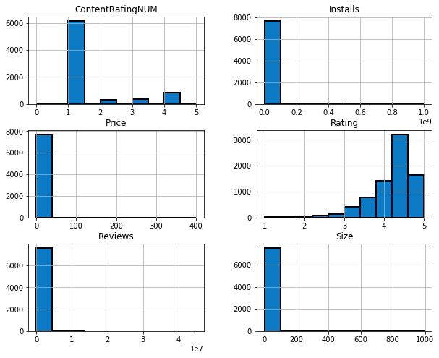
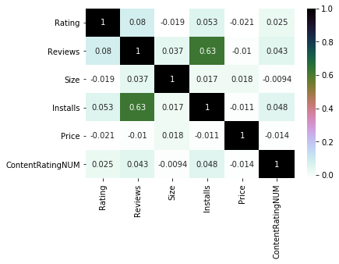
Histogram of the data
Heatmap with input as the correlation matrix calculated by(google app.corr())

Slide 15


Scikit Learn Library Statistical model

Slide 16
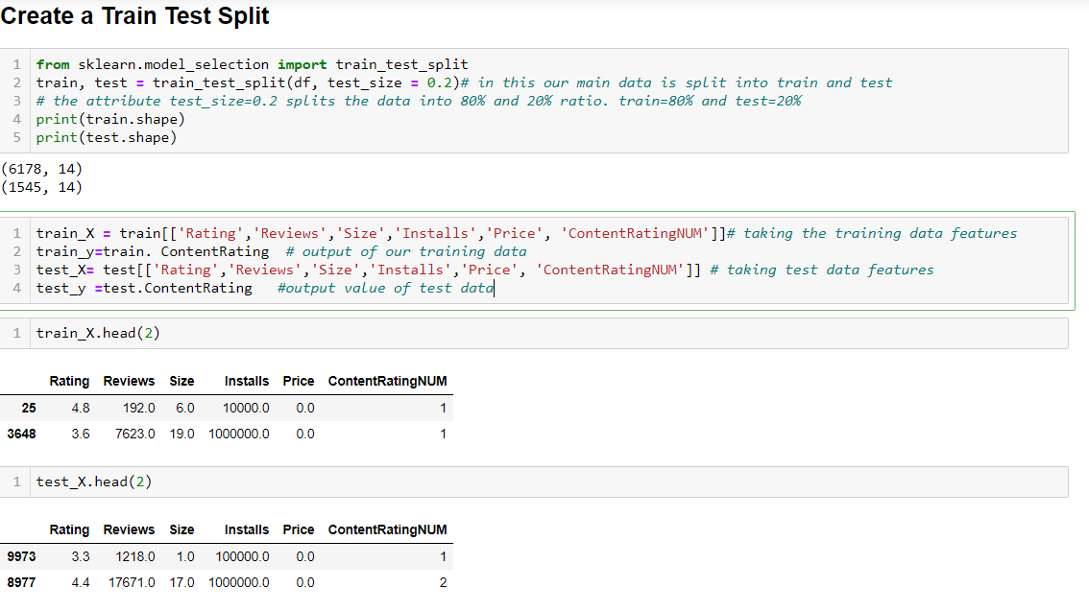
SVC Model ‘Content Rating’ is used as label for classifying based on various features
Train Test Split

Slide 17
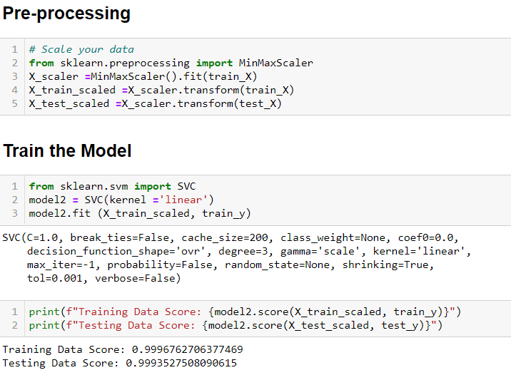
SVC Model
Scale the Data and Train The Model

Slide 18
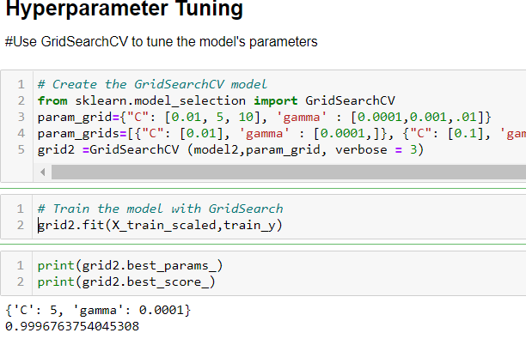
SVC Model
Hyperameter Tuning with GridSearchCV

Slide 19
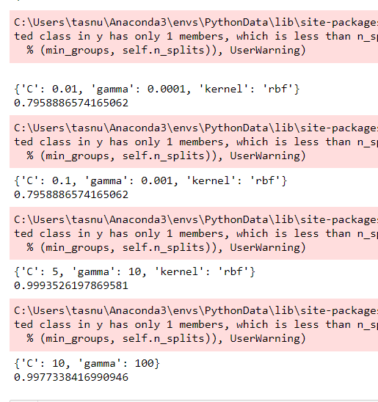
SVC Model
We have used C, gamma and kernel parameters to measure the accuracy of the test results.
Lower values of these parameters gives lower score and higher values of these parameters gives us higher score which is 99%

Slide 20

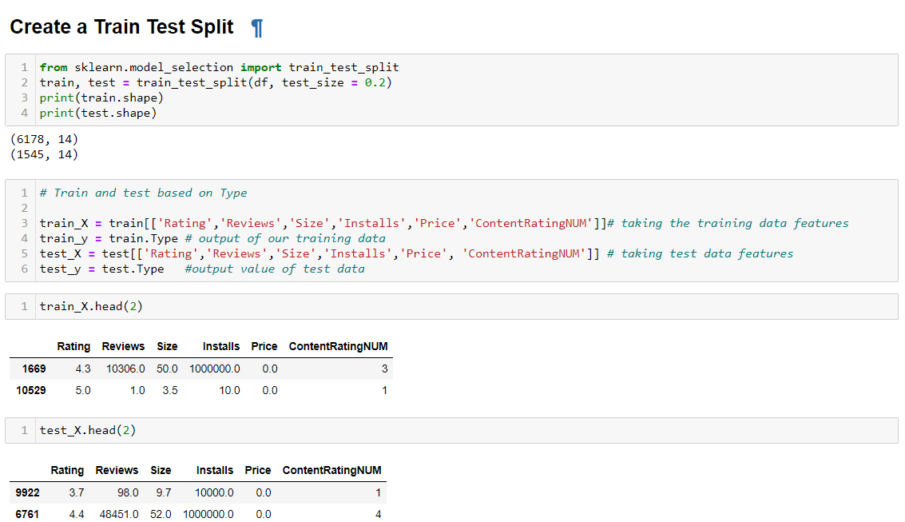
Logistic Regression
App ‘Type’ as Y value

Slide 21
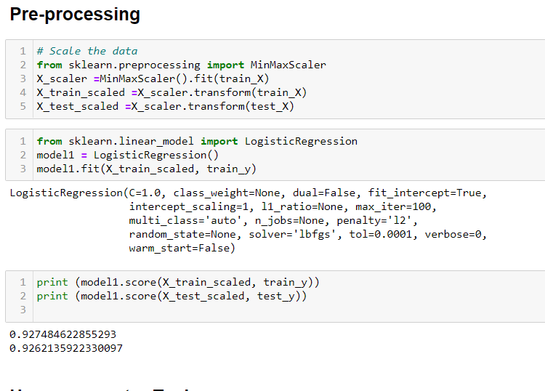

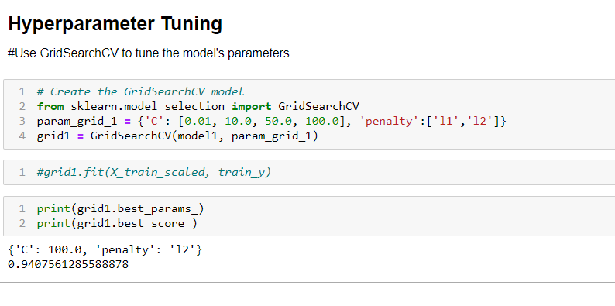
Logistic Regression
Hyperameter Tuning Result is 94% which is higher than the Pre-Processing scores

Slide 22
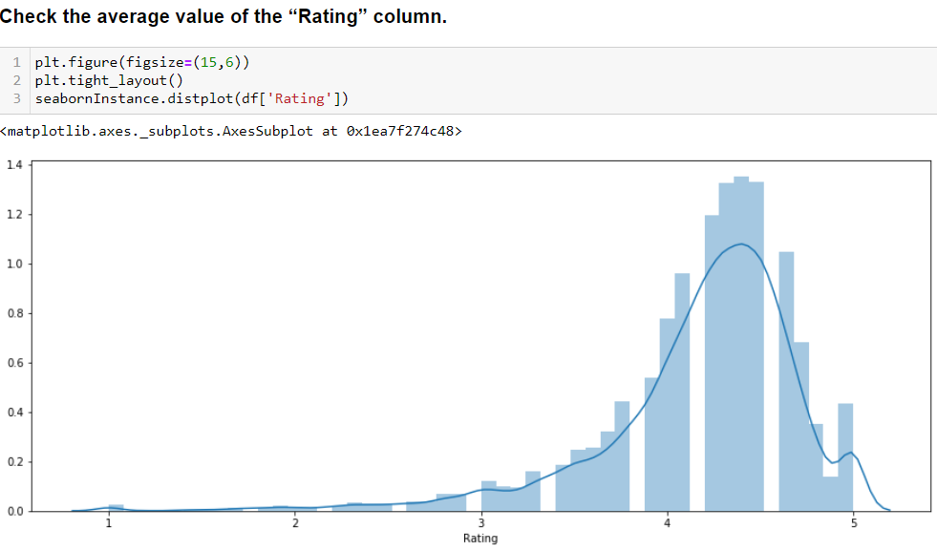
Multiple Linear Regression and error test
Divide the data into “attributes” and “labels”.
X variable contains all the attributes/features and y variable contains labels.
Average Rating falls between 4 and 5.

Slide 23
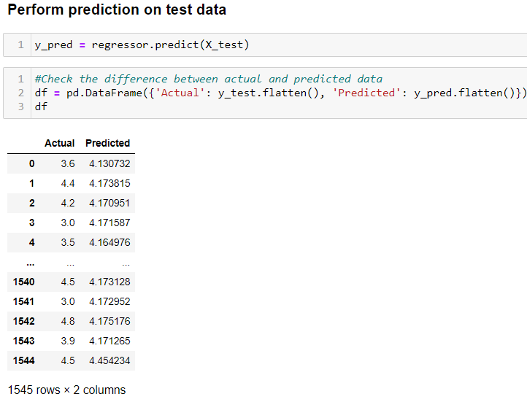
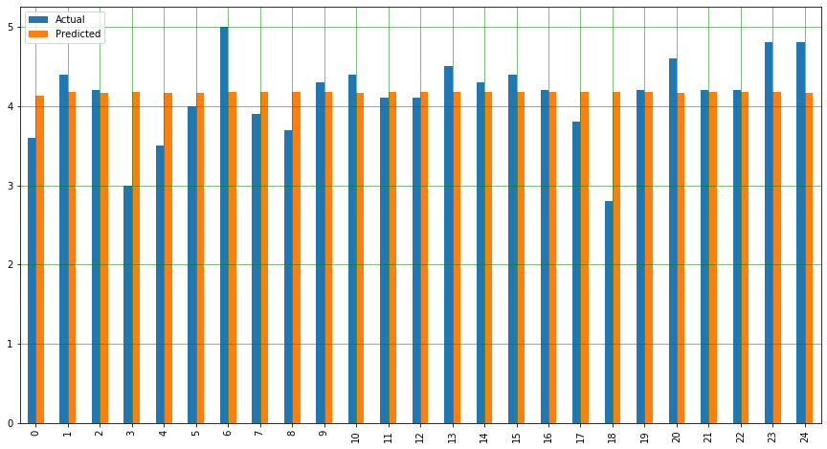
Multiple Linear Regression and error test We can see that our model has returned pretty good predicted results. Actual and predicted scores are pretty close.

Slide 24
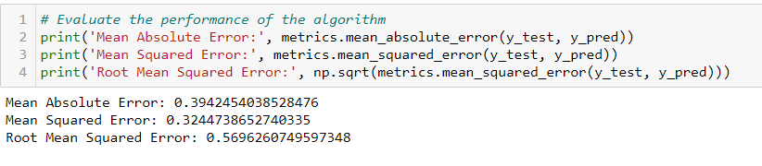
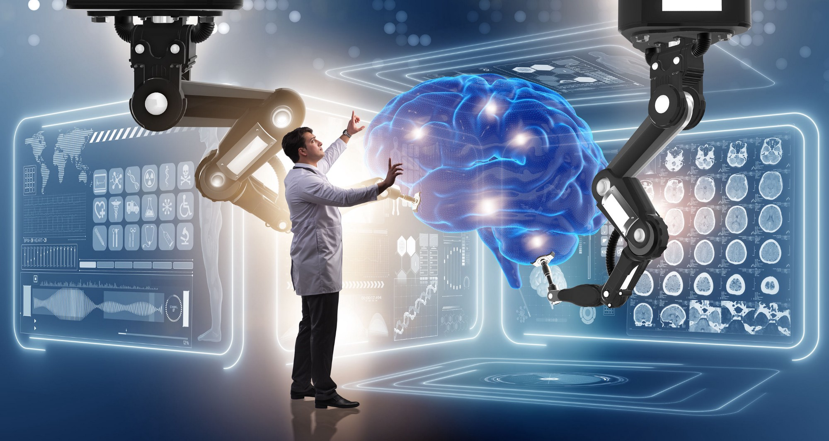
Multiple Linear Regression and error test
Here we can see the Mean absolute error is 39% that means we are almost 60% certain of the prediction to the actual value, which is reasonably good prediction.

Slide 25
Pytorch Library Neural Network Model

Slide 26
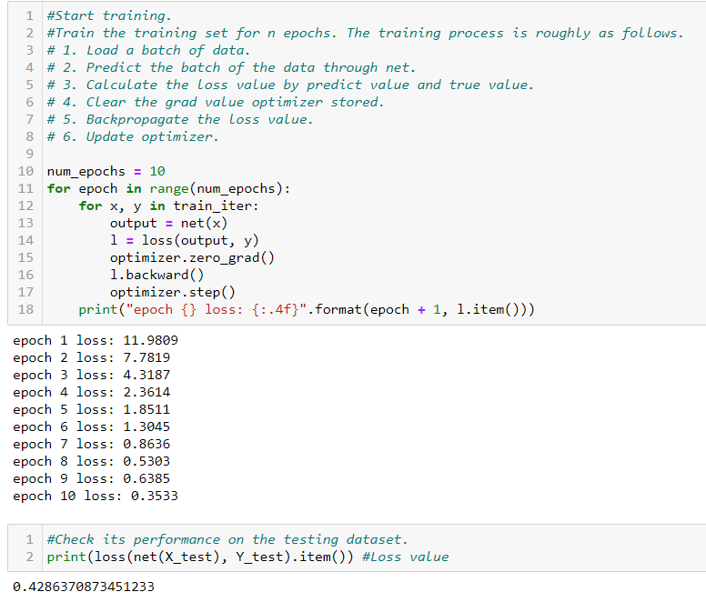
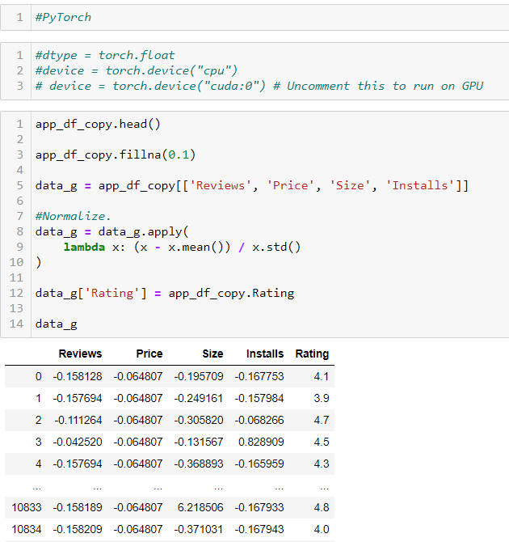

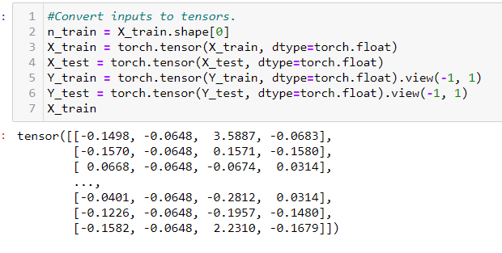
Pytorch : Classifier
Epoc shows how many times iteration is happening
It is training and tuning the model
More training lower the epoc loss
Create a new data frame to use for this model
Convert input to tensor to feed to the neural network model
X train is a multidimensional array
Notes:
Classifier

Slide 27
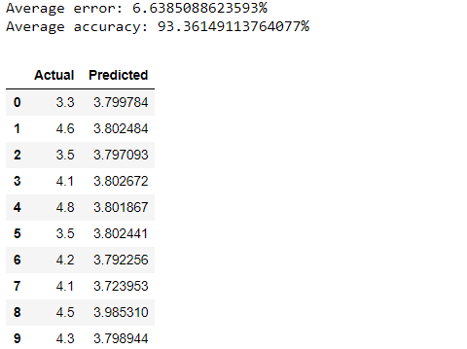
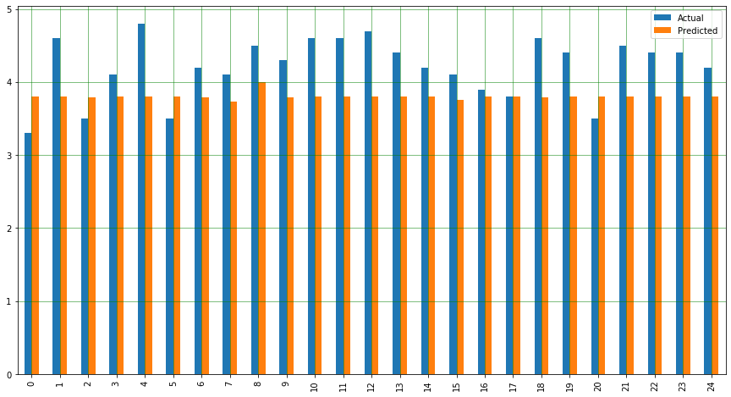
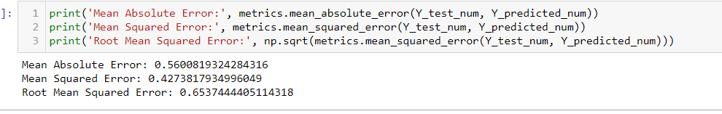
Pytorch : Classifier

Slide 28
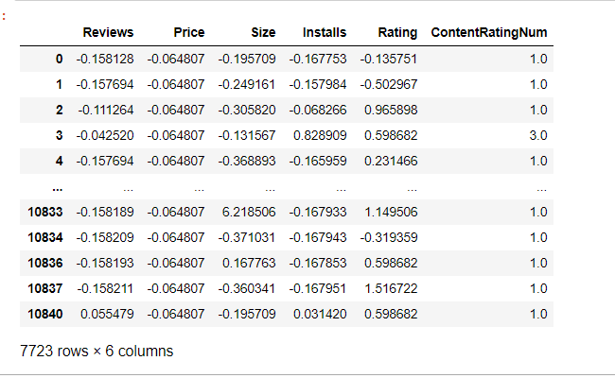
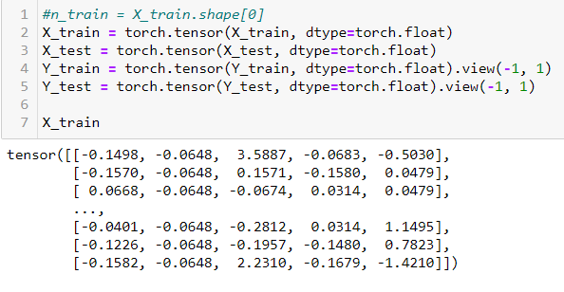
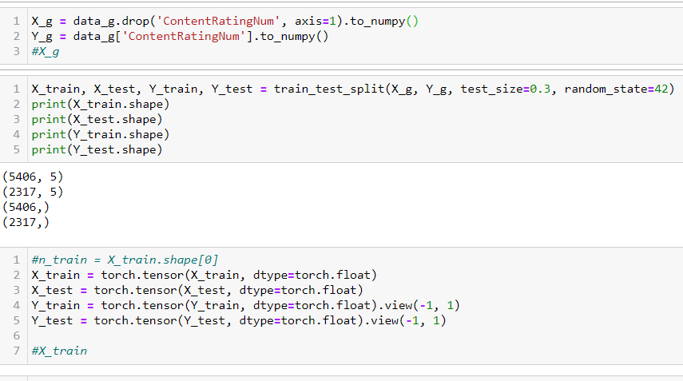
Pytorch classifier (SVM)
Create a data frame to use in the model. We are using Category Rating for the SVM model here.
Convert input to tensor to feed to the neural network model
X train is a multidimensional array

Slide 29
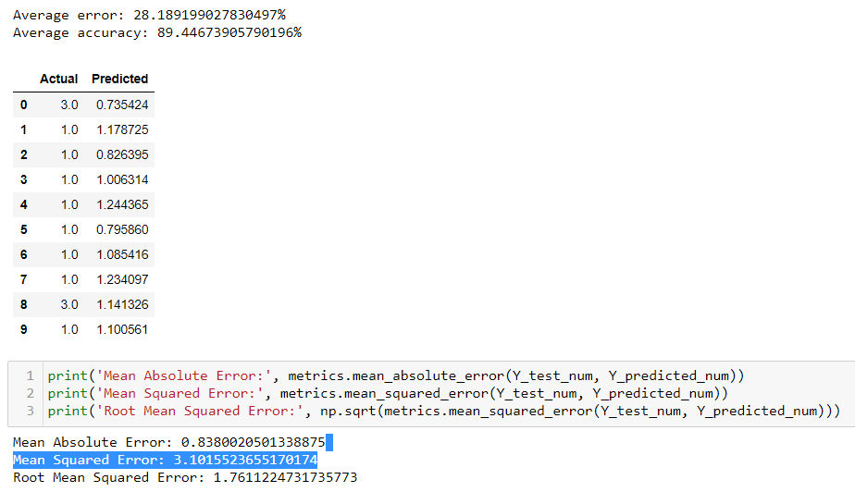
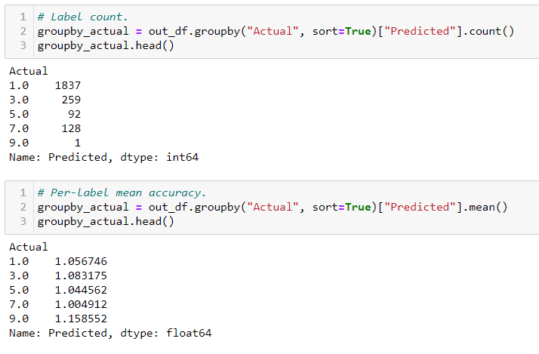
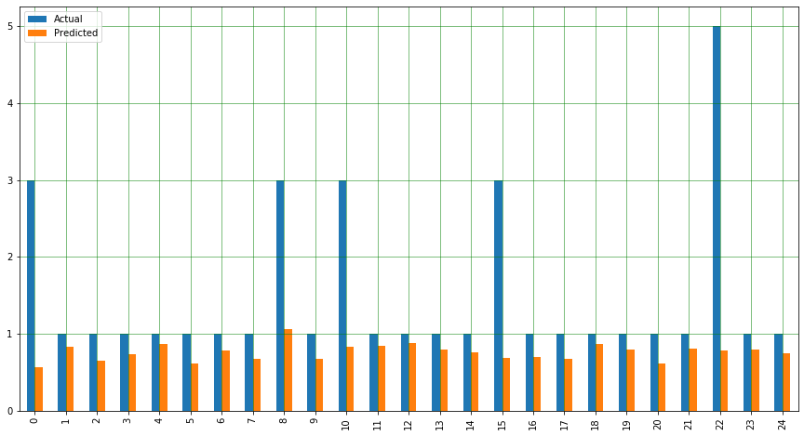
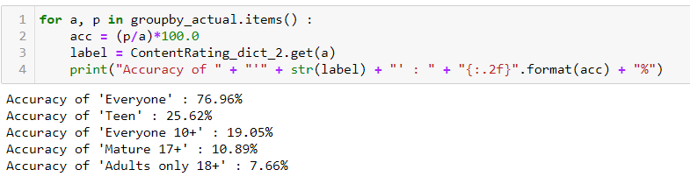
Pytorch classifier (SVM)

Slide 30
Model Comparison (Linear Regression)
Scikit Learn
Pytorch

Slide 31
The Models show us the accuracy of prediction of the customer rating and user feedback on various features of the products can determine and guide the app market to the right direction for future app development.

Slide 32
References
https://towardsdatascience.com/a-beginners-guide-to-linear-regression-in-python-with-scikit-learn-83a8f7ae2b4f
https://www.kaggle.com/ash316/ml-from-scratch-with-iris
https://medium.com/the-research-nest/data-science-tutorial-analysis-of-the-google-play-store-dataset-c720330d4903
https://developers.google.com/machine-learning/glossary#m
https://www.sas.com/en_us/insights/analytics/machine-learning.html
https://www.codeproject.com/Articles/5245488/Introduction-to-Machine-Learning-and-ML-NET-Part-1
https://www.slideteam.net/machine-learning-process-knowledge-ppt-powerpoint-presentation-file-images.html

Slide 33

Questions?

