Slide 1
A novel predictive CAT method for screening instruments
Tasos Psychogyiopoulos
University of Amsterdam
Psychoco 2025

Slide 2
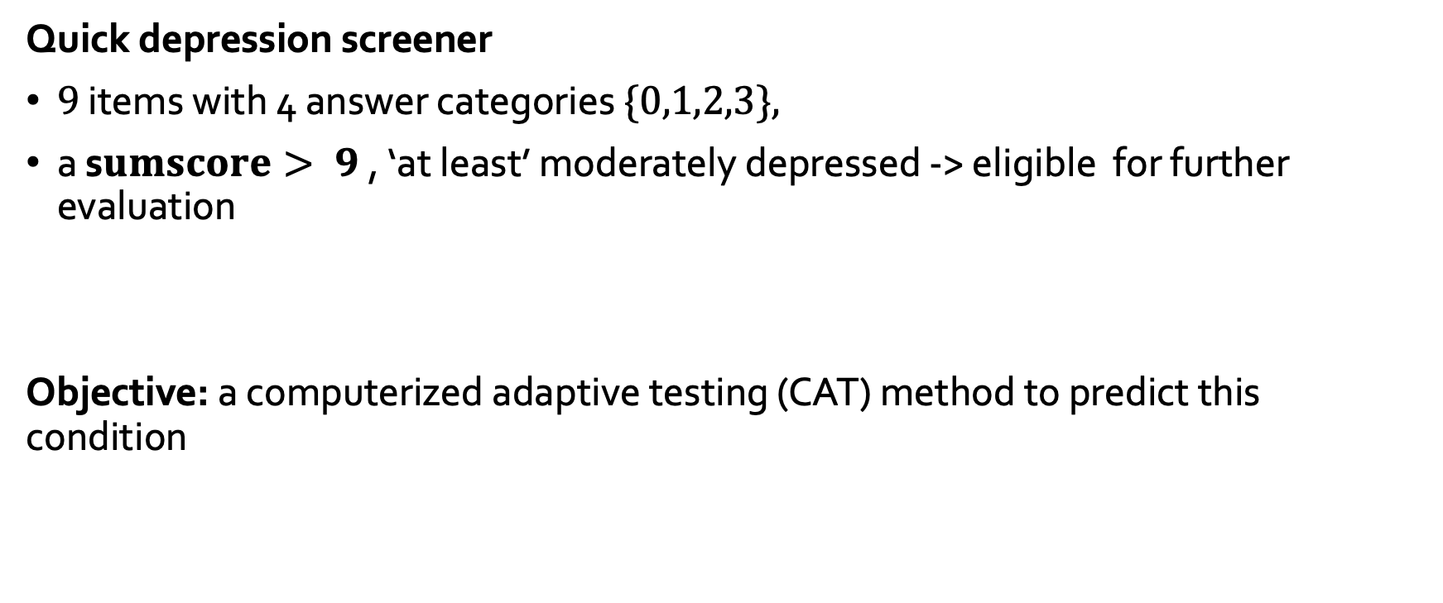
PHQ-9 Patient Depression Questionnaire (Kroenke et al., 2001)
Quick depression screener
$9$ items with 4 answer categories $\{0,1,2,3\},$
a s$umscore> 9$, ‘at least’ moderately depressed -> eligible for further evaluation
Objective: a computerized adaptive testing (CAT) method to predict this condition

Slide 3
An illustration using PHQ9

Slide 4
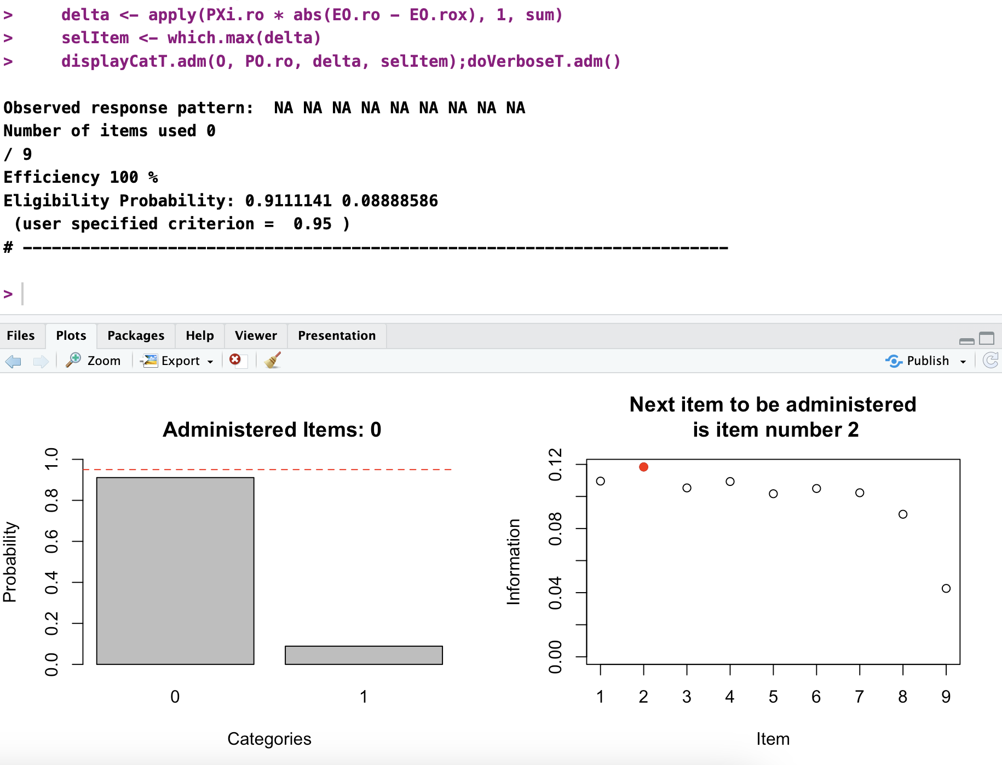

Slide 5
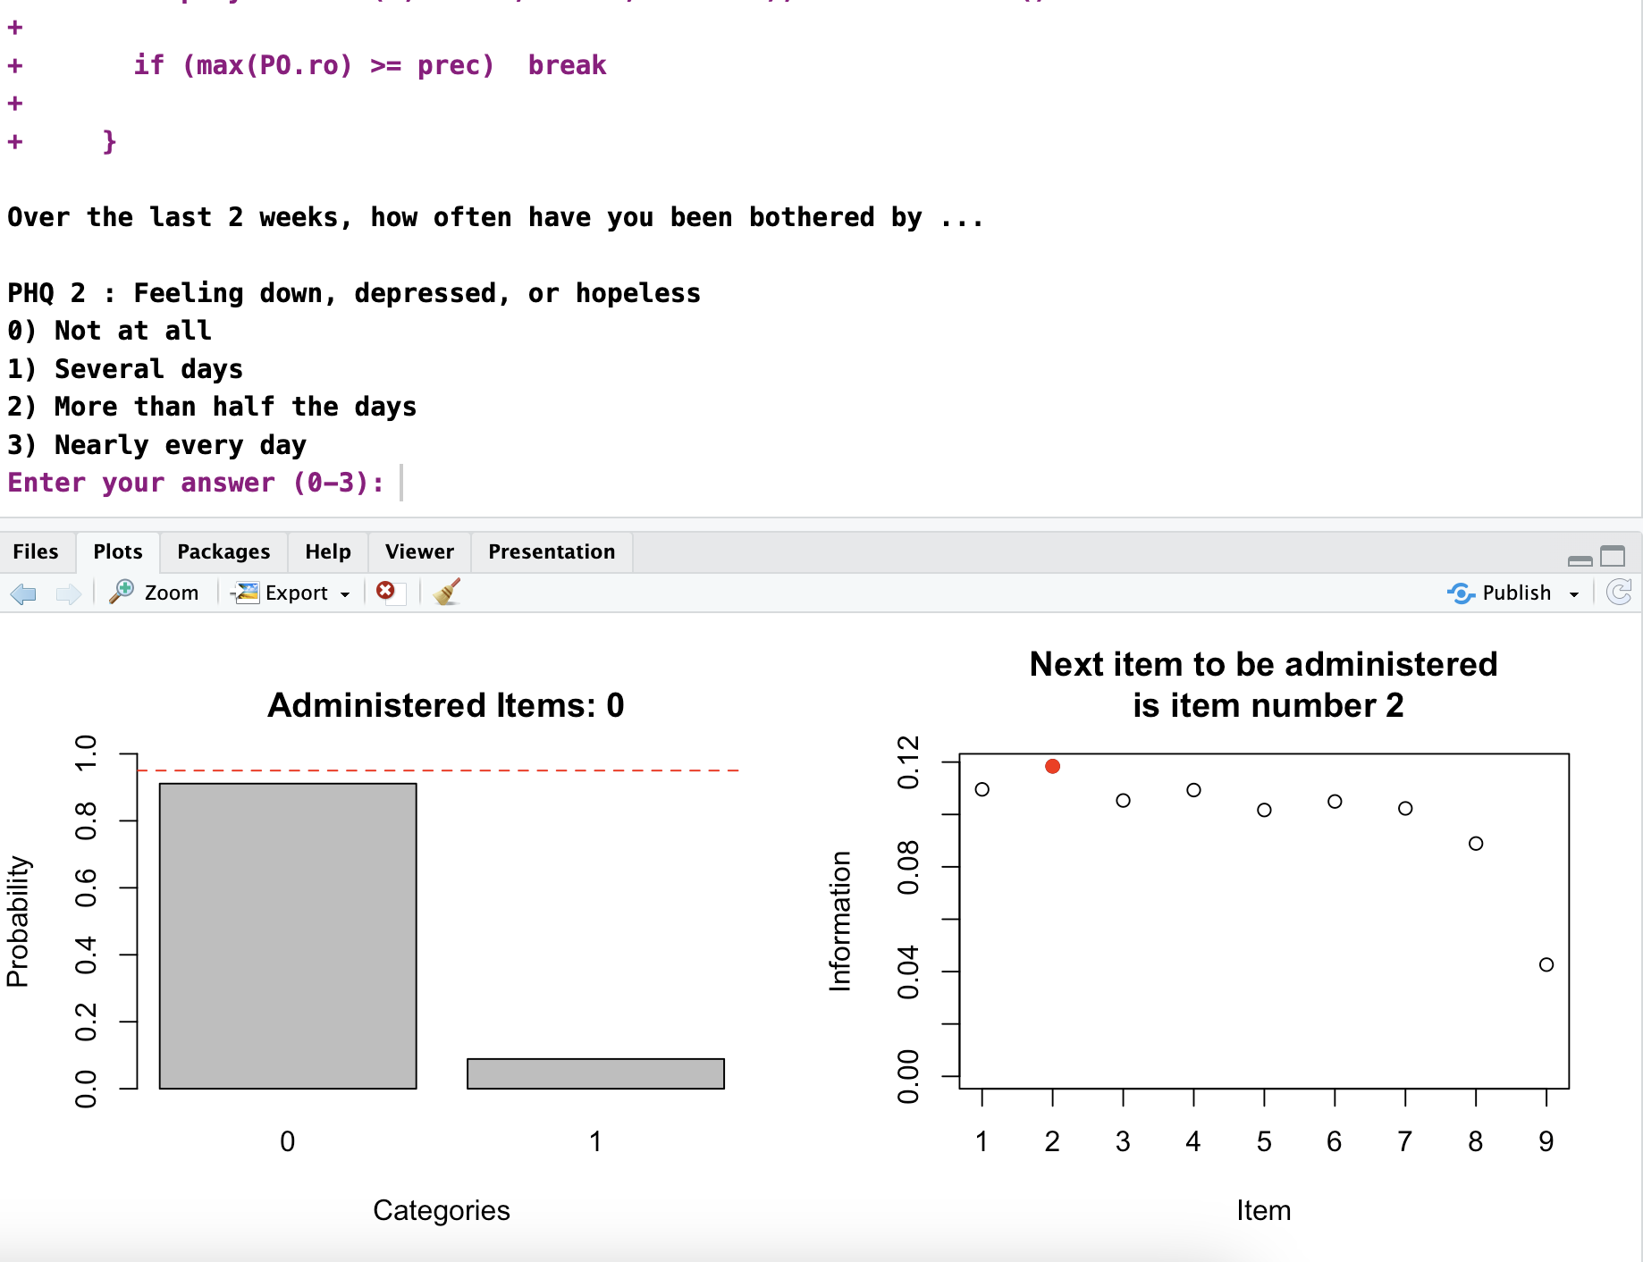
1

Slide 6
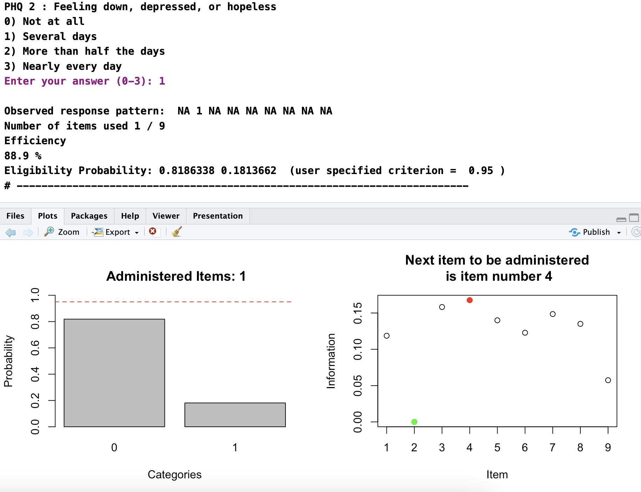

Slide 7
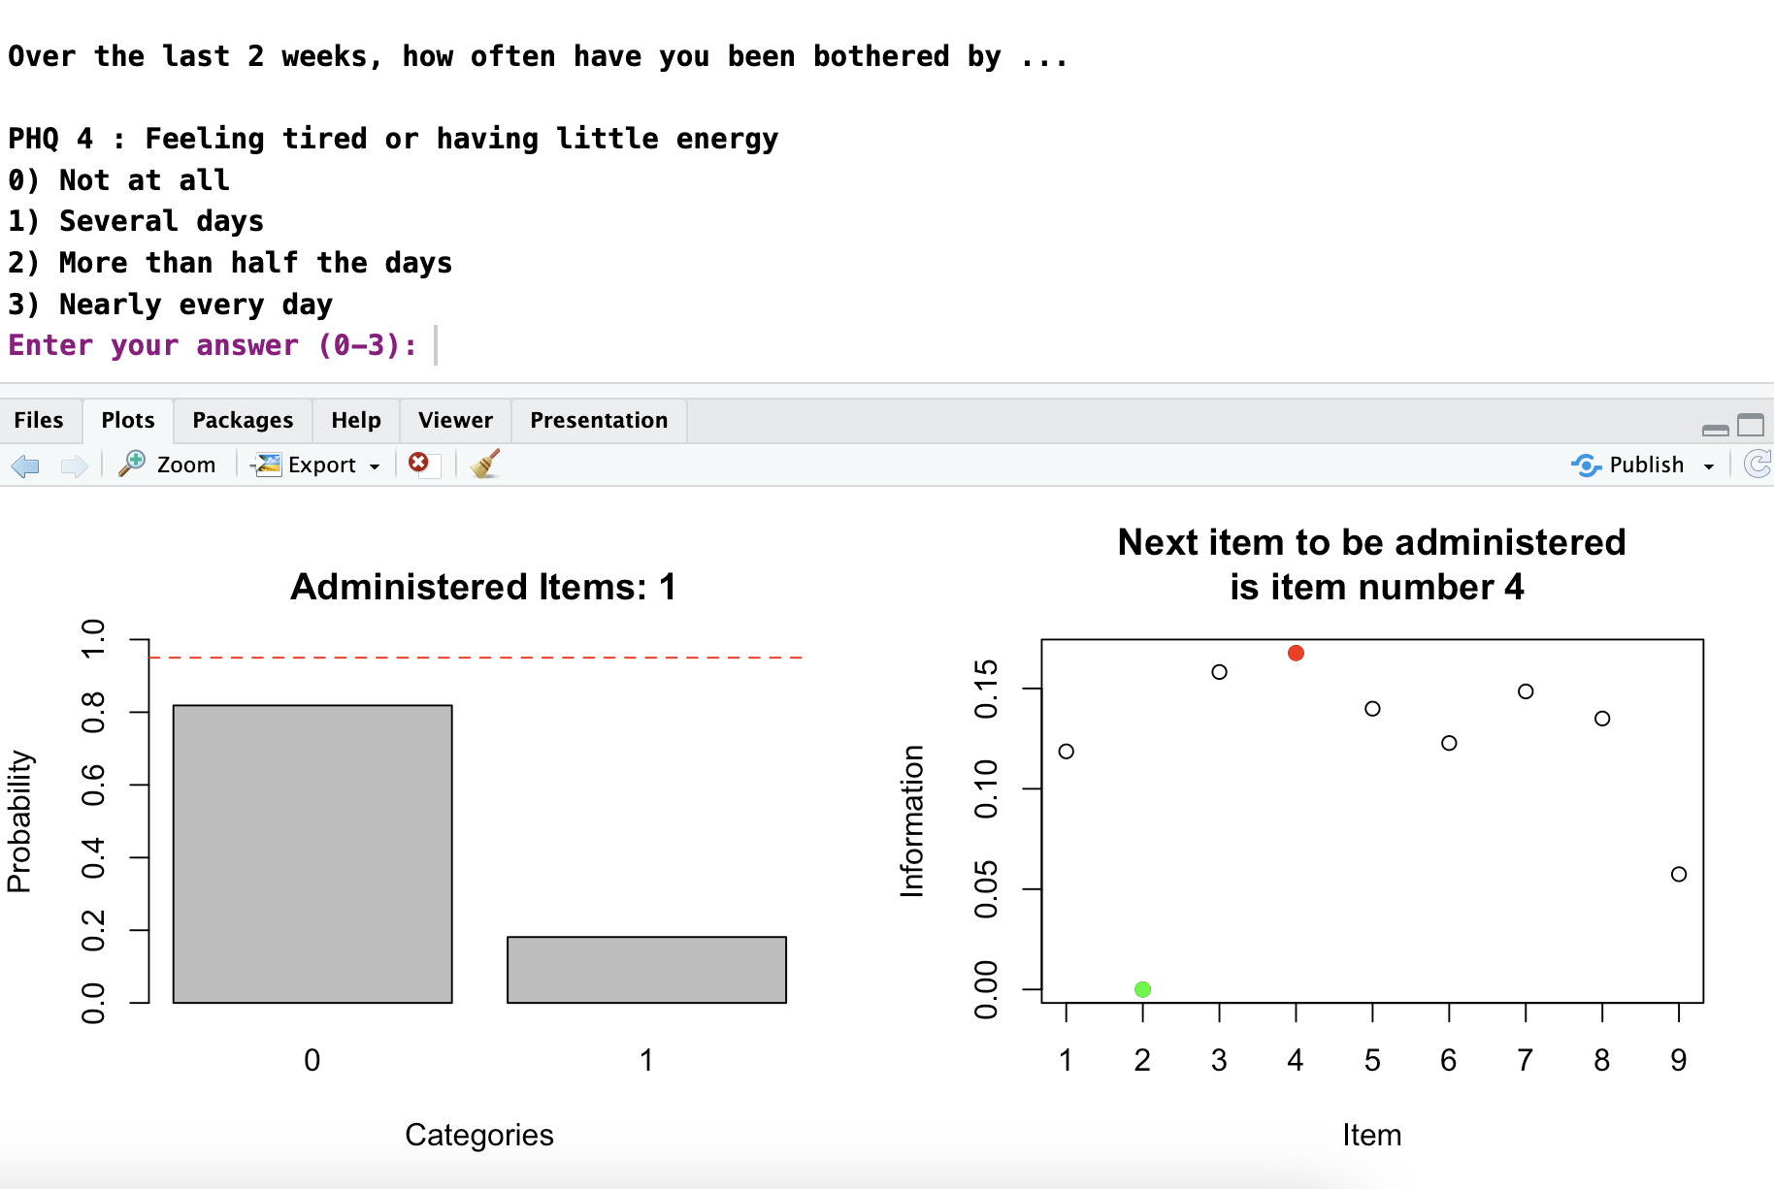
0

Slide 8
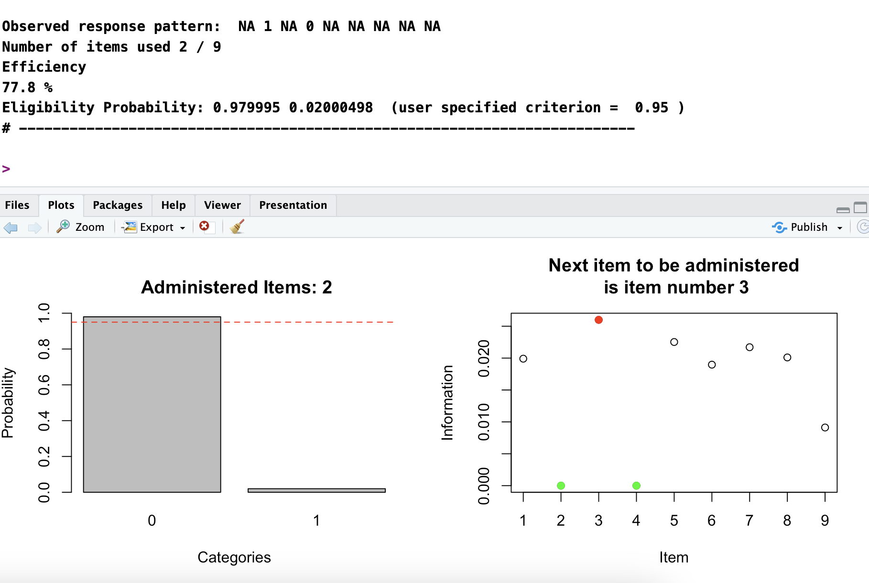

Slide 9
FlexCAT Framework (Van der Ark & Smits, 2023)
score : The variable used to communicate the respondent’s value.
engine: The model used to estimate the joint density of item scores.
Item response theory (IRT)
model
Latent trait θ
Latent class models (LCM)
Probability Status
Notes:
A data driven model
Convinient estimate the item score density

Slide 10
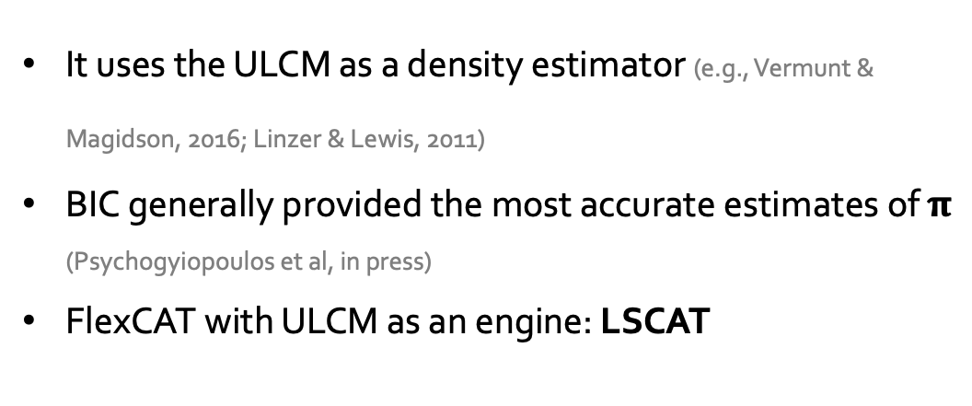

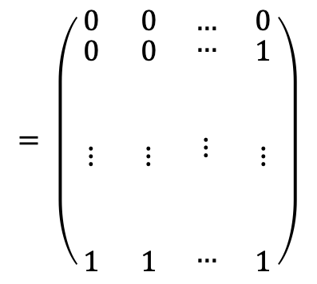
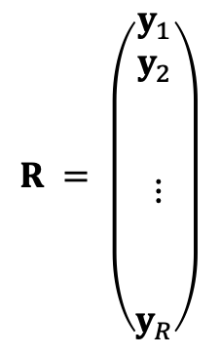

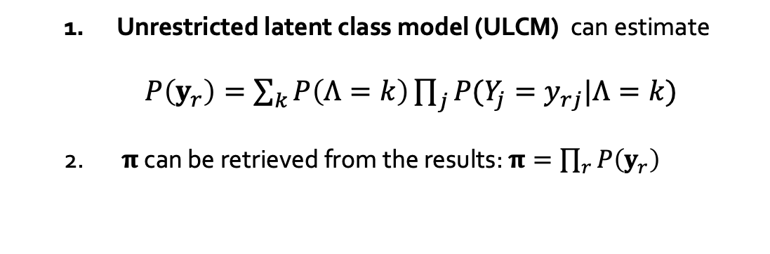
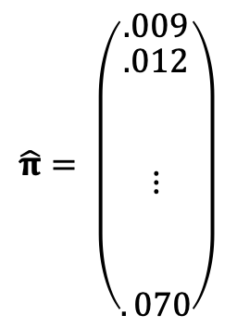
engine
For $9$ items with $4$answer categories,
there are $49=262,144$ response patterns:
$y_{1}, …,y_{R}$: All possible response patterns
$$R = \left(\begin{matrix}\begin{aligned}y_{1} \\ y_{2} \\ \\ \\ ⋮ \\ \\ \\ y_{R}\end{aligned}\end{matrix}\right)$$
$$= \left(\begin{matrix}0 & 0 & … & 0 \\ \begin{aligned}0 \\ \\ \\ ⋮ \\ \\ \\ 1\end{aligned} & \begin{aligned}0 \\ \\ \\ ⋮ \\ \\ \\ 1\end{aligned} & \begin{aligned}… \\ \\ \\ ⋮ \\ \\ \\ …\end{aligned} & \begin{aligned}1 \\ \\ \\ ⋮ \\ \\ \\ 1\end{aligned}\end{matrix}\right)$$
π $=P(y_{1}, …,y_{R})$: joint item score density
Unrestricted latent class model (ULCM) can estimate
$P\left(y_{r}\right)=\sum_{k}{P\left(Λ=k\right)\prod_{j}{P(Y_{j}=y_{rj}|Λ=k)}}$
$π$ can be retrieved from the results: $π=\prod_{r}{P\left(y_{r}\right)}$
$$\hat{π}= \left(\begin{matrix}.009 \\ \begin{aligned}.012 \\ \\ \\ ⋮ \\ \\ \\ . 070\end{aligned}\end{matrix}\right)$$
It uses the ULCM as a density estimator (e.g., Vermunt & Magidson, 2016; Linzer & Lewis, 2011)
BIC generally provided the most accurate estimates of $π$ (Psychogyiopoulos et al, in press)
FlexCAT with ULCM as an engine: LSCAT

Slide 11
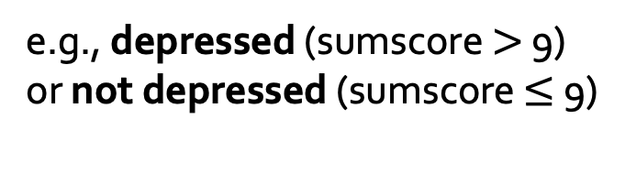
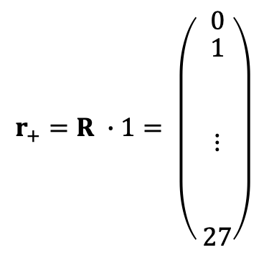
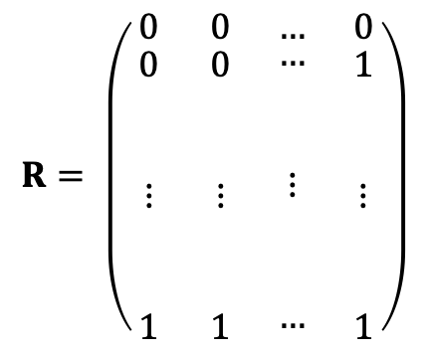

score : The variable used to communicate the respondent’s value.
I want to predict a status
e.g., depressed (sumscore $>$ 9)
or not depressed (sumscore $≤$ 9)
$$R= \left(\begin{matrix}0 & 0 & … & 0 \\ \begin{aligned}0 \\ \\ \\ ⋮ \\ \\ \\ 1\end{aligned} & \begin{aligned}0 \\ \\ \\ ⋮ \\ \\ \\ 1\end{aligned} & \begin{aligned}… \\ \\ \\ ⋮ \\ \\ \\ …\end{aligned} & \begin{aligned}1 \\ \\ \\ ⋮ \\ \\ \\ 1\end{aligned}\end{matrix}\right)$$
$$r_{+}=R ∙1= \left(\begin{matrix} 0 \\ \begin{aligned} 1 \\ \\ \\ ⋮ \\ \\ \\ 27\end{aligned}\end{matrix}\right)$$
$$(49× 9)$$

Slide 12
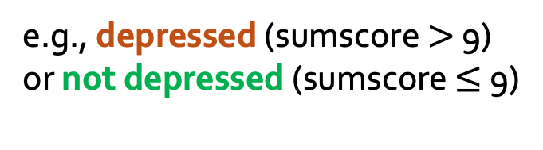

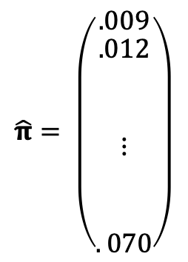
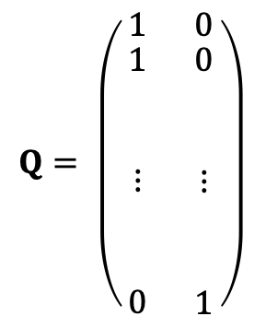
score : The variable used to communicate the respondent’s value.
I want to predict a status
e.g., depressed (sumscore $>$ 9)
or not depressed (sumscore $≤$ 9)
$$R= \left(\begin{matrix}0 & 0 & … & 0 \\ \begin{aligned}0 \\ \\ \\ ⋮ \\ \\ \\ 1\end{aligned} & \begin{aligned}0 \\ \\ \\ ⋮ \\ \\ \\ 1\end{aligned} & \begin{aligned}… \\ \\ \\ ⋮ \\ \\ \\ …\end{aligned} & \begin{aligned}1 \\ \\ \\ ⋮ \\ \\ \\ 1\end{aligned}\end{matrix}\right)$$
$$r_{+}=R ∙1= \left(\begin{matrix} 0 \\ \begin{aligned} 1 \\ \\ \\ ⋮ \\ \\ \\ 27\end{aligned}\end{matrix}\right)$$
$$Q= \left(\begin{matrix}1 & 0 \\ \begin{aligned}1 \\ \\ \\ ⋮ \\ \\ \\ 0\end{aligned} & \begin{aligned}0 \\ \\ \\ ⋮ \\ \\ \\ 1\end{aligned}\end{matrix}\right)$$
$$(49× 9)$$
$$\hat{π}= \left(\begin{matrix}.009 \\ \begin{aligned}.012 \\ \\ \\ ⋮ \\ \\ \\ . 070\end{aligned}\end{matrix}\right)$$
we calculate
$$\hat{π}S=qT\hat{π}= \left(\begin{matrix}.911 \\ .088\end{matrix}\right)$$

Slide 13
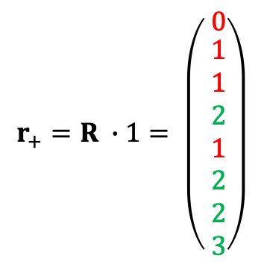
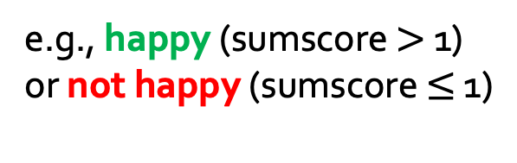
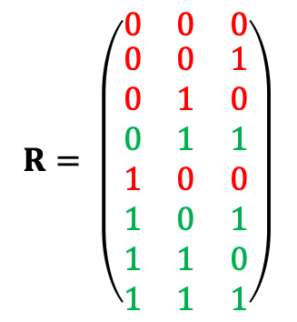
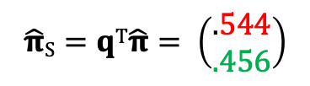
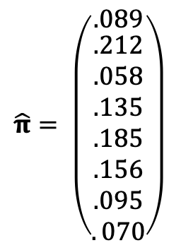
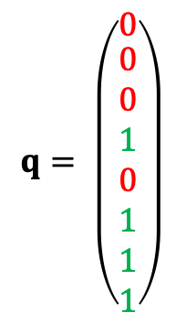
score : The variable used to communicate the respondent’s value.
I want to predict a status
e.g., happy (sumscore $>$ 1)
or not happy (sumscore $≤$ 1)
$$R= \left(\begin{matrix}0 & 0 & 0 \\ \begin{aligned}0 \\ 0 \\ 0 \\ 1 \\ 1 \\ 1 \\ 1\end{aligned} & \begin{aligned}0 \\ 1 \\ 1 \\ 0 \\ 0 \\ 1 \\ 1\end{aligned} & \begin{aligned}1 \\ 0 \\ 1 \\ 0 \\ 1 \\ 0 \\ 1\end{aligned}\end{matrix}\right)$$
$$r_{+}=R ∙1= \left(\begin{matrix} 0 \\ \begin{aligned} 1 \\ 1 \\ 2 \\ 1 \\ 2 \\ 2 \\ 3\end{aligned}\end{matrix}\right)$$
$$q= \left(\begin{matrix}0 \\ \begin{aligned}0 \\ 0 \\ 1 \\ 0 \\ 1 \\ 1 \\ 1\end{aligned}\end{matrix}\right)$$
$$\hat{π}= \left(\begin{matrix}.089 \\ \begin{aligned}.212 \\ .058 \\ .135 \\ .185 \\ .156 \\ .095 \\ . 070\end{aligned}\end{matrix}\right)$$
Then, with
we can calculate
$$\hat{π}S=qT\hat{π}= \left(\begin{matrix}.544 \\ .456\end{matrix}\right)$$

Slide 14
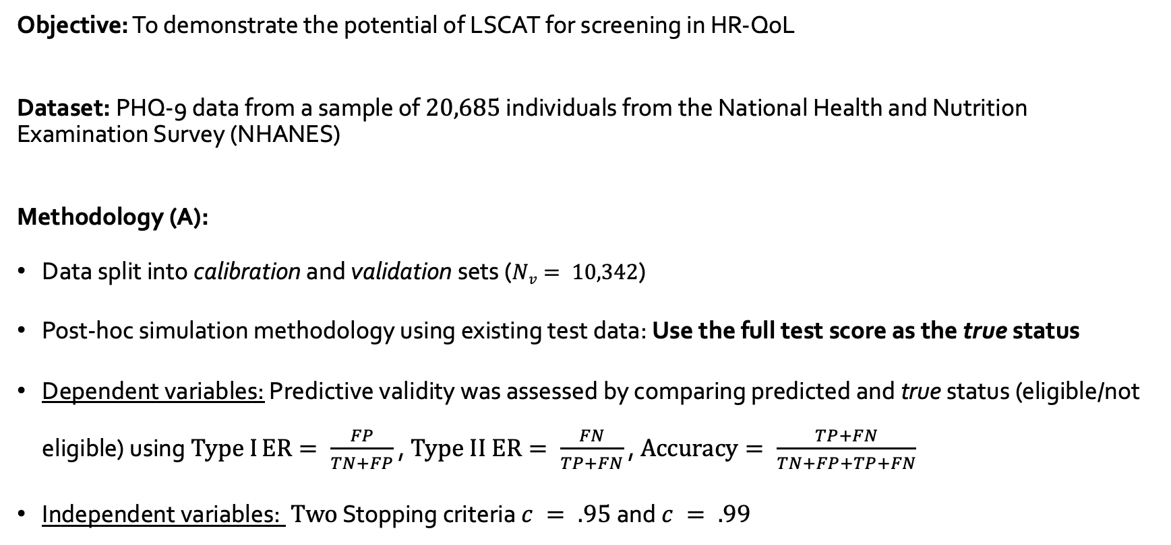
Study: LSCAT as a Screener for Prediction
Objective: To demonstrate the potential of LSCAT for screening in HR-QoL
Dataset: PHQ-9 data from a sample of $20,685$ individuals from the National Health and Nutrition Examination Survey (NHANES)
Methodology (A):
Data split into calibration and validation sets ($Nv= 10,342$)
Post-hoc simulation methodology using existing test data: Use the full test score as the true status
Dependent variables: Predictive validity was assessed by comparing predicted and true status (eligible/not eligible) using $Type I ER= \frac{FP}{TN+FP}$ , $Type II ER= \frac{FN}{TP+FN}$ , $Accuracy= \frac{TP+FN}{TN+FP+TP+FN}$
Independent variables: $Two$ Stopping criteria $c = .95$and $c = .99$

Slide 15
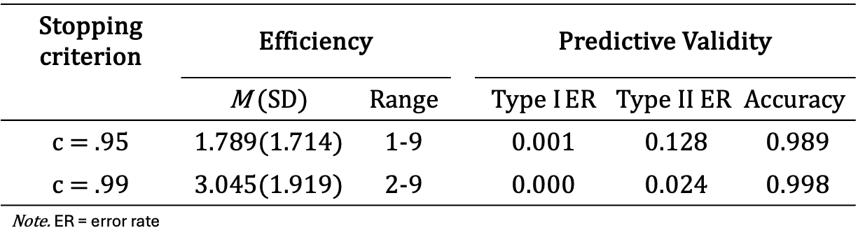
LSCAT Results
Stopping criterion | Efficiency |  |  | Predictive Validity
 | M (SD) | Range |  | $Type I ER$ | $$Type II ER$$ | $$Accuracy$$
c = .95 | 1.789(1.714) | 1-9 |  | 0.001 | 0.128 | 0.989
c = .99 | 3.045(1.919) | 2-9 |  | 0.000 | 0.024 | 0.998
Note. ER = error rate

Slide 16
Study: LSCAT as a Screener for Prediction
Objective: To demonstrate the potential of LSCAT for screening in HR-QoL, comparing to benchmark methods:
• Stochastic Curtailment (SC) (e.g., Smits & Finkelman, 2015; Finkelman et al. 2011)
• CAT using Decision Trees (DTCAT) (e.g., Yan et al. 2004; Gibbons et al. 2023;2013)
Hypothesis: LSCAT would perform better because it employs dynamic item selection
Methodology (B):
Same Post-hoc simulation methodology
Efficiency (average administered items) was fixed across methods
Notes:
Under SC, the test items are administered until there is sufficient confidence
about the respondent’s status. Typically, sufficient confidence is achieved when the
sum of the administered items exceeds a pre-specified cutoff

Slide 17
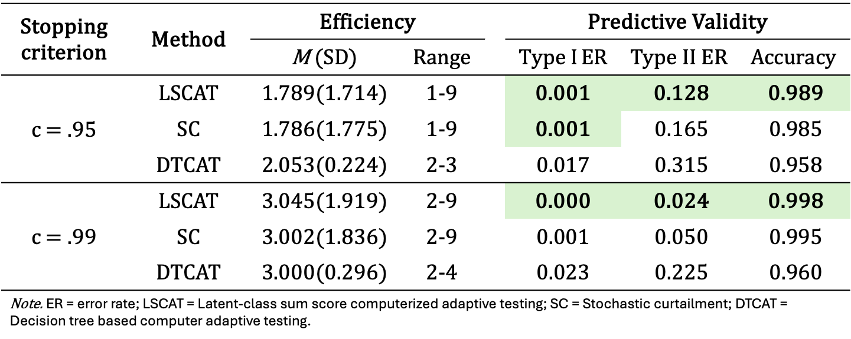
Study B - Results
Stopping criterion | Method | Efficiency |  |  | Predictive Validity
 |  | M (SD) | Range |  | $Type I ER$ | $$Type II ER$$ | $$Accuracy$$
c = .95 | LSCAT | 1.789(1.714) | 1-9 |  | 0.001 | 0.128 | 0.989
 | SC | 1.786(1.775) | 1-9 |  | 0.001 | 0.165 | 0.985
 | DTCAT | 2.053(0.224) | 2-3 |  | 0.017 | 0.315 | 0.958
c = .99 | LSCAT | 3.045(1.919) | 2-9 |  | 0.000 | 0.024 | 0.998
 | SC | 3.002(1.836) | 2-9 |  | 0.001 | 0.050 | 0.995
 | DTCAT | 3.000(0.296) | 2-4 |  | 0.023 | 0.225 | 0.960
Note. ER = error rate; LSCAT = Latent-class sum score computerized adaptive testing; SC = Stochastic curtailment; DTCAT = Decision tree based computer adaptive testing.

Slide 18
Conclusion
LSCAT consistently outperformed SC and DTCAT
proof-of-concept study
High accuracy for all methods
DTCAT showed (surprisingly) the least favourable results
SC similar performance to LSCAT: The first items on the sequence were the most informative ones

Slide 19
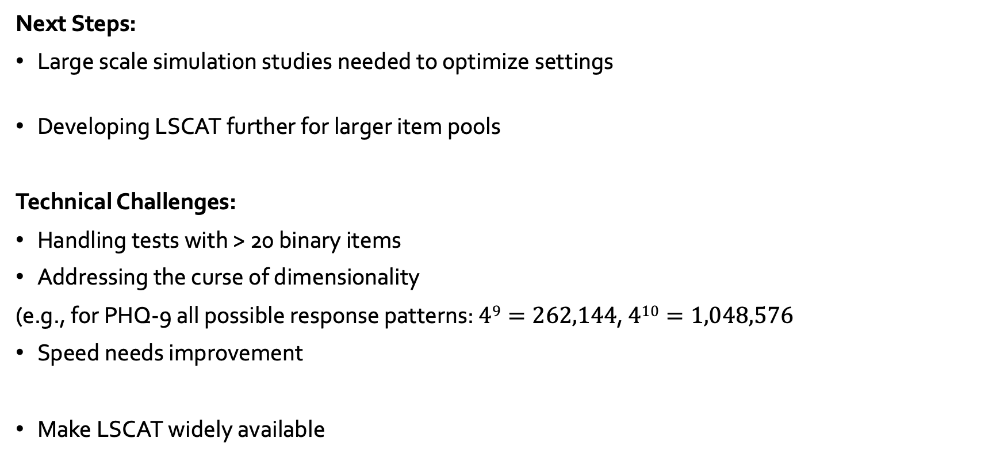
Future Directions and Challenges
Next Steps:
Large scale simulation studies needed to optimize settings
Developing LSCAT further for larger item pools
Technical Challenges:
Handling tests with > 20 binary items
Addressing the curse of dimensionality
(e.g., for PHQ-9 all possible response patterns: $49=262,144$, $410=1,048,576$
Speed needs improvement
Make LSCAT widely available

Slide 20
Thank you! ☺
Questions, Suggestions
a.psychogyiopoulos@uva.nl

Slide 21
Reference list
Gibbons, R. D., Weiss, D. J., Frank, E., & Kupfer, D. (2015). Computerized Adaptive Diagnosis and Testing of Mental Health Disorders. Annual Review of Clinical Psychology, 12(1), 83–104. https://doi.org/10.1146/annurev-clinpsy-021815-093634
Van der Ark, & Smits, N. (2023). Computerized Adaptive Testing Without IRT for Flexible Measurement and Prediction. In: van der Ark, L.A., Emons, W.H.M., Meijer, R.R. (eds) Essays on Contemporary Psychometrics. Methodology of Educational Measurement and Assessment, 369–388. https://doi.org/10.1007/978-3-031-10370-4_19
Finkelman, M. D., He, Y., Kim, W., & Lai, A. M. (2011). Stochastic curtailment of health questionnaires: A method to reduce respondent burden. Statistics in Medicine, 30(16), 1989–2004. https://doi.org/10.1002/sim.4231
Smits, N., & Finkelman, M. D. (2015). Shortening the PHQ-9: a proof-of-principle study of utilizing Stochastic Curtailment as a method for constructing ultrashort screening instruments. General Hospital Psychiatry, 37(5), 464–469. https://doi.org/10.1016/j.genhosppsych.2015.04.011
Gibbons, R. D. (2013, July 15). The Computerized Adaptive Diagnostic Test for Major Depressive Disorder (CAD-MDD): A Screening Tool for Depression. Psychiatrist.com; Primary Care Companion for CNS Disorders. https://www.psychiatrist.com/jcp/computerized-adaptive-diagnostic-test-major-depressive/
Yan, D., Lewis, C., & Stocking, M. (2004). Adaptive Testing With Regression Trees in the Presence of Multidimensionality. Journal of Educational and Behavioral Statistics, 29(3), 293–316. https://doi.org/10.3102/10769986029003293
Linzer, D. A., & Lewis, J. B. (2011). poLCA: AnRPackage for Polytomous Variable Latent Class Analysis. Journal of Statistical Software, 42(10). https://doi.org/10.18637/jss.v042.i10
Kroenke, K., Spitzer, R. L., & Janet. (2001). The PHQ-9. Journal of General Internal Medicine, 16(9), 606–613. https://doi.org/10.1046/j.1525-1497.2001.016009606.x
Psychogyiopoulos, A., Smits, N., Van der Ark, L.A.: Estimating the joint item score density using an unrestricted latent class model: Advancing flexibility in computerized adaptive testing. Journal of Computerized Adaptive Testing (in press)

