Slide 1

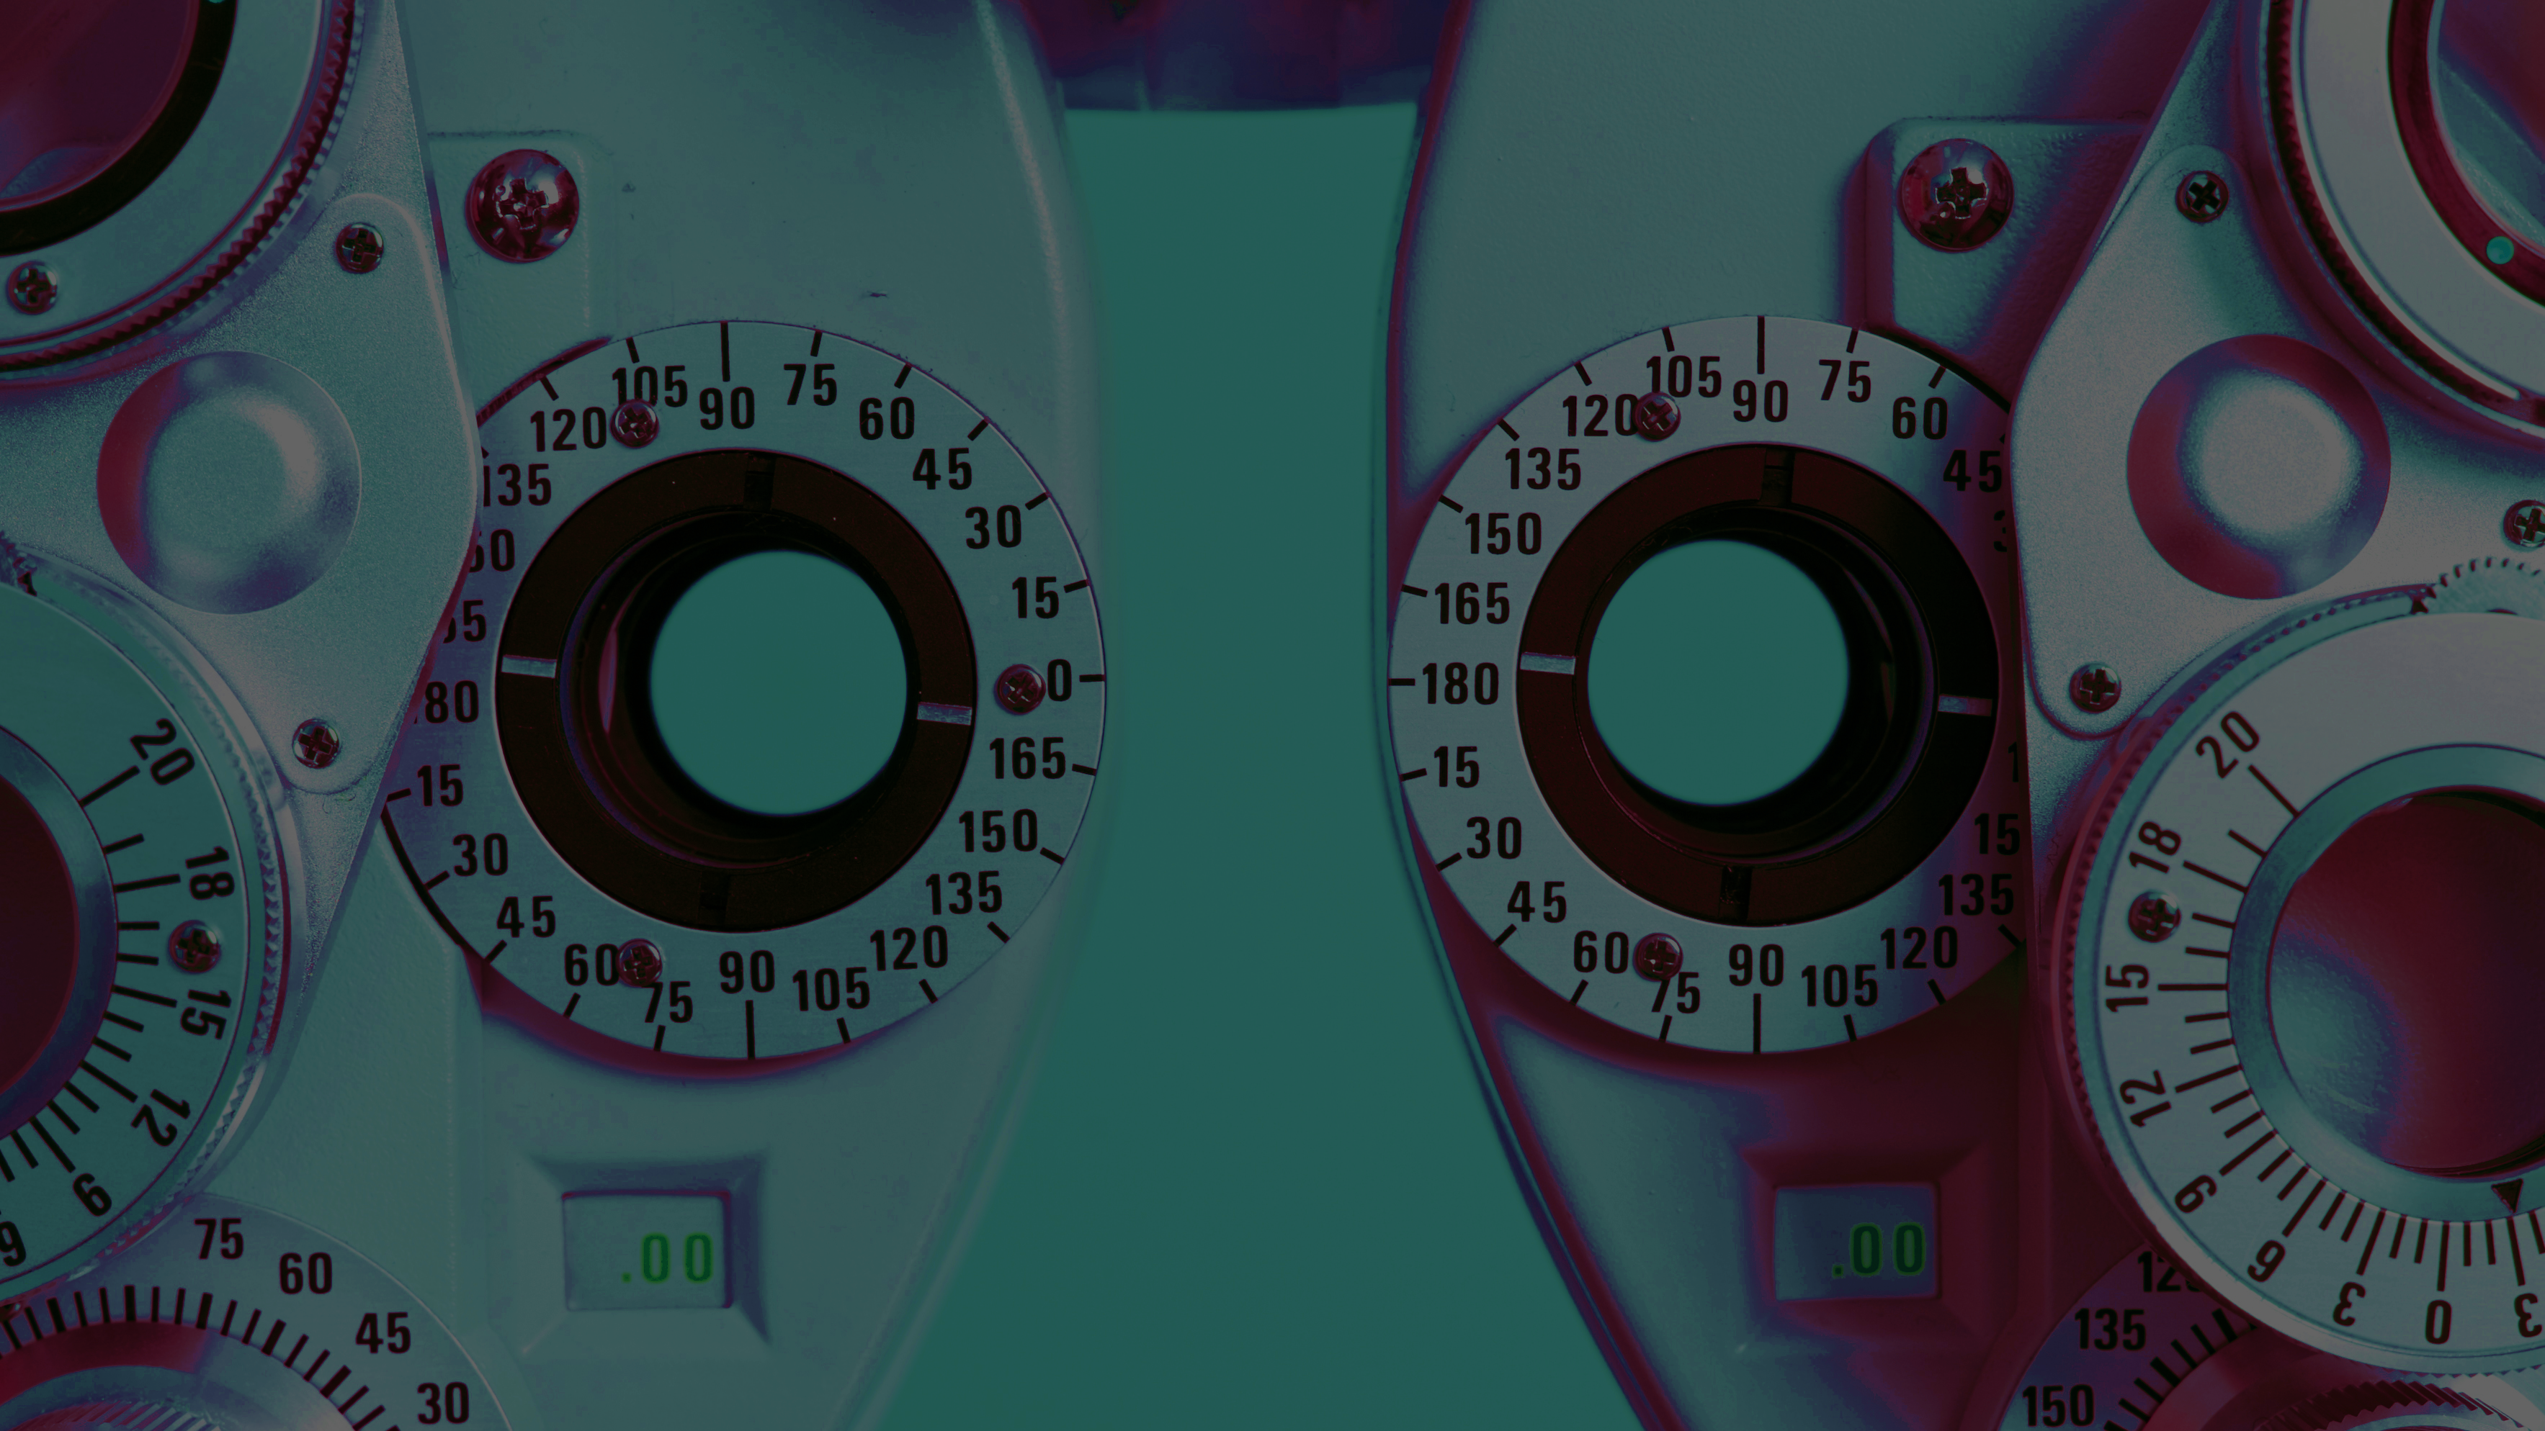
An Explainable AI and Retrieval-Augmented Assistant for OCT-Based Retinal Disease Decision Support
Anastasios Rigos
Prada Mehavannan

Slide 2
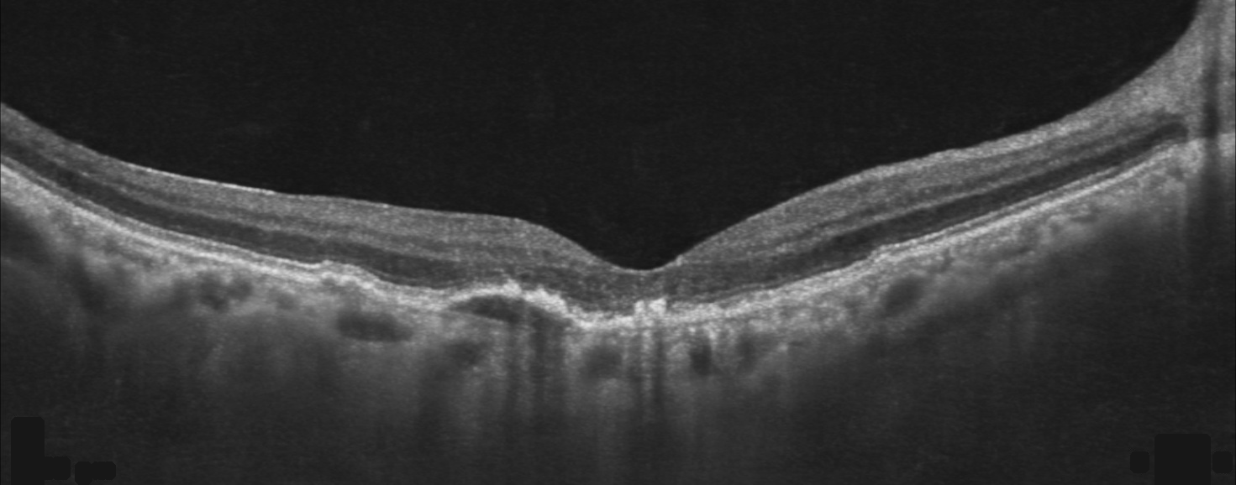
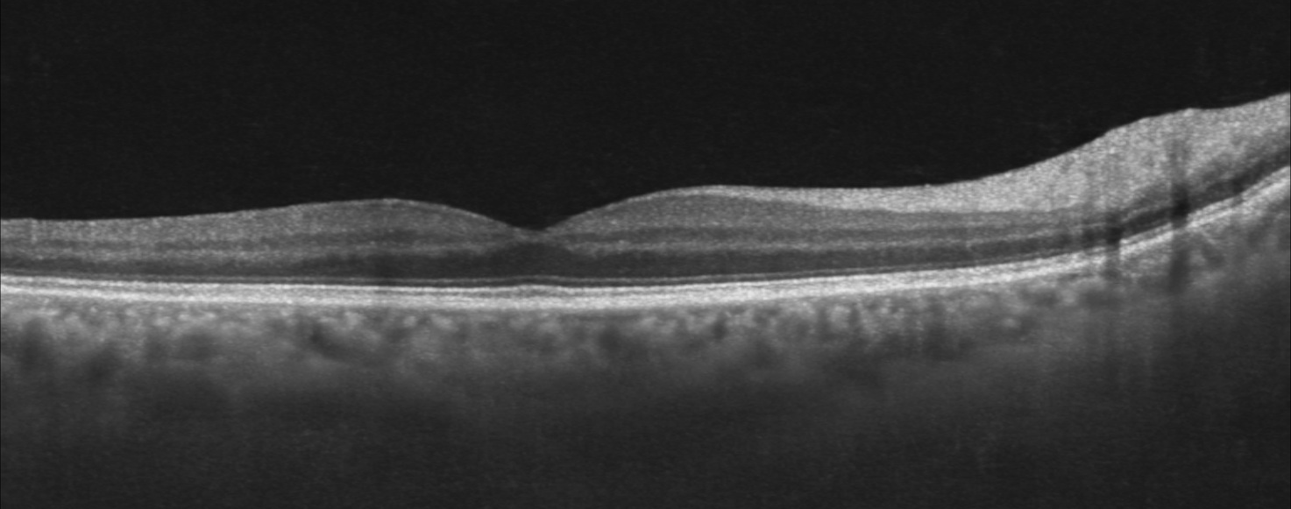
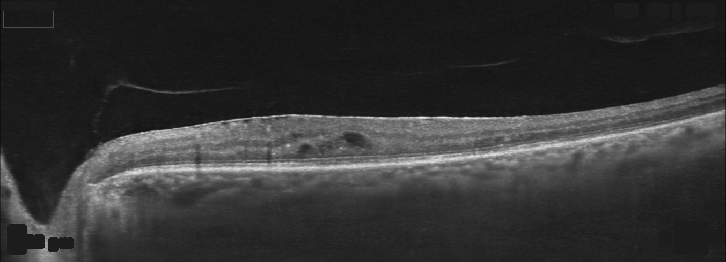
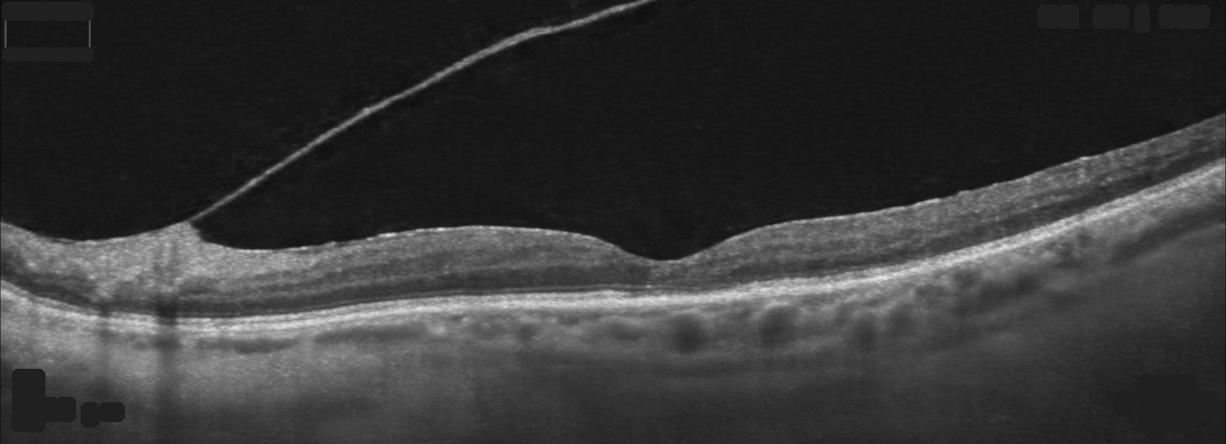
What is an OCT B-scan?
Retina → Retinal layers → Abnormal region

Slide 3
Dataset Exploration
Our Final Selection​
KERMANY OCT2017​
OCTDL ​
Clinic scans ​
Our Experiment
Different dataset
Model failure in spotting scanner not disease
Our Reconstruction
Examined on training set imbalance with class weights
Rebuilt patient leakage data split
Normalized inconsistent image sizes
Fast screening subsample on 12k images.

Slide 4
Model Selection
DRUSEN showed the largest performance differences between architectures
ViT-B underperformed particularly on DRUSEN
Backbone | Parameters | Input | Macro-F1 | DRUSEN Recall
ConvNeXt-Tiny | 27.8M | 384×256 | 0.917 | 0.766
ResNet50 | 23.5M | 256×256 | 0.901 | 0.667
ViT-B | 85.8M | 256×256 | 0.867 | 0.604
Custom CNN | 1.2M | 256×256 | 0.785 | 0.583

Slide 5
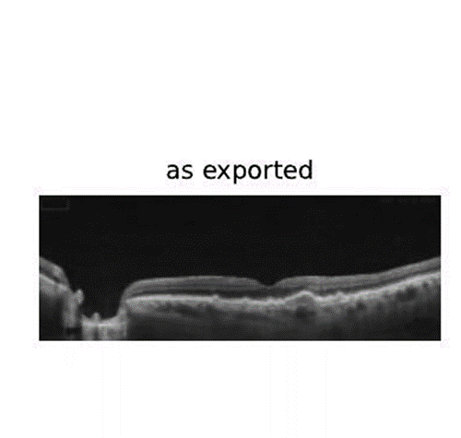
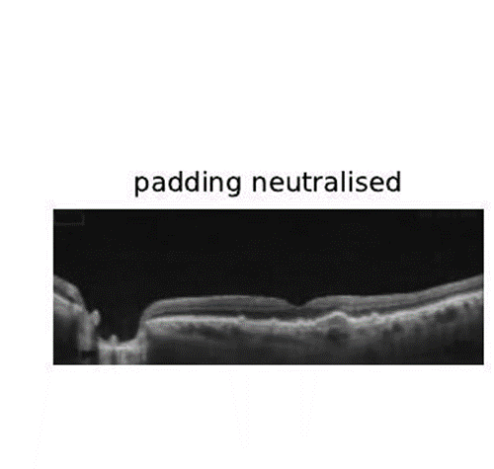
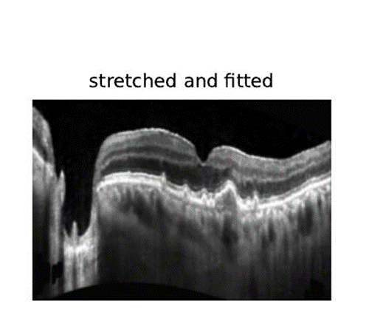
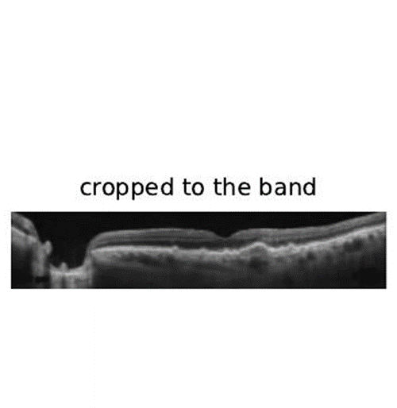
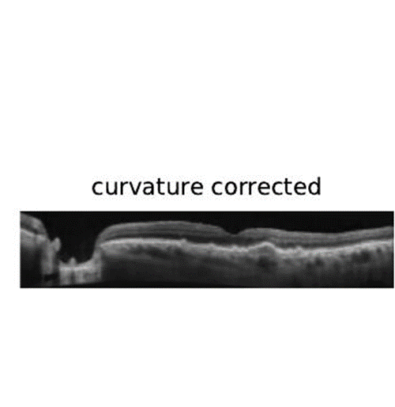
Data Pre-processing
Raw OCT image
Padding removal
Cropping of retinal band
Flatten Retinal curvature
Normalize Intensity
Resize to 384×256 frame
Why this pipeline?
Curvature correction
Improve DRUSEN recall by 12 – 14%
Retinal Cropping
Achieved the best Macro-F1 (0.894) with fewer pixels
Letterboxing
Lowest Macro-F1 (0.490) and introduced scanner specific padding that reduced generalization

Slide 6
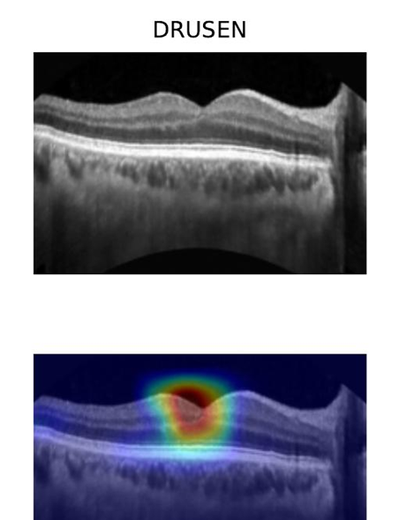
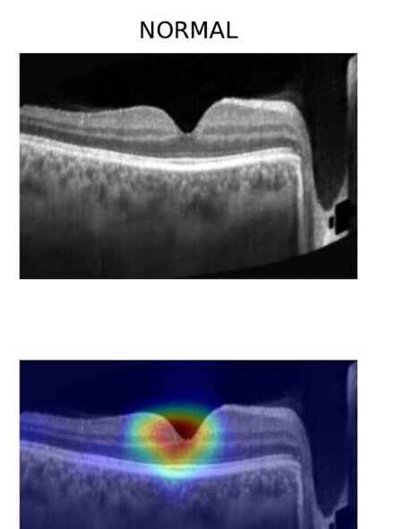
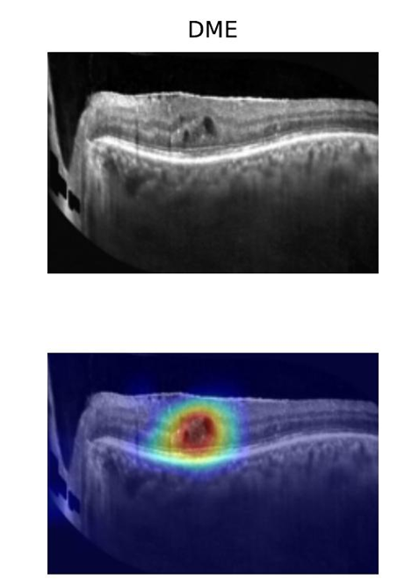
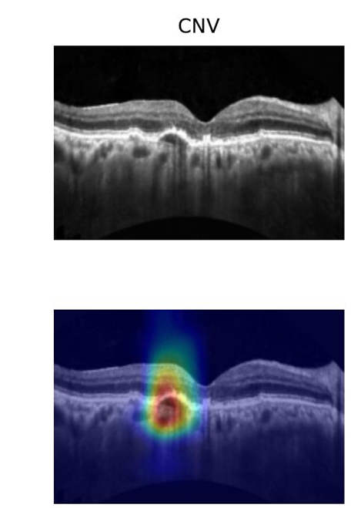
Where the model looks: Grad-CAM
Highlights which part of the scan drove the decision via a heatmap laid over the original image
Heatmap then lands on the retinal tissue at all 4 classes on correct predictions.

Slide 7

How the Model Performs?

Slide 8

94.8% Accuracy on the training device
94.5% Accuracy on unseen device
93.1% Macro-F1 on unseen device
73.0% Accuracy on Clinic real patient scans
27 of 37 correct on real clinic scans
CNV, DME and Normal are all classified accurately
12 out of 22 of DRUSEN scan correctly classified

Slide 9
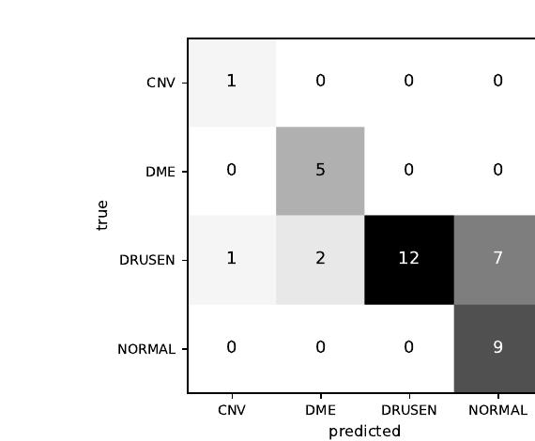
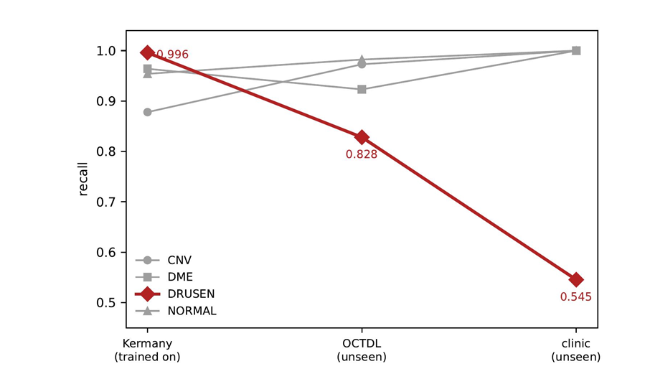

Slide 10

Error Analysis

Slide 11
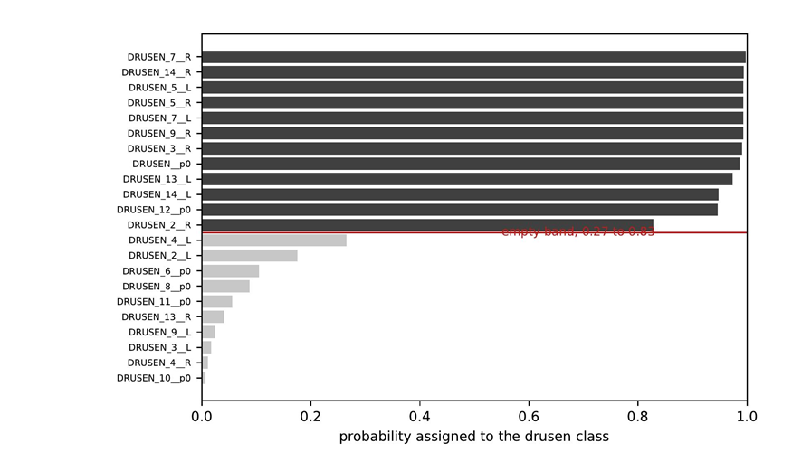
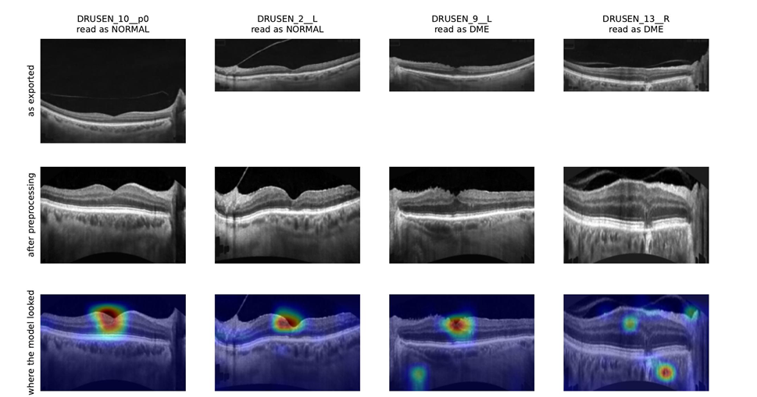
Confidence Gap of 22 DRUSEN Scans
7 scans misread as a healthy retina
3 misread as a different disease

Slide 12


Slide 13
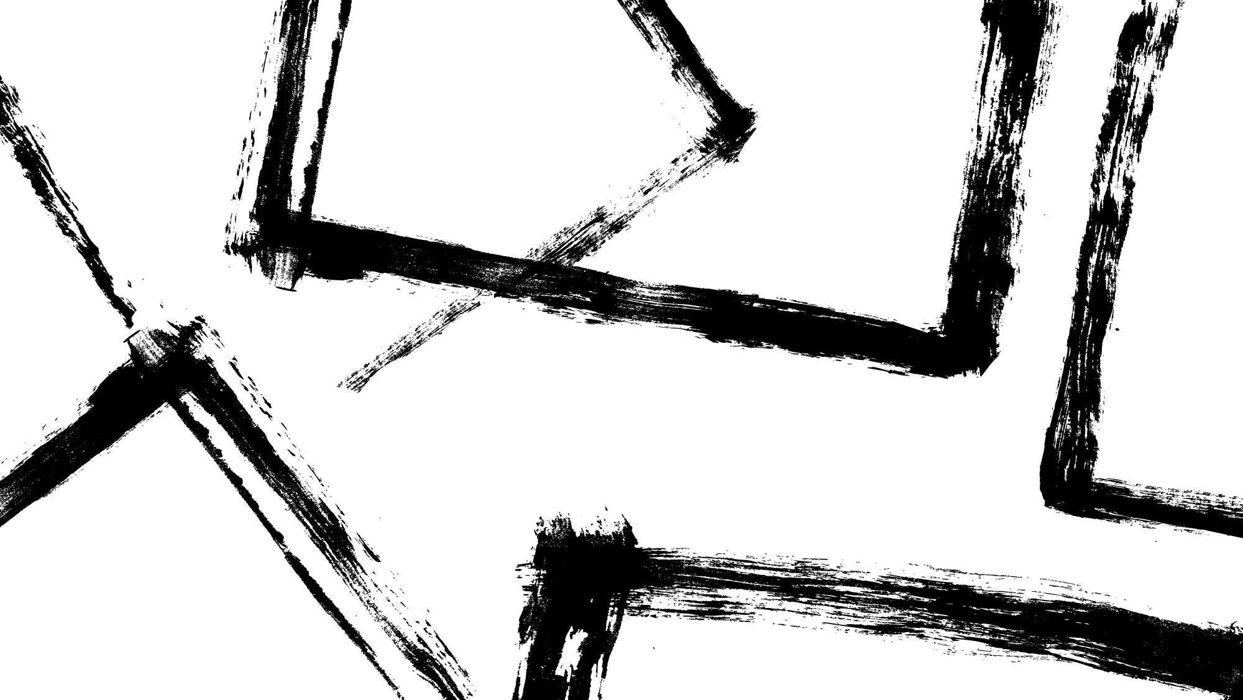
The Corpus
Collected 508 open-access ophthalmology articles from PubMed Central, keeping only reusable (CC-BY) licenses
2. Chunking
Split those articles into searchable passages, testing three strategies as fixed, section, semantic.
Finding fixed-length chunks that will work best.
3. Retrieval
Built a hybrid search combining exact keyword matching and meaning based matching and a reranker
4. Answering
Generated the final response by having the model answer only from retrived passages and cite them.

Slide 14
Clinical Guardrails implementation
Limited to ophthalmology & OCT interpretation
Rejects out-of-scope requests and prompt injection
Retrieves evidence before answering
Cites supporting literature
No fabricated information
Predictions presented with confidence scores
Not a clinical diagnosis
Highlights model limitations
No treatment recommendations or drug dosing
Encourages clinical correlation
Advises urgent referral when appropriate
Does not request or disclose patient-identifying information

Slide 15
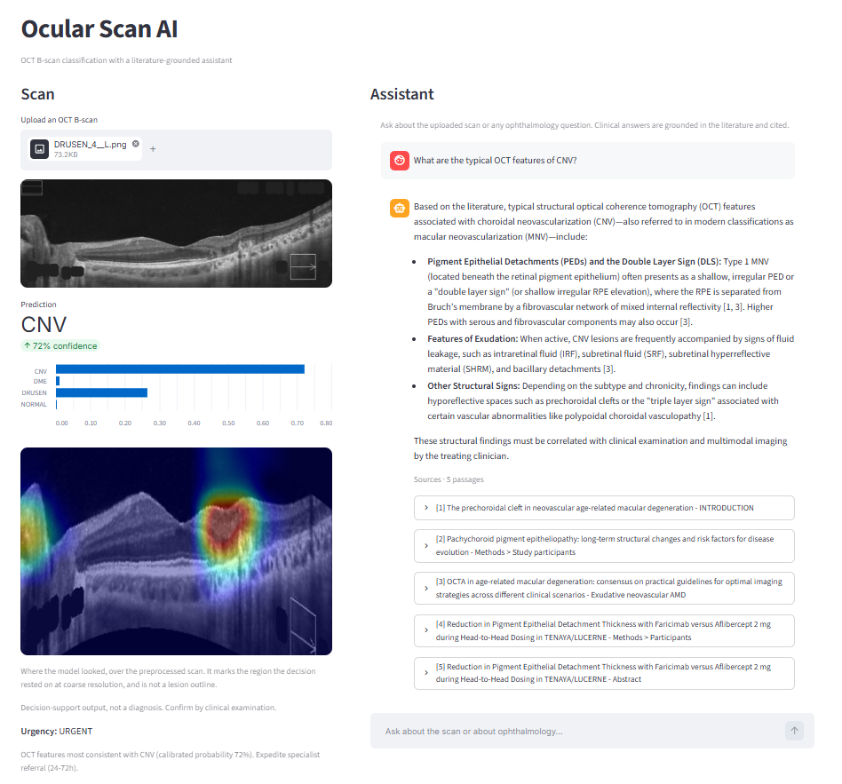
Ocular Scan AI Interface

Slide 16

Thank You

