Slide 1

Data Search & Extraction with Microservices
Προπτυχιακή Διπλωματική Εργασία τμήματος Ηλεκτρολόγων Μηχανικών και Τεχνολογίας Υπολογιστών Πανεπιστημίου Πατρών
Ζαμπέτης Αναστάσιος
ΑΜ: 228322
Επιβλέπων Καθηγητής: Δερματάς Ευάγγελος

Slide 2
Content
Motivation - Problem Statement
Related Work
Design Concepts
Key Technologies - Technology Selection
Implementation & Architecture
Dataset & Sensor Simulation
Monitoring
Results
Conclusions

Slide 3
Motivation
Explosion of IoT data; value only if processed and available.
Need for scalable, maintainable, observable systems.
Use case: air-quality sensor network simulation.

Slide 4
Problem Statement
Collect realistic sensor data, process it, and make it observable.
Constraints: low-resource devices, intermittent networks.
Goal: reproducible, containerized pipeline for metrics and dashboards, showcasing a microservice design approach.

Slide 5
Related Work
IoT Environmental Monitoring: De Vito et al. (2008) demonstrated field-deployable low-cost gas sensor arrays for urban air quality;
Kumar et al. (2015) surveyed low-cost sensor networks and underscored the need for real-time data pipelines and visualization.
IoT Simulation: Anderson et al. (2014) a realistic simulation requires replaying real data, not random generation.
IOTSim (Zeng et al., 2017), MobIoTSim (Kertesz et al., 2019), and Kaala (Dayalan et al., 2022) all bridge simulated devices with real backends.
Microservice Architectures: Gos & Zabierowski (2020), Auer et al. (2021), and Chandrinos (2021) confirm microservices enable independent deployment and scaling at the cost of upfront design complexity.
Observability: Jani (2024) and Pragathi et al. (2024) established Prometheus + Grafana as the de facto stack for distributed microservice monitoring.

Slide 6
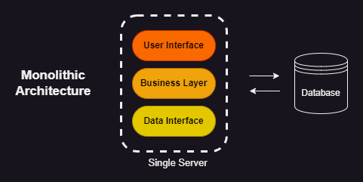
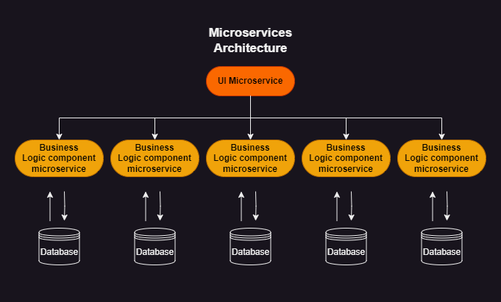
Monolithic vs Microservice Design
Monolithic: single deployable, simple to design, hard to scale/maintain
Microservices: independent services, fine-grained scaling, complex initial design
Performance vs Flexibility

Slide 7
Containers
OS-level virtualization that packages an application and its dependencies into an isolated user-space instance.
Containers share the host kernel but have separate namespaces for processes, network, and filesystem, giving isolation without a full guest OS.
Compared to VMs: much smaller and faster to start, lower resource overhead.
Images & layers: build images from a Dockerfile; each instruction creates a layer that can be cached and reused to speed builds.
Images are distributed via registries (Docker Hub, private registries) for reproducible deployments.
Benefits: portability, reproducibility, quick scale-up, small footprint.
Orchestration tools needed for production deployments.

Slide 8
IoT Device Simulation
Purpose: provide realistic inputs to test and evaluate systems without deploying physical sensors.
Typical IoT device constraints: low CPU/RAM, intermittent connectivity, unpredictable sampling intervals, limited storage.
Simulation approaches: replay recorded datasets in a scripted way.
Benefits: no hardware required (lower cost), reproducible test scenarios, easy scaling (multiple simulators), reduced privacy concerns, safe stress-testing.

Slide 9
Key Technologies & Selection
Docker — containerization platform; Docker Compose for single-command multi-service deployment. Chosen over Podman/containerd: most mature ecosystem, official images for every service used, Compose YAML covers the full orchestration need.
MQTT (Mosquitto) — lightweight publish/subscribe protocol for constrained IoT devices. Chosen over HTTP REST / CoAP: broker-mediated pub/sub natively supports many sensors → one controller; over EMQX/HiveMQ for minimal footprint in a containerized dev environment.
Prometheus — pull-based time-series metrics collection and querying (PromQL). Chosen over InfluxDB: pull model fits the limited resources IoT scenario; avoids coupling sensors directly to the storage backend.
Grafana — interactive dashboards for historical trends and live monitoring with alerting. Chosen over Kibana/custom dashboards: native Prometheus integration, variable templating, rich panel library, no custom dev effort.

Slide 10
Docker
Docker: platform to build and run containers, ensuring consistent behavior across environments.
Images: layered artifacts built from `Dockerfile`; layers enable caching and smaller transfers.
Engine: Docker Daemon + CLI + REST API manage lifecycle; use registries to distribute images.
Storage: volumes/mounts for persistence and data sharing.
Compose: YAML for local multi-container app deployments (services, ports, volumes).

Slide 11
Prometheus
Pull-based monitoring for timestamped time-series metrics.
Exporters expose metrics; custom exporters are straightforward to implement.
Storage: optimized TSDB with configurable retention.
PromQL: query language for dashboards and alerting; integrates with Alertmanager.
Features: service discovery, Pushgateway for short-lived jobs, and label-based multidimensional metrics.

Slide 12
Grafana
Visualization platform for building interactive dashboards from many data sources.
Panels: graphs, heatmaps, gauges, tables; supports annotations and dashboard variables.
Templating: variables enable reusable, parameterized dashboards for different environments.
Typical uses: combine data sources, create alerts, and enable interactive exploration for operators.

Slide 13
MQTT
Lightweight publish/subscribe protocol designed for constrained devices and unreliable networks.
Broker routes messages by topic; clients publish/subscribe with QoS options for delivery guarantees.
Strengths: low overhead, fast reconnection, and scalability to many clients.
Considerations: broker is a single point of failure unless deployed HA; secure communication with TLS and client authentication.

Slide 14
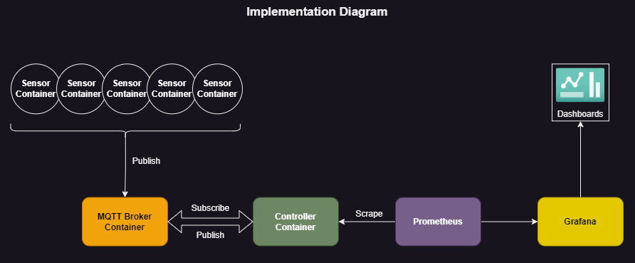
System Architecture

Slide 15
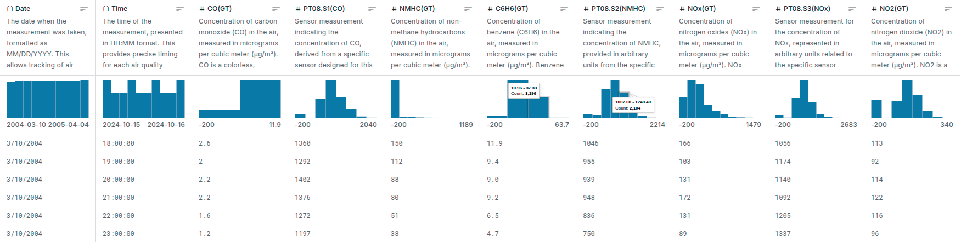
Dataset
UCI / Kaggle Air Quality dataset: hourly averages, multiple gas sensors.
Key attributes: CO, NMHC, Benzene, NOx, NO2, temperature, RH, AH.
Used to generate realistic synthetic data on the sensor emulators.
Preprocessing: CSV cleanup → JSON with indexed timestamps.

Slide 16
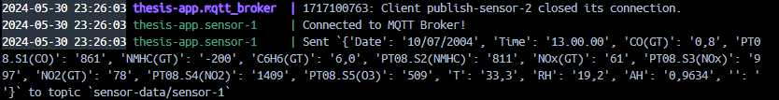
Sensor Simulators
Listener/publisher model: subscriber listens for `collect-data` and triggers publishers to read/generate payloads.
Data selection: replay from `dataset.json` with small-window randomization to emulate variability but keep logical consistency; `STARTPOINT` tracks progression.
Packaging: implemented in Python using `paho-mqtt` and `python-dotenv`; built with PyInstaller for compact Alpine images.

Slide 17
MQTT Broker
Eclipse Mosquitto container used for simplicity and low footprint.
Config: `persistence false` since Prometheus takes care of data retention, `listener 1883`, `allow_anonymous true` (lab mode).

Slide 18
Controller Node
Subscribes to `sensor-data/#`, maps JSON fields to Prometheus Gauges labeled by sensor.
Exposes `/metrics` via a FastAPI app (served with Gunicorn in production); Prometheus scrapes this endpoint.
Benefits: central place to convert messages into time-series metrics for observability.
Example Prometheus metrics
`#HELP air_quality_co_gt_gauge True hourly averaged concentration CO in mg/m^3`
`air_quality_co_gt_gauge{sensor="sensor-5"} 4.6`
`air_quality_t_gauge{sensor="sensor-5"} 18.4`

Slide 19
Prometheus configuration
Scrape target: `host.docker.internal:8000` (container->host mapping for local compose)
Flags used: `--web.enable-lifecycle` for config reload and `--storage.tsdb.retention.time=1y` for retention
Persisted TSDB volume to preserve time-series data across container restarts.

Slide 20
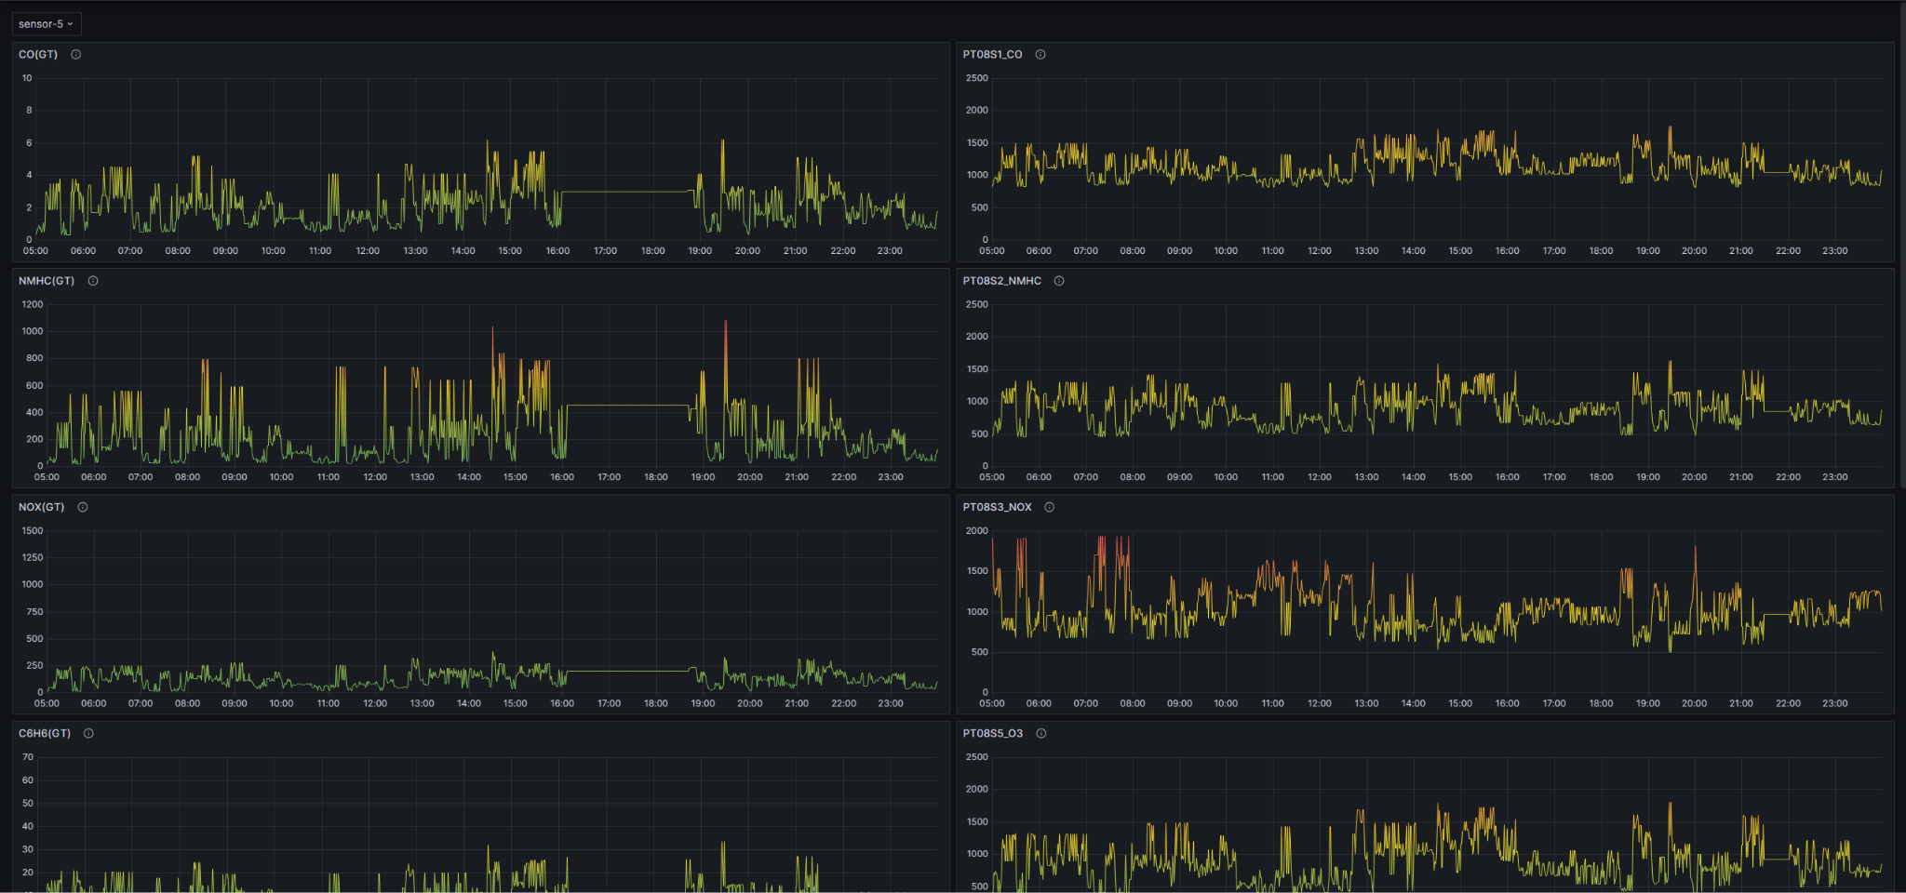
Grafana dashboards & visuals - Historical
Historical trends (templated for sensor selection)
Use variables for `sensor` to switch contexts quickly in the

Slide 21
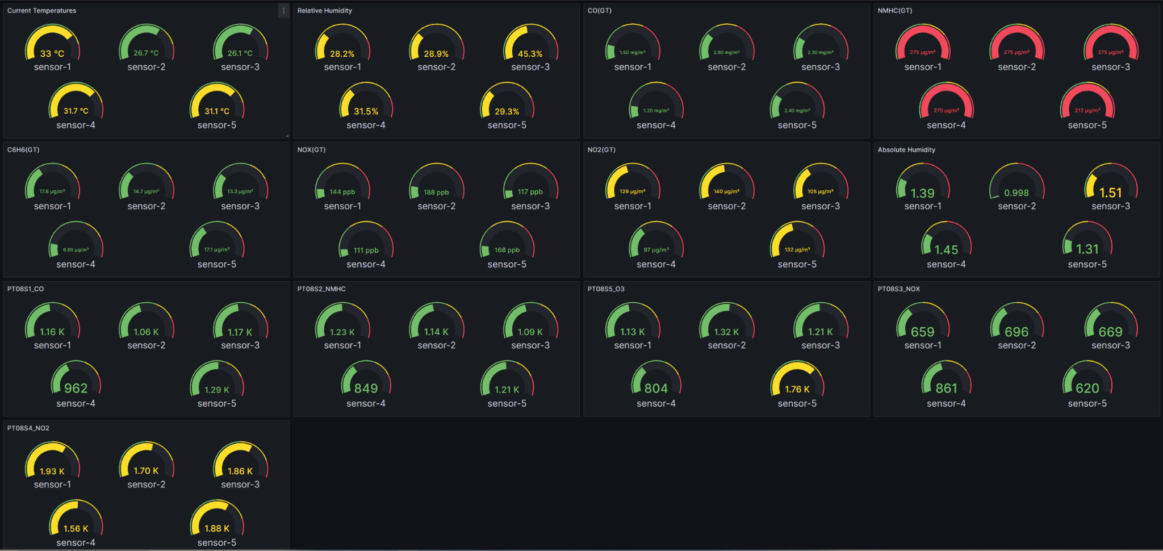
Grafana dashboards & visuals - Live
Live gauge overview with color thresholds.

Slide 22
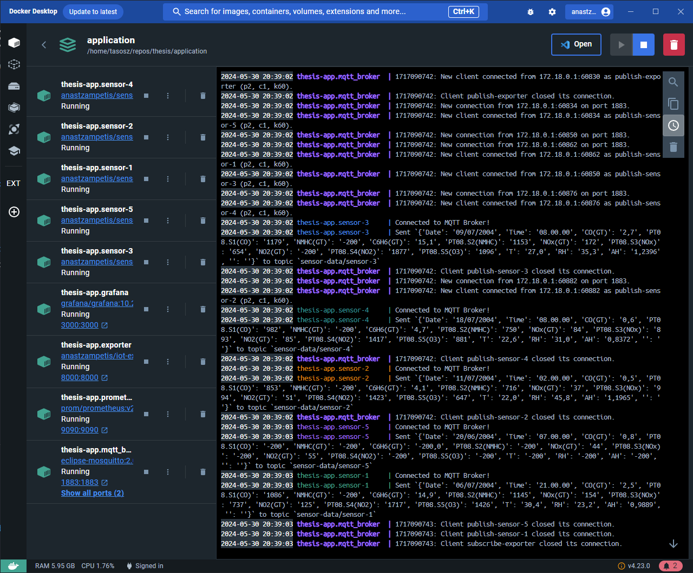
Orchestration & Deployment
Docker Compose defines services: `mqtt_broker`, `exporter`, `prometheus`, `grafana`, and individual `sensor-*` services.
Volumes: `prometheus_data` and Grafana directory mounted to persist state.

Slide 23
Results & Observations
The pipeline is modular, reproducible, and easy to run locally with `docker compose up`.
Components can be scaled easily, both horizontally and vertically.
Monitoring provides both live status and historical trends enabling diagnostics and evaluation.
Trade-offs: added network overhead and orchestration complexity vs. greater flexibility and scalability.

Slide 24
Future Work
Replace simulators with real campus sensors for production validation.
Move to Kubernetes for HA, autoscaling, and better resource management.
Add long-term storage (Thanos + S3) and robust alerting (Alertmanager + notification channels).
Add CI/CD for automated builds and deployments.

Slide 25
Questions
Ευχαριστώ πολύ! Ερωτήσεις;

