Slide 1

GR5291 ADVANCED DATA ANALYSIS
Wines Reviews
Professor: Demissie Alemayehu
Group 25
Members:
Huang Huang, Hao Li , Jianping Mu, Lingfeng Shen, Yang Shi, Zhenyun Shi,
Duan Wang, Nannan Wang, Yize Wang, Yixin Zhang, Xuanhao Zhang,
Qingyang Zhong

Slide 2



Contents
1
Basic Introduction
Introduction of wine and wine market
Target of our research
2
Descriptive Statistics
Data Preview
Distribution of wine price & points
Wordcloud
3
Four Algorithm
KNN
SOM
Balltree
Random Forest Regression
4
Conclusion

Slide 3
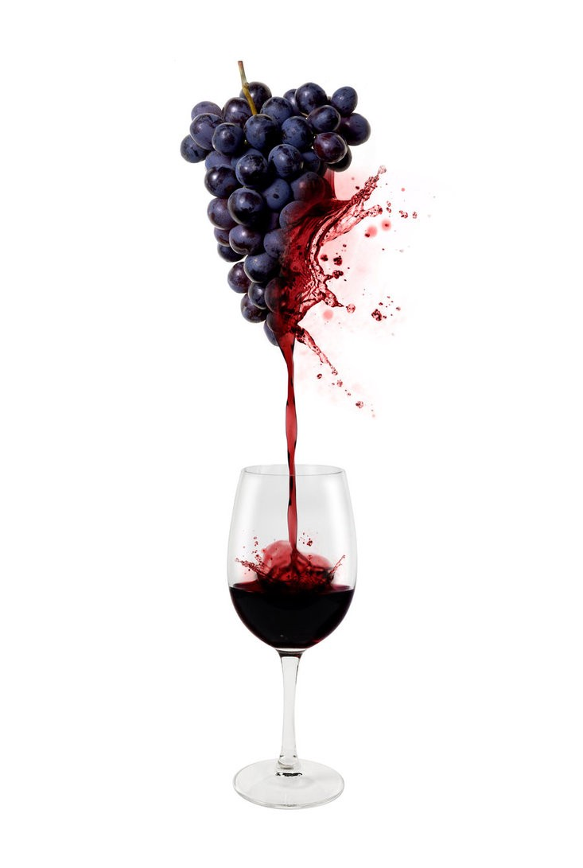
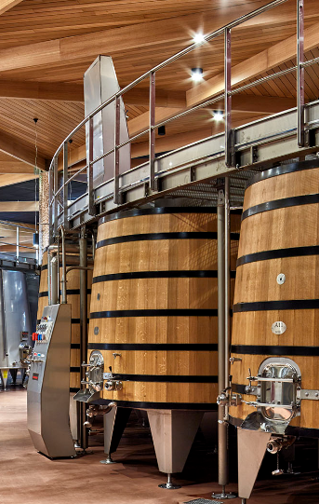
1. Basic Introduction
(1)Wine And Wine market
Wine is an alcoholic beverage made with the fermented juice of grapes, but they are different than what you’ll find at the grocery store. Technically, wine can be made with any fruit (i.e. apples, cranberries, plums, etc) but most wines are made with wine grapes.
The quality of grapes decides the quality and price of wine.
The quality of grapes decides the quality and price of wine.
Wine market is huge and growing steadily.U.S. consumers quaffed $32 billion worth of wine in 2017, and that figure is expected to reach $43 billion by 2022, an annual growth rate of more than 6%.Premium is the place to be, the “fine and premium” category (over $10 a bottle) has been almost bubbly.

Slide 4
1. Basic Introduction
(2). Target of our research
Governments
Companies
To help local governments manage the grape and wine industry and introduce suitable varieties and companies.
To assist companies build new factories in the profitable loactions.
Wine
Reviews
Shops
Customers
To enhance the quality and value of money of the wine they sell. To guide them sell more popular wine.
To advise customers choose wine by the quality, money and the place of origin.

Slide 5
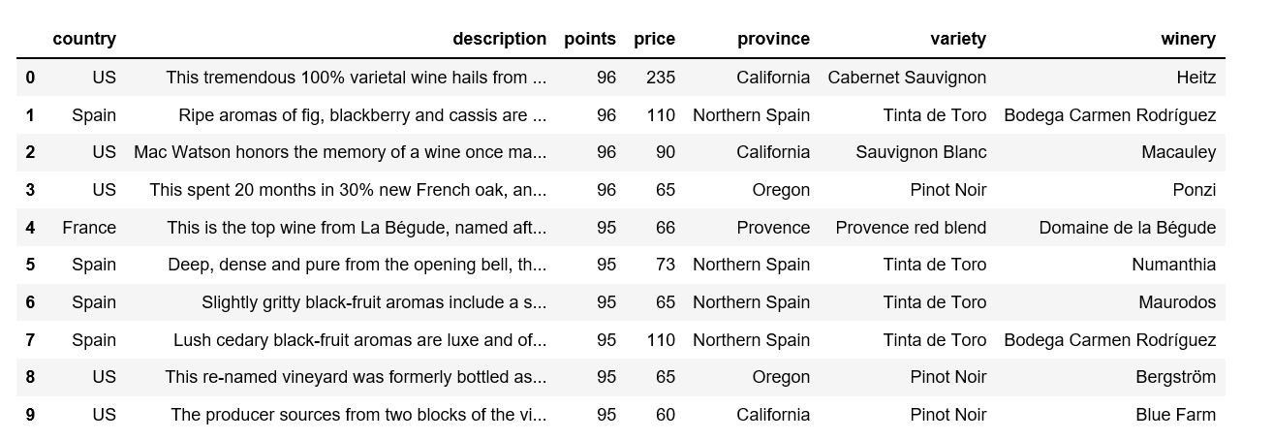
2.Descriptive Statistics
(1). Data preview
Companies
Customers
The data are collected from Kaggle, after we removing all NA values we finally get 258144 data.

Slide 6
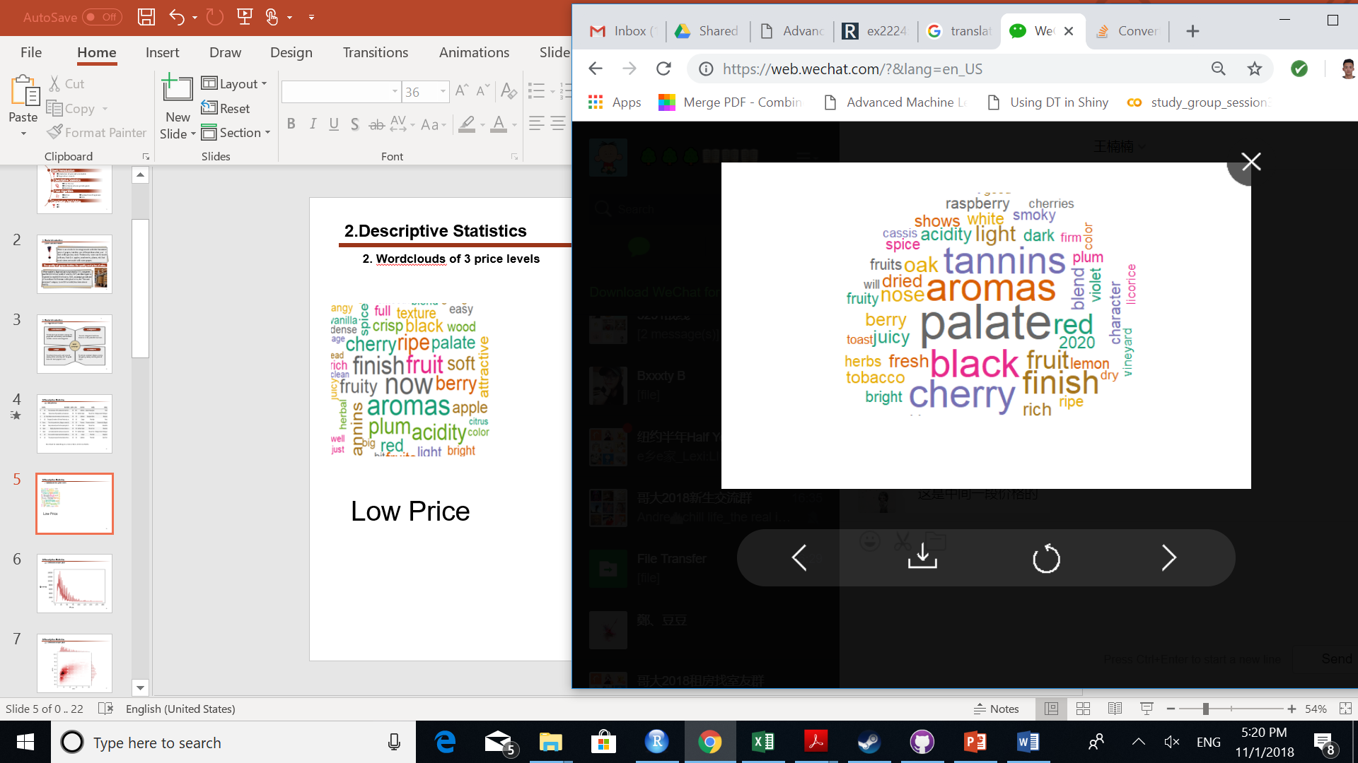
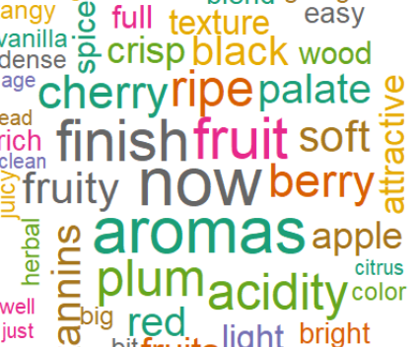

2.Descriptive Statistics
(2). Wordclouds of 3 price levels
Low Price
Medium Price
High Price
h
Companies

Slide 7
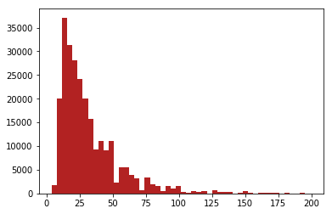
2.Descriptive Statistics
(3). Distribution of wine price
Quantity
Companies
Customers
Price

Slide 8
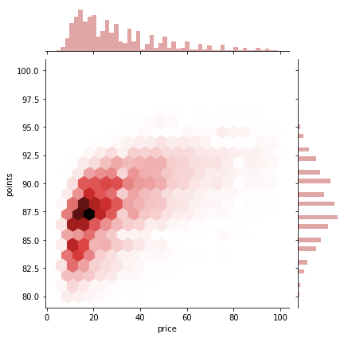
2.Descriptive Statistics
(4). Distribution of wine price & points
Companies
Customers

Slide 9
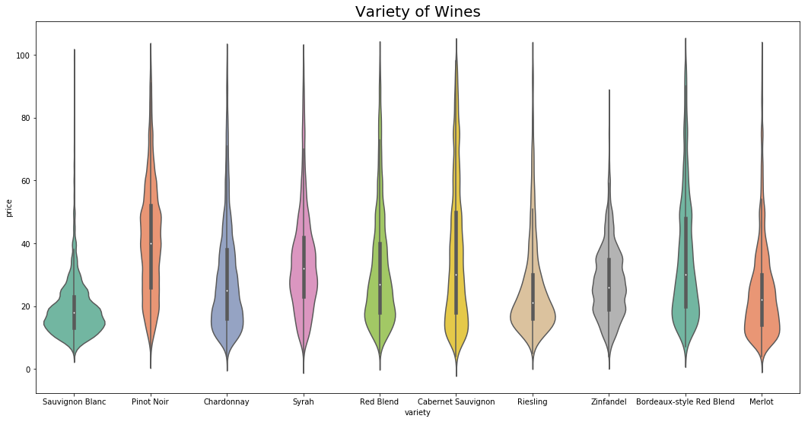
2.Descriptive Statistics
(5). Price of wine by variety
Companies
Customers

Slide 10
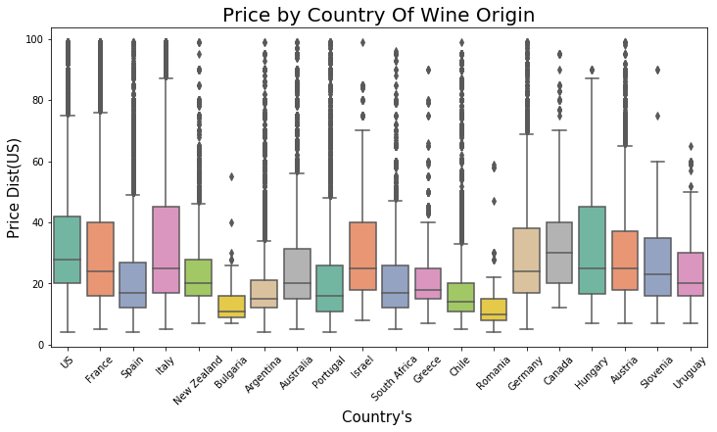
2.Descriptive Statistics
(6) Price of wine by country
Companies
Customers

Slide 11
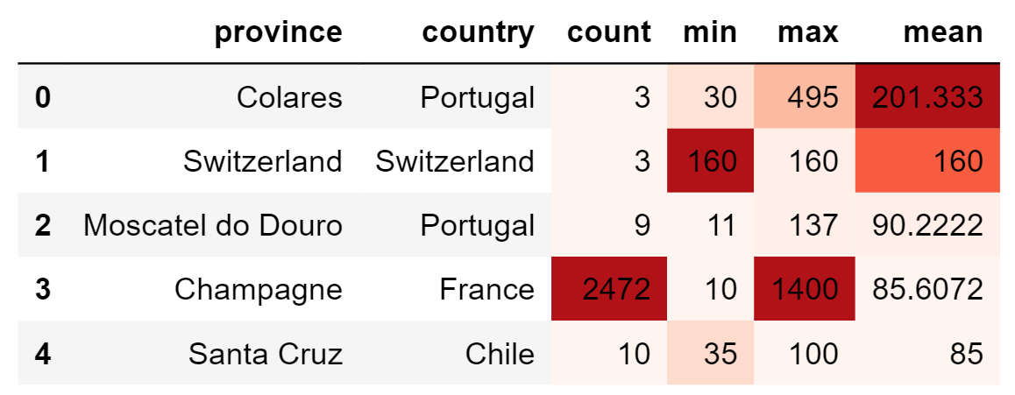
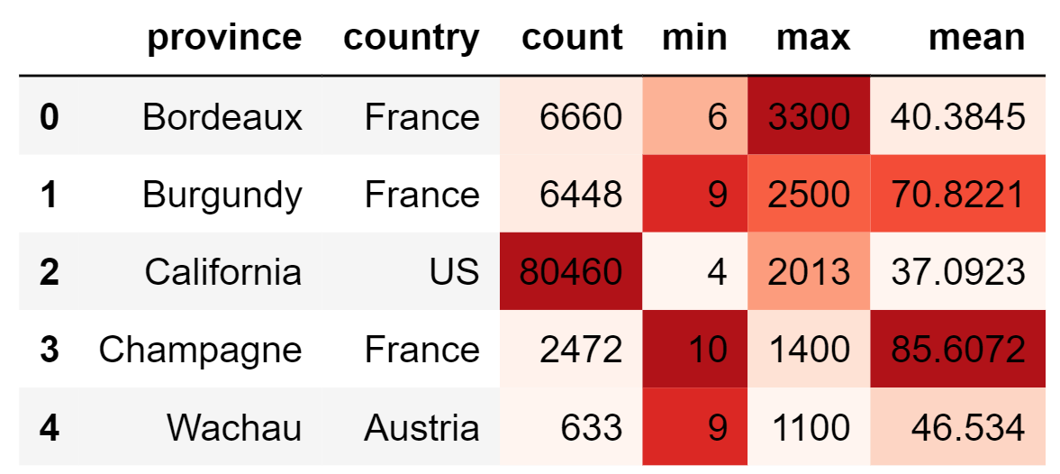
2.Descriptive Statistics
(7) Wine Data Ranking
Ranking of means of Wines by province
Companies
Customers
Ranking of maximum of Wines by province

Slide 12
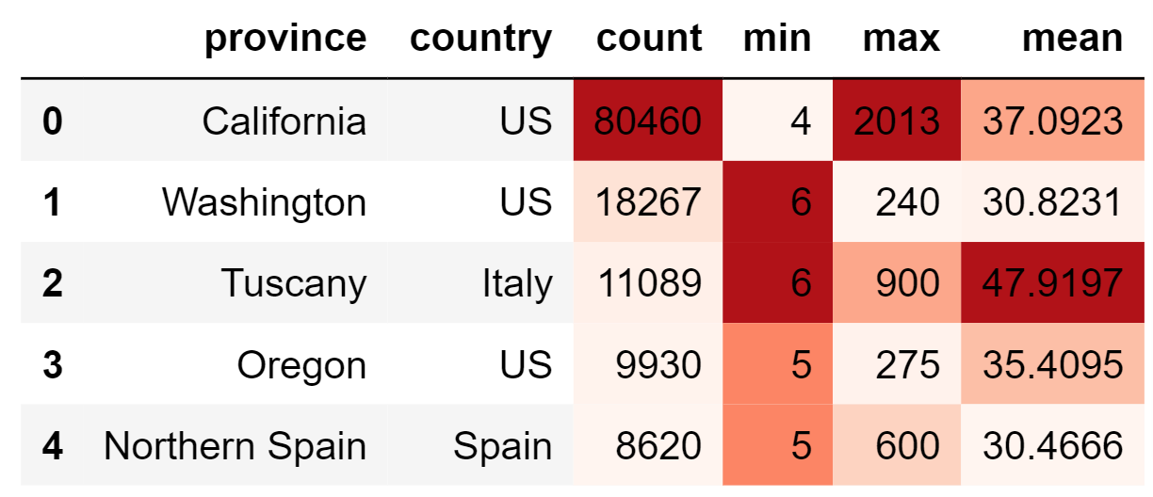
2.Descriptive Statistics
(7) Wine Data Ranking
Ranking of count of Wines by province

Slide 13
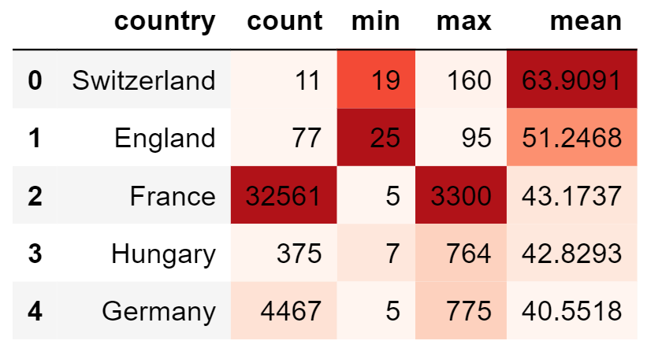
2.Descriptive Statistics
(8) Wine Data Ranking
Companies
Customers

Slide 14
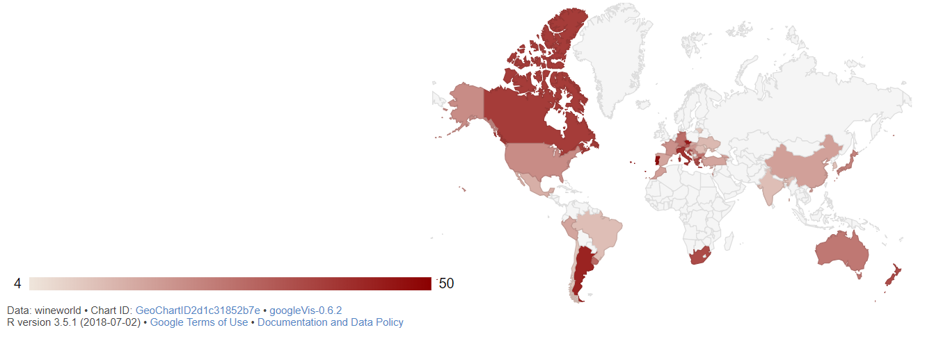
2.Descriptive Statistics
(9) Price shown in Worldmap
Companies
Customers

Slide 15
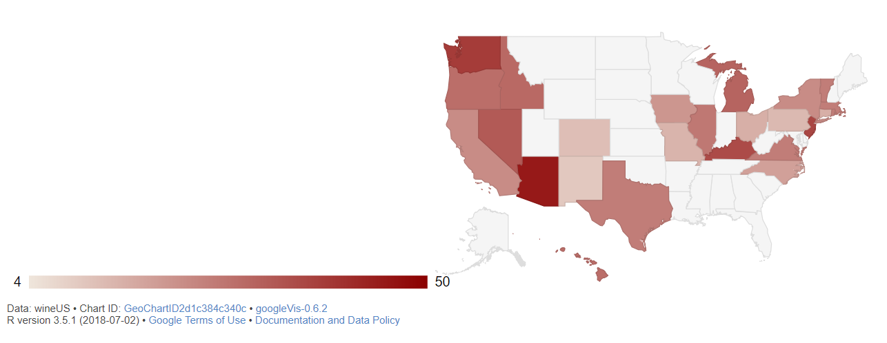
2.Descriptive Statistics
(10) Price shown in USmap
Companies
Customers

Slide 16
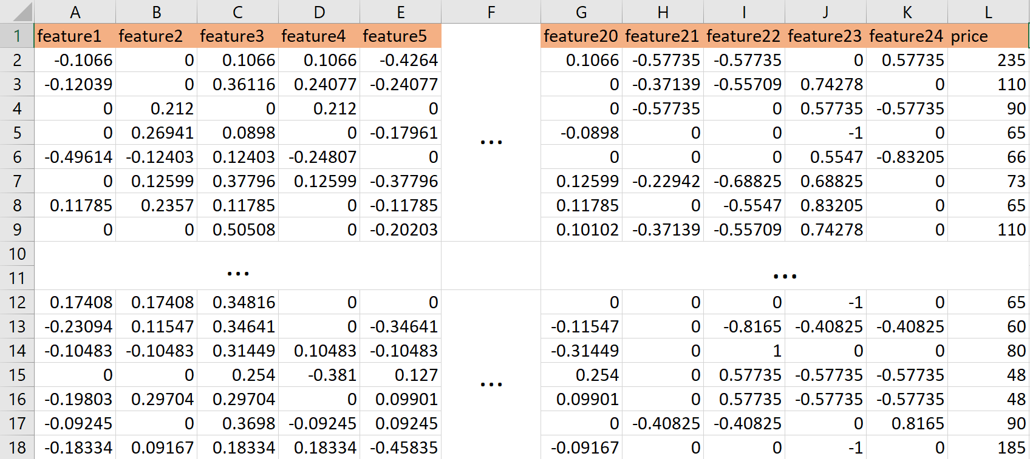
2.Descriptive Statistics
(11) Data Processing (Text Number)
Hashing Vectorizer
Companies
Customers
Description: feature1-feature20
Country/Province/Variety/Winery: feature21-feature24

Slide 17
3.Algorithm
(1).K-nearest neighbors algorithm
Calculate the distance between two data instances within the training set, using Euclidean distance measure
Companies
Locate k most similar data instances in the training set with the similarity measures
Split the data into a training set (to make predictions) and a test set (to evaluate model accuracy)
2. Distance Calculation
3. K Decision
KNN
Algorithm
1.Dataset
Creation
Customers
4. Response Generation
For the most similar neighbors of a test instance given by k most similar data instances in the training set, we can generate a response
5. Accuracy
test
Test the accuracy of predictions
KNN method has to run every data in the dataset, so it is very time consuming.

Slide 18
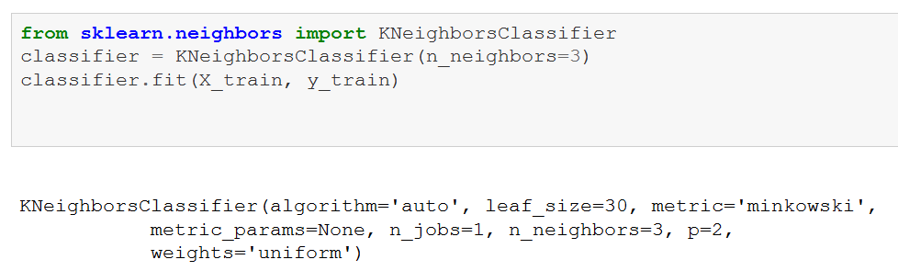
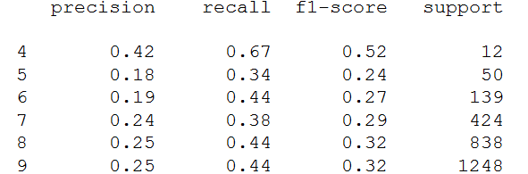
3.Algorithm
(1).K-nearest neighbors algorithm
Take the response of the two nearest points for each predictor and compare it with the test set.
Companies
Output Result
When the KNN model is applied to the test set, the average precision is only 28%.
The relevance between features is not high, resulting in poor adaptability of KNN and 28% average precision.

Slide 19
3.Algorithm
(2). Balltree
Advantage: Higher
running spped than other
algorithm
Disadvantage:
Calculating and
understanding the
meanning are not easy.
Advantage: Higher
running spped than other
algorithm
Disadvantage:
Calculating and
understanding the
meanning are not easy.
Calculate distances between all other points and p, then select the largest one marked as p1.
Generate/Select a random point p in the hyperspace
2
1
3
Repeat step 2-5 until there are less than k points in subset n.
Calculate distances between all other points and p1, then select the largest one marked as p2.
Balltree
Customers
6
Finally we will get a tree with many leaves or external nodes.
4
Calculate distances between all other points in subset1 and p1, select the largest one denoted as r1. Repeated in subset 2 and p2.
Compare the distance of point to p1 and p2.If a point is closer to p1, we can put it into subset1, otherwise put it into subset2.
5

Slide 20
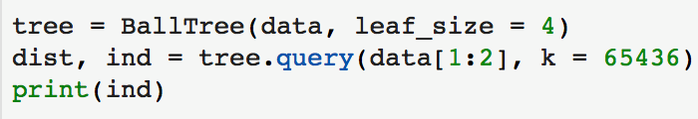

3.Algorithm
(2). Balltree
We classify the data into four classes through balltree.
Code
The quantities of clusters is depend on ourselves, here is four. Considering the factors like description, combined of others, price, origin, grape varieties etc.
By calculating Euclidean distance between Wine No.1 and other wines, it reaches the lowest value between itelf, and second lowest value to Wine No.257857, which means Wine No.1 is most similar to Wine No.257857 except itself.
Output

Slide 21
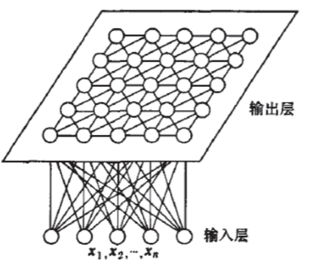
3.Algorithm
(3). Self-Organizing Map (SOM)
SOM is a type of artificial neural network (ANN) that is trained using unsupervised learning to produce a low-dimensional (typically two-dimensional), discretized representation of the input space of the training samples, called a map, and is therefore a method to do dimensionality reduction.
Companies
Output Layer
Input Layer
Advantages
1.Randomize the node weight vectors in a map
1. Data mapping is easily interpreted.
2. Capable of organizing large, complex data sets.
Disadvantages
5. Increase s and repeat from step 2 while s<
2.Randomly pick an input vector
1. Difficult to determine what input weights to use.
2. Mapping can result in divided clusters.
3. Requires that nearby points behave similarly.
5 Steps
Applications
4.Update the weight vectors by pulling them closer to the input vector
3.Traverse each node in the map.
1. WEBDOM organization of a massive document collection.
2. Phonetic Typewriter.
3. Classifying world proverty.

Slide 22
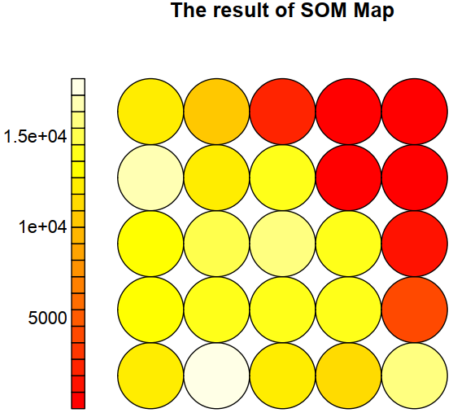
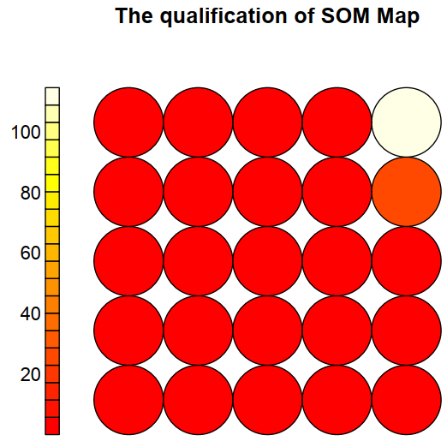
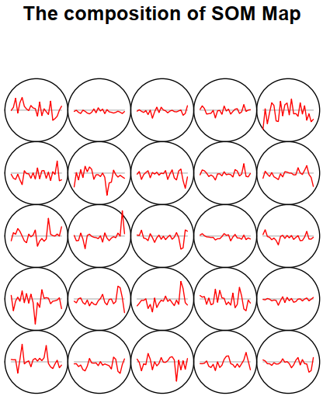
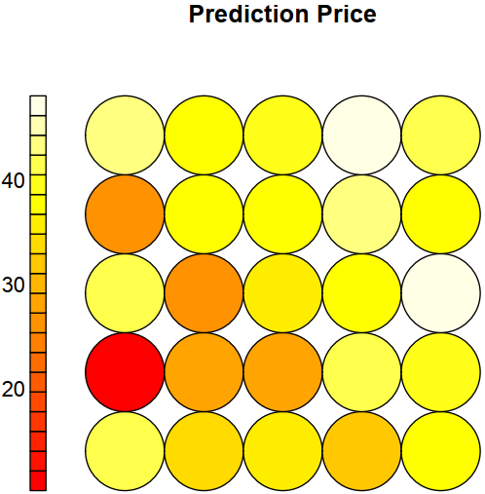
3.Algorithm
(3). Self-Organizing Map (SOM) Output
Result
Qualification
The lighter color represents the more data is located in that area. Thus, V2 and V16 have largest quantities of data.
The lighter color represents lower quality. So V25 has be worst quality (according to the classification before)
Composition
Prediction
This picture shows the data flucation in every vector, take V2 as an example, more data locates under the horizontal line.
V6 has the darkest color, which represents the prices are lowest. And V15 and V24 have the highest price.

Slide 23
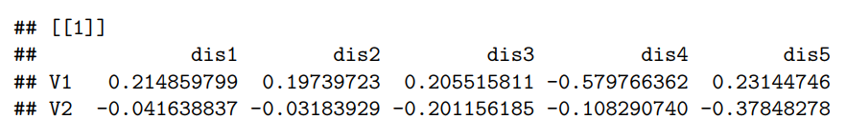


3.Algorithm
(3). Self-Organizing Map (SOM) Analysis
Other wines which have common charaters with v2 also have relative high price, like v15 and v24 .
Take V2 as an example, as it shown in the first picture, most data in V2 is located under the horizontal line. And from the second output, we can see that for V2,the factor dis8, dis9, dis10,dis11,dis13,dis19,dis20 and comb4 have positive results. Among them, dis19 has the largest influence factor. These factors are also the genral factors that have a significant influence on other vector.

Slide 24
3.Algorithm
(4).Random Forest Regression
Random forests or random decision forests are an ensemble learning method for classification, regression and other tasks, that operate by constructing a multitude of decision trees at training time and outputting the class that is the mode of the classes (classification) or mean prediction (regression) of the individual trees. Random decision forests correct for decision trees' habit of overfitting to their training set.
Advantages
1. Selecting the data, delete the rows(columns) which have many N.A. data.
2. Spilting the data into two groups, training and testing.
1. It is one of the most accurate learning algorithms available. For many data sets, it produces a highly accurate classifier.
2. It gives estimates of what variables are important in the classification.
3. It can prevent outfitting can even fit non-linear model.
Prediction Of Price
3.Selecting the optimal parameters in the training group by grid search cross validation.
4.Seting evaluation model and doing prediction.

Slide 25
3.Algorithm
(4).Random Forest Regression
Output
Without grid search cv
Fitting 3 folds
Model Performance
Average Error: 12.5656 degrees.
Accuracy = 51.85%.
Fitting 3 folds for each of 120 candidates, totalling 360 fits
Model Performance
Average Error: 8.3928 degrees.
Accuracy = 66.98%.

Slide 26
4. Conclusion
KNN Algorithm
Companies
Classifying the wines data by their relevance, to help the stores sell more wines with lower price and higher quality.
Balltree
Clustering the wines according to the balltree algorithm. Dividing the red wines into four types according to price and point.
Making recommendations of the same type based on the description of each wine.
SOM Algorithm
Customers
Random Forest Regression
Clustering the data, which may help the factories to evaluate their wines.
Predicting the price, can help the farmers and factories to produce better grapes and better wines, and gain more profits.
Dividing the data set into training set and test set, and then using the precision of Random Forest Regression algorithm to predict the price of wine(Average Error: 8.3928 degrees)

Slide 27
Thanks！
Q&A

