Slide 1

Vanier
FLOSS DAY
2023

Slide 2
FLOSS

Slide 3
FLOSS
=
Free / Libre Open Source Software

Slide 4
The four essential software freedoms
(by Richard Stallman, 1986)
To use for any purpose
To study and modify the source-code
To redistribute copies
To redistribute modified versions

Slide 5
FLOSS licenses
Are licenses in conformity with the four essential software freedoms
Software licenses are legal documents
Sometimes hard to read
  Easy to find online the key points of well-know FLOSS licenses
Usually hard to write for (non-lawyers)
  Avoid crafting your own, it might be a barrier for adoption

Slide 6
Well-known FLOSS licenses
The Free Software Foundation (FSF) publishes a list of well-known FLOSS licenses
GPLv3: copyleft, redistribution under same conditions
Mozilla Public License 2.0: file-based copyleft, or weak copyleft
MIT: simple and straightforward, allows sublicensing
Apache 2.0: requires notice of changes, allows patenting
Distributed as a LICENSE file along with the source code

Slide 7
If the source code is published online, does it mean the project is FLOSS?
ONLY if you attach a FLOSS license to
https://choosealicense.com/

Slide 8
What if I do not choose a license?
Maybe no one will notice???

Slide 9
BAD choice!
The default is exclusive copyright
Any contributor will also have exclusive copyright
Even the original author will not have the right to use, modify, redistribute their work
What about project dependencies? Do they pose any restriction?

Slide 10
What if what I produce is not software?
A content license is more appropriate for cu

Slide 11
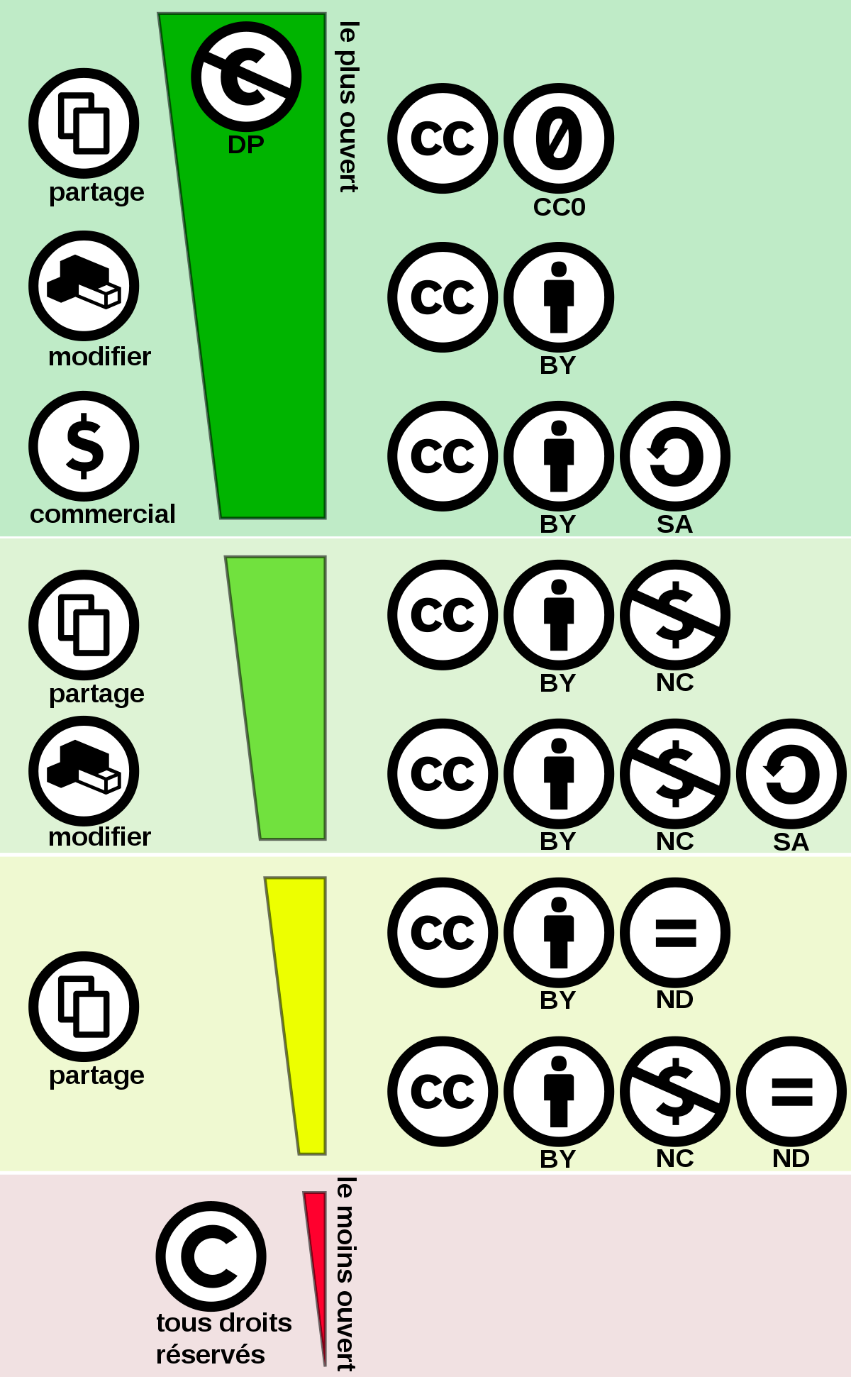
Creative Commons License Spectrum by Shaddim (CC BY)

Slide 12







A few examples
Mozilla Public License 2.0
A few more
Mozilla Public License 2.0
CC BY SA
GPLv2 Classpath Exception
GPLv3
GPLv2
Apache 2.0

Slide 13
Thanks to...
Vanier College, STEM Center for hosting us
Faculty of Science and Technology for providing lunch
The Debian Project for USB stickers and snacks
Debian contributors for Debian Bookworm live image
All speakers for the content delivered
All participants for coming on a sunny Saturday
FLOSS Day orga team

Slide 14
Thanks!!!
Vanier FLOSS Day © 2023
by Tassia Camoes-Araujo

