Slide 1


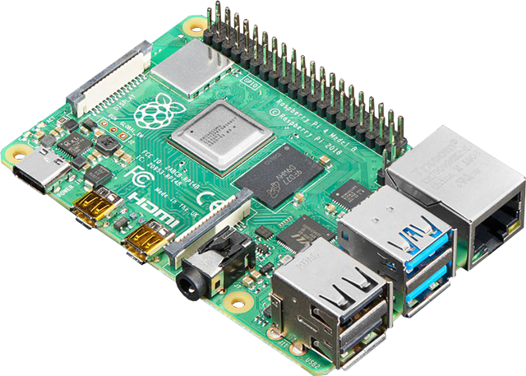

Raspberry Pi
Workshop
Justin Bax

Slide 2
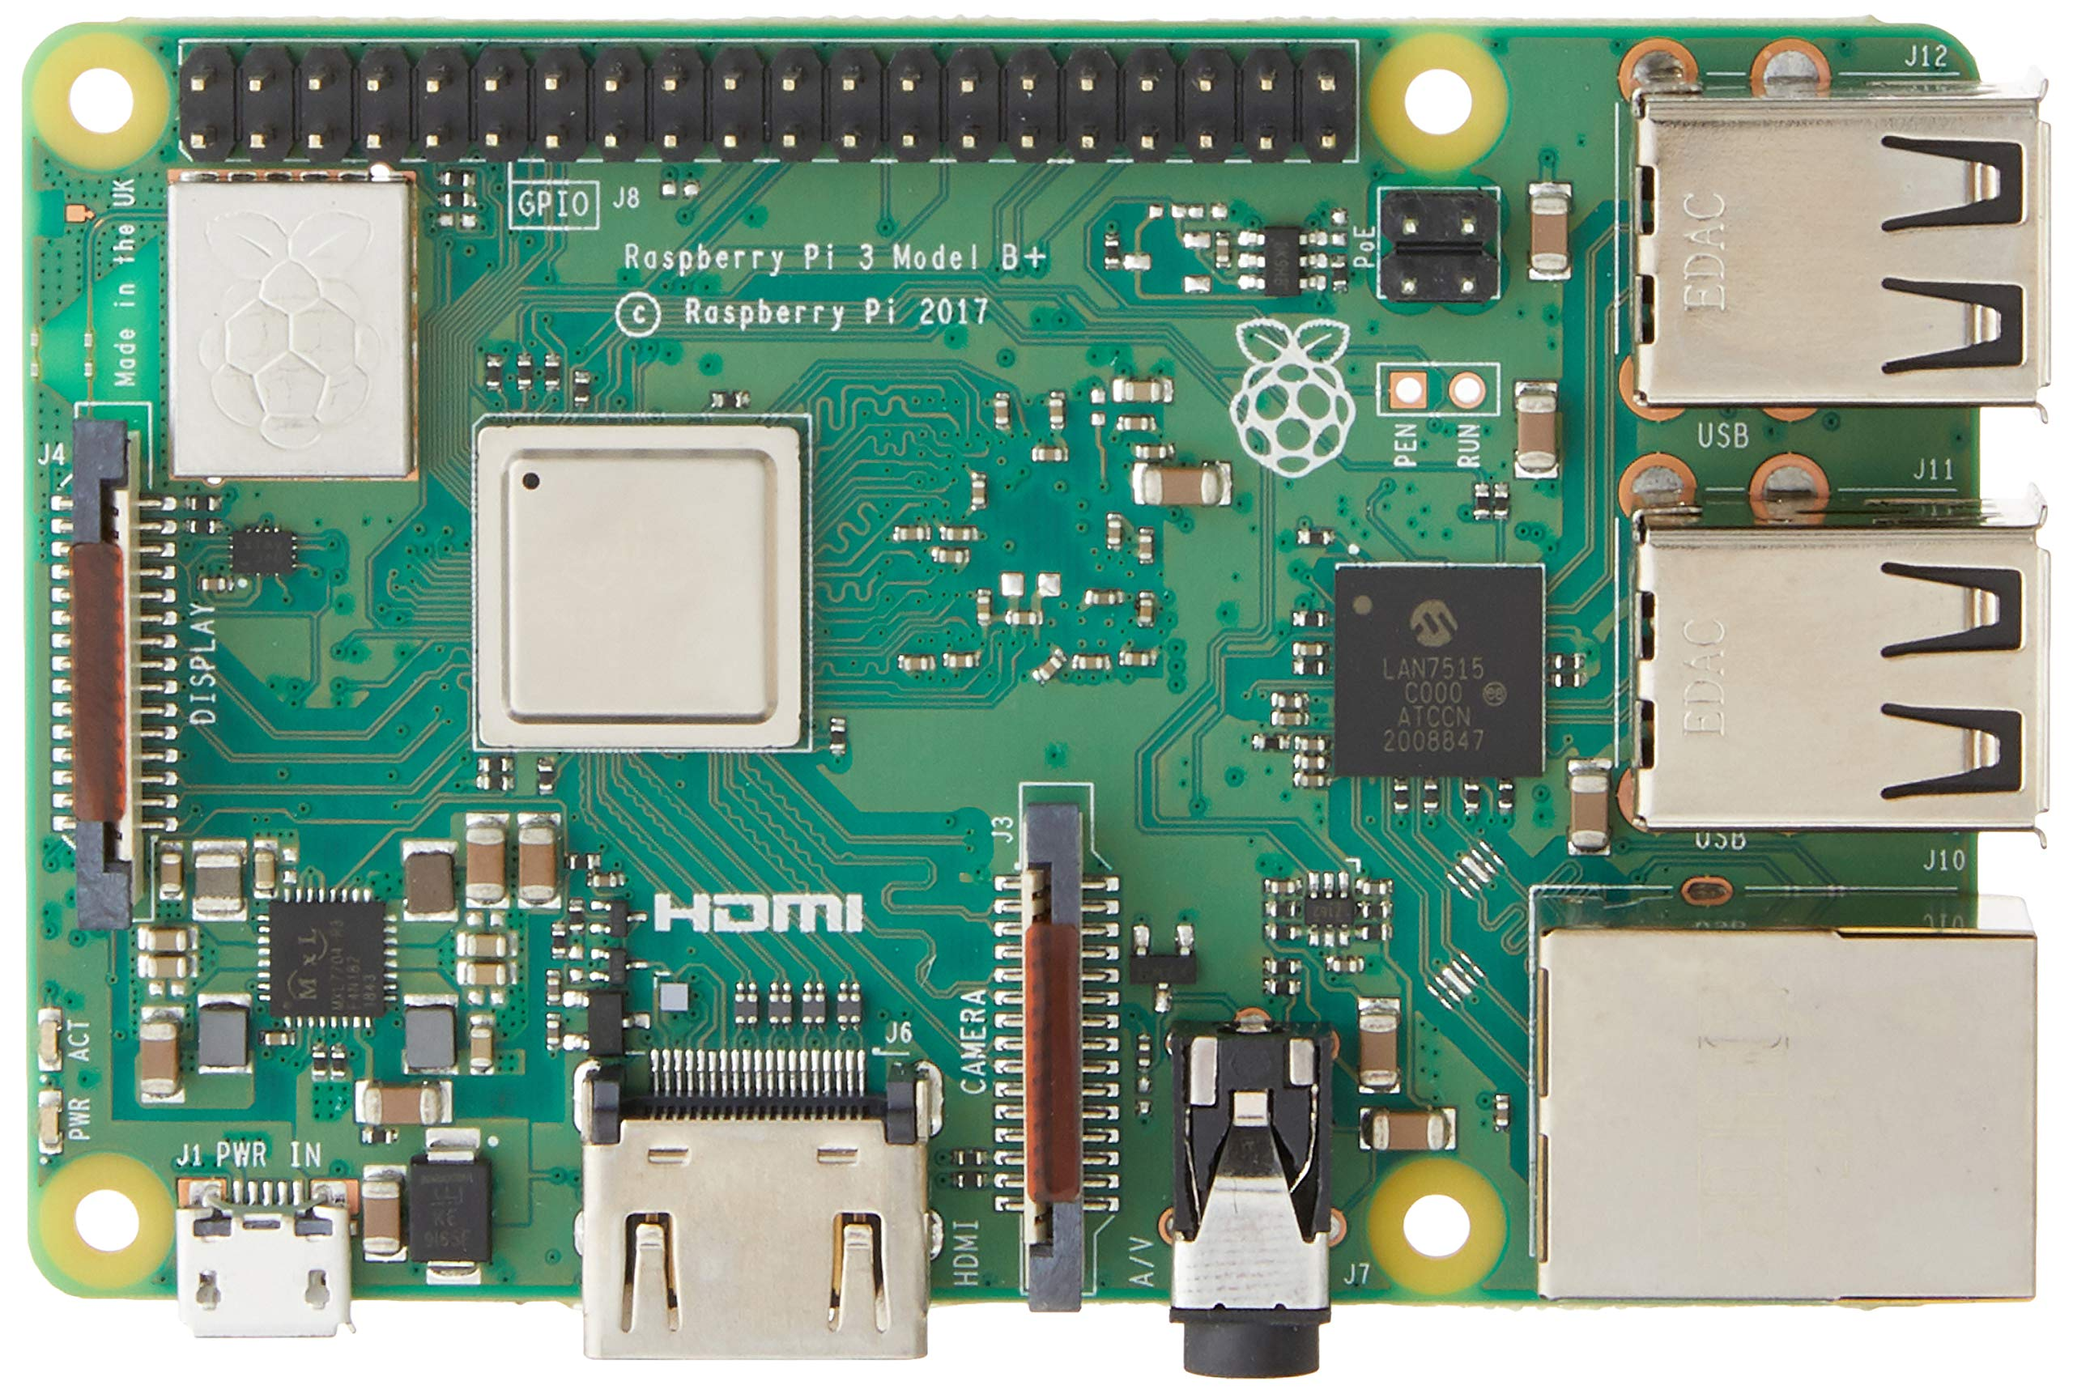
What is a Raspberry Pi?

Slide 3
Requirements
MicroSD card (4GB minimum)
MicroSD card reader
MicroUSB power cable
Raspberry Pi (any model with wireless capabilities)

Slide 4
DNS Sinkhole
www.adserver.com
Raspberry Pi
(DNS Server)
External DNS Server
Computer
0.0.0.0

Slide 5
DNS Sinkhole
www.google.com
www.google.com
Raspberry Pi
(DNS Server)
External DNS Server
Computer
8.8.4.4
8.8.4.4

Slide 6

PiVPN
Internet
Home network
Listening on port 51820
Raspberry Pi – VPN Server
Router
w.x.y.z
Open port 51820
Encrypted VPN connection
Your device
(c) 2023 Justin Bax for FLOSS Day 23

