Slide 1
Crime prediction in Chicago
Final course of IBM Data Science Professional Certificate by Coursera

Slide 2
Real world case
In general, every traveler, whether for business or pleasure, intends to enjoy a little of the place and have fun. Inspired by a scenario in which some co-workers will go to Chicago on business, they will have a few more days to explore the city. Knowing them, I know they like to go out at night after work and drink some drikes and listen to good music. This project's main idea is to predict the potential for a crime to happen close to a nightclub search on foursquare. Let's go!

Slide 3
Data acquisition and cleaning
The data were accessed at: https://data.cityofchicago.org/Public-Safety/Crimes-2019/w98m-zvie , where the API was generated to download in https://data.cityofchicago.org/api/views/w98mzvie/rows.csv?accessType=DOWNLOAD&api_foundry=true
After some procedures for cleaning the data and creating new columns (which can be seen in detail in the attached notebook, remember, we are in the "Readme"), a new dataframe was created for the crimes that occurred in 2019.

Slide 4

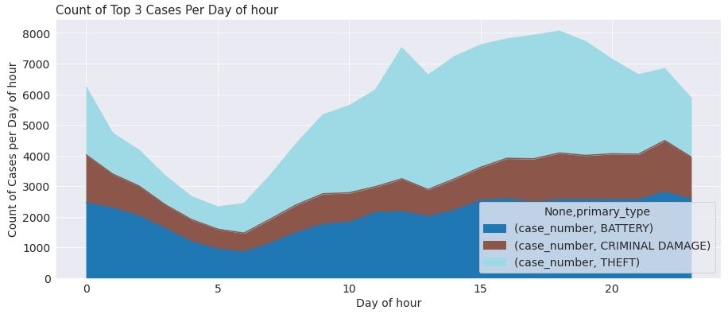
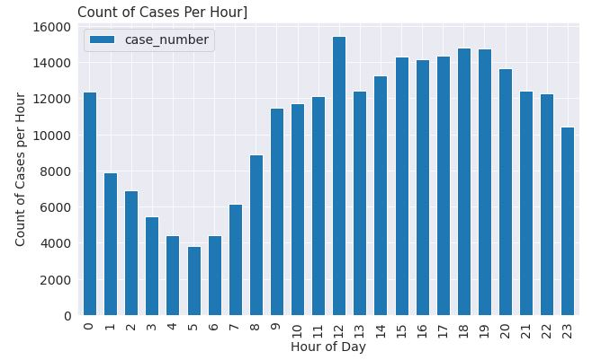
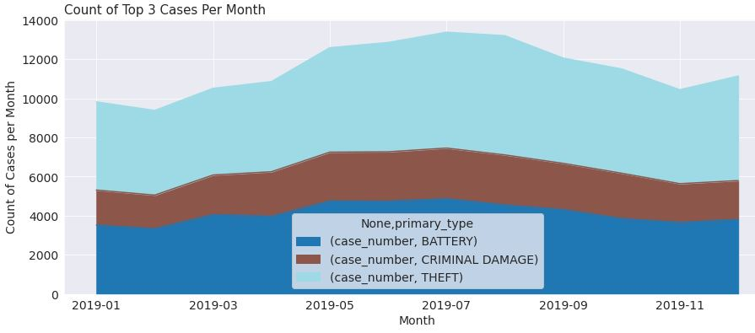
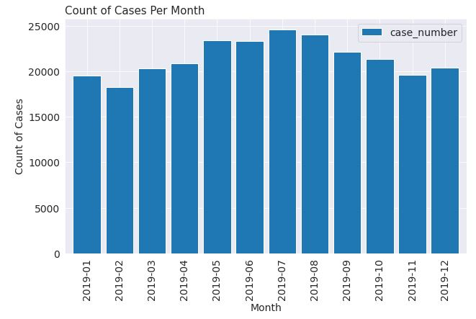
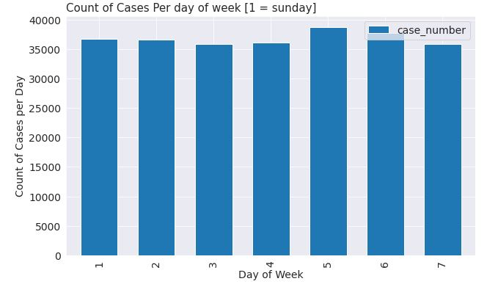
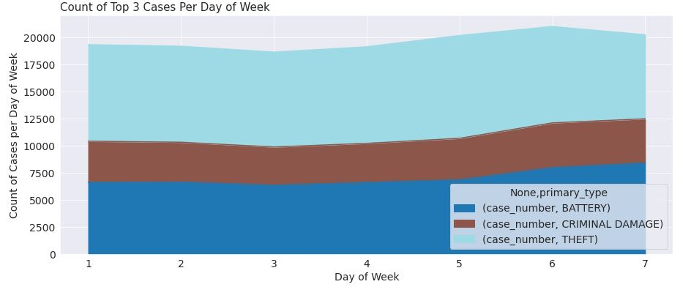
Descriptive statistics of Chicago crimes (Graphs)
3 most commonly occurring ones

Slide 5
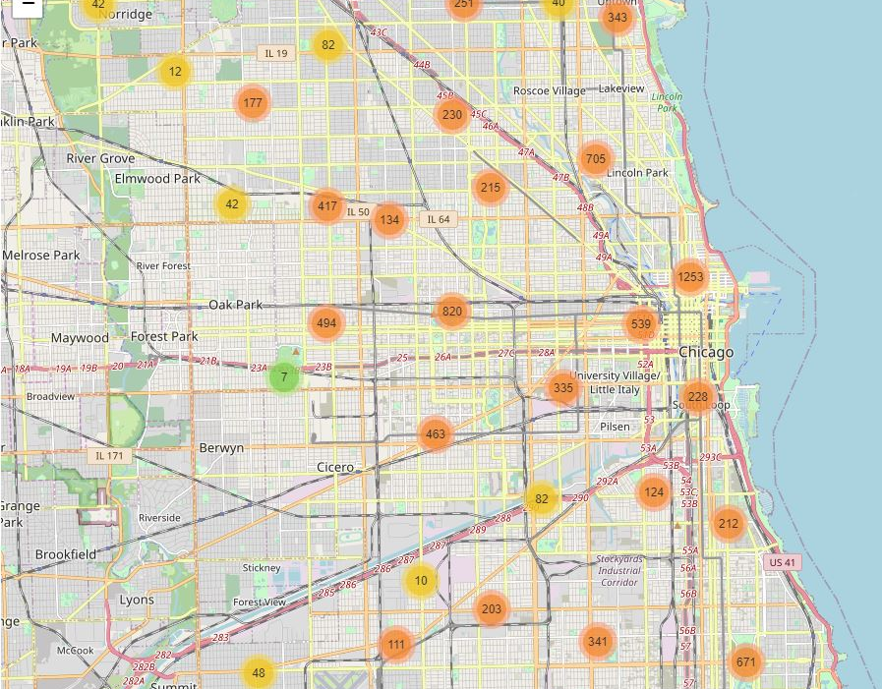
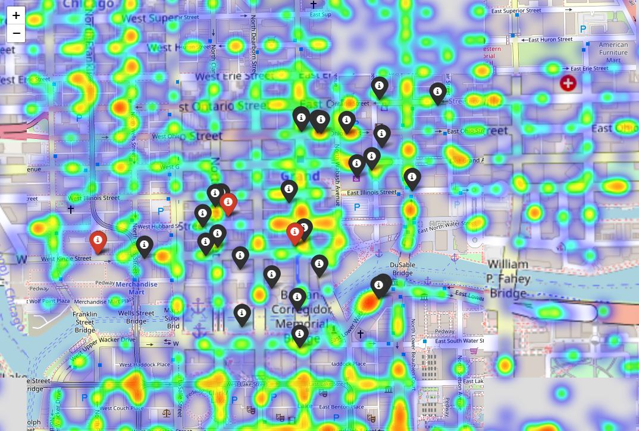
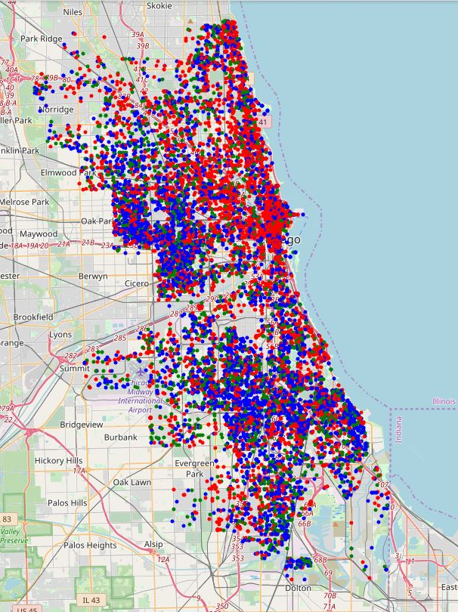
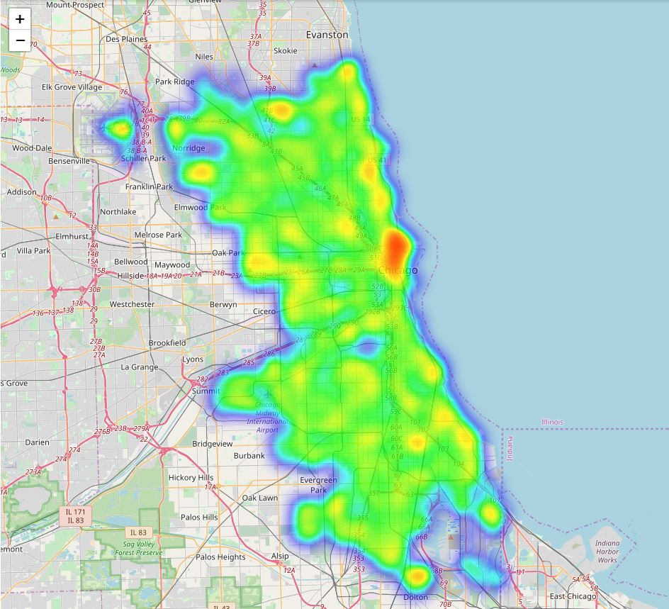
Chicago crimes (Maps)
Nightclubs and crimes

Slide 6
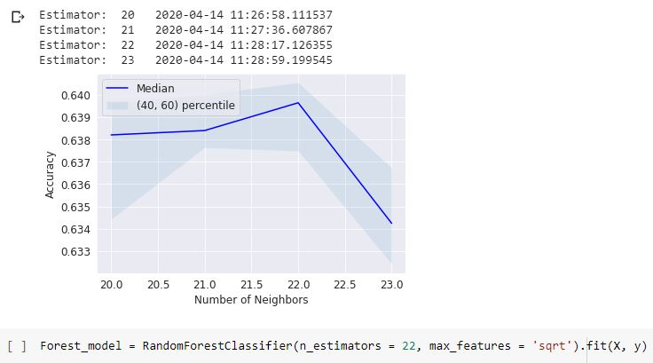
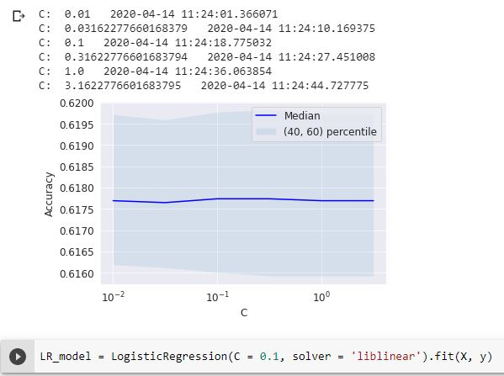
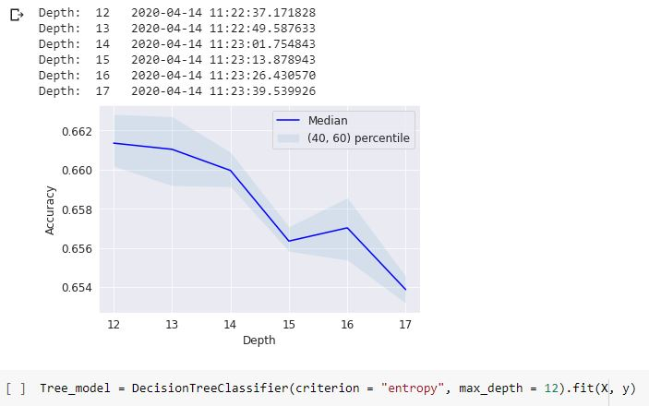
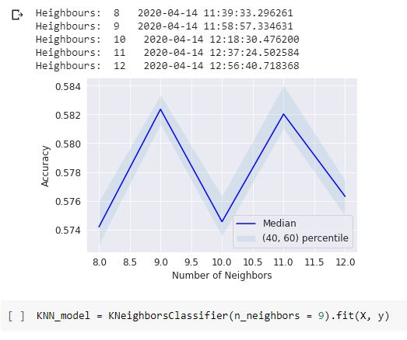
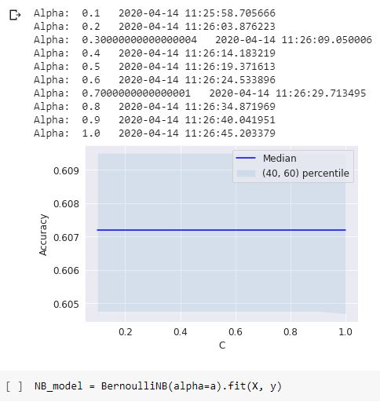
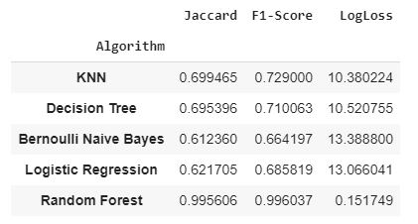
Models
Best model
Decision Forest using a Random Forest

Slide 7
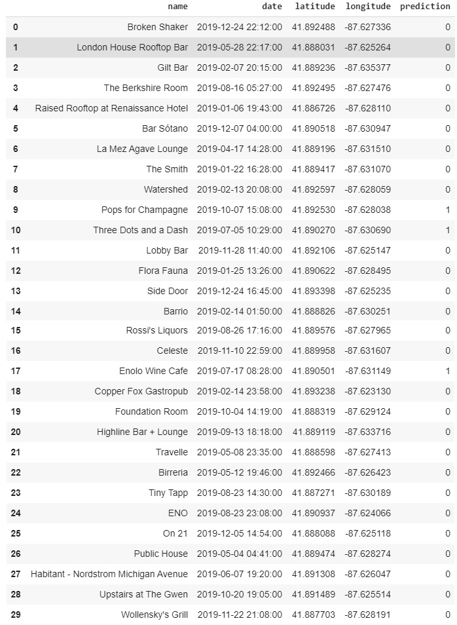
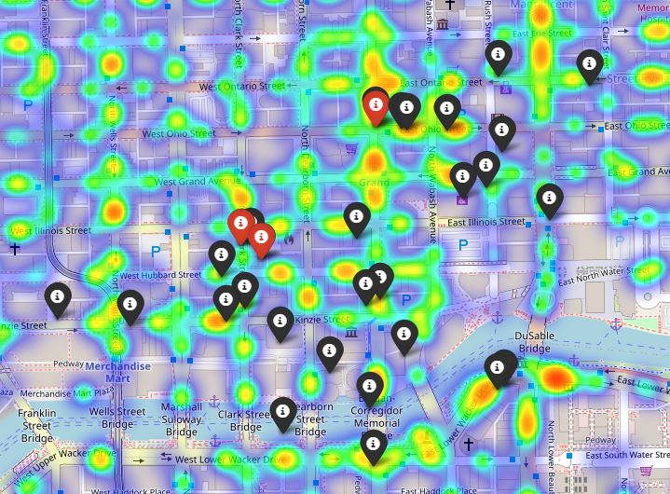
Prediction
1 - Enolo Wine Cafe | 2 - Three Dots and Dash | 3 - Pops for Champagne

Slide 8
Conclusion and Discussion
First of all, I have to mention the growth of my skills after all the courses of the IBM Data Science Professional Certificate, all the challenges proposed were of great value for the accomplishment of this project.
The objectives were achieved despite some problems midway through. The basic plan of the Foursquare API for Developers has a very short limit of consultations per day and until I get used to it, I exceeded that limit several times, making me have to wait for the next day and later having to pass the data to my personal drive and introducing it again.
Chicago is to be congratulated for providing open data with this quality and with an extremely interactive and simple platform, even having an area for developers.
Today (2020), we are experiencing the Coronavirus pandemic and I have observed many platforms developed for this cause, with humanitarian aid from data scientists to carry out projects on top of the data.
With the example of Chicago and the available data on Cornonavirus ... Shouldn't they look more at the importance of data and its availability?

