Slide 1
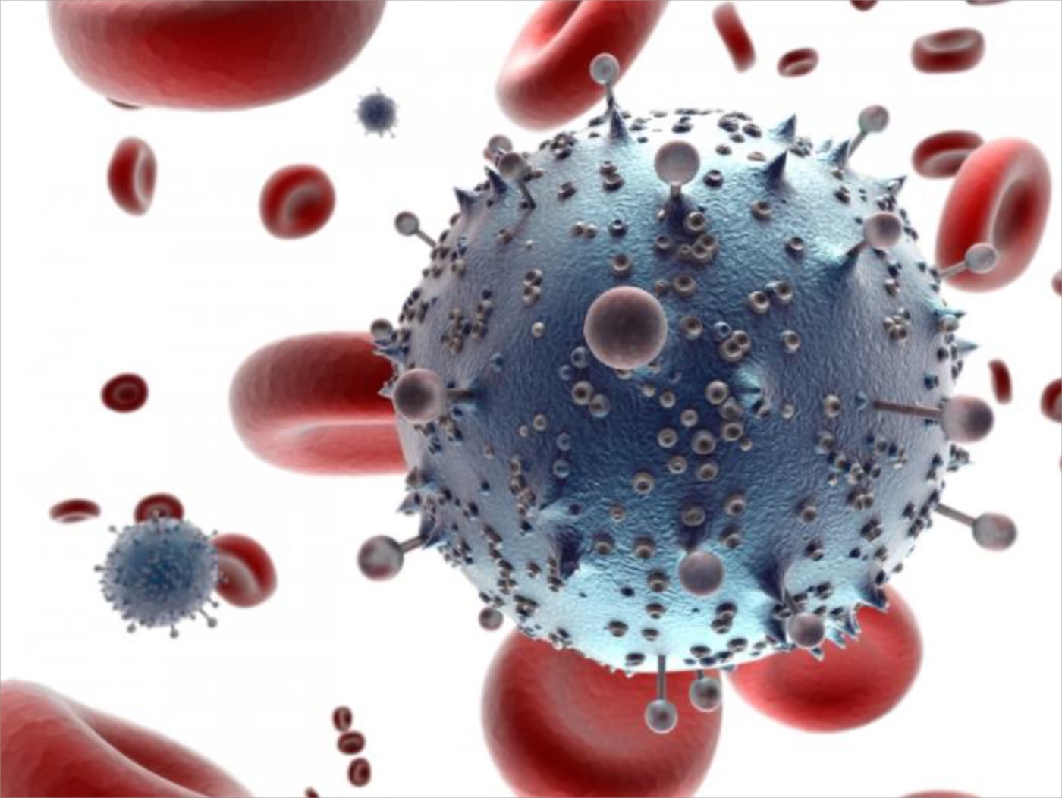
HIV-1 Dynamics in Vivo and Models for Proposed Treatments
Dharsan Chandrakumar and Tassos Sapalidis

Slide 2
History/Relevance
37 million people are currently living with HIV
1.2 million people died from AIDS in 2014
First reported incident of HIV was in 1981
Mathematical models can guide clinical research
Goal: Apply various treatments to HIV models
Determine which treatments to focus on clinically

Slide 3
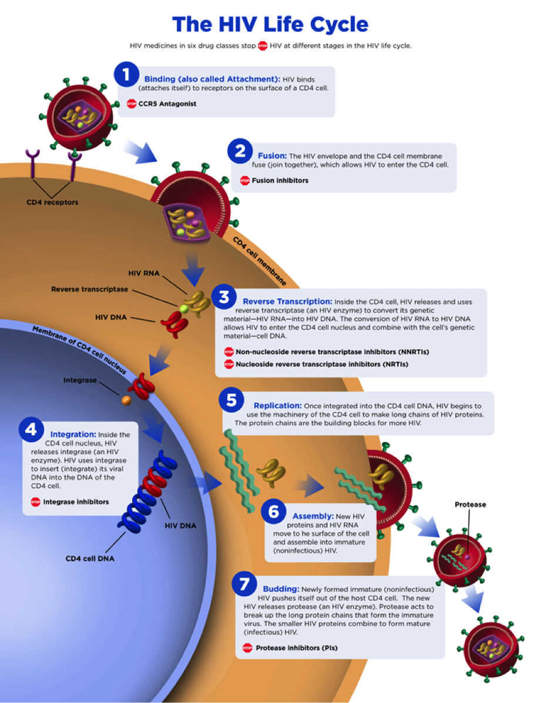

Slide 4
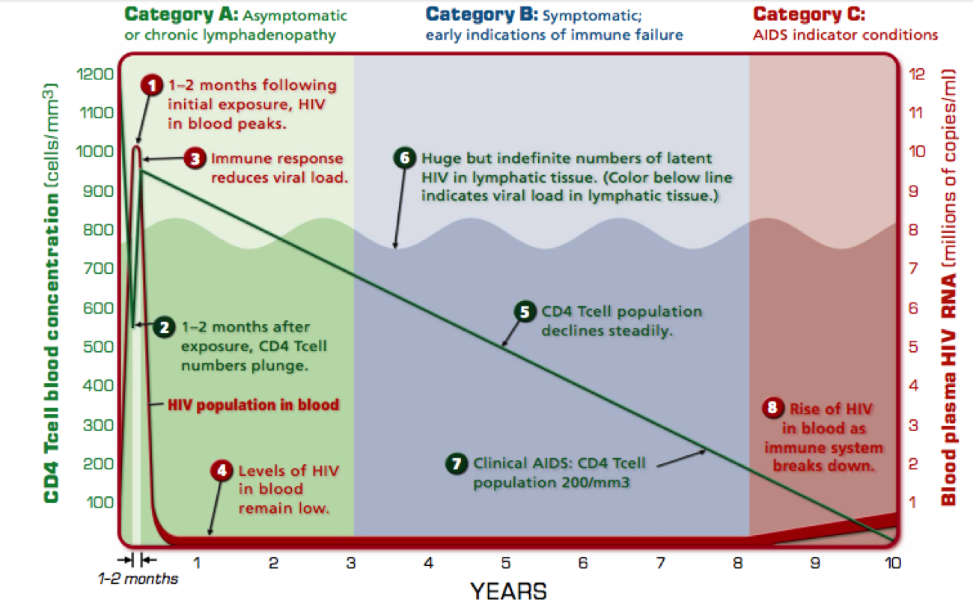

Slide 5
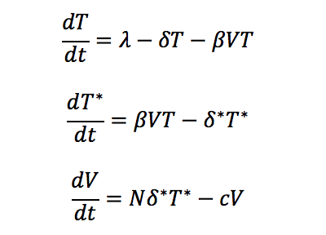
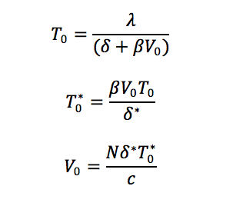
Perelson’s Model

Slide 6
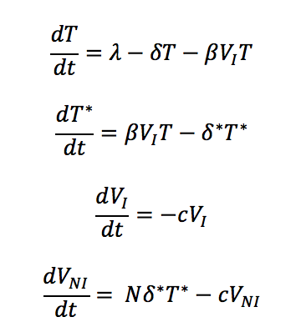
Protease Inhibitor (Ritonavir)

Slide 7
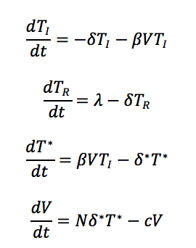
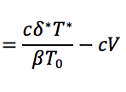
CCR5 Receptor Mutagen (Tassovir)

Slide 8
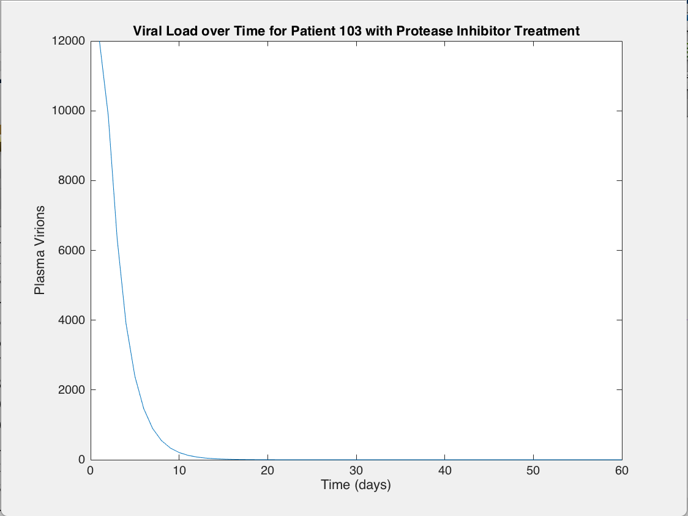
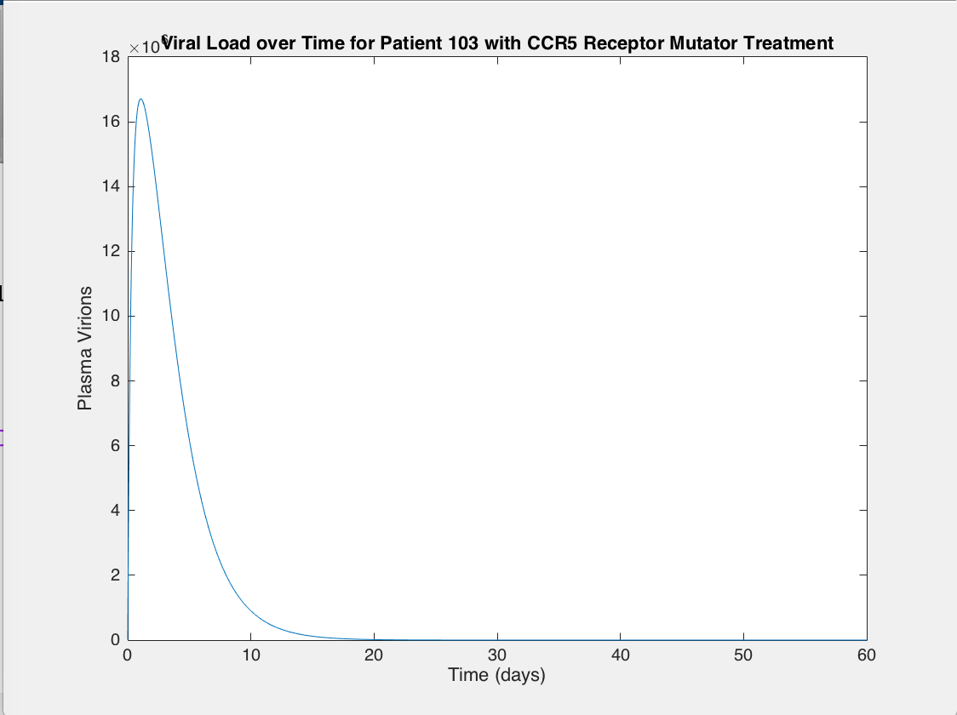
Viral Load Dynamics

Slide 9
Viral Load Dynamics

Slide 10
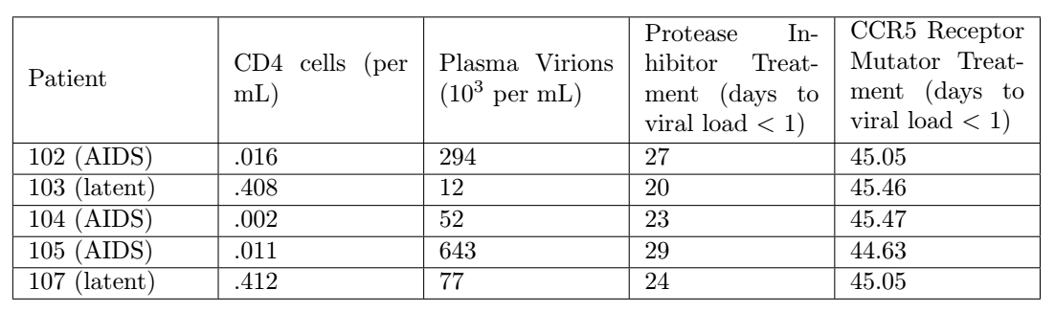
Patient Simulations

Slide 11
Results/Implications of CCR5 Receptor Mutagen (Tassovir)
Dynamics are different from protease inhibitor (different curve shape)
Efficiency is less variant than that of protease inhibitor
Higher viral loads correspond to higher efficiency for Tassovir
*These differences may indicate different real-world effects

Slide 12
Future Research
Alternative Treatment
CRISPR-CAS9 System
Change host cells genome
CD4+ cells will be able to cleave HIV-1
Mathematical Models
Unrealistic to assume ~ 100 % efficacy
Differential equation describing efficacy of gene therapy
Include degradation term of virus dependent of efficacy of gene therapy, viral load, and T-cell concentration

