Slide 1
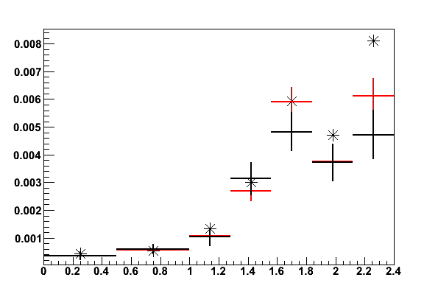
- Data driven method from Z
- MC Truth on Z events
* Electron Gun sample
Charge-Flip Rate
||

