Slide 1
Teach Humanoid Robots How to Take a Penalty Kick

Slide 2
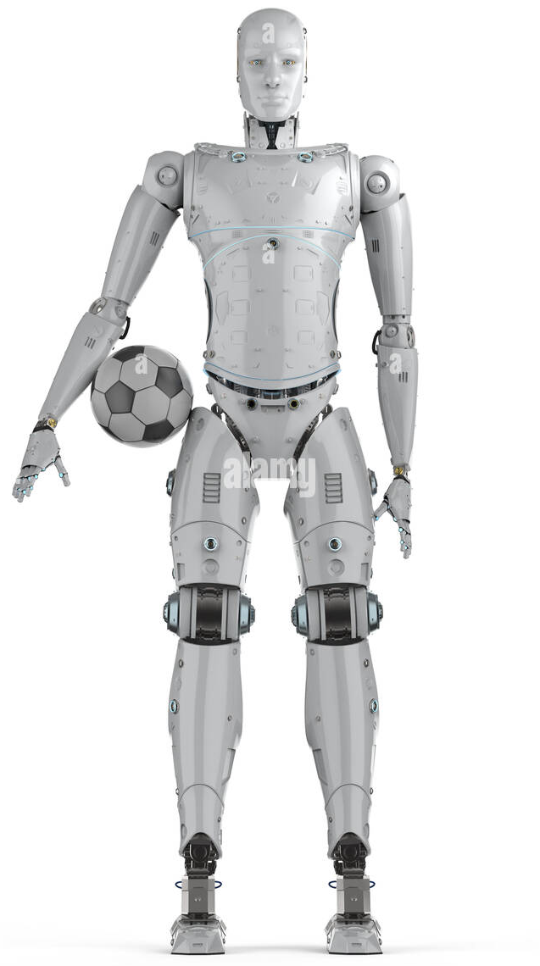
Introduction
Penalty kick

Slide 3


Simulation Settings
Muscle force
Foot angle
Height

Slide 4
Flowchart of Our Project
Validation
Simulation
Training
Prediction

Slide 5
Modeling of a Multibody System

Slide 6
Modeling of a Multibody System
Muscles

Slide 7
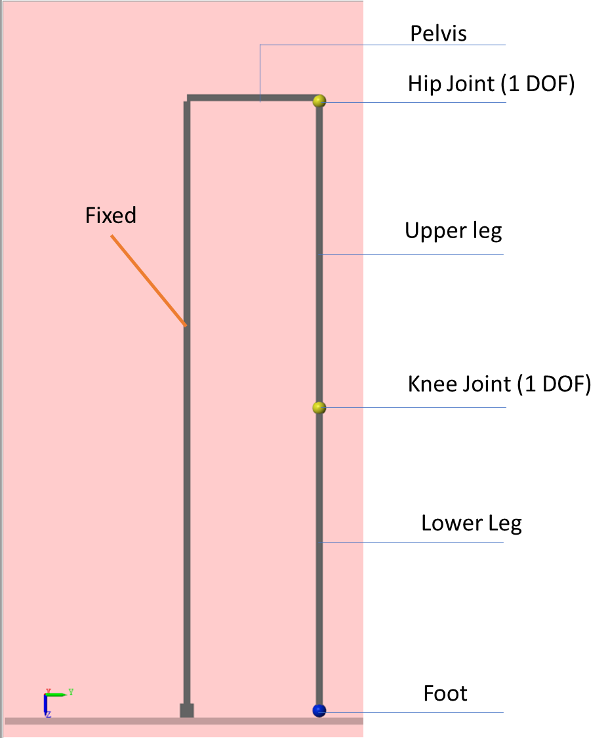


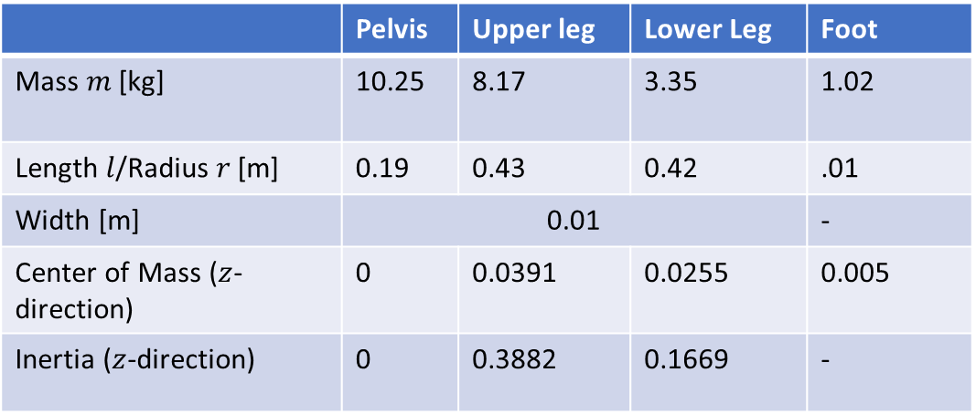
 | Pelvis | Upper leg | Lower Leg | Foot
Mass $m$ [kg] | 10.25 | 8.17 | 3.35 | 1.02
Length $l$/Radius$r$[m] | 0.19 | 0.43 | 0.42 | .01
Width [m] | 0.01 |  |  | -
Center of Mass ($z$-direction) | 0 | 0.0391 | 0.0255 | 0.005
Inertia ($z$-direction) | 0 | 0.3882 | 0.1669 | -
$$I=\frac{1}{12}ml^{2} + md_{1}^{2}$$
Inertia of a thin stick
Parallel axis theorem
$d_{1}^{}:$Distance to the center of mass

Slide 8
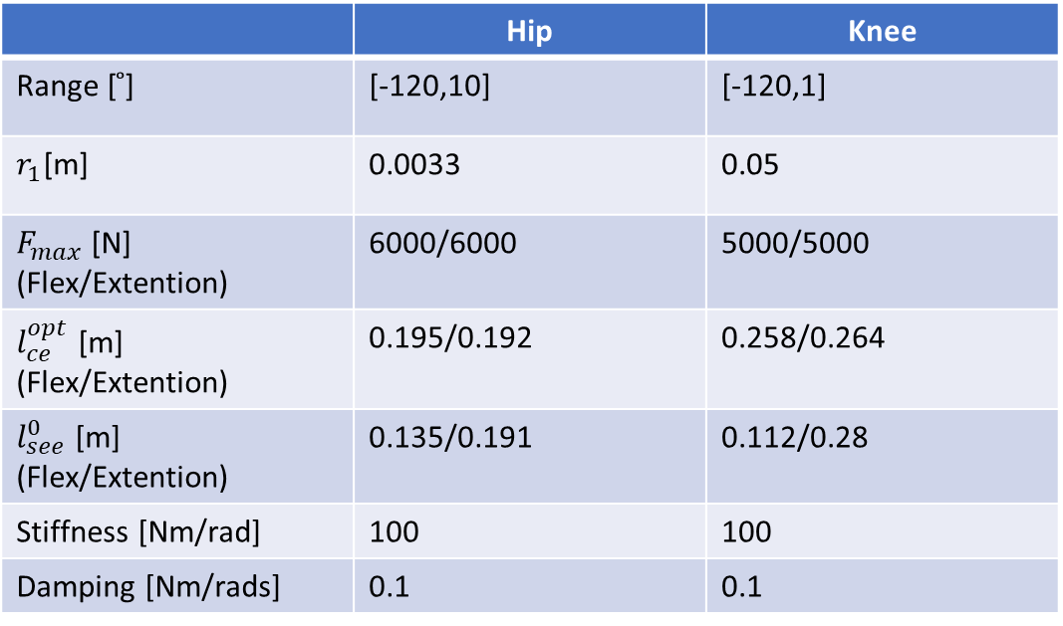
 | Pelvis | Upper leg | Lower Leg | Foot
Mass $m$ [kg] | 10.25 | 8.17 | 3.35 | 1.02
Length $l$/Radius$r$[m] | 0.19 | 0.43 | 0.42 | .01
Width [m] | 0.01 |  |  | -
Center of Mass ($z$-direction) | 0 | 0.0391 | 0.0255 | 0.005
Inertia ($z$-direction) | 0 | 0.3882 | 0.1669 | -
 | Hip | Knee
Range [ ̊] | [-120,10] | [-120,1]
$r_{1}$[m] | 0.0033 | 0.05
$F_{max}$[N] (Flex/Extention) | 6000/6000 | 5000/5000
$l_{ce}^{opt}$ [m] (Flex/Extention) | 0.195/0.192 | 0.258/0.264
$l_{see}^{0}$ [m] (Flex/Extention) | 0.135/0.191 | 0.112/0.28
Stiffness [Nm/rad] | 100 | 100
Damping [Nm/rads] | 0.1 | 0.1

Slide 9
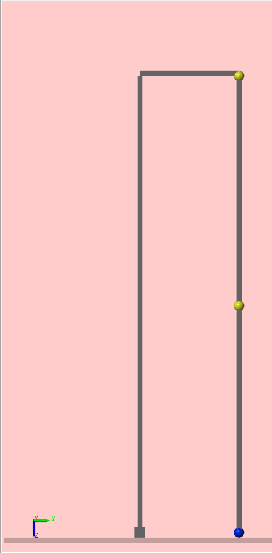
Pelvis
Hip Joint (1 DOF)
Fixed
Upper leg
Knee Joint (1 DOF)
Lower Leg
Foot

Slide 10
Machine Learning: Framework
Multilayer perceptron (MLP)
Levenberg-Marquardt approach
…
…
…
…
Input
Layer
Hidden
Layer
Output
Layer

Slide 11
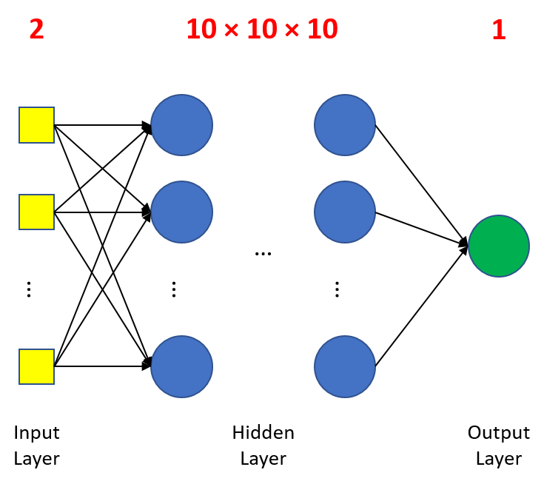
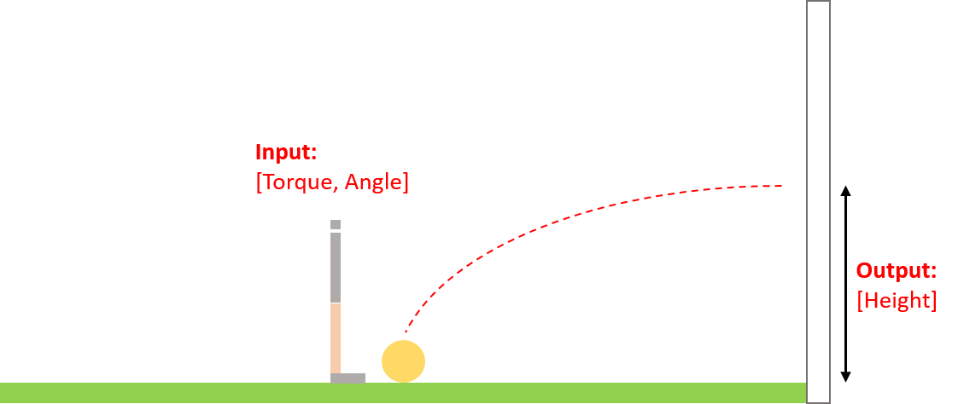
Machine Learning: Framework

Slide 12
Machine Learning: Results
Training Data
Number of data set: 1004
Data variation
Validation

Slide 13
Predictive Modeling Algorithms
Evolutionary algorithm
Global optimization algorithm
Stochastic algorithm
Survival of the fittest
Min value

Slide 15
Results

Slide 16
Machine Learning Framework
2
10 × 10 × 10
1
Input:
[Torque, Angle]
Output:
[Height]
…
…
…
…
Input
Layer
Hidden
Layer
Output
Layer

