Slide 1
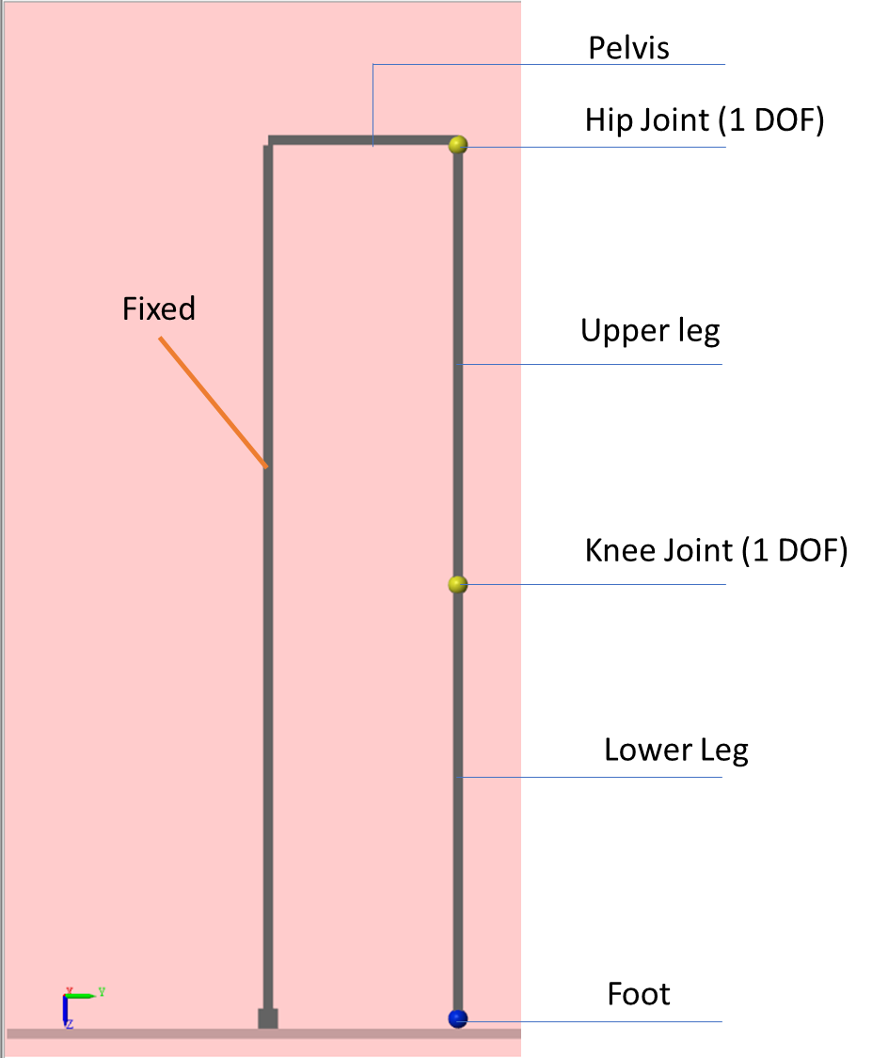


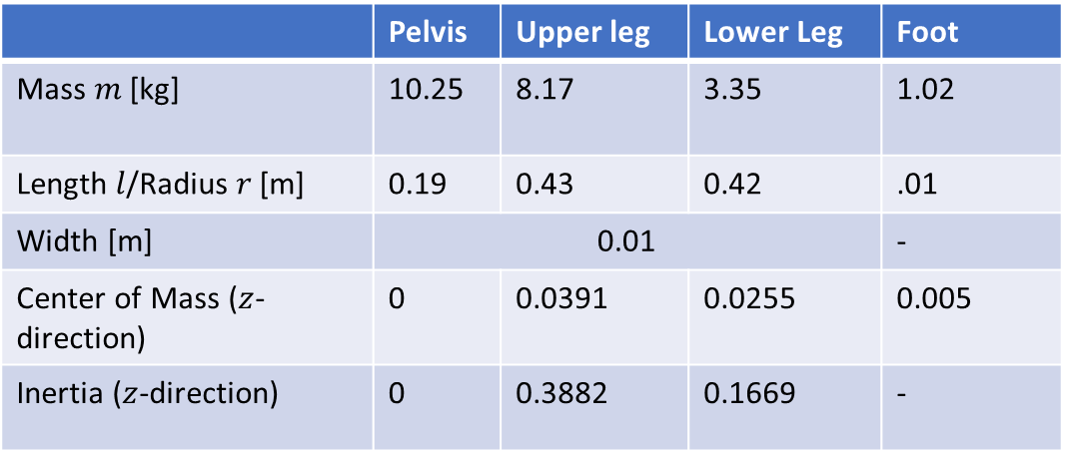
 | Pelvis | Upper leg | Lower Leg | Foot
Mass $m$ [kg] | 10.25 | 8.17 | 3.35 | 1.02
Length $l$/Radius$r$[m] | 0.19 | 0.43 | 0.42 | .01
Width [m] | 0.01 |  |  | -
Center of Mass ($z$-direction) | 0 | 0.0391 | 0.0255 | 0.005
Inertia ($z$-direction) | 0 | 0.3882 | 0.1669 | -
$$I=\frac{1}{12}ml^{2} + md_{1}^{2}$$
Inertia of a thin stick
Parallel axis theorem
$d_{1}^{}:$Distance to the center of mass

Slide 2
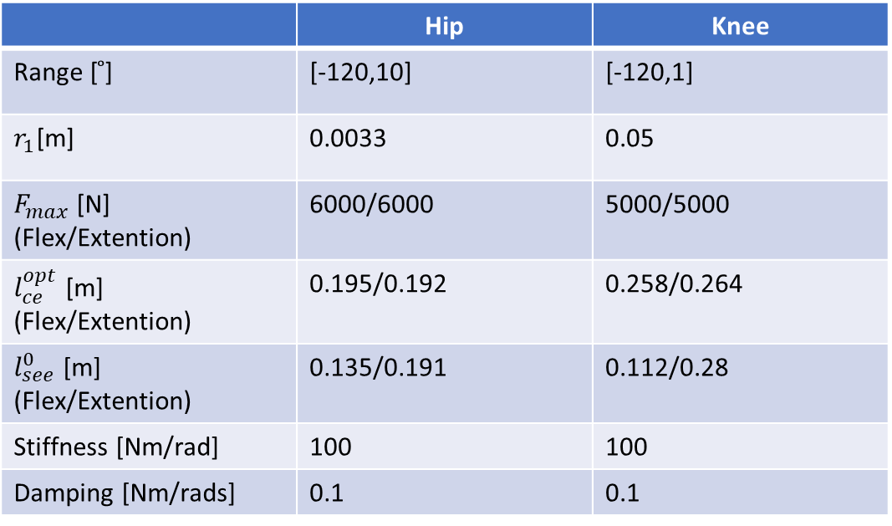
 | Pelvis | Upper leg | Lower Leg | Foot
Mass $m$ [kg] | 10.25 | 8.17 | 3.35 | 1.02
Length $l$/Radius$r$[m] | 0.19 | 0.43 | 0.42 | .01
Width [m] | 0.01 |  |  | -
Center of Mass ($z$-direction) | 0 | 0.0391 | 0.0255 | 0.005
Inertia ($z$-direction) | 0 | 0.3882 | 0.1669 | -
 | Hip | Knee
Range [ ̊] | [-120,10] | [-120,1]
$r_{1}$[m] | 0.0033 | 0.05
$F_{max}$[N] (Flex/Extention) | 6000/6000 | 5000/5000
$l_{ce}^{opt}$ [m] (Flex/Extention) | 0.195/0.192 | 0.258/0.264
$l_{see}^{0}$ [m] (Flex/Extention) | 0.135/0.191 | 0.112/0.28
Stiffness [Nm/rad] | 100 | 100
Damping [Nm/rads] | 0.1 | 0.1

Slide 4
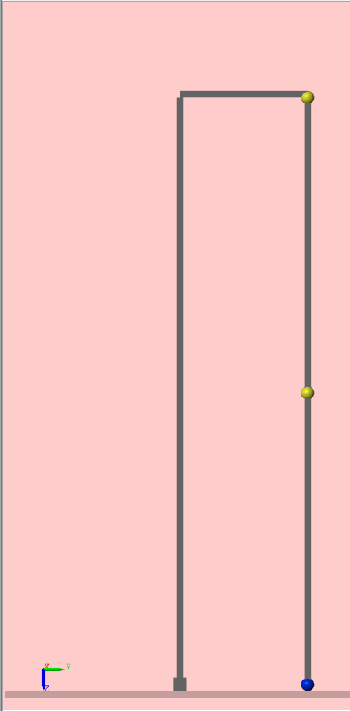
Pelvis
Hip Joint (1 DOF)
Fixed
Upper leg
Knee Joint (1 DOF)
Lower Leg
Foot

