Slide 1
R—Tutorial
Halil Bisgin, PhD

Slide 2

Installation
R
https://cran.rstudio.com/
Have your R installed first, then Rstudio will ask you about R
Rstudio—Nice IDE
https://posit.co/download/rstudio-desktop/
This page has the links for R and Rstudio

Slide 3

Nuts & Bolts
Entering Input
x <- 1
print(x)
msg <- "hello”
print(msg)
Evaluation
x<-5
x

Slide 4

R Objects
Data Types
• character
• numeric (real numbers)
• integer
• complex
• logical (True/False)
The most basic type of R object is a vector.
Empty vectors can be created with the vector() function
You can always check the data type with: class() function.

Slide 5

Attributes
R objects can have attributes, which are like metadata for the object:
names, dimnames
dimensions (e.g. matrices, arrays)
class (e.g. integer, numeric)
length
other user-defined attributes/metadata

Slide 6
Creating Vectors
> x <- c(0.5, 0.6) ## numeric
> x <- c(TRUE, FALSE) ## logical
> x <- c(T, F) ## logical
> x <- c("a", "b", "c") ## character
> x <- 9:29 ## integer
> x <- c(1+0i, 2+4i) ## complex

Slide 7
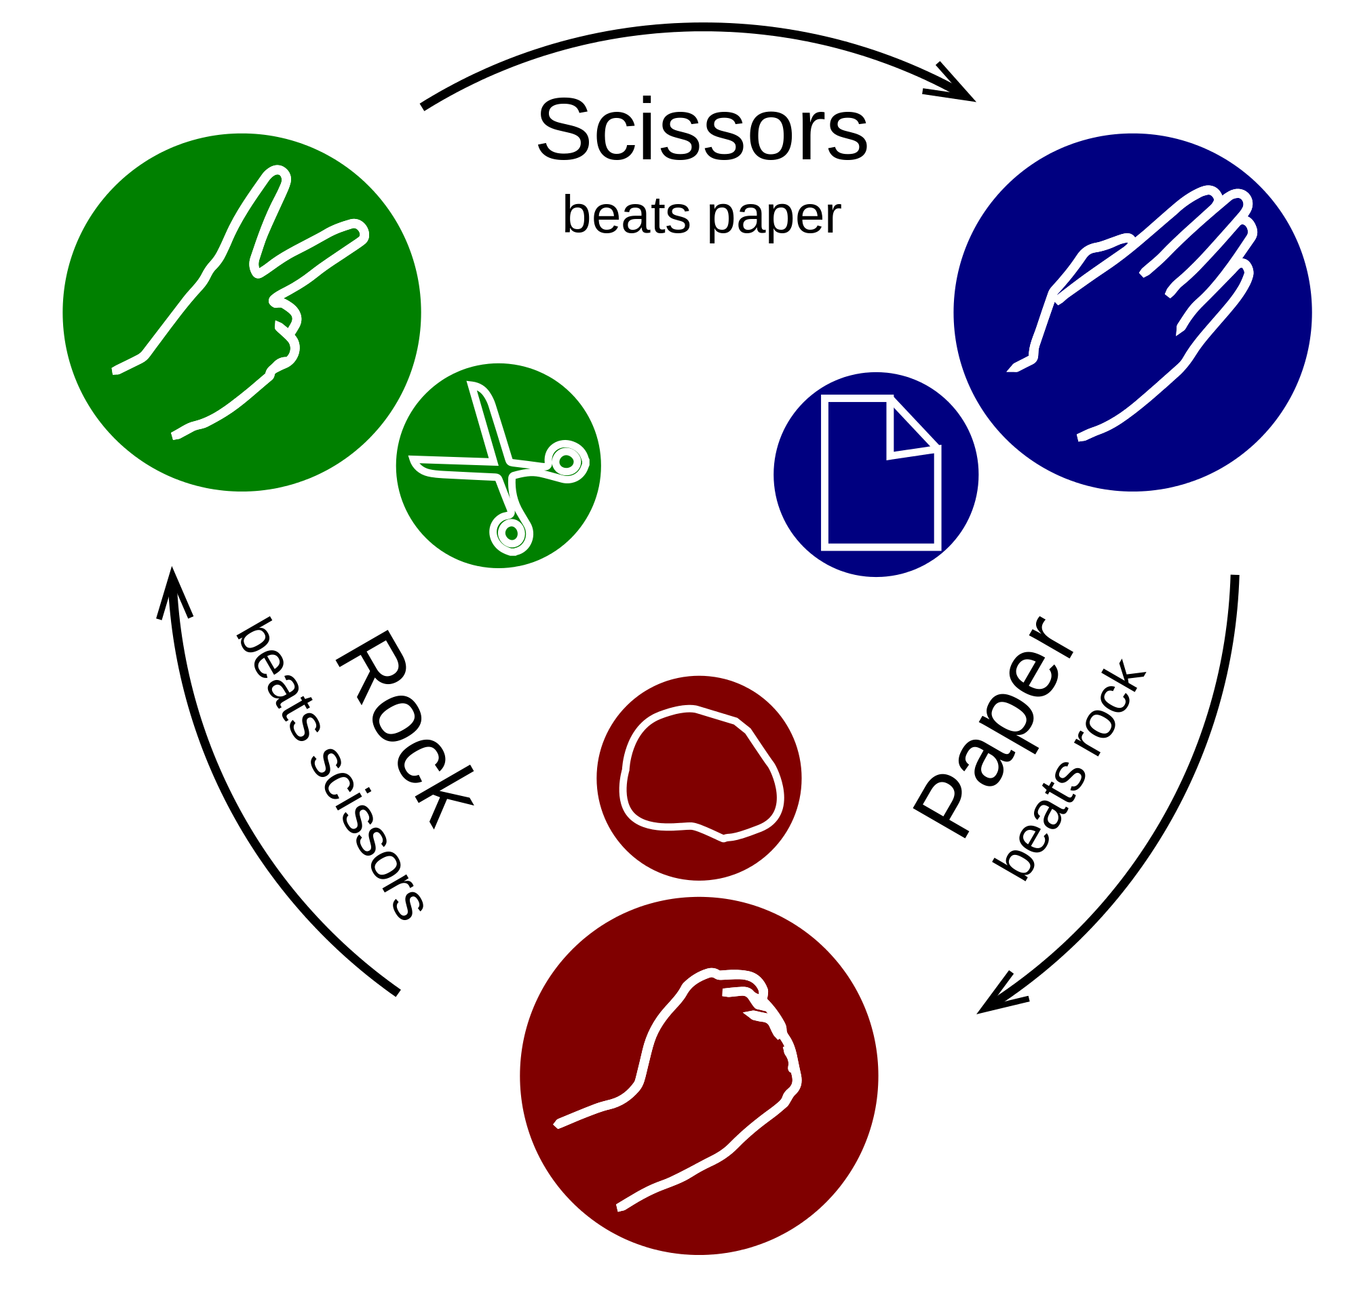
Mixing Objects
> y <- c(1.7, "a") ## character
> y <- c(TRUE, 2) ## numeric
> y <- c("a", TRUE) ## character

Slide 8
Explicit Coercion
> x <- 0:6
> class(x)
[1] "integer"
> as.numeric(x)
[1] 0 1 2 3 4 5 6
> as.logical(x)
[1] FALSE TRUE TRUE TRUE TRUE TRUE TRUE
> as.character(x)
[1] "0" "1" "2" "3" "4" "5" "6"

Slide 9
Matrices
> m <- matrix(nrow = 2, ncol = 3)
> m
[,1] [,2] [,3]
[1,] NA NA NA
[2,] NA NA NA
> dim(m)
[1] 2 3
> attributes(m)
$dim
[1] 2 3

Slide 10
Matrices
> m <- matrix(1:6, nrow = 2, ncol = 3)
> m
[,1] [,2] [,3]
[1,] 1 3 5
[2,] 2 4 6
> m <- 1:10
> m
[1] 1 2 3 4 5 6 7 8 9 10
> dim(m) <- c(2, 5)
> m
[,1] [,2] [,3] [,4] [,5]
[1,] 1 3 5 7 9
[2,] 2 4 6 8 10
Sunday, January 14, 2024
10

Slide 11
Matrices
Matrices can be created by column-binding or row-binding with the cbind() and rbind() functions.
> x <- 1:3
> y <- 10:12
> cbind(x, y)
x y
[1,] 1 10
[2,] 2 11
[3,] 3 12
> rbind(x, y)
[,1] [,2] [,3]
x 1 2 3
y 10 11 12

Slide 12
Lists
Lists are a special type of vector that can contain elements of different classes.
x <- list(1, "a", TRUE, 1 + 4i)
We can also create an empty list of a pre-specified length with the vector() function
x <- vector("list", length = 5)

Slide 13
Factors
Factors are used to represent categorical data and can be unordered or ordered.
One can think of a factor as an integer vector where each integer has a label.
Factors are important in statistical modeling and are treated specially by modelling functions like lm().
Often factors will be automatically created for you when you read a dataset in using a function like read.table().
x <- factor(c("yes", "yes", "no", "yes", "no"))
table(x)
unclass(x)

Slide 14
Missing Values
Missing values are denoted by NA or NaN for undefined mathematical operations.
is.na() is used to test objects if they are NA
is.nan() is used to test for NaN
NA values have a class also, so there are integer NA, character NA, etc.
A NaN value is also NA but the converse is not true
>x <- c(1, 2, NA, 10, 3)
> is.na(x)
[1] FALSE FALSE TRUE FALSE FALSE
> is.nan(x)
[1] FALSE FALSE FALSE FALSE FALSE

Slide 15
Data Frames
Data frames are used to store tabular data in R.
Data frames are represented as a special type of list where every element of the list has to have the same length
Unlike matrices, data frames can store different classes of objects in each column
Data frames have a special attribute called row.names
Data frames can be converted to a matrix by calling data.matrix(). (as.matrix() also works )

Slide 16
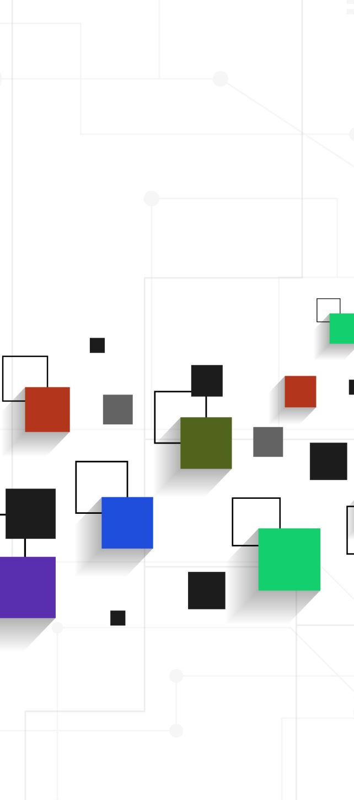
Data Frames
> var1 <- 1:5
> var2 <- (1:5)/10
var3 <- c("R", "and", "Data Mining", "Examples", "Case Studies")
df1 <- data.frame(col1=var1, col2=var2, col3=var3)
names(df1) <- c("VarInt", "VarReal", "VarChar")

Slide 17

Data Frame
> m <- matrix(1:4, nrow = 2, ncol = 2)
> dimnames(m) <- list(c("a", "b"), c("c", "d"))
> m
c d
a 1 3
b 2 4
> colnames(m) <- c("h", "f")
> rownames(m) <- c("x", "z")

Slide 18
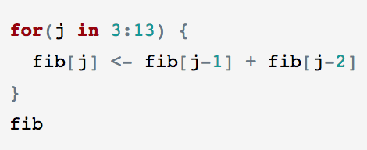
FOR LOOPS
Not much different.
Need to indicate the index and its range, though

Slide 19

Other flow control
R has a while function as well as a for function. This allows iterations of flexible length.
while(expression)
{
code block
}
should be read as
while the expression is true, iteratively execute the code block and re-evaluate the expression based on the result.

Slide 20

Conditional execution in R
The syntax of the if function in R is
if(expression) { code block}
which is executed as “if the expression is TRUE, execute the code block, otherwise skip it”.
This is handy when the code block can only be executed when some condition holds.
There is also an if else combination.
if(expression) { code block}
else {other code block}

Slide 21
Functions
R has a rich collection of functions for performing calculations necessary for doing statistics.
Much of learning R comes down to acquiring a large enough vocabulary of functions to solve your problems.
The actual structure of the programs may be quite simple, but you still need to learn the names of the functions that do the required work.
However, even for everyday users need to write their own functions.

Slide 22
Functions
Functions are written in a library file with a .R extension and the files are loaded into the R Markdown document doing an analysis with the source command.
Putting the code into its own function saves retyping the commands and ensures reproducibility by forcing exactly the same code to be run when it is used.

Slide 23

Function definition
myfun <- function (a, b, c)
{
do something ….
do another thing …
output #this line will be without <- or =
}

Slide 24

Function example
mymean <-function (x,y)
{
output = (x+y)/2
output
}

Slide 25

Default arguments
mymean <-function (x=0,y=0)
{
output = (x+y)/2
output
}

Slide 26
Using built-in functions for rows/columns
set.seed(123)
v <- sample(x = -10:10, size = 12)
M1 <- matrix(v, nrow=4)
M1
apply
Example: sum_stats <- apply(expr_mat, 1, summary)
dimension
function
data

Slide 27
Getting Data In and Out
Read data from and write data to
R native formats (incl. Rdata and RDS)
CSV files
EXCEL files
ODBC databases
SAS databases

Slide 28
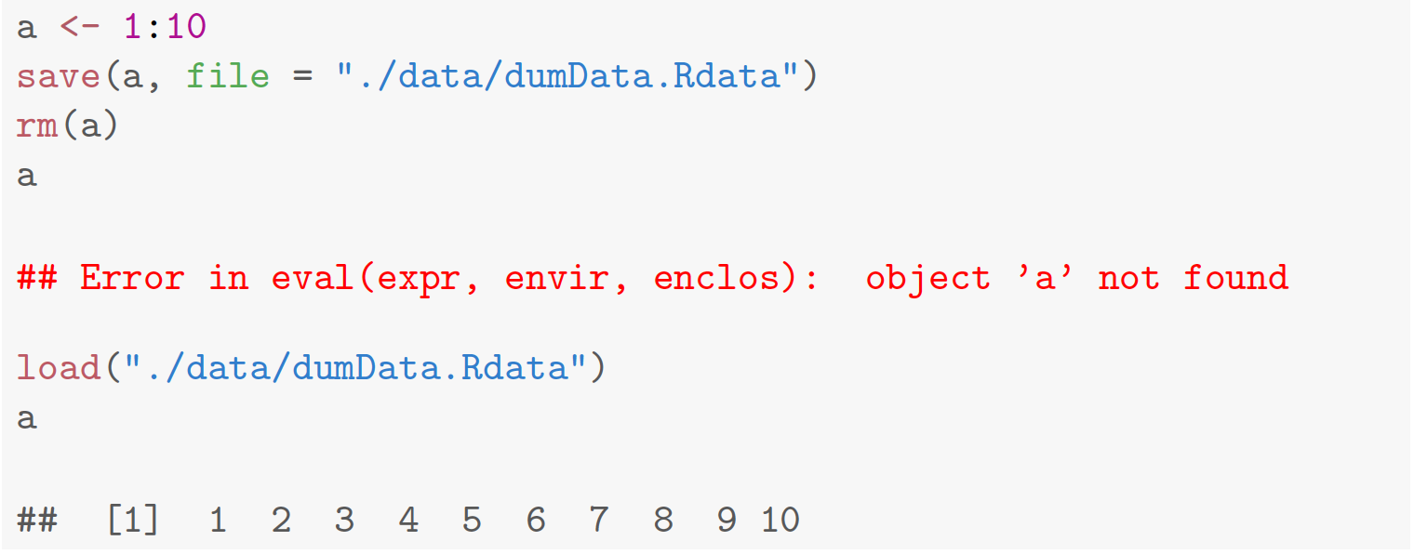
Getting Data In and Out

Slide 29
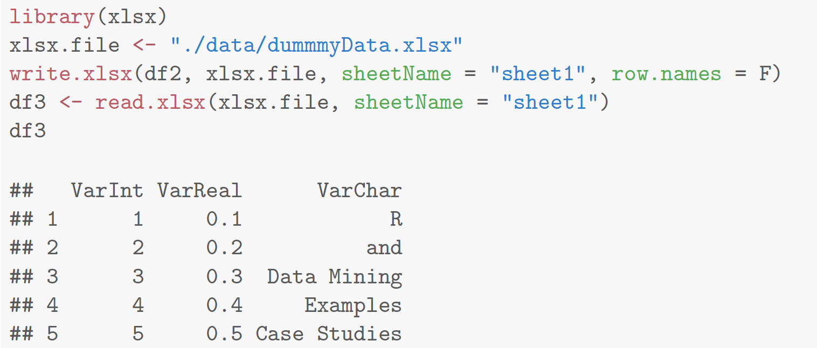
Getting Data In and Out

Slide 30
Getting Data In and Out
read.delim(file, header = TRUE, sep = “\t”)
read.csv(file, header = TRUE, sep = ",”)
read.table(file, header = FALSE, sep = ””)
The read.table() function is one of the most commonly used functions for reading data
file: filename in quotation marks (may need to include path)
header: if your file has headers (column names)
sep: separator; each function has its default separator
There are further options in these functions if you need
Built in datasets: mtcars, iris
data= read.delim("~/Documents/TEACHING/Data_Science/R/data/Su_raw_matrix.txt")

Slide 31
Getting Data In and Out
file, the name of a file, or a connection
header, logical indicating if the file has a header line
sep, a string indicating how the columns are separated
colClasses, a character vector indicating the class of each column in the dataset
nrows, the number of rows in the dataset. By default read.table() reads an entire file.
Built in datasets: mtcars, iris
write.table
write.table(x, file = "", append = FALSE, quote = TRUE, sep = " ",
eol = "\n", na = "NA", dec = ".", row.names = TRUE,
col.names = TRUE)
Sunday, January 14, 2024
31

Slide 32
Working Directory
> getwd() # get current working directory
You can select a different working directory with the function setwd(), and thus avoid entering the full path of the data files.
> setwd("<new path>") # set working directory
Note that the forward slash should be used as the path separator even on Windows platform.
> setwd("C:/MyDoc")

Slide 33

Install and import a library
install.packages(“ggplot2”)
library(ggplot2)

Slide 34
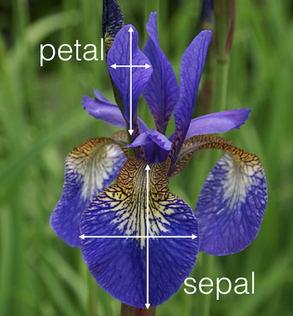
Exploring Data
dim(iris)
str(iris)
names(iris)
attributes(iris)
head(iris, 3)
tail(iris, 3)
iris[1:10, "Sepal.Length"]
summary(iris)
library(Hmisc)
describe(iris[, c(1, 5)])
range(iris$Sepal.Length)
quantile(iris$Sepal.Length, c(0.1, 0.3, 0.65))

Slide 35

Exploring Data
Histogram
hist(iris$Sepal.Length)
Density
plot(density(iris$Sepal.Length))
Pie Chart
table(iris$Species)
pie(table(iris$Species))
Bar Plot
barplot(mtcars$cyl)

Slide 36
Exploring Data
aggregate(Sepal.Length ~ Species, summary, data = iris)
boxplot(Sepal.Length ~ Species, data = iris)
with(iris, plot(Sepal.Length, Sepal.Width, col = Species, pch = as.numeric(Species)))
pairs(iris) – scatter plots
3D Scatter plot
library(scatterplot3d)
scatterplot3d(iris$Petal.Width, iris$Sepal.Length, iris$Sepal.Width)
Heat Map
dist.matrix <- as.matrix(dist(iris[, 1:4]))
heatmap(dist.matrix)

Slide 37
Exploring Data
contour
filled.contour(volcano, color = terrain.colors, asp = 1, plot.axes = contour(volcano, add = T))
3D Surface
persp(volcano, theta = 25, phi = 30, expand = 0.5, col = "lightblue")
Parallel Coordinates
parcoord(iris[1:4], col = iris$Species)
Parallel Coordinates with Package lattice
library(lattice)
parallelplot(~iris[1:4] | Species, data = iris)
Visualization with Package ggplot2
library(ggplot2)
qplot(Sepal.Length, Sepal.Width, data = iris, facets = Species ~ .)
p<-ggplot(data=iris, aes(x=Sepal.Length, y=Sepal.Width)) + geom_point() + facet_grid(Species ~.)

Slide 38
Saving figures
# save as a PDF file
pdf("myPlot.pdf")
x <- 1:50
plot(x, log(x))
graphics.off()
# Save as a postscript file
postscript("myPlot2.ps")
x <- -20:20
plot(x, x^2)
graphics.off()

Slide 39
Clustering with R
k-means: kmeans(), kmeansruns()
k-medoids: pam(), pamk()
Hierarchical clustering: hclust(), agnes(), diana()
DBSCAN: fpc
BIRCH: birch

Slide 40
Clustering Example
>iris2 <- iris
>iris2$Species <- NULL
>(kmeans.result <- kmeans(iris2, 3))
>table(iris$Species, kmeans.result$cluster)
>plot(iris2[c("Sepal.Length", "Sepal.Width")], col = kmeans.result$cluster)
>points(kmeans.result$centers[, c("Sepal.Length", "Sepal.Width")],
col = 1:3, pch = 8, cex = 2) # plot cluster centers

Slide 41
Classification with R
Decision trees: rpart, party
Random forest: randomForest, extendedForest, party
SVM: e1071, kernlab
Neural networks: nnet, neuralnet, RSNNS
Performance evaluation: ROCR

Slide 42
Association Rule Mining with R
Association rules: apriori(), eclat() in package arules
Sequential patterns: arulesSequence
Visualization of associations: arulesViz

