Slide 1
Data Mining: Concepts and Techniques (3rd ed.) — Chapter 8 —
1
Notes:
1

Slide 2
Chapter 8. Classification: Basic Concepts
Classification: Basic Concepts
Decision Tree Induction
Bayes Classification Methods
Rule-Based Classification
Model Evaluation and Selection
Techniques to Improve Classification Accuracy: Ensemble Methods
Summary
2
Notes:
2

Slide 3
Supervised vs. Unsupervised Learning
Supervised learning (classification)
Supervision: The training data (observations, measurements, etc.) are accompanied by labels indicating the class of the observations
New data is classified based on the training set
Unsupervised learning (clustering)
The class labels of training data is unknown
Given a set of measurements, observations, etc. with the aim of establishing the existence of classes or clusters in the data

Slide 4
Prediction Problems: Classification vs. Numeric Prediction
Classification
predicts categorical class labels (discrete or nominal)
classifies data (constructs a model) based on the training set and the values (class labels) in a classifying attribute and uses it in classifying new data
Numeric Prediction
models continuous-valued functions, i.e., predicts unknown or missing values
Typical applications
Credit/loan approval:
Medical diagnosis: if a tumor is cancerous or benign
Fraud detection: if a transaction is fraudulent
Web page categorization: which category it is

Slide 5
Classification—A Two-Step Process
Model construction: describing a set of predetermined classes
Each tuple/sample is assumed to belong to a predefined class, as determined by the class label attribute
The set of tuples used for model construction is training set
The model is represented as classification rules, decision trees, or mathematical formulae
Model usage: for classifying future or unknown objects
Estimate accuracy of the model
The known label of test sample is compared with the classified result from the model
Accuracy rate is the percentage of test set samples that are correctly classified by the model
Test set is independent of training set (otherwise overfitting)
If the accuracy is acceptable, use the model to classify new data
Note: If the test set is used to select models, it is called validation (test) set

Slide 6



Cat or dog?

Slide 7
Classification: A Mathematical Mapping
Classification: predicts categorical class labels
E.g., Personal homepage classification
x_{i} = (x₁, x₂, x₃, …), y_{i} = +1 or –1
x₁ : # of word “homepage”
x₂ : # of word “welcome”
Mathematically, x ∈ X = ℜ^{n}, y ∈ Y = {+1, –1},
We want to derive a function f: X → Y
Linear Classification
Binary Classification problem
Data above the red line belongs to class ‘x’
Data below red line belongs to class ‘o’
Examples: SVM, Perceptron, Probabilistic Classifiers
x
x
x
x
x
x
x
x
x
o
o
x
o
o
o
o
o
o
o
o
o
o
o
7
Notes:
7

Slide 8
What Is Prediction?
(Numerical) prediction is similar to classification
construct a model
use model to predict continuous or ordered value for a given input
Prediction is different from classification
Classification refers to predict categorical class label
Prediction models continuous-valued functions
Major method for prediction: regression
model the relationship between one or more independent or predictor variables and a dependent or response variable
Regression analysis
Linear and multiple regression
Non-linear regression
Other regression methods: generalized linear model, Poisson regression, log-linear models, regression trees
8

Slide 9
Process (1): Model Construction
Classification
Algorithms
Training
Data
Classifier
(Model)
IF rank = ‘professor’
OR years > 6
THEN tenured = ‘yes’

Slide 10
Process (2): Using the Model in Prediction
Classifier
Testing
Data
Unseen Data
(Jeff, Professor, 4)
Tenured?

Slide 11
Chapter 8. Classification: Basic Concepts
Classification: Basic Concepts
Decision Tree Induction
Bayes Classification Methods
Rule-Based Classification
Model Evaluation and Selection
Techniques to Improve Classification Accuracy: Ensemble Methods
Summary
11
Notes:
11

Slide 12
Decision Tree Models
ID3
C4.5
Classification and Regression Trees (CART)

Slide 13
Decision Tree Model
Example: “I’m thinking of a Pizza Topping…”
You could ask, “Is it Pepperoni?”
- But only rules out one topping…
- Too many left, only have 20 questions

Slide 14
Decision Tree Model
Example: “I’m thinking of a Pizza Topping…”
“Is it a Meat?”
- Better question:
- Rules out more options
If yes, “Is it a Pork product?”
- Rules out Sausage, Pepperoni…
And So On…

Slide 15
Decision Tree Model
Is the Pizza Topping a Meat?
Is the topping a Pork product?
Is it Pepperoni?
Is it Anchovies?
Other question…
And so on…
Y
N
Y
N

Slide 16
Decision Tree Model
Training dataset used to “build” the complete Decision Tree.
Usually recursive algorithm
After Training (building tree), the tree can be used to analyze new data, with organization similar to the Training Data.

Slide 17
Decision Tree Induction: An Example
Training data set: Buys_computer
The data set follows an example of Quinlan’s ID3 (Playing Tennis)
Resulting tree:
age?
<=30
overcast
>40
31..40
student?
yes
credit rating?
no
yes
excellent
fair
no
yes
no
yes

Slide 18
Algorithm for Decision Tree Induction
Basic algorithm (a greedy algorithm)
Tree is constructed in a top-down recursive divide-and-conquer manner
At start, all the training examples are at the root
Attributes are categorical (if continuous-valued, they are discretized in advance)
Examples are partitioned recursively based on selected attributes
Test attributes are selected on the basis of a heuristic or statistical measure (e.g., information gain)
Conditions for stopping partitioning
All samples for a given node belong to the same class
There are no remaining attributes for further partitioning – majority voting is employed for classifying the leaf
There are no samples left

Slide 19
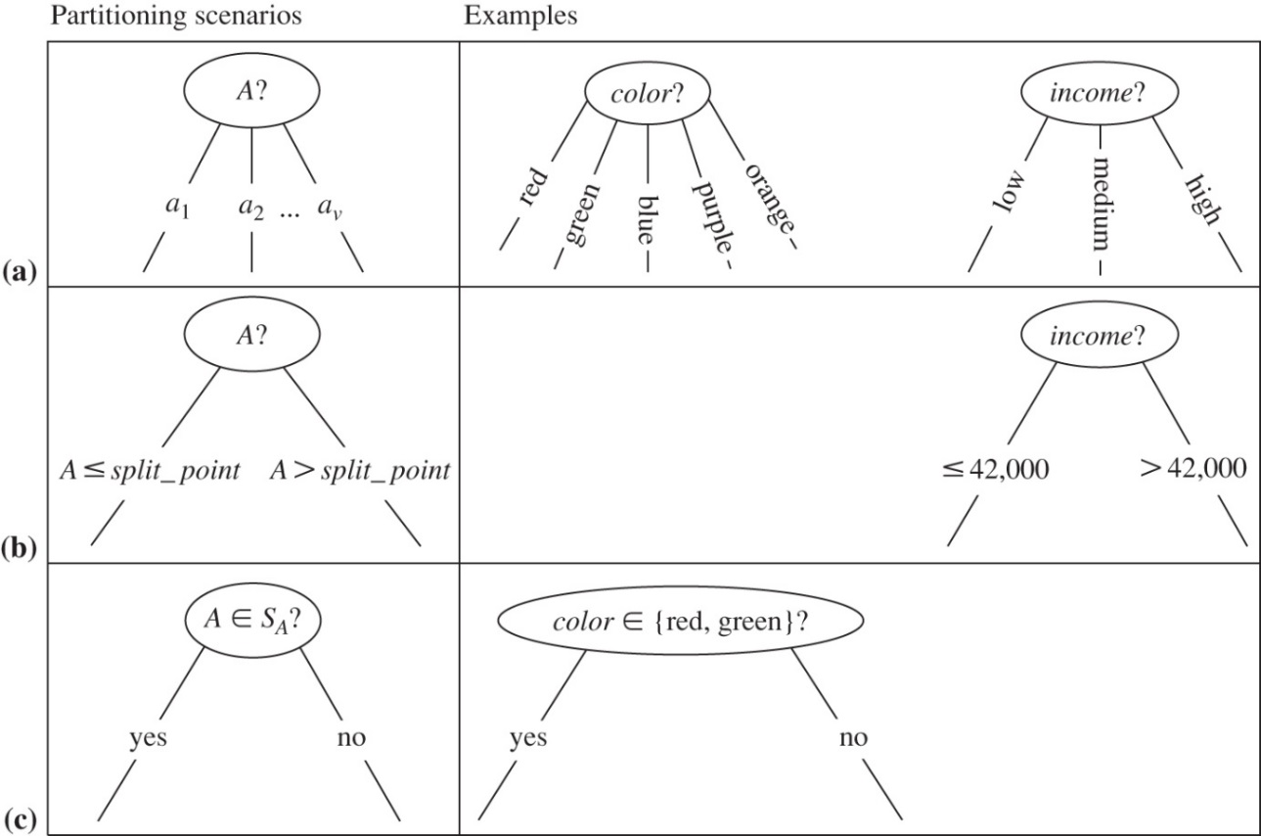
Possible partitioning schemas
(a) If A is discrete-valued, then one branch is grown for each known value of A.
(b) If A is continuous-valued, then two branches are grown, corresponding to A ≤ split_point and A > split_point.
(c) If A is discrete-valued and a binary tree must be produced, then the test is of the form A ∈ S_{A}, where S_{A} is the splitting subset for A.

Slide 20
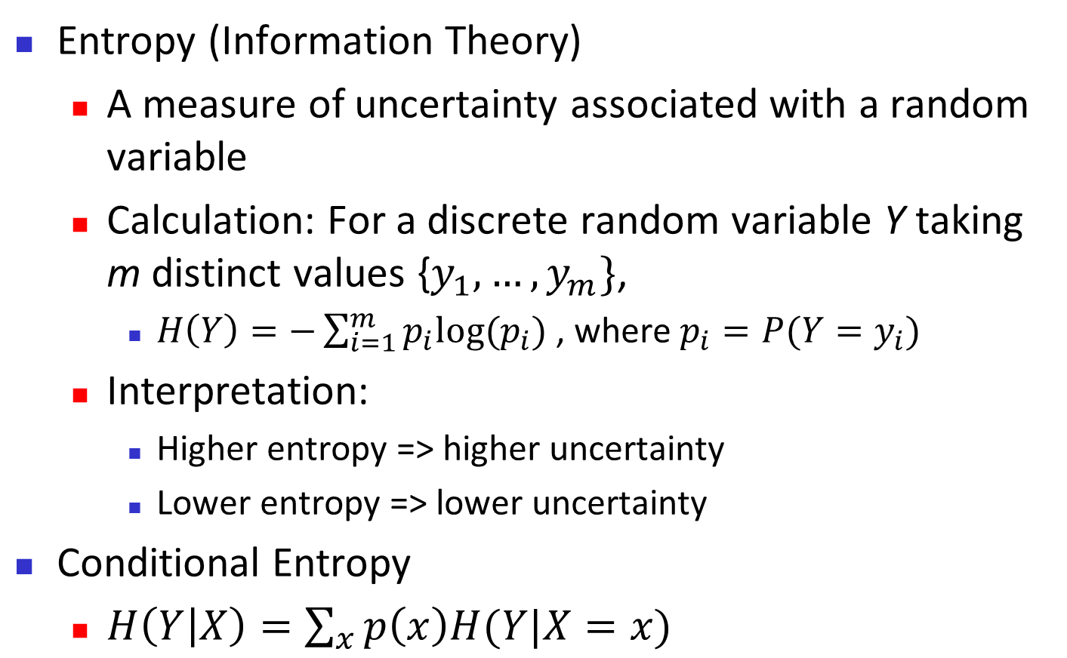
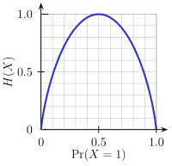
Brief Review of Entropy
p1=seq(0,1,.1)
p2=1-p1
entropy = -p1*log2(p1+0.000000001)-p2*log2(p2+0.000000001)
plot(entropy)
lines(entropy, col="blue")
m = 2

Slide 21
Attribute Selection Measure: Information Gain (ID3/C4.5)
Select the attribute with the highest information gain
Let p_{i} be the probability that an arbitrary tuple in D belongs to class C_{i}, estimated by |C_{i, D}|/|D|
Expected information (entropy) needed to classify a tuple in D:
Information needed (after using A to split D into v partitions) to classify D:
Information gained by branching on attribute A
Notes:
I : the expected information needed to classify a given sample
E (entropy) : expected information based on the partitioning into subsets by A

Slide 22
Attribute Selection: Information Gain
Class P= “yes”
Class N= “no”
means “age <=30” has 5 out of 14 samples, with 2 yes’es and 3 no’s.
Similarly,

Slide 23
Computing Information-Gain for Continuous-Valued Attributes
Let attribute A be a continuous-valued attribute
Must determine the best split point for A
Sort the value A in increasing order
Typically, the midpoint between each pair of adjacent values is considered as a possible split point
(a_{i}+a_{i+1})/2 is the midpoint between the values of a_{i} and a_{i+1}
The point with the minimum expected information requirement for A is selected as the split-point for A. i.e.,
Split:
D1 is the set of tuples in D satisfying A ≤ split-point, and D2 is the set of tuples in D satisfying A > split-point

Slide 24
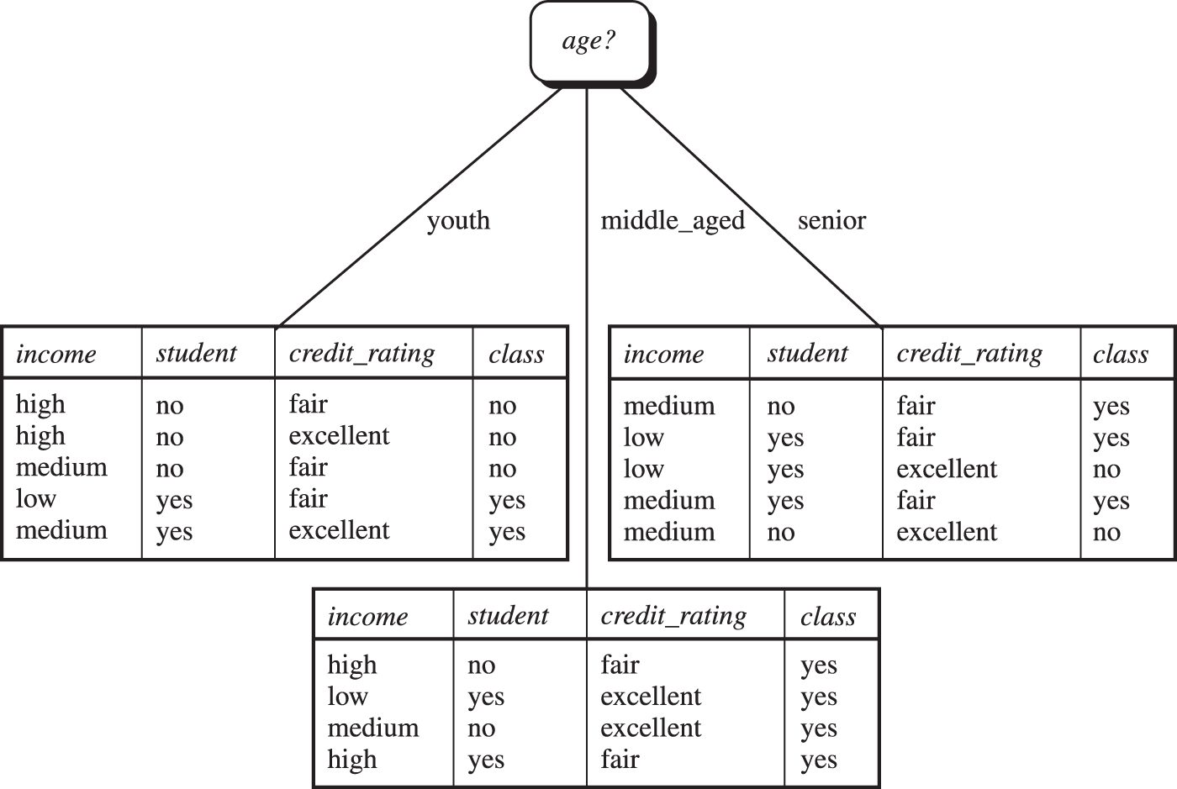
Age has the highest info
All yes!
Then what?

Slide 25
Gain Ratio for Attribute Selection (C4.5)
Information gain measure is biased towards attributes with a large number of values. i.e., product_id, each partition is pure
C4.5 (a successor of ID3) uses gain ratio to overcome the problem (normalization to information gain)
GainRatio(A) = Gain(A)/SplitInfo(A)
Ex.
The attribute with the maximum gain ratio is selected as the splitting attribute (gain_ratio(income) = 0.029/1.557 = 0.019)
low: 4->3 yes
medium: 6->4 yes
high: 4 -> 2 yes
Notes:
Numbers from each group have effect on the calculation, so we try to normalize

Slide 26
Gain Ratio-Example
low: 4->3 yes
medium: 6->4 yes
high: 4 -> 2 yes
Gain(A)=Info(D)-Info_{income}(D)
Gain(A)=0.940 -( (4/14)*(-(3/4)*log2(3/4) - (1/4)*log2(1/4) ) #3 yes, 1 no
+ (6/14)*(-(4/6)*log2(4/6) - (2/6)*log2(2/6)) #4 yes, 2 no
+ (4/14)*((-2/4)*log2(2/4) - (2/4)*log2(2/4)) ) #2 yes, 2 no
The attribute with the maximum gain ratio is selected as the splitting attribute
(gain_ratio(income) = 0.029/1.557 = 0.019)

Slide 27
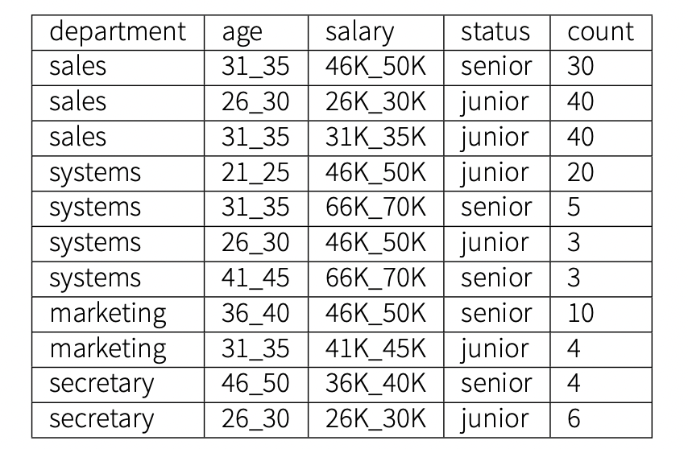
Another example
What is Info_{(D)}
What is Info_{(department)}?
dept | senior | junior | p_{senior} | p_{junior}
sales | 30 | 80
systems | 8 | 23
marketing | 10 | 4
secretary | 4 | 6
TOTAL | 52 | 113
165

Slide 28
Gini Index (CART, IBM IntelligentMiner)
If a data set D contains examples from n classes, gini index, gini(D) is defined as
where p_{j} is the relative frequency of class j in D
If a data set D is split on A into two subsets D₁ and D₂, the gini index gini(D) is defined as
Reduction in Impurity:
The attribute provides the smallest gini_{split}(D) (or the largest reduction in impurity) is chosen to split the node (need to enumerate all the possible splitting points for each attribute)

Slide 29
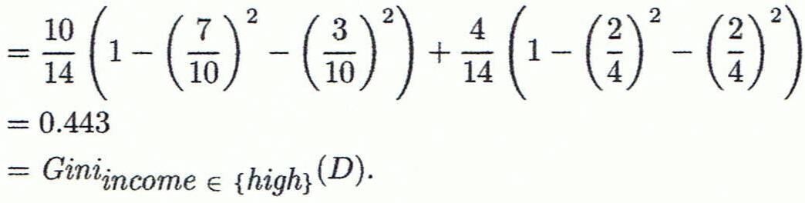
Computation of Gini Index
Ex. D has 9 tuples in buys_computer = “yes” and 5 in “no”
Suppose the attribute income partitions D into 10 in D₁: {low, medium} and 4 in D₂:{high}
Gini_{{low,high}} is 0.458; Gini_{{medium,high}} is 0.450. Thus, split on the {low,medium} (vs. {high}) since it has the lowest Gini index
low: 4->3 yes
high: 4->2 yes
medium: 6->4 yes
(8/14)*(1-(5/8)^2-(3/8)^2) + (6/14)*(1-(2/6)^2-(4/6)^2)

Slide 30
Comparing Attribute Selection Measures
The three measures, in general, return good results but
Information gain:
biased towards multivalued attributes
Gain ratio:
tends to prefer unbalanced splits in which one partition is much smaller than the others
Gini index:
biased to multivalued attributes
has difficulty when # of classes is large
tends to favor tests that result in equal-sized partitions and purity in both partitions

Slide 31
Other Attribute Selection Measures
CHAID: a popular decision tree algorithm, measure based on χ² test for independence
C-SEP: performs better than info. gain and gini index in certain cases
G-statistic: has a close approximation to χ² distribution
MDL (Minimal Description Length) principle (i.e., the simplest solution is preferred):
The best tree as the one that requires the fewest # of bits to both (1) encode the tree, and (2) encode the exceptions to the tree
Multivariate splits (partition based on multiple variable combinations)
CART: finds multivariate splits based on a linear comb. of attrs.
Which attribute selection measure is the best?
Most give good results, none is significantly superior than others

Slide 32
Further tree use
Random Forest: While not a single decision tree algorithm, Random Forest is an ensemble method that builds multiple decision trees and combines their predictions. Each tree is trained on a random subset of the data and features.
Gradient Boosting Trees (e.g., XGBoost, LightGBM, CatBoost): Again, not a single algorithm, but a family of algorithms that build decision trees sequentially, with each tree trying to correct the errors of the previous one. XGBoost, LightGBM, and CatBoost are popular implementations of gradient boosting.

Slide 33
Overfitting and Tree Pruning
Overfitting: An induced tree may overfit the training data
Too many branches, some may reflect anomalies due to noise or outliers
Poor accuracy for unseen samples
Two approaches to avoid overfitting
Prepruning: Halt tree construction early ̵ do not split a node if this would result in the goodness measure falling below a threshold
Difficult to choose an appropriate threshold
Postpruning: Remove branches from a “fully grown” tree—get a sequence of progressively pruned trees
Use a set of data different from the training data to decide which is the “best pruned tree”

Slide 34
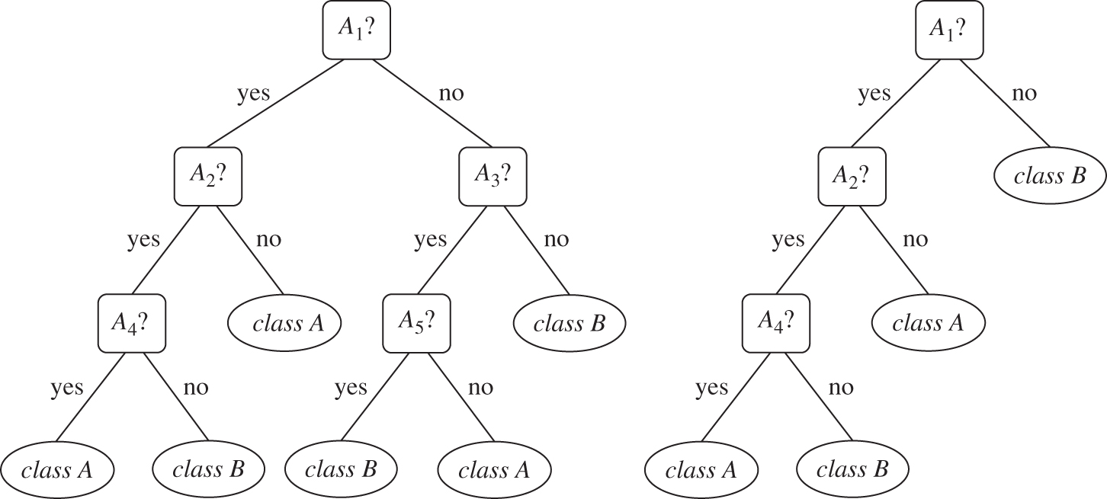
Post pruning example
Suppose that the most common class within this subtree is “class B .” In the pruned version of the tree, the subtree in question is pruned by replacing it with the leaf “class B .

Slide 35
Classification in Large Databases
Classification—a classical problem extensively studied by statisticians and machine learning researchers
Scalability: Classifying data sets with millions of examples and hundreds of attributes with reasonable speed
Why is decision tree induction popular?
relatively faster learning speed (than other classification methods)
convertible to simple and easy to understand classification rules
can use SQL queries for accessing databases
comparable classification accuracy with other methods
RainForest (VLDB’98 — Gehrke, Ramakrishnan & Ganti)
Builds an AVC-list (attribute, value, class label)

Slide 36
BOAT (Bootstrapped Optimistic Algorithm for Tree Construction)
Use a statistical technique called bootstrapping to create several smaller samples (subsets), each fits in memory
Each subset is used to create a tree, resulting in several trees
These trees are examined and used to construct a new tree T’
It turns out that T’ is very close to the tree that would be generated using the whole data set together
36
Notes:
36

Slide 37
The k-Nearest Neighbor Algorithm
All instances correspond to points in the n-D space
The nearest neighbor are defined in terms of Euclidean distance, dist(X₁, X₂)
Target function could be discrete- or real- valued
For discrete-valued, k-NN returns the most common value among the k training examples nearest to x_{q}
_
.
_
_
+
_
+
_
x_{q}
+
_
+

Slide 38
Discussion on the k-NN Algorithm
k-NN for real-valued prediction for a given unknown tuple
Returns the mean values of the k nearest neighbors
Distance-weighted nearest neighbor algorithm
Weight the contribution of each of the k neighbors according to their distance to the query x_{q}
Give greater weight to closer neighbors
Robust to noisy data by averaging k-nearest neighbors
Curse of dimensionality: distance between neighbors could be dominated by irrelevant attributes
To overcome it, axes stretch or elimination of the least relevant attributes

