Slide 1
Chapter 8. Classification: Basic Concepts
Classification: Basic Concepts
Decision Tree Induction
Bayes Classification Methods
Rule-Based Classification
Model Evaluation and Selection
Summary

Slide 2
Issues Affecting Model Selection
Accuracy
  classifier accuracy: predicting class label
Speed
  time to construct the model (training time)
  time to use the model (classification/prediction time)
Robustness: handling noise and missing values
Scalability: efficiency for large amounts of data
Interpretability
  understanding and insight provided by the model
Other measures, e.g., goodness of rules, such as decision tree size or compactness of classification rules

Slide 3
Model Evaluation and Selection
Evaluation metrics: How can we measure accuracy? Other metrics to consider?
Use validation test set of class-labeled tuples instead of training set when assessing accuracy
Methods for estimating a classifier’s accuracy:
  Holdout method, random subsampling
  Cross-validation
  Bootstrap
Comparing classifiers:
  Confidence intervals
  Cost-benefit analysis and ROC Curves

Slide 4
Classifier Evaluation Metrics:
Confusion Matrix
Confusion Matrix:
Actual class\Predicted class | C₁ | ¬ C₁
C₁ | True Positives (TP) | False Negatives (FN)
¬ C₁ | False Positives (FP) | True Negatives (TN)
Example of Confusion Matrix:
Actual class\Predicted class | buy_computer = yes | buy_computer = no | Total
buy_computer = yes | 6954 | 46 | 7000
buy_computer = no | 412 | 2588 | 3000
Total | 7366 | 2634 | 10000
Given m classes, an entry, CM_{i,j} in a confusion matrix indicates # of tuples in class i that were labeled by the classifier as class j
May have extra rows/columns to provide totals

Slide 5
Classifier Evaluation Metrics: Accuracy, Error Rate, Sensitivity and Specificity
A\P | C | ¬C
C | TP | FN | P
¬C | FP | TN | N
 | P’ | N’ | All
Class Imbalance Problem:
  One class may be rare, e.g. fraud, or HIV-positive
  Significant majority of the negative class and minority of the positive class
  Sensitivity: True Positive recognition rate
    Sensitivity = TP/P
  Specificity: True Negative recognition rate
    Specificity = TN/N
Classifier Accuracy, or recognition rate: percentage of test set tuples that are correctly classified
  Accuracy = (TP + TN)/All
Error rate: 1 – accuracy, or
  Error rate = (FP + FN)/All

Slide 6




Classifier Evaluation Metrics:
Precision-Recall, and F-measures
A\P | C | ¬C
C | TP | FN | P
¬C | FP | TN | N
 | P’ | N’ | All
Precision: exactness – what % of tuples that the classifier labeled as positive are actually positive
Recall: completeness – what % of positive tuples did the classifier label as positive?
Perfect score is 1.0
Inverse relationship between precision & recall
F measure (F₁ or F-score): harmonic mean of precision and recall,
F_{ß}: weighted measure of precision and recall
  assigns ß times as much weight to recall as to precision

Slide 7
Classifier Evaluation Metrics: Example
Actual Class\Predicted class | cancer = yes | cancer = no | Total | Recognition(%)
cancer = yes | 90 (TP) | 210 (FN) | 300 | 30.00 (sensitivity
cancer = no | 140 (FP) | 9560 (TN) | 9700 | 98.56 (specificity)
Total | 230 | 9770 | 10000 | 96.40 (accuracy)
  Precision = 90/230 = 39.13% Recall = 90/300 = 30.00%

Slide 8
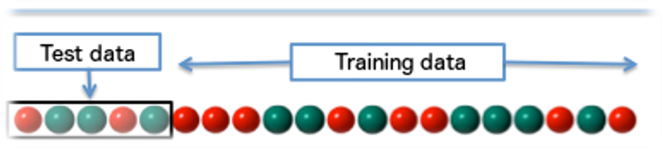
Evaluating Classifier Accuracy:
Holdout Method
Holdout method
  Given data is randomly partitioned into two independent sets
    Training set (e.g., 2/3) for model construction
    Test set (e.g., 1/3) for accuracy estimation
  Random sampling: a variation of holdout
    Repeat holdout k times, accuracy = avg. of the accuracies obtained
Whole data set

Slide 9
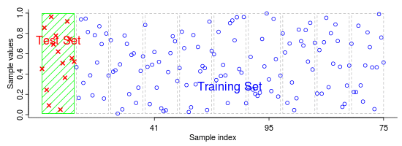
Evaluating Classifier Accuracy:
Cross-Validation Methods
Cross-validation (k-fold, where k = 10 is most popular)
  Randomly partition the data into k mutually exclusive subsets, each approximately equal size
  At i-th iteration, use D_{i} as test set and others as training set
  Leave-one-out: k folds where k = # of tuples, for small sized data
  *Stratified cross-validation*: folds are stratified so that class dist. in each fold is approx. the same as that in the initial data

Slide 10

Evaluating Classifier Accuracy: Bootstrap
Bootstrap
  Works well with small data sets
  Samples the given training tuples uniformly with replacement
    i.e., each time a tuple is selected, it is equally likely to be selected again and re-added to the training set
Several bootstrap methods, and a common one is .632 boostrap
  A data set with d tuples is sampled d times, with replacement, resulting in a training set of d samples. The data tuples that did not make it into the training set end up forming the test set. About 63.2% of the original data end up in the bootstrap, and the remaining 36.8% form the test set (since (1 – 1/d)^{d} ≈ e⁻¹ = 0.368)
  Repeat the sampling procedure k times, overall accuracy of the model (M):

Slide 11



Model Selection: ROC Curves
ROC (Receiver Operating Characteristics) curves: for visual comparison of classification models
Shows the trade-off between the TPR and the FPR
The area under the ROC curve is a measure of the accuracy of the model
The closer to the diagonal line, the less accurate is the model
  (i.e., the closer the area is to 0.5)
Sensitivity = TP/P
Specificity = TN/N
FPR = 1-Specificity=FP/N
better
less accurate

Slide 12
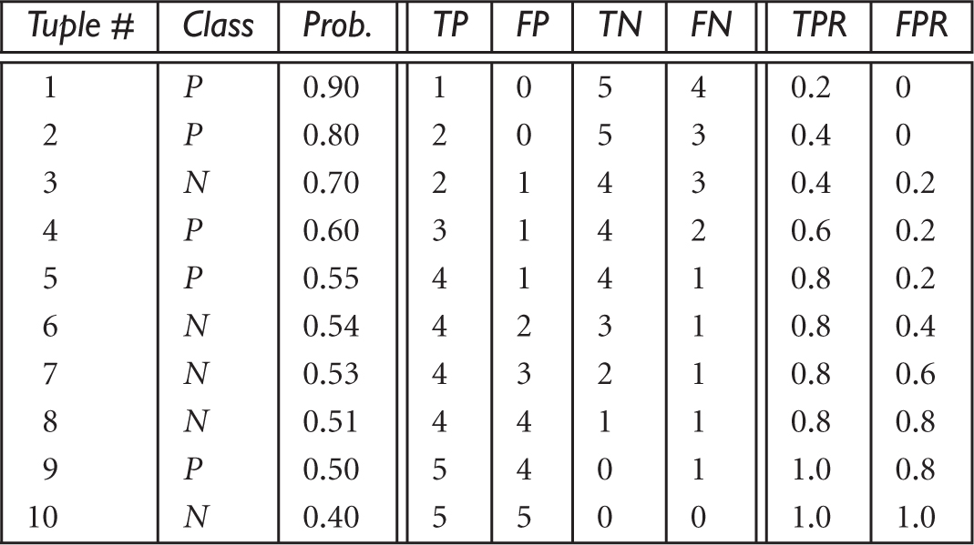

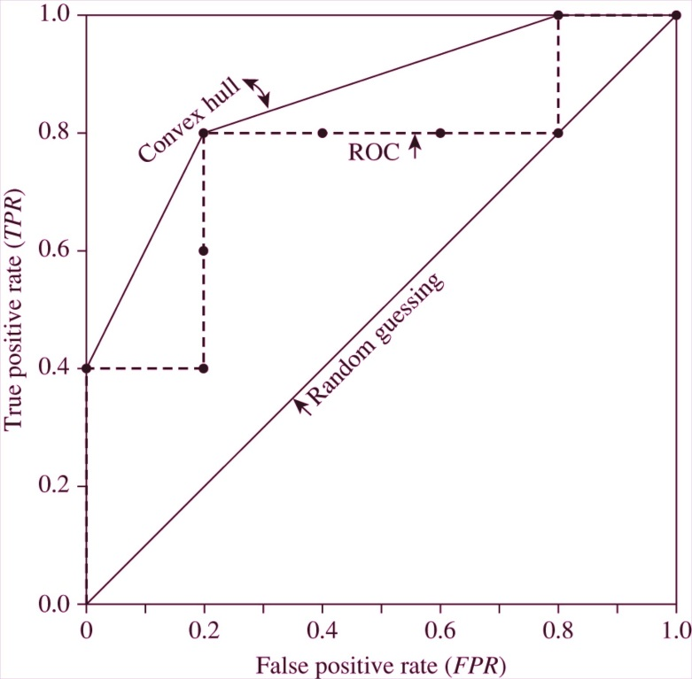

ROC Curves
5 P, 5N
Rank the test tuples in decreasing order:
The one that is most likely to belong to the positive class appears at the top of the list
Sensitivity = TP/P
Specificity = TN/N
FPR = 1-Specificity=FP/N
Vertical axis represents the true positive rate
Horizontal axis rep. the false positive rate
The plot also shows a diagonal line
A model with perfect accuracy will have an area= 1.0

Slide 13
Chapter 8. Classification: Basic Concepts
Classification: Basic Concepts
Decision Tree Induction
Bayes Classification Methods
Rule-Based Classification
Model Evaluation and Selection
Techniques to Improve Classification Accuracy: Ensemble Methods
Summary

Slide 14
Classification of Class-Imbalanced Data Sets
Class-imbalance problem: Rare positive example but numerous negative ones, e.g., medical diagnosis, fraud, oil-spill, fault, etc.
Traditional methods assume a balanced distribution of classes and equal error costs: not suitable for class-imbalanced data
Typical methods for imbalance data in 2-class classification:
  Oversampling: re-sampling of data from positive class
  Under-sampling: randomly eliminate tuples from negative class
  Threshold-moving: moves the decision threshold, t, so that the rare class tuples are easier to classify, and hence, less chance of costly false negative errors
  Ensemble techniques: Ensemble multiple classifiers introduced above
Still difficult for class imbalance problem on multiclass tasks

Slide 15
Chapter 8. Classification: Basic Concepts
Classification: Basic Concepts
Decision Tree Induction
Bayes Classification Methods
Rule-Based Classification
Model Evaluation and Selection
Techniques to Improve Classification Accuracy: Ensemble Methods
Summary

Slide 16
Summary (I)
Classification is a form of data analysis that extracts models describing important data classes.
Effective and scalable methods have been developed for decision tree induction, Naive Bayesian classification, rule-based classification, and many other classification methods.
Evaluation metrics include: accuracy, sensitivity, specificity, precision, recall, F measure, and F_{ß} measure.
Stratified k-fold cross-validation is recommended for accuracy estimation.

Slide 17
Summary (II)
Significance tests and ROC curves are useful for model selection.
There have been numerous comparisons of the different classification methods; the matter remains a research topic
No single method has been found to be superior over all others for all data sets
Issues such as accuracy, training time, robustness, scalability, and interpretability must be considered and can involve trade-offs, further complicating the quest for an overall superior method

Slide 18
References (1)
C. Apte and S. Weiss. Data mining with decision trees and decision rules. Future Generation Computer Systems, 13, 1997
C. M. Bishop, Neural Networks for Pattern Recognition. Oxford University Press, 1995
L. Breiman, J. Friedman, R. Olshen, and C. Stone. Classification and Regression Trees. Wadsworth International Group, 1984
C. J. C. Burges. A Tutorial on Support Vector Machines for Pattern Recognition. Data Mining and Knowledge Discovery, 2(2): 121-168, 1998
P. K. Chan and S. J. Stolfo. Learning arbiter and combiner trees from partitioned data for scaling machine learning. KDD'95
H. Cheng, X. Yan, J. Han, and C.-W. Hsu, Discriminative Frequent Pattern Analysis for Effective Classification, ICDE'07
H. Cheng, X. Yan, J. Han, and P. S. Yu, Direct Discriminative Pattern Mining for Effective Classification, ICDE'08
W. Cohen. Fast effective rule induction. ICML'95
G. Cong, K.-L. Tan, A. K. H. Tung, and X. Xu. Mining top-k covering rule groups for gene expression data. SIGMOD'05

Slide 19
References (2)
A. J. Dobson. An Introduction to Generalized Linear Models. Chapman & Hall, 1990.
G. Dong and J. Li. Efficient mining of emerging patterns: Discovering trends and differences. KDD'99.
R. O. Duda, P. E. Hart, and D. G. Stork. Pattern Classification, 2ed. John Wiley, 2001
U. M. Fayyad. Branching on attribute values in decision tree generation. AAAI’94.
Y. Freund and R. E. Schapire. A decision-theoretic generalization of on-line learning and an application to boosting. J. Computer and System Sciences, 1997.
J. Gehrke, R. Ramakrishnan, and V. Ganti. Rainforest: A framework for fast decision tree construction of large datasets. VLDB’98.
J. Gehrke, V. Gant, R. Ramakrishnan, and W.-Y. Loh, BOAT -- Optimistic Decision Tree Construction. SIGMOD'99.
T. Hastie, R. Tibshirani, and J. Friedman. The Elements of Statistical Learning: Data Mining, Inference, and Prediction. Springer-Verlag, 2001.
D. Heckerman, D. Geiger, and D. M. Chickering. Learning Bayesian networks: The combination of knowledge and statistical data. Machine Learning, 1995.
W. Li, J. Han, and J. Pei, CMAR: Accurate and Efficient Classification Based on Multiple Class-Association Rules, ICDM'01.

Slide 20
References (3)
T.-S. Lim, W.-Y. Loh, and Y.-S. Shih. A comparison of prediction accuracy, complexity, and training time of thirty-three old and new classification algorithms. Machine Learning, 2000.
J. Magidson. The Chaid approach to segmentation modeling: Chi-squared automatic interaction detection. In R. P. Bagozzi, editor, Advanced Methods of Marketing Research, Blackwell Business, 1994.
M. Mehta, R. Agrawal, and J. Rissanen. SLIQ : A fast scalable classifier for data mining. EDBT'96.
T. M. Mitchell. Machine Learning. McGraw Hill, 1997.
S. K. Murthy, Automatic Construction of Decision Trees from Data: A Multi-Disciplinary Survey, Data Mining and Knowledge Discovery 2(4): 345-389, 1998
J. R. Quinlan. Induction of decision trees. Machine Learning, 1:81-106, 1986.
J. R. Quinlan and R. M. Cameron-Jones. FOIL: A midterm report. ECML’93.
J. R. Quinlan. C4.5: Programs for Machine Learning. Morgan Kaufmann, 1993.
J. R. Quinlan. Bagging, boosting, and c4.5. AAAI'96.

Slide 21
References (4)
R. Rastogi and K. Shim. Public: A decision tree classifier that integrates building and pruning. VLDB’98.
J. Shafer, R. Agrawal, and M. Mehta. SPRINT : A scalable parallel classifier for data mining. VLDB’96.
J. W. Shavlik and T. G. Dietterich. Readings in Machine Learning. Morgan Kaufmann, 1990.
P. Tan, M. Steinbach, and V. Kumar. Introduction to Data Mining. Addison Wesley, 2005.
S. M. Weiss and C. A. Kulikowski. Computer Systems that Learn: Classification and Prediction Methods from Statistics, Neural Nets, Machine Learning, and Expert Systems. Morgan Kaufman, 1991.
S. M. Weiss and N. Indurkhya. Predictive Data Mining. Morgan Kaufmann, 1997.
I. H. Witten and E. Frank. Data Mining: Practical Machine Learning Tools and Techniques, 2ed. Morgan Kaufmann, 2005.
X. Yin and J. Han. CPAR: Classification based on predictive association rules. SDM'03
H. Yu, J. Yang, and J. Han. Classifying large data sets using SVM with hierarchical clusters. KDD'03.

