Slide 1
Data Mining: Concepts and Techniques (3rd ed.) — Chapter 9 — Classification: Advanced Methods Support Vector Machines
1
Notes:
1

Slide 2
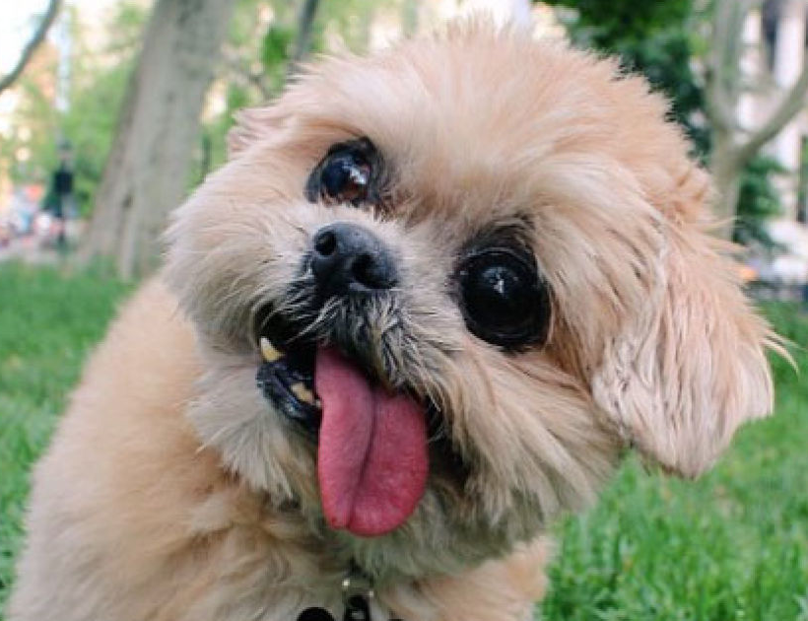
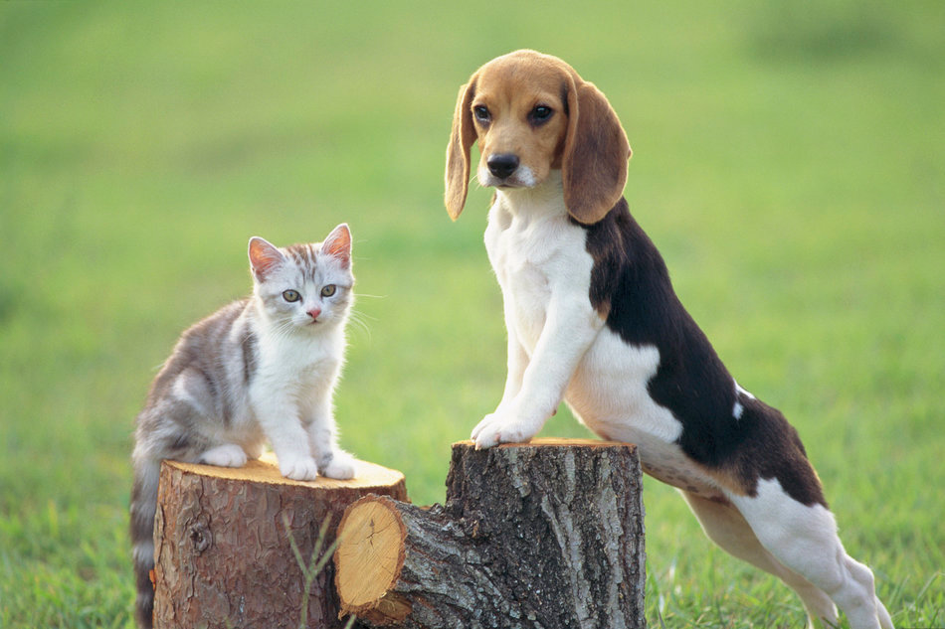
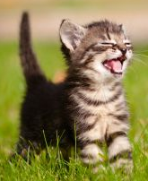
Cat or dog?

Slide 3
Classification: A Mathematical Mapping
Classification: predicts categorical class labels
E.g., Personal homepage classification
x_{i} = (x₁, x₂, x₃, …), y_{i} = +1 or –1
x₁ : # of word “homepage”
x₂ : # of word “welcome”
Mathematically, x ∈ X = ℜ^{n}, y ∈ Y = {+1, –1},
We want to derive a function f: X → Y
Linear Classification
Binary Classification problem
Data above the red line belongs to class ‘x’
Data below red line belongs to class ‘o’
Examples: SVM, Perceptron, Probabilistic Classifiers
x
x
x
x
x
x
x
x
x
o
o
x
o
o
o
o
o
o
o
o
o
o
o
3
Notes:
3

Slide 4
What Is Prediction?
(Numerical) prediction is similar to classification
construct a model
use model to predict continuous or ordered value for a given input
Prediction is different from classification
Classification refers to predict categorical class label
Prediction models continuous-valued functions
Major method for prediction: regression
model the relationship between one or more independent or predictor variables and a dependent or response variable
Regression analysis
Linear and multiple regression
Non-linear regression
Other regression methods: generalized linear model, Poisson regression, log-linear models, regression trees
4

Slide 5
SVM—Support Vector Machines
A relatively new classification method for both linear and nonlinear data
It uses a nonlinear mapping to transform the original training data into a higher dimension
With the new dimension, it searches for the linear optimal separating hyperplane (i.e., “decision boundary”)
With an appropriate nonlinear mapping to a sufficiently high dimension, data from two classes can always be separated by a hyperplane
SVM finds this hyperplane using support vectors (“essential” training tuples) and margins (defined by the support vectors)

Slide 6
SVM—History and Applications
Vapnik and colleagues (1992)—groundwork from Vapnik & Chervonenkis’ statistical learning theory in 1960s
Features: training can be slow but accuracy is high owing to their ability to model complex nonlinear decision boundaries (margin maximization)
Used for: classification and numeric prediction
Applications:
handwritten digit recognition, object recognition, speaker identification, benchmarking time-series prediction tests

Slide 7
SVM—General Philosophy
Small Margin
Large Margin
Support Vectors

Slide 8
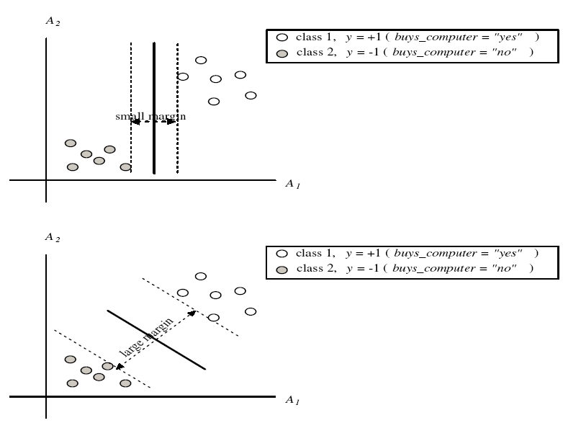
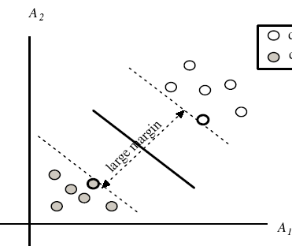
SVM—Margins and Support Vectors

Slide 9
SVM—When Data Is Linearly Separable
m
Let data D be (X₁, y₁), …, (X_{|D|}, y_{|D|}), where X_{i} is the set of training tuples associated with the class labels y_{i}
There are infinite lines (hyperplanes) separating the two classes but we want to find the best one (the one that minimizes classification error on unseen data)
SVM searches for the hyperplane with the largest margin, i.e., maximum marginal hyperplane (MMH)

Slide 10
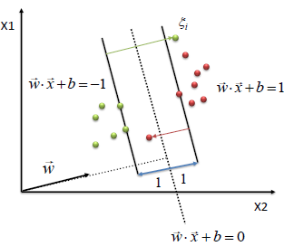
SVM—Linearly Separable
A separating hyperplane can be written as
W ● X + b = 0
where W={w₁, w₂, …, w_{n}} is a weight vector and b a scalar (bias)
For 2-D it can be written as
w₀ + w₁ x₁ + w₂ x₂ = 0
The hyperplane defining the sides of the margin:
H₁: w₀ + w₁ x₁ + w₂ x₂ ≥ 1 for y_{i} = +1
H₂: w₀ + w₁ x₁ + w₂ x₂ ≤ – 1 for y_{i} = –1

Slide 11
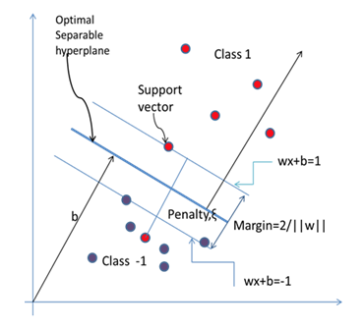
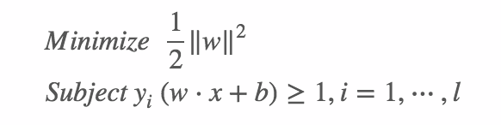
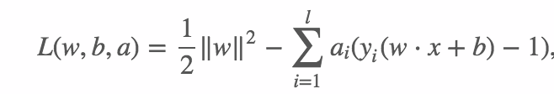
Any training tuples that fall on hyperplanes H₁ or H₂ (i.e., the sides defining the margin) are support vectors
This becomes a constrained (convex) quadratic optimization problem: Quadratic objective function and linear constraints → Quadratic Programming (QP) → Lagrangian multipliers
image: http://www.ausmt.org/index.php/AUSMT/article/view/183/216

Slide 12
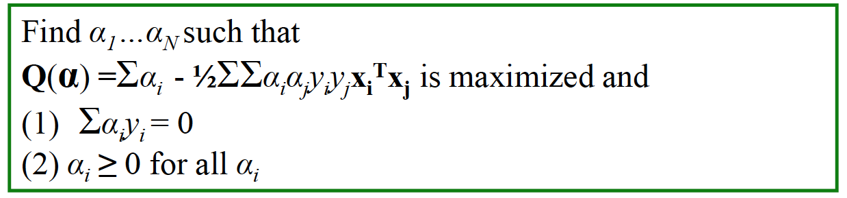
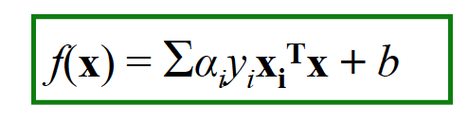
Dual form and classifying function
The solution has the form:
Each non-zero α_{i} indicates that corresponding x_{i} is a support vector.
Then the classifying function will have the form:

Slide 13
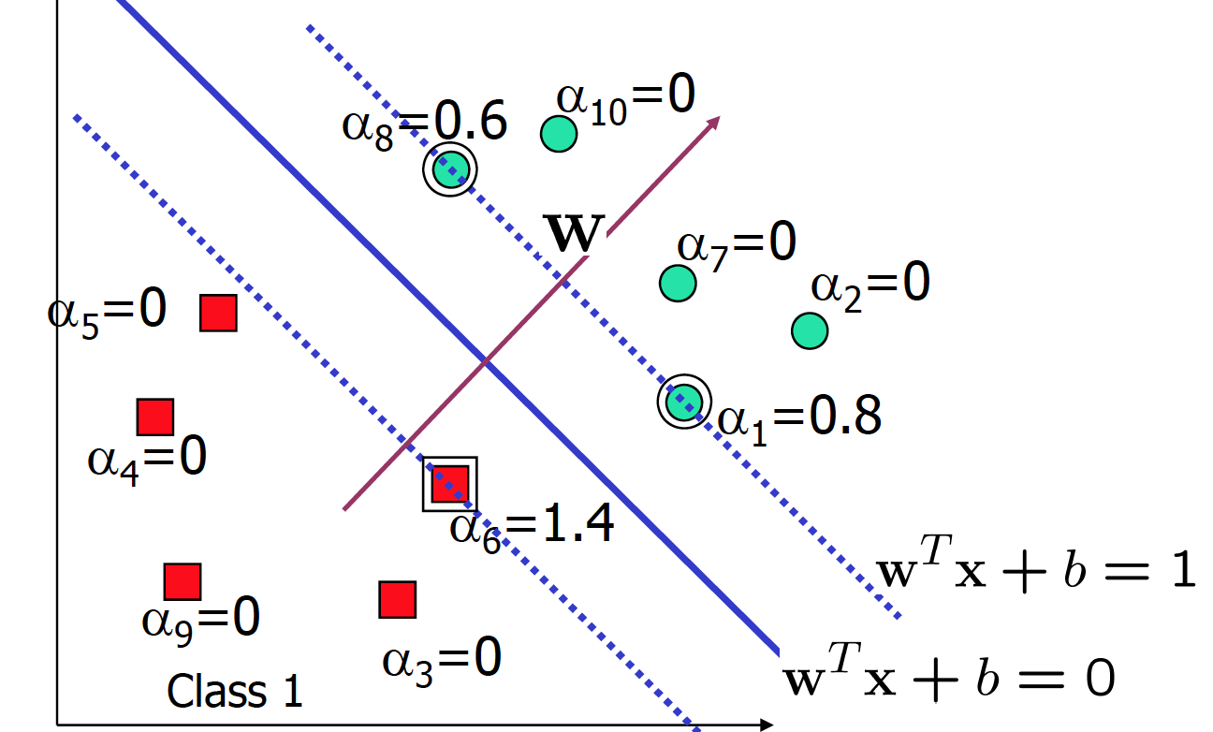

Slide 14

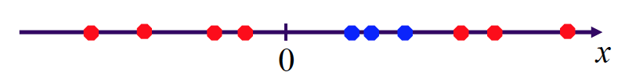
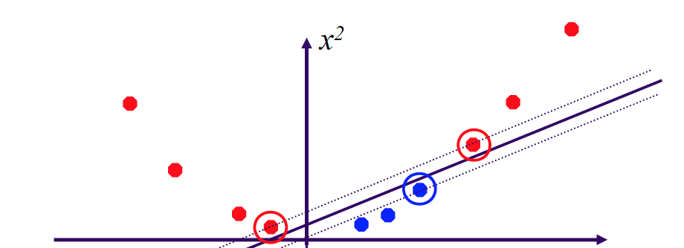
Is it always easy?
Datasets that are linearly separable with some noise work out great:
But what are we going to do if the dataset is just too hard?
How about… mapping data to a higher-dimensional space:

Slide 15
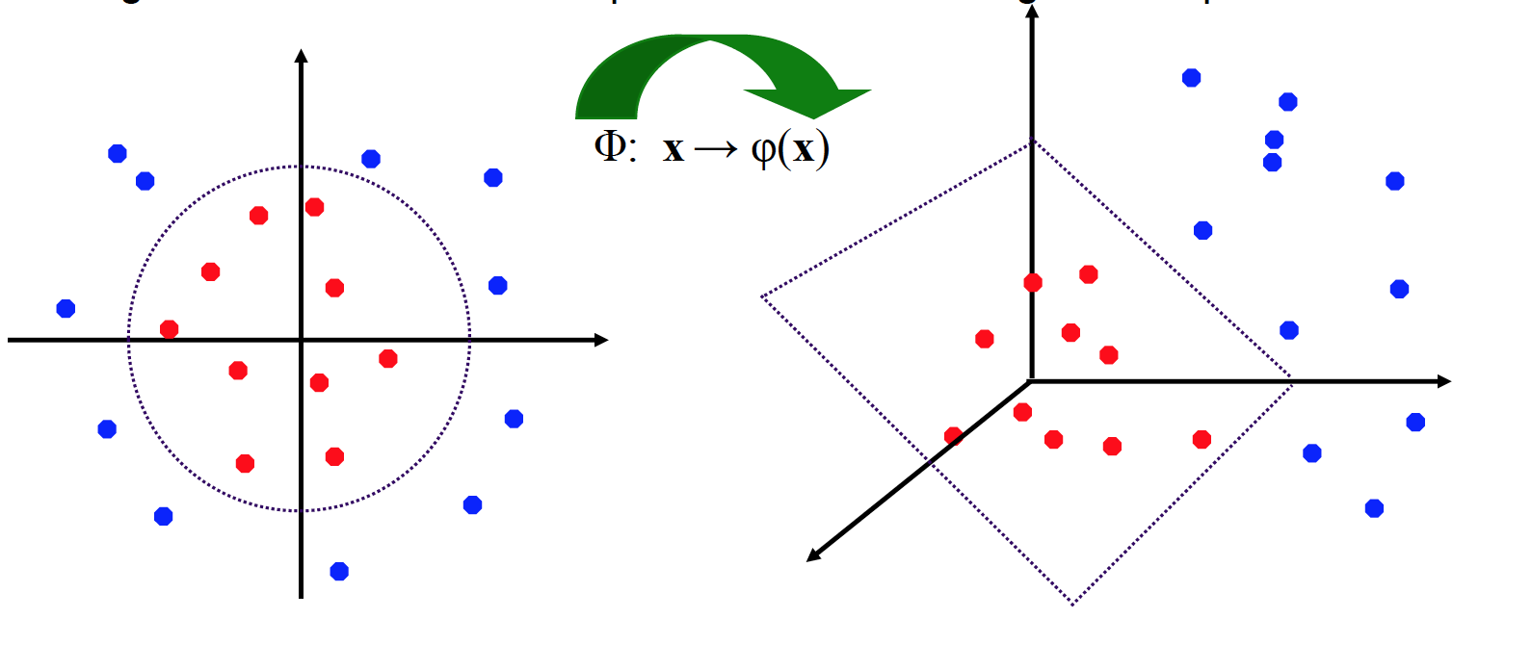
SVM—Linearly Inseparable?
The original feature space can always be mapped to some higher-dimensional feature space where the training set is separable:

Slide 16
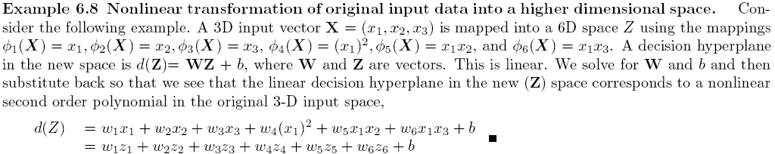
SVM—Linearly Inseparable
Transform the original input data into a higher dimensional space
Search for a linear separating hyperplane in the new space

Slide 17
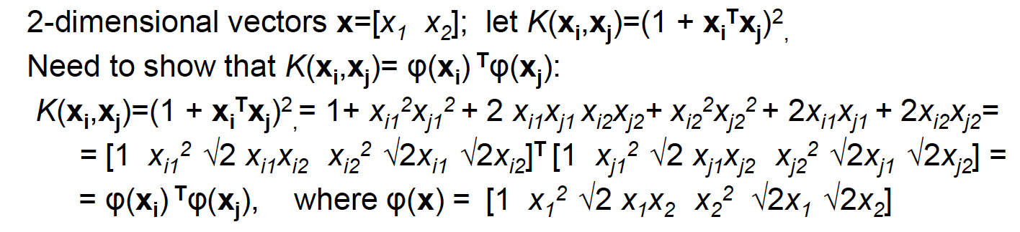
Kernel trick
The linear classifier relies on inner product between vectors K(x_{i}, x_{j})=x_{i}^{T}x_{j}
If every data point is mapped into high-dimensional space via some transformation Φ: x→ φ(x), the inner product becomes:
K(x_{i},x_{j})= φ(x_{i})^{T}φ(x_{j})
A kernel function is some function that corresponds to an inner product into some feature space.

Slide 18
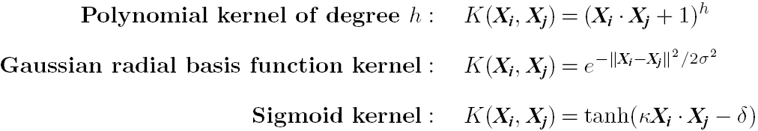
SVM: Different Kernel functions
Instead of computing the dot product on the transformed data, it is math. equivalent to applying a kernel function K(X_{i}, X_{j}) to the original data, i.e., K(X_{i}, X_{j}) = Φ(X_{i})^{T} Φ(X_{j})
Typical Kernel Functions
SVM can also be used for classifying multiple (> 2) classes and for regression analysis (with additional parameters)

Slide 19
Why Is SVM Effective on High Dimensional Data?
The complexity of trained classifier is characterized by the # of support vectors rather than the dimensionality of the data
The support vectors are the essential or critical training examples —they lie closest to the decision boundary (MMH)
If all other training examples are removed and the training is repeated, the same separating hyperplane would be found
The number of support vectors found can be used to compute an (upper) bound on the expected error rate of the SVM classifier, which is independent of the data dimensionality
Thus, an SVM with a small number of support vectors can have good generalization, even when the dimensionality of the data is high

Slide 20
SVM in short
SVM
Deterministic algorithm
Nice generalization properties
Hard to learn – learned in batch mode using quadratic programming techniques
Using kernels can learn very complex functions

Slide 21
SVM Related Links
SVM Website: http://www.kernel-machines.org/
Representative implementations
LIBSVM: an efficient implementation of SVM, multi-class classifications, nu-SVM, one-class SVM, including also various interfaces with java, python, etc.
SVM-light: simpler but performance is not better than LIBSVM, support only binary classification and only in C
SVM-torch: another recent implementation also written in C

Slide 22
The k-Nearest Neighbor Algorithm
All instances correspond to points in the n-D space
The nearest neighbor are defined in terms of Euclidean distance, dist(X₁, X₂)
Target function could be discrete- or real- valued
For discrete-valued, k-NN returns the most common value among the k training examples nearest to x_{q}
_
.
_
_
+
_
+
_
x_{q}
+
_
+

Slide 23
Discussion on the k-NN Algorithm
k-NN for real-valued prediction for a given unknown tuple
Returns the mean values of the k nearest neighbors
Distance-weighted nearest neighbor algorithm
Weight the contribution of each of the k neighbors according to their distance to the query x_{q}
Give greater weight to closer neighbors
Robust to noisy data by averaging k-nearest neighbors
Curse of dimensionality: distance between neighbors could be dominated by irrelevant attributes
To overcome it, axes stretch or elimination of the least relevant attributes

Slide 24
Multiclass Classification
Classification involving more than two classes (i.e., > 2 Classes)
Method 1. One-vs.-all (OVA): Learn a classifier one at a time
Given m classes, train m classifiers: one for each class
Classifier j: treat tuples in class j as positive & all others as negative
To classify a tuple X, the set of classifiers vote as an ensemble
Method 2. All-vs.-all (AVA): Learn a classifier for each pair of classes
Given m classes, construct m(m-1)/2 binary classifiers
A classifier is trained using tuples of the two classes
To classify a tuple X, each classifier votes. X is assigned to the class with maximal vote
Comparison
All-vs.-all tends to be superior to one-vs.-all
Problem: Binary classifier is sensitive to errors, and errors affect vote count
24

Slide 25
Semi-Supervised Classification
Semi-supervised: Uses labeled and unlabeled data to build a classifier
Self-training:
Build a classifier using the labeled data
Use it to label the unlabeled data, and those with the most confident label prediction are added to the set of labeled data
Repeat the above process
Adv: easy to understand; disadv: may reinforce errors
Co-training: Use two or more classifiers to teach each other
Each learner uses a mutually independent set of features of each tuple to train a good classifier, say f₁
Then f₁ and f₂ are used to predict the class label for unlabeled data X
Teach each other: The tuple having the most confident prediction from f₁ is added to the set of labeled data for f₂, & vice versa
Other methods, e.g., joint probability distribution of features and labels
25

