Slide 1
Chapter 10. Cluster Analysis: Basic Concepts and Methods
Cluster Analysis: Basic Concepts
Partitioning Methods
Hierarchical Methods
Density-Based Methods
Grid-Based Methods
Evaluation of Clustering
Summary
1
1
Notes:
1

Slide 2
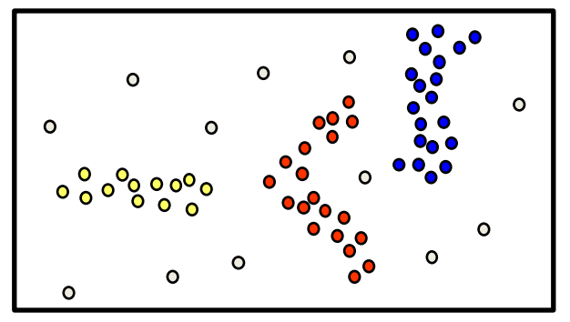
Density-based Clustering
Basic idea
Clusters are dense regions in the data space, separated by regions of lower object density
A cluster is defined as a maximal set of density connected points
Discovers clusters of arbitrary shape
Method
DBSCAN

Slide 3
Density-Based Clustering Methods
Major features:
Discover clusters of arbitrary shape
Handle noise
One scan
Need density parameters as termination condition
Several interesting studies:
DBSCAN: Ester, et al. (KDD’96)
OPTICS: Ankerst, et al (SIGMOD’99).
DENCLUE: Hinneburg & D. Keim (KDD’98)
CLIQUE: Agrawal, et al. (SIGMOD’98) (more grid-based)

Slide 4
Density-Based Clustering: Basic Concepts
Two parameters:
Eps: Maximum radius of the neighbourhood
MinPts: Minimum number of points in an Eps-neighbourhood of that point
N_{Eps}(p): {q belongs to D | dist(p,q) ≤ Eps}
Directly density-reachable: A point p is directly density-reachable from a point q w.r.t. Eps, MinPts if
p belongs to N_{Eps}(q)
core point condition:
|N_{Eps} (q)| ≥ MinPts
neighborhood
p
MinPts = 5
Eps = 1 cm
q

Slide 5
Core, Border & Outlier
A point is a core point if it has more than a specified number of points (MinPts) within Eps-
These are points that are at the interior of a cluster.
A border point has fewer than MinPts within Eps, but is in the neighborhood of a core point.
A noise point is any point that is not a core point nor a border point.
Outlier
Border
Core
 = 1cm, MinPts = 5

Slide 6
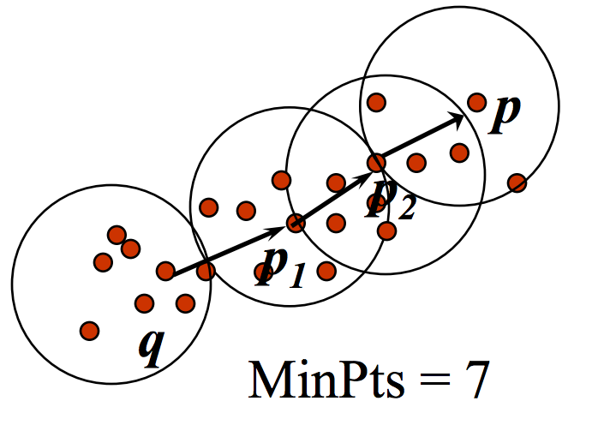
Density-Reachable
Density-reachable:
A point p is density-reachable from a point q w.r.t. Eps, MinPts if there is a chain of points p₁, …, p_{n}, p₁ = q, p_{n} = p such that p_{i+1} is directly density-reachable from p_{i}
A point p is directly density-reachable from p₂
p₂ is directly density-reachable from p₁
p₁ is directly density-reachable from q
p←p₂←p₁←q form a chain
p

Slide 7
Density-Connected
Density-connected
A point p is density-connected to a point q w.r.t. Eps, MinPts if there is a point o such that both, p and q are density-reachable from o w.r.t. Eps and MinPts
p
q
o

Slide 8
DBSCAN: Density-Based Spatial Clustering of Applications with Noise
Relies on a density-based notion of cluster: A cluster is defined as a maximal set of density-connected points
Discovers clusters of arbitrary shape in spatial databases with noise
Outlier
Border
Eps = 1cm
MinPts = 5
Core

Slide 9
DBSCAN: The Algorithm
Arbitrary select a point p
Retrieve all points density-reachable from p w.r.t. Eps and MinPts
If p is a core point, a cluster is formed
If p is a border point, no points are density-reachable from p and DBSCAN visits the next point of the database
Continue the process until all of the points have been processed

Slide 10
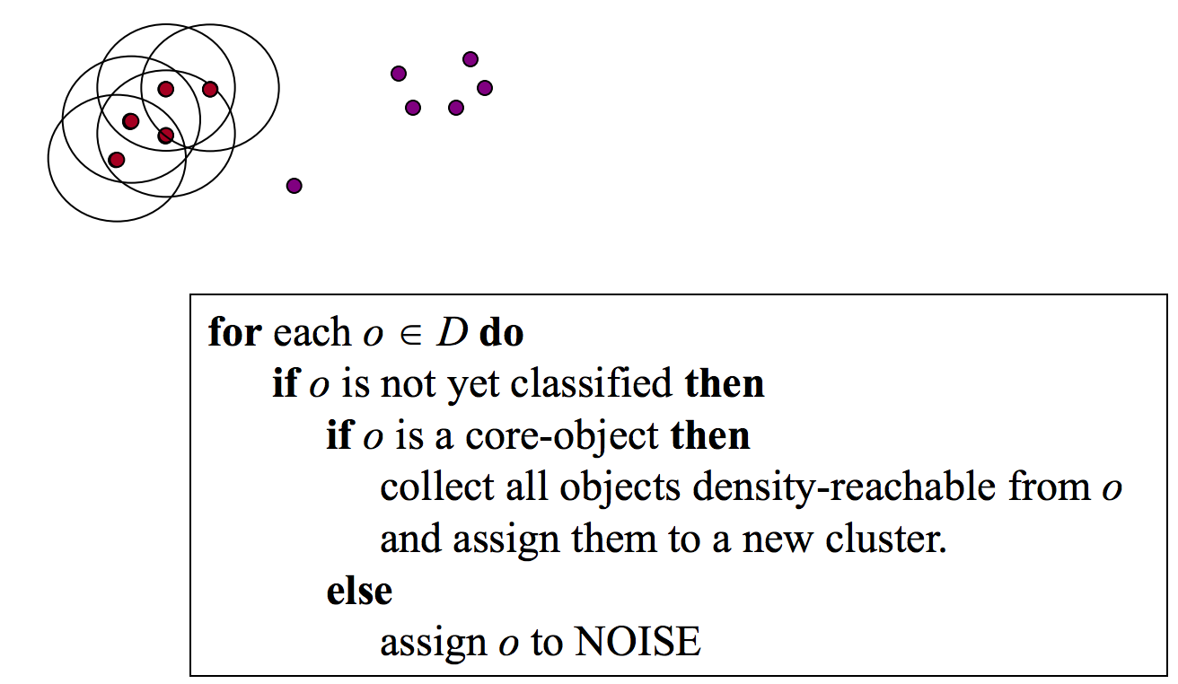
Algorithm-example (1/3)
Parameters:
•  = 2 cm
• MinPts = 3

Slide 11
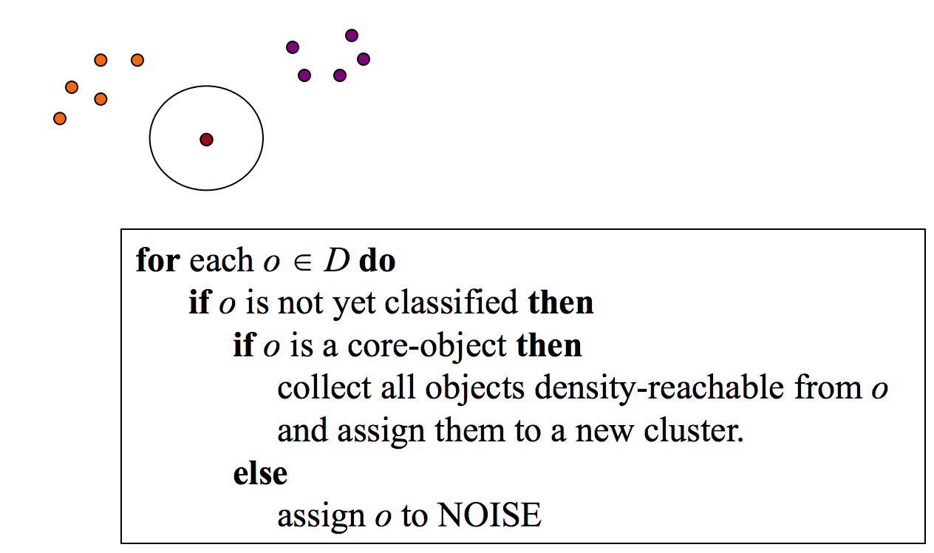
Algorithm-example (2/3)
Parameters:
•  = 2 cm
• MinPts = 3

Slide 12
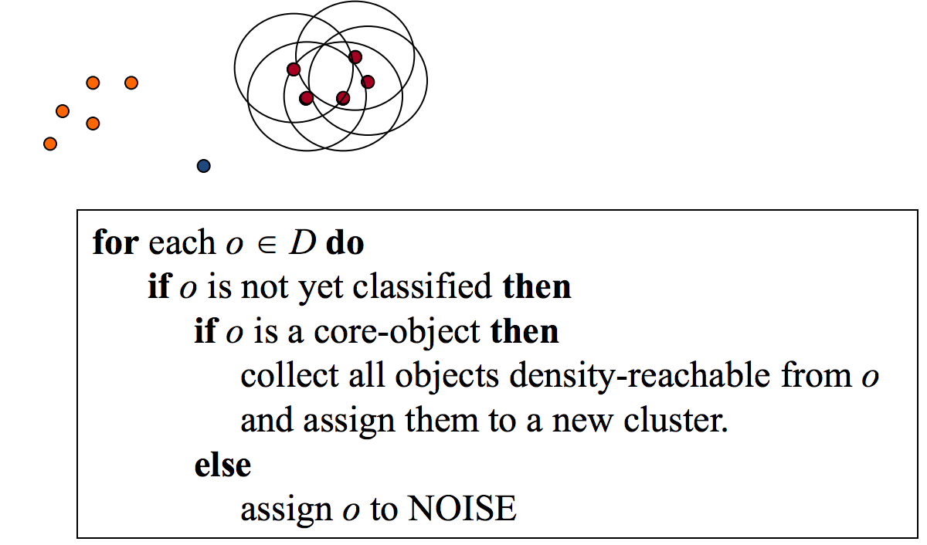
Algorithm-example (3/3)
Parameters:
•  = 2 cm
• MinPts = 3

Slide 13
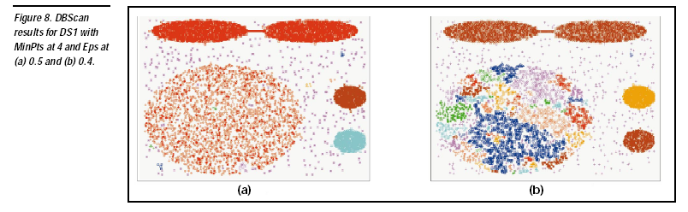

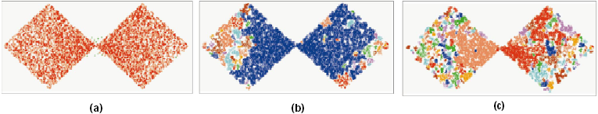
DBSCAN: Sensitive to Parameters

Slide 14
DBSCAN visualization
https://www.naftaliharris.com/blog/visualizing-dbscan-clustering/

Slide 15
Chapter 10. Cluster Analysis: Basic Concepts and Methods
Cluster Analysis: Basic Concepts
Partitioning Methods
Hierarchical Methods
Density-Based Methods
Evaluation of Clustering
Summary
15
15
Notes:
15

Slide 16

Willingness for clustering?
A data set uniformly spread in space…Any hope?

Slide 17
Assessing Clustering Tendency
Assess if non-random structure exists in the data by measuring the probability that the data is generated by a uniform data distribution
Sample uniformly n points (p₁,…, p_{n}) from D.
For each point p_{i}∈D, find it’s nearest neighbor pj; then compute the distance between p_{i} and p_{j} and denote it as x_{i}=dist(p_{i},p_{j})
Generate a simulated dataset (random_{D}) drawn from a random uniform distribution with n points (q₁,…, q_{n}) and the same variation as the original real dataset D.
For each point q_{i}∈random_{D}, find it’s nearest neighbor q_{j} in D; then compute the distance between q_{i} and q_{j} and denote it y_{i}=dist(q_{i},q_{j})
Sum of the nearest neighbor distance in the random dataset
Sum of the neighbor distances in the real and across the simulated dataset.
H=
Hopkins statistics
A value for H higher than 0.75 indicates a clustering tendency at the 90% confidence level.
Notes:
Higher means random data set has points far away from each other whereas the original dataset has points close to each other and we reject the null hypothesis.
Null hypothesis: the data set D is uniformly distributed (i.e., no meaningful clusters)
Alternative hypothesis: the data set D is not uniformly distributed (i.e., contains meaningful clusters)

Slide 18
Determine the Number of Clusters
Empirical method
# of clusters ≈√n/2 for a dataset of n points
Elbow method
Use the turning point in the curve of sum of within cluster variance w.r.t the # of clusters
Cross validation method
Divide a given data set into m parts
Use m – 1 parts to obtain a clustering model
Use the remaining part to test the quality of the clustering
E.g., For each point in the test set, find the closest centroid, and use the sum of squared distance between all points in the test set and the closest centroids to measure how well the model fits the test set
For any k > 0, repeat it m times, compare the overall quality measure w.r.t. different k’s, and find # of clusters that fits the data the best
18
Notes:
For each point in the test set, find the closest centroid, and use the sum of squared distance between all points in the test set and the closest centroids to measure how well the model fits the test set
You may need to compare the average of square distances to decide in which k value it’s the smallest

Slide 19
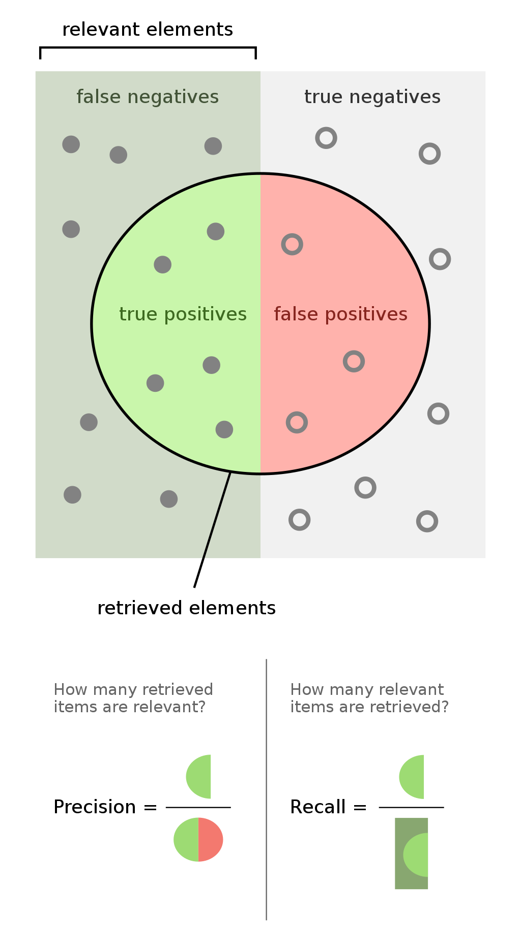
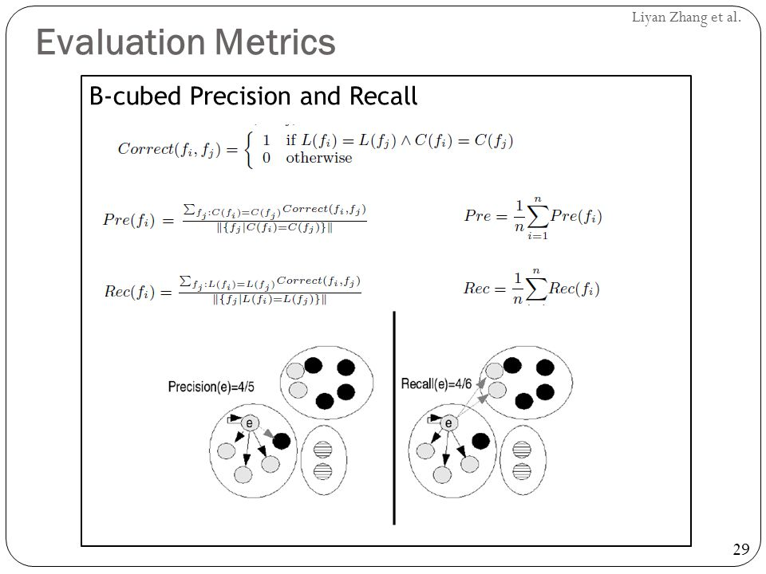
Measuring Clustering Quality-I
Suppose there’s clustering tendency and we determined k:
Two methods: extrinsic vs. intrinsic
Extrinsic: supervised, i.e., the ground truth is available
BCubed Precision: how many other objects in the same cluster actually belong to the same category.
Bcubed Recall: how many objects in the same category are assigned to the same cluster
19

Slide 20



Measuring Clustering Quality-II
Intrinsic: unsupervised, i.e., the ground truth is unavailable
Evaluate the goodness of a clustering by considering how well the clusters are separated, and how compact the clusters are
Ex. Silhouette coefficient
a: average distance between i and other objects in the same cluster
b: minimum average distance from i to all other clusters
Closer to 1 is better
Should be done for all i and averaged

Slide 21
Chapter 10. Cluster Analysis: Basic Concepts and Methods
Cluster Analysis: Basic Concepts
Partitioning Methods
Hierarchical Methods
Density-Based Methods
Evaluation of Clustering
Summary
21
21
Notes:
21

Slide 22
Summary
Cluster analysis groups objects based on their similarity and has wide applications
Measure of similarity can be computed for various types of data
Clustering algorithms can be categorized into partitioning methods, hierarchical methods, density-based methods, grid-based methods, and model-based methods
K-means and K-medoids algorithms are popular partitioning-based clustering algorithms
Quality of clustering results can be evaluated in various ways

Slide 23
Appendix

