Slide 1
Data Mining: Concepts and Techniques (3rd ed.) — Chapter 6 — part 2
1
Notes:
1

Slide 2
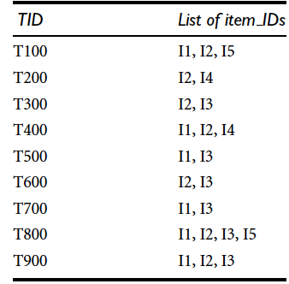
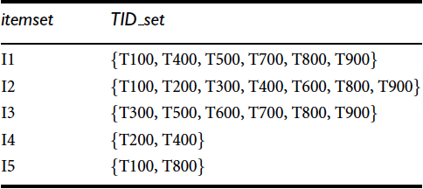
ECLAT: Mining by Exploring Vertical Data Format
Vertical format: t(AB) = {T₁₁, T₂₅, …}
tid-list: list of trans.-ids containing an itemset

Slide 3
Mining by Exploring Vertical Data Format
Deriving frequent patterns based on vertical intersections
t(X) = t(Y): X and Y always happen together
Baskets including diaper always includes beer
t(X) ⊂ t(Y): transaction having X always has Y
t(I5) ⊂ t(I2) => {T100, T800} ⊂ {T100, T200, T300, T400, T600, T800, T900}

Slide 4
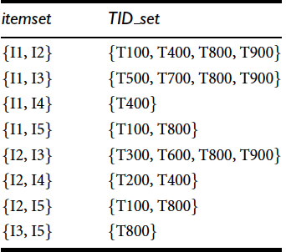
Mining by Exploring Vertical Data Format
X
10 possible combinations, but 8 of them are frequent
No need to scan DB over & over
since support can be derived
from TID_set

Slide 5
Mining by Exploring Vertical Data Format
Using diffset to accelerate mining
Only keep track of differences of tids of a (k+1)-itemset and corresponding k-itemset.
t(X) = {T₁, T₂, T₃}, t(XY) = {T₁, T₃}
diffset (XY, X) = {T₂}
t(I1) = {T100, T400, T500, T700, T800, T900} and t(I1, I2) = {T100,T400, T800, T900}.
The diffset between the two is diffset(t(I1, I2), t(I1)) = {T500, T700}.
Experiments show that in certain situations, such as when the data set contains many dense and long patterns, this technique can substantially reduce the total cost of vertical format mining of frequent itemsets.
Eclat: Equivalence CLASS Transformation (Zaki et al. @KDD’97)

Slide 6
Chapter 6: Mining Frequent Patterns, Association and Correlations: Basic Concepts and Methods
Basic Concepts
Frequent Itemset Mining Methods
Which Patterns Are Interesting?—Pattern Evaluation Methods
Summary

Slide 7
Which Patterns Are Interesting?
Although minimum support and confidence thresholds help exclude the exploration of a good number of uninteresting rules, many rules so generated are still not interesting to the users.
Unfortunately, this is especially true when mining at low support thresholds or mining for long patterns.
Strong rules are not necessarily interesting…
Suppose min.sup=30%, min.conf=60%
There are 10000 transactions in a DB
6,000 computer games
7,500 videos
4,000 buy both computer games and videos.
Misleading because the probability of purchasing videos is 75%, which is even larger than 66%. In fact, computer games and videos are negatively associated
X=Computer games, Y=Videos
P(X U Y) = 4000/10000= 40%
P(Y | X) = 4000/6000 = 66%
CG → Videos (40%, 66%)

Slide 8
Interestingness Measure: 1- Lift
play basketball ⇒ eat cereal [40%, 66.7%] is misleading
The overall % of students eating cereal is 75% > 66.7%.
play basketball ⇒ not eat cereal [20%, 33.3%] is more accurate, although with lower support and confidence
Measure of dependent/correlated events: lift
 | Basketball | Not basketball | Sum (row)
Cereal | 2000 | 1750 | 3750
Not cereal | 1000 | 250 | 1250
Sum(col.) | 3000 | 2000 | 5000
In other words, we’re comparing their real joint probability to their hypothetical join probability it they were independent.

Slide 9
Lift
Range [0, inf]
If the resulting value is less than 1, then the occurrence of A is negatively correlated with the occurrence of B.
If the resulting value is greater than 1, then A and B are positively correlated, meaning that the occurrence of one implies the occurrence of the other.
If the resulting value is equal to 1, then A and B are independent and there is no correlation between them.

Slide 10
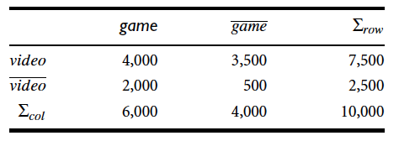
Back to Computer Games vs Videos
P({game}) = 0.60
P({video}) = 0.75
P({game,video}) = 0.40
P({game, video})=( P({game}) P({video})) = 0.40/(0.60x0.75) = 0.89.
Negative correlation between the occurrence of {game} and {video}, why?
The sale of games is said to increase or “lift” the likelihood of the sale of videos by a factor of the value returned by Equation

Slide 11
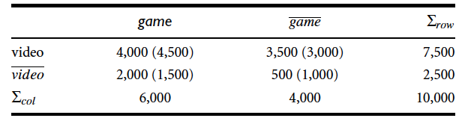
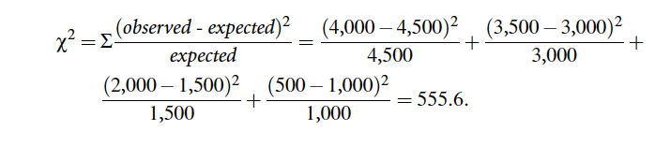
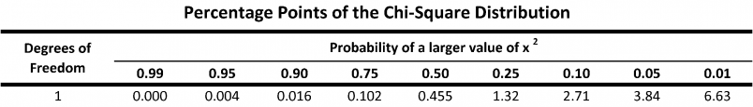
Interestingness Measure 2: χ² measure
Observed value of the slot (game, video) =4,000, which is less than the expected value 4,500, buying game and buying video are negatively correlated.

Slide 12
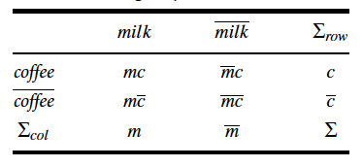


Interestingness Measure: 3-All confidence
A1 | milk | ~milk
coffee | 1000 | 100
~coffee | 100 | 100000
is the maximum (single) item support of all the items in X, and hence is called the max item sup of the itemset X.
0.91
A2 | milk | ~milk
coffee | 1000 | 100
~coffee | 100 | 10000
C1 | milk | ~milk
coffee | 100 | 1000
~coffee | 1000 | 100000
B1 | milk | ~milk
coffee | 1000 | 1000
~coffee | 1000 | 1000
0.91
0.09
0.50
Notes:
A1. 1000(mc)/1100(c), 1000(mc)/1100(m)
A2. same
A3. 100/1100,
A4. 1000/2000

Slide 13
Interestingness Measure: 4-max confidence
max_conf(A,B) = max{P(A|B), P(B|A)}
P(coffee,milk)/P(coffee) = (1000/T)/(1100/T) = 0.91
P(coffee,milk)/P(milk) = (1000/T)/(1100/T) = 0.91
A1 | milk | ~milk
coffee | 1000 | 100
~coffee | 100 | 100000
0.91

Slide 14

Interestingness Measure: 5-Kulc confidence
Kulc
Average of confidence values

Slide 15

Cosine measure
A1 | milk | ~milk
coffee | 1000 | 100
~coffee | 100 | 100000
0.91
A2 | milk | ~milk
coffee | 1000 | 100
~coffee | 100 | 10000
C1 | milk | ~milk
coffee | 100 | 1000
~coffee | 1000 | 100000
B1 | milk | ~milk
coffee | 1000 | 1000
~coffee | 1000 | 1000
0.91
0.09
0.50

Slide 16
Leverage
Leverage computes the difference between the observed frequency of A and C appearing together and the frequency that would be expected if A and C were independent.
A leverage value of 0 indicates independence.
Leverage(A=>C) = sup(A=>C) – sup(A)xsup(C); range [-1, 1]

Slide 17
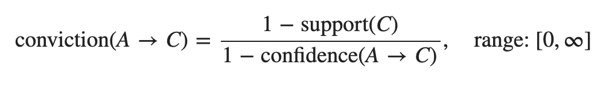
Conviction
A high conviction value means that the consequent is highly depending on the antecedent.
For instance, in the case of a perfect confidence score, the denominator becomes 0 (due to 1 - 1) for which the conviction score is defined as 'inf’.
Similar to lift, if items are independent, the conviction is 1.

Slide 18
Zhangs metric
Measures both association and dissociation.
Value ranges between -1 and 1.
A positive value (>0) indicates association and negative value indicates dissociation.

Slide 19
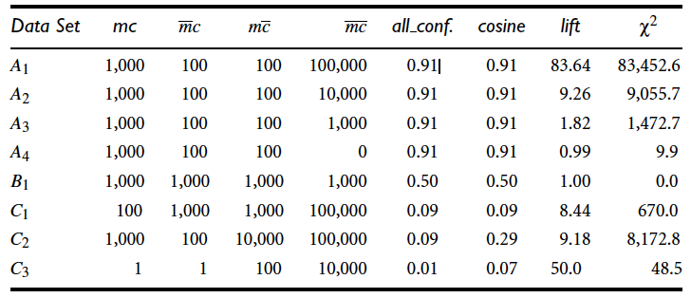
Four measures at one shot
m and c are positively correlated in A1 through A4, independent in B1, and negatively correlated in C1 through C3.
All four measures are good indicators for the independent case, B1.
Lift and χ² are poor indicators of the other relationships, whereas all confidence and cosine are good indicators
Another interesting fact is that between all confidence and cosine, cosine is the better indicator when mc and mc are not balanced
Notes:
+: you can see the tendency to buy cm together is higher when compared to the negative cases where we observe people tend to buy only c or only m rather than buying them together.
chiexpect <- function (mc, umc, ucm, ucum)
{
p=(mc+umc)/(mc+ umc + ucm + ucum)
print(p)
mc-mc*p
}

Slide 20
C1 should be more negatively correlated for m and c than C2 because mc is the smallest among the three counts, mc, mc, and mc, in C1.
However, this can only be seen by checking the cosine measure because the all confidence values are identical in C1 and C2.

Slide 21
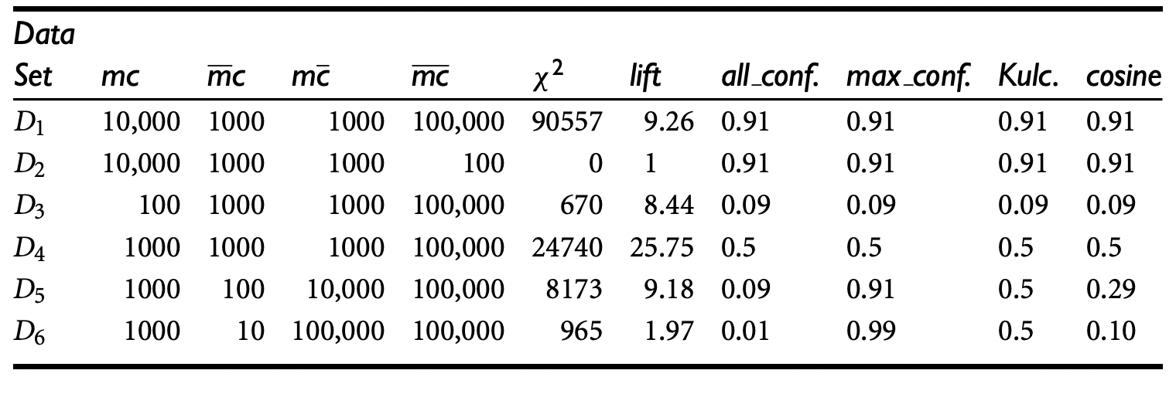
Four measures at one shot
lift and χ2 generate dramatically different measure values for D1 and D2 due to their sensitivity to mc
In many real-world scenarios, mc is usually huge and unstable
A good interestingness measure should not be affected by transactions that do not contain the itemsets of interest
D3: the four new measures correctly show that m and c are strongly negatively associated because the m to c ratio equals the mc to m ratio, that is, 100/1100 = 9.1%. However, lift and χ 2 both contradict this in an incorrect way: Their values for D2 are between those for D1 and D3.

Slide 22
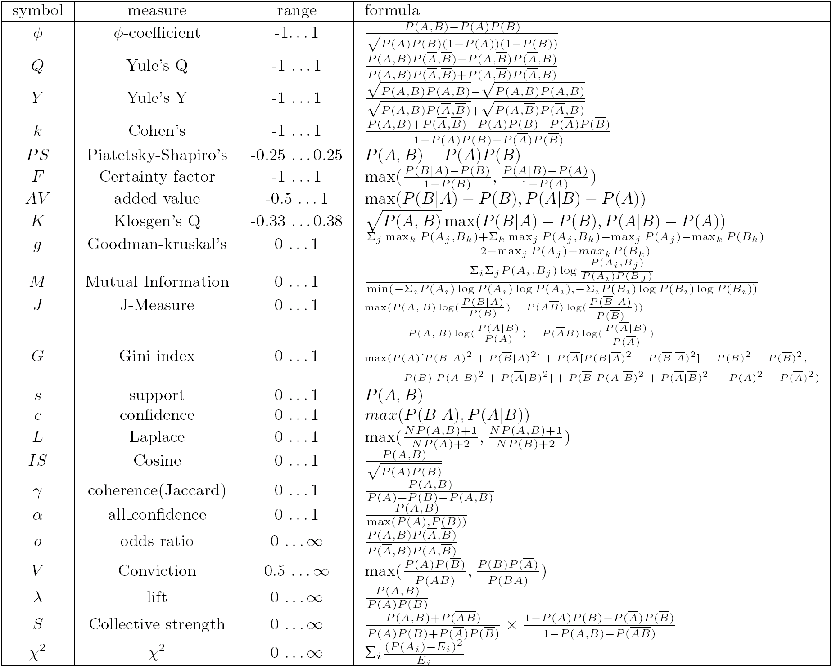
Are lift and χ² Good Measures of Correlation?
“Buy walnuts ⇒ buy milk [1%, 80%]” is misleading if 85% of customers buy milk
Support and confidence are not good to indicate correlations
Over 20 interestingness measures have been proposed (see Tan, Kumar, Sritastava @KDD’02)
Which are good ones?

Slide 23
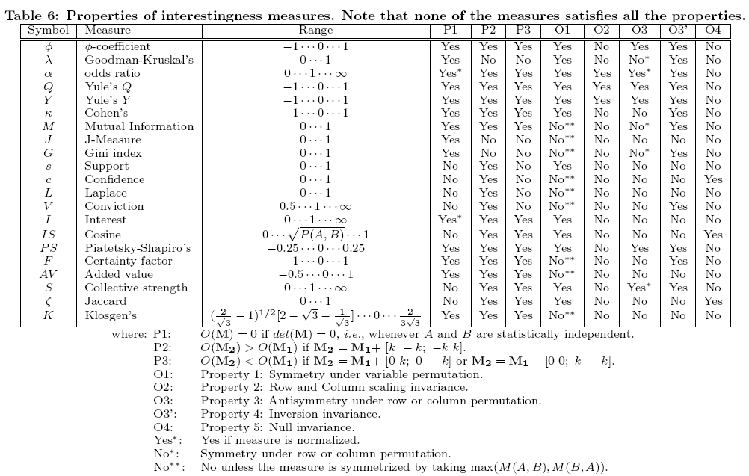
Null-Invariant Measures

Slide 24
Null-Invariant Measures
A null-transaction is a transaction that does not contain any of the itemsets being examined.
Good interestingness measure should not be affected by transactions that do not contain the itemsets of interest.
Any measure whose value is not affected by null transactions is called a null-invariant.
Lift and χ² are null-variant. That’s why:
Number of null-transactions can outweigh the number of purchases.
Many people by neither milk or coffee. Does it mean no relation??
Notes:
a good strategy is to perform the all confidence or cosine analysis first, and when the result shows that they are weakly postively/negatively correlated, other
analyses can be performed to assist in obtaining a more complete picture

Slide 25
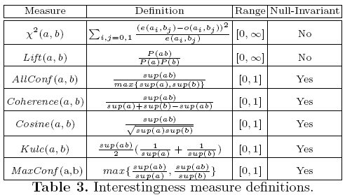
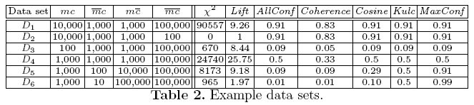
Comparison of Interestingness Measures
Null-(transaction) invariance is crucial for correlation analysis
Lift and χ² are not null-invariant
5 null-invariant measures
 | Milk | No Milk | Sum (row)
Coffee | m, c | ~m, c | c
No Coffee | m, ~c | ~m, ~c | ~c
Sum(col.) | m | ~m | Σ
Null-transactions w.r.t. m and c
Null-invariant
Subtle: They disagree

Slide 26
Which Null-Invariant Measure Is Better?
IR (Imbalance Ratio): measure the imbalance of two itemsets A and B in rule implications
Kulczynski and Imbalance Ratio (IR) together present a clear picture for all the three datasets D₄ through D₆
D₄ is balanced & neutral
D₅ is imbalanced & neutral
D₆ is very imbalanced & neutral

Slide 27
Conclusions
The use of only support and confidence generates rules most of which may not be interesting.
We can augment the support-confidence framework with a correlation measure.
substantially reduces the number of rules generated, and leads to more meaningful rules.
However, no single correlation measure that works well for all cases.
It is important to consider the null-invariance property
Both all confidence and cosine are good correlation measures for large applications, although it is wise to augment them with additional tests, such as lift, when the test result is not conclusive.
Use Kulcyznski together with the imbalance ratio.

Slide 28
Chapter 5: Mining Frequent Patterns, Association and Correlations: Basic Concepts and Methods
Basic Concepts
Frequent Itemset Mining Methods
Which Patterns Are Interesting?—Pattern Evaluation Methods
Summary

Slide 29
Summary
Basic concepts: association rules, support-confident framework, closed and max-patterns
Scalable frequent pattern mining methods
Apriori (Candidate generation & test)
Projection-based (FPgrowth, CLOSET+, ...)
Vertical format approach (ECLAT, CHARM, ...)
Which patterns are interesting?
Pattern evaluation methods

Slide 30
Ref: Apriori and Its Improvements
R. Agrawal and R. Srikant. Fast algorithms for mining association rules. VLDB'94
H. Mannila, H. Toivonen, and A. I. Verkamo. Efficient algorithms for discovering association rules. KDD'94
A. Savasere, E. Omiecinski, and S. Navathe. An efficient algorithm for mining association rules in large databases. VLDB'95
J. S. Park, M. S. Chen, and P. S. Yu. An effective hash-based algorithm for mining association rules. SIGMOD'95
H. Toivonen. Sampling large databases for association rules. VLDB'96
S. Brin, R. Motwani, J. D. Ullman, and S. Tsur. Dynamic itemset counting and implication rules for market basket analysis. SIGMOD'97
S. Sarawagi, S. Thomas, and R. Agrawal. Integrating association rule mining with relational database systems: Alternatives and implications. SIGMOD'98

Slide 31
Ref: Depth-First, Projection-Based FP Mining
R. Agarwal, C. Aggarwal, and V. V. V. Prasad. A tree projection algorithm for generation of frequent itemsets. J. Parallel and Distributed Computing, 2002.
G. Grahne and J. Zhu, Efficiently Using Prefix-Trees in Mining Frequent Itemsets, Proc. FIMI'03
B. Goethals and M. Zaki. An introduction to workshop on frequent itemset mining implementations. Proc. ICDM’03 Int. Workshop on Frequent Itemset Mining Implementations (FIMI’03), Melbourne, FL, Nov. 2003
J. Han, J. Pei, and Y. Yin. Mining frequent patterns without candidate generation. SIGMOD’ 00
J. Liu, Y. Pan, K. Wang, and J. Han. Mining Frequent Item Sets by Opportunistic Projection. KDD'02
J. Han, J. Wang, Y. Lu, and P. Tzvetkov. Mining Top-K Frequent Closed Patterns without Minimum Support. ICDM'02
J. Wang, J. Han, and J. Pei. CLOSET+: Searching for the Best Strategies for Mining Frequent Closed Itemsets. KDD'03

Slide 32
Ref: Vertical Format and Row Enumeration Methods
M. J. Zaki, S. Parthasarathy, M. Ogihara, and W. Li. Parallel algorithm for discovery of association rules. DAMI:97.
M. J. Zaki and C. J. Hsiao. CHARM: An Efficient Algorithm for Closed Itemset Mining, SDM'02.
C. Bucila, J. Gehrke, D. Kifer, and W. White. DualMiner: A Dual-Pruning Algorithm for Itemsets with Constraints. KDD’02.
F. Pan, G. Cong, A. K. H. Tung, J. Yang, and M. Zaki , CARPENTER: Finding Closed Patterns in Long Biological Datasets. KDD'03.
H. Liu, J. Han, D. Xin, and Z. Shao, Mining Interesting Patterns from Very High Dimensional Data: A Top-Down Row Enumeration Approach, SDM'06.

Slide 33
Ref: Mining Correlations and Interesting Rules
S. Brin, R. Motwani, and C. Silverstein. Beyond market basket: Generalizing association rules to correlations. SIGMOD'97.
M. Klemettinen, H. Mannila, P. Ronkainen, H. Toivonen, and A. I. Verkamo. Finding interesting rules from large sets of discovered association rules. CIKM'94.
R. J. Hilderman and H. J. Hamilton. Knowledge Discovery and Measures of Interest. Kluwer Academic, 2001.
C. Silverstein, S. Brin, R. Motwani, and J. Ullman. Scalable techniques for mining causal structures. VLDB'98.
P.-N. Tan, V. Kumar, and J. Srivastava. Selecting the Right Interestingness Measure for Association Patterns. KDD'02.
E. Omiecinski. Alternative Interest Measures for Mining Associations. TKDE’03.
T. Wu, Y. Chen, and J. Han, “Re-Examination of Interestingness Measures in Pattern Mining: A Unified Framework", Data Mining and Knowledge Discovery, 21(3):371-397, 2010

