Slide 1
Chapter 10. Cluster Analysis: Basic Concepts and Methods
Cluster Analysis: Basic Concepts
Partitioning Methods
Hierarchical Methods
Density-Based Methods
Evaluation of Clustering
Summary

Slide 2
Hierarchical Clustering
Use distance matrix as clustering criteria. This method does not require the number of clusters k as an input, but needs a termination condition
Step 0
Step 1
Step 2
Step 3
Step 4
agglomerative
(AGNES)
a
a b
b
a b c d e
c
c d e
d
d e
e
divisive
(DIANA)
Step 4
Step 3
Step 2
Step 1
Step 0

Slide 3

AGNES (Agglomerative Nesting)
Introduced in Kaufmann and Rousseeuw (1990)
Implemented in statistical packages,
Use the single-link method and the dissimilarity matrix
Merge nodes that have the least dissimilarity
Eventually all nodes belong to the same cluster

Slide 4
Dendrogram: Shows How Clusters are Merged
  Decompose data objects into a several levels of nested partitioning (tree of clusters), called a dendrogram
  A clustering of the data objects is obtained by cutting the dendrogram at the desired level, then each connected component forms a cluster

Slide 5
DIANA (Divisive Analysis)
Introduced in Kaufmann and Rousseeuw (1990)
Implemented in statistical analysis packages
Inverse order of AGNES
Eventually each node forms a cluster on its own
Comment:
  when n is large, it becomes harder.
  uses heuristics in partitioning which can lead inaccurate results.

Slide 6
Distance between Clusters
Single link: smallest distance between an element in one cluster and an element in the other, i.e., dist(K_{i}, K_{j}) = min(t_{ip}, t_{jq})
Complete link: largest distance between an element in one cluster and an element in the other, i.e., dist(K_{i}, K_{j}) = max(t_{ip}, t_{jq})
X
X

Slide 7
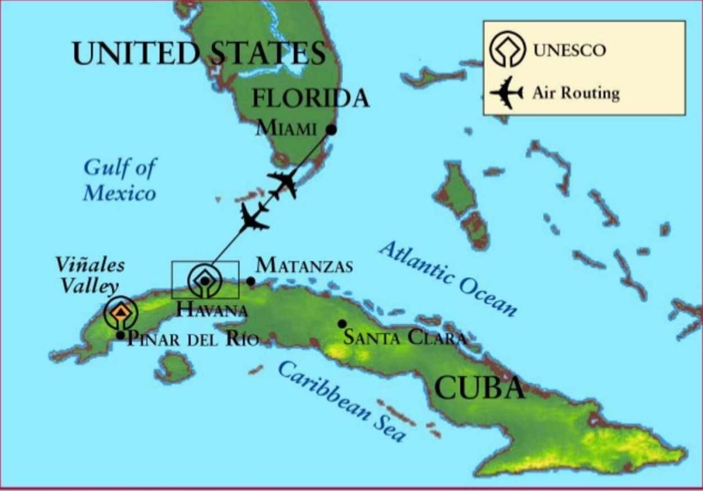
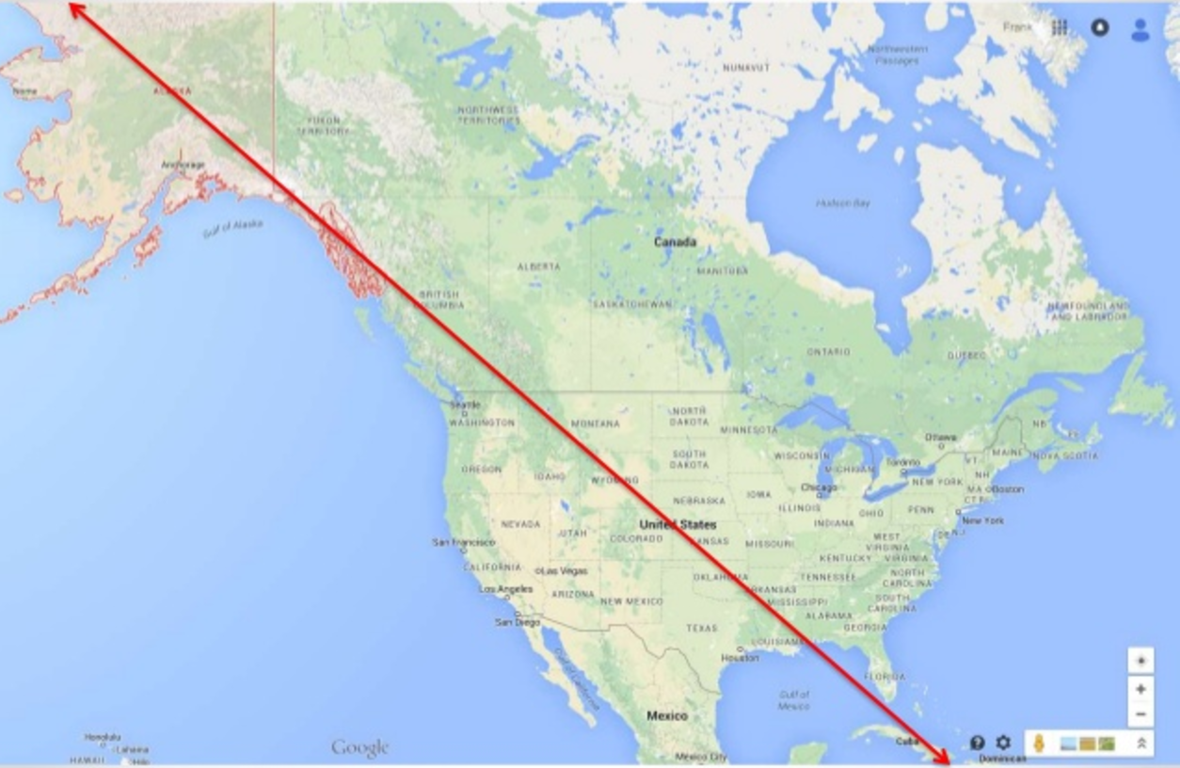
Distance between Clusters
How close US and Cuba?

Slide 8

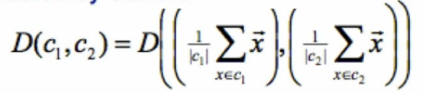
Distance between Clusters
Average: avg distance between an element in one cluster and an element in the other, i.e., dist(K_{i}, K_{j}) = avg(t_{ip}, t_{jq})
Centroid: distance between the centroids of two clusters, i.e., dist(K_{i}, K_{j}) = dist(C_{i}, C_{j})
X
x
x

Slide 9
Distance between Clusters
Medoid: distance between the medoids of two clusters, i.e., dist(K_{i}, K_{j}) = dist(M_{i}, M_{j})
  Medoid: a chosen, centrally located object in the cluster

Slide 10



Clustering Features
(for numerical data sets)
Centroid: the “middle” of a cluster
Radius: square root of average distance from any point of the cluster to its centroid
Diameter: square root of average mean squared distance between all pairs of points in the cluster

Slide 11
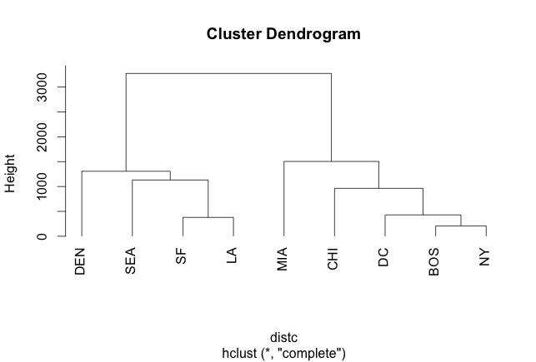
Clustering Cities
 | BOS | NY | DC | MIA | CHI | SEA | SF | LA | DEN
BOS | 0 | 206 | 429 | 1504 | 963 | 2976 | 3095 | 2979 | 1949
NY | 206 | 0 | 233 | 1308 | 802 | 2815 | 2934 | 2786 | 1771
DC | 429 | 233 | 0 | 1075 | 671 | 2684 | 2799 | 2631 | 1616
MIA | 1504 | 1308 | 1075 | 0 | 1329 | 3273 | 3053 | 2687 | 2037
CHI | 963 | 802 | 671 | 1329 | 0 | 2013 | 2142 | 2054 | 996
SEA | 2976 | 2815 | 2684 | 3273 | 2013 | 0 | 808 | 1131 | 1307
SF | 3095 | 2934 | 2799 | 3053 | 2142 | 808 | 0 | 379 | 1235
LA | 2979 | 2786 | 2631 | 2687 | 2054 | 1131 | 379 | 0 | 1059
DEN | 1949 | 1771 | 1616 | 2037 | 996 | 1307 | 1235 | 1059 | 0

Slide 12
Clustering Cities
 | BOS/NY | DC | MIA | CHI | SEA | SF | LA | DEN
BOS/NY | 0 | 223 | 1308 | 802 | 2815 | 2934 | 2786 | 1771
DC | 223 | 0 | 1075 | 671 | 2684 | 2799 | 2631 | 1616
MIA | 1308 | 1075 | 0 | 1329 | 3273 | 3053 | 2687 | 2037
CHI | 802 | 671 | 1329 | 0 | 2013 | 2142 | 2054 | 996
SEA | 2815 | 2684 | 3273 | 2013 | 0 | 808 | 1131 | 1307
SF | 2934 | 2799 | 3053 | 2142 | 808 | 0 | 379 | 1235
LA | 2786 | 2631 | 2687 | 2054 | 1131 | 379 | 0 | 1059
DEN | 1771 | 1616 | 2037 | 996 | 1307 | 1235 | 1059 | 0

Slide 13
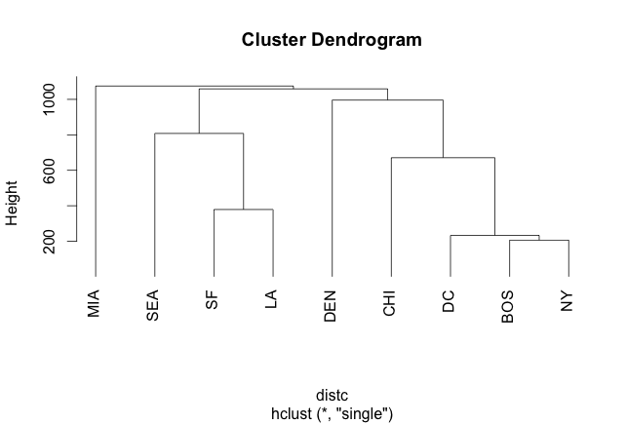
Clustering Cities
 | BOS/NY/DC | MIA | CHI | SEA | SF | LA | DEN
BOS/NY/DC | 0 | 1075 | 671 | 2684 | 2799 | 2631 | 1616
MIA | 1075 | 0 | 1329 | 3273 | 3053 | 2687 | 2037
CHI | 671 | 1329 | 0 | 2013 | 2142 | 2054 | 996
SEA | 2684 | 3273 | 2013 | 0 | 808 | 1131 | 1307
SF | 2799 | 3053 | 2142 | 808 | 0 | 379 | 1235
LA | 2631 | 2687 | 2054 | 1131 | 379 | 0 | 1059
DEN | 1616 | 2037 | 996 | 1307 | 1235 | 1059 | 0

Slide 14
Clustering Cities
 | BOS/NY/DC | MIA | CHI | SEA | SF/LA | DEN
BOS/NY/DC | 0 | 1075 | 671 | 2684 | 2631 | 1616
MIA | 1075 | 0 | 1329 | 3273 | 2687 | 2037
CHI | 671 | 1329 | 0 | 2013 | 2054 | 996
SEA | 2684 | 3273 | 2013 | 0 | 808 | 1307
SF/LA | 2631 | 2687 | 2054 | 808 | 0 | 1059
DEN | 1616 | 2037 | 996 | 1307 | 1059 | 0

Slide 15
Clustering Cities
 | BOS/NY/DC/CHI | MIA | SEA | SF/LA | DEN
BOS/NY/DC/CHI | 0 | 1075 | 2013 | 2054 | 996
MIA | 1075 | 0 | 3273 | 2687 | 2037
SEA | 2013 | 3273 | 0 | 808 | 1307
SF/LA | 2054 | 2687 | 808 | 0 | 1059
DEN | 996 | 2037 | 1307 | 1059 | 0

Slide 16
Clustering Cities
 | BOS/NY/DC/CHI | MIA | SF/LA/SEA | DEN
BOS/NY/DC/CHI | 0 | 1075 | 2013 | 996
MIA | 1075 | 0 | 2687 | 2037
SF/LA/SEA | 2054 | 2687 | 0 | 1059
DEN | 996 | 2037 | 1059 | 0

Slide 17
Clustering Cities
 | BOS/NY/DC/CHI/DEN | MIA | SF/LA/SEA
BOS/NY/DC/CHI/DEN | 0 | 1075 | 1059
MIA | 1075 | 0 | 2687
SF/LA/SEA | 1059 | 2687 | 0

Slide 18
Clustering Cities
 | BOS/NY/DC/CHI/DEN/SF/LA/SEA | MIA
BOS/NY/DC/CHI/DEN/SF/LA/SEA | 0 | 1075
MIA | 1075 | 0

Slide 19
Extensions to Hierarchical Clustering
Major weakness of agglomerative clustering methods
  Can never undo what was done previously
  Do not scale well: time complexity of at least O(n²), where n is the number of total objects
Integration of hierarchical & distance-based clustering
  BIRCH (1996): uses CF-tree and incrementally adjusts the quality of sub-clusters
  CHAMELEON (1999): hierarchical clustering using dynamic modeling

Slide 20
In class assignment-II
Download distances.csv from BB
Apply hierarchical clustering by using hclust() in R.
Plot the dendogram
Cut the tree and observe the labels
Some functions you need:
  read.delim()
  hclust()
  as.dist()
  cutree()

