Slide 1
Data Mining:
Concepts and Techniques
(3rd ed.)
— Chapter 6 —

Slide 2
Chapter 5: Mining Frequent Patterns, Association and Correlations: Basic Concepts and Methods
Basic Concepts
Frequent Itemset Mining Methods
Which Patterns Are Interesting?—Pattern Evaluation Methods
Summary

Slide 3
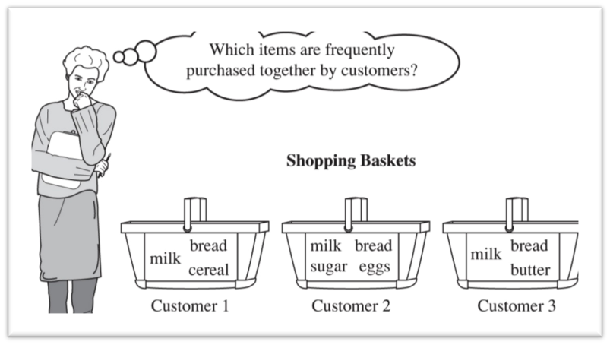
What Is Frequent Pattern Analysis?
Frequent pattern: a pattern (a set of items, subsequences, substructures, etc.) that occurs frequently in a data set
Motivation: Finding inherent regularities in data
  What products were often purchased together?— Beer and diapers?!
  What are the subsequent purchases after buying a PC?
Applications
  Basket data analysis, cross-marketing, catalog design, …

Slide 4

Why Is Freq. Pattern Mining Important?
Freq. pattern: An intrinsic and important property of datasets
Foundation for many essential data mining tasks
  Association, correlation, and causality analysis
  Sequential, structural (e.g., sub-graph) patterns
  Pattern analysis in spatiotemporal, multimedia, time-series, and stream data
  Classification: discriminative, frequent pattern analysis
  Cluster analysis: frequent pattern-based clustering
Find all frequent itemsets (more costly)
Generate strong association rules from the frequent itemsets
{…}=>{…}, i.e., {Halil, Data Mining} => Turkish Delight

Slide 5
Basic Concepts: Frequent Patterns
Tid | Items bought
10 | Beer, Nuts, Diaper
20 | Beer, Coffee, Diaper
30 | Beer, Diaper, Eggs
40 | Nuts, Eggs, Milk
50 | Nuts, Coffee, Diaper, Eggs, Milk
itemset: A set of one or more items
k-itemset X = {x₁, …, x_{k}}
(absolute) support, or, support count of X: Frequency or occurrence of an itemset X
(relative) support, s, is the fraction of transactions that contains X (i.e., the probability that a transaction contains X)
An itemset X is frequent if X’s support is no less than a minsup threshold
Customer
buys both
Customer
buys diaper
Customer
buys beer

Slide 6
Basic Concepts: Association Rules
Find all the rules X → Y with minimum support and confidence
  support, s, probability that a transaction contains X ∪ Y
  confidence, c, conditional probability that a transaction having X also contains Y
Let minsup = 50%, minconf = 50%
Freq. Pat.: Beer:3, Nuts:3, Diaper:4, Eggs:3, {Beer, Diaper}:3
Tid
Items bought
10
Beer, Nuts, Diaper
20
Beer, Coffee, Diaper
30
Beer, Diaper, Eggs
40
Nuts, Eggs, Milk
50
Nuts, Coffee, Diaper, Eggs, Milk
support=P(X U Y): both
confidence=P(Y | X)
Assume X=Diaper, Y=Beer:
P(X U Y) = 3/5 = 60%
P(Y | X) = 3/4 = 75%
Diaper → Beer (60%, 75%)
What about Beer → Diaper ?
Assume X=Beer, Y=Diaper:
P(X U Y) = 3/5 = 60%
P(Y | X) = 3/3 = 100%
Beer → Diaper (60%, 100%)

Slide 7
Closed Patterns and Max-Patterns
A long pattern contains a combinatorial number of sub-patterns, e.g., {a₁, …, a₁₀₀} contains (₁₀₀¹) + (₁₀₀²) + … + (₁¹₀⁰₀⁰) = 2¹⁰⁰ – 1 = 1.27*10³⁰ sub-patterns!
Solution: Mine closed patterns and max-patterns instead
An itemset X is closed if X is frequent and there exists no super-pattern Y כ X, with the same support as X. e.g., {A,E} = 4; {A,D,E} = 3 (suppose min_sup>=3)
An itemset X is a max-pattern if X is frequent and there exists no frequent super-pattern Y כ X. e.g., {A,D,E} = 3; {A,B,C,E} = 1 (suppose min_sup>=3)
Closed pattern is a lossless compression of freq. patterns
  Reducing the # of patterns and rules

Slide 8
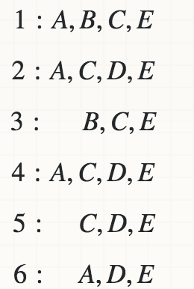
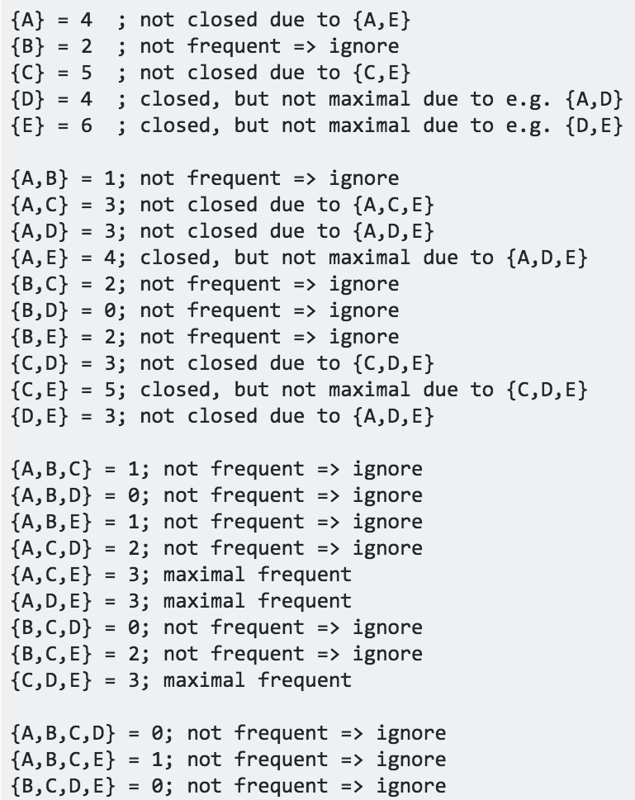
Closed Patterns and Max-Patterns
(suppose min_sup>=3)
Notes:
The important aspect in the definition of closed is, that it does not matter if an immediate superset exists with more support, only immediate supersets with exactly the same support do matter.

Slide 9
Closed Patterns and Max-Patterns
Exercise. DB = {<a₁, …, a₁₀₀>, < a₁, …, a₅₀>}
  Min_sup = 1.
What is the set of closed itemset?
  <a₁, …, a₁₀₀>: 1
  < a₁, …, a₅₀>: 2
What is the set of max-pattern?
  <a₁, …, a₁₀₀>: 1
Let C be the set of closed frequent itemsets for a data set S satisfying a minimum support threshold, min sup.
Let M be the set of maximal frequent itemsets for S satisfying min sup.
C and its count information can be used to derive the whole set of frequent itemsets.
C contains complete information regarding its corresponding frequent itemsets.
On the other hand, M registers only the support of the maximal itemsets.

Slide 10
Computational Complexity of Frequent Itemset Mining
How many itemsets are potentially to be generated in the worst case?
  The number of frequent itemsets to be generated is senstive to the minsup threshold
  When minsup is low, there exist potentially an exponential number of frequent itemsets
  The worst case: M^{N} where M: # distinct items, and N: max length of transactions

Slide 11
Chapter 5: Mining Frequent Patterns, Association and Correlations: Basic Concepts and Methods
Basic Concepts
Frequent Itemset Mining Methods
Which Patterns Are Interesting?—Pattern Evaluation Methods
Summary

Slide 12
Scalable Frequent Itemset Mining Methods
Apriori: A Candidate Generation-and-Test Approach
Improving the Efficiency of Apriori
FPGrowth: A Frequent Pattern-Growth Approach
ECLAT: Frequent Pattern Mining with Vertical Data Format

Slide 13
The Downward Closure Property and Scalable Mining Methods
The downward closure property of frequent patterns
  Any subset of a frequent itemset must be frequent
  If {beer, diaper, nuts} is frequent, so is {beer, diaper}
    i.e., every transaction having {beer, diaper, nuts} also contains {beer, diaper}
Scalable mining methods: Three major approaches
  Apriori (Agrawal & Srikant@VLDB’94)
  Freq. pattern growth (FPgrowth—Han, Pei & Yin @SIGMOD’00)
  Vertical data format approach (Charm—Zaki & Hsiao @SDM’02)

Slide 14
Apriori: A Candidate Generation & Test Approach
Apriori pruning principle: If there is any itemset which is infrequent, its superset should not be generated/tested!
Method:
  Initially, scan DB once to get frequent 1-itemset
  Generate length (k+1) candidate itemsets from length k frequent itemsets
  Test the candidates against DB
  Terminate when no frequent or candidate set can be generated

Slide 15

The Apriori Algorithm—An Example
Sup_{min} = 2
Itemset | sup
{A} | 2
{B} | 3
{C} | 3
{D} | 1
{E} | 3
Database TDB
Itemset | sup
{A} | 2
{B} | 3
{C} | 3
{E} | 3
L₁
Tid | Items
10 | A, C, D
20 | B, C, E
30 | A, B, C, E
40 | B, E
C₁
1st scan
C₂
Itemset | sup
{A, B} | 1
{A, C} | 2
{A, E} | 1
{B, C} | 2
{B, E} | 3
{C, E} | 2
C₂
L₂
Itemset
{A, B}
{A, C}
{A, E}
{B, C}
{B, E}
{C, E}
Itemset | sup
{A, C} | 2
{B, C} | 2
{B, E} | 3
{C, E} | 2
2nd scan
C₃
Itemset
{B, C, E}
3rd scan
L₃
Itemset | sup
{B, C, E} | 2

Slide 16

Candidate Generation: An SQL Implementation
SQL Implementation of candidate generation
  Suppose the items in L_{k-1} are listed in an order
  Step 1: self-joining L_{k-1}
    insert into C_{k}
    select p.item₁, p.item₂, …, p.item_{k-1}, q.item_{k-1}
    from L_{k-1} p, L_{k-1} q
    where p.item₁=q.item₁, …, p.item_{k-2}=q.item_{k-2}, p.item_{k-1} < q.item_{k-1}
  Step 2: pruning
    forall itemsets c in C_{k} do
      forall (k-1)-subsets s of c do
        if (s is not in L_{k-1}) then delete c from C_{k}

Slide 17
The Apriori Algorithm (Pseudo-Code)
C_{k}: Candidate itemset of size k
L_{k} : frequent itemset of size k
L₁ = {frequent items};
for (k = 1; L_{k} !=∅; k++) do begin
C_{k+1} = candidates generated from L_{k};
for each transaction t in database do
  increment the count of all candidates in C_{k+1} that are contained in t
L_{k+1} = candidates in C_{k+1} with min_support
end
return ∪_{k} L_{k};

Slide 18
Implementation of Apriori
How to generate candidates?
  Step 1: self-joining L_{k}
  Step 2: pruning
Example of Candidate-generation
  L₃={abc, abd, acd, ace, bcd}
  Self-joining: L₃*L₃
    abcd from abc and abd
    acde from acd and ace
  Pruning:
    acde is removed because ade is not in L₃
  C₄ = {abcd}

Slide 19
Scalable Frequent Itemset Mining Methods
Apriori: A Candidate Generation-and-Test Approach
Improving the Efficiency of Apriori
FPGrowth: A Frequent Pattern-Growth Approach
ECLAT: Frequent Pattern Mining with Vertical Data Format
Mining Close Frequent Patterns and Maxpatterns

Slide 20
Further Improvement of the Apriori Method
Major computational challenges
  Multiple scans of transaction database
  Huge number of candidates
  Tedious workload of support counting for candidates
Improving Apriori: general ideas
  Reduce passes of transaction database scans
  Shrink number of candidates
  Facilitate support counting of candidates

Slide 21
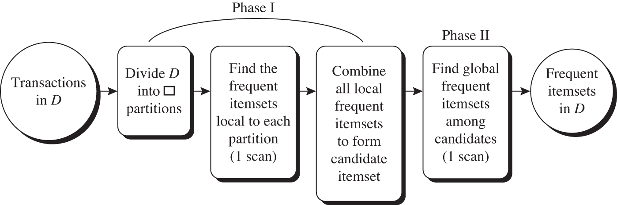
Partition: Scan Database Only Twice
Any itemset that is potentially frequent in DB must be frequent in at least one of the partitions of DB
  Scan 1: partition database, find local frequent patterns
  Scan 2: consolidate global frequent patterns
A local frequent may/not be frequent globally.
However,
Any itemset that is potentially frequent w.r.t D must occur as a frequent itemset in at least one of the partitions.

Slide 22
Sampling for Frequent Patterns
Select a sample of original database, mine frequent patterns within sample using Apriori
  Trade off some degree of accuracy against efficiency
  We can lower threshold not to miss
  Then we use the actual database to get the actual counts of candidates.
A second pass can be done to find any missed frequent patterns.

Slide 23
Dynamic Itemset Counting (DIC):
Reduce Number of Scans
ABCD
Once both A and D are determined frequent, the counting of AD begins
Once all length-2 subsets of BCD are determined frequent, the counting of BCD begins
ABC
ABD
ACD
BCD
AB
AC
BC
AD
BD
CD
Transactions
1-itemsets
A
B
C
D
Apriori
2-itemsets
…
{}
Itemset lattice
1-itemsets
2-items
DIC
3-items

Slide 24
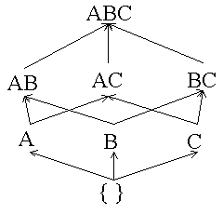
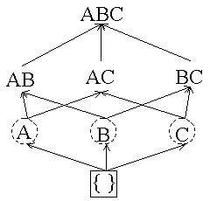

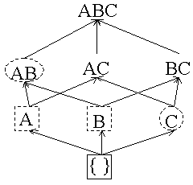


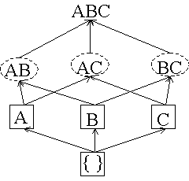
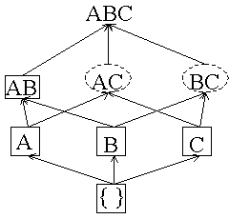
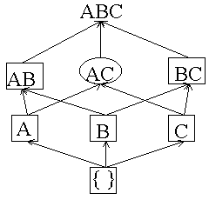
example: minsup = 25% and M = 2
TID A B C
T1 1 1 0
T2 1 0 0
T3 0 1 1
T4 0 0 0
confirmed frequent itemset
confirmed infrequent itemset
suspected frequent itemset
suspected infrequent itemset
M
both subsets box
Counters: A = 0, B = 0, C = 0
A = 2, B = 1, C = 0, AB = 0
2M
3M
4M
A = 2, B = 2, C = 1, AB = 0, AC = 0, BC = 0
A = 2, B = 2, C = 1, AB = 1, AC = 0, BC = 0
A = 2, B = 2, C = 1, AB = 1, AC = 0, BC = 1

Slide 25
Scalable Frequent Itemset Mining Methods
Apriori: A Candidate Generation-and-Test Approach
Improving the Efficiency of Apriori
FPGrowth: A Frequent Pattern-Growth Approach
ECLAT: Frequent Pattern Mining with Vertical Data Format
Mining Close Frequent Patterns and Maxpatterns

Slide 26
Pattern-Growth Approach: Mining Frequent Patterns Without Candidate Generation
Bottlenecks of the Apriori approach
  Breadth-first (i.e., level-wise) search
  Candidate generation and test
    Often generates a huge number of candidates
The FPGrowth Approach (J. Han, J. Pei, and Y. Yin, SIGMOD’ 00)
  Depth-first search
  Avoid explicit candidate generation
Major philosophy: Grow long patterns from short ones using local frequent items only
  “abc” is a frequent pattern
  Get all transactions having “abc”, i.e., project DB on abc: DB|abc
  “d” is a local frequent item in DB|abc → abcd is a frequent pattern

Slide 27
Construct FP-tree from a Transaction Database
TID Items bought (ordered) frequent items
100 {f, a, c, d, g, i, m, p} {f, c, a, m, p}
200 {a, b, c, f, l, m, o} {f, c, a, b, m}
300 {b, f, h, j, o, w} {f, b}
400 {b, c, k, s, p} {c, b, p}
500 {a, f, c, e, l, p, m, n} {f, c, a, m, p}
min_support = 3
{}
Header Table
Item frequency head
f 4
c 4
a 3
b 3
m 3
p 3
Scan DB once, find frequent 1-itemset (single item pattern)
Sort frequent items in frequency descending order, f-list
Scan DB again, construct FP-tree
f:4
c:1
c:3
b:1
b:1
a:3
p:1
m:2
b:1
F-list = f-c-a-b-m-p
p:2
m:1

Slide 28
Partition Patterns and Databases
Frequent patterns can be partitioned into subsets according to f-list
  F-list = f-c-a-b-m-p
  Patterns containing p
  Patterns having m but no p
  …
  Patterns having c but no a nor b, m, p
  Pattern f
Completeness and non-redundency

Slide 29
Find Patterns Having P From P-conditional Database
Starting at the frequent item header table in the FP-tree
Traverse the FP-tree by following the link of each frequent item p
Accumulate all of transformed prefix paths of item p to form p’s conditional pattern base
{}
Header Table
Item frequency head
f 4
c 4
a 3
b 3
m 3
p 3
f:4
c:1
Conditional pattern bases
item cond. pattern base
c f:3
a fc:3
b fca:1, f:1, c:1
m fca:2, fcab:1
p fcam:2, cb:1
c:3
b:1
b:1
a:3
p:1
m:2
b:1
p:2
m:1
Notes:
M conditional pattern bases: fca:2, fcab:1. In the next step, calculate the cumulative number. We’ll ignore b in that case since it’s just 1, but fca is followed again to reach m from this branch. Therefore, we’ll count fca being 3 which is greater than the minsup. Then take all subsets that also include m.

Slide 30
From Conditional Pattern-bases to Conditional FP-trees
For each pattern-base
  Accumulate the count for each item in the base
  Construct the FP-tree for the frequent items of the pattern base
m-conditional pattern base:
  fca:2, fcab:1
{}
Header Table
Item frequency head
f 4
c 4
a 3
b 3
m 3
p 3
f:4
c:1
All frequent patterns relate to m
m,
fm, cm, am,
fcm, fam, cam,
fcam
{}
c:3
b:1
b:1

f:3

a:3
p:1
m:2
b:1
c:3
p:2
m:1
a:3
m-conditional FP-tree

Slide 31
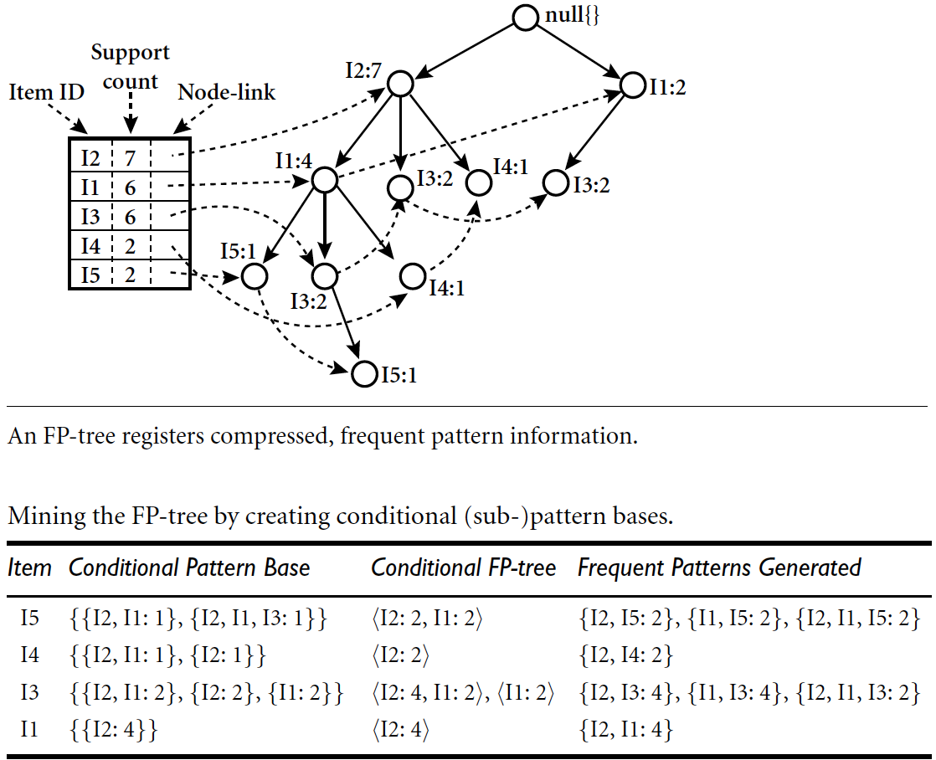
FP-growth example II

Slide 32

Apriori vs. FP-Growth

Slide 33
Benefits of the FP-tree Structure
Completeness
  Preserve complete information for frequent pattern mining
  Never break a long pattern of any transaction
Compactness
  Reduce irrelevant info—infrequent items are gone
  Items in frequency descending order: the more frequently occurring, the more likely to be shared
  Never be larger than the original database

Slide 34
The Frequent Pattern Growth Mining Method
Idea: Frequent pattern growth
  Recursively grow frequent patterns by pattern and database partition
Method
  For each frequent item, construct its conditional pattern-base, and then its conditional FP-tree
  Repeat the process on each newly created conditional FP-tree
  Until the resulting FP-tree is empty, or it contains only one path—single path will generate all the combinations of its sub-paths, each of which is a frequent pattern

