Slide 1
Data Mining:
Concepts and Techniques

Slide 2
Getting to Know Your Data
Data Objects and Attribute Types
Basic Statistical Descriptions of Data
Data Visualization
Measuring Data Similarity and Dissimilarity
Summary

Slide 3


Types of Data Sets
Record
  Relational records
  Data matrix, e.g., numerical matrix, crosstabs
  Document data: text documents: term-frequency vector
  Transaction data
Graph and network
  World Wide Web
  Social or information networks
  Molecular Structures
Ordered
  Video data: sequence of images
  Temporal data: time-series
  Sequential Data: transaction sequences
  Genetic sequence data
Spatial, image and multimedia:
  Spatial data: maps
  Image data:
  Video data:

Slide 4
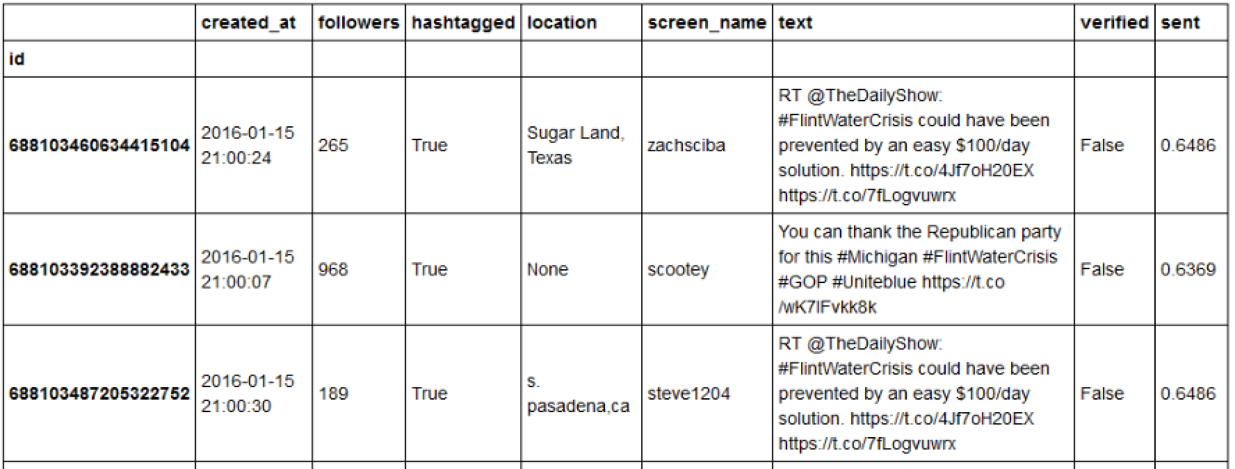
Tweets on #FlintWaterCrisis

Slide 5
Important Characteristics of Structured Data
Dimensionality
  Curse of dimensionality
Sparsity
  Only presence counts
Resolution
  Patterns depend on the scale
Distribution
  Centrality and dispersion

Slide 6
Data Objects
Data sets are made up of data objects.
A data object represents an entity.
Examples:
  sales database: customers, store items, sales
  medical database: patients, treatments
  university database: students, professors, courses
Also called samples , examples, instances, data points, objects, tuples.
Data objects are described by attributes.
Database rows -> data objects; columns ->attributes.

Slide 7
Attributes
Attribute (or dimensions, features, variables): a data field, representing a characteristic or feature of a data object.
  E.g., customer _ID, name, address
Types:
  Nominal
  Binary
  Numeric: quantitative
    Interval-scaled
    Ratio-scaled

Slide 8
Attribute Types
Nominal: categories, states, or “names of things”
  Hair_color = {auburn, black, blond, brown, grey, red, white}
  marital status, occupation, ID numbers, zip codes
Binary
  Nominal attribute with only 2 states (0 and 1)
  Symmetric binary: both outcomes equally important
    e.g., gender
  Asymmetric binary: outcomes not equally important.
    e.g., medical test (positive vs. negative)
    Convention: assign 1 to most important outcome (e.g., HIV positive)
Ordinal
  Values have a meaningful order (ranking) but magnitude between successive values is not known.
  Size = {small, medium, large}, grades, army rankings

Slide 9
Numeric Attribute Types
Quantity (integer or real-valued)
Interval
    Measured on a scale of equal-sized units
    Values have order
      E.g., temperature in C˚or F˚, calendar dates
    No true zero-point
Ratio
    Inherent zero-point
    We can speak of values as being an order of magnitude larger than the unit of measurement (10 K˚ is twice as high as 5 K˚).
      e.g., temperature in Kelvin, length, counts, monetary quantities
      Such as exponential growth, i.e., Ae^{Bt}

Slide 10
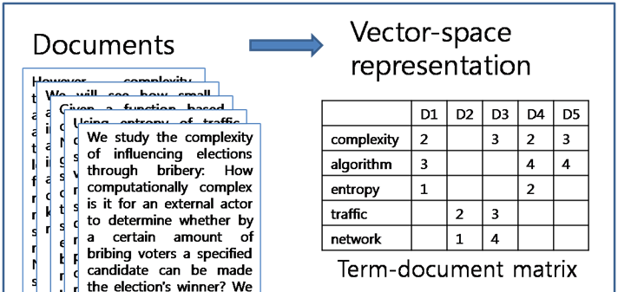
Discrete Attributes
Discrete Attribute
  Has only a finite or countably infinite set of values
    E.g., zip codes, profession, or the set of words in a collection of documents
  Sometimes, represented as integer variables
  Note: Binary attributes are a special case of discrete attributes

Slide 11
Continuous Attributes
Continuous Attribute
  Has real numbers as attribute values
    E.g., temperature, height, or weight
  Practically, real values can only be measured and represented using a finite number of digits
  Continuous attributes are typically represented as floating-point variables

Slide 12
Getting to Know Your Data
Data Objects and Attribute Types
Basic Statistical Descriptions of Data
Data Visualization
Measuring Data Similarity and Dissimilarity
Summary

Slide 13
Basic Statistical Descriptions of Data
Motivation
  To better understand the data: central tendency, variation and spread
Data dispersion characteristics
  median, max, min, quantiles, outliers, variance, etc.
Numerical dimensions correspond to sorted intervals
  Data dispersion: analyzed with multiple granularities of precision
  Boxplot or quantile analysis on sorted intervals
Dispersion analysis on computed measures
  Folding measures into numerical dimensions
  Boxplot or quantile analysis on the transformed cube

Slide 14
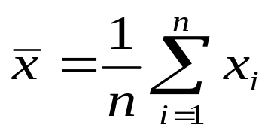


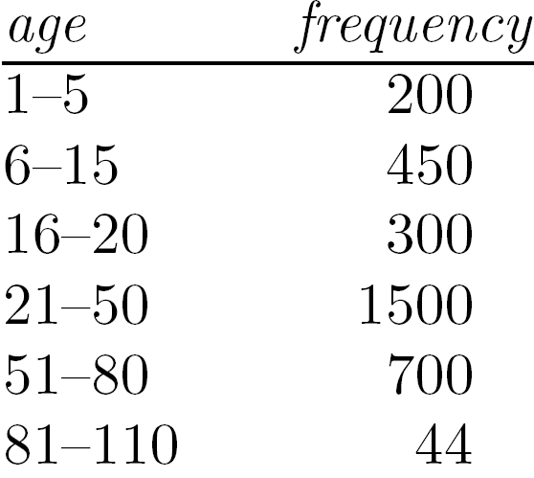
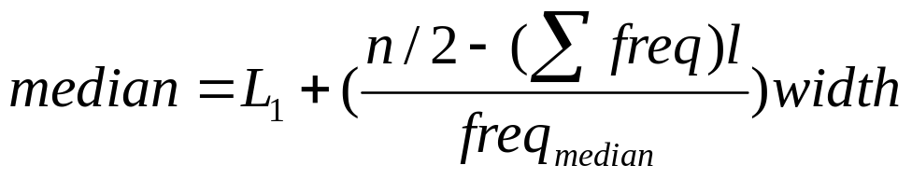
Measuring the Central Tendency
Mean (algebraic measure) (sample vs. population):
  Note: n is sample size and N is population size.
  Weighted arithmetic mean:
  Trimmed mean: chopping extreme values
Median:
  Middle value if odd number of values, or average of the middle two values otherwise
  Estimated by interpolation (for grouped data):
Mode
  Value that occurs most frequently in the data
  Unimodal, bimodal, trimodal
  Empirical formula for skewed :

Slide 15



Symmetric vs. Skewed Data
Median, mean and mode of symmetric, positively and negatively skewed data
symmetric
positively skewed
negatively skewed
Data Mining: Concepts and Techniques

Slide 16


Measuring the Dispersion of Data
Quartiles, outliers and boxplots
  Quartiles: Q₁ (25th percentile), Q₃ (75th percentile)
  Inter-quartile range: IQR = Q₃ – Q₁
  Five number summary: min, Q₁, median, Q₃, max
  Boxplot: ends of the box are the quartiles; median is marked; add whiskers, and plot outliers individually
  Outlier: usually, a value higher/lower than 1.5 x IQR
Variance and standard deviation (sample: s, population: σ)
  Variance: (algebraic, scalable computation)
  Standard deviation s (or σ) is the square root of variance s² ⁽or σ²⁾

Slide 17
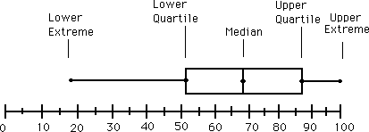
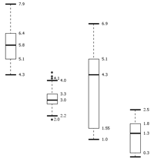
Boxplot Analysis
Five-number summary of a distribution
  Minimum, Q1, Median, Q3, Maximum
Boxplot
  Data is represented with a box
  The ends of the box are at the first and third quartiles, i.e., the height of the box is IQR
  The median is marked by a line within the box
  Whiskers: two lines outside the box extended to Minimum and Maximum
  Outliers: points beyond a specified outlier threshold, plotted individually

Slide 18
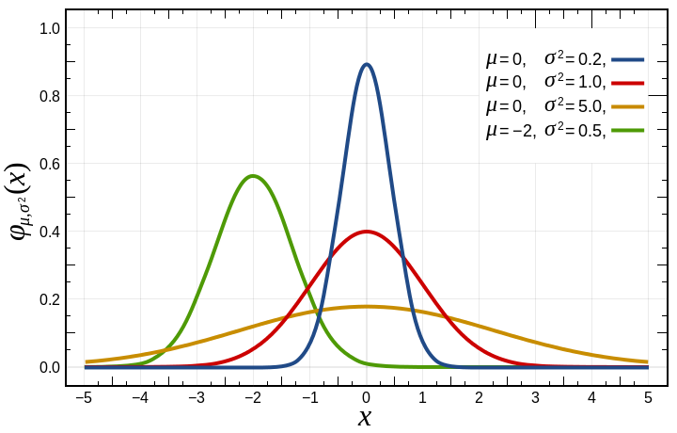
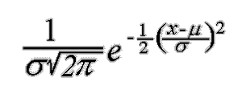
Normal Distribution

Slide 19
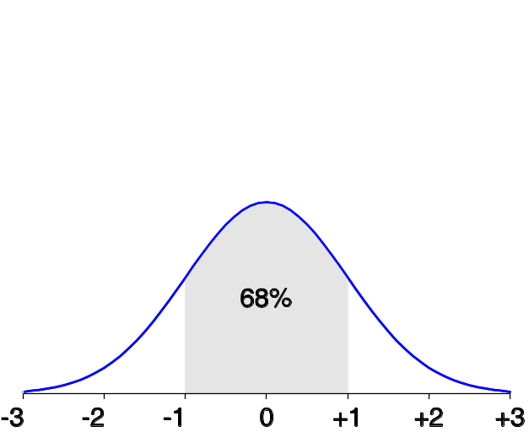
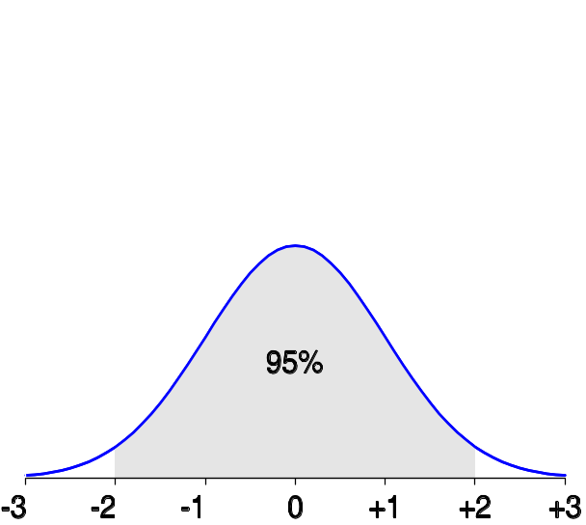
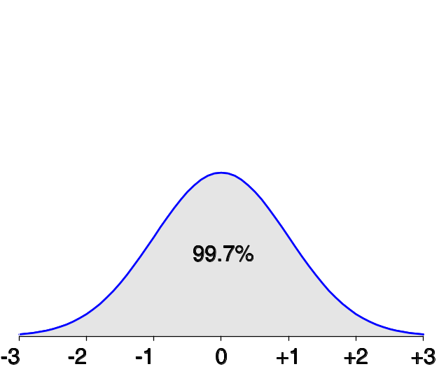
Properties of Normal Distribution Curve
The normal (distribution) curve
  From μ–σ to μ+σ: contains about 68% of the measurements (μ: mean, σ: standard deviation)
  From μ–2σ to μ+2σ: contains about 95% of it
  From μ–3σ to μ+3σ: contains about 99.7% of it

Slide 20
Graphic Displays of Basic Statistical Descriptions
Boxplot: graphic display of five-number summary
Histogram: x-axis are values, y-axis repres. frequencies
Quantile plot: each value x_{i} is paired with f_{i} indicating that approximately 100 f_{i} % of data are ≤ x_{i}
Quantile-quantile (q-q) plot: graphs the quantiles of one univariant distribution against the corresponding quantiles of another
Scatter plot: each pair of values is a pair of coordinates and plotted as points in the plane

Slide 21
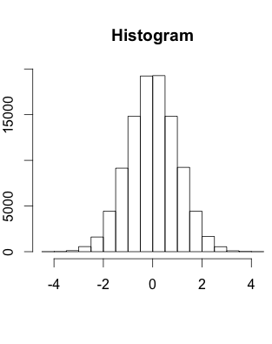
Histogram Analysis
Histogram: Graph display of tabulated frequencies, shown as bars
It shows what proportion of cases fall into each of several categories
Differs from a bar chart.
The categories are usually specified as non-overlapping intervals of some variable. The categories (bars) must be adjacent

Slide 22
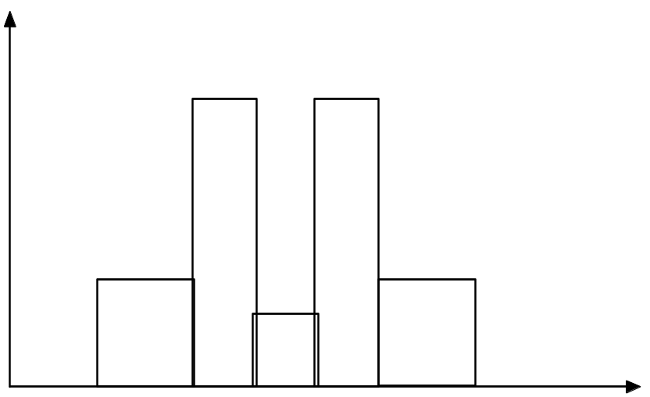
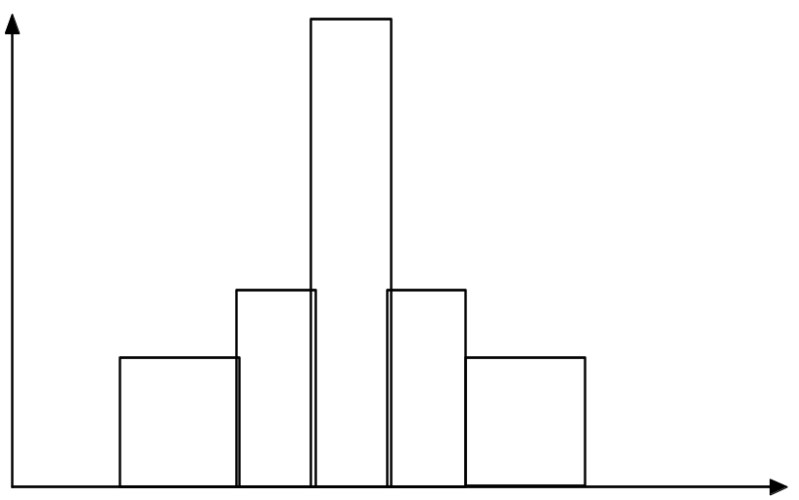
Histograms Often Tell More than Boxplots
The two histograms shown in the left may have the same boxplot representation
  The same values for: min, Q1, median, Q3, max
But they have rather different data distributions
Why?

Slide 23
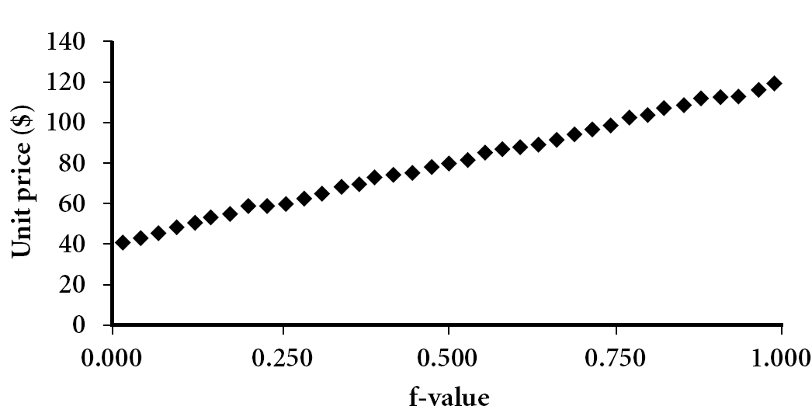
Quantile Plot
Displays all of the data (allowing the user to assess both the overall behavior and unusual occurrences)
Plots quantile information
  For a data x_{i} data sorted in increasing order, f_{i} indicates that approximately 100 f_{i}% of the data are below or equal to the value x_{i}
Data Mining: Concepts and Techniques

Slide 24
Quantile Plot
We define the quantiles for the set of values:
3.7 2.7 3.3 1.3 2.2 3.1
as follows.
First sort the values into order:
1.3 2.2 2.7 3.1 3.3 3.7
Associate the ordered values with sample fractions equally spaced from zero to one.
Sample fraction | 0 | .2 | .4 | .6 | .8 | 1
Quantile | 1.3 | 2.2 | 2.7 | 3.1 | 3.3 | 3.7

Slide 25
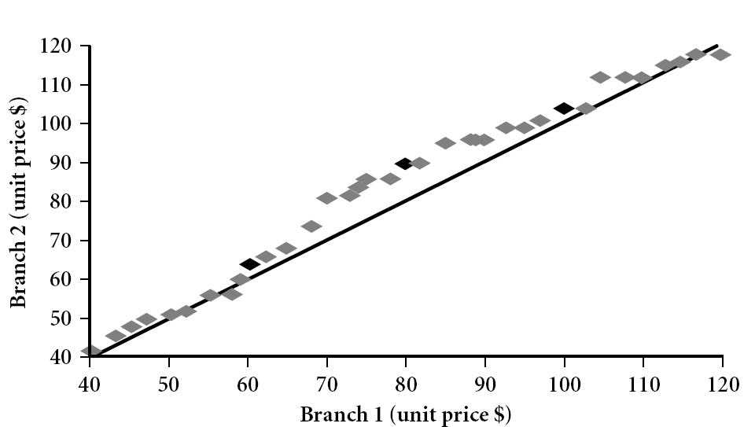

Quantile-Quantile (Q-Q) Plot
Graphs the quantiles of one univariate distribution against the corresponding quantiles of another
View: Is there is a shift in going from one distribution to another?
Example shows unit price of items sold at Branch 1 vs. Branch 2 for each quantile. Unit prices of items sold at Branch 1 tend to be lower than those at Branch 2.
qqplot(diabetes$mass, diabetes$insu)
Notes:
Note: We need to label the dark plotted points as Q1, Median, Q3 – that would help in understanding this graph.
Tell audience: There is a shift in distribution of branch 1 WRT branch 2 in that the unit prices of items sold at branch 1 tend to be lower than those at branch 2.

Slide 26
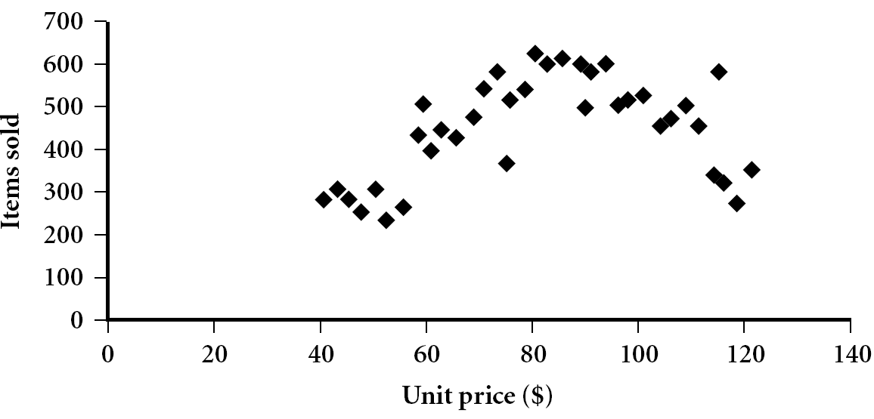

Scatter plot
Provides a first look at bivariate data to see clusters of points, outliers, etc
Each pair of values is treated as a pair of coordinates and plotted as points in the plane
p<-ggplot(diabetes, aes(x=age, y=mass)) + geom_point()
show(p)
q<-ggplot(diabetes, aes(x=age, y=mass)) + geom_point(aes(colour=class)) + facet_grid(class~.)
show(q)

Slide 27


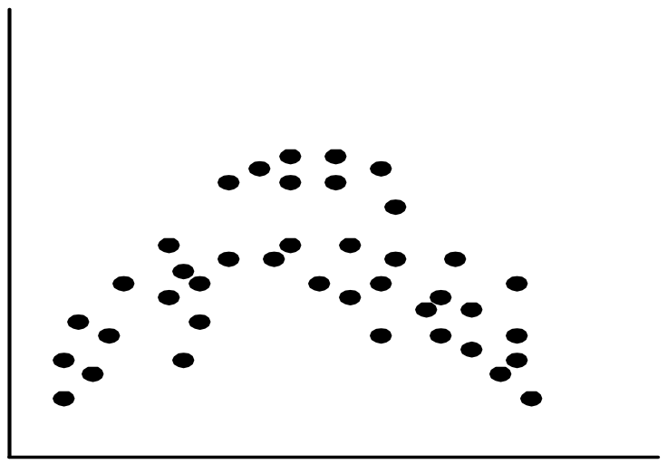
Positively and Negatively Correlated Data
The left half fragment is positively correlated
The right half is negative correlated

Slide 28


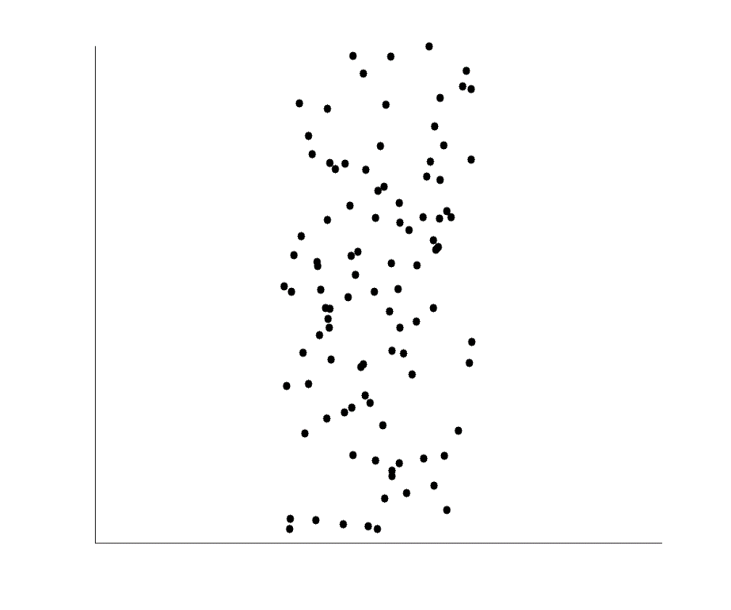
Uncorrelated Data

Slide 29
Getting to Know Your Data
Data Objects and Attribute Types
Basic Statistical Descriptions of Data
Data Visualization
Measuring Data Similarity and Dissimilarity
Summary

Slide 30
Data Visualization
Why data visualization?
  Gain insight into an information space by mapping data onto graphical primitives
  Provide qualitative overview of large data sets
  Search for patterns, trends, structure, irregularities, relationships among data
  Help find interesting regions and suitable parameters for further quantitative analysis
  Provide a visual proof of computer representations derived
Categorization of visualization methods:
  Pixel-oriented visualization techniques
  Geometric projection visualization techniques
  Icon-based visualization techniques
  Hierarchical visualization techniques
  Visualizing complex data and relations

Slide 31
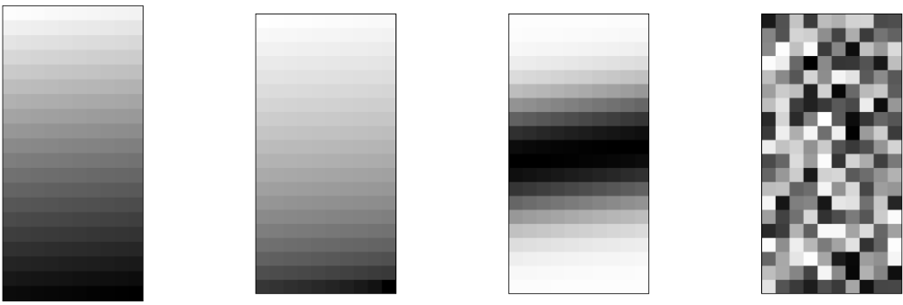
Pixel-Oriented Visualization Techniques
For a data set of m dimensions, create m windows on the screen, one for each dimension
The m dimension values of a record are mapped to m pixels at the corresponding positions in the windows
The colors of the pixels reflect the corresponding values
Income
(b) Credit Limit
(c) transaction volume
(d) age

Slide 32
Geometric Projection Visualization Techniques
Visualization of geometric transformations and projections of the data
Methods
  Direct visualization
  Scatterplot and scatterplot matrices
  Landscapes
  Projection pursuit technique: Help users find meaningful projections of multidimensional data
  Prosection views
  Hyperslice
  Parallel coordinates

Slide 33
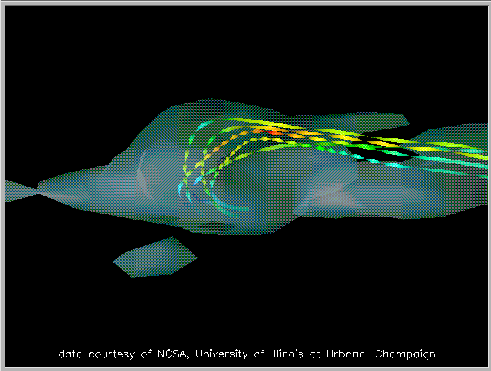
Direct Data Visualization
Ribbons with Twists Based on Vorticity
Data Mining: Concepts and Techniques
Notes:
http://books.elsevier.com/companions/1558606890/pictures/Chapter_01/fig1-6b.gif

Slide 34
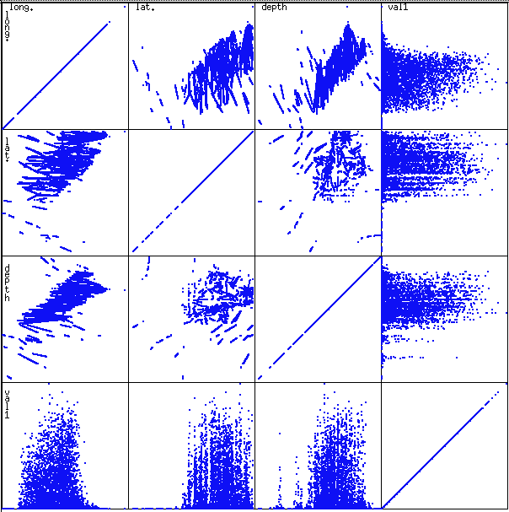

Scatterplot Matrices
Used by ermission of M. Ward, Worcester Polytechnic Institute
pairs(diabetes)
pairs(iris)
Matrix of scatterplots (x-y-diagrams) of the k-dim. data [total of (k2/2-k) scatterplots]

Slide 35
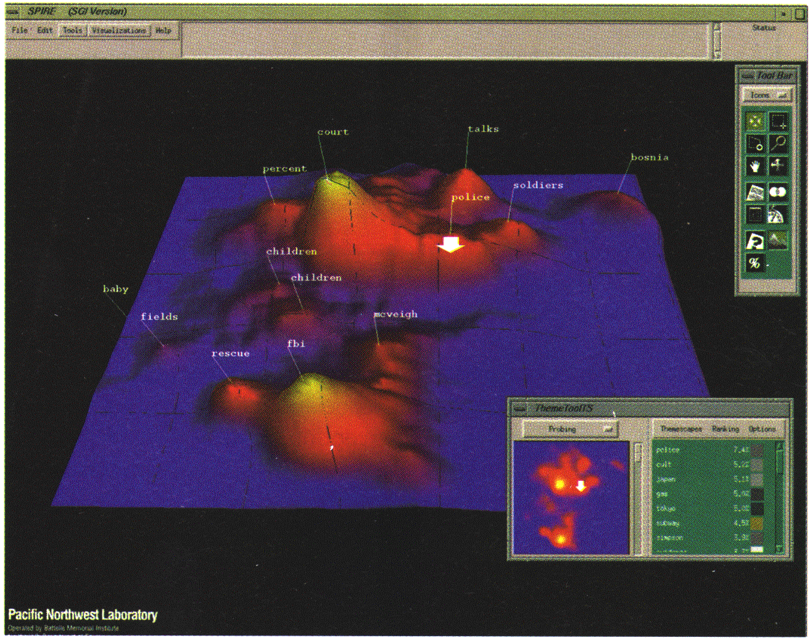
Landscapes
news articles
visualized as
a landscape
Used by permission of B. Wright, Visible Decisions Inc.
Visualization of the data as perspective landscape
The data needs to be transformed into a (possibly artificial) 2D spatial representation which preserves the characteristics of the data

Slide 36

Word Clouds

Slide 37
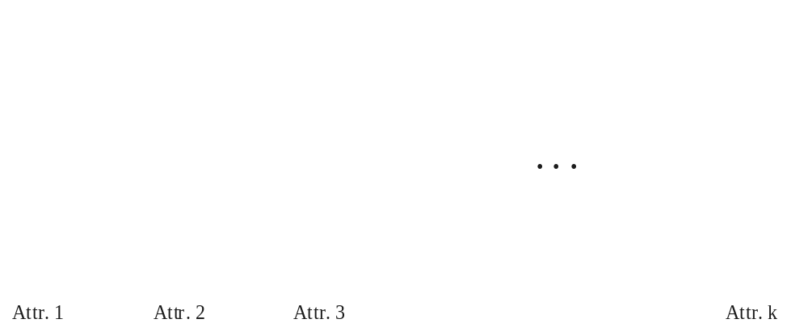
Parallel Coordinates
n equidistant axes which are parallel to one of the screen axes and correspond to the attributes
The axes are scaled to the [minimum, maximum]: range of the corresponding attribute
Every data item corresponds to a polygonal line which intersects each of the axes at the point which corresponds to the value for the attribute

Slide 38

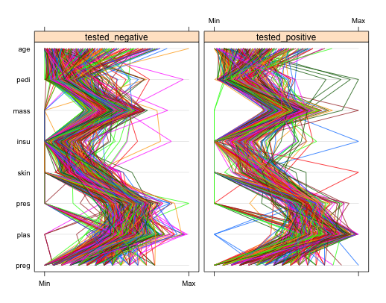
Parallel Coordinates of a Data Set
parallelplot(diabetes)
parallelplot(~diabetes[1:8] | class, data=diabetes)

Slide 39
Getting to Know Your Data
Data Objects and Attribute Types
Basic Statistical Descriptions of Data
Data Visualization
Measuring Data Similarity and Dissimilarity
Summary

Slide 40
Similarity and Dissimilarity
Similarity
  Numerical measure of how alike two data objects are
  Value is higher when objects are more alike
  Often falls in the range [0,1]
Dissimilarity (e.g., distance)
  Numerical measure of how different two data objects are
  Lower when objects are more alike
  Minimum dissimilarity is often 0 (no dissimilarity)
  Upper limit varies
Proximity refers to a similarity or dissimilarity

Slide 41


Data Matrix and Dissimilarity Matrix
Data matrix
  n data points with p dimensions
  Two modes
Dissimilarity matrix
  n data points, but registers only the distance
  A triangular matrix
  Single mode
Notes:
The rows and columns of the data matrix represent different entities, while those of the
dissimilarity matrix represent the same entity. Thus, the data matrix is often called a
two-mode matrix, whereas the dissimilarity matrix is called a one-mode matrix.

Slide 42

Proximity Measure for Nominal Attributes
Can take 2 or more states, e.g., red, yellow, blue, green (generalization of a binary attribute)
Method 1: Simple matching
  m: # of matches, p: total # of variables
Method 2: Use a large number of binary attributes
  creating a new binary attribute for each of the M nominal states

Slide 43
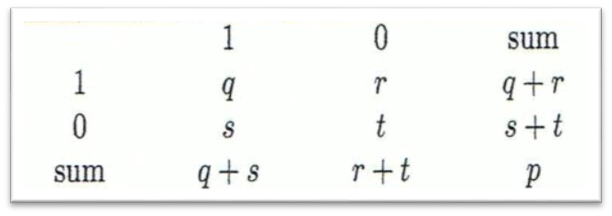
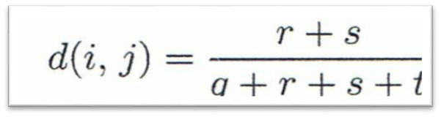
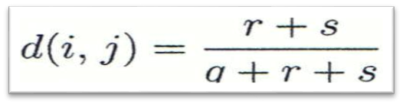
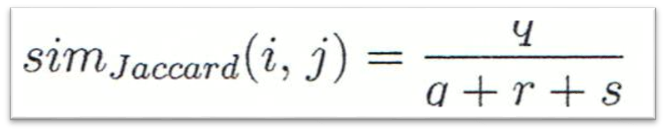
Proximity Measure for Binary Attributes
Object_{j}
A contingency table for binary data
Distance measure for symmetric binary variables:
Distance measure for asymmetric binary variables (agreement on 0 doesn’t count, distance gets bigger, i.e., 2/3 vs 2/4):
Jaccard coefficient (similarity measure for asymmetric binary variables):
Object_{i}

Slide 44


Dissimilarity between Binary Variables
Example (Based on asymmetric)
  Gender is a symmetric attribute
  The remaining attributes are asymmetric binary
  Let the values Y and P be 1, and the value N 0

Slide 45
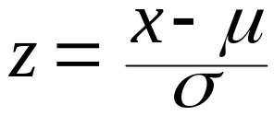
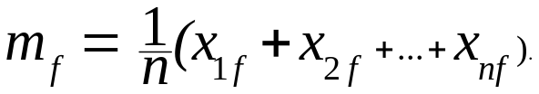
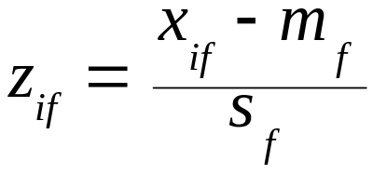
Standardizing Numeric Data
Z-score:
  x: raw score to be standardized, μ: mean of the population, σ: standard deviation
  the distance between the raw score and the population mean in units of the standard deviation
  negative when the raw score is below the mean, “+” when above
An alternative way: Calculate the mean absolute deviation
  where
  standardized measure (z-score):
Using mean absolute deviation is more robust than using standard deviation

Slide 46
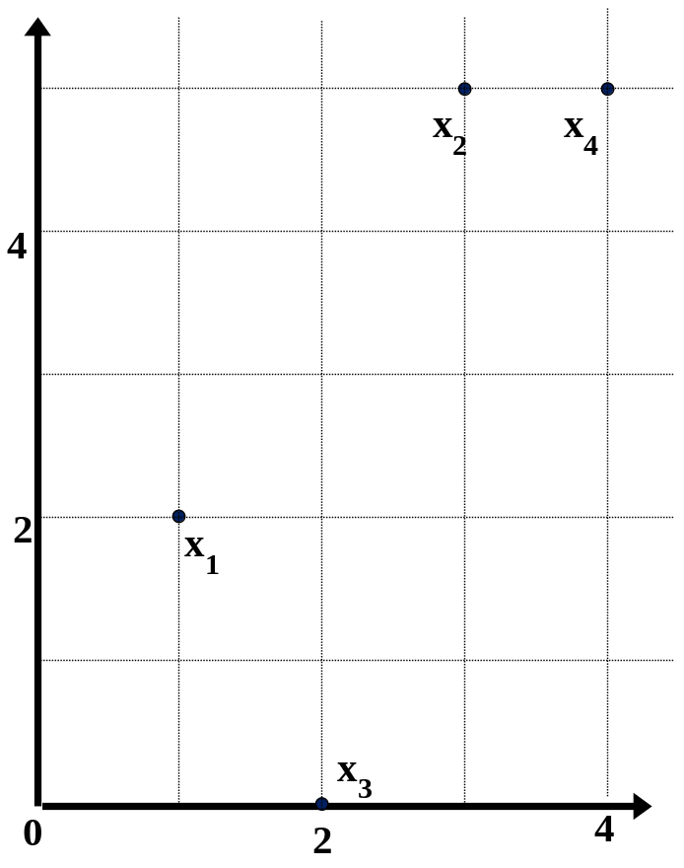
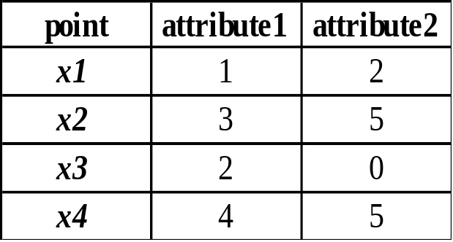
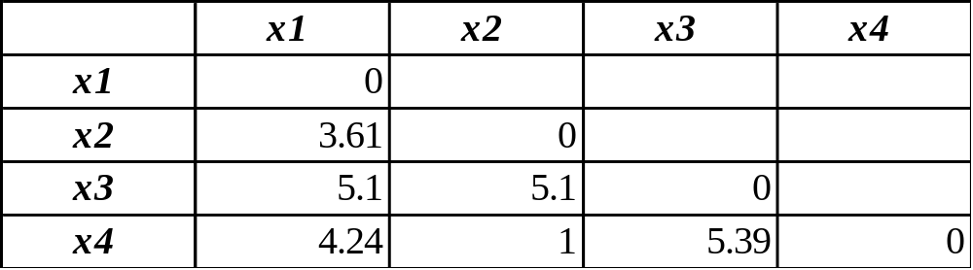
Example:
Data Matrix and Dissimilarity Matrix
Data Matrix
Dissimilarity Matrix
(with Euclidean Distance)

Slide 47
Distance on Numeric Data: Minkowski Distance
Minkowski distance: A popular distance measure
  where i = (x_{i1}, x_{i2}, …, x_{ip}) and j = (x_{j1}, x_{j2}, …, x_{jp}) are two p-dimensional data objects, and h is the order (the distance so defined is also called L-h norm)
Properties
  d(i, j) > 0 if i ≠ j, and d(i, i) = 0 (Positive definiteness)
  d(i, j) = d(j, i) (Symmetry)
  d(i, j) ≤ d(i, k) + d(k, j) (Triangle Inequality)
A distance that satisfies these properties is a metric

Slide 48


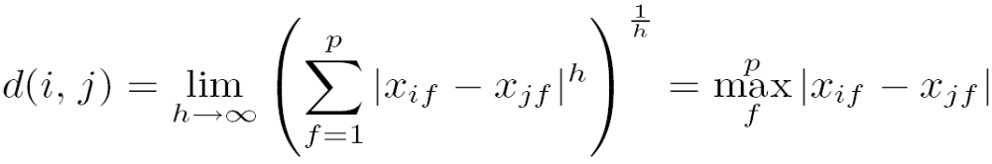
Special Cases of Minkowski Distance
h = 1: Manhattan (city block, L₁ norm) distance
  E.g., the Hamming distance: the number of bits that are different between two binary vectors
h = 2: (L₂ norm) Euclidean distance
h → ∞. “supremum” (L_{max} norm, L∞ norm) distance.
  This is the maximum difference between any component (attribute) of the vectors

Slide 49
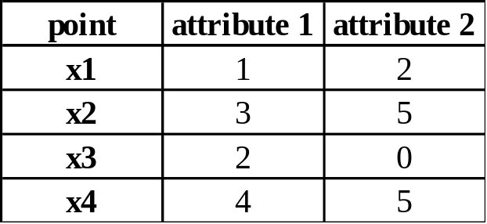
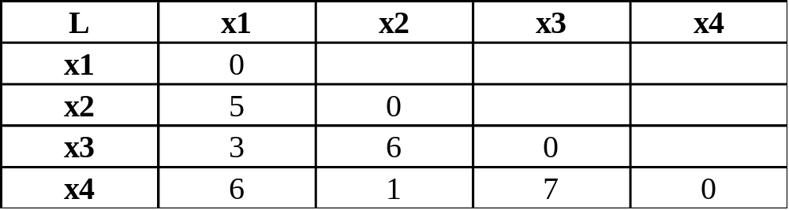
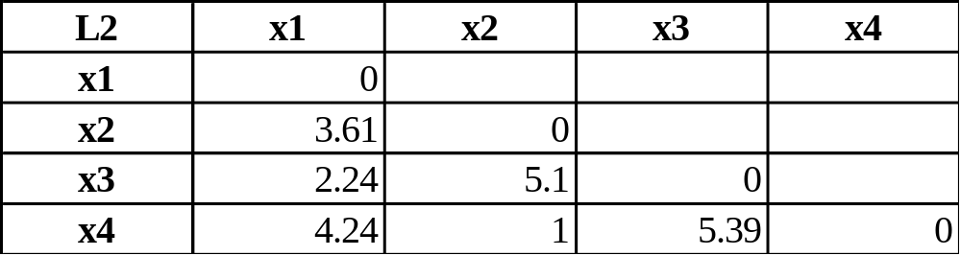
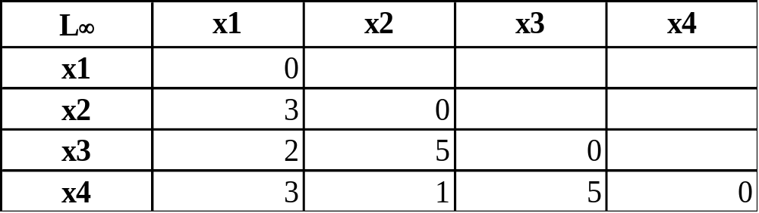
Example: Minkowski Distance
Dissimilarity Matrices
Manhattan (L₁)
Euclidean (L₂)
Supremum

Slide 50


Ordinal Variables
An ordinal variable can be discrete or continuous
Order is important, e.g., rank
Can be treated like interval-scaled
  replace x_{if} by their rank
  map the range of each variable onto [0, 1] by replacing i-th object in the f-th variable by
  compute the dissimilarity using methods for interval-scaled variables

Slide 51
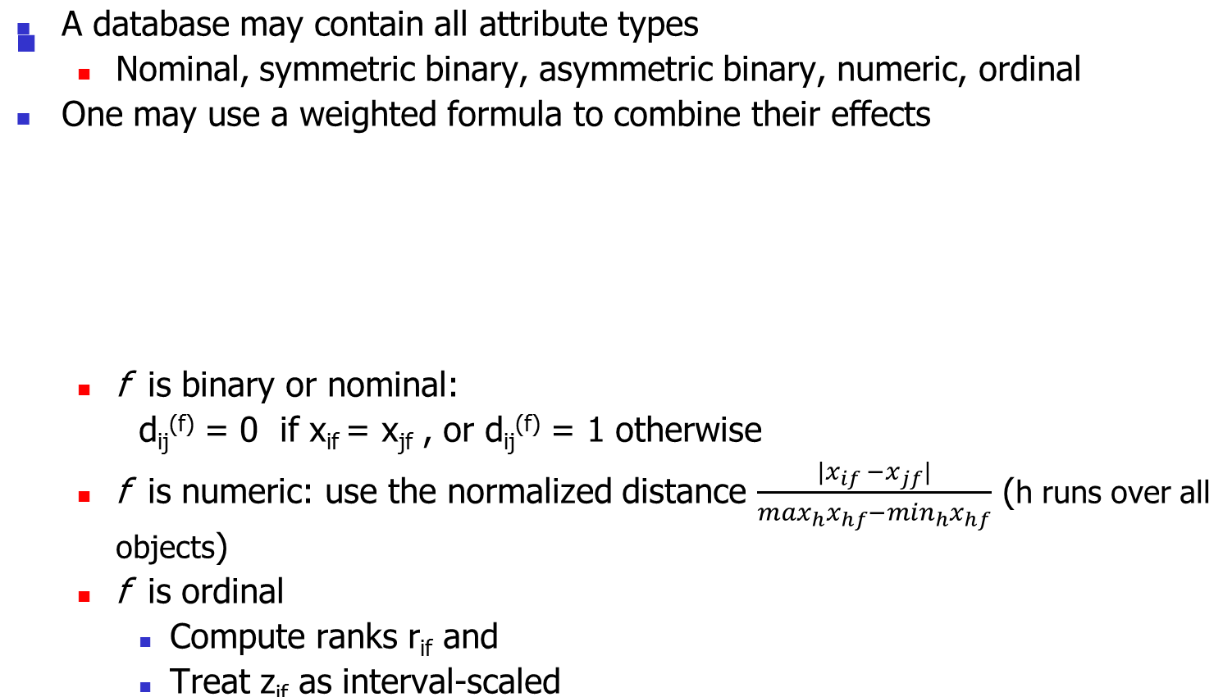



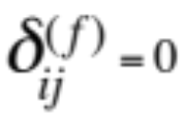

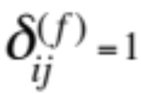
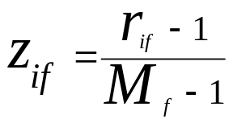
Attributes of Mixed Type
x_{if} or x_{jf} missing
x_{if} = x_{jf} =0 and f is asymmetric binary
if
otherwise

Slide 52



Example
x_{if} or x_{jf} missing
x_{if} = x_{jf} =0 and f is asymmetric binary
if
otherwise
Identifier | Automatic T. | Cyl. | Weight | Condition | Clear Title*
car1 | Y | 4 | 2.5 | Excellent | 0
car2 | Y | 4 | 2.0 | Fair | 1
car3 | N | 6 | 3.4 | Good | 1
car4 | Y | 8 | 3.5 | Excellent | 0
*Suppose clear title is asymmetric binary attribute
Q. What are d(car₁, car₂) and d(car₁, car₄)?

Slide 53
Example cont.d
x_{if} or x_{jf} missing
x_{if} = x_{jf} =0 and f is asymmetric binary
if
otherwise
Identifier | Automatic T. | Cyl. | Weight | Condition | Clear Title*
car1 | Y | 4 | 2.5 | Excellent | 0
car2 | Y | 4 | 2.0 | Fair | 1
car3 | N | 6 | 3.4 | Good | 1
car4 | Y | 8 | 3.5 | Excellent | 0
*Suppose clear title is asymmetric binary attribute
Q. What are d(car₁, car₂) and d(car₁, car₄)?

Slide 54
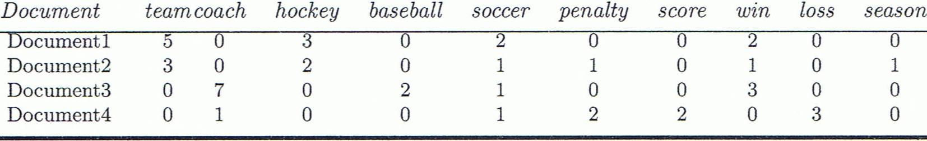
Cosine Similarity
A document can be represented by thousands of attributes, each recording the frequency of a particular word (such as keywords) or phrase in the document.
Other vector objects: gene features in micro-arrays, …
Applications: information retrieval, biologic taxonomy, gene feature mapping, ...
Cosine measure: If d₁ and d₂ are two vectors (e.g., term-frequency vectors), then
cos(d₁, d₂) = (d₁ • d₂) /||d₁|| ||d₂|| ,
  where • indicates vector dot product, ||d||: the length of vector d

Slide 55
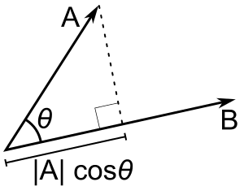

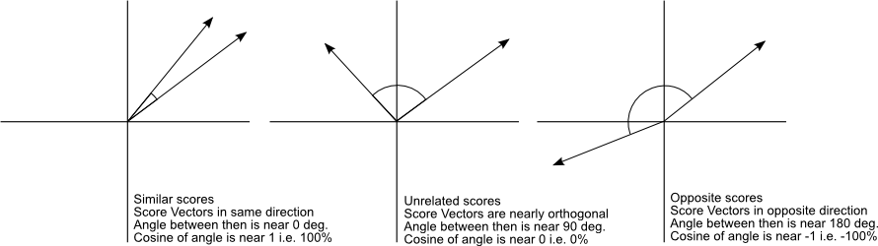
Cosine similarity-meaning
image: http://blog.christianperone.com/wp-content/uploads/2013/09/cosinesimilarityfq1.png

Slide 56
Example: Cosine Similarity
cos(d₁, d₂) = (d₁ • d₂) /||d₁|| ||d₂|| ,
  where • indicates vector dot product, ||d|: the length of vector d
Ex: Find the similarity between documents 1 and 2.
  d₁ = (5, 0, 3, 0, 2, 0, 0, 2, 0, 0)
  d₂ = (3, 0, 2, 0, 1, 1, 0, 1, 0, 1)
  d₁•d₂ = 5*3+0*0+3*2+0*0+2*1+0*1+0*1+2*1+0*0+0*1 = 25
  ||d₁||= (5*5+0*0+3*3+0*0+2*2+0*0+0*0+2*2+0*0+0*0)^{0.5}=(42)^{0.5} = 6.481
  ||d₂||= (3*3+0*0+2*2+0*0+1*1+1*1+0*0+1*1+0*0+1*1)^{0.5}=(17)^{0.5} = 4.12
  cos(d₁, d₂ ) = 0.94

Slide 57
Getting to Know Your Data
Data Objects and Attribute Types
Basic Statistical Descriptions of Data
Data Visualization
Measuring Data Similarity and Dissimilarity
Summary

Slide 58
Summary
Data attribute types: nominal, binary, ordinal, interval-scaled, ratio-scaled
Many types of data sets, e.g., numerical, text, graph, Web, image.
Gain insight into the data by:
  Basic statistical data description: central tendency, dispersion, graphical displays
  Data visualization: map data onto graphical primitives
  Measure data similarity
Above steps are the beginning of data preprocessing.
Many methods have been developed but still an active area of research.

Slide 59
References
W. Cleveland, Visualizing Data, Hobart Press, 1993
T. Dasu and T. Johnson. Exploratory Data Mining and Data Cleaning. John Wiley, 2003
U. Fayyad, G. Grinstein, and A. Wierse. Information Visualization in Data Mining and Knowledge Discovery, Morgan Kaufmann, 2001
L. Kaufman and P. J. Rousseeuw. Finding Groups in Data: an Introduction to Cluster Analysis. John Wiley & Sons, 1990.
H. V. Jagadish, et al., Special Issue on Data Reduction Techniques. Bulletin of the Tech. Committee on Data Eng., 20(4), Dec. 1997
D. A. Keim. Information visualization and visual data mining, IEEE trans. on Visualization and Computer Graphics, 8(1), 2002
D. Pyle. Data Preparation for Data Mining. Morgan Kaufmann, 1999
S. Santini and R. Jain,” Similarity measures”, IEEE Trans. on Pattern Analysis and Machine Intelligence, 21(9), 1999
E. R. Tufte. The Visual Display of Quantitative Information, 2nd ed., Graphics Press, 2001
C. Yu , et al., Visual data mining of multimedia data for social and behavioral studies, Information Visualization, 8(1), 2009

