Slide 1

Predicting Academic Risk of CSE Students: a ML model Comparison
Winter 2023
CSC 587 – Advanced data mining
Project Group
Dan getty – CERG Dsci student
Mason Turner – ms dsci student
Matthew Nickols – Bs CIS student
Halil bisgin phd – faculty advisor

Slide 2


Why predict course failure risk?
Early Intervention
Retention and Graduate Rates
Student Success and Well-Being
Data Drive Decision Making
Accreditation and Accountability
Federal Reporting Requirements
Notes:
Using the Generative AI model by Meta called llama3.1 we “Extracted Wisdom” on the body of Literature surrounding “Student Academic Risk Prediction”
Early intervention - This can include tutoring, academic advising, supplemental instruction, mental health, financial, food, housing, security or other forms of assistance. This relies heavily on the participation of the various student service centers’ leadership and collaboration [1],[2]
Retention and Graduation Rates - Students who are identified as being at risk of failing may be more likely to drop out of a course or even leave the institution altogether. By identifying these students early, the university can take steps to retain them and increase overall retention and graduation rates. [2],[3]
Student Success and well being- Identifying students who are struggling can help universities prioritize student success initiatives and allocate resources more effectively. This can include providing additional support services, such as academic advising, counseling, or mental health services. [2],[4]
Data Driven Decision Making - By analyzing data on student performance and identifying areas of struggle, we can make informed decisions about course design, teaching methods, and resource allocation to improve student outcomes. [2],[5]
Accreditation and Accountability - Accrediting agencies often require institutions to demonstrate a commitment to student success and retention rates. Identifying students at risk of failing can help universities meet these requirements and maintain accreditation. [2],[6]
Federal Reporting Requirements - The U.S. Department of Education requires all Title IV Institutions to report student academic measures via the Integrated Postsecondary Education Data System (IPEDS). By identifying students who are struggling, the potential to increase student completion and persistence rates are reflected in multiple reports including Degree Completions, 12-Month enrollment, Graduation Rates, Graduation rates 200%, Outcome Measures, and Fall Enrollment . [2],[7]
References:
[1] Cotten, S. R., & Wilson, J. H. (2020). The Effectiveness of Early Warning Systems in Predicting Student
Success: A Systematic Review. Journal of Educational Research, 113(4), 355-366.
[2] Prenner, L. M., & Haas, D. C. (2018). Predictive Modeling for Identifying At-Risk Students: An Exploratory
Study. Journal of Postsecondary Education and Human Policy, 30(1), 1-15.
[3] Wang, Y., & Zhang, J. (2019). The Relationship Between Early Warning Systems and Student Retention: A National
Study. Journal of Higher Education Policy and Practice, 4(2), 123-136.
[4] Hwang, S., & Kim, D. (2020). The Effectiveness of Early Warning Systems in Improving Student Success: A
Meta-Analysis. Journal of Educational Research, 113(3), 241-253.
[5] Kim, J., & Lee, Y. K. (2020). The Use of Data Analytics to Inform Student Success Initiatives: A Case Study.
Journal of Postsecondary Education and Human Policy, 32(2), 147-162.
[6] National Association of Colleges and Employers. (2019). The Relationship Between Accreditation and Student
Success: A National Study. Retrieved from
<https://www.naceweb.org/library/file/2019/04/The-Relationship-Between-Accreditation-and-Student-Success.pdf>
[7] U.S. Department of Education. (2020). Federal Reporting Requirements for Higher Education Institutions.
Retrieved from <https://www2.ed.gov/policy/higher-education/leg/braun-stable-funding-act-of-2015.html>

Slide 3
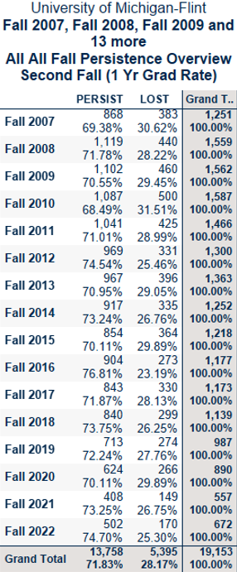
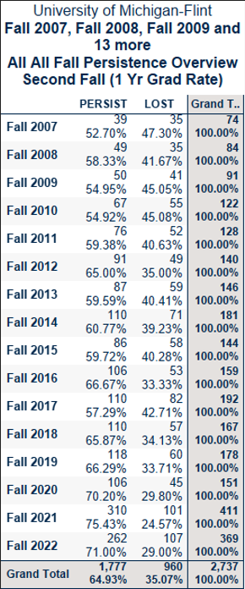
Trend of “Online Only” Students in Cohorts increasing over time
All New UG Avg “F2F and Mixed Mode” students Lost within the first year
All New UG Avg “Online Only” students Lost within the first year
Notes:
Here we have 16 years of Data from the UM-Flint. Looking at all New UG students lost F2F and MM vs Online Only; we can see that students are lost at 28% vs 35%. This is a 7% difference. Also observe that the grand total trends of Online students have been increasing over time.

Slide 4

What to do about it
Develop an “Successful / Unsuccessful Indicator” for students
Identify Important Features
Choose a ML Algorithm to further explore Student Academic Risk
Notes:
We aim to investigate this challenge, specifically, for the computer science and engineering students at U of M – Flint. We plan to leverage institutional sources such as the Canvas Learning Management System (LMS), and the Banner Enterprise Resource Planning (ERP) data. Our population selection will include student who were in at least one online-course during their time as a CSE student.

Slide 5

Data sources to Mine
Sources
Canvas Learning Management System (LMS)
Banner Enterprise Resource Planning (ERP)
Destination
U of M – Flint IA Data Warehouse
This Photo by Unknown Author is licensed under CC BY-SA-NC
Notes:
The Canvas LMS data offers valuable insights into student engagement, performance, course modality, and assignment scores
The Banner ERP system provides a wealth of data, including demographic, standardized test scores, incoming high school and previous college GPA scores, current college GPA’s and registration holds. Banner further records past time-invariant data from students’ prior academic outcomes and makes several vectors like final course grade, satisfactory unsatisfactory, and discretized grade distributions available.
This Canvas LMS and Banner ERP data is consolidated into the Data Warehouse where it is transformed into denormalized data sets. Some of the data preprocessing is done during this transformation process prior to being analyzed.

Slide 6
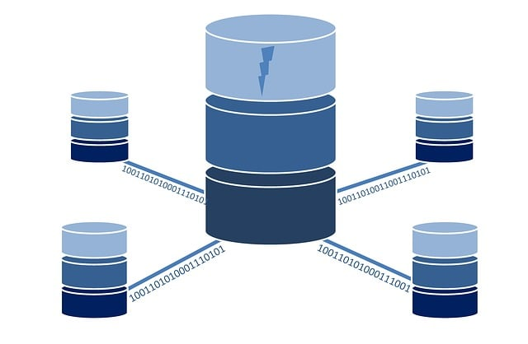
Data preprocessing
In the Datawarehouse Tables
Data to Train the Model(Past Year UG Enrollment)
ACADEMIC_RISK_TRAIN_DATA_TBL
(1 row/student/term/crn)
Data to Predict (Current Term)
ACADEMIC_RISK_PREDICT_DATA_TBL
(1 row/student/term/crn)
Store Predictions (Current Term)
ACADEMIC_RISK_PREDICT_RESULT
(1 row/student/term/crn)
Notes:
As mentioned, Blending of multi dimensional Data was performed using SQL scripts on the Data warehouse. We have blended Course, Student, Student Demographic, Student Incoming Score, Current GPA, and Holds.
Dimensional Features were identified with the name ending in (bin, cat, ord) to aid in the data type identification process. After extraction, Test scores and GPA NULL values were replaced with overall average scores, Comments that were NULL were replaced with the string neutral for sentiment analysis.
The table with all denormalized data being analyzed is referred to as the “Time Variant Student Course Activity” (TVCAA) Table. The grain is “one row/student/term/course/assignment” some values that are representative of the student or term level will repeat in the data set.

Slide 7

Feature Set Categories
Three Feature Categories explained
Past Time-Invariant Student (PTIS)
Features that are immutable to the student
Time-Varying Semester Activity (TVSA)
Features that changes on each semester
Time-Varying Course Assignment Activity (TVCAA)
Features that change during the semester (Canvas Data)
Notes:
Past Time-Invariant Student (PTIS)
Features that are immutable to the student
Including: Self ID Gender, Ethnicity, incoming scores like HS and Pcol GPA, SAT, etc
Time-Varying Semester Activity (TVSA)
Features that changes on each semester
Including: Online Only, Age, Cumulative GPA, Holds, etc.
Time-Varying Course Assignment Activity (TVCAA)
Features that change during the semester (Canvas Data)
Including: Assignment Score, and current course grade

Slide 8
feature Descriptions
Notes:
Features were identified with the name ending in (bin, cat, ord) to aid in the data type identification process.

Slide 9
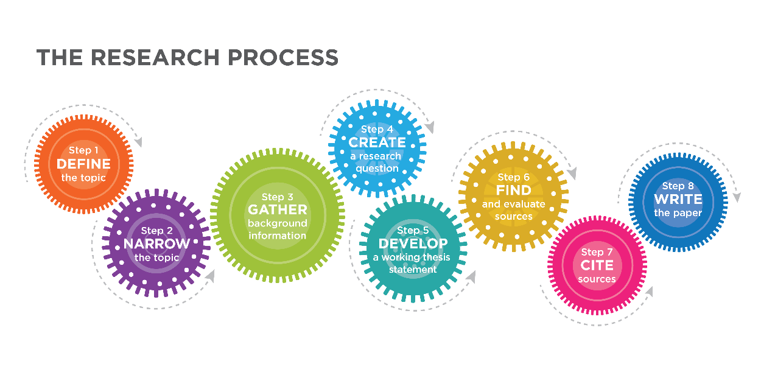
Dependent Variable (DV) Operational Definition
Dependent Variable (DV) – SATISFACTORY_UNSATISFACTORY_BIN
1 = Satisfactory = Passing Course with D or Better
0 = Un-Satisfactory = D- and lower, Drop, Withdrawal, Incomplete
Notes:
The DV is part of the Time-Varying Semester Activity Data

Slide 10
Apps and Installation
Anaconda Navigator – Python env management
https://www.anaconda.com/anaconda-navigator
Python 3.12 – Programming Language
https://www.python.org/downloads/
Microsoft Visual Studio Code – python IDE
https://code.visualstudio.com/download
R Studio – Building markdown files
https://posit.co/download/rstudio-desktop/

Slide 11

Machine Learning algorithms Compared
Algorithms:
Decision Tree
Random Forest
Support Vector Machines
K-Nearest Neighbors
Naïve Bayes
Notes:
Supervised Models used for Classification and Regression
Decision Tree – Best for interpretability and handling categorical features (e.g., loan approval, customer segmentation)
Random Forest – Best for Robustness against overfitting, handling high-dimensional datasets (e.g., bioinformatics, image classification)
Support Vector Machines – Best for Binary classification in small- to medium-sized datasets and high-dimensional spaces (e.g., text classification, face detection)
K-Nearest Neighbors – Best for Simple and intuitive classification for datasets where similar instances have similar labels (e.g., recommendation systems, pattern recognition)
Naïve Bayes – Best for Baseline text classification and when feature independence holds (e.g., spam filtering, sentiment analysis)

Slide 12

Python libraries
Python Libraries for Data Mining
Libraries:
pandas
Numpy
Scipy
matplotlib
sklearn
textblob
Notes:
Pandas – Used for ML in the form of data frames
Numpy – Used for Mathematical operations on large datasets
Scipy – Addas additional functionality to the Numpy Library
Matplotlib – Used for Visualization
scikit-learn – A ML library for Python with tools for Classification, Regression, Clustering, Dimensionality Reduction, Model Selection, and Data Preprocessing.
Textblob – (NLP) tasks such as part-of-speech tagging, noun phrase extraction, sentiment analysis, and classification.

Slide 13

Analysis and results

Slide 14

Concerns & Ethical Considerations
Privacy and Confidentiality - Controlling access to who and when.
Stigma and Shame – labeling of students “at-risk” or “un-successful”
Over-Intervention – potential to neglect students “not at-risk”
Lack of Context – Student needs help but not “at-risk” of course failure
Bias and Discrimination – Models trained on one population then used to predict another
Inadequate Support Systems – Students “at-risk” now what?
Over-Reliance on Technology – “students been identified, someone must have already addressed it”
Concerns about Data Quality – “Have we eliminated or added any support services recently?”, “Have we changed admissions requirements?”, “Have our student demographics shifted?”
Potential for Misuse – Who has access? What can they do with the information?
Notes:
Again, using the Generative AI model llama3.1 we “Extracted Wisdom” on the body of Literature surrounding “Student Academic Risk Prediction”
Concerns & Ethical Considerations - The use of predictive models raises ethical considerations, such as whether institutions have a moral obligation to help struggling students and how they should go about doing so.[19],[20]
Privacy and Confidentiality - When universities identify students at risk, they may need to share this information with faculty members, advisors, or other staff. This raises concerns about maintaining student privacy and confidentiality. [1],[2]
Stigma and Shame - Labeling a student as "at-risk" can lead to feelings of shame and stigma, which may negatively impact their academic performance and overall well-being. [3],[4]
Over-Intervention - Identifying students at risk can sometimes result in over-intervention, where institutions focus too much on the students who are struggling, while neglecting those who are succeeding. [5],[6]
Lack of Context - Predictive models used to identify students at risk may not account for important contextual factors, such as personal or family circumstances that affect their academic performance. [7],[8]
Bias and Discrimination - Some predictive models, when trained on external data, may have inherent bias towards certain groups of students..[9],[10]
Inadequate Support Systems - Even if institutions identify students at risk, they may not have adequate support systems in place to help these students succeed. [11],[12]
Over-Reliance on Technology - Relying too heavily on technology-based solutions can lead to a lack of human interaction and personalized support for students who are struggling. [13],[14]
Concerns about Data Quality - The quality of the data used to identify students at risk may be poor, which can lead to inaccurate predictions and potential misidentification of students. [15],[16]
Potential for Misuse - Institutions or individuals may misuse the information obtained from predictive models, such as using it to discriminate against certain groups of students. [17],[18]
References:
[1] National Association of Colleges and Employers. (2020). Student Data Analytics: A Review of the Literature.
[2] American Council on Education. (2019). The Intersection of Student Data, Privacy, and Higher Education.
[3] Journal of College Student Psychotherapy. (2018). Stigma and Shame: The Experiences of Students Who Are
At-Risk of Dropping Out.
[4] Journal of Higher Education Policy and Practice. (2020). The Role of Stigma in Student Retention.
[5] Journal of College Student Development. (2019). Over-Intervening: The Consequences of Well-Meaning but
Misguided Attempts to Improve Student Success.
[6] Journal of Higher Education Research. (2020). The Dark Side of Intervention: How Well-Intentioned Efforts Can
Actually, Harm Students.
[7] Journal of Educational Data Mining. (2019). Beyond Predictive Analytics: The Importance of Contextualizing
Student Data.
[8] Journal of Higher Education Policy and Practice. (2020). Context Matters: How Social and Economic Factors
Influence Student Success.
[9] Journal of Predictive Analytics. (2020). Bias in Predictive Analytics: A Review of the Literature.
[10] Journal of Higher Education Research. (2019). The Impact of Implicit Bias on Student Success.
[11] Journal of College Student Development. (2020). Inadequate Supports: The Barriers to Student Success.
[12] Journal of Higher Education Policy and Practice. (2019). The Role of Support Systems in Student Retention.
[13] Journal of Technology in Higher Education. (2020). The Dark Side of Technology: How Over-Reliance Can
Negatively Impact Student Success.
[14] Journal of Higher Education Research. (2019). The Limits of Technology: Why Human Interaction Matters in
Higher Education.
[15] Journal of Educational Data Mining. (2020). Data Quality Concerns in Predictive Analytics: A Review of the
Literature.
[16] Journal of Higher Education Policy and Practice. (2019). The Importance of Data Quality in Higher Education
Decision-Making.
[17] Journal of Predictive Analytics. (2020). The Potential for Misuse in Predictive Analytics: A Review of the
Literature.
[18] Journal of Higher Education Research. (2019). The Importance of Ethical Considerations in Higher Education
Decision-Making.
[19] Journal of Educational Ethics. (2020). Ethical Considerations in Predictive Analytics: A Review of the
Literature.
[20] Journal of Higher Education Policy and Practice. (2019). The Role of Ethics in Higher Education
Decision-Making.

Slide 15
Thank you. Any Questions!!
Dan Getty
dgetty@umich.edu
Mason Turner
machtu@umich.edu

