Slide 1

Predicting Academic Risk of CSE Students: a ML model Comparison
Winter 2023
CSC 587 – Advanced data mining
Project Group
Dan getty – CERG Dsci student
Mason Turner – ms dsci student
Matthew Nickols – Bs CIS student
Halil bisgin phd – faculty advisor

Slide 2


Data mining process
Understand the problem
Collect the data
Perform data preprocessing
Create the model(s)
Evaluate the model

Slide 3

Problem to solve!
Student Academic Risk in online CS and EGR courses
Bad for Institution
Bad for Departments
Bad for Students
Notes:
Student academic risk has been a major concern for higher education as it can lead to multi-faceted issues including financial problems and low academic performance for both
students and institutions. These issues are exacerbated for institutions offering Massive Open Online Courses (MOOCs).

Slide 4
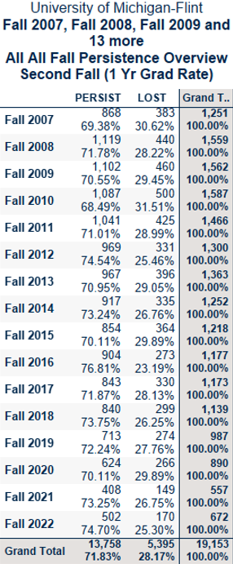
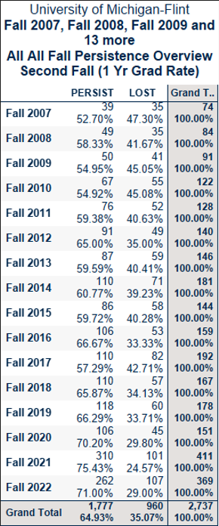
Trend of “Online Only” Students in Cohorts increasing over time
All New UG Avg “F2F and Mixed Mode” students Lost within the first year
All New UG Avg “Online Only” students Lost within the first year
Notes:
Here we have 16 years of Data from the UM-Flint. Looking at all New UG students lost F2F and MM vs Online Only we can see that students are lost at 28% vs 35%. This is a 7% difference. Also observe that the grand total trends of Online students have been increasing over time.

Slide 5

What to do about it
Develop an “Successful / Unsuccessful Indicator” for students
Identify Overall “At-Risk”
Identify “Risk-Attributes”
Develop Early Alert system
Notes:
We aim to investigate this challenge, specifically, for the computer science and engineering students at U of M – Flint. We plan to leverage institutional sources such as the Canvas Learning Management System (LMS), and the Banner Enterprise Resource Planning (ERP) data. Our population selection will include student who were in at least one online-course during their time as a CSE student.

Slide 6

Data sources to Mine
Sources
Canvas Learning Management System (LMS)
Banner Enterprise Resource Planning (ERP)
Destination
U of M – Flint Data Warehouse (IAPROD)
Notes:
The Canvas LMS data offers valuable insights into student engagement and performance as it can record all interactions. Recent studies have shown the utility of LMS logs, which can include student activities, such as syllabus view, recording views, assignment attempts, assignment scores, and faculty comments for identifying at risk online students.
The Banner ERP system provides a wealth of data, including demographic, standardized test scores, incoming high school and previous college GPA scores, current college GPA’s and registration holds. It further records past time-invariant data from students’ prior academic outcomes and makes several vectors like final course grade, Drop/Fail/Withdrawal (DFW), completed indicator, satisfactory unsatisfactory, and discretized grade distribution available.
This Canvas LMS and Banner ERP data is consolidated in the Data Warehouse where it is transformed into denormalized data sets. Some of the data preprocessing is done during this transformation process prior to the export of CSV files for analysis.

Slide 7
Data preprocessing effort
SQL Scripting in Datawarehouse
Blending of Data from multiple sources
Replaced NULL from Dimensional attributes (NA, None)
String Data or varchar2 in Oracle speak are trimmed to 4000 characters.
Notes:
As mentioned, Blending of multi dimensional Data was performed using SQL scripts on the Data warehouse. We have blended Course, Student, Student Demographic, Student Incoming Score, Current GPA, and Holds.
Dimensional Features were identified with the name ending in (bin, cat, ord) to aid in the data type identification process. After extraction, Test scores and GPA NULL values were replaced with overall average scores, Comments that were NULL were replaced with the string neutral for sentiment analysis.
The table with all denormalized data being analyzed is referred to as the “Time Variant Student Course Activity” (TVCAA) Table. The grain is “one row/student/term/course/assignment” some values that are representative of the student or term level will repeat in the data set.

Slide 8
Independent Variable (IV) Outline
Independent Variables (IVs) by Source Type
Time-Varying Semester Activity (TVSA) (3,416)
Online Indicator
Course Enrollment Data
UMF GPA Data
Account Holds
Time-Varying Course Assignment Activity (TVCAA) (63,476)
Assignment Scores Data
Past Time-Invariant Student (PTIS) (N = 463)
Demographics
Incoming Student Scores

Slide 9
Dependent Variable (DV) Operational Definition
Dependent Variable (DV) – Satisfactory/Un-Satisfactory (3416)
Satisfactory = Passing Course with D or Better
Un-Satisfactory = D- and lower, Drop/Withdrawal, Incomplete
Notes:
The DV is part of the Time-Varying Semester Activity Data

Slide 10
Apps and Installation
Anaconda Navigator – Python env management
https://www.anaconda.com/anaconda-navigator
Python 3.12 – Programming Language
https://www.python.org/downloads/
Microsoft Visual Studio Code – python IDE
https://code.visualstudio.com/download
R Studio – Building markdown files
https://posit.co/download/rstudio-desktop/

Slide 11

Machine Learning algorithms
Algorithms:
Decision Tree
Random Forest
Support Vector Machines
K-Nearest Neighbors
Naïve Bayes

Slide 12

Python libraries
Python Libraries for Data Mining
Libraries:
pandas
numpy
matplotlib
sklearn
Scipy
textblob

Slide 13

Analysis and results

Slide 14

Publication Plan
Submitting to Frontiers In Education Conference
Title: Predicting Dropout Risk in Computer Science and Engineering Courses
Abstract Accepted
Conference Dates: October 13th-16th 2024
Destination: Washington DC
https://2024.fie-conference.org/

Slide 15
Thank you. Any Questions!!
Dan Getty Matthew Nickols
dgetty@umich.edu mnickols@umich.edu
Mason Turner Halil Bisgin
machtu@umich.edu bisgin@umich.edu

